Slide 1


Summer Food Service Program (SFSP)
Meal Pattern

Slide 2

SFSP Meal Pattern:
No Age/Grade groups
No Whole Grain requirement
No vegetable subgroups
No milk variety or type required
Notes:
There are some differences with the National School lunch and breakfast program meal patterns and the summer food service program meal pattern.
There are no age grade groups that need to be followed.
The grain requirement in the summer food service program does not require all grains to be whole grain. Grains offered in the summer program must be whole grain or enriched.
There are not vegetable subgroups in the summer food service program meal pattern.
When serving milk, you may offer any milk type and you do not need a milk variety for the summer program.
The summer food service program nutrition guide is posted on our website under the summer food service program tab. It is a great reference tool when you are getting started with the summer food service program.

Slide 3
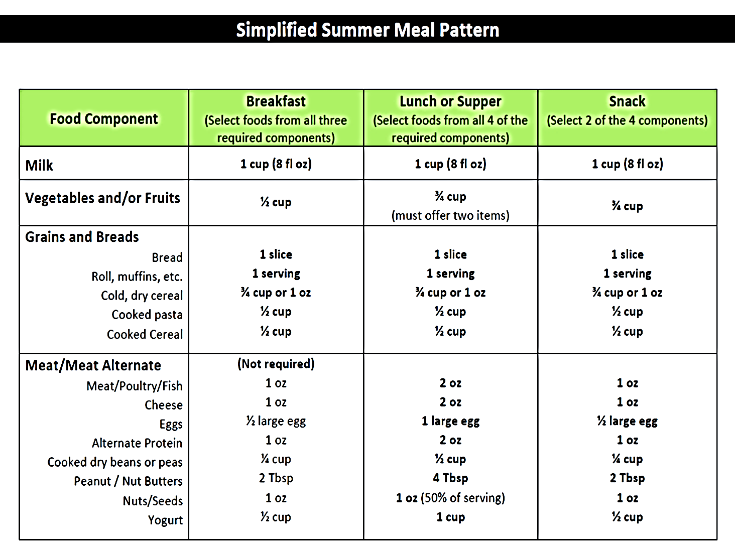

SFSP Meal Pattern
Notes:
This is the Summer Food Service Program meal pattern which can be found in the Nutrition Guide Manual.
Notice milk, fruit/veg, and grains are required for breakfast, lunch, and supper. Lunch and supper must contain a meat/meat alternative.
Snack can be any two components, as long as they are not the same. Example: Can not have an orange and orange juice.

Slide 4
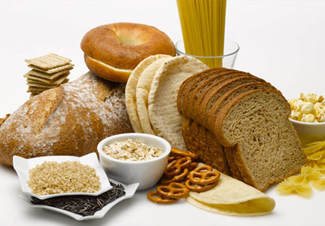
Meal Pattern Requirements
Grains:
Required at breakfast and lunch/supper
May be one of the two components of snack
 | Breakfast | Lunch/Supper | Snack
Grains Bread Roll, Muffins, etc. Cold, dry cereal Cooked pasta Cooked cereal | 1 slice 1 serving ¾ cup or 1 oz. ½ cup ½ cup | 1 slice 1 serving ¾ cup or 1 oz. ½ cup ½ cup | 1 slice 1 serving ¾ cup or 1 oz. ½ cup ½ cup
Notes:
Whole grain products are not required on the SFSP meal pattern but the goal is to serve nutritious meals and be consistent with what the kids are receiving at school. Grains offered must be whole grain or enriched.

Slide 5
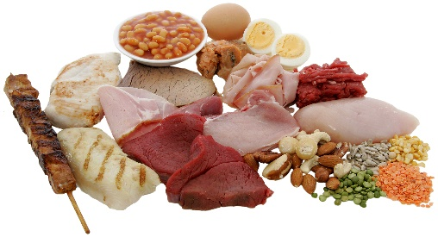
Meal Pattern Requirements
Meat/Meat Alternatives:
Required at Lunch/Supper
May be one of the two components of snack
Optional for Breakfast
 | Breakfast | Lunch/Supper | Snack
Meat/Meat alt. Meat/Poultry/Fish Cheese Eggs Alternate Protein Cooked dry beans/peas Peanut/Nut Butter Nuts/Seeds Yogurt | Not Required 1 oz. 1oz. ½ large egg 1 oz. ¼ cup 2 Tbsp. 1 oz. ½ cup | Required 2 oz. 2 oz. 1 large egg 2 oz. ½ cup 4Tbsp. 1 oz. (50% of serv) 1 cup | Not Required 1 oz. 1oz. ½ large egg 1 oz. ¼ cup 2 Tbsp. 1 oz. ½ cup
Notes:
Note that meat/meat alternate is not required at breakfast but, if served, must be at least 1 oz equivalent of meat/meat alternate.
Meat/meat alternate is required at lunch and supper in a 2 oz serving.
It can be one of the 2 components of snack but is not required.
If serving meat alternates, make sure you are providing a large enough serving size to meet meal pattern requirements.
Example: If a peanut butter sandwich is served at lunch or dinner you would need to have 4 tablespoons of peanut butter to equal 2oz of meat alternate equivalent if that is the only meat/meat alternate you are offering.

Slide 6
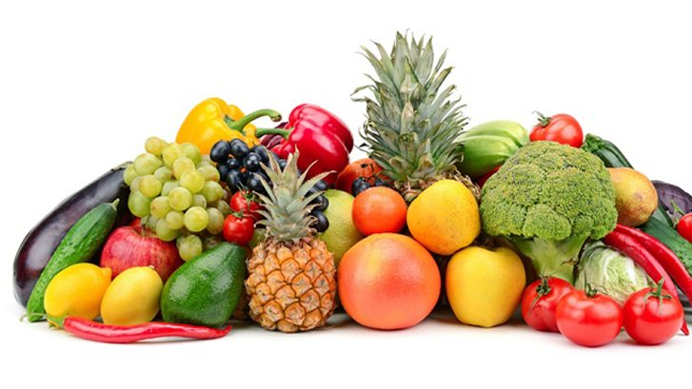
Meal Pattern Requirement
Vegetables/Fruit:
REQUIRED at breakfast and lunch/supper
Must be two items at lunch/supper = total ¾ cup
May be one of the two components at snack
Minimum creditable serving = 1/8 cup
If serving juice, 100% fruit/vegetable juice is required
Notes:
The fruit & veg. component is required at breakfast, lunch, and supper.
Must be two items at lunch/supper totaling ¾ cup.
Could be ½ cup strawberries and ¼ cup cucumbers. Doesn’t have to be one fruit and one veg. it can be any combo.
It must be at least 1/8 cup to count as creditable.
If Juice is being served, it must be 100% fruit juice.
Serve fruits and vegetables that are fresh and in season whenever possible.

Slide 7

Meal Pattern Requirements
Milk:
8oz serving required at breakfast, lunch and supper
May be one of the two components chosen for snack
Allowable milk options:
Unflavored or flavored
Fat free, low-fat, reduced fat, whole
Lactose-reduced, lactose free
Notes:
An 8 oz serving of milk must be served with each meal.

Slide 8
Snack Meal Pattern Requirements
Snack
Choose 2 DIFFERENT components
  1 serving of milk
  1 serving of vegetable or fruit or 100% juice (all 1 component)
  1 serving of grain or bread
  1 serving of meat/meat alternate
  Grain-based sweet snacks (cakes, cookies, etc.) may not be served more than twice in a five-day week or more than three times in a seven-day week.
Notes:
For snack, the menu needs to offer at least 2 different components. Remember the vegetable, fruit, or juice is all considered to be one component.
Two components can not be apple juice and apple, or carrots and apples, or orange juice and oranges.
Milk and apple would be considered a reimbursable snack.

Slide 9
Offer VS Serve
Allows children to decline item(s) at each meal
1 item at breakfast and 2 items at lunch and supper
Offer vs. Serve
Offer 4 items at breakfast; child must select 3 items
Offer 5 items at lunch and supper; child must select 3 items
Notes:
Provided SED’s waiver request is approved by the National office, OVS can be an option chosen by all sponsors at the time of renewal
All components must be offered in the full serving size and those taken must meet required minimum portion size.
May be implemented at breakfast, lunch, and supper. Not snack.
Children get to choose which component(s) to decline. Helps decrease food cost and waste.
Refer to Admin Guidance Manual for more info

Slide 10
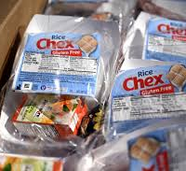
BREAKFAST

Slide 11
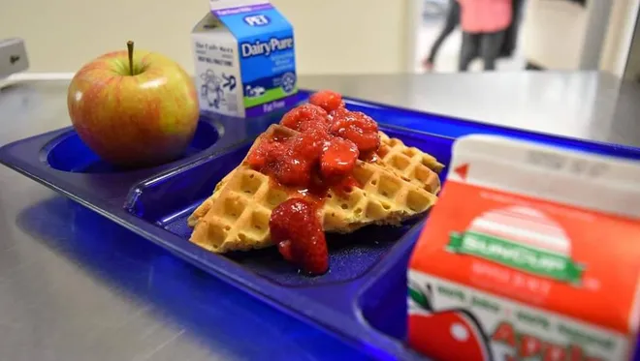
Breakfast meal pattern
MUST OFFER 3 COMPONENTS
Grain
Fruit/Vegetable
Fluid Milk

Slide 12
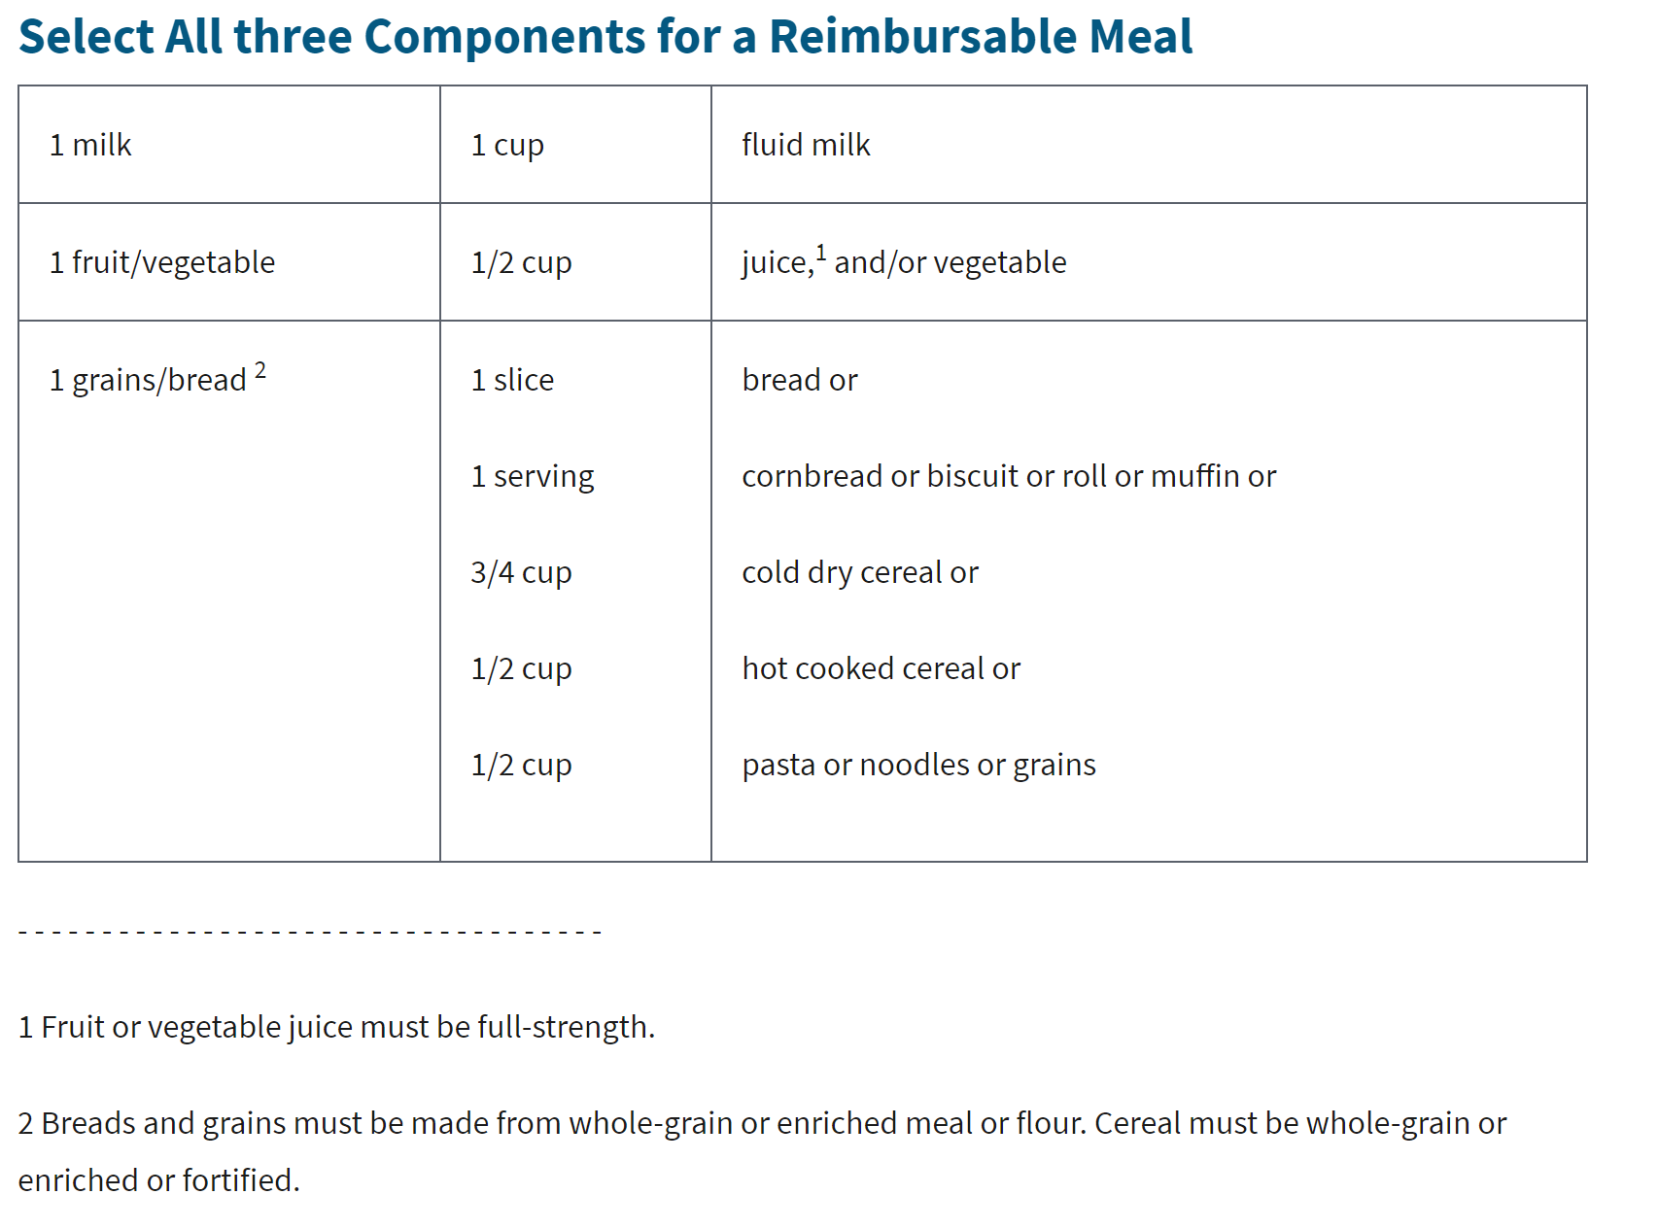
Breakfast Meal Pattern:
3 Required Components

Slide 13
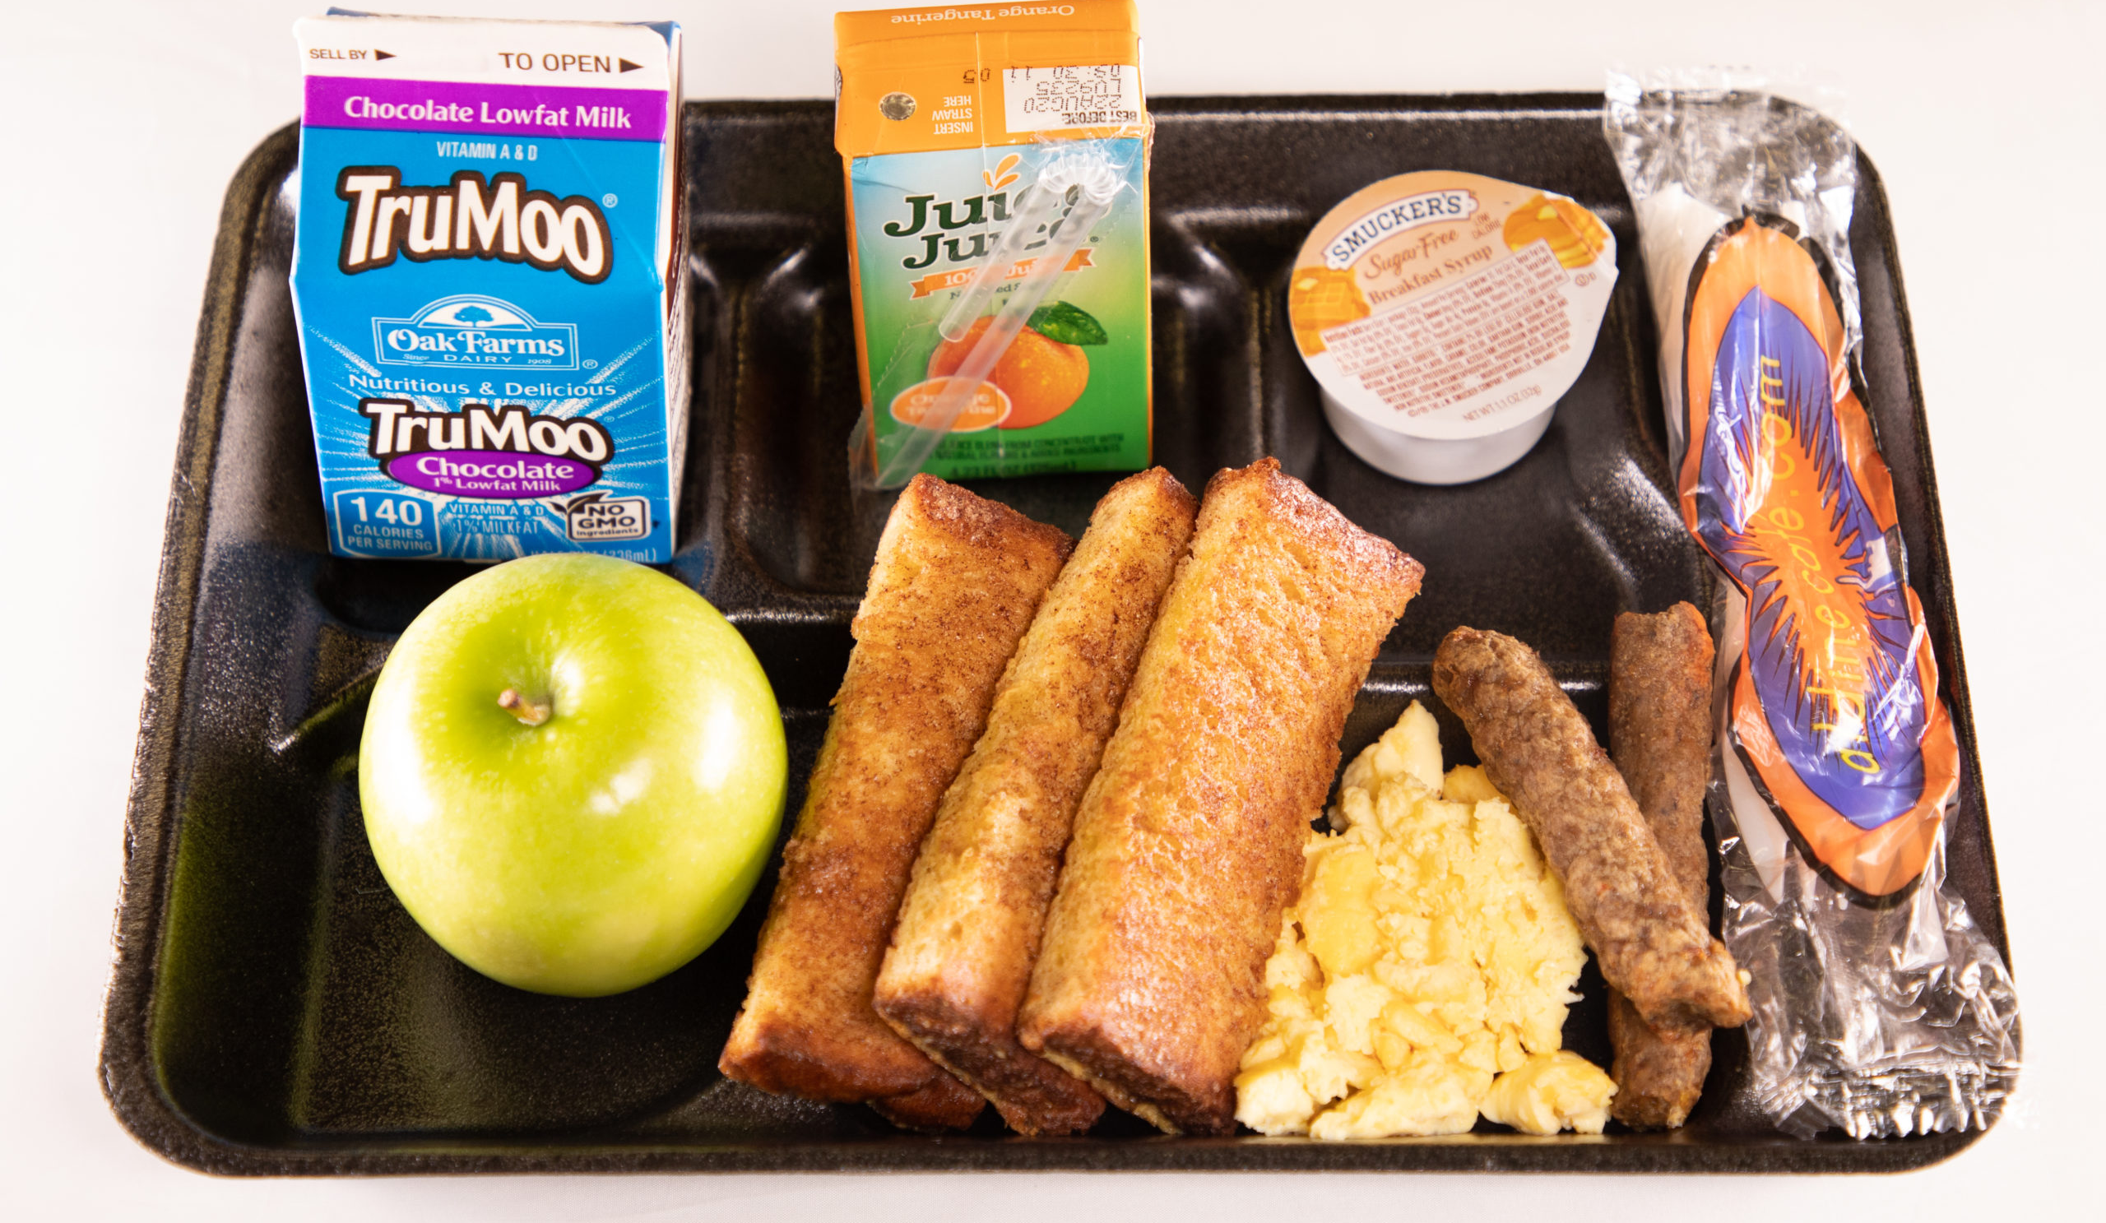
OFFER vs. SERVE BREAKFAST
Must offer 4 food Items
  1 serving of fruit/vegetable
  1 serving of bread/bread alternative
  1 serving fluid milk
  1 additional serving of:
    Fruit/Vegetable
    Bread/Bread alternative
    Meat/Meat alternative
Students must select 3 out of 4 items
*All items offered must be different from each other

Slide 14
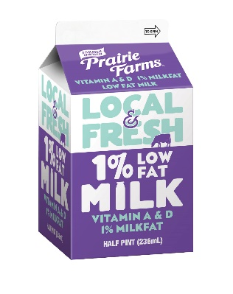
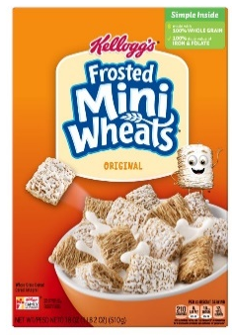




Offer Vs Serve Breakfast Example
4 food items offered
3 food items selected
Reimbursable
Notes:
For a reimbursable breakfast under OVS, a child may select:
Muffin, Cereal, and Apple; or
Muffin, Apple, and Milk; or
Cereal, Apple, and Milk; or
Muffin, Cereal, and Milk.

Slide 15


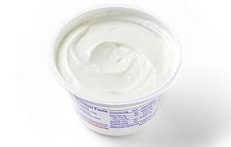




Offer vs. Serve Breakfast Example
Non-Reimbursable

Slide 16

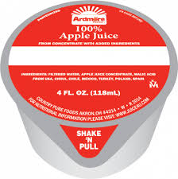



Offer Vs. Serve Breakfast Example
Breakfast food items
4 food items offered (English muffin, egg, juice, milk)
3 food items selected

Slide 17
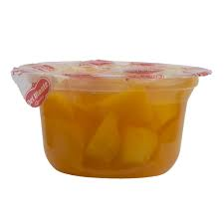
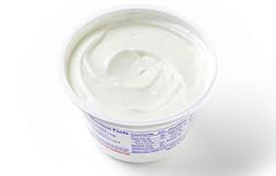

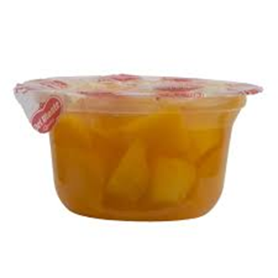


Offer Vs. Serve Breakfast Example
breakfast FOODS
4 food items offered
2 food items selected

Slide 18

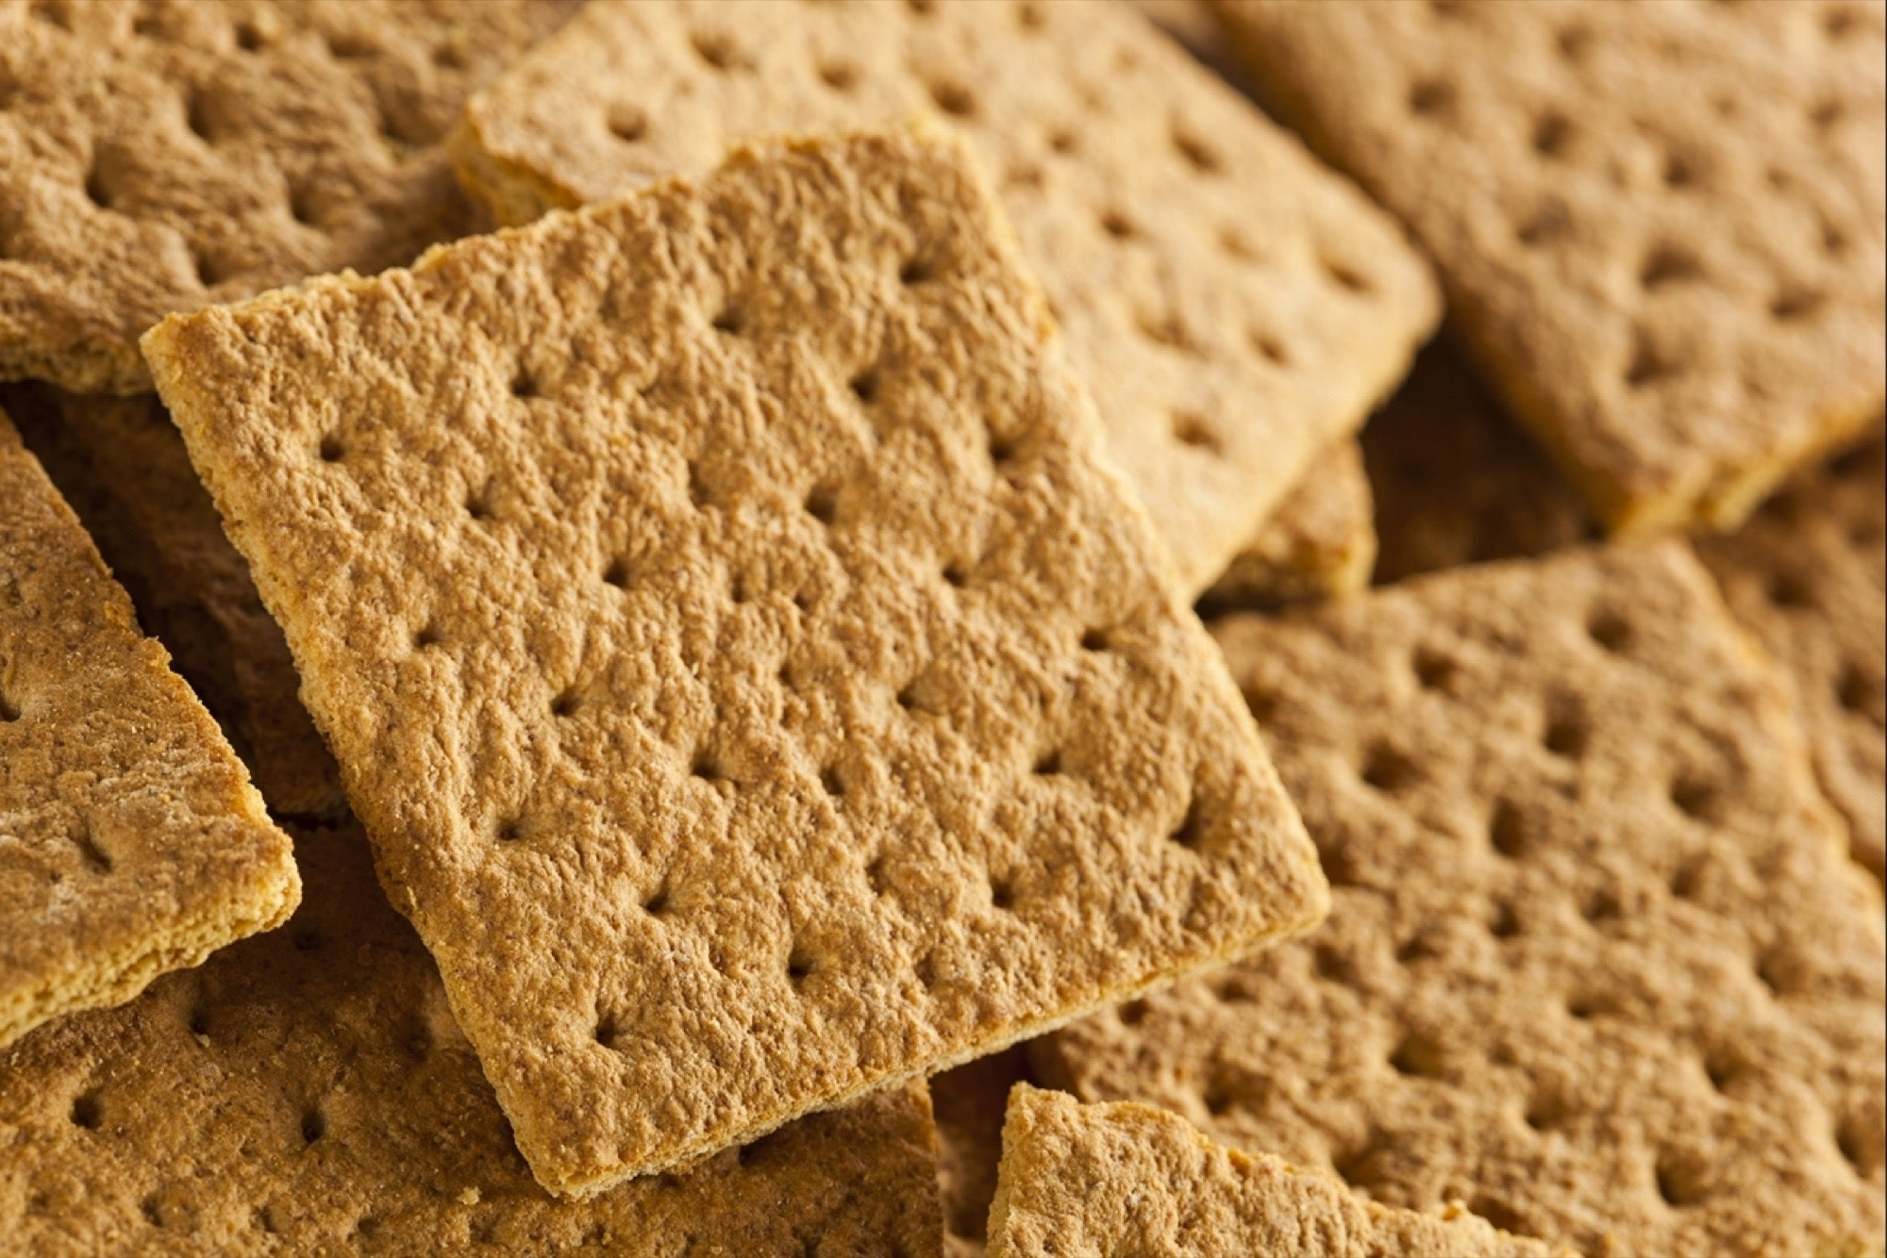




Offer Vs. Serve Breakfast Examples

Slide 19
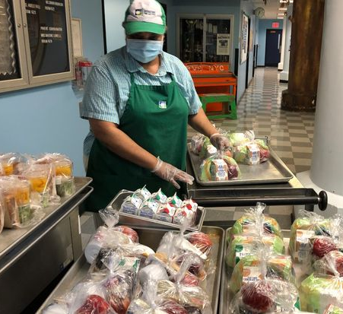
LUNCH

Slide 20
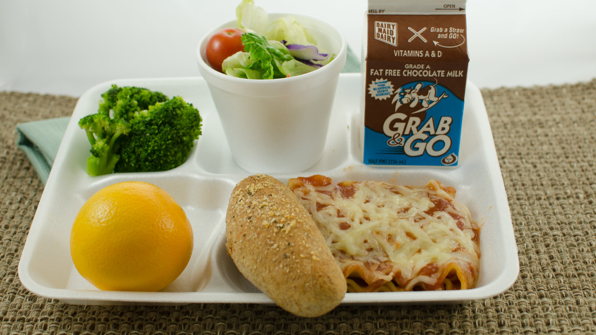
LUNCH MEAL PATTERN
MUST OFFER 5 COMPONENTS
Grain
Meat/Meat Alternate
Fruit/Vegetable (2 servings)
Fluid Milk
STUDENT MUST SELECT 3 COMPONENTS

Slide 21
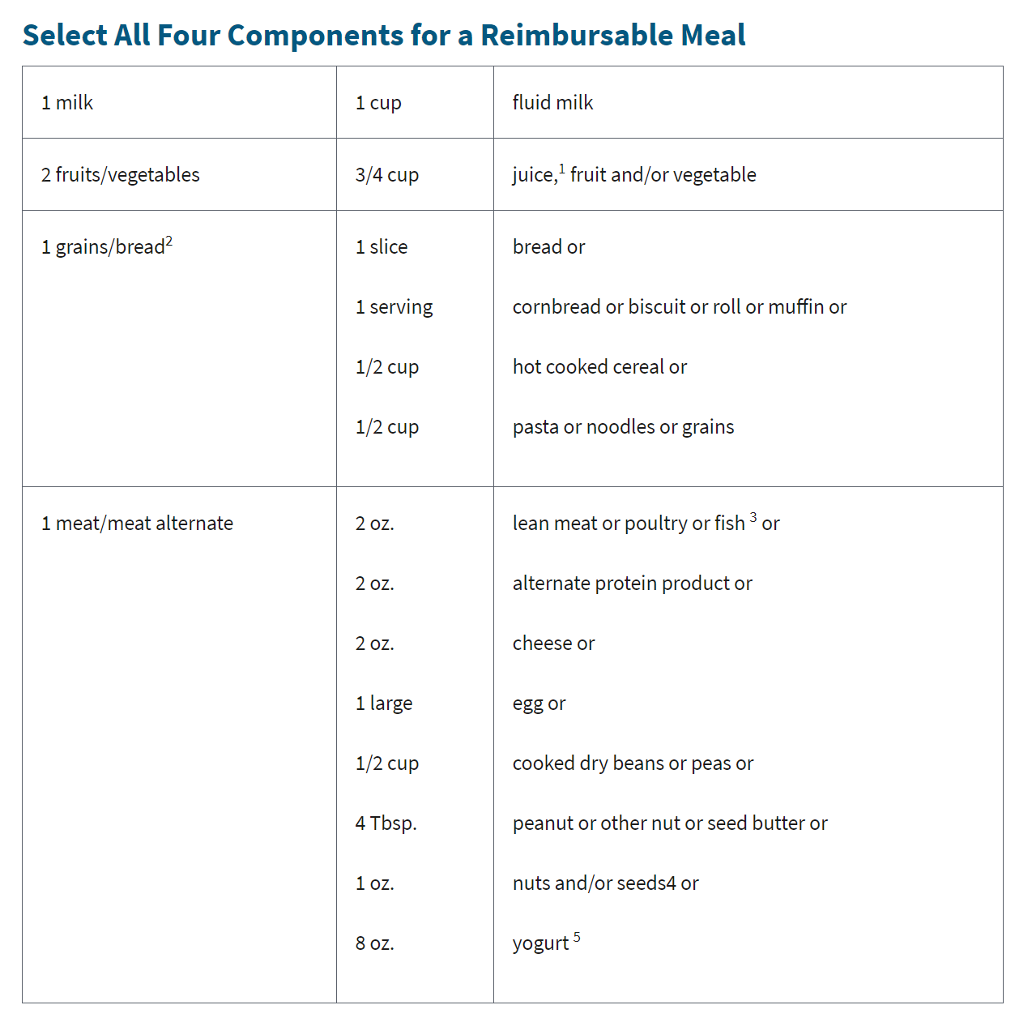
Lunch Meal Pattern:
5 Components

Slide 22
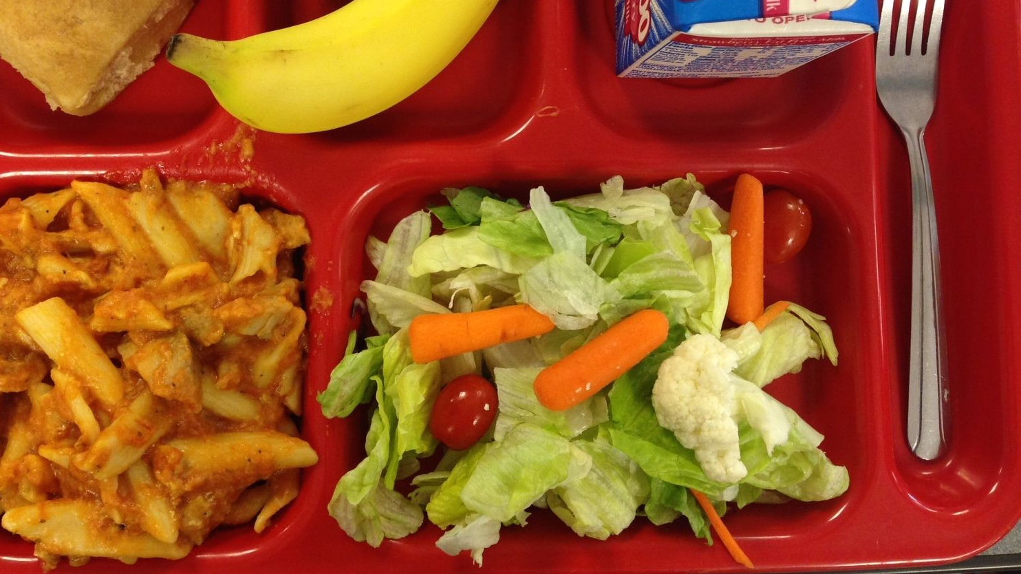
Offer Vs Serve Lunch
Must offer 5 Components
1 serving of Meat/Meat alternate
2 servings of fruit/vegetable (must be two different items)
1 serving of Bread/Bread alternative
1 serving fluid milk
Students must select 3 components
*All food items must be different from each other

Slide 23




Offer vs. Serve Lunch Examples
Lunch foods
5 components offered
3 components selected
*Chicken Nuggets has a CN label/Product Formulation Statement documenting that it credits as a serving grain and meat/meat alternate.

Slide 24

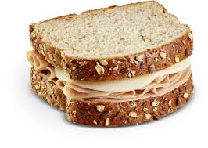

Offer Vs Serve Lunch Examples
3 components selected
5 components offered

Slide 25


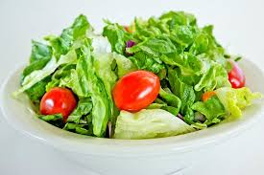




Offer Vs. Serve Lunch Example
5 components offered
3 components selected

Slide 26

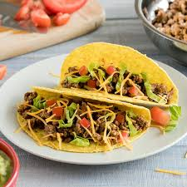


Offer Vs. Serve Lunch Examples
5 components offered
3 components selected

Slide 27

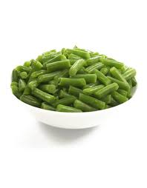
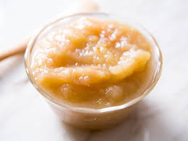


Offer Vs. Serve Lunch Examples
5 components offered
(Pizza has CN label showing 1 slice is the equivalent of 1 serving of grain and 2 oz m/ma)
3 components selected

Slide 28

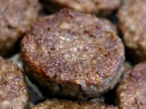





Offer Vs. Serve for Lunch Example
Breakfast for Lunch Day
5 components offered
3 components selected

Slide 29


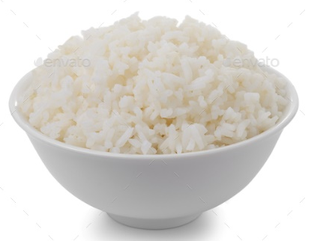
Offer vs serve Lunch example
5 components offered
2 components selected
Notes:
Some other reimbursable options are:
Chicken fingers, Rice, and Broccoli; or
Chicken fingers, Apple Slices, and milk; or
Chicken fingers, Broccoli, and Milk; or
Milk, Rice, and Broccoli.

Slide 30
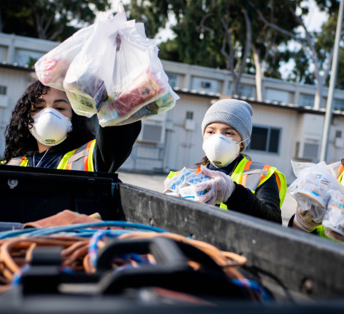
SNACK

Slide 31
SNACK exampleS:
MUST TAKE BOTH ITEMS, NO OVS
Carrots Cheese Stick | Hummus Carrots | Apple Pretzels
Muffin Milk | Milk Yogurt | Orange Crackers
Strawberries Pretzels | Applesauce Graham Crackers | 100% Apple Juice Biscuit

Slide 32

Questions
CNTRAINING@NYSED.GOV

