Slide 1

Standardized Recipes
1 hour Professional Standards Training
Notes:
This PowerPoint will contribute 1 hour towards Professional Standards training requirements. This training reviews Standardized Recipes in the Child Nutrition Programs.
Federal Regulations require that all School Food Authorities develop and utilize Standardized Recipes.

Slide 2

Standardized Recipes
Have been tested, modified and retested several times
Produces same good results and yield EVERY time
Are required for any food item with more than one ingredient
Notes:
A standardized recipe is one that “has been tried and retried several times by a foodservice operation and has been found to produce the same good results and yield every time when the exact procedures are used with the same type of equipment and the same quantity and quality of ingredients”.
SFAs are required to complete and maintain standardized recipes for all menu items containing more than one ingredient.
SFAs need recipes for deli sandwiches, alternate menu items, and vegetables which have other items added to it such as butter/margarine.
2

Slide 3

Standardized Recipes
Provide supporting documentation to show meal pattern requirements are met
For consistent quality and quantity
  Use exact directions and procedures
  Use same type of equipment and quality of ingredients
  Train staff on the importance of following the recipe
Notes:
Standardized recipes are a source of documentation to show meal pattern requirements are being met.
For consistent quality and quantity in menu items, the exact directions and procedures, type of equipment, and quality of ingredients must be used. Staff must be trained on the importance of yielding a consistent product. The use of standardized recipes ensures that the menu items will be consistent in quality and quantity each time they are prepared and served.
SFAs should ensure the standardized recipes have been updated to accurately reflect component contributions.
In addition, during an Administrative Review, SFAs must provide a week of menus, recipes, and production records to be reviewed by SED. Meal Pattern validation cannot be completed if the recipes are missing information or provide inaccurate information regarding ingredients, yield, or serving size.

Slide 4
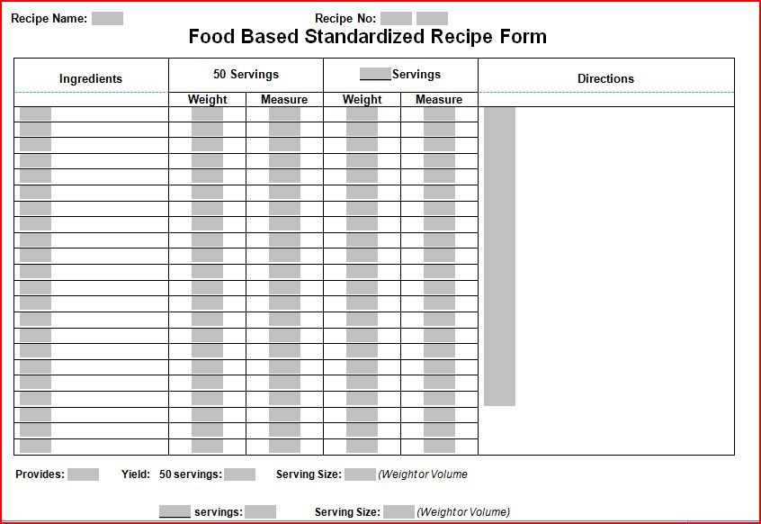
Standardized Recipes
Notes:
This template of a standardized recipe can be found on the Child Nutrition Knowledge Center website. You may use your own template but must ensure all required elements are included.
By utilizing the template you can be sure you are including all aspects in your standardized recipe.
4

Slide 5

Standardized Recipes
Standardized Recipes must include:
  Name/Number
  Ingredients
  Weights and Measures
  Servings
  Yield
  Directions
Notes:
Each standardized recipe must be named and/or numbered and include the ingredients, weights and measures, servings, yield, and preparation instructions.
Ingredients are often listed in the first column and in order of use. It should specify alternative ingredients when necessary.
The weight and measurements will describe the amount of each ingredient needed throughout the recipe based on the number of servings. It is best to use volume measurements unless you are weighing food items.
The serving size will describe the amount in which one student will receive; for example: 1 cup or 1 slice
The yield describes the total amount of servings the recipe will produce; for example: 10 muffins
The directions must be written clearly and include all aspects, including cooking times and temperatures, to ensure that any individual can follow the recipe and produce a consistent product at the end.

Slide 6
Standardized Recipes
Name
  Name should be descriptive and easily understood
Number
  Helpful for organization
  Needed for identification of recipe on production records
Notes:
The Recipe Name and/or Number. Numbering your recipe is not required but may be helpful for organization and recording the standardized recipe on your production records. Each recipe should have a name. The name should be descriptive of the product and easily understood by everyone who is working in the operation.

Slide 7
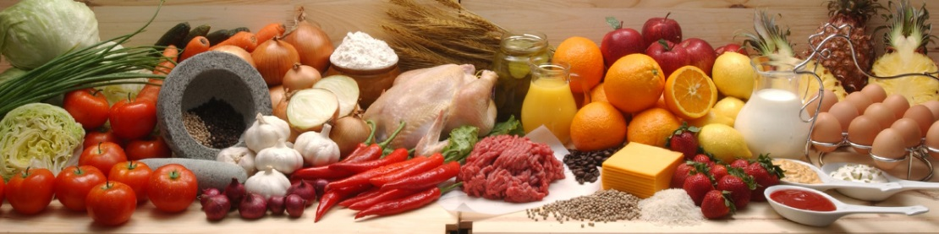
Standardized Recipes
Ingredients
  Specify alternative ingredients when necessary
  Ex. dehydrated onions for fresh onions
Notes:
The ingredients are listed in the first column. They should specify alternative ingredients when necessary. Alternative ingredients are sometimes listed for use in place of a similar ingredient in the recipe; for example, dehydrated onions instead of fresh onions.

Slide 8

Standardized Recipes
Weights and Measures
  weights or volume
  Be specific-avoid using “1 package”
  List quantities in easiest unit of measure
Notes:
When reviewing the weights and measures for each ingredient, a decision should be made whether weights, volumes, or both will be used to describe the amount of each ingredient needed for the recipe. Deciding whether to use weights or measures is based on the practice of your cooks and also is best based on how an item credits towards the Meal Pattern requirements. An example would be a recipe containing vegetables, such as a Black Bean and Corn Salad. Best practice will guide you to develop the recipe utilizing volume. Developing the recipe to state how many cups of each vegetable will assist you in crediting the contribution of each vegetable category towards the weekly subgroup requirement, which are designated in cups per week.
When reviewing the recipe, if the ingredient quantity is not in the preferred weight or volume, conversions will need to be made before the recipe can be prepared. Avoid using packaging or “1 package” to describe the amount of a product.
Products can be packaged a number of ways and package size can vary depending on supplier. The amount of product in each package may vary depending on the product quality. Quantities should be listed in the easiest unit of measure, for example 1 lb. 4 oz. instead of 20 oz. or 1⁄2 cup instead of 8 Tbsp. Standard abbreviations for units of measure should be used.

Slide 9
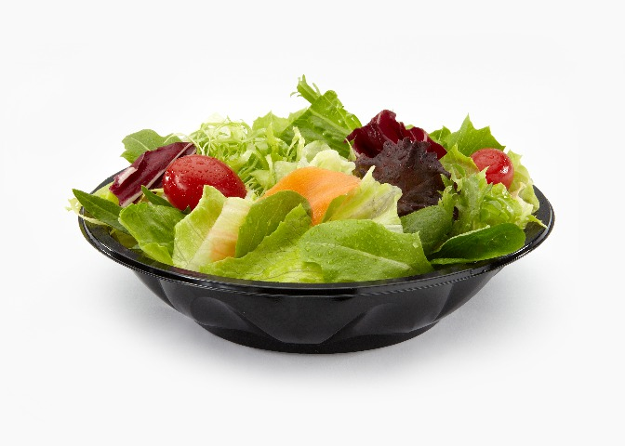
Standardized Recipes
Serving
  Amount that makes one serving
Notes:
Serving describes the amount or size of prepared food that makes one serving. Indicate the weight, such as 2 oz., ¼ cup, or measure, #16 scoop. Ideally, the amount of one serving will be identified in addition to a general description of serving size such as 1⁄2 cup.
Fruits and vegetables should be in cups if using volume measurements. If making recipes from scratch, grains and meat/meat alternate must be calculated in ounce equivalents per serving.
Sandwich recipes, Chicken Patty, Hamburgers which include bread/rolls/wraps etc. serving may be 1 each.

Slide 10
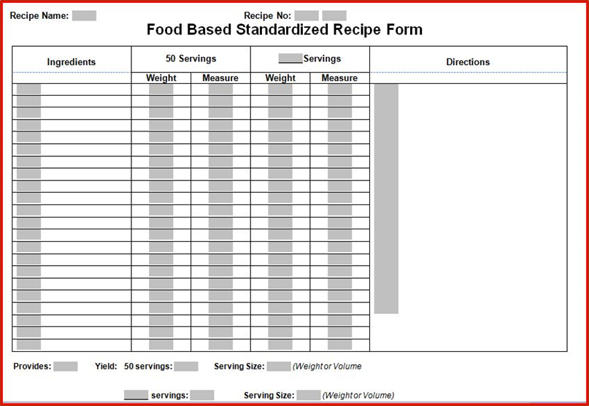
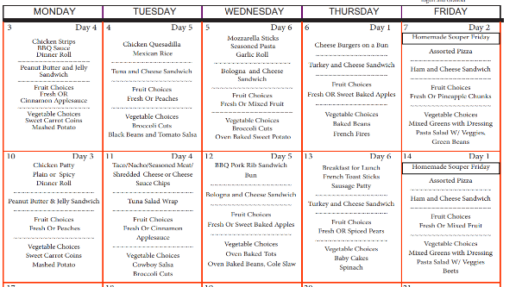
Standardized Recipes
Yield
  Total number of servings in recipe
  Important in menu planning
Notes:
Yield gives the approximate total number of servings of the recipe. The yield is often forgotten but is very important for menu planning. For example: Vegetarian Beans “50 Servings would be your yield”

Slide 11
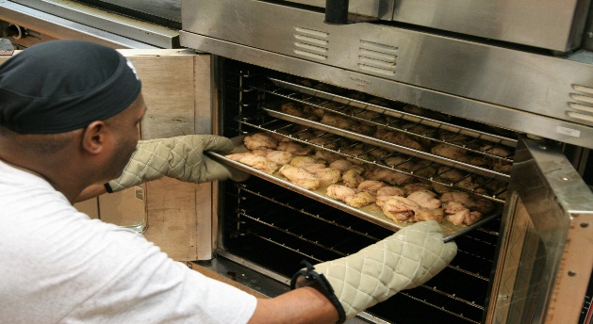
Standardized Recipes
Directions
  How to prepare recipe
  Ensure all staff understand exactly what it meant
  Include cooking times/temperatures
Notes:
Directions tell how to prepare the recipe and should indicate how ingredients are to be combined. All preparation and cooking terms should be reviewed to make sure staff members understand exactly what each means. If the correct procedures are not used, the final product will not be correct. Where appropriate, times and temperatures are given for the type of food service equipment being used.

Slide 12
Food Based standardized recipe form
Chef Salad
155
Ingredients | 50 Servings |  | 1 Servings |  | Directions
 | Weight | Measure | Weight | Measure
Romaine Lettuce |  | 50 cups |  | 1 cup | Wash and cut all vegetables. Slice Deli meat into ¼ inch slices. Individual Salad: Portion lettuce, tomato, carrots, and cucumbers in amounts listed., in serving container. Slice turkey, ham, and cheese into long thin slices and place on top of lettuce. Serve each salad with 2 whole grain rolls Monday-Thursday or 4 packages of graham crackers on Fridays ONLY!
Iceberg Lettuce |  | 25 cups |  | 1/2 cup
Tomatoes |  | 12.5 cups |  | 1/4 cup
Cucumbers |  | 12.5 cups |  | 1/4 cup
Carrots |  | 12.5 cups |  | 1/4 cup
Deli Turkey | 50 oz. |  | 1 oz.
Deli Ham | 50 oz. |  | 1 oz.
American Cheese | 100 oz. | 100 slices | 2 oz. | 2 slices
Graham Crackers or Roll |  | 200 packages or 100 rolls |  | 4 packages or 2 rolls
1
Notes:
Here is an example of a standardized recipe that is completed correctly.
The recipe name and number are clearly recorded. All ingredients are listed, the weights/measures of each ingredient, serving size and yield are clearly descripted, and directions are specific and detailed.
We can clearly see what is included in the chef salad and a person who is unfamiliar with the recipe could easily prepare the salad.
During an administrative review, a reviewer could look at this recipe and validate what various meal components are included in the salad. This recipe shows which vegetable subgroups are included, as well as the meat and grain components.
It is crucial for standardized recipes to be specific and detailed. Starting in SY 2016-17 if an SFA has repeat violations, fiscal sanctions may be assessed.
For example, the chef salad recipe on the current slide clearly states that graham crackers are only offered on Fridays. Graham crackers are considered a grain based dessert, and only 2 oz. equivalent of a grain based dessert may be served per week. The chef salad recipe validates that only 2 oz. equivalent of grain based dessert are offered per week.

Slide 13
Food based standardized recipe form incorrect
Chef Salad
Ingredients | 50 Servings |  | 100 Servings |  | Directions
 | Weight | Measure | Weight | Measure
Lettuce |  | 5 Bags |  | 10 Bags | Wash and cut all vegetables. Slice Deli meat into ¼ inch slices. Portion lettuce and vegetables in individual containers. Top lettuce with turkey, ham, and cheese. Serve each salad with a grain component.
Assorted Vegetables |  | 10 cups |  | 20 cups
Deli Turkey/Ham |  | 2 slices |  | 2 slices
American Cheese | 2 oz. |  | 2 oz.
Graham Crackers or Roll |  | 200 packages or 100 rolls |  | 4 packages or 2 rolls
1 container
100
1 container
Notes:
This is an example of a poorly constructed standardized recipe.
What is wrong with this recipe?
Answers:
There is no recipe number recorded, and there is no way of validating that this is the recipe that was used.
The ingredients are listed but we can not substantiate what type of lettuce or vegetables are in the salad. For example, is the lettuce romaine which would be in the Dark Green Vegetable subgroup or Iceberg lettuce which would be in the “other” vegetable subgroup. In this example, lettuce is measured in “bags” but there is no way of knowing how much lettuce is in each bag or each salad.
The deli turkey and ham are listed as ingredients but the specific weight or measure of the meat is not included on the recipe. By only recording “2 slices” the reviewer would not know how much meat is being offered since a slice of deli meat can be various amounts. There is no way of validating that students are being offered the minimum meat/meat alternate requirements over the course of the week.
The directions indicate that each salad is served with a grain component but there is no way to distinguish whether the grain component is graham crackers or a roll.
There is no way to calculate how much of each meal component is offered in each individual salad, so a reviewer could not determine whether menu components are meeting daily and weekly minimum requirements.
Always ensure standardized recipes are clear, specific, and detailed.

Slide 14
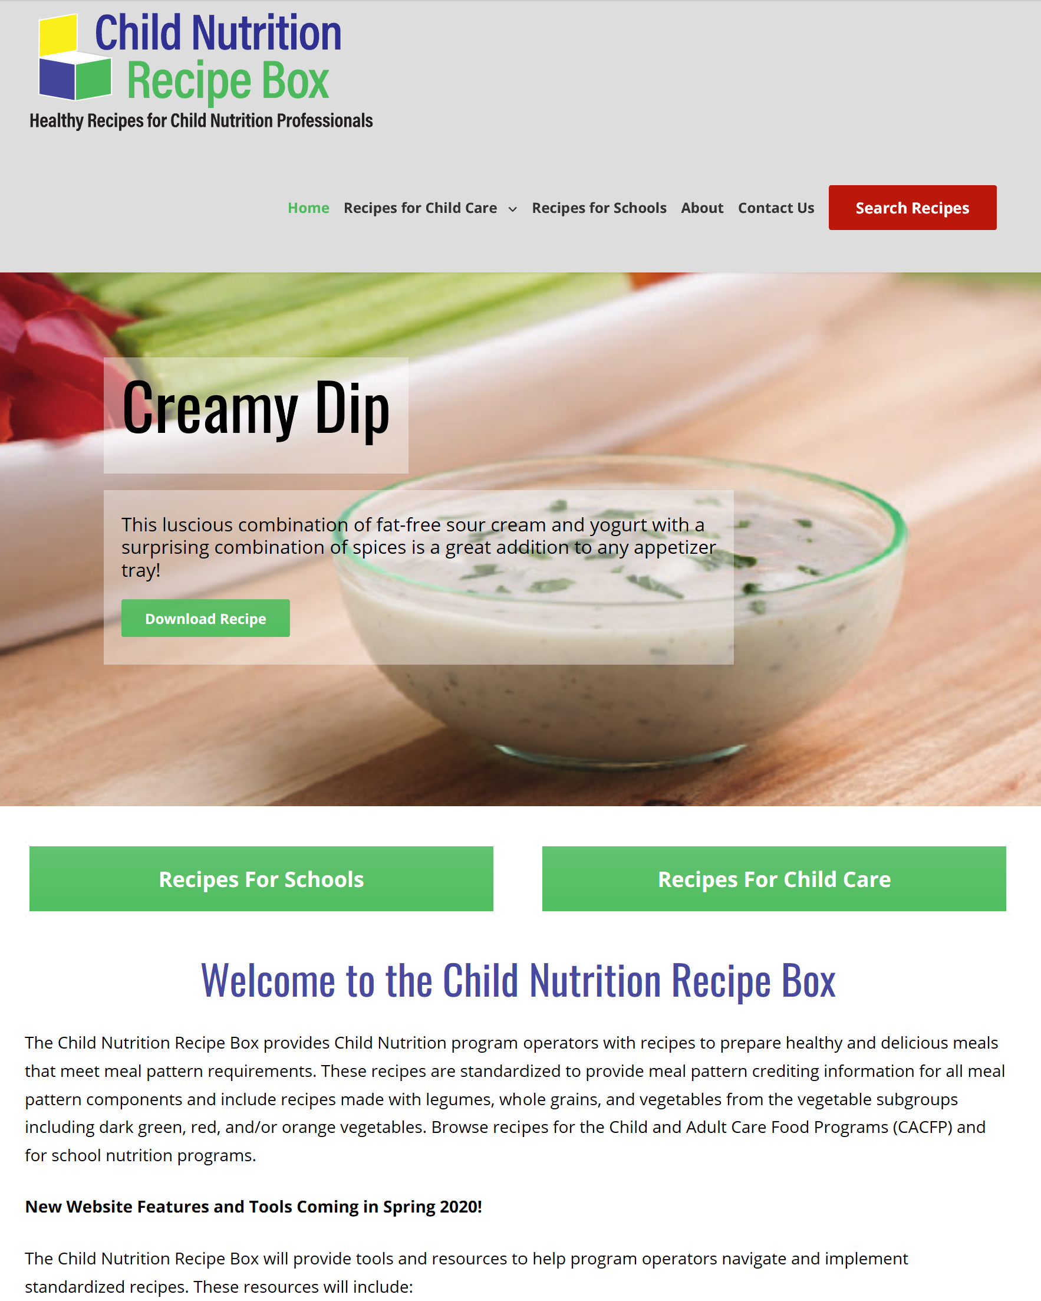
USDA Standardized Recipes
https://theicn.org/cnrb/
Notes:
This is a link to the updated USDA Standardized Recipes. https://theicn.org/cnrb/
These recipes provide Child Nutrition Program operators exciting, new, nourishing, and wholesome dishes that meet the current meal pattern requirements.
These custom-made recipes have been standardized to provide updated crediting information, including the vegetable subgroups.
They also provide recipes that include beans and legumes, whole grains, dark green and red/orange vegetables.

Slide 15


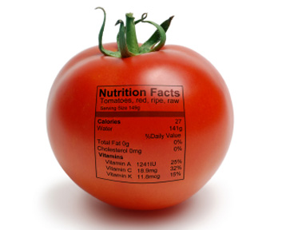
Importance of Standardized Recipes
Cost
  Food cost control
  Labor cost control
    Written standardized procedures in the recipe make efficient use of labor time and allow for planned scheduling of foodservice personnel for the work day. Training costs are reduced because new employees are provided specific instructions for preparation in each recipe.
Nutrients per serving
Customer Satisfaction
Notes:
Including food and labor cost controls; nutrients per serving; and customer satisfaction are three main areas of school foodservice operation negatively impacted when standardized recipes are not used.
Standardized recipes provide consistent and accurate information for food cost control because the same ingredients and quantities of ingredients per serving are used each time the recipe is produced.
Standardized recipes allow for efficient use of labor time and allow for planned scheduling of foodservice personnel for the workday. Training costs are reduced because new employees are provided specific instructions for preparation of each recipe.
Standardized recipes will ensure that nutritional values per serving are valid and consistent.
A well-developed recipe that appeals to students is an important factor in maintaining and increasing student participation levels. Schools may take a lesson from national restaurant chains that have developed popular menu items consistent in every detail of ingredient, quantity, preparation, and presentation. Standardized recipes provide this consistency and can result in increased customer satisfaction.
15

Slide 16
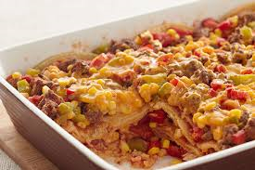
Cost
Example A:
Fiesta Beef Casserole calls for 35 lb of ground beef to make 200 servings. The cook uses four 10 lb packages (40 lb) of ground beef, as opposed to the 35 lb that the recipe calls for.
$0.05 per serving x 200 servings x 160 school days = $1,600
$0.05 per serving x 200 servings x 160 school days = $1,600
Fiesta Beef Casserole Cost per Serving with 35 lb ground beef $0.46 | Fiesta Beef Casserole Cost per Serving with 40 lb ground beef $ 0.51 | Difference in Cost per Serving of Fiesta Beef Casserole + $ 0.05
Notes:
Recipes are developed with specific ingredient amounts. When additional amounts of ingredients are added to a recipe they become portioned incorrectly, leading to a change in the cost to produce that recipe.
For example, the school foodservice has a recipe for Fiesta Beef Casserole which calls for 35 lb. of ground beef to make 200 servings.
If a cook uses 40 lb. of ground beef, the cost per portion increases significantly because 5 additional pounds of meat were used.
The cost of each serving of Fiesta Beef Casserole projected by the use of a standardized recipe is $0.46.
The cost of each serving of the casserole when the standardized recipe was not followed is $0.51.
This is $0.05 more than projected because five additional pounds of meat were used.
If similar changes were made each day during the school year by not following standardized recipes the $0.05 per serving multiplied by 200 servings over 160 school days would be an additional total cost of $1,600.
16

Slide 17
Cost
Example B:
  Yield: 25
  Instructions: Cut a half steam table pan (12" x 10" x 21⁄2") 5 x 5
  Cook cuts pan 4 x 5 and yielded 20 servings instead of 25.
Servings per pan 20 servings 25 servings Difference | Cost per serving $ 0.58 $ 0.46 + $ 0.12
$0.12 per serving x 200 servings x 160 school days = $3,840
Notes:
Example B demonstrates how costs are based on the assumption that a recipe will yield a certain number of servings.
The Fiesta Beef Casserole recipe is specified to yield 25 servings per pan by cutting a half steam table pan (12" x 10" x 21⁄2") five by five ways.
What if the pan was cut four by five ways and yielded 20 servings instead of 25 servings?
The cost per serving for a pan that yields 20 servings is $0.58, and the cost per serving for a pan that yields 25 servings is $0.46 this is a difference of $0.12 per serving.
If you serve 200 students for 160 days, that’s an additional $3,840 over the course of the school year.
If similar mistakes are made multiple times a day, the costs really add up! Plate waste also may increase when servings are too large and, because a larger portion was served to each student, the likelihood of running out of food increases greatly.

Slide 18

Nutrients per Serving
Nutrients per serving for a recipe can be
altered significantly when a recipe is not followed
Nutrient Facts | 25 servings per Pan | 20 servings per Pan
Serving size | 6.5 oz. | 8.1 oz.
Calories | 255 | 318
Total Fat | 12.5 g | 15.6 g
Saturated Fat | 5.0 g | 6.2 g
Sodium | 404.0 mg | 506.0 mg
Notes:
Besides increases in cost, the nutrients per serving for a recipe can be altered significantly when a recipe is not followed.
Take a look at the comparison of nutrient content of a serving of the Fiesta Beef Casserole when cut into 20 servings versus 25 servings.
The serving size increases which in turn increases the calories, total fat, saturated fat, and sodium
18

Slide 19

Customer Satisfaction
Well developed recipes are often the most popular recipe
Increased employee confidence
Notes:
Another very important reason to use standardized recipes is keeping customers happy and satisfied. Standardized recipes provide the same recipe outcome no matter who is preparing them.
Production and other staff members can become familiar with the recipes quicker because recipes have the same format. Guesswork is eliminated because staff members have confidence that the recipe will turn out how it is intended.
Customers will be more satisfied, and participation may increase because customers know what to expect each time a product is served. Employees feel more satisfied and confident in their jobs because standardized recipes decrease the chances of producing poor food products and prevent shortages of servings during meal service.
19

Slide 20

Benefits of Standardized Recipes
Customer satisfaction
Consistent nutrient content / Nutrients per Serving
Food & labor cost controls
Consistent food quality
Predictable yield
Inventory control
Efficient purchasing procedures
Increased employee confidence
Reduced record keeping
Notes:
To recap, using standardized recipes provides many benefits to foodservice operations.
These benefits include customer satisfaction; consistent nutrient content; food & labor cost controls; consistent food quality. Standardized recipes will give a predictable yield, which can help to reduce the amount of leftover food if there has been overproduction.
Standardized recipes can prevent shortages of servings on the line, assist in inventory control and provide efficiency in purchasing procedures. Employees feel more satisfied and confident in their jobs because standardized recipes eliminate guesswork, decreases the chances of producing poor food products, and prevents shortages of servings during meal service.
A collection of standardized recipes for menu items will reduce the amount of information required on a daily food production record. Standardized recipes will include the ingredients and amounts of food used for a menu item. The food production record will only need to reference the recipe, number of planned servings, and leftover amounts.
Well-developed recipes that appeal to students are an important factor in maintaining and increasing student participation levels. Schools may take a lesson from national restaurant chains that have developed popular menu items consistent in every detail of ingredient, quantity, preparation, and presentation. Standardized recipes provide this consistency and can result in increased customer satisfaction.

Slide 21

Record Keeping
Standardized Recipes must be retained for 3 years plus the current year.
Notes:
Child Nutrition Record Retention requirements apply to standardized recipes, 3 years plus the current year.

Slide 22

This concludes Standardized Recipes
New York State Education Department
Child Nutrition Program Administration
(518)473-8781
CN@nysed.gov
Notes:
Thank you. This concludes Standardized Recipes.
Remember to record completion of this training for Annual Professional Standards Training requirements.
If you have any additional questions, please do not hesitate to call or email us.

