Slide 1
Introduction to New York State Education Department (SED) Child Nutrition Programs
The mission of SED is to preserve the nutritional and fiscal integrity of Child Nutrition Programs by providing:
Technical Assistance
Professional Training
Comprehensive Reviews
Nutrition Evaluations

Slide 2
Child Nutrition Programs
National School Lunch Program (NSLP):
"The National School Lunch Program is a federally assisted meal program operating in public and nonprofit private schools and residential child care institutions. It provides nutritionally balanced, low-cost or free lunches to children each school day. The program was established under the National School Lunch Act, signed by President Harry Truman in 1946."
School Breakfast Program (SBP):
"The School Breakfast Program provides cash assistance to states to operate nonprofit breakfast programs in schools and residential childcare institutions. The Food and Nutrition service administers the SBP at the Federal level. State education agencies administer the SBP at the state level, and local school food authorities operate the Program in schools.”
After School Care Program (Snack):
"The National School Lunch Program offers cash reimbursement to help schools serve snacks to children in afterschool activities aimed at promoting the health and well-being of children and youth in our communities. A school must provide children with regularly scheduled activities in an organized, structured and supervised environment and include educational or enrichment activities (e.g., mentoring or tutoring programs). It does not include religious instruction or explicitly religious activities. Competitive interscholastic sports teams are not an eligible afterschool program. The programs must meet State/local licensing requirements, if available, or State/local health and safety standards. All programs that meet the eligibility requirements can participate in the National School Lunch Program and receive USDA reimbursement for afterschool snacks.”
Fresh Fruit and Vegetable Program (FFVP):
To provide fresh fruits and vegetables, free of charge, to all enrolled students in elementary schools with the highest percentage of students certified for free and reduced-price benefits

Slide 3
Child Nutrition Programs
Extended Day Snack Program
“A school operating longer than the traditional school day may be eligible for afterschool snack reimbursement through NSLP, provided that it operates a school day that is at least one hour longer than the minimum number of school day hours required for the comparable grade levels by the local educational agency in which the school is located.”
Special Milk Program (SMP):
"The Special Milk Program provides milk to children in schools and childcare institutions who do not participate in other Federal meal service programs. The program reimburses schools for the milk they serve. Schools in the National School Lunch or School Breakfast Programs may also participate in the Special Milk Program to provide milk to children in half-day pre-kindergarten and kindergarten programs where children do not have access to the school meal programs.”
Summer Food Service Program (SFSP):
"The Summer Food Service Program (SFSP) was established to ensure that low-income children continue to receive nutritious meals when school is not in session. Free meals, that meet Federal nutrition guidelines, are provided to all children 18 years old and under at approved SFSP sites in areas with significant concentrations of low-income children.
Notes:
There is no mandate for SFA’s to participate in the National School Lunch Program (NSLP), After School Care Program (Snack) or the Summer Food Service Program (SFSP). However, SED strongly encourages all SFA’s to participate in these programs if it is in the best interest of the children.
There is a State mandate for Public schools to participate in the School Breakfast Program.
The State Legislature, in an effort to help improve classroom learning, expanded the number of children who can benefit from the SBP. Section 389 of Chapter 57 of the Laws of 1993 and Chapters 614 and 615 of the Laws of 1993 required school districts to establish no later than September 1, 1993, a school breakfast program in all "severe need" elementary schools and no later than September 1, 1994, in all "severe need" schools and no later than September 1, 1995, in all elementary schools (grades K-6) that participated in the National School Lunch Program (NSLP) on or after January 1, 1993. A "severe need" school is one that served 40 percent or more of its lunches under the NSLP at a free or reduced price in the second preceding year.

Slide 4
Regulatory Authority
7 CFR
Part 210– National School Lunch Program
Part 215– Special Milk Program
Part 220– School Breakfast Program
Part 235– State Administrative Expense
Part 245– Free and Reduced Price Eligibility
Part 200- Audit Requirements
Public Law 111-296 (Healthy, Hunger-Free Kids Act of 2010)
2 CFR Chapter I, and Chapter II, Parts 200, 215, 220, 225, and 230- Uniform Administrative Requirements, Cost Principles, and Audit Requirements for Federal Awards; Final Rule
All USDA, SED guidance, memos, and instructions

Slide 5
Who is Eligible to Apply for Participation?
Only recognized public and charter schools, not-for-profit non-public/private schools, and residential child care institutions (RCCIs) are eligible to apply for participation.
A “school” is defined in Federal Regulation 7 CFR 210.2 as: “an educational unit of high school grade or under, recognized as part of the educational system in the State and operating under public or nonprofit private ownership in a single building or complex of buildings.”
Must obtain a Basic Educational Data System (BEDS) code and as applicable, State Office of Religious and Independent Schools (SORIS) code.

Slide 6
SED Policy
Organizations receiving federal funding for multiple CN programs must do business using the same legal name that corresponds with the FEIN number for all CN programs. This legal entity name and FEIN number must be consistent with the organizations 501c3 provided to SED for participation in CN programs.
Furthermore, the same legal corporate name with the same corresponding FEIN number in which the sponsoring organization is doing business with SED for CN program operations is required to incur program costs. Supporting documentation should be under this same FEIN number for workers compensation, disability insurance, A-133 audits, banks accounts and bills.
Organizations operating with a DBA must be able to provide on request, supporting documentation that links the DBA to this same FEIN number that the organization is doing business with SED.
Please be advised that failure to comply with this requirement and with federal and state Child Nutrition Program requirements may jeopardize future program participation.

Slide 7
Funding
The goal of every school should be to have a financially sound School Meals Program. To achieve this goal, it is important to ensure the income from all meals served covers the cost of producing these meals.
Federal Funding
The USDA reimbursement provided for a free, reduced-price, or paid meal, along with the value of commodities (donated foods), is determined annually. Rates for the current academic year can be found on the SED Child Nutrition Programs website: www.nysed.gov/cn/cnms.htm
State Funding
The State Funds are distributed on a per-meal basis. The rate varies.
Notes:
Reimbursement generated is not for adults, student teachers, principal/supt., other administrators, custodians, monitors. Only food service staff who prepare and serve meals receive meals as a benefit at no charge

Slide 8
Ways to Participate
Two options for participation:
(1) Complete an application and set up an agreement with SED to operate as a School Food Authority (SFA); allowing full program responsibility, or
(2) Become a Recipient Agency (RA) sponsored by another SFA; sharing program responsibility.
A separate application is required and can be accessed by submitting an Application Request Form at: http://www.cn.nysed.gov/content/child-nutrition-programs-application-submission-process

Slide 9
How will meals be provided?
To determine which meal service appropriately serves the SFA, evaluate the facilities, contact similar SFA’s utilizing the Child Nutrition Programs, and reach out to SED with any questions or concerns
Meal service options:
(1) SFA will self-prepare school meals
(2) contract with another school or contract with a vendor for meals
(3) use a food service management company (FSMC)
Governed by special federal rules, and takes additional time to implement
Competitively bid process to obtain a management company to manage the food service operation in whole or in part
Must use SED IFB
Contract must be approved by SED prior to submitting a New SFA Application
SFAs will not be reimbursed for meals served prior to the FSMC contract being approved by SED.

Slide 10
Method of Service
Self-Prep – Meals are prepared and served on site
Satellite – Meals are prepared within the SFA and delivered to each site
Sat-Prep – Meals are prepared and served on site and sent to additional sites
Vended – Prepared meals are delivered from an outside organization
A valid NYS Permit to Operate a Food Service is required to be submitted with all new SFA Applications for each site the SFA is applying for.

Slide 11
6-Cent Certification
SFA’s receive an additional 6-cents per lunch reimbursement for meals certified to be in compliance with the meal patterns.
The 6-cent certification worksheets can be accessed on USDA’s website at: https://www.fns.usda.gov/school-meals/certification-compliance
You must submit completed worksheets and menus for breakfast and lunch
If your SFA is seeking any of the following waivers to the meal pattern, you must submit a written request stating the reason for the request:
Dark Green Vegetable Wavier- substitute other vegetable subgroups for the dark green subgroup
Passover Grain Waiver- exemption from the enrichment and whole grain portions of the CNP grain requirement during Passover
Milk Waiver- allows for flexibility for meals that contain poultry or meat- must be in accordance with Jewish Dietary Law
Age & Grade Flexibility- allows for flexibility to serve meal pattern for the highest age/grade group in residence or alternative schools due to operational limitations to separating age/grade groups for safety concerns

Slide 12
Staffing
Staffing requirements may vary depending on number of students served and food production method
Food Service Director
Directly responsible for the management of the day-to-day operations of the school nutrition program for all participating schools under the jurisdiction of the SFA.
Food Service Manager
Directly responsible for the management of the day-to-day operations of the school nutrition program for a participating school(s) under the jurisdiction of the SFA.
Program Staff
Individuals without managerial responsibility who are involved in routine operations of the school nutrition programs for a participating school(s). Program staff may include those individuals who prepare and serve meals, process transactions at the point of service and review free and reduced price applications.

Slide 13
Professional Standards
USDA has established minimum professional standards requirements for school nutrition professionals who manage and operate the National School Lunch and School Breakfast Programs.
Hiring and training standards
All SFAs MUST have a representative from the SFA acting in the program director capacity
Please visit the CNKC for detailed requirements and guidance
http://www.cn.nysed.gov/content/professional-standards
SFA must ensure compliance
Maintain documentation
SED Tracking Tool Link
USDA Tracking Tool
http://www.USDA.usda.gov/school-meals/professional-standards
Notes:
Minimum hiring standards are only for Food Service Directors.
School nutrition program directors are those individuals directly responsible for the management of the day-to-day operations of the school food service for all participating schools under the jurisdiction of the SFA.
When the director is responsible for multiple SFAs, include the enrollments of all SFAs the director is responsible for. For example, if a director is responsible for four SFAs with enrollments of 1,000, 4,000, 3,000 and 2,000 – for a total cumulative enrollment of 10,000, then the director would be required to meet the standards for the SFAs with 10,000-24,999 student category.
If the individual is hired to perform more than one school nutrition job, the hiring standards for the higher level position will apply. For example, if the individual is hired in the cook/manager title but is responsible for the overall administration of the federal programs, this individual would be required to meet the standards established for the school nutrition program director.
If an individual will serve in two completely different capacities, such as principal and school nutrition program director, the minimum hiring standards for the appropriate SFA size still apply.
SFAs who receive meals from a vendor must still employee a food service director who meets the hiring standards.
Consultants are not required to meet the final rule standards. However, it is in the best interest of the SFA to include desired education requirements, a level of experience in the operation of one or more federal nutrition programs and relevant food safety training in their contract specifications for procuring a consultant.
SFAs must maintain a recordkeeping system that annually documents compliance with the professional standards requirements for all school nutrition program employees.
Documentation must be adequate to support to the State’s satisfaction during administrative or other program reviews , that all employees are meeting the minimum professional standards.
At a minimum the SFA would review employee education/training progress periodically throughout the year and certify employee compliance no later than the end of each school year.
USDA has provided prototype tools to assist SFAs in maintaining this recordkeeping system.
State agencies are required to ensure that the SFA complies with the professional standards for nutrition program directors, managers and food service personnel.

Slide 14
Administering CNP’s
Certification and Benefit Issuance- certification of student’s eligibility for free and reduced-price meals to ensure eligible children receive meals to which they are entitled
Verification-process to confirm selected students’ eligibility for free and reduced-price meals
Menu Planning- ensure meals meet meal pattern requirements, all goods and services are purchased using proper procurement and meal prices
Meal Counting and Claiming-system to accurately count, record, consolidate and report the number of reimbursable meals claimed by category
Resource Management-systemic approach to ensuring the overall financial health of an SFA’s nonprofit school food service account

Slide 15
Required Documents (not inclusive)
Approved Application and Single Permanent Agreement
Meal production records
Standardized recipes
Crediting documentation for food served (Nutrition Facts labels, CN labels, Product Formulation Statements)
6 cent certification documents
Daily meal or milk counts by category of meals/milk served to each child at the Point Of Service (POS)
Local Wellness Policy
Revenue from children’s payments, Federal reimbursement, food sold to adults, and a la carte sales
Food service expenditures
Free and reduced price applications – approved and denied (if applicable)
Application verification, Verification Summary Report (if applicable)
Benefit Issuance list of students eligible for free or reduced price meals (if applicable)
Direct Certification lists
Civil Rights poster and statement
Health inspection reports
Food Safety HACCP Plan
Meal Charge Policy/Anti-meal shaming policy
Training documentation
Annual Self-reviews

Slide 16
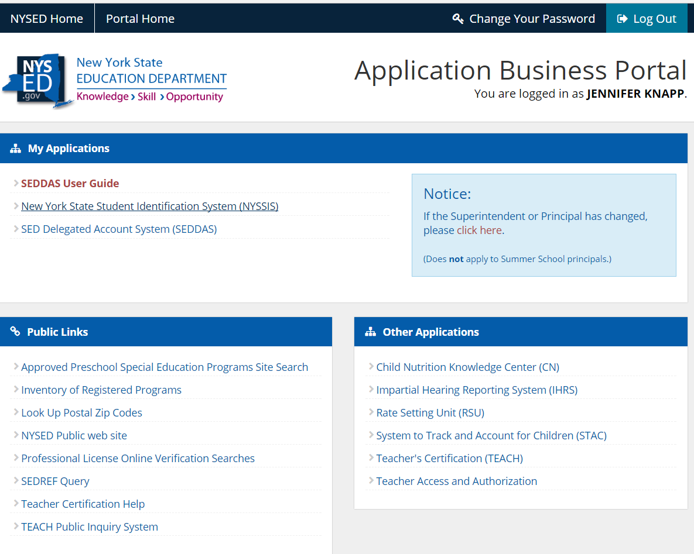
State-Level Direct Certification Matching Process (DCMP)
Provides SNAP and Medicaid data pre-matched to student records/IDs.
The NYSSIS system and State Match capabilities are available on the NYSED Web site, at the NYSED Application Business Portal
https://portal.nysed.gov/abp
Please visit the CNKC for detailed requirements and guidance
http://www.cn.nysed.gov/content/new-state-wide-direct-certification-matching-process-and-mandatory-reporting-snapmedicaid
Notes:
To provide increased access to free meals to children entitled to free meal benefits and allow for more accurate reporting, better policy and decision making at the local, State and federal levels, the Child Nutrition Program Administration (CNPA) has developed a State-Level Direct Certification Matching Process (DCMP).
The State Match feature provides users with access to direct certification (DC) data (e.g., SNAP and Medicaid lists) and to DC data that has been matched to New York State student records through the New York State Student Identification System (NYSSIS). The NYSSIS system is already in-use by school personnel responsible for assigning unique IDs to students.
You can access the new direct certification data by clicking the “Business Portal” link on the Child Nutrition Knowledge Center Website. This will take you to the NYSED Application Business Portal website. This is a separate website than the Child Nutrition Knowledge Center and requires another user id and password separate from the one you use for CNMS.

Slide 17
Community Eligibility Provision (CEP)
CEP is an option to allow high-poverty schools to feed more students and focus on meal quality rather than on paperwork.
Claiming alternative in high poverty areas
Four year provision with potential grace year
Any school district can use this option if at least one of it’s schools has 40% or more students certified for free meals without application (called “Identified Students”)
The district may implement community eligibility in one school, a group of schools or district-wide
Must participate in both breakfast and lunch
All meals served to all students no charge
Please visit the CNKC for detailed requirements and guidance
http://www.cn.nysed.gov/content/2018-19-cep-application-due-june-30-2018
Notes:
The Community Eligibility Provision is a counting and claiming alternative available to schools with high economic need. The CEP is a four year provision with a potential for a fifth grace year.
Entire SFA/group of schools or individual schools may participate in CEP. The SFA/Group/Individual schools must have an identified student percentage of at least 40% for participation using April 1 enrollment and direct certification data from the previous year.
The Identified Student Percentage or ISP is comprised of SNAP/Medicaid DCMP & extensions and DC through foster, homeless, migrant, runaway, Headstart, and Evenstart. A letter or list from a group home from students who are wards of the State may also be included.
Schools using CEP must participate in both breakfast and lunch.
All meals are provided to all students at no charge during all years of CEP participation.

Slide 18
Meal Charge Policy/Anti-Meal Shaming
Required for SFA’s that charge for meals
Develop and adopt a plan to ensure students with unpaid school meal fees are not shamed or treated differently
Please visit the CNKC for detailed requirements and guidance
http://www.cn.nysed.gov/content/meal-charge-and-prohibition-against-meal-shaming-policy-template
Notes:
The purpose of this initiative is to immediately end the practice of meal shaming of any kind by first prohibiting any act used to humiliate a student who cannot afford school meals, and second, require that all students are offered the same reimbursable meals as others, regardless of their ability to pay, and not limited to an alternate meal starting in the 2018-19 school year.
Applies to all SFAs that participate in NSLP or SBP except schools serving at no charge such as schools participating in the Community Eligibility Provision, Provision 2, or zero pricing schools.
A template policy has been developed for schools to use to ensure all required areas are addressed, and is included as a handout in this webinar.

Slide 19
Breakfast After The Bell (BAB)
Who | Required: Public schools with at least 70% or more free and reduced-price eligible students in prior year Optional: All other schools
What | Offer all students a breakfast after the instructional day has begun
SED | May- notify schools Monitor compliance December- publish BAB participation information
Next Steps- SFA | Please visit the CNKC for detailed requirements and guidance http://www.cn.nysed.gov/content/breakfast-after-bell-implementation-and-reporting-breakfast-delivery-methods
Notes:
While nearly 60 percent of students in New York public schools are currently eligible to receive a free or reduced-price breakfast at school, only 34 percent of these students eat breakfast on any given day.
Beginning in the 18-19 SY, all public schools where 70% of the school’s enrollment qualifies for free and reduced price meals, based on BEDS data , will be required to offer breakfast to all students after the instructional day has begun. For all other schools, participation in BAB is optional.
On or before May 1st of each year, beginning this year, SED will post on the Child Nutrition website, the list of the public schools that meet the requirements for operating such programs, and provide notification to these schools.
Schools subject to this requirement will provide notice to students' parents and guardians that the school will be offering breakfast after the bell.
Schools will notify SED on their annual renewal if they are participating in Breakfast after the Bell and if so, what delivery model(s) they are using so that it can be reported out by SED by December each year.
Still have to comply with all regs – counting and claiming, following meal pattern, maintaining production records, etc.

Slide 20
30% NYS
SFAs that are self-prep or have a FSMC
Not available for SFAs that procure vended meals
State reimbursement not to exceed $.25/lunch meal
30% total lunch food costs in previous school year from NYS farmers, growers, producers, or processors
Apply to SED annually for additional subsidy
Payment through Child Nutrition claims for reimbursement
Please visit the CNKC for detailed requirements and guidance
http://www.cn.nysed.gov/content/additional-state-subsidy-purchasing-new-york-state-food-products
Notes:
The incorporation of nutritious, locally grown foods supports healthy eating habits and is critical to the development of children. When schools use food products from local sources, it supports local farmers and provides healthy choices for children in the school meal programs while supporting the local economy.
Governor Cuomo’s No Student Goes Hungary plan includes an incentive for SFAs to purchase locally sourced products. SFAs that spend at least thirty percent of total food costs for the school lunch program on NYS food products in the preceding school year are eligible for additional State reimbursement that, combined with any existing State reimbursement, will not exceed twenty-five cents for any school lunch meal.
This opportunity for additional funding is available to all SFAs that directly purchase individual food items or contract with a Food Service Management Company to purchase individual food items on the SFA’s behalf. SFA’s that purchase vended* meals are not eligible.
SFAs will track their purchases of NYS food products for their NSLP during the 18-19 SY to receive funding for meals served in the 19-20 SY.
SED will be providing a formula for determining the minimum amount of NYS food product purchases for school lunch required to qualify for the additional State reimbursement.
SFAs will apply annually for this additional funding through SED’s Child Nutrition Management System. SFAs must document lunch food purchases and costs in the preceding school year and certify that at least thirty percent of its total cost of food products for its school lunch program was from New York state products. **

Slide 21
Record Keeping
SFA records shall be retained for a period of 3 years after submission of the final claim for reimbursement for the fiscal year to which they pertain. However, if audit findings have not been resolved the records shall be retained beyond the 3 year period as long as required for resolution of the issues raised by the audit.
Please be advised that these records must be readily retrievable or immediately available upon request.

Slide 22
Civil Rights
Annual Civil Rights training must be provided by the SFA for all staff who deal directly with program applicants and participants.
“Justice For All” poster must be displayed
Racial Ethnic data collection/ Civil Rights Compliance Report
Please view the Civil Rights folder on the CNKC for further guidance.

Slide 23
Non-Discrimination Statement
In accordance with Federal civil rights law and U.S. Department of Agriculture (USDA) civil rights regulations and policies, the USDA, its Agencies, offices, and employees, and institutions participating in or administering USDA programs are prohibited from discriminating based on race, color, national origin, sex, disability, age, or reprisal or retaliation for prior civil rights activity in any program or activity conducted or funded by USDA.
Persons with disabilities who require alternative means of communication for program information (e.g. Braille, large print, audiotape, American Sign Language, etc.), should contact the Agency (State or local) where they applied for benefits. Individuals who are deaf, hard of hearing or have speech disabilities may contact USDA through the Federal Relay Service at (800) 877-8339. Additionally, program information may be made available in languages other than English.
To file a program complaint of discrimination, complete the USDA Program Discrimination Complaint Form, (AD-3027) found online at: http://www.ascr.usda.gov/complaint_filing_cust.html, and at any USDA office, or write a letter addressed to USDA and provide in the letter all of the information requested in the form. To request a copy of the complaint form, call (866) 632-9992. Submit your completed form or letter to USDA by:
(1) mail: U.S. Department of Agriculture
Office of the Assistant Secretary for Civil Rights
1400 Independence Avenue, SW
Washington, D.C. 20250-9410;
(2) fax: (202) 690-7442; or
(3) email: program.intake@usda.gov.
This institution is an equal opportunity provider.

Slide 24
How To Apply to be an SFA
Review the Introduction to the Child Nutrition Programs PowerPoint
Review webinars, tutorials, snip-its available on the Child Nutrition Knowledge Center under the ‘Trainings’ tab
Submit the New Application Request Form, found at: http://www.cn.nysed.gov/content/child-nutrition-programs-application-submission-process
Once submitted, an application packet will be e-mailed to your SFA
Complete the New SFA Application and required documents
Conduct DCMP
If you are applying for CEP, complete the CEP application
Submit a complete application to the following e-mail: cn@nysed.gov by June 30, 2019
Applications submitted after this date will not be accepted
Please do not mail a paper copy
If an application is approvable, SED will send your SFA a Single Permanent Agreement. You must read and sign this agreement and mail back to the Child Nutrition office with an original signature.
If approved, your SFA will be sent an approval letter

Slide 25
Contact Us
NYS Child Nutrition Program Administration
89 Washington Avenue, 375 EBA
Albany, NY 12234
(518) 473-8781
(518) 486-1086
(518) 473-0018 FAX
http://portal.nysed.gov/portal/page/portal/CNKC

