Slide 1
COMMUNITY
ELIGIBILITY PROVISION
Office of Child Nutrition
Notes:
Welcome to the Community Eligibility Provision webinar hosted by the New York State Education Department Office of Child Nutrition.
Presenting today is Susan Adinolfe and answering questions are Sara Hayes and Tara Webster
Following today’s presentation, you will receive an email containing the slides from today’s webinar.
If you do not receive them, please email CNTraining@nysed.gov. Additionally, a copy of today’s webinar will be posted to the Child Nutrition website.
If you have any questions throughout the presentation, please use the Q&A box to type and send them to our staff. We will answer questions at the end of the presentation.

Slide 2
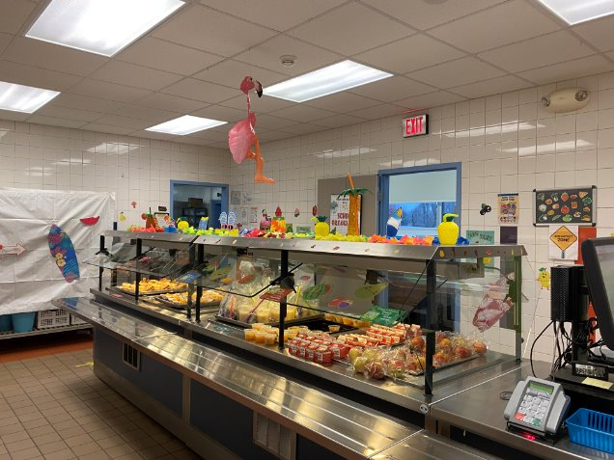
ACRONYMS
c
CEP- Community Eligibility Provision​
SFA- School Food Authority (school district)​
RA- Recipient Agency (school building)​
ISP- Identified Student Percentage​
SNAP- Supplemental Nutrition Assistance Program​
DCMP- Direct Certification Matching Process​
RCCI- Residential Child Care Institution
Saratoga Springs CSD
Notes:
Throughout today's webinar, there are acronyms that will be used.
As a refresher, we thought it would be a good idea to go through them before we get started.
We will be referring to Community Eligibility Provision as CEP.
SFA is the School Food Authority. The SFA is the governing body which is responsible for the administration of the Child Nutrition Programs at the local level. In most cases, this is the school district. The school buildings within the SFA are to referred to as Recipient Agencies or RAs.
ISP is Identified Student Percentage, which we will be discussing in detail later in this presentation. SNAP is Supplemental Nutrition Assistance Program. DCMP is direct certification matching process. DCMP provides SFA's with access to SNAP and certain Medicaid data. And the last acronym is RCCI, which is Residential Child Care Institution.

Slide 3
AGENDA
Community Eligibility Provision (CEP):​
Benefits ​
Eligibility​
Claiming and Reimbursement​
Application Process
Notes:
During today's webinar, we will explain what CEP is and its benefits. We will walk through the process of how to determine eligibility for CEP, how to apply for CEP and how to implement the provision once approved. We also be discussing the CEP reimbursement, including the CEP State Subsidy.

Slide 4
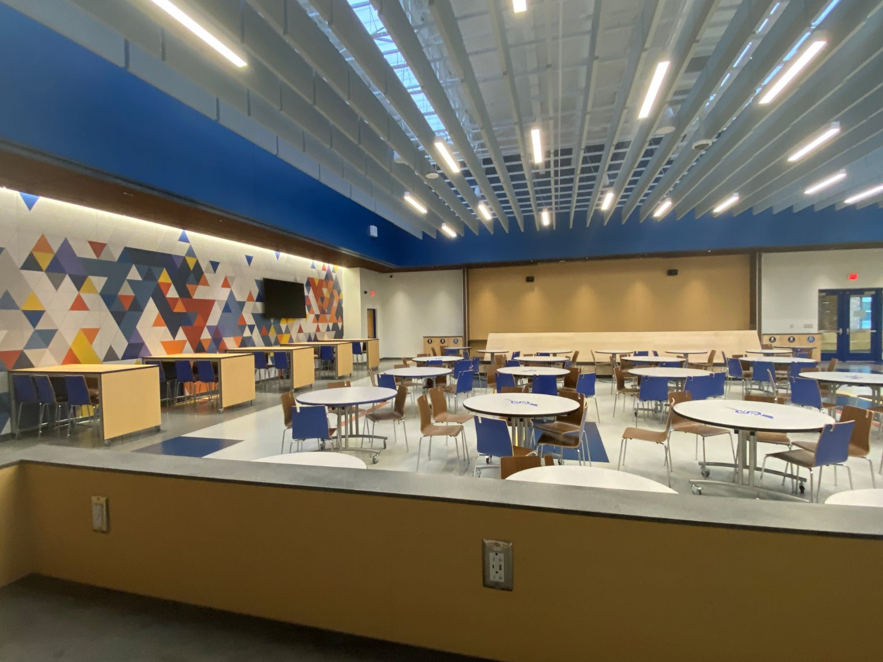
WHAT ARE THE BENEFITS?
Free Breakfast and Lunch to all students
Lessens Administrative Work
No school meal income applications
No income verification
Increases Participation
Improves Efficiency
WHAT IS CEP?
Saratoga Springs CSD
Notes:
CEP allows qualifying schools to provide breakfast and lunch at no cost to all students without the burden of collecting and processing school meal applications. Participation in both breakfast and lunch is required to implement CEP.
Schools operating CEP benefit from increased participation in both breakfast and lunch, increase in meal service efficiency and an overall reduction in the administrative requirements for operating Child Nutrition Programs.

Slide 5
Who Can Participate in CEP?
At least 25 percent of students certified for free ​meals without an application:​
Entire SFA​
Group of RAs​
Individual RA​
Multiple Groups and/or Individual RAs
Notes:
To participate in CEP at least 25% of enrolled students must be certified for free meals without an application. A single RA, a group of RAs, or the entire SFA can participate in CEP.
SFAs should determine how to implement CEP to maximize the benefit to the most students.
Again, to be eligible for CEP, an SFA, Group of RAs, or an Individual RA must have a cumulative identified student percentage, referred to an ISP, of at least 25% .

Slide 6
How to Determine Identified Students
Supplemental Nutrition Assistance Program (SNAP)​
Certain Medicaid​
Extension of DCMP to Siblings/Household Members
DCMP & Extensions
Homeless​
Migrant​
Runaway​
Certified Foster children ​
Headstart/Evenstart​
Other Students Certified For Free Meals
Notes:
The first step in calculating your ISP is determining the number of eligible students, including any UPK students, known as identified students.
These students include:
SNAP and certain Medicaid recipients identified through the electronic direct certification matching process (DCMP) only
Students residing in the same household as SNAP and Medicaid recipients identified through the electronic DCMP, which are known as “Extensions”
Students eligible for free meals via Other Source Categorical Eligibility:
Students identified as “Homeless” by the LEA’s homeless liaison or by an official of a homeless shelter;
A migrant by the State or local Migrant Education Program coordinator or homeless liaison;
A runaway who is identified by the local education liaison as receiving assistance through a program under the Runaway and Homeless Youth Act; or
A foster child whose care and placement is the responsibility of the State, or who is formally placed by a court with a caretaker household through which the State retains legal custody of the child.
Students enrolled in a Federal Head Start or Even Start program.
Students who are eligible for free meals based on submission of school meal applications are NOT included in the ISP, even if the application includes a SNAP number.

Slide 7
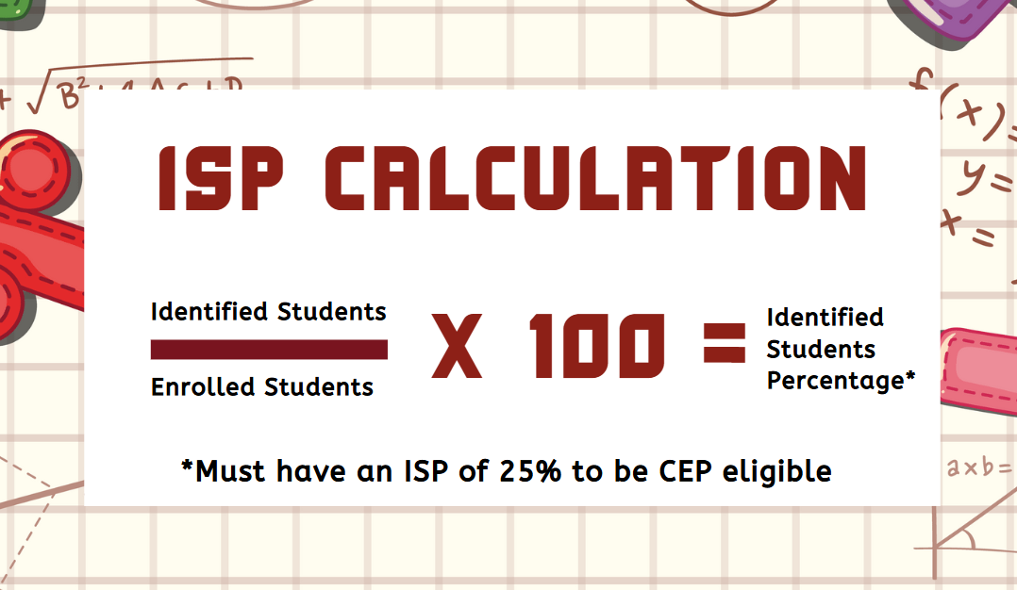
How to Calculate Identified Student Percentage
Notes:
Once you have determined the number of identified students, then you can calculate the ISP for each RA. To calculate the ISP, divide the number of identified students by total number of enrolled students then multiply by 100. The product of that calculation is the ISP.

Slide 8
CEP Grouping Examples
RA​ | ISP​ | Average ISP by Group​ | CEP Eligible?​
North ES​ | 48.98​ | ​ 30.72​ | ​ Yes​
South MS/HS​ | 12.45​
RA ​ | ISP​ | Average ISP by Group​ | CEP Eligible?​ ​
Purple ES​ | 34.27​ | ​ ​ 22.45​ | ​ ​ No​
Yellow MS​ | 17.21​
Blue HS​ | 15.84​
Notes:
Here are some examples of how SFAs can group schools to participate in CEP.
In the first example, South MS/HS does not qualify based on it’s individual ISP but North ES does. The SFA can group both schools together to maximize federal reimbursement and elect CEP in both RAs.
In the second example, the three RAs grouped together do not qualify based on the average ISP. However, Purple ES can be grouped with either Yellow MS or Blue HS for 2 of the RAs to be eligible for CEP.

Slide 9
CEP Federal Reimbursement
Claiming ISP​​ | Times the Multiplier​ | Percent of Meals Reimbursed at Free Rate​ (ISP x 1.6)​ | Percent of Meals Reimbursed at Paid Rate ​​ ​​
62.5​ | 1.6​ | 100​ | 0​
25​ | 1.6​ | 40​ | 60​
c
Notes:
CEP federal Reimbursement is calculated by multiplying the ISP by 1.6. This calculation gives you the percentage of total meals claimed at the free rate. The remainder is reimbursed at the paid rate. The CEP percent of meals reimbursed at the free rate cannot exceed 100.

Slide 10
NYS CEP
State Subsidy
Ensures all CEP meals are reimbursement at the free rate. ​
​
To receive the Subsidy:​
Must be approved to participate in CEP​
Subsidy provided for meals reimbursed at federal paid rate
Notes:
In school year 2023-24, the CEP State Subsidy began providing additional funding to ensure all CEP meals are reimbursement at the free rate. This subsidy is available for meals served in schools approved for and participating in CEP which 100% of the meals are not paid the federal free rate reimbursement. Schools currently approved to operate CEP and are in an active cycle in the 2024-2025 school year, will not have to reapply to receive this subsidy.

Slide 11
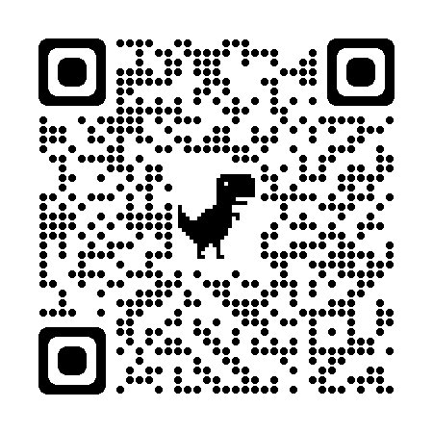
Application Process
Enrollment Period
Begins Spring 2025
April 01, 2025 Enrollment Data
Step #1: Application
3 Tabs to complete: CEP Application Form, Affirmation, and Policy Statement Amendment
Submit to CN@nysed.gov
Step #2: Upload Student Roster
CN Rep will provide access to secure server
Notes:
SFAs must submit an application and be approved by the Child Nutrition Office in order participate in CEP. Applications and instructions can be found on the Child Nutrition website. The CEP application can be accessed by scanning this QR code.
With the application process, schools are required to submit enrollment records to support the calculated ISP. A 2-step submission process has been put in place to ensure that enrollment data is securely transferred to our office.
The first step is emailing the completed CEP Application, which includes the completed Affirmation and Policy Statement Amendment tabs to CN@nysed.gov. Once this is submitted, an email will be sent with instructions on accessing NYSED SharePoint folder or Go Anywhere account. The second step is uploading the enrollment records to the secure server. Please do not include the enrollment records/master list within your initial email to the CN office as it contains confidential personal identifiable information.

Slide 12
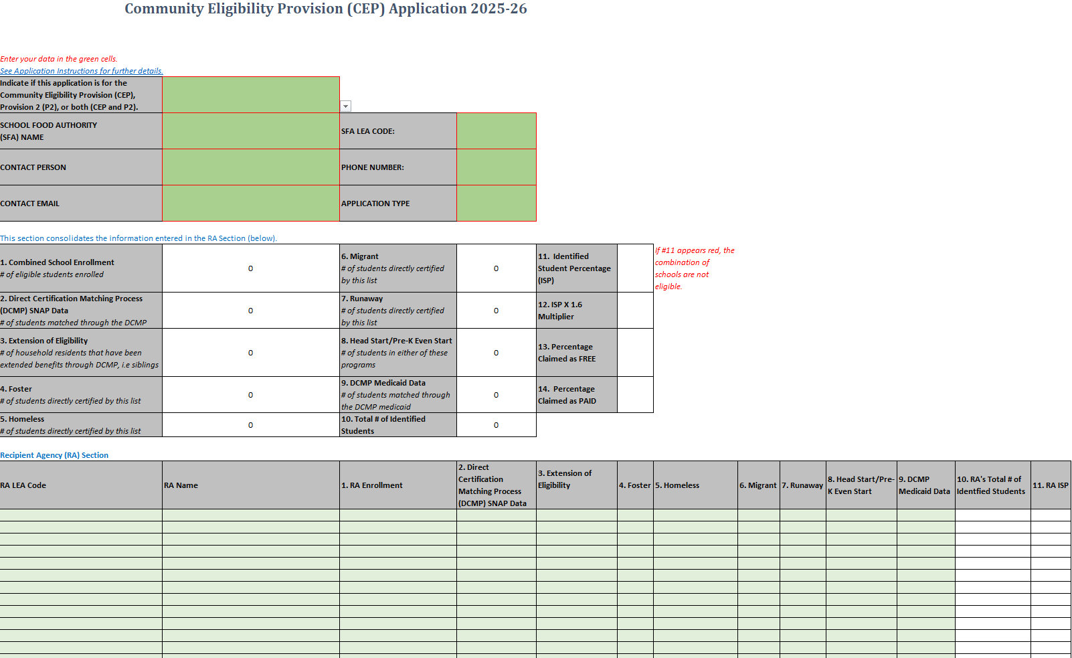
Step 1: SY 2025-2026 CEP Application
Notes:
The CEP application is an excel document that will automatically calculate the ISP for each RA once all the information is entered. Schools complete the green sections, which includes all data used to calculate the ISP- DCMP, foster, homeless, migrant and runaway. All RAs electing CEP must be included on the application.

Slide 13
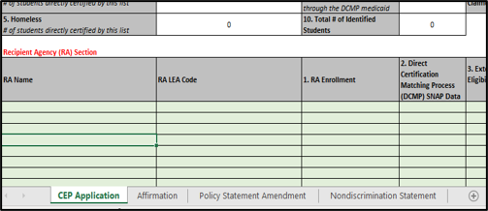
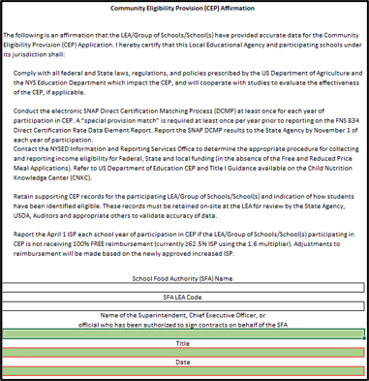
Complete: Name, Title & Date in Affirmation Tab
Notes:
The application also includes multiple tabs at the bottom that must be completed. The Affirmation tab must be electronically signed by a school official that has authorization to sign on behalf of the school district, such as the Superintendent or Chief Executive Officer, attesting that all data is true and accurate.

Slide 14
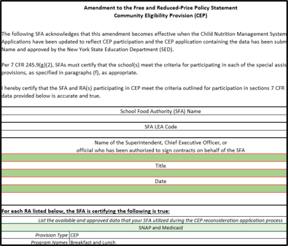
Policy Amendment Tab
Complete: Name, Title & Date
List available & approved data used during application process
Notes:
Since operating under CEP requires changes to the SFAs free and reduced-price policy statement, a signed Policy Statement Amendment must accompany the application. Again, the SFA must fill in all green boxes. The Policy Statement Amendment is found under the third tab of the CEP Application.

Slide 15
School C RA ISP
1. Combined School
6. Migrant
11.
Enrollment
# of students
Identified
# of eligible students
200
directly certified
0
Student
51.50%
Total Combined ISP for all 3 RAs
enrolled
by this list
Percentage
(ISP)
2. Direct Certification
7. Runaway
12. ISP X 1.6
Matching Process
60
# of students
0
Multiplier
82.40%
(DCMP) SNAP Data
directly certified
3. Extension of
8. Head Start/Pre-
13.
Federal Claiming Percentages:
Free-82.40%
Paid-17.60% (Receive additional NYS subsidy)
Eligibility
6
K Even Start
0
Percentage
82.40%
# of household
# of students in
Claimed as
4. Foster
9. DCMP
14.
# of students directly
1
Medicaid Data
35
Percentage
17.60%
certified by this list
# of students
Claimed as
5. Homeless
1
10. Total # of
103
# of students directly
Identified
Notes:
Let’s now go through an example to show how the identified students, qualifications and claiming all work.
This is a copy of a completed CEP application. If you look at the top chart with the green shaded boxes, the RAs listed are either your entire SFA or a group of your RAs. You will fill in the green shaded boxes with your RA name(s) that are applying, LEA codes, enrollment and number of identified students for each category. The remaining unshaded sections will fill for you.
For the first RA, named School A, they have an enrollment of 100 students in the entire RA. 30 of these students were found on the DCMP as having SNAP benefits, 2 are siblings or other household members that attend this same RA but weren’t found on the DCMP so they are an extension of eligibility, 1 is a foster student, 1 is a homeless student and 20 are Medicaid students found on the DCMP. This adds up to a total of 54 identified students. This 54 is then divided by the RA enrollment of 100 and multiplied by 100 to get a RA ISP of 54%.
Now let's look at School C. In box #10 it shows that they have a total of 16 identified students at that RA from their students found through SNAP, Medicaid and extensions with a total Identified Student Percentage of 32%, when grouped with the other RAs, the total identified student percentage combined is at 51.50% which makes this grouping eligible for CEP
In the example, 82.40 percent of meals will be reimbursed at the federal free rate and 17.60 percent will be reimbursed at federal paid rate. The 17.60 percent will receive the state subsidy.

Slide 16
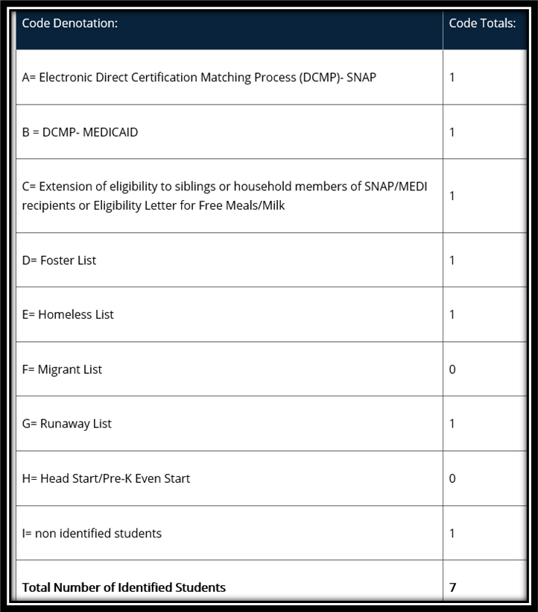
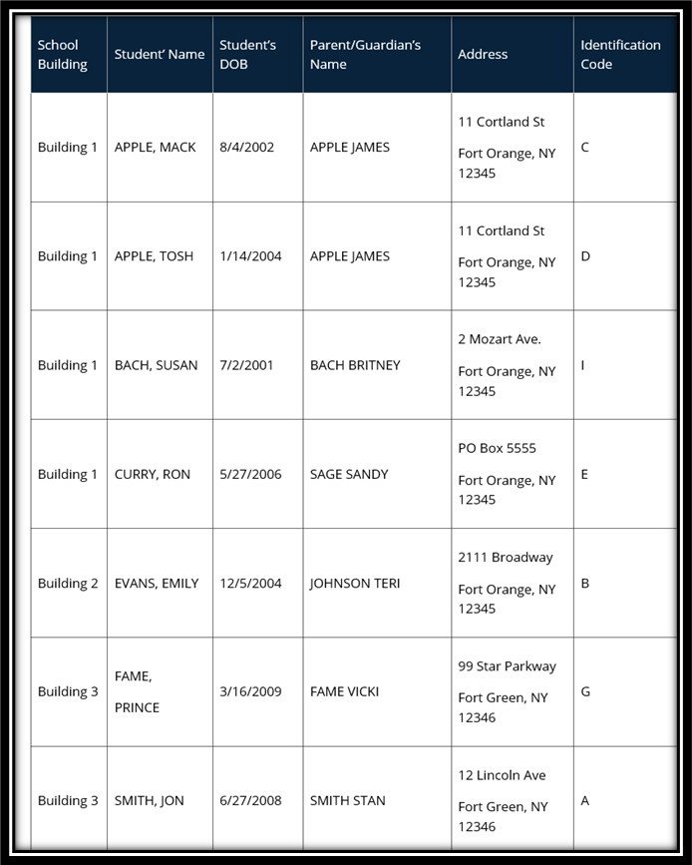
Step 2: Sample Coded Roster/Master List
This data should be organized by qualifying RA.
The enrollment record/master list must include ALL students and be coded to indicate which students were identified to be eligible for the CEP.
Notes:
Step 2 is uploading the entire student enrollment records/master list enrollment data for each RA on the application. The enrollment record/master list must include all students and be coded to indicate which students were identified to be eligible for the CEP based on: SNAP/Medicaid Direct Certification Matching Process (DCMP), extension of direct certification eligibility to other household member, foster, migrant, runaway, homeless, and Head Start/Even Start. The student enrollment and identified students by category should match your CEP application.
A sample code denotation and totals is shown in exhibit A while a sample coded student enrollment record/master list is shown in exhibit B.
Schools must retain these records used in the development of the ISP during the entire period CEP is in effect. In addition, the ISP documentation must be retained for three years after submission of the final claim for reimbursement under that claiming percentage. All other standard record keeping requirements continue to apply.

Slide 17
Roster Data Must Match Data Inputted On CEP Application
Notes:
Although submitting the roster is the second step of the application process, it is advisable to have this roster completed prior to submission given the roster will give you the figures to report in the application. The roster and the application will need to match.

Slide 18
Supporting Documentation for Other Source Categorically Eligible Students
As determined to be:​
Homeless by the LEA’s homeless liaison or by an official of a homeless shelter;​
Migrant by the State or local Migrant Education Program coordinator or homeless liaison;​
Runaway by the local education liaison as receiving assistance through a program under the Runaway and Homeless Youth Act;​
Foster whose care and placement is the responsibility of the State or who is formally placed by a court with a caretaker household through which the State retains legal custody of the child
Notes:
Earlier we discussed students to include in the ISP as “Other Source Categorically Eligible”, such as: Homeless, Migrant, Runaway and Foster.
The CN Representative reviewing your CEP application may require documentation to validate these students' eligibility.

Slide 19
Other Source Categorical Eligibility Acceptable Documentation
Migrant Education Program (MEP)
A list of names of participating children;​
Runaway & Homeless Youth Act (RHYA)
A list of names of participating children;​
The effective dates and the signature of a MEP official; or​
A letter from an MEP official or local educational liaison provided by the household to the school confirming the child currently participates in MEP.
The effective dates and the signature of an RHYA official;​
A letter from a RHYA official or homeless liaison provided by the household to the school confirming the child currently participates in a RHYA program.
Notes:
Acceptable documentation for MEP participation includes:
A list of names of participating children;
The effective dates and the signature of a MEP official; or
A letter from an MEP official or local educational liaison provided by the household to the school confirming the child currently participates in MEP.
Acceptable documentation for RHYA participation includes:
A list of names of participating children;
The effective dates and the signature of a RHYA official;
A letter from a RHYA official or homeless liaison provided by the household to the school confirming the child currently participates in a RHYA program.

Slide 20
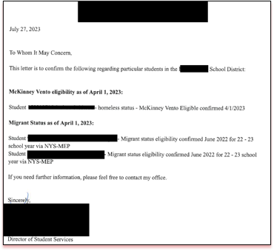
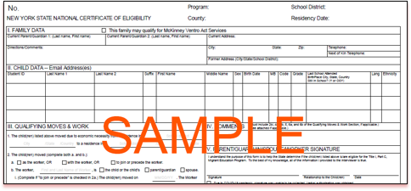
Acceptable Documentation SAMPLES
Letter from MEP /RHYA official /Homeless Liaison
MEP NYS National Certificate of Eligibility (COE)
Notes:
Here are some sample documents to provide upon request.

Slide 21
McKinney-Vento Homeless Assistance Act
Acceptable documentation:
A list of names of homeless children;
The effective dates and the signature of a homeless liaison;
A letter from a homeless liaison provided by the household to the school confirming the child is currently homeless.
Notes:
Acceptable documentation to establish eligibility based on homelessness includes:
A list of names of homeless children;
The effective dates and the signature of a homeless liaison; or
A letter from a homeless liaison provided by the household to the school confirming the child is currently homeless.

Slide 22
Other Source Categorical Eligibility Acceptable Documentation
Foster
Electronic or computer match provided directly to the LEA indicating the status of the child as a foster child without further application;​
Headstart
Approved Federal Head Start application,​
Letter from the State, local welfare agency or court confirming the child’s foster status​
Documentation from the welfare agency or court stating the courts have taken legal custody of a child who has been placed in the foster care system;​
List of children in foster care from the welfare agency or court
Statement of Head Start enrollment, or​
List of participants from a Head Start official.
Notes:
Acceptable documentation for foster children includes:
An electronic or computer match provided directly to the LEA indicating the status of the child as a foster child without further application;
A letter from the State or local welfare agency or court confirming the child’s status as a foster child;
Documentation from the welfare agency or court stating that the courts have taken legal custody of a child who has been placed in the foster care system; or
A list of children in foster care from the welfare agency or court
Acceptable documentation for Head Start includes:
An approved federal Head Start application,
A statement of federal Head Start enrollment, or
A list of participants from a Head Start official.

Slide 23
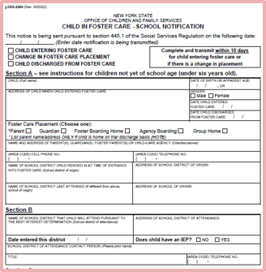
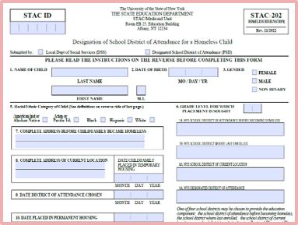
Acceptable Documentation SAMPLES
STAC-202 Homeless Designation Form
OCFS Child in Foster Care – School Notification​
Notes:
Here are some sample documents to provide upon request.

Slide 24
Application Deadlines and Approval
CEP Application- Due by June 30, 2025
Once CEP is approved, a notification email will be sent.
Notes:
Applications are due by June 30, 2025. We highly suggest submitting the CEP application early to ensure approval prior to the beginning of the school year.
SFAs receive an email notification once the CEP application is approved, and the information is entered into the Child Nutrition Management System. The approval email also includes links to templates that SFAs can use to notify families of CEP participation, as notification is required.

Slide 25
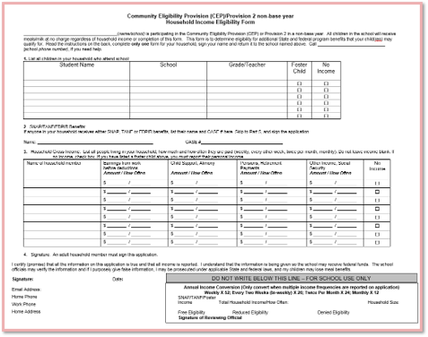
Alternate Household Income Collection Forms
Schools may collect family income information using an alternative collection form for other federal, stated, and local funding
These activities may NOT be charged to Child Nutrition Program funds
CNKC: Special Provision Option Documents
https://www.cn.nysed.gov/content/special-provision-option-documents
Notes:
Since SFAs use the free and reduced-price data as a proxy for many SFA functions, such as BEDS reporting, E-rate, and other local, state, and federal funding; SFAs may opt to collect family income data in addition to the required annual Direct Certification process for theses reporting purposes. While the annually required Direct Certification process for CEP reporting purposes is an allowable cost to Child Nutrition Program funds, the collection of income information from families is NOT considered an allowable expense and therefore is not chargeable to Child Nutrition Program Funds.
Our office makes this alternate Income collection form available for schools approved to implement CEP, along with the modified parent letter and media release on the CNKC

Slide 26
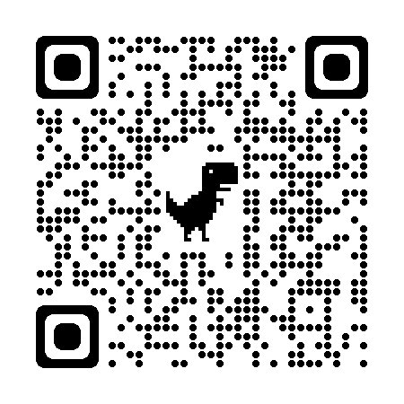
Notification Requirements
(Special Provision Option Documents)
Public Announcement/Media Release
Parent Letter
Notes:
SFAs operating CEP must notify the media and parents regarding implementation prior to the start of the school year.
Templates for modified versions of the Public Announcement and Parent Letter can be found on the CNKC by searching: Special Provision Option Documents or by scanning this QR code.

Slide 27
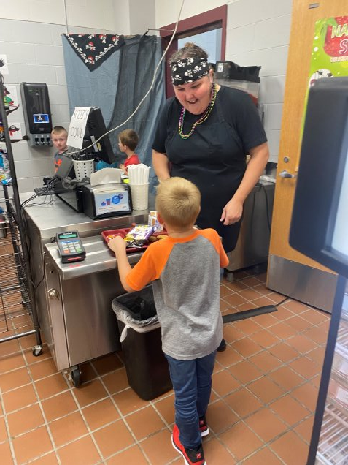
Meal Counts and Edit Checks
Total Count Of Reimbursable Meals By Meal Is Required
One Meal Per Child Per Day
Recommend Use of Point-of-Sale System
Non-Reimbursable Meals Are Not Allowed To Be Claimed
Argyle CSD
Notes:
Serving lines must still be adequately supervised to confirm that all meals claimed for reimbursement meet meal pattern requirements and that reimbursement is only claimed for one meal per child per day. For this reason, schools are encouraged to continue using a Point of Sale, or POS system. CEP schools take a total count of reimbursable meals, by meal program.
When an SFA submits meal claims each month, the total reimbursable meal counts for each RA will be entered by meal type. The Child Nutrition Management System will then separate out the counts into the free and paid meal counts based on the CEP claiming percentage. The percent that goes into the paid rate will automatically receive the additional reimbursement through the state subsidy.
While students may not be charged for reimbursable meals under CEP, schools may continue to charge a la carte prices for non-reimbursable meals and al la carte items.

Slide 28
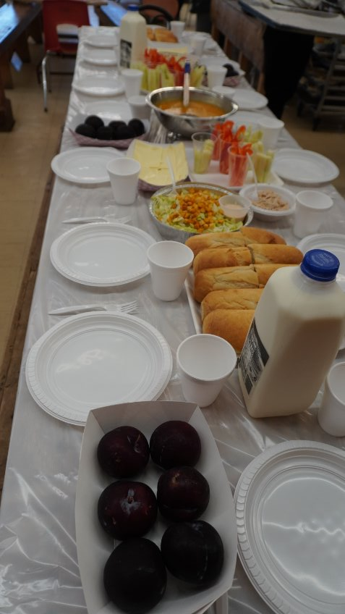
Key Points
CEP is for 4 years with the optional 1-year grace year
If the ISP increases, a new CEP application should be submitted, starting a new 4-year cycle
RAs participating in CEP must offer breakfast and lunch
RCCI’s are not eligible for CEP
To fully maximize CEP, schools should capture as many students as possible in the ISP. This will help to ensure the longevity of the state subsidy.
SFAs must continue to conduct DCMP
Bais Yaakov Academy for Girls
Notes:
Some key points to remember in regard to the CEP are:
CEP is for 4 years, with an option 1-year grace period. An SFA in year four of their CEP cycle with an ISP of at least 15 percent but less than 25 percent are permitted to continue to use the CEP for an additional fifth year, called the grace year. The grace year eligibility must be based on the ISP enrollment of year four. The reimbursements provided in the grace year will be generated by the year four ISP. The grace year is optional and is a local decision.
For those SFAs that determine their ISP has increased since implementation a new CEP application should be submitted to reflect the higher ISP and to maximize federal reimbursement. Whenever an application is approved a new 4-year cycle begins.
Residential Child Care Institutions, or RCCIs, may not participate in the CEP as they are not included in the purpose of the legislation. To fully maximize CEP, schools should capture as many students as possible in the ISP. This will help to ensure the longevity of the state subsidy.
While we encourage SFAs to conduct DCMP monthly, you are required to conduct at least one direct certification data match in each school year to report the number of SNAP and Medicaid matched eligible by RA to SED for federal reporting purposes.
The intent of the state funding is to cover the costs of providing meals at no charge. Since monies aren’t being collected from students, SFAs need to ensure that the CEP reimbursement covers all meal costs or ensure those costs are covered from another non-federal source such as the general fund or donations if the financial impact of implementing CEP is higher than the reimbursement received. This additional state funding will help to cover these costs.

Slide 29
Questions?
Contact Information:
Email CN@nysed.gov or CNtraining@nysed.gov
Child Nutrition Program Office: (518) 473-8781
CN Representative for questions specific to your SFA
Notes:
This concludes the presentation portion of the CEP webinar. We will now take questions on anything discussed during today’s webinar. Again, please use the Q&A box in the lower corner to type and send it to our staff to which we will answer for all viewers to hear. Please remember you may always contact your CN representative for questions specific to your SFA.

