Slide 1


Managing Your Child Nutrition Program
Eligibility/Applications
August 2015
Notes:
Welcome to the Eligibility Webinar!
This webinar was previously presented live by the NYSED Office of Child Nutrition Programs on August 5th, 2015 and covered information related to eligibility requirements for the National School Lunch Program and the School Breakfast Program.
This webinar is about 1 hour; you must view the entire presentation in order to receive continuing education/training credits.
After you have watched the entire presentation, you may close out of your browser by selecting the “X” on the right side of the webinar window. You will then be directed to complete a brief five question assessment of the content covered in the webinar. You must complete the assessment to receive credit for viewing this webinar.

Slide 2
Professional Standards for State and Local Nutrition Program Personnel Final Rule
Effective July 1, 2015
This webinar will contribute 1 Training Hour towards the Professional Standard training requirements
Required to track the number of training hours earned each year and maintain documentation of the trainings attended
SED prototype tracking excel document for School Food Service Directors
More information will be provided in upcoming SED webinars
Notes:
Before we get started, the Professional Standards for State and Local Nutrition Program Personnel Final Rule became finalized and became effective on July 1, 2015.
The Final Rule requires all school food service personnel to complete annual continuing education/training requirements. The number of required training hours varies depending on the position of the school food personnel.
This webinar will contribute 1 Training Hour towards the training requirements. You will receive a certificate for completing this training after you complete the short survey that will be emailed to you after this training has ended.
You are required to track the number of training hours you earn each year and maintain documentation of the trainings that you have attended.
Our office is developing an excel document that you may use to do this. SFAs may use this excel document to track staff training hours. The excel training document will be posted to the Child Nutrition Knowledge Center in the near future.
If you are utilizing USDA Learning Topic Codes, the code for todays Eligibility webinar training is 3100.
Our Child Nutrition Program Office will be covering the Professional Standards Final Rule requirements in more detail in an upcoming webinar at the end of August. Information on how to sign up for this webinar will be posted on the Child Nutrition Knowledge Center.

Slide 3

Regulatory Authority
7 CFR
  Part 210– National School Lunch Program
  Part 215– Special Milk Program
  Part 220– School Breakfast Program
  Part 235– State Administrative Expense
  Part 245– Free and Reduced Price Eligibility
  Part 3016- Procurement for Public & Charter Schools
  Part 3019- Procurement for Non-Public Schools
  Part 3052- Audit Requirements
Public Law 111-296 (Healthy, Hunger-Free Kids Act of 2010)
2 CFR Chapter I, and Chapter II, Parts 200, 215, 220, 225, and 230- Uniform Administrative Requirements, Cost Principles, and Audit Requirements for Federal Awards; Final Rule
  Supersedes and streamlines requirements from OMB CIRCULARS A-87; A-122
All USDA, SED guidance, memos, and instructions
Notes:
These are program regulations that are important for you to be aware of and familiar with.
It is important for you to keep current on federal and State regulations, policies, instructions and memos.
It is recommended that you check our Child Nutrition Knowledge Center website daily to ensure you are accessing the most up to date information regarding the Program.
Today we are focusing on Part 245- Free and Reduced Price Eligibility

Slide 4
Purpose
All schools participating in the NSLP or SBP must make free and reduced price meals available to eligible children; and all schools and institutions participating in the free milk option of the SMP must make free milk available to eligible children
Eligibility
  Important to ensure eligibility determinations are accurate & proper benefits are provided at the point of service
    Student eligibility is the foundation for the claim for reimbursement!
  Accountability for meals served and claimed
Notes:
All schools participating in the National School Lunch Program and School Breakfast Program must make free and reduced price meals available to eligible children.
Also, schools participating in the Special Milk Program who have chosen to participate in the free milk option of the Special Milk Program must also make free milk available to eligible children.
Student eligibility is really the foundation for the claim for reimbursement.
It is important to ensure that eligibility determinations are made accurately and that once the determinations are made- that the student is receiving the correct benefits at the point of service
If a student is approved incorrectly, this carries over to the point of service and further to the claim for reimbursement.

Slide 5
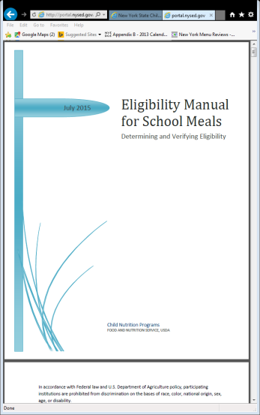
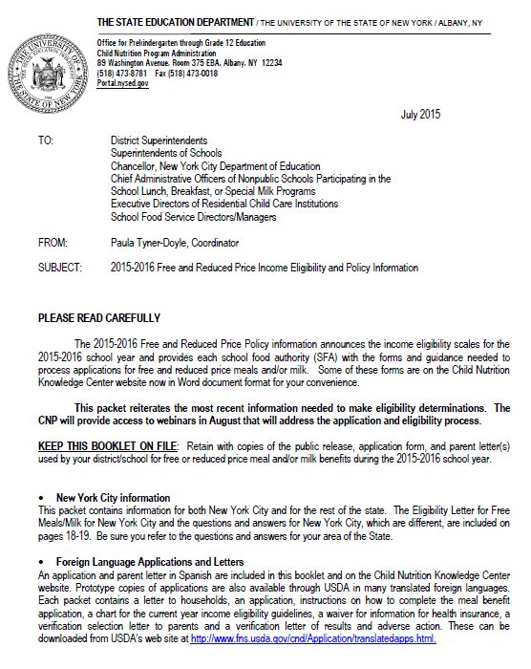
Important Guidance Documents
USDA Eligibility Manual for School Meals
NYSED Free and Reduced Price Income Eligibility and Policy Information Booklet
  Referenced throughout presentation in bottom right corner
Notes:
SFAs should refer to the USDA eligibility manual for school meals
The manual provides detailed information on the entire eligibility and verification process
The USDA eligibility manual was updated by USDA this July. The updated manual is on our Child Nutrition Knowledge Center website under the “Eligibility” tab
On the updated manual, the changes are highlighted in yellow.
Please read through the updated manual to ensure you are up to date with all requirements
SFAs should also refer to the SED Free and Reduced Price Income Eligibility and Policy Information Booklet
The Policy Booklet is updated each year by SED and posted on the Child Nutrition Knowledge Center website prior to the start of each new school year
A hard copy of the Policy Booklet is also mailed to the individuals listed as contacts in our Child Nutrition Management System
The Policy Booklet also contains prototype letters that your SFA should use to ensure compliance
When we are going through this power point, these page numbers in the lower right hand corner of the slide indicate the page to reference in the SED Policy Booklet

Slide 6
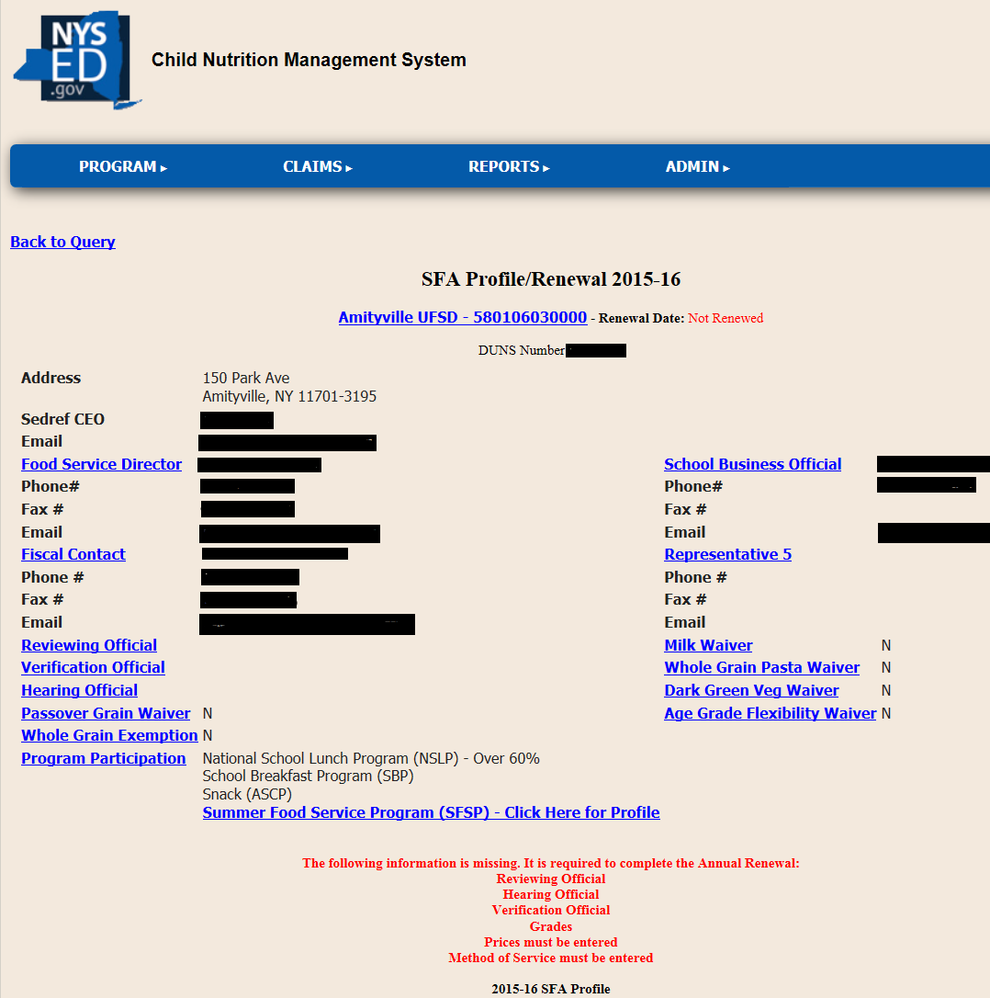
Certification of Acceptance
SFA must identify the Reviewing, Verification and Hearing Official prior to starting the application process
Will be completed as part of the Annual Renewal process on CNMS
Reviewing & Verification official may be the same person
Hearing Official cannot be the Reviewing Official or the Verification Official
Notes:
Prior to starting the application process you must determine who the reviewing official, verification official and hearing official will be.
Reviewing official: Person responsible for approving applications
Verification official: Person responsible for conducting the verification process
Hearing official: An impartial party that will review an eligibility determination if a family appeals the decision of the reviewing official
The Reviewing and Verification Official: may be same person, but the Hearing official must be someone with no prior knowledge of the application approval.
Will complete the certification of acceptance as part of the annual renewal on CNMS.
You should print a copy and maintain with program records
A paper copy is in the Policy booklet
page 42 schools/districts of the policy booklet
page 43 RCCIs and jails of the policy booklet

Slide 7

Public Announcement
Near the beginning of each school year, the public must be notified that free and reduced price meals are available at your SFA
SFA must distribute the Public Announcement annually prior to the start of school
  Local newspapers, unemployment office, major employers
Prototype in the SED Policy Booklet
  Any changes to the prototype requires SED approval
Contains both the Free & Reduced Price Income Scales
  May NOT post to school website
                (Attachment II: Pages 40-41)
Notes:
The public must be notified that free and reduced price meals and/or free milk is available at your School Food Authority. To notify the public that your SFA participates in the National School Lunch Program, School Breakfast Program or Special Milk Program, your SFA must distribute the public announcement at the beginning of each school year (also called the public release).
SED publishes a prototype public announcement in the SED Free and Reduced Price Income Eligibility and Policy Information Booklet. The public announcement must be sent to the local newspaper, local unemployment office and to any major area employers that are contemplating large layoffs. Your SFA is responsible for sending the public announcement to the local newspaper however, you are not required to pay to have it printed. You should keep a copy of the entire public announcement that your SFA distributed along with a copy of the locations that you distributed the announcement to for your records.
You may not post the public announcement on your school website because it contains the free eligibility scale.
*Also please note that if you are posting any information regarding the Child Nutrition Program on your school website- you must include the current USDA nondiscrimination statement !
Please note, if your SFA does not charge for meals, you must still distribute the public announcement to the appropriate locations
Refer to the Policy Book pages 40-41 Annual News Release-Public Announcement
**Not applicable to RCCI’s with NO day students and Jails

Slide 8
Parent Letter
SFA must distribute an information letter to the families of children attending the SFA at or near the beginning of each school year
  Informs families about the Child Nutrition Programs offered at the SFA & how to apply
Must be distributed with the free and reduced price income application to all student households
Prototype Parent Letter in the SED Policy Booklet
  Any changes to the prototype requires SED approval
Contains the reduced price scale ONLY
(Attachment VII: Page 50-52)
Notes:
You are also required to notify families with children attending your School Food Authority of the availability of the Child Nutrition Programs and inform them how they can apply to participate
To do this, you must distribute the parent letter to all families in your SFA along with a copy of the free and reduced price income application
SED publishes a prototype parent letter in the SED Free and Reduced Price Income Eligibility and Policy Information Booklet each year
The prototype parent letter is available in a word document that is fillable
This is found on the Child Nutrition Knowledge Center website under the “Need to Know” section in the 2015-16 Policy booklet memo
If your SFA is not using the SED prototype letter, you must request SED approval to ensure all required components are included
The parent letter may ONLY include the reduced price scale!!
Sending the parent letter with both free and reduced price scales is not allowable and could jeopardize your reimbursement
SED will make necessary changes to the prototype letter each year- Always make sure you are using the current letter from the policy booklet
Please be aware- Households who are enrolling new students in a School Food Authority, after the start of the school year, must still be provided with the parent letter and free and reduced application form when they enroll
Your SFA must keep a copy of the parent letter that was distributed on file with Program records.

Slide 9

Methods of Determining Eligibility
Categorical Eligibility Direct Certification Other Source Categorical Eligible
2. Applications Categorical Applications Income Applications
Notes:
There are different ways to determine eligibility and we will go through each of these in depth in the following slides.
(See the above list)
USDA has implemented very strict reporting requirements regarding free and reduced price eligibility.
SFAs will be required to report the number of students deemed eligible based on the different types and methods of eligibility .
It is important that you maintain detailed records and a benefit issuance document that will allow for you to report accurate information to SED.
We will discuss the different methods of determining eligibility and how to properly maintain a benefit issuance document further in the presentation.

Slide 10
Categorical Eligibility
  Children automatically eligible for free meals or free milk because they, or any household member, receive benefits under Assistance Programs; or they are designated as members of Other Source Categorically Eligible Programs
      Direct Certification
      Documentation from local agency (foster, homeless, runaway)
      SNAP/TANF notification
      Eligibility letters
Notes:
Children are automatically eligible for free meals or free milk if they, or any household member, receive benefits under Assistance Programs; or they are designated as members of Other Source Categorically Eligible Programs.
Students may be deemed categorically eligible for free meal benefits through documentation from SNAP, Eligibility Letters from NYS, documentation from a local agency such as a homeless liaison or foster agency.
Remember, you will be required to report the number of children eligible through categorical eligibility.

Slide 11
Direct Certification
  Process under which SFAs certify children who are members of households receiving assistance under the Assistance Programs as eligible for free school meals, without further application, based on information provided by the State/local agency administering those programs
  SFAs are required to report the number of students who are directly certified for free meal benefits
  Direct Certification is the highest form of eligibility!
Notes:
Direct Certification is the process under which SFAs certify children who are members of households receiving assistance under the Assistance Programs as eligible for free school meals, without further application, based on information provided by the State/local agency administering those programs.
Free meal eligibility is extended to ALL students living in the household of a child who is directly certified.
Direct Certification is the highest level of eligibility.
SFAs will directly certify students for free meal benefits by conducting the Direct Certification Matching Process (DCMP).

Slide 12
Direct Certification Matching Process (DCMP)
  SFAs will directly certify students for free meal benefits by conducting the Direct Certification Matching Process (DCMP)
  Access data through the Child Nutrition Management System (CNMS)
    Names and addresses of students in New York State who receive assistance through the Supplemental Nutrition Assistance Program (SNAP) and meet very specific criteria
  Medicaid Matching now included in the DCMP
    Medicaid direct certification data was included with the SNAP DCMP data as of the SY 2014-2015
    DCMP- Only way Medicaid deems a student eligible
  Students will be flagged either SNAP or MEDI
    SNAP is highest level of eligibility
    Must report SNAP and Medicaid DC separately!
Notes:
The Direct Certification Matching Process (DCMP) is a process that is conducted electronically by your SFA. To directly certify students for free meal benefits, or in other words- identify students who are eligible for free meals without further application, your SFA will access data through the Child Nutrition Management System (CNMS)
The data that is accessed through CNMS will include the names and addresses of students in New York State who receive assistance through the Supplemental Nutrition Assistance Program (Formally known as Food Stamps) and who also meet a very specific income criteria.
The data included through the DCMP also includes students who receive assistance through Medicaid. Not everyone who receives Medicaid qualifies for free meals; they must meet very specific income criteria. Please note, DCMP is the only way Medicaid qualifies a child for meal benefits!
Students on this DCMP list must be provided free meal benefits without further application.
When accessing the DCMP data, each student will be flagged either SNAP or MEDI. SFAs are required to report the number of students directly certified through SNAP separately from the number of students directly certified through Medicaid. So, you must keep this data separate.
If you use an electronic system to conduct DCMP- ensure it is programmed to maintain this information separately
Again, free meal benefits are extended to ALL students living in the household of a child who is found on the direct certification matching process.

Slide 13
Direct Certification Matching Process (DCMP)
  SFAs will search the direct certification database by zip code and identify students who attend their SFA
      To identify an eligible student, the SFA must match at least 3 unique identifiers to their enrollment records
          First Name, Last Name, Case Name/Guardian
          First Name, Last Name, DOB
          First Name, Last Name, Case Number
          First Name, Last Name, Address
  SFAs may also search the DCMP database by a last name or case number search
Notes:
To conduct the DCMP, you will log into CNMS and follow the instructions as listed in the Direct Certification Memo on our Child Nutrition Knowledge Center.
When conducting the DCMP, SFAs can choose how to run the DCMP search to easily identify students in their SFA who qualify for free meal benefits.
The initial search conducted for each data set is usually done by zip code to allow for the most matches.
SFAs will use this data to match students who attend their SFA with students who appear on the DCMP list.
To make a match, SFAs must identify a student using at least three unique identifiers to the student enrollment data at the SFA.
Ie. First name, Last name, Case name/Guardian
Ie. First name, Last name, DOB
Ie. First name, Last name, Case number
Ie. First name, Last name, Address
SFAs also have the ability to conduct the DCMP by searching by last name or by case number if they want to look up a specific student.
SFAs must maintain these DC lists not just the rosters.

Slide 14
Direct Certification Matching Process (DCMP)
DCMP must be conducted at least three times each school year
  SED provides DCMP data in August, October, January & April
  DCMP with August data is required
SFAs must maintain a record of each DCMP match on file
  SFAs are required to notify families of children who are directly certified of free meal eligibility
  Written notification must include option to decline benefits
  Use NYSED prototype (Attachment X: Page 56)
Notes:
SED will provide updated DCMP data 4 times during the 15-16 school year, in August, October, January and April.
SFAs must ensure the DCMP is conducted at least three times throughout the school year- however, the first DCMP in August is required for all SFAs. It is the SFAs responsibility to check the website for these updates and complete the DCMP at least three times each school year.
SFAs must keep documentation of the DCMP match each time they access the data.
SFAs will also be responsible to send letters to households of directly certified children notifying them of their free status.
Families have the right to decline benefits by returning the letter indicating declining benefits (page 56 policy booklet)
If not using the prototype letter you, must request SED approval to ensure all required components are included
*SFAs must keep all information confidential.
Direct Certification is extremely important.
There are benefits to conducting DCMP:
You are able to reach more students who are eligible for free meals
The more students you can directly certify the less applications to approve and verify

Slide 15
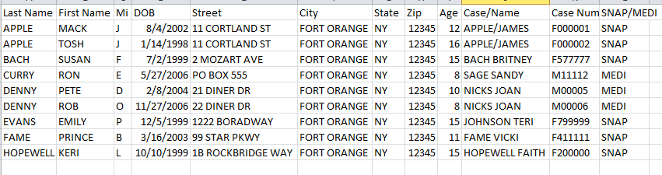
SAMPLE Direct Certification Data

Slide 16
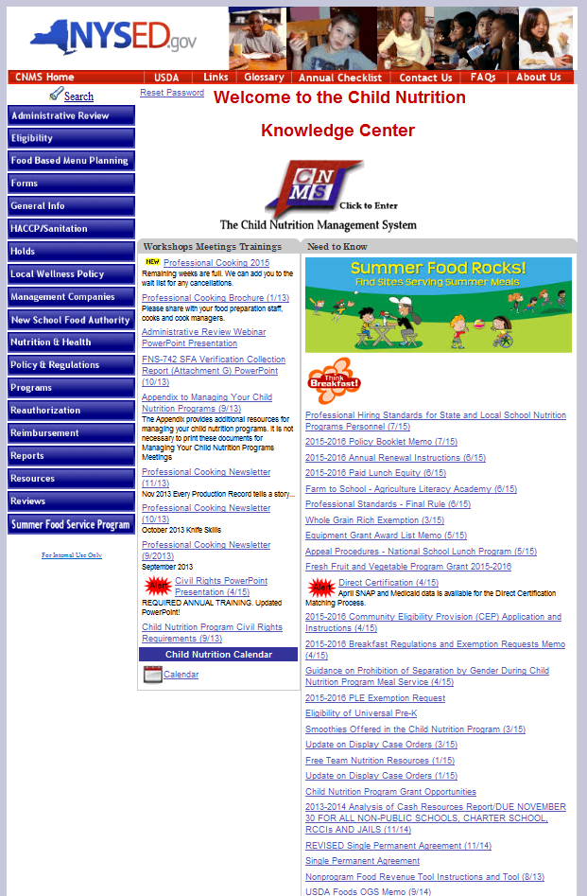
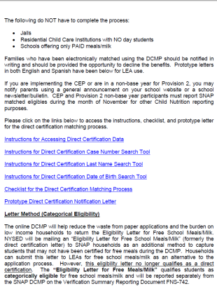
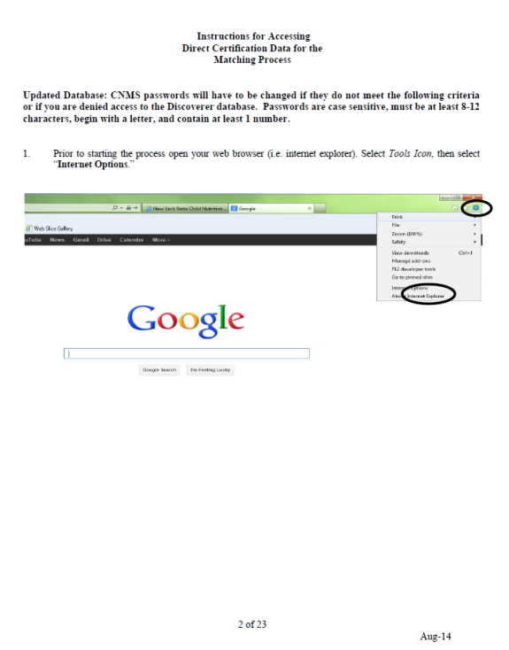
DCMP Information
#2
#1
#3
Notes:
Information on the Direct Certification Matching Process can be found on the Child Nutrition Knowledge Center website
When you click on Direct Certification on the Child Nutrition Knowledge Center #1 under the “Need to Know” section you will be directed to the Direct Certification memo (#2)
The Direct Certification Memo explains the DCMP and includes step by step screen shot instructions on how to conduct DC (#3)
Your SFA should review the DCMP instructions prior to starting the process.

Slide 17
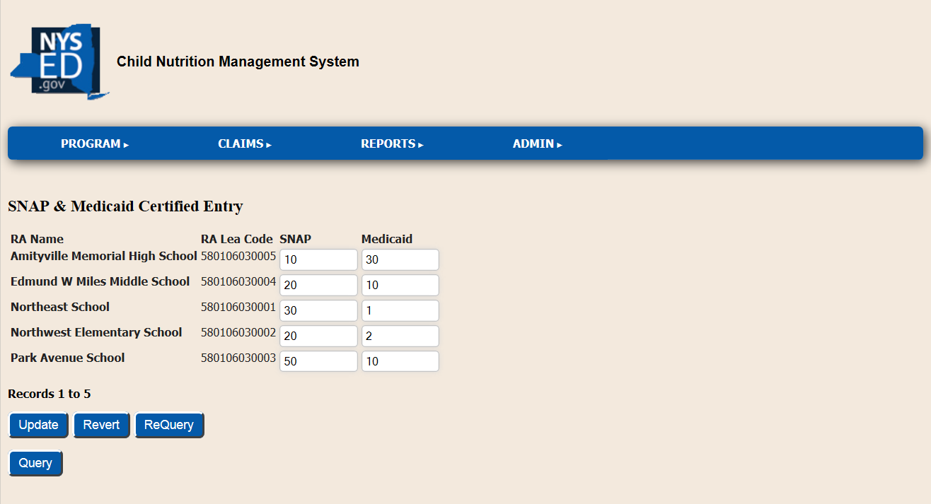
Direct Certification Data Reporting
Prior to submission of the September claim, SFAs must report the number of students directly certified through the August DCMP on CNMS
Reported by Recipient Agency
SNAP & Medicaid reported separately
Notes:
New this year- SFAs must report the number of students directly certified by recipient agency to SED prior to submitting their September claim for reimbursement.
SFAs will report this information through CNMS. The screenshot on the slide shows what you will see when you enter this information.
SFAs will be required to report the number of students identified through the August DCMP match by recipient agency. The data must be broken down by the number of students receiving snap and the number of students receiving Medicaid.
It is extremely important that your SFA maintain this information to ensure accurate data is reported. If you use an electronic point of sale system to conduct the DCMP- ensure it is designed to capture the number of SNAP students separately from the number of Medicaid students.
* If your SFA has more than 50 recipient agencies, we will be collecting this information separately.

Slide 18
Eligibility Letter
Children from families receiving SNAP or TANF receive a letter from SED in August indicating they are eligible for free meal benefits
SFA must accept letter and provide free meal benefits
  No further application is needed
  Eligibility Letters must be current year (2015-16)
Benefits extend to all household members
    Attach school enrollment record as backup
Must report number of students deemed eligible through an eligibility letters
(Information on Pages 17-30)
Notes:
Children from families receiving SNAP or TANF receive a letter from SED in August indicating they are eligible for free meal benefits. This letter is called an “Eligibility Letter”. SFAs must accept this letter and provide free meal benefits to the children listed on the letter. These letters do not need to be signed or approved by the reviewing official. These letters are not subject to verification.
If a student transfers, allow him/her to take the original, and the district keeps a copy in the discharge folder.
Benefits are extended to all students living in the household of a child who receives an “Eligibility Letter”.
You will be required to report the number of students eligible through eligibility letters.
Eligibility Letters Questions & Answers, pages 17-30 in the Policy Booklet.
NYC, Upstate, English and Spanish Versions
If you receive an eligibility letter and also find the child on the online DCMP then you should indicate the date of disregard on the letter and retain the letter on file. Direct certification is the highest form of eligibility and therefore the student would be considered directly certified for reporting purposes.

Slide 19
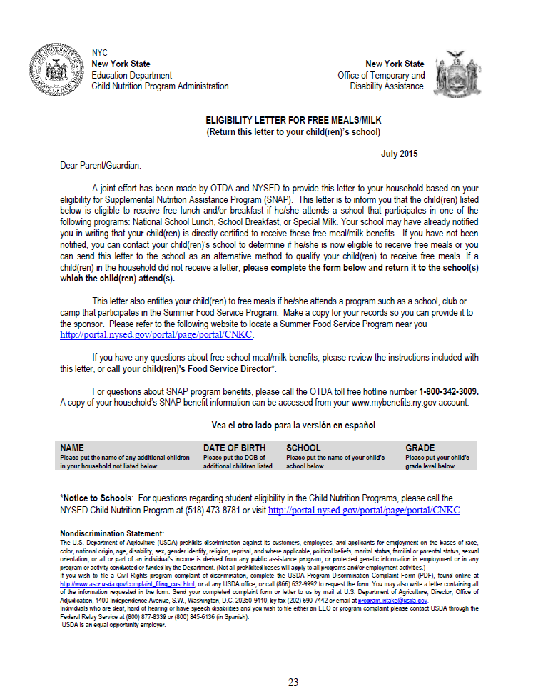
Notes:
This is an example of what an eligibility letter looks like.
Eligibility letters for free school meals/milk are no longer direct certifications. They are now considered categorical eligible.
You will be required to report the number of students who were deemed eligible through an Eligibility Letter.
Samples of this letter in English and Spanish are on Pages 23-30 of policy booklet if its difficult to see on the screen.

Slide 20

Other Source Categorical Eligibility
Other Source Categorical Eligibility:
  Migrant
  Runaway
  Homeless
  Foster
  Federally funded Head Start or Even Start programs
    Except for a foster child, the household indication of Other Source Categorically Eligible status must be confirmed through documentation prior to certifying the child’s eligibility for free meals
    Other Source Categorical Eligibility for free meal benefits may NOT be extended to all household members
(Information on Pages 4-5)
Notes:
Children who are considered “Other Source Categorically Eligible” are also eligible for free meal benefits. Other Source Categorically Eligible includes Migrant, Runaway, Homeless, Foster and Head Start/Even Start Children.
Except for a foster child, the household indication of Other Source Categorical Eligible status must be confirmed through documentation prior to certifying the child’s eligibility for free meals.
Other Source Categorical Eligibility for free meal benefits may NOT be extended to all household members.
We will discuss how to confirm benefits for children who are considered other source categorically eligible on the next slide.

Slide 21
Other Source Categorical Eligibility
Migrant Students
  State or local Migrant Education Program (MEP) coordinator
Runaway Students
  Identified by the local education liaison as receiving assistance through a program under the Runaway and Homeless Youth Act
Homeless Students
  Homeless Liaison or homeless shelter may deem a student homeless
    McKinney-Vento Act- www.nysteachs.org
Foster Child
    Care and placement is the responsibility of the State
  Head Start/Even Start
    Child enrolled in Federal Head Start/Even Start Program
Notes:
For Migrant Students, The state or local Migrant education Program coordinator must confirm the child’s eligibility
Runaway students should be identified by the local education liaison as receiving assistance through a program under the runaway and homeless youth act
Homeless students must be deemed eligible by the Homeless Liaison or by a homeless shelter
The website, www.nysteachs.org identifies the homeless liaison for each public district. Non-public schools may contact the liaison designated for their public district.
Head Start students are categorically eligible for free meals. Obtain names of all students enrolled in Head Start classrooms. Siblings of Head Start students ARE NOT categorically eligible – no extension of eligibility exists for these students.
These officials may provide you with a list of students. The list must be dated and signed by coordinator, liaison or provider – List is sufficient- no applications needed.
All public Schools have someone designated for these positions.
Other source categorical eligibility does not extend to all students living in the household.
If you have an application from the family, certify the other students based on the information on the application.

Slide 22

Extension of Free Meal Benefits
All children in a household with at least one child or household member who receives benefits from an Assistance Program are eligible for free meals
  SFA will use school enrollment records to validate the household address & maintain documentation on file
Notes:
Again, if one child in the household receives benefits through an assistance program then all students living in the household are eligible for free school meals.
To extend eligibility, the SFA will use school enrollment records to identify additional children that live in the same household as a child identified through the DCMP.
The SFA will use the enrollment records to validate that the child resides in the same household.
It is important to note that eligibility is extended to all students living in the household, even if the children are not related.
If a student has been identified as living in the same household as a student directly certified, the SFA should keep the enrollment records on file for that student and provide free meal benefits without further application.
The students who are extended eligibility are considered directly certified for reporting purposes.

Slide 23
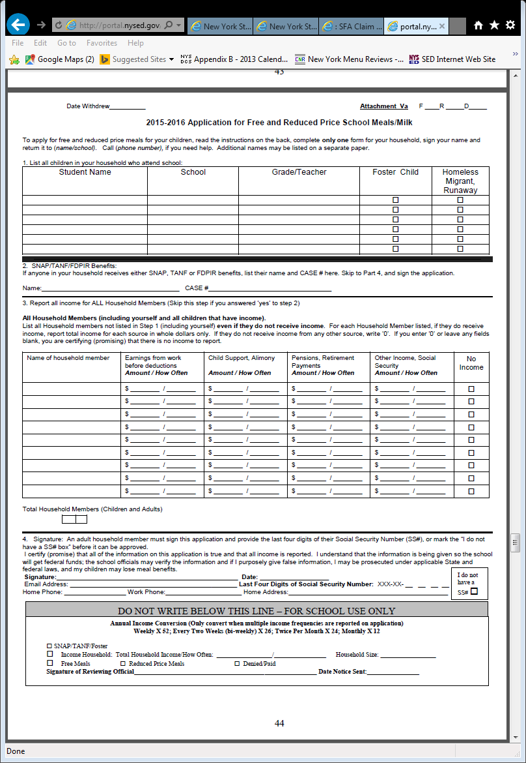
Free & Reduced Price School Meals Family Application
Found in the SED Policy Booklet
  Word & PDF document available
Application & instructions must be sent home with Parent Letter
SFAs may use USDA Prototype
Approving Applications:
Categorical Applications
Income Applications
Notes:
For students who are not directly certified for benefits, you will use the Free & Reduced Price School Meals Family application to provide benefits. SFAs should distribute the family application and issue benefits using a centralized processing system so information can be readily communicated to all schools within the SFA .
The Application can be found in our SED Policy Booklet and is available in a Word document and a PDF document. This year, USDA made changes to their prototype application- SFAs may use USDA’s version of the application however, we recommend that SFAs use our SED prototype.
The USDA version does not allow much room for the family to enter information, does not provide a space for the family to note the school their child attends and does not have a space for the reviewing official to mark the eligibility status the child has been approved for.
There are two ways to approve applications that you will receive: Categorical Applications and Income Applications
We will go through each type and how to approve them .

Slide 24

Categorical Applications
Contain a valid SNAP/TANF/FDPIR case #
  Automatically eligible for free meal benefits
Indicate Other Source Categorical Eligibility
    The appropriate box under other source on the application must be checked
    Eligibility does NOT extend to all household members
  Foster Child
    Foster child box must be checked- Automatically eligible
    Other children in household must be deemed eligible through household income and size
  Homeless/Migrant/Runaway
    Documentation of Other Source Categorical Eligibility is required from other source liaisons
  Do not use Medicaid case # on an application to provide free meal
  benefits!
Notes:
As we discussed, a child may be deemed categorically eligible through documentation or by submitting a free and reduced price application. A family who receives assistance through SNAP, TANF or FDPIR may submit a free and reduced price application noting their assistance program case number. This is considered a categorical application. These families are automatically eligible for free meal benefits!
SFAs should be familiar with what their local assistance program case numbers look like.
Do not use Medicaid case # on an application to provide free meal benefits!
Please note: You may not accept the 16 digit number on EBT cards or the 9 digit social security #.
When you receive an application that lists a SNAP case number, you should check the Direct Certification Matching database to see if the child can be directly certified for benefits. If you do not find the student in the direct certification matching database, you must still take the application at face value and provide free meal benefits. *Do NOT deny benefits for a family that has written a SNAP case number when you cannot find them electronically .
A child who is considered Other Source Categorically Eligible may also apply through an application.
For Foster Child –Foster child box must be checked on the household application to indicate the foster child. Free meal benefits are then provided to the foster child. The foster child is classified as free; other children in the household are categorized based on the family income or other criteria (SNAP/TANF case #). Foster child can be included in total household size for certification of other children.
As we discussed, you must obtain documentation of eligibility for students who check Homeless, Runaway, Migrant on the application
Categories NOT categorically eligible:
Students with Disabilities, foreign exchange, immigrant and refugees.

Slide 25
Free & Reduced Price School Meals Family Application
Categorical Application
Must include:
Student name(s)
Valid Case #
Foster Child/Homeless, Migrant/Runaway box checked-if applicable
Adult signature
Only complete applications may be approved!
Notes:
This screen shows an application based on Categorical eligibility- SNAP (food stamps), TANF, FDPIR. The highlighted areas need to be completed.

Slide 26
Income Eligibility
  A child whose household qualifies based on current free/reduced price income guidelines determined by information provided on the application for free/reduced price meals.
  Applications are taken at face value!
  Once approved, the student(s) remains eligible for entire school year
  Families may submit an application at anytime throughout the school year
  Only complete applications may be approved
    New for SY 2015-2016: If applicant enters “0” or leaves any income field blank, they are certifying (promising) that there is no income to report.
Notes:
The free and reduced price family application is also used to provide meal benefits to students who qualify based on income.
Income Eligibility is a method to provide benefits to a child whose household qualifies based on current free/reduced price income guidelines determined by information provided on the application .
The reviewing official will review the income application to determine which level of benefits the child(ren) qualify for. Applications must be taken at face value.
Students remain eligible all year. For example if a student was deemed eligible in August for free meals because they received SNAP and in Nov they no longer receive SNAP, they are still eligible for the year.
Families can submit applications at any time during the school year or report a loss of income to qualify.
If a family is denied benefits and then reapplies with a new application- the information on the new application should be verified. However, if a family reapplies for benefits after being approved for reduced, you do not verify that new application.
Only complete applications may be approved- we will discuss what a complete application looks like.
NOTE! **New for SY 2015-2016: If the income section is not completed for a household member- this is an indication that the person does not make income and the application is still considered complete- page 51 & 54 of manual.

Slide 27
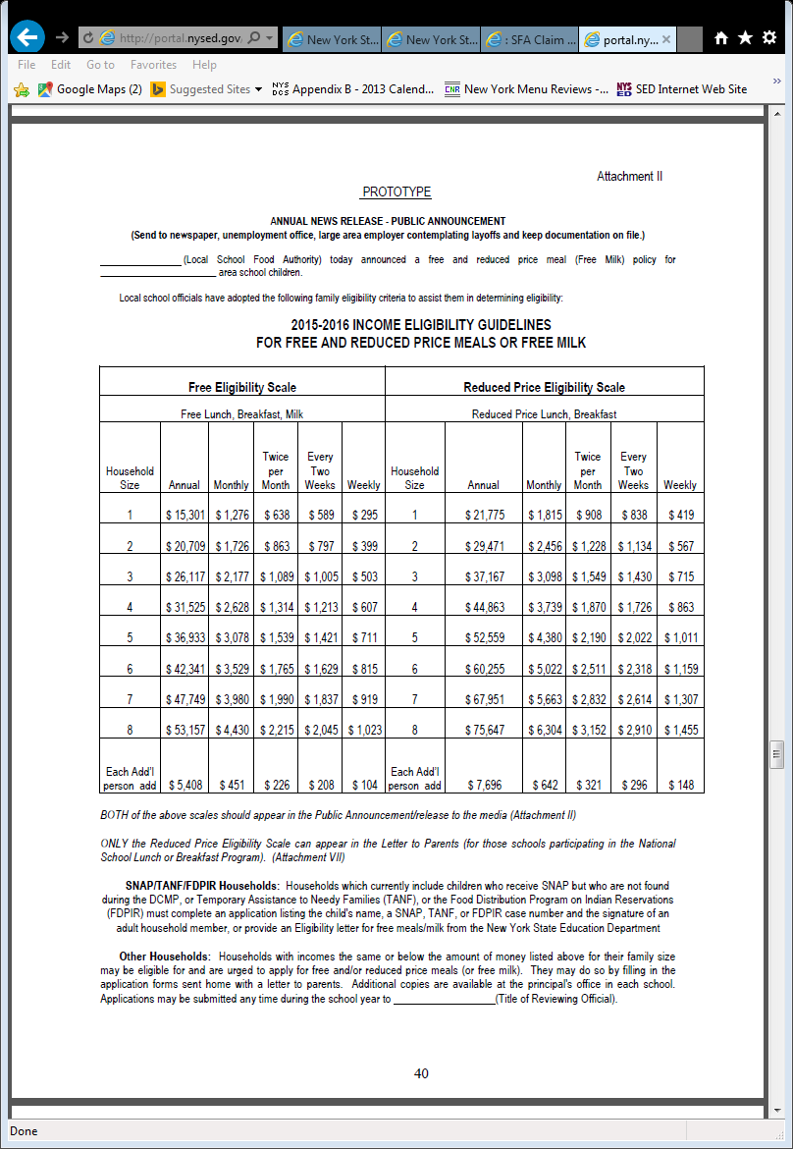
Notes:
These are the eligibility guidelines that the reviewing official will use to approve income applications. Every year, new eligibility guidelines are released by USDA. You must ensure you are using the most current guidelines each school year when approving applications.
How to use the scale:
Based on the number of persons in the household, compare the total income for each income application to the Free Scale First. If the income falls at or below the free scale then the application is approved for free meals. If the income is over the free scale then compare the household size and income to the reduced scale. If the income falls at or below the reduced scale, approve the application for reduced meals. If the income is over the reduced scale then the application is denied (paid).
We will discuss how to approve income applications in further detail on the next few slides.

Slide 28
Free & Reduced Price School Meals Family Application
Income Application
Must include:
Student name(s)
Household member names and total number of members
Income and frequency for each household member
  *Any income field left blank indicates that they are certifying that there is no income to report
Social Security # (last 4 digits only)
Adult signature
Only complete applications may be approved!
Notes:
This slide demonstrates what is required on an income application. An income application must include:
Student names
Household Members
There is also a place under the household members for the family to indicate the total number of household members including all children
Income and Frequency of Income for all household members
Again, Please be aware that USDA has made an update this year! If a household member does not list income, they are certifying that no income is received for that household member. They are no longer required to check the no income box on the application – Page 51 & 54 of USDA Manual
You should refer to the USDA Eligibility Manual for information on the types of income that must be included on the application!
Last four digits of the adult household member’s Social Security Number or the “no SS#” box must be checked
Adult Signature
Once a complete application is received, the reviewing official must review the application and implement the determination within 10 operating days. – We will discuss how to approve applications on the next slide in the presentation.
NOTE: Emancipated Minors can sign their own applications as a family of one (1) If application indicates “no income” or the number “zero” for any household member, the family must be given free meal benefits for the year.

Slide 29
Income Applications
Reviewing official will use the current income eligibility guidelines to approve or deny benefits using the total household members and total income listed on the application
One income frequency listed:
  Add the total income listed for the one frequency and compare to the eligibility guidelines for the household size
Multiple income frequencies:
  Must convert the different frequencies to annual income
    Total annual income then added together and compared to the eligibility guidelines for the household size
No income frequency listed:
  Contact family to obtain frequency of income
    If no response, consider the income weekly
Notes:
To approve income applications, the reviewing official will use the current income eligibility guidelines . We displayed the guidelines on a previous slide in this presentation. The reviewing official must review the total number of household members and review the income listed.
As we saw on the income eligibility guidelines -the frequency columns include annual, monthly, twice per month, every two weeks and weekly. If only one frequency of income is listed on the application, the reviewing official will only need to look at the income scale for that one frequency.
If multiple incomes are listed in the same income frequency, the reviewing official will total the incomes for that one income frequency
If different frequencies are listed- the reviewing official must convert all incomes listed to an annual income using the conversion factors at bottom of application. Do not round the values resulting from each conversion. Sum all the values and compare the total to the published income scale for annual income for appropriate household size.
If no income frequency listed on the application, contact family. (If you add anything that is missing to the application you need to document that you talked to the family. Initial, date and whom you spoke to). If family contact not successful, must consider income as weekly.
If you use a computer program for applications, make sure it is up-to-date and converts correctly. It makes a difference in the income.
You may verify for cause if you have reason (someone reports this information to you) to believe information provided is incorrect.

Slide 30
Free & Reduced Price School Meals Family Application
Approved Application
Reviewing Official Must:
Indicate approval date
Indicate the level of benefit for which each child is approved
Sign or initial the application
The reviewing official must sign or initial and date each application, or sign or initial and date a cover sheet attached to a batch of applications.
Only complete applications may be approved!
Notes:
Reviewing officials must record the eligibility determination as follows:
Indicate approval date;
Indicate the level of benefit for which each child is approved, if it is different; and
Sign or initial the application.
The reviewing official must sign or initial and date each application, or sign or initial and date a cover sheet attached to a batch of applications. *This is a new requirement- be sure to begin this process.
The SED prototype application does have a space to include this information however, if you are using the USDA prototype, the application does not have a space to record this.
The prototype USDA application may be modified to collect this information, or it can be recorded in the margins or on a separate piece of paper attached to the application.
For electronic applications-
A notation should be made to an electronic file.
A computer system should be able to capture the original date of approval, the basis for the determination (that is what household size and income was used), and update the status of applications to account for transfers, withdrawals, terminations, and other changes

Slide 31
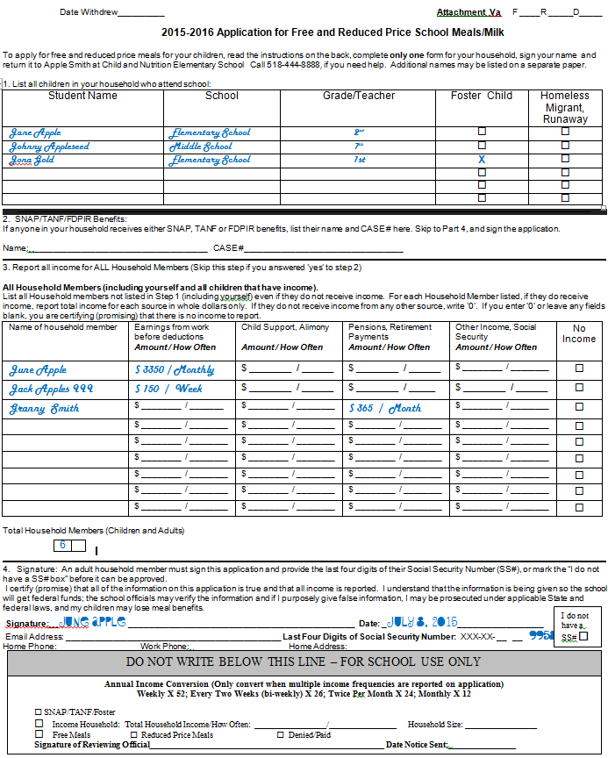
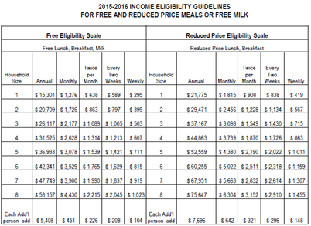
Bonus Round!
Sample Income Application
Jona Gold is a Foster Child
Calculate Income in Box #3. Frequency is in different increments. Use Income Conversion.
$3,350 x 12 months = $40,200
$150 x 52 weeks = $7,800
$365 x 12 months = $4,380
Total Household Income- $52,380 annually
Determine Application Status- Cast your Vote !
A- Everyone is Free
B- Everyone is Reduced
C- Foster is Free, Other students reduced
D- Denied
Notes:
Step 1- Look over application and make sure it is complete.
Step 2- Review Part #1. Note that Joan Gold is a Foster Child.
Step 3- Calculate Income in Part #3. Notice there are multiple frequencies reported on the application (monthly and weekly) therefore the income needs to be converted to annual income. Using the Income Conversion listed in the grey box at the bottom of the application:
$3350 given monthly x 12 months = $40,200 annually
$150 given weekly x 52 weeks = $7,800 annually
$365 given monthly x 12 months = $4,380 annually
Total Household Income = $52,380 annually
Jane Apple and Johnny Appleseed are Reduced based on the Income Eligibility Guidelines. For a household of six members their income is more than $42,341 annually to qualify them for free meals. However the income is less than $60,255 annually so they qualify for reduced meals.

Slide 32
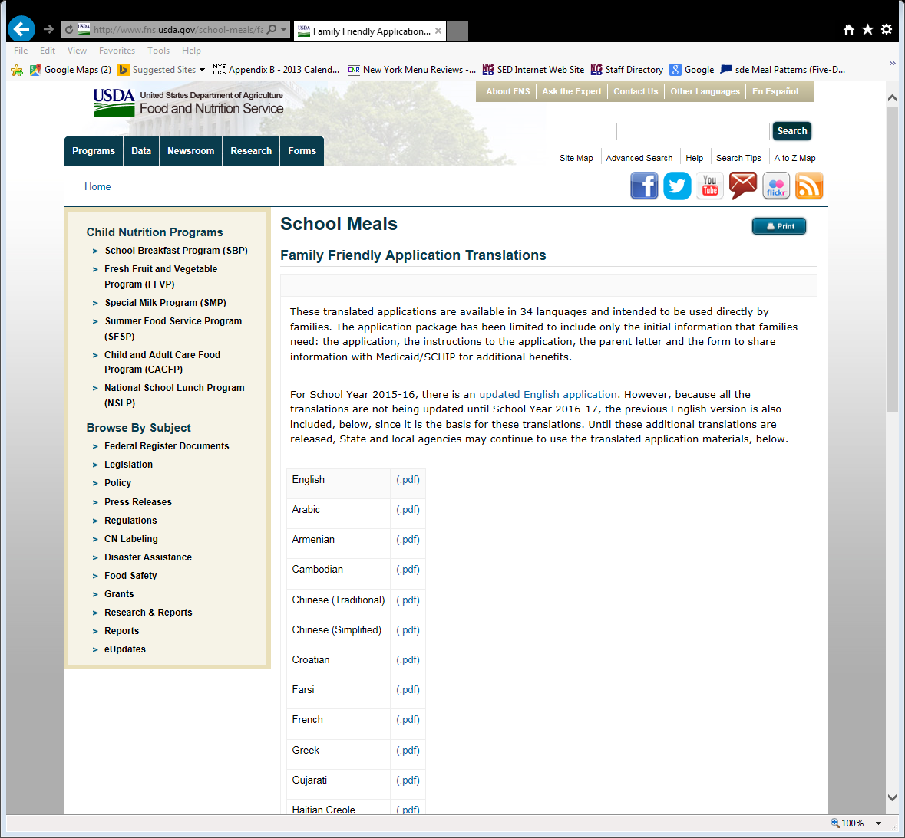
Notes:
Applications and parent letters are available for 34 foreign languages at the USDA website: http://www.fns.usda.gov/school-meals/family-friendly-application-translations.
Can use the USDA Prototype Application if you want to. However, the updated application is only available in English. Again, we do not recommend it because the words are small, there is no place to indicate the benefit level & for the Food Service Director to sign and there is no spot for the family to indicate which school the child attends.
Please note the highlighted information on the USDA site… For SY 2015-2016, there is an updated English application. However, because all the translations are not being updated until School Year 2016-17, the previous English version is also included, below, since it is the basis for these translations.
Applications and the Parent letter are also available in Spanish on the SED Child Nutrition Knowledge Center.

Slide 33
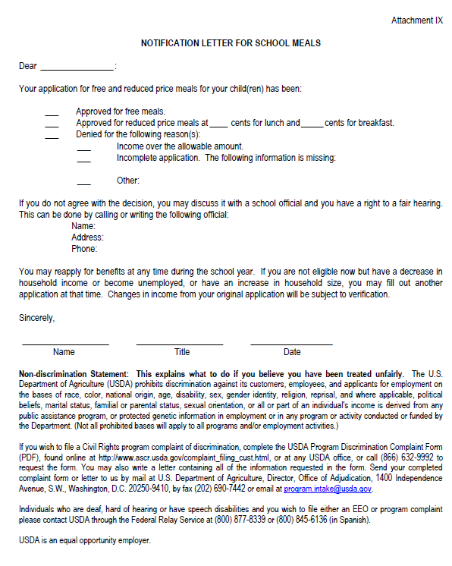
Notification of Eligibility
Families must be notified of eligibility
  Includes non-pricing schools
NYSED Prototype Notification Letter
  Different letter for students deemed eligible
  through DCMP
Denial Letters
  Reason for Denial
  Right to Appeal (and who to contact)
  Family may reapply for benefits
Must maintain a copy of notification letter
on file with Program records
Must contain correct USDA non-discrimination statement- Update system generated letters from POS systems
(Attachment IX: Page 55)
Notes:
Families must be notified either in writing or verbally, of their eligibility status as approved for free or reduced price benefits. We encourage schools to use the prototype letters contained in the free and reduced price eligibility guidance manual for notifying families of their status and their appeal rights (pg. 55 in policy booklet).
The LEA may e-mail the notification of the household’s approval for meal benefits to the adult household member who signed the application.
Denied families must be notified in writing to allow them the appeal/hearing process.
Letters must be kept on file for 3 years plus current year. (ATTACH to Application)
Use prototype letters to be sure all required info is provided to families.
If you are using computer software or POS system ex: WinSnap, NutriKids, etc that generates letters, be sure that the information is correct. We find that some of these programs are still saying that if your income increases, you must report it to the school. This is no longer required. Remember- once an application is approved, the eligibility is good for the year. Keep copies on file for 3 years plus current year.
Ensure the non-discrimination statement is current!
Even if you are a non-pricing school (you do not charge for meals at all and the costs of meals are covered through another fund) you still must notify households

Slide 34

Benefit Issuance Document
Master List of all eligible free and reduced price students
  Indicate how the student was deemed eligible
    Direct Certification
      SNAP
      MEDI
    Categorical Application
      Foster, Eligibility Letter, Homeless, Migrant, Runaway, FDPIR
    Income Application
      Free
      Reduced
Record Keeping
  Confidential information
    List should be coded
  Must keep a current list updates/changes
    Update with changes & indicate date of changes
POS systems should keep hard copy of master list at registers
Notes:
SFAs are required to maintain a benefit issuance document
Reporting requirements are extremely detailed
You will be required to report the number of students eligible by the different types of eligibility! Your benefit issuance document will help to track this information
Your benefit issuance document should indicate how each student was deemed eligible
(Read the types on the slide)
The benefit issuance document should note the date the child was approved for the benefits
Student eligibility is confidential information!
The benefit issuance document should use codes A, B or 1, 2 not the letters F and R for free and reduced
Keep it current – Note when students leave or change category
Have a copy near the cash register so cashiers can refer to it
It is extremely important that your benefit issuance document reflects accurate eligibility determinations
If you use an electronic POS system to maintain eligibility- you must ensure it is set up to allow for you to maintain this information. You must be able to identify each type of eligibility separately.

Slide 35
Eligibility Carryover
  Previous year’s eligibility must be carried over to the new school year
  Carryover is for up to 30 operating days (beginning with the first operating day of school) into the current school year OR until a new eligibility determination is made, either approved or denied
  The new eligibility determination supersedes the carryover eligibility
  Applications must be reviewed in a timely manner. Once an application is processed and approved or denied, the new determination must be implemented within 10 operating days of receipt of the application.
Notes:
Carryover allows families time to submit an application while children can still be fed based on last years eligibility status.
SFAs must permit a carryover period of 30 operating days, beginning on the first operating day of school, or until a new eligibility determination is made.
The SFA may not have a carryover period of less than 30 operating days.
Once a family submits an application, the new determination supersedes the carryover eligibility and must be implemented within 10 operating days of receipt.

Slide 36

Application Maintenance
Personally Identifiable Information (PII)
Help Us Help You- Organize paperwork alphabetically by last name for the entire SFA
Duplicate Applications and Eligibility Letters
  Staple together
  If application was received but student found on the DC list, indicate date of disregard, and must be retained.
Inactive/discharged applications
  Must be maintained separately
Student transfers
  May accept an application from another district but must ensure it is approved correctly!
Notes:
Keep all applications and eligibility determinations in a locked area.
Duplicate applications: Staple applications and eligibility letters. For example, if you certified a student using electronic DC, and also receive an eligibility letter and application, the name on the electronic DC list supersedes the eligibility letter and application. For the State Agency review purposes, we will want to see the paperwork for any student found on an electronic DC list.
Applications for students who are inactive or, no longer enrolled in your school, should be maintained separately. The date the student withdrew/transferred should be noted on the application as well as the benefit issuance document
If you receive an application from another district, it is your responsibility to check if it was correctly approved.

Slide 37
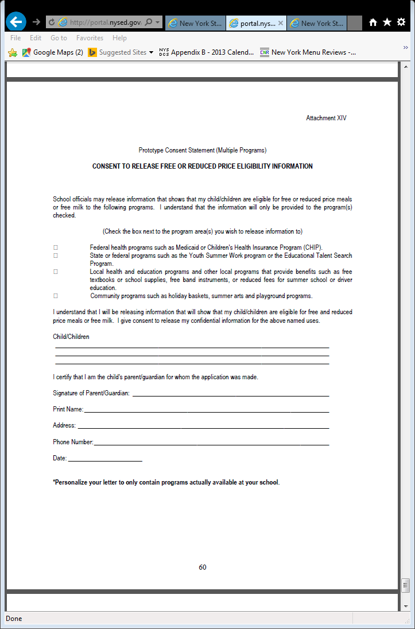
Disclosure
Disclosure of eligibility status is limited
  Refer to Disclosure Chart in Policy Booklet
Need parental written consent
  Prototype Consent Forms: Pages 58-60
Aggregate information permitted
(Disclosure Chart: Page 36)
Notes:
The issues of privacy and confidentiality of personal data are complicated as well as
sensitive.
The NSLA specifies that SFAs may disclose children’s free and reduced price eligibility information to persons directly connected with the administration or enforcement of certain programs or activities. There is a section in USDA’s eligibility manual on disclosure. Information about disclosure is also in NYSED Child Nutrition Policy Booklet.
Certain programs require parental consent to disclose a children’s free or reduced status. For example, the disclosure of children's eligibility for free and reduced price meals or free milk to determine eligibility for free text books, free band instruments, holiday baskets, school supplies, etc., or reduced fees for summer school or driver education programs, would require written consent by the child's parent/guardian.
Written prototype consent forms are available in the policy booklet (attachment 12, 13, 14)
The LEA may disclose aggregate data (percentage of free and reduced or total number of free and reduced students) to any program or individual when children cannot be identified through release of the aggregate data or by means of deduction. An example of aggregate data is the number of children eligible for free or reduced price meals in the school district.

Slide 38
Residential Childcare Institution
(RCCI)
  Students residing in a RCCI are considered a family of one with zero income
  RCCIs must maintain a Resident Eligibility List:
    A master list for all residents of the RCCI/Jail
    List should include:
    Name, date of birth, admission date and time, discharged date and time, signature of administrator
  RCCI with day students:
    Must have eligibility documentation on file for day students; claim by category for those students
Notes:
All residents are considered a family of one in a RCCI
Claimed up to the age of twenty-one
Day students must have an application or other certification document on file

Slide 39
Independent Review of Applications
SFAs that demonstrate high levels of, or a high risk for administrative error associated with certification, verification and other administrative processes will be required to conduct an independent review of the initial eligibility determinations for free and reduced price school meal applications for accuracy prior to notifying households of eligibility.
SED will notify SFAs that need to complete this independent review of applications prior to the beginning of the 2015-16 school year.
Notes:
SFAs that demonstrate high levels of, or a high risk for administrative error associated with certification, verification and other administrative processes will be required to conduct an independent review of the initial eligibility determinations for free and reduced price school meal applications for accuracy prior to notifying households of eligibility.
This means a second person must review all applications prior to providing benefits .
SED will notify the SFAs that need to complete this process prior to the beginning of the school year.

Slide 40
http://portal.nysed.gov/
Child Nutrition Program Administration
89 Washington Avenue, Room 375 EBA
Albany, NY 12234
518-473-8781
The U.S. Department of Agriculture prohibits discrimination against its customers, employees, and applicants for employment on the bases of race, color, national origin, age, disability, sex, gender identity, religion, reprisal, and where applicable, political beliefs, marital status, familial or parental status, sexual orientation, or all or part of an individual's income is derived from any public assistance program, or protected genetic information in employment or in any program or activity conducted or funded by the Department. (Not all prohibited bases will apply to all programs and/or employment activities.)
If you wish to file a Civil Rights program complaint of discrimination, complete the USDA Program Discrimination Form, found online at http://www.ascr.usda.gov/complaint_filing_cust.html, or at any USDA office, or call (866) 632-9992 to request a form. You may also write a letter containing all of the information requested in the form. Send your completed complaint form or letter to us by mail at U.S. Department of Agriculture, Director, Office of Adjudication, 1400 Independence Avenue, S.W., Washington, D.C. 20250-9410, by fax (202) 690-7442 or email at program.intake@usda.gov.
Individuals who are deaf, hard of hearing or have speech disabilities, may contact USDA through the Federal Relay Service at (800) 877-8339; or (800) 845-6136 (Spanish).
USDA is an equal opportunity provider and employer.

