Slide 1
Menu Planning Tools
New York State Education Department
Child Nutrition Program

Slide 2
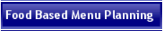
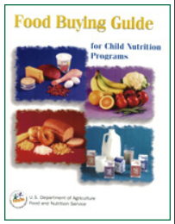
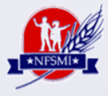
What Resources Are
Available For Menu Planning?
NYSED Child Nutrition Knowledge Center
  Food Based Menu Planning button
  http://portal.nysed.gov/portal/page/pref/CNKC
USDA’s Food Buying Guide- Updated!
  http://teamnutrition.usda.gov/Resources/foodbuyingguide.html
National Food Service Management Institute
http://www.nfsmi.org
Notes:
The Food Buying Guide has been updated and there is a link to USDA’s FBG on the CNKC.
Appendix A & B of the Food Buying Guide provides information and examples for Standardized Recipes.
Appendix C of the Food Buying Guide provides information and an example for CN labels.
NFSMI provides Child Nutrition menu planning and food safety resources and training.

Slide 3

What Tools Are Required
For Planning A Menu?
7 CFR §210.10(a)(3)
Nutrition Information
  Child Nutrition (CN) Labels
  Product Formulations Statements
  Nutrition Fact Labels
Standardized Recipes
Production Records
Menu
Notes:
The regulation states: “Schools must keep production and menu records for the meals they produce. These records must show how the meals contribute to the required food components, food items or menu items every day.”
This regulations requires nutrition information, standardized recipes and production records for all participants in Child Nutrition Programs.
Make sure supporting documents for your menus are up-to-date.
For Example: If you change a recipe, make sure you update the standardized recipe!

Slide 4
Child Nutrition Program (CN) Labels
A CN labeled product will always contain the following:
The CN logo, which is a distinct border
The meal pattern contribution statement
A unique 6-digit product identification number (assigned by FNS) appearing in the upper right hand corner of the CN logo
The USDA/FNS authorization statement
The month and year of final FNS approval appearing at the end of the authorization statement
The remaining required label features: product name, inspection legend, ingredient statement, signature/address line, and net weight
http://www.fns.usda.gov/cnd/cnlabeling/authorized.htm
Notes:
**Use caution when it comes to Child Nutrition information on food product labels. Some product labels are now stating “Child Nutrition Program: 1 bread equivalent”. These statements are not the same as an approved “CN statement”.
USDA provided a list of currently approved CN labels: see link above
You will see an example on the next slide.

Slide 5

Sample CN Label
Chicken Stir-Fry Bowl
Ingredient Statement:
Chicken, brown rice, broccoli, red peppers, carrots, onions, water, olive oil, soy sauce, spices.
CN
099135
Each 4.5 oz. Chicken Stir-Fry Bowl provides 1.5 oz. equivalent meat, 1.0 oz eq grains, ¼ cup dark green vegetable, ¼ cup red/orange vegetable, and ⅛ cup other vegetable for Child Nutrition Meal Pattern Requirements. (Use of this logo and statement authorized by the Food and Nutrition Service, USDA XX/XX).
CN
CN
CN
Net Wt.: 18 pounds
Chicken Wok Company
1234 Kluck Street Poultry, PA 12345
Notes:
Crediting food products, specifically grain products, has been a big issue.
We strongly encourage you to purchase products with CN labels whenever possible.
What are the advantages of using CN labels?
A CN label statement clearly identifies the contribution of a product toward the meal pattern requirements. It protects a school from exaggerated claims about a product.
A CN label provides a warranty against audit claims, if used according to the manufacturer's directions.
We understand that many products that you serve do not contain CN labels, especially a lot of the grain items that are served at breakfast, such as pop tarts, mini pancakes and waffles, breakfast bars, etc. We have had discussions with many of you on how to credit these products b/c the manufacturer is stating that it is a certain ounce equivalent which may not be correct. In this case, USDA has provided us guidance on the use of Product Formulation Statements.

Slide 6
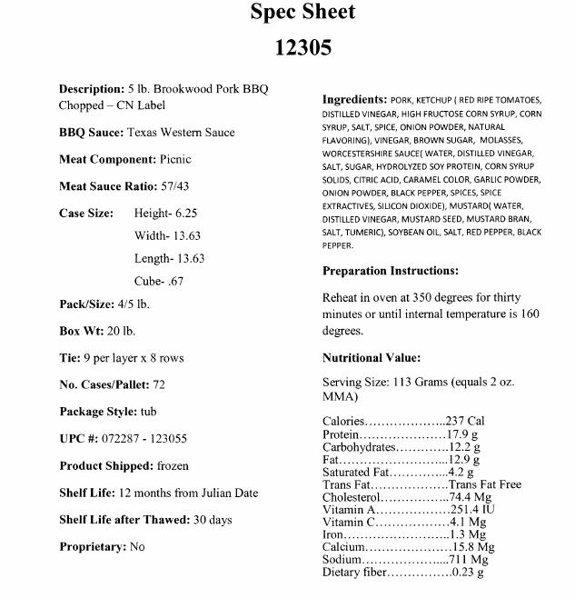
Invalid CN Label
Notes:
Here is an example of a manufacturer’s product statement that claims to be a CN label, but this is not a CN label.
Based on the information provided in the previous slide, why do you think this is not a valid CN label?

Slide 7
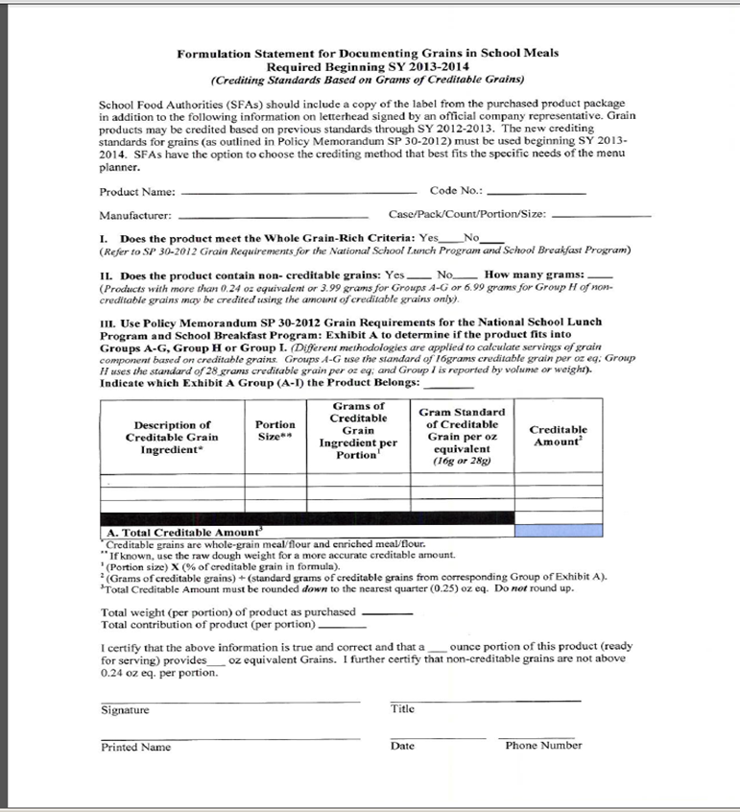
Product Formulation Statement
Notes:
This is an example of a PFS.
We strongly encourage SFAs when purchasing a processed product without a CN label, that they have a completed, signed and dated PFS from the manufacturer for accurate crediting purposes.
A Product Formulation Statement (PFS) will provide specific information about how the product credits to meet CN meal patterns
The Food Buying Guide can be used for foods in their natural state (cooked or un-cooked) that do not have added ingredients such as a bone-in chicken breast with no additives
Prototype Product Formulation Statements are available for:
meat/meat alternates;
grain components;
vegetables; and
fruits.
We know you are all running into the same issues with the vendors nutrition and bid specs that are stating that their products credit as certain ounce equivalents; however, they are not accurate in all instances. We encourage you to ask vendors for product formulation statements.

Slide 8
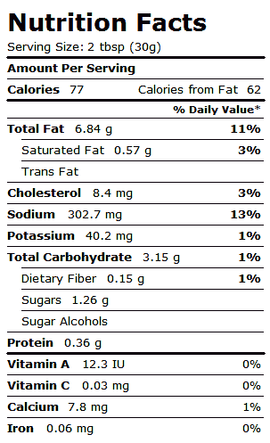
Nutrition Fact Labels
Ranch Dressing
Labels are required for
all processed foods.
Notes:
This is an example of a nutrition fact label and the information that should be provided on the label.
Labels are required for processed foods served as part of the CN programs.
You do not have to supply nutrition information for fresh food products, like a fresh apples or oranges.
***Examples of labels we need to review are salad dressings, soups, pizza, etc.
Many processed commodity items do not come with a nutrition facts label.
Contact the manufacturer and ask them to supply this information.
Make sure labels are up-to-date:
For example- If you switch from Tyson chicken nuggets to Gold Kist chicken nuggets, make sure you have the new nutrition facts label for Gold Kist on file.

Slide 9
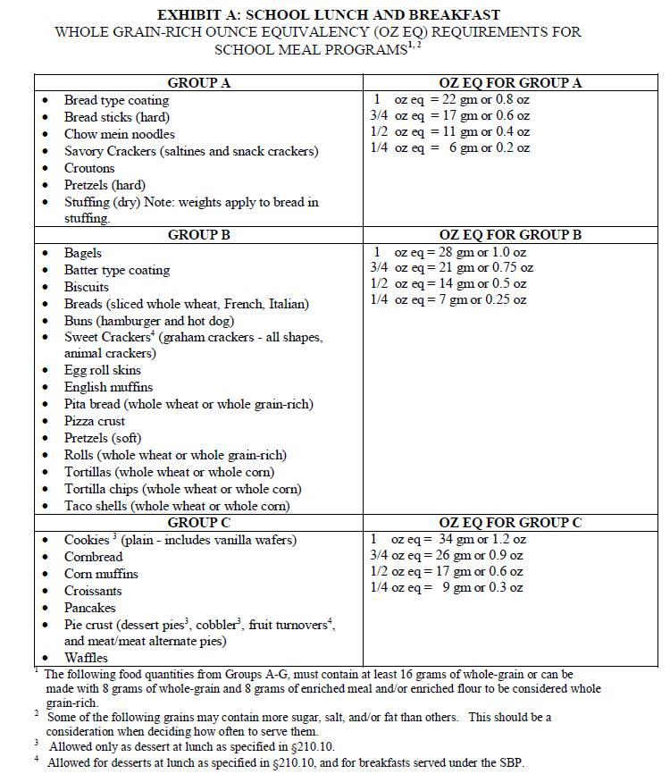
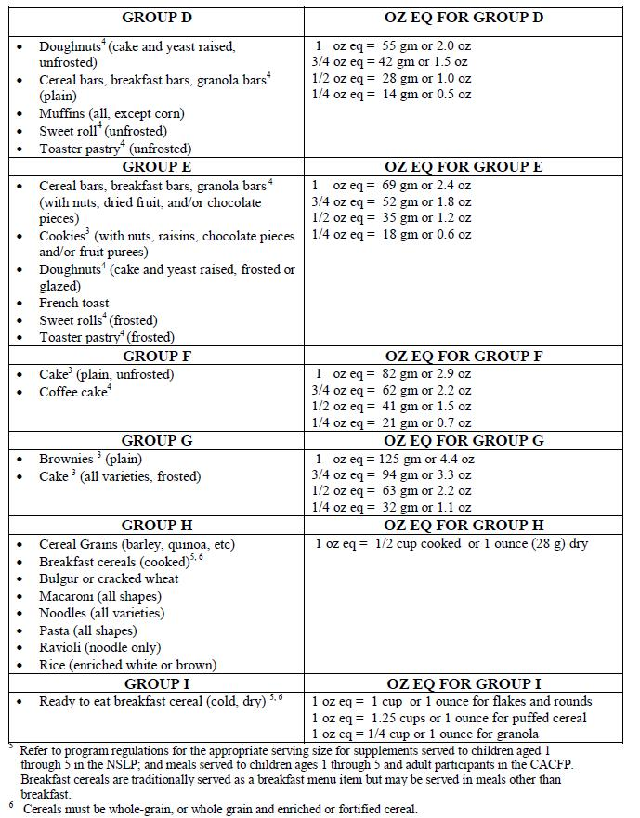
EXHIBIT A:
School Lunch and Breakfast Whole Grain-­Rich
Ounce Equivalency (oz eq) Requirements For School Meal Programs
Notes:
The Food Buying Guide has been updated and provides guidance for the grain component. Beginning School Year 2013-14, Exhibit A as shown above, is the version that must be used.
Refer to Exhibit A when crediting grains if a CN label is not available for that grain food product.
This is a very important part of menu planning. It will also be useful for production records.

Slide 10
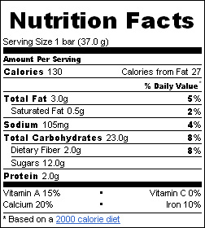
Calculating Grain Ounce Equivalency
Using Exhibit A
This is a label from a popular cereal bar containing fruit.
The label states:
Child Nutrition Program: 1 bread equivalent
Is this acceptable?
NO! If we don’t have a CN label or a PFS, we use Exhibit A to calculate the ounce equivalency based on the weight of the whole product.
Which category on Exhibit A would we use?
Group E - cereal bar containing fruit
How many grams is equal to a one ounce equivalent in Group E?
69 grams
How many grams does the cereal bar weigh?
37 grams
Notes:
We want to go over how to calculate ounce equivalency if you do not have a CN label or Product Formulation Statement.

Slide 11
Calculating Grain Ounce Equivalency
Using Exhibit A
Calculation:
37 grams ÷ 69 grams = 0.53623
Always round down to the nearest quarter
0.53623 = 0.50
This cereal bar is actually 0.5 ounce equivalent.
You would have to serve two cereal bars to equal the required one ounce equivalent of grain for the school breakfast program.
Notes:
With new oz eq standards and WGR requirements, we are encouraging SFA’s to use products with CN labels or to try to obtain PFS’s from the vendors to ensure that products you are serving meet meal pattern requirements for all meals served at breakfast, lunch and snack.
Please refer to the guidance on our website under the Food Based Menu Planning tab, dated February 22, 2012 Subject: USDA Food Crediting Information

Slide 12
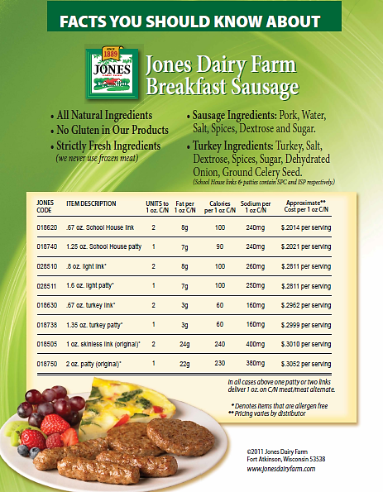
Breakfast Sausage
Notes:
Meat/Meat Alternate Equivalents
Not all processed meat/meat alternates are credited ounce for ounce. Some products contain fillers that do not contribute to the protein equivalency. For example, note on the chart that product #018750 is a 2 oz. patty. Even though it weighs 2 oz., the CN contribution is ONE M/MA for one patty.
Be sure that you have a CN label or a manufacturer product formulation statement denoting the protein contribution. **Remember the manufacturer’s nutrition information may not be accurate!!

Slide 13
Standardized Recipes
Have been tested, modified and retested several times
For consistent quality and quantity
  Use exact directions and procedures
  Use same type of equipment and quality of ingredients
  Train staff on the importance of following the recipe
Notes:
Standardized recipes, if followed correctly, will:
Produce the same quality and yield each time.
Contribute consistent meal pattern components each time.
Contribute consistent calories and nutrients to the meal each time.
***Make sure your standardized recipes have been updated to accurately reflect component contributions for the Food Based Menu Plan.***
Standardized Recipes are cost effective because they specify:
exact amounts of ingredients for inventory.
predictable yields to help eliminate unexpected leftovers and substitutions.

Slide 14
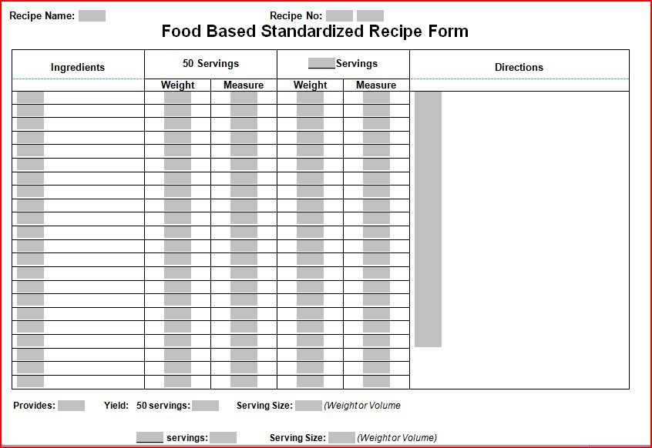
Required Elements of
Standardized Recipes
7 CFR §210.10(1)(8)
Recipe Name/Number
Ingredients
Weights and Measures
Servings
Yield
Directions
Notes:
This standardized recipe form is available on the Child Nutrition Knowledge Center for you to use as a template. You may use your own template but make sure all of the required elements are included.
Recipe Name/Number- Don’t forget to list the recipe name. Numbering your recipes is not required but may be helpful for organization and recording the standardized recipe on your production records.
Ingredients - The ingredients are listed in the first column, and should specify alternative ingredients when necessary. Alternative ingredients are sometimes given for use in place of a similar ingredient in the recipe; for example, dehydrated onions instead of fresh onions.
Weights and Measures - In most cases, the quantity of each ingredient is given in both weight and volume measure for both number of servings 50 and 100 servings.
Serving - This describes the amount or size of prepared food that makes one serving. (Indicate the weight 2 oz, volume ¼ cup, or measure #16 scoop).
Yield - This gives the approximate total yield (or total number of servings) of the recipe in gallons, loaves, or other appropriate units. *The yield is often forgotten but very important for menu planning!
Directions - This column tells how to prepare the recipe. Where appropriate, times and temperatures are given for the type of food service equipment being used.

Slide 15
Advantages of
Standardized Recipes
Ensure product quality
Consistency in menu planning
Provide supporting documentation to show meal pattern requirements are met
Costs are easier to control
Same quality results can be produced time after time
Notes:
Ensure product quality
yield consistently high quality food items
the same amount of product is produced each time
the same portion is provided each time
Consistency in menu planning
The # of portions can be accurately predicted from each recipe.
Predictable yield will help eliminate excessive amounts of leftovers and substitutions.
Provide supporting documentation to show that meal pattern requirements are met
Meal pattern contributions can be calculated based on established ingredient measures.
Nutrient analysis of a recipe will be accurate when ingredients and preparation methods are consistent.
Costs are easier to control
Inventory is easier because recipes specify the exact amount of ingredients
Purchasing and storage can be more easily managed
Same good results can be produced time after time
Food service staff will have more confidence in what they are doing.
Students will be happier because food quality will be consistent.

Slide 16

Production Records
7 CFR §210.10(a)(3)
Daily documentation of what was planned, prepared and served at your foodservice operation
Necessary to support the claim for reimbursable meals
Identifies information needed for the nutrient analysis
Required for Breakfast, Lunch and Snack programs
Notes:
Production records are the main documentation to demonstrate that what you served on each lunch line was in full compliance with the food based menu plan.
They are a cost effective tool that provide a student selection history for forecasting production requirements and minimizing leftover food/waste
A production record is a working tool which outlines the type and quantity of foods that need to be purchased and available for the meal service. To be a successful menu planning tool, production records should be started well in advance of the meal service.

Slide 17

Required Elements of a Production Record
All Food Items on the Reimbursable Meal
-including condiments and toppings
Recipe or Product Name/Number
Portion Sizes/Equivalents for Each Age/Grade Group
Amount/Quantity Prepared
Planned Number of Servings for the Reimbursable Meal
Actual Number of Servings for the Reimbursable Meal
Number of Non Reimbursable Portions Served (adult meals, a la carte and second meals)
Number of Leftover Portions
Date
Notes:
All planned menu items, including all choices, types of milk, desserts, condiments, and substitutions
All condiments served as part of the reimbursable meal, including gravy, butter, margarine, mayonnaise, relish, ketchup, mustard, salad dressing, etc
Recipe Name/Number (Spaghetti and Meatballs) or Product Name/Number (Tyson Chicken Nuggets)
Serving or portion sizes and the equivalents of each planned menu item or condiment for each age or grade grouping. Our template is separated by age/grade group but you can put all age/grade groups on one production record.
If menus are planned for more than one age or grade group at one school building, clearly indicate portion differences on food production records
Total amount of food actually prepared for each food item or menu item
Planned number of portions (servings) of each menu or food item to be served; include planned a la carte sales in the planned portions
Planned number of meals by age or grade group for students; number of adult/other meals planned
Actual number of reimbursable meals served. Indicate this information for each age or grade group
Actual number of non-reimbursable meals (adult meals, second meals served to students)
Amount of leftovers for each menu item
Portion sizes should be listed in the measurement the item is served; ex. ½ c carrots vs. 4 oz carrots.

Slide 18
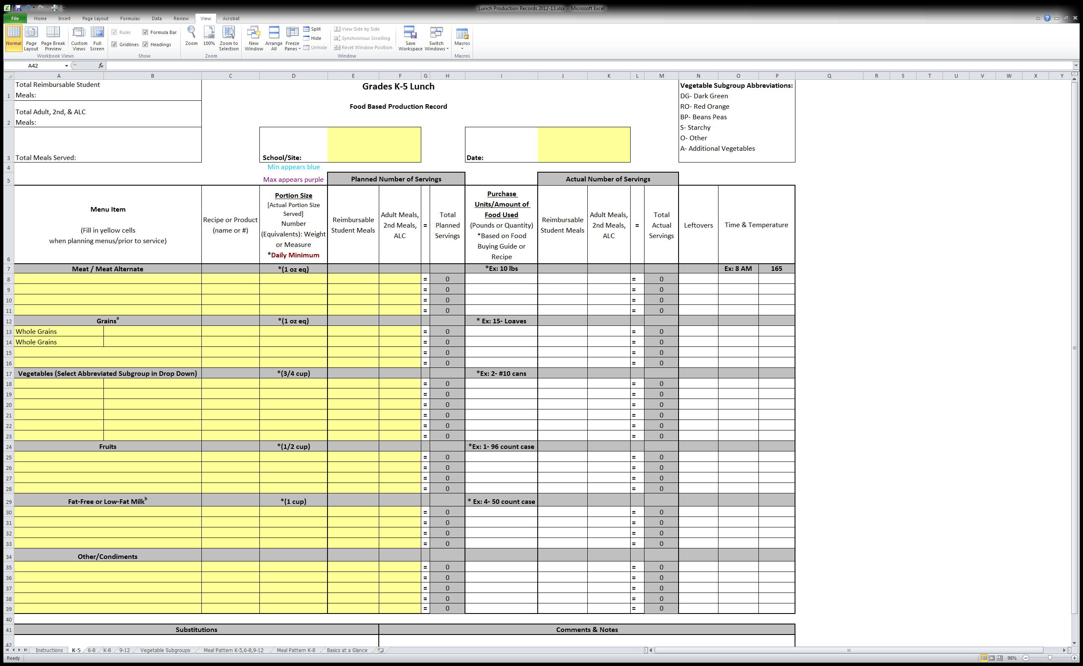
Production Record Form
Notes:
This production record form is available on the Child Nutrition Knowledge Center (Food Based Menu Planning Button) for you to use as a template. It is set up by age/grade groups: K-5, 6-8, 9-12 and K-8. You may use your own template but make sure all of the required elements are included, that were stated on the previous slide. It is optional to include time and temperature on your production records, but this can be a helpful reminder for staff and can streamline paperwork.
This template is an excel file which has guides on different tabs at the bottom the spreadsheet to help you with menu planning. For example, a link to the Food Buying Guide, the Basics at a Glance chart and a list of vegetables within their subgroups.
Your Point of Sale (POS) software system, may already have a production record component. Contact your POS company for further information. Make sure you have a backup document available if your system goes down.

Slide 19
Complete Before Service
Prefill:
School/Site
Date
Menu Item
Recipe or Product Name/Number
Portion Size
Planned Number of Servings
  Student
  Adult/2nd/A La Carte
Notes:
School/Site and Date: Do not forget to record the school name and date for accurate record keeping.
Menu Item: The way a food is menued can make a difference in the outcome of the nutrient analysis.
Recipe or Product Name/Number:
Recipes can be made for most menu items. We need recipes for all items that are more than one ingredient. (Example Turkey Sandwich)
If you serve the corn directly from the can, you can indicate #10 here . If you are serving corn on the cob, you should indicate that here. If, when you make the corn, you add butter and salt, you should have a recipe for the corn.
Portion Size: Make sure that the required minimum portion size is offered, but you must record the actual portion size served to the students. For example, if you serve a ½ cup of peaches but the students may select 2- ½ cup portions to meet the 1 cup fruit requirement, then you will record the ½ cup portion size on the production record.
Planned Number of Servings: This is the total number of planned servings (total individual portion sizes) for the reimbursable student meals and the adult/2nd student meals/A La Carte meals. If you opened up 4 #10 can of corn. At 24 ½ cup portions per can, that gives us 96 portions.

Slide 20
Complete the Day of Service
Fill in when service is over:
Amount Used
Actual Number of Servings
  Student
  Adult/2nd/A La Carte
Leftovers
Time & Temperatures (Optional)
Total Reimbursable Meals Served
Substitutions
Comments & Notes
Notes:
Purchase Units/Amount of Food Used: This is the amount of food that can be determined by the food buying guide or manufacturer invoice. If you list cases in the quantity, indicate the number of ounces in a can, and the number of cans in a case. Every case is different depending on the item so this is important.
Actual Number of Servings: This is the total number of actual servings (total individual portion sizes) for the reimbursable student meals and the adult/2nd student meals/A La Carte meals. This must be recorded after service is over.
Total Reimbursable Student Meals: This information supports your claim for reimbursement. It is also to help forecast the appropriate number of reimbursable meals to be planned in the future.
Total adult/2nd student meals/A La Carte meals: This is to help forecast the appropriate number of additional meals to be planned in the future.
Total Meals Served: This is to help forecast the appropriate number of total meals to be planned in the future.
Leftovers: May be served on another day. When served, they should be tracked for their contribution to the reimbursable meal. Leftovers are not included in the nutrient analysis on the day they are left over
Time & Temperature: It is optional to include on production records but may simplify record keeping.
**Substitutions: Indicating substitutions is very important for the Food Based Menu Plan. For example, if you planned to serve broccoli run out of broccoli you should make a substitution from the dark green vegetable subgroup category so that you are consistent with the menu you have planned. This will help to ensure that you meet the menu plan requirements.
Comments/Notes: Reporting weather on the production record is important for forecasting. (Bad weather would explain why your participation was low that day). Other comments may include field trips, special events, which is helpful information for future forecasting.

Slide 21
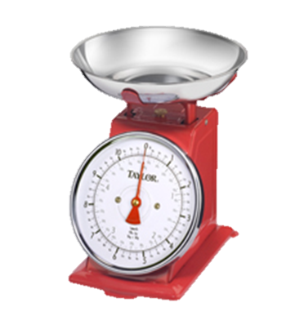
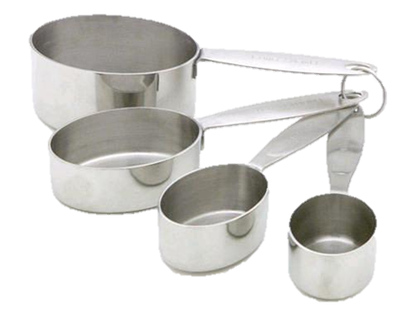
Weight vs. Volume
Peaches, canned
Weight: 6 oz. = 92 calories
Volume: ¾ cup = 102 calories
Cheese, grated
Weight: 2 oz. = 212 calories
Volume: ¼ cup = 84 calories
French Fries, potato puffs
Weight: 4 oz. = 252 calories
Volume: ½ cup = 142 calories
Notes:
This is one of the most significant problems we find with production records. (Read Slide)
2 ounces does not equal one quarter cup.
If you have a scale and are weighing items that are being served, feel free to use weight.
It is best to measure food as indicated in the food based menu plan.

Slide 22
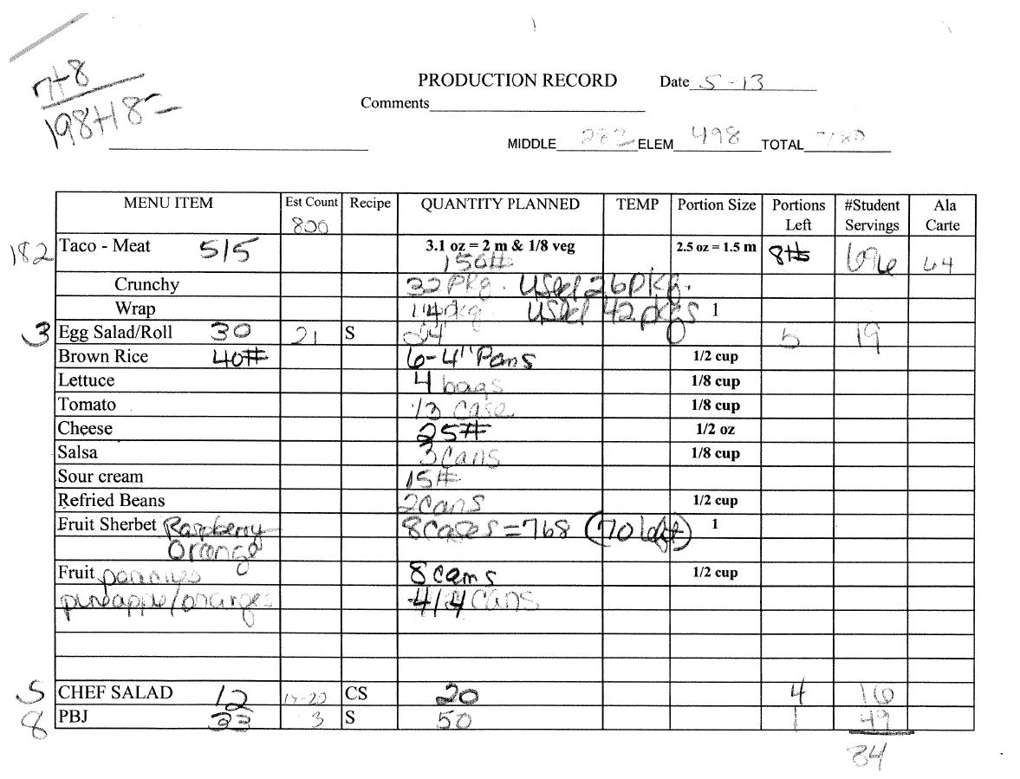
Example of Poorly Completed Production Record
Notes:
Ask audience: Why is it poorly completed?
Incomplete – portion sizes
No grade groups
Quantity planned inconsistent and incorrect
Number of meals served not completed – reimbursable and a la carte
Random numbers on the page
Date incomplete
Illegible

Slide 23
Common Production
Record Errors
Missing Information
Incorrect Information Recorded
Portion Sizes Not Quantified
Weights vs. Volume
Missing Condiments
Missing Daily Items
Not Legible
Notes:
Missing information- leaving information off of the production record.
Incorrect Information- record the information as soon as possible. Do not try to recreate the information from memory later, which can lead to errors.
Portion Sizes- Serving sizes are not consistent with what is actually being served to students.
Weights vs. Volume- this was discussed in detail on the previous slide.
Condiments- these are part of the reimbursable meal and must be recorded.
Daily Items- are often forgotten because they are served everyday but must be recorded when served.
Not legible- If it isn’t legible then it will not accurately account for what was served.

Slide 24
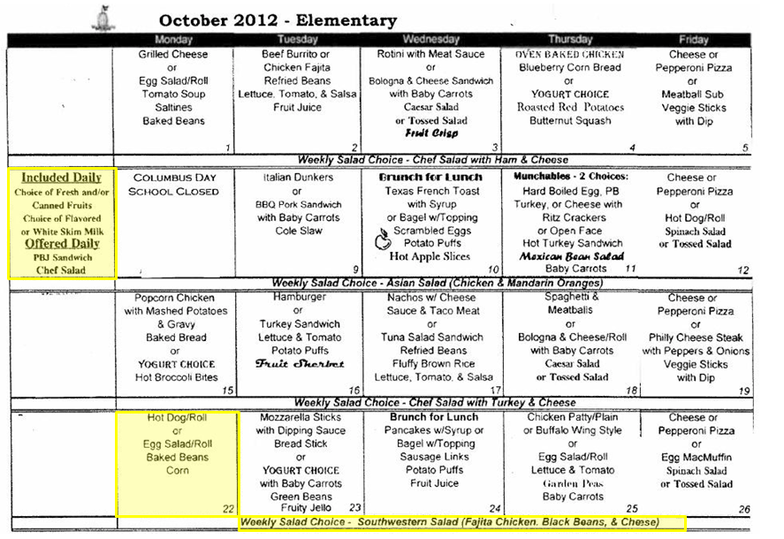
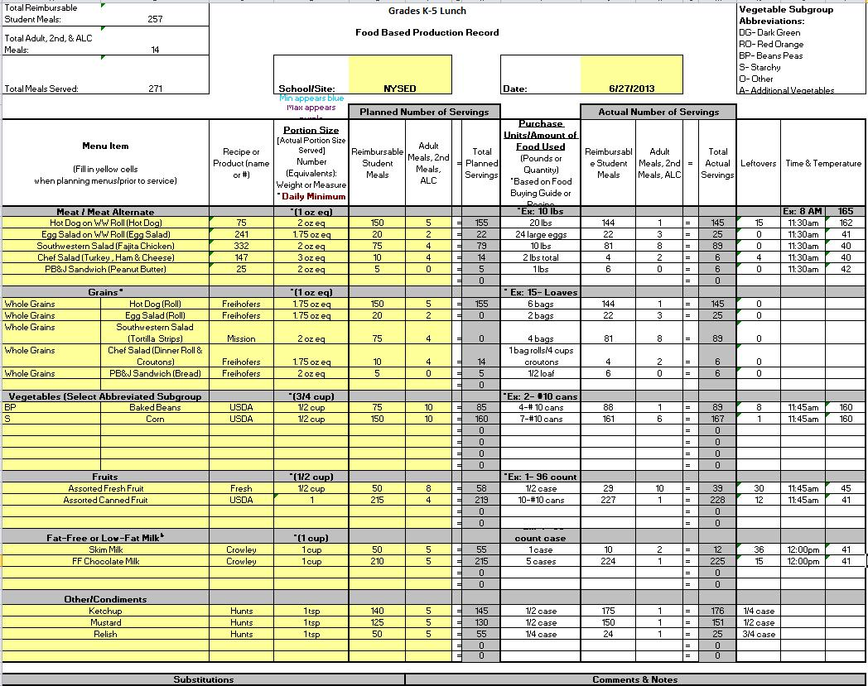
Menu and Production Record
Daily Menu
Daily Production Record

Slide 25
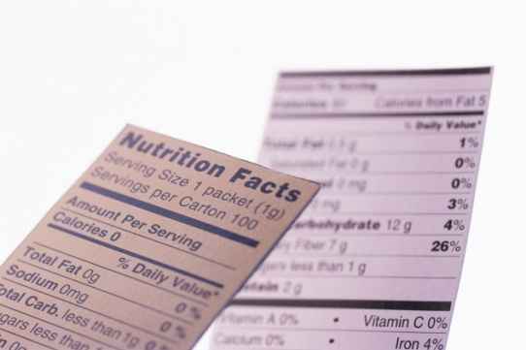
Nutrient Analysis Done by LEA
USDA approved software
Appropriate age/grade groupings
All food items included in analysis
Data entered correctly
Data reasonable
Weighted average
Planned servings
Meet key nutrients
Notes:
The State Agency will be using the “Dietary Specification Assessment Tool” to determine risk for violations related to calories, saturated fat, sodium and trans fat. This will be an on and off site assessment tool.
The State Agency may need to conduct a nutrient analysis of your menu for further evaluation based on the findings.
LEAs may want to evaluate their menus to ensure they are meeting the requirements but it is not mandatory.
Check the CNKC website for an up-to-date list of USDA approved software to conduct a nutrient analysis of your menu.
Make sure that your nutrient analysis software has the appropriate grade groups selected K-5, 6-8, K-8 and 9-12.
Make sure you include all PLANNED food items for the reimbursable student meal in your analysis. It used to be the actual number of reimbursable menu items served.
Make sure you analyze the weighted average.
Make sure the data you are inputting is reasonable. (Sometimes people make mistakes with recipes, if you are making a recipe for one sandwich, don’t put 7lbs of meat and cheese in ingredient column.)
Key nutrients: Calories, saturated fat, sodium and trans fat.

Slide 26
Consistent & Current
All supporting documentation for your menu should be consistent and current!
  Nutrition Information
  Standardized Recipes
  Production Records
  Nutrient Analysis
For Example
Monday you serve:
  Spaghetti and Meatballs
  Dinner Roll
  Green Beans
  Pears
  Fat Free Chocolate Milk
  1% White Milk
Notes:
Make sure all information is up-to-date and accurately reflected on ALL menu planning documents.
During reviews we often find discrepancies between menu planning documents. Make sure all of your menu planning documents reflect the same menu items! For example, if on Monday you serve: spaghetti and meatballs, dinner roll, green beans, pears, fat free chocolate milk and 1% white milk.
Current nutrition information should be on file for each of the processed items listed above
A Standardized recipe should be available for applicable menu items (spaghetti and meatballs & green beans if butter/oil are added)
Production records must include all of the menu items listed above and condiments that go with the meal (butter for bread or hot sauce for spaghetti and meatballs). If you need to substitute cauliflower for green beans… indicate this substitution on the production record to avoid a discrepancy or failure to meet meal pattern requirements!
Nutrient analysis must include all planned servings of the items listed above. The planned servings should come from the planned servings recorded on the production record.

Slide 27
Child Nutrition Program
Contact Information
Thank You!
For questions, please contact your Child Nutrition Representative at:
Please frequently refer to the Child Nutrition Knowledge Center website:
(518) 473-8781
http://www.nysed.gov/cn/cnms.htm

