Slide 1


Notes:
Welcome to The New York State Education Department's Office of Child Nutrition tutorial on completing the Annual Renewal.
All School Food Authorities (SFA) participating in the National School Lunch Program, School Breakfast Program and/or Special Milk Program are required to complete an Annual Renewal prior to the beginning of the school year.
The purpose of the Annual Renewal is to recommence the SFAs’ single permanent agreement between New York State Education Department (SED) and the SFA. In addition, the Annual Renewal is also the mechanism for SFAs to report program specific information.

Slide 2
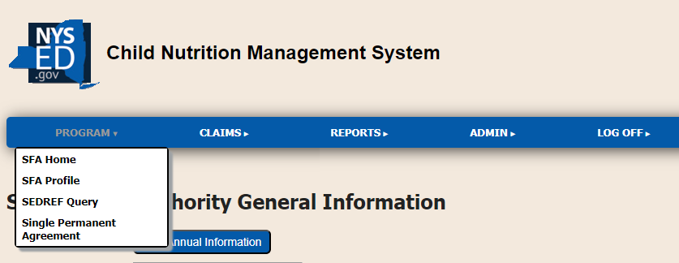
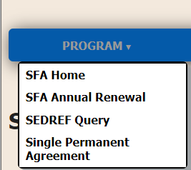
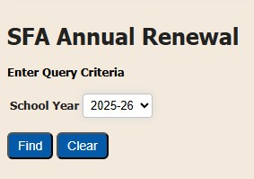
How To Access the SFA Annual Renewal
Notes:
To access the renewal, log into the Child Nutrition Management System, also known as CNMS, with your username and password. Once logged in, go to the blue menu bar and hover over “Program” and select “SFA Annual Renewal” from the drop-down menu, select the correct school year, and click “Find”.

Slide 3
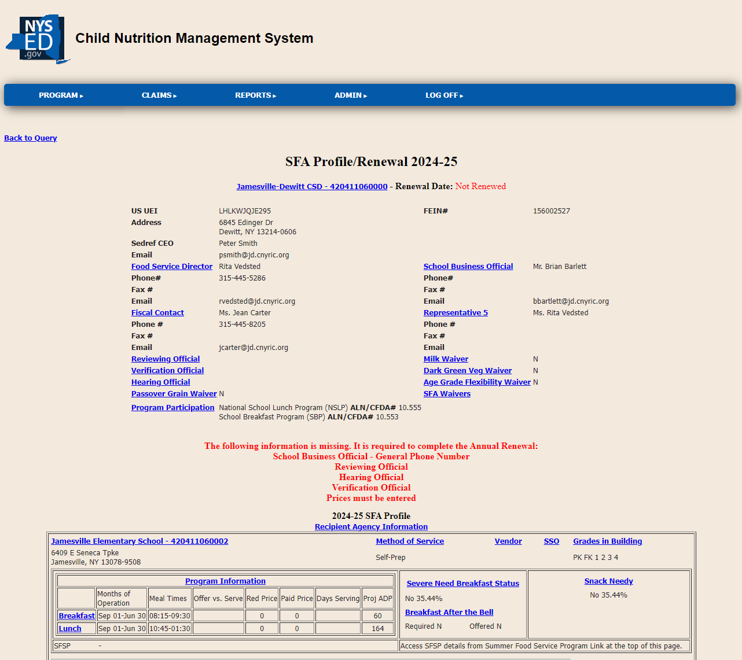



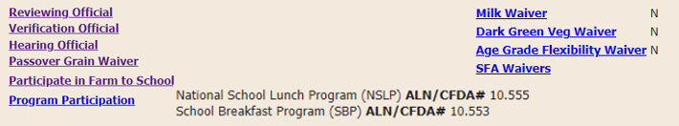

Main Page
Your SFA Name Here
ABCD12345678
123456789
123 Main Street Anywhere, NY
Jonathan Ross
Joh.Ross@email.com
518-867-5309
Fozzy Bear
Fozzythebear@email.com
518-867-5309
Kermit Frog
Kermit.Frog@email.com
518-867-5309
Polly Cracker
Polly.Cracker@email.com
518-867-5309
Notes:
Once find is clicked, the annual renewal screen is displayed. The annual renewal screen contains all SFA and Recipient Agency (RA) information that must be reviewed and updated prior to completing the renewal.
All SFA information should be reviewed and updated, as applicable. Information that is missing and needs to be completed prior to completing the renewal is displayed in red.
Once all this information is updated, the displayed missing information will be removed and an “I agree” button will appear.

Slide 4
Unique Entity Identifier (UEI) Number and System for Award Management (SAM)
For NYSED to validate an active UEI, the SFA must select "allow public search" in SAM.gov.
Your SFA Name Here
ABCD12345678
123456789
123 Main Street Anywhere, NY
Jonathan Ross
Joh.Ross@email.com
518-867-5309
Fozzy Bear
Fozzythebear@email.com
518-867-5309
Kermit Frog
Kermit.Frog@email.com
518-867-5309
Polly Cracker
Polly.Cracker@email.com
518-867-5309
Notes:
The SFAs Unique Entity Identifier (UEI) number is displayed on the renewal. UEI’s are required to have an active registration on SAM.gov. If the SFAs UEI has expired a message will display on the screen indicating that the UEI registration is expired with a link to SAM.gov.
After the renewal of the UEI number, it will not be transferred to NYSED until after the original expiration date. It may also take up to one week to renew and for the data to be transferred to NYSED. For NYSED to validate an active UEI, the SFA must select "allow public search" in SAM.gov.

Slide 5

Farm to School
Your SFA Name Here
ABCD12345678
123456789
123 Main Street Anywhere, NY
Jonathan Ross
Joh.Ross@email.com
518-867-5309
Fozzy Bear
Fozzythebear@email.com
518-867-5309
Kermit Frog
Kermit.Frog@email.com
518-867-5309
Polly Cracker
Polly.Cracker@email.com
518-867-5309
Notes:
To indicate if the SFA participates in Farm to School, click the “Participate in Farm to School” hyperlink, and select yes or no on the next screen.
Not sure? Do you buy food from local farmers or vendors? If yes, then you do participate!

Slide 6
Updating Contact Information
Your SFA Name Here
ABCD12345678
123456789
123 Main Street Anywhere, NY
Jonathan Ross
Joh.Ross@email.com
518-867-5309
Fozzy Bear
Fozzythebear@email.com
518-867-5309
Kermit Frog
Kermit.Frog@email.com
518-867-5309
Polly Cracker
Polly.Cracker@email.com
518-867-5309
Notes:
SFA Name and Address is transferred to CNMS from The State Education Department Reference File (SEDREF). Ensure the information listed is accurate. To update or to make a change to the SFA Address or SEDREF CEO, refer to the NYSED SEDREF Home: https://www.oms.nysed.gov/sedref/home.html
The next step is to review and update as needed the contact information for the Food Service Director, Fiscal Contact, and School Business Official.
To update a contact, click on the contact title, for example, “Food Service Director.”

Slide 7
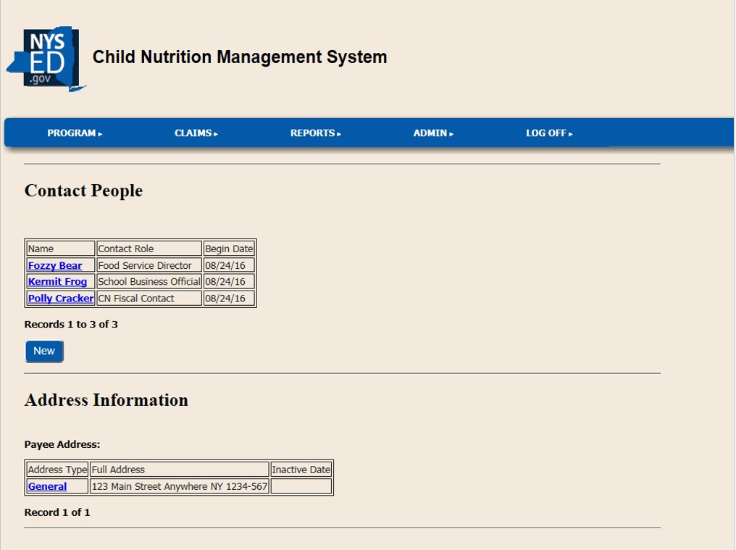
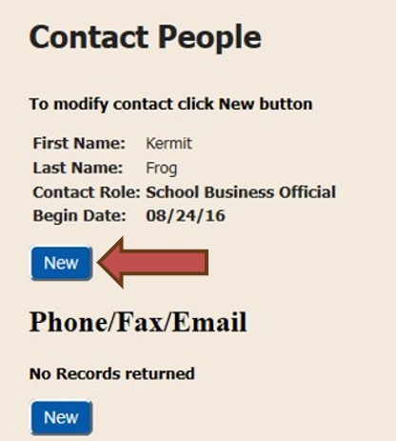
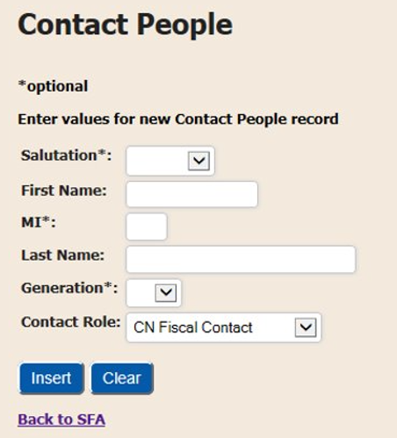
Updating Contact Information
Notes:
To change the name of the contact person, click on the first “New” button.
Enter the new contact person’s name and choose their role by using the drop-down box next to the words “Contact Role.” Then click insert. You will see the word “Success!” in green.
Now to change the phone number, e-mail or fax click on the second “New” button.
Choose from “Device Type” and enter the information in the “Value” box, then click on the “Insert” button. Again, you will see the word “Success!” in green.
Repeat this process for each contact you wish to update.

Slide 8
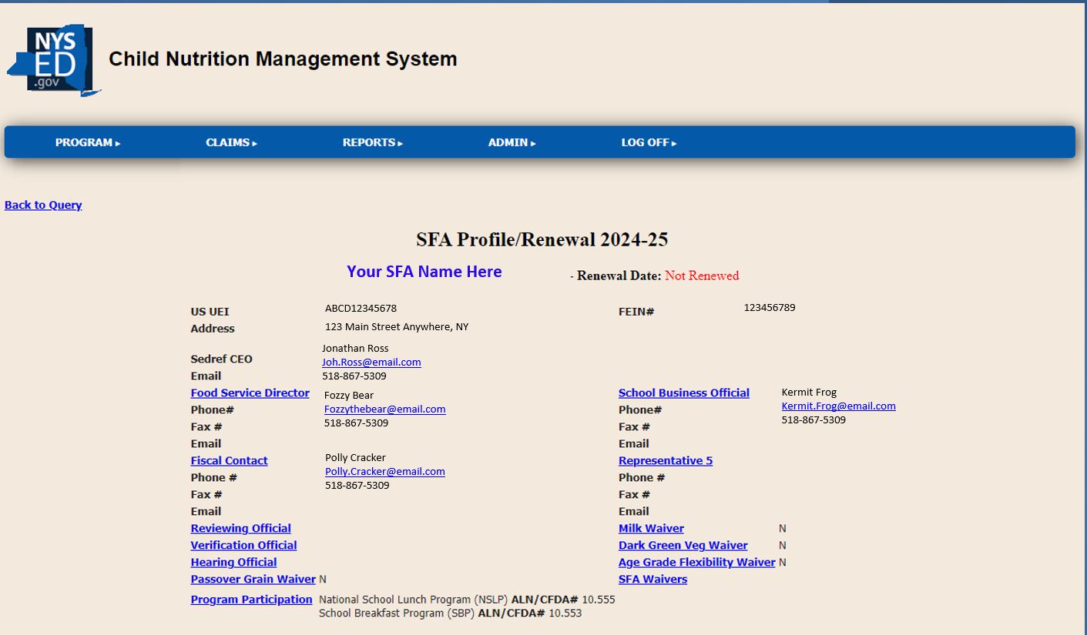
Certification of Acceptance
Notes:
Once this is completed make your way back to the annual renewal page. Go to the blue menu bar and hover over “Program” and select “SFA Annual Renewal” from the drop-down menu, select the correct school year, and click “Find”.
SFAs operating in the Base Year of Provision 2 and Residential Childcare Institutions (RCCIs) with no day students:
Review and update, as applicable, the SFA’s Reviewing Official, Verification Official and a Hearing Official.
Reviewing Official: individual responsible for processing free and reduced-price meal applications.
Verification Official: individual responsible for conducting income verification. This person can be the same as the Reviewing Official.
Hearing Official: individual responsible for overseeing the free and reduced-price application appeal process. This person must be someone removed from the application review and approval process.
You may do this by clicking on a title (example: “Reviewing Official.”) -> go to the next slide
*NOT required for SFAs operating the Community Eligibility Provision (CEP) and/or a non-base year of Provision 2

Slide 9
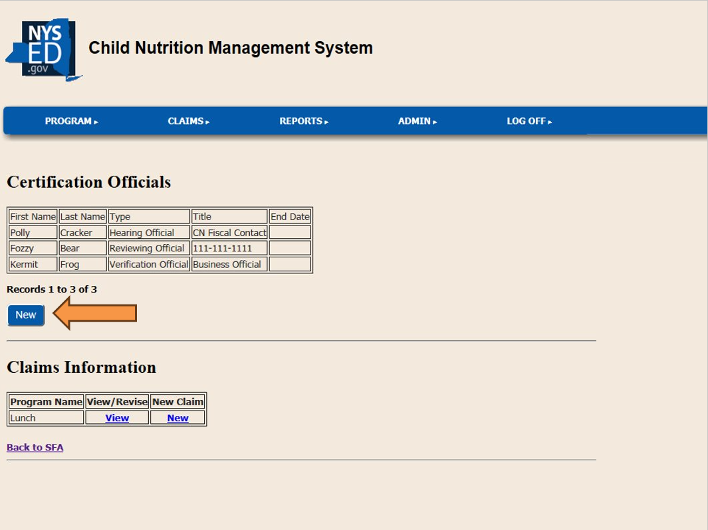
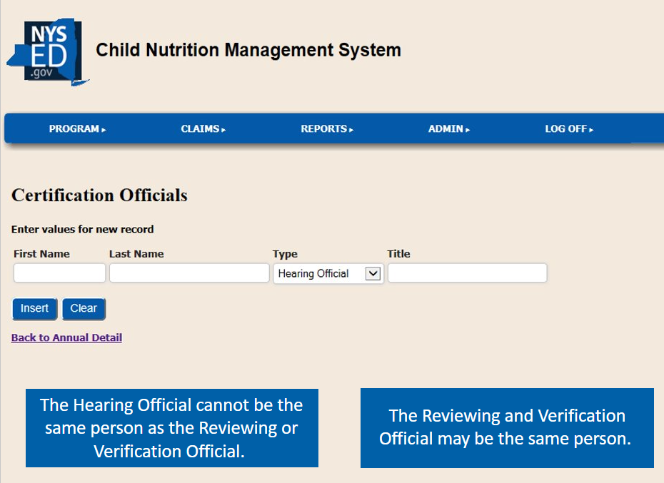
Certification of Acceptance
Notes:
To begin entering the name and titles of the designated officials, click on the “New” button under the heading “Certification Officials”. Enter the First and Last Name. Select the type of official and then enter their title. then hit “Insert”.
To enter the next two officials, click “NEW”, enter the First and Last Name. Select the type of official and then enter their title.
Repeat this process until the reviewing, verification and hearing official have been entered.
As a reminder, the Hearing Official cannot be the same person as the Reviewing or Verification Official. A message will appear if the same name is entered for the Hearing Official and either the Reviewing or Verification Officials.
When you have completed entering the official’s information, go to the blue menu bar and hover over “Program” and select “SFA Profile” from the drop-down menu, select the correct school year, and click “Find”.

Slide 10
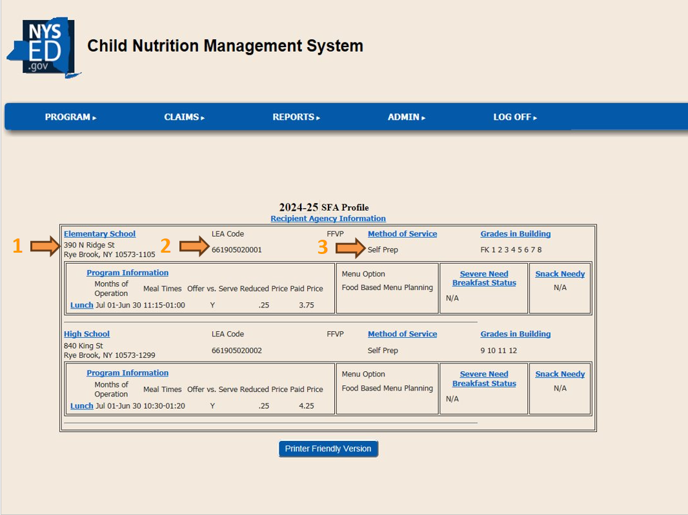
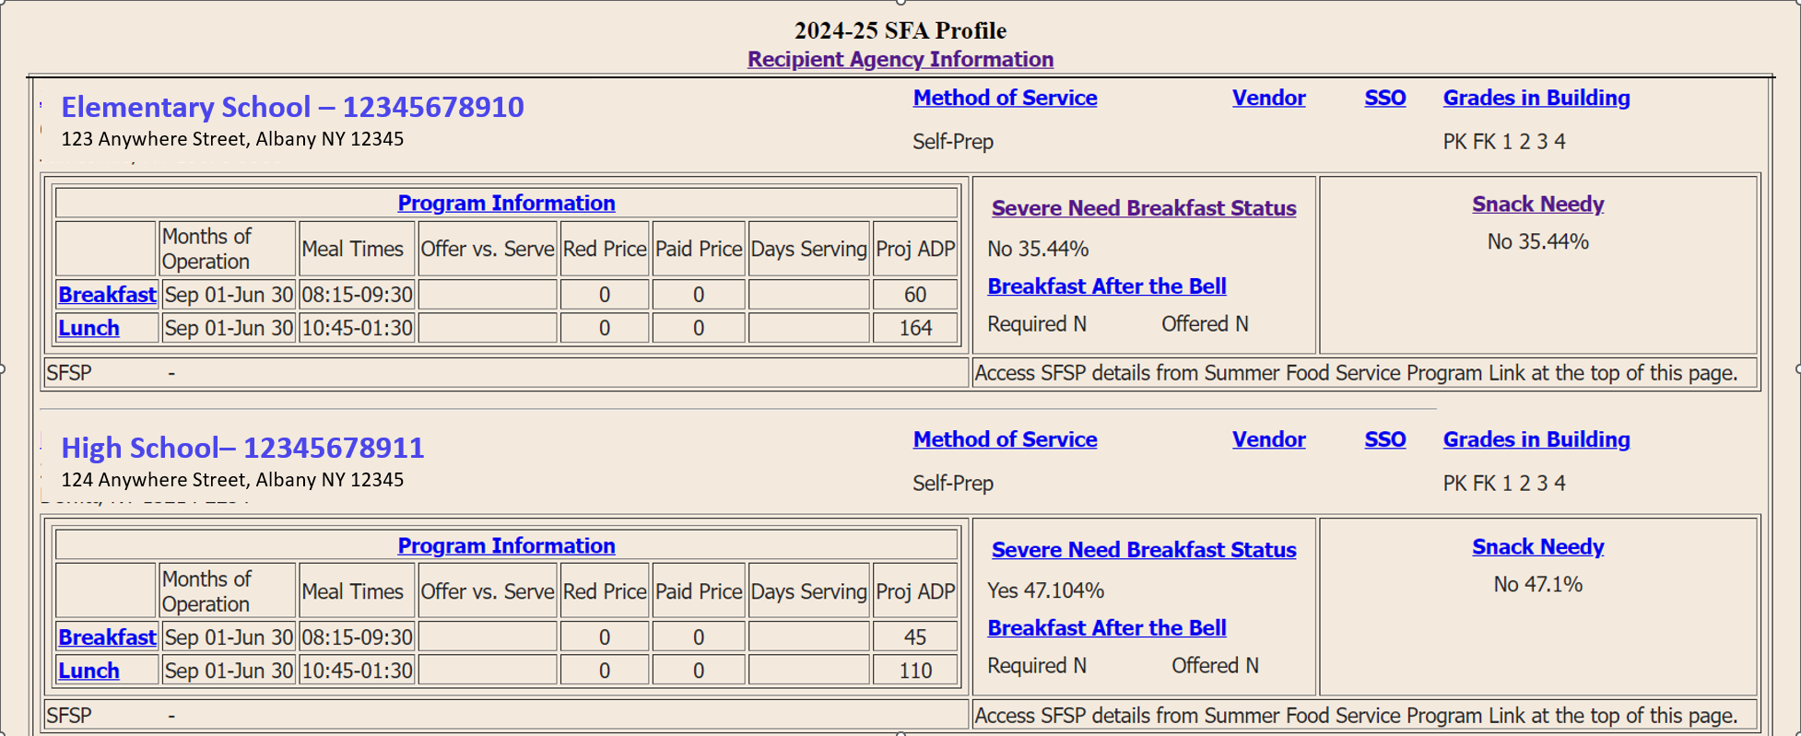
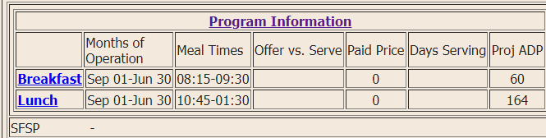
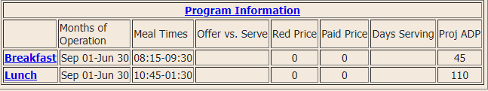
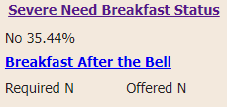

Verifying Information
Address
LEA Code
123456789
123456789
Notes:
Next review the RA information:
RA Name and Address is transferred to CNMS from The State Education Department Reference File (SEDREF). Ensure the information listed is accurate. To update or to make a change to the RA Address or SEDREF CEO, refer to NYSED SEDREF Main Information Page: https://www.oms.nysed.gov/sedref/home.html

Slide 11
Verifying Information
Methods of Service
123456789
123456789
Notes:
Next will be reviewing the Method of Service for each RA. If the current method of service is incorrect, click on the Methods of Service hyperlink.

Slide 12
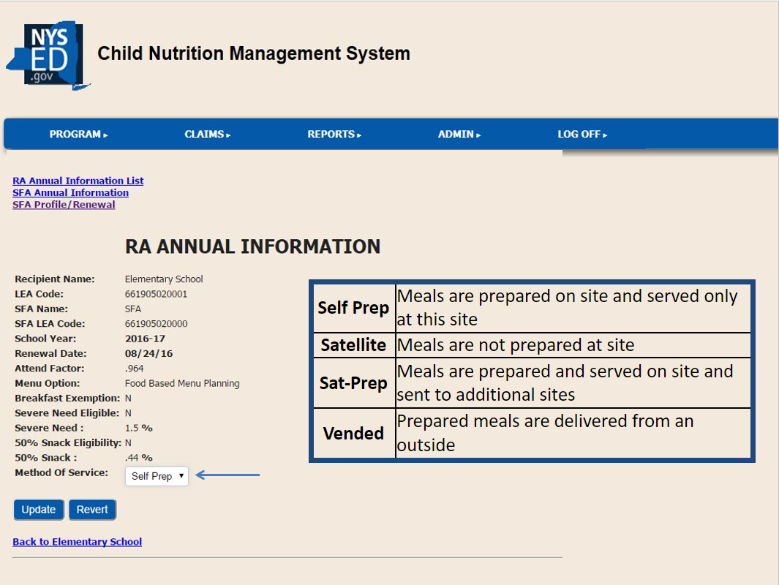

Verifying Information
Method of Service
source
Notes:
Here choose the correct method of service used to serve meals from the drop-down box.
The choices of service include
Self prep, where meals are prepared on site and served only at this site.
Satellite, where meals are not prepared at the site
Sat-Prep, where meals are prepared and served on site and also sent to additional sites.
Or vended, which is when prepared meals are delivered from an outside organization.
Once the correct method of service is chosen, click the blue update button.
Next, scroll down this page to enter the grade levels that are served meals in the RA.

Slide 13
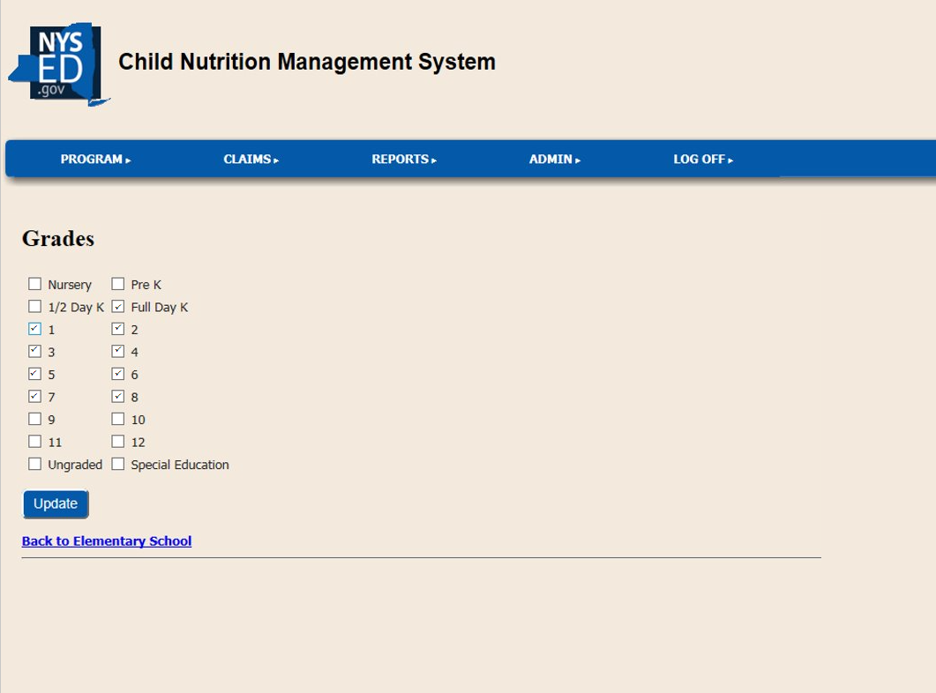
Verifying Information
Grades
Notes:
Click on each grade level that is in the chosen RA and click update.
You must enter both the method of service and grade levels for each RA separately.

Slide 14
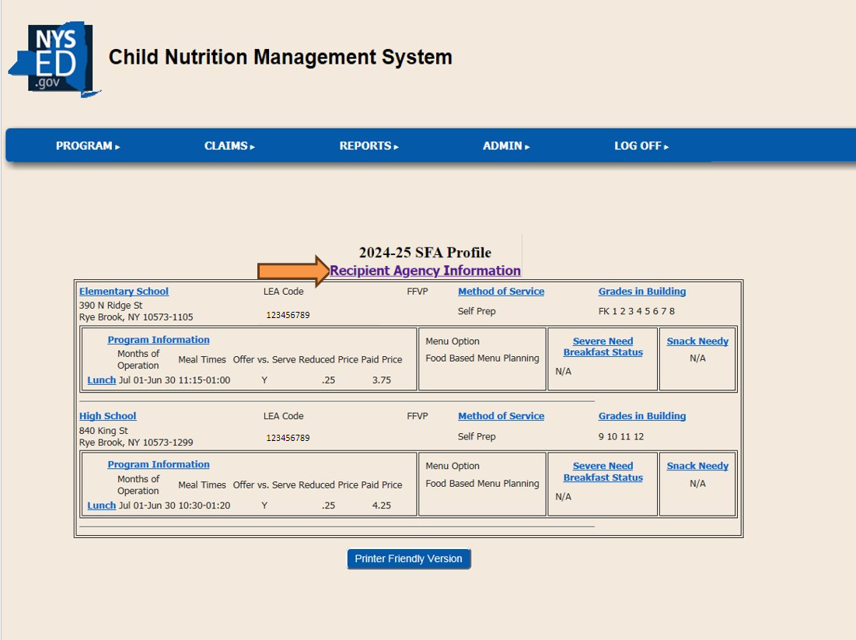
Verifying Information
Times of service
Notes:
Once the method of service and grade levels has been entered, you can see the mealtimes under the RA Information Section. To update these times click on the “Recipient Agency Information” hyperlink.

Slide 15
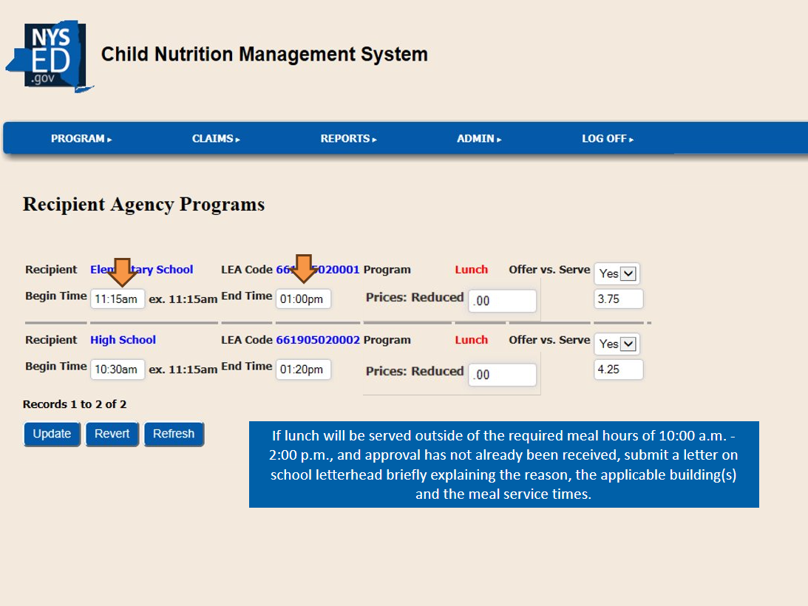
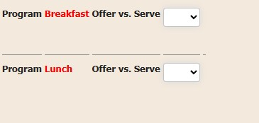

Verifying Information
Times of service
Notes:
The Recipient Agency programs page allows program specific information for each RA to be entered and updated on one screen. On this screen, enter the program begin and end times and indicate if over verses serve is implemented. Once all the information is entered for each RA and program, click the update button at the bottom of the screen.
Regulations require that lunch is served between 10am and 2 pm. SFAs must receive approval to serve lunch outside of those hours. To request approval from the Child Nutrition office, send a letter on school letterhead briefly explaining the reason, the applicable buildings, and the meal service times. Offer vs. Serve is required for grades 9-12 for lunch, but optional for all other grades and for all grades for breakfast.
To return to the renewal page, go to the blue menu bar and hover over “Program” and select “SFA Annual Renewal” from the drop-down menu, select the correct school year, and click “Find”.

Slide 16
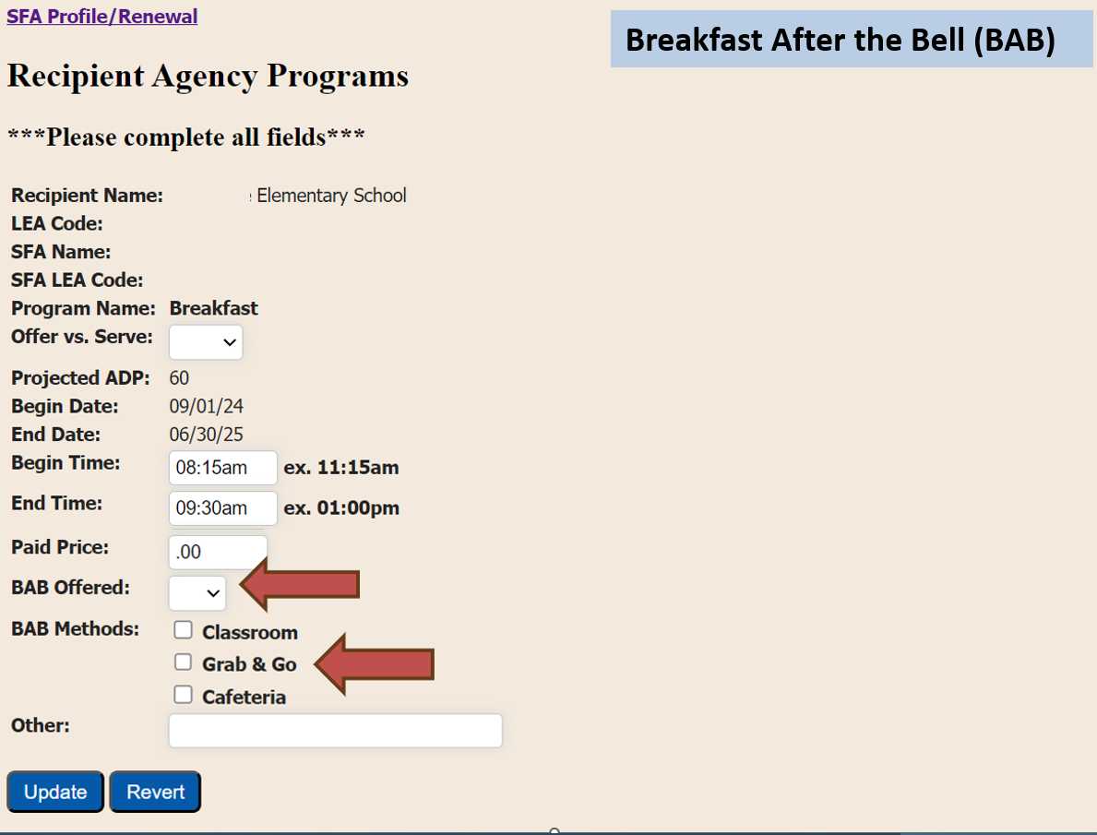


Notes:
Once on this screen, click on the drop-down box to choose “Y” (yes) or “N” (no) for “BAB Offered”. If mandated to implement BAB, the SFA is required to indicate which BAB Method(s) are used or request a waiver. If the SFA is not mandated but offered BAB it is required to indicate which BAB method(s) are used. Then click update.
Repeat this process for each RA.

Slide 17
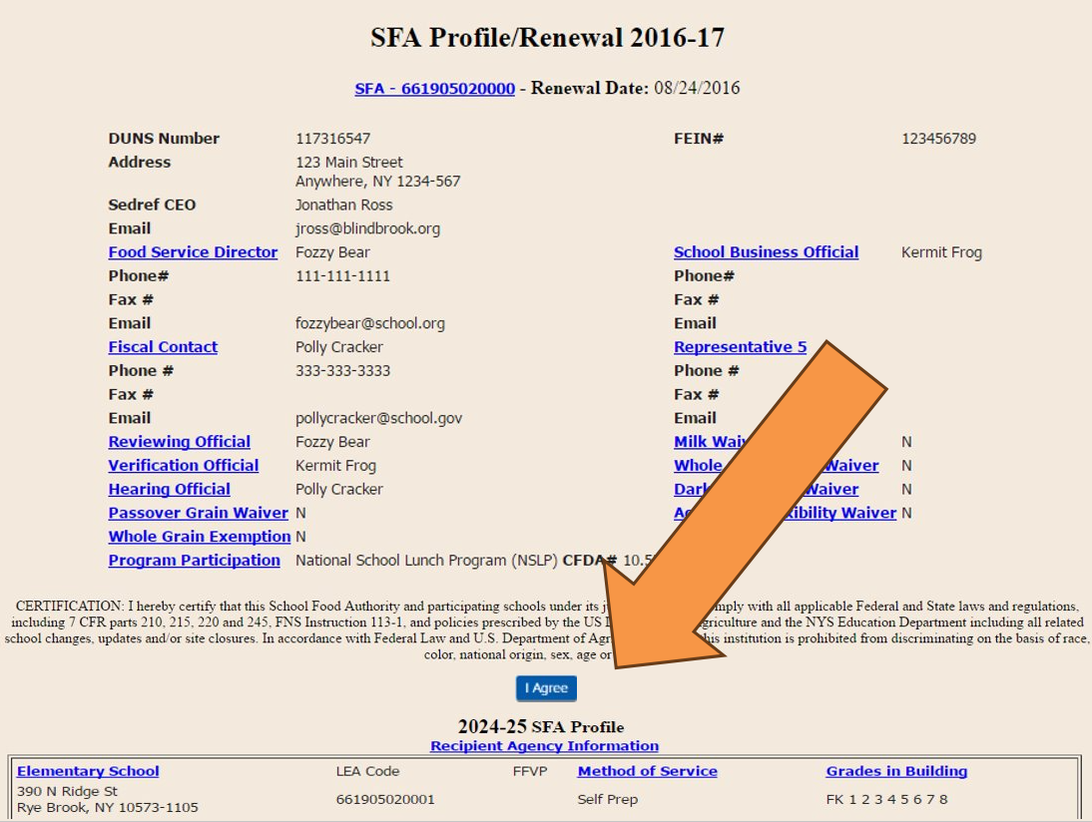



2024-2025
2025-2026
2025-26 SFA Annual Renewal
Notes:
Back on the SFA profile renewal page, once all required information is entered, the blue I agree button will now appear under the Certification statement. If you do not see this button, ensure you have entered all information. The missing information will be listed in red.
Once you have read the certification statement, click I agree. Your annual renewal is then considered complete.
Failure to complete the annual renewal prior to the start of the school year may jeopardize reimbursement and may result in the SFA’s program participation being deemed abandoned. No Renewals will be accepted after December 1st, 2025. In the event that the SFA fails to renew, the SFA will be required to submit a new SFA program application in accordance with Child Nutrition Program Administration (CNPA) procedures during the designated annual enrollment period. In addition, the SFA will be subject to a close out review in accordance with CNPA procedures.

