Slide 1
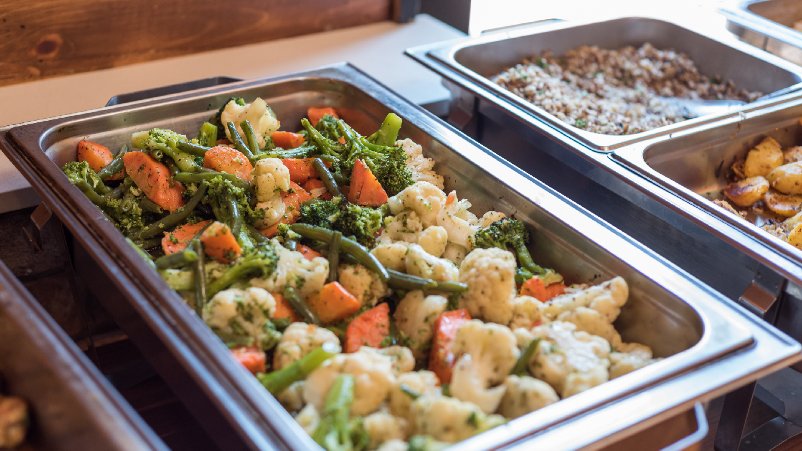



BATCH COOKING
1 Credit Hour
Professional Standard Training
Notes:
This CN Snip-it will contribute 1 credit hour towards Professional Standards.
This PowerPoint will explain batch cooking and discuss the advantages of implementing this cooking method.

Slide 2
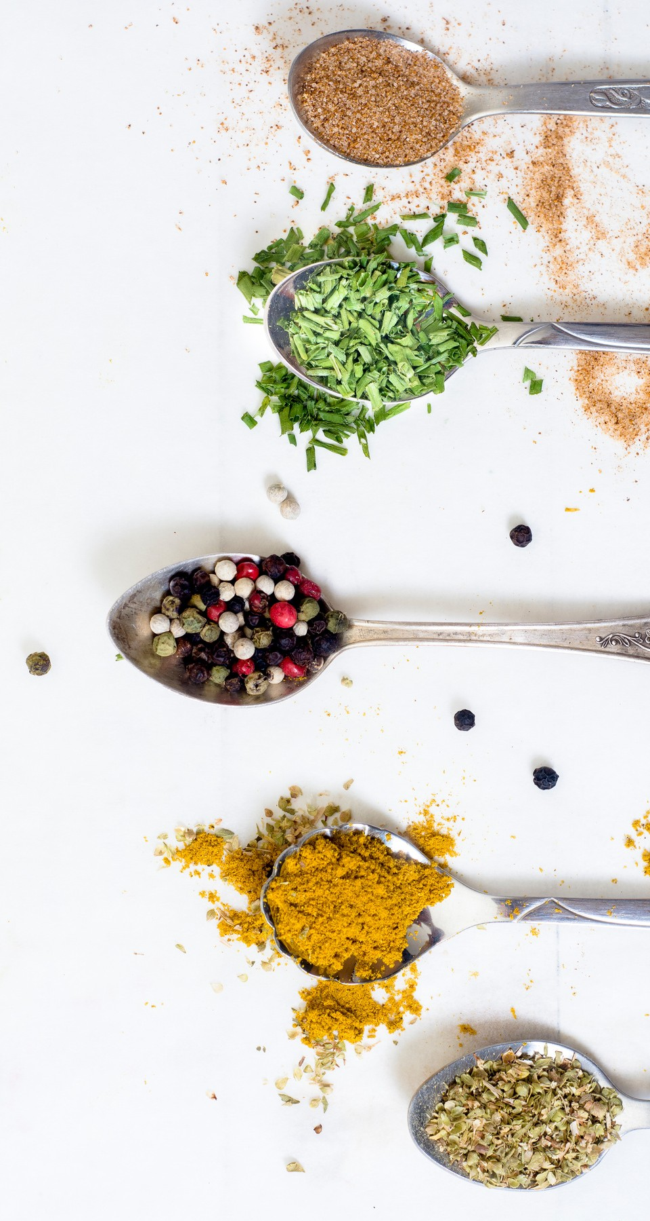



BATCH COOKING METHOD
Cooking in small quantities requires:
Planning
Staff scheduling
Staff training
Notes:
As you know, the primary goal of school nutrition providers is to serve students the highest quality food possible with optimal appearance, flavor, texture, and nutritional value.
A key to achieving this goal is to plan food preparation in small batches throughout serving periods whenever possible.
Cooking with this method allows food service staff to prepare food as it is needed; preventing over production and reducing food waste.
This method of food preparation is called Batch Cooking.
Students often choose food according to its appearance. Therefore, serving visually appealing foods is essential for increasing student participation.
However, sometimes food ends up being held in warmers longer than it should due to preparation and serving time constraints.
Food left in the warmer or steam table too long can leave food with an unappealing look, taste, and texture.
Batch cooking maximizes food quality, reduces waste, and increases student participation.
When planning for batch cooking, standardized recipes or production notes should specify the yield and cook times for each batch.
To ensure successful batch cooking, staff schedules will also need to be planned around cooking schedules.
For example, rotating staff breaks to ensure there is enough time to make small batches of food and still have time for daily duties.
Training food service staff on the benefits and planning involved in batch cooking will help staff understand why this is the best method to use and how to batch cook successfully.

Slide 3



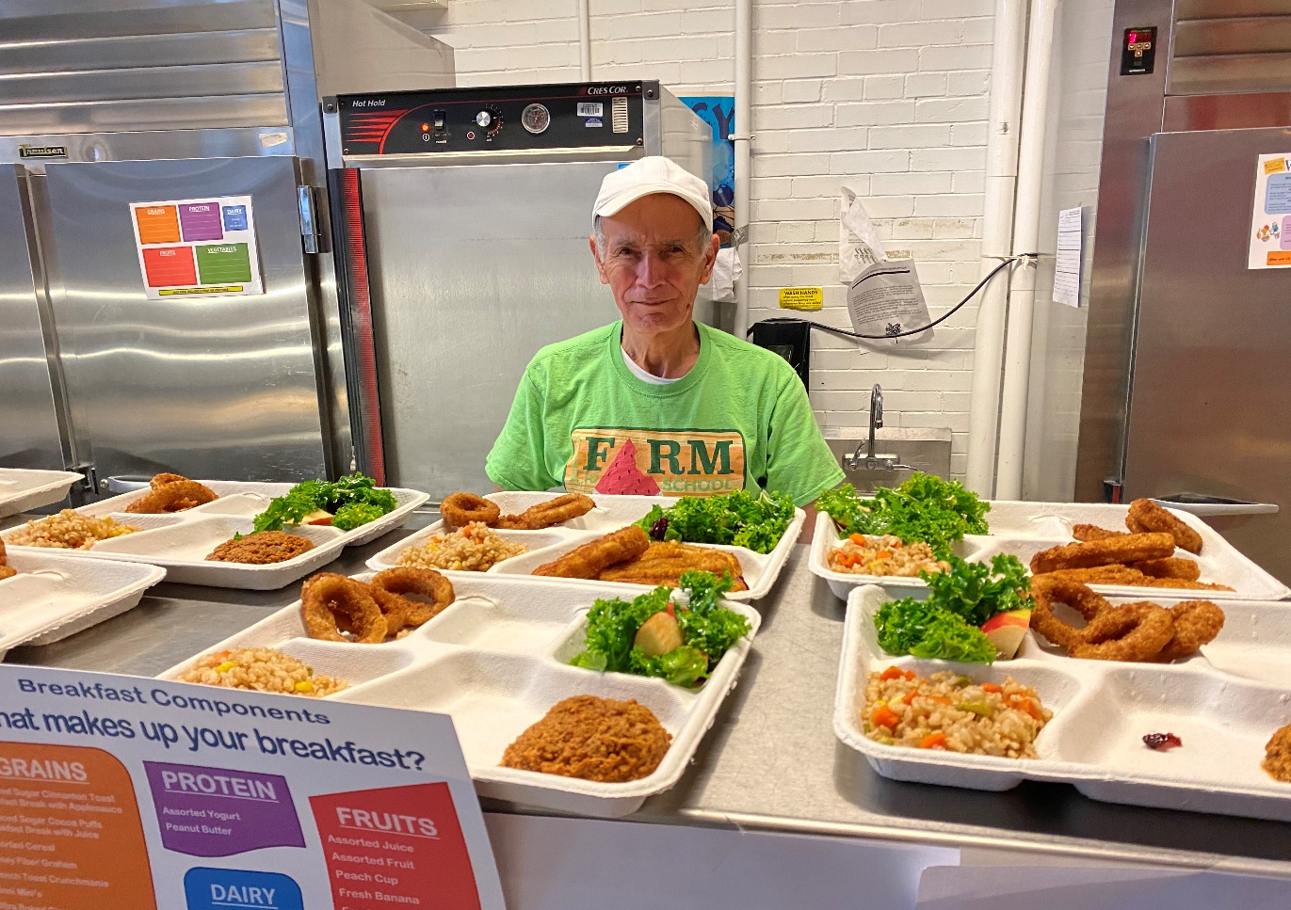
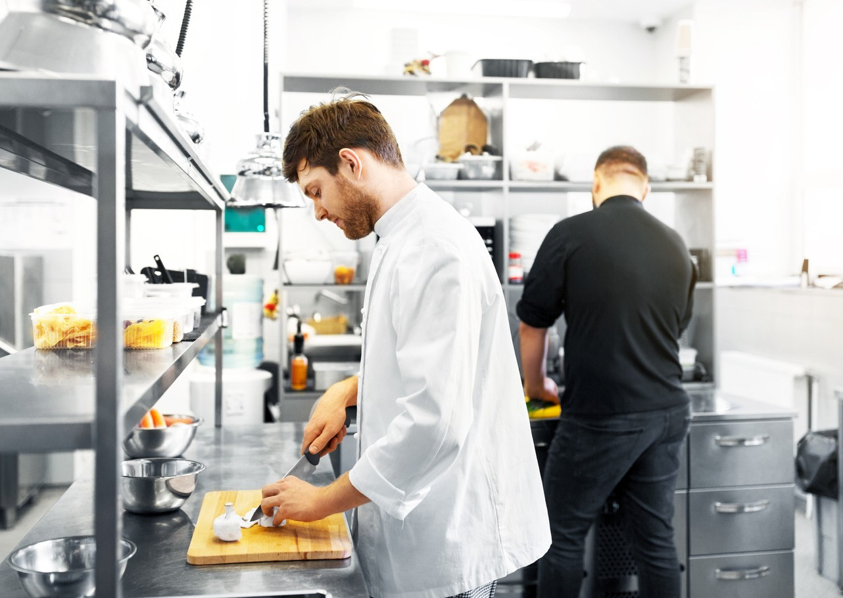
CHALLENGES
Photo courtesy of Buffalo City SD
Learning new methods takes time
Change in the routine
Staff resistance
Notes:
One of the biggest barriers to implementing the Batch Cooking method is the change it imposes on food service staff.
Food service workers may be used to preparing food a specific way on a specific schedule. They may want all food prepared before the service begins, due to concerns over not enough food. They may also prioritize after-service duties earlier in the day because they worry that there will not be enough time to complete their duties by the end of the shift. These fears of changes in their preparation process often leads to staff being resistant to change.
For example:
The head cook typically aims to have food prepared and in holding by 10:00 a.m. Currently the kitchen staff prepares and cooks all the food needed for the day and put into warmers before they sit down for their own lunch at 10:00 a.m.
When staff resumes work, they record the temperatures of foods, clean the entire kitchen, and freshen-up in preparation for the arrival of the students at 11:15 a.m.
When the first serving period begins, the food has been held for 1 hour and 15 minutes.
The last child is served at 12:15 p.m., adding 1 hour to the total time that the hot food is held.
The length of time in hot holding greatly impacts the quality of the food, and the last students served will receive lower quality meals than students at the beginning of food service.
Batch cooking requires organized planning with schedules to ensure there is enough staff to prep and cook in batches.
This may mean that the routine may change for staff.
Proper training is imperative to ensure staff understands the new methods and advantages of batch cooking.
This will make staff more comfortable with the change in routine and more likely accept those changes.

Slide 4
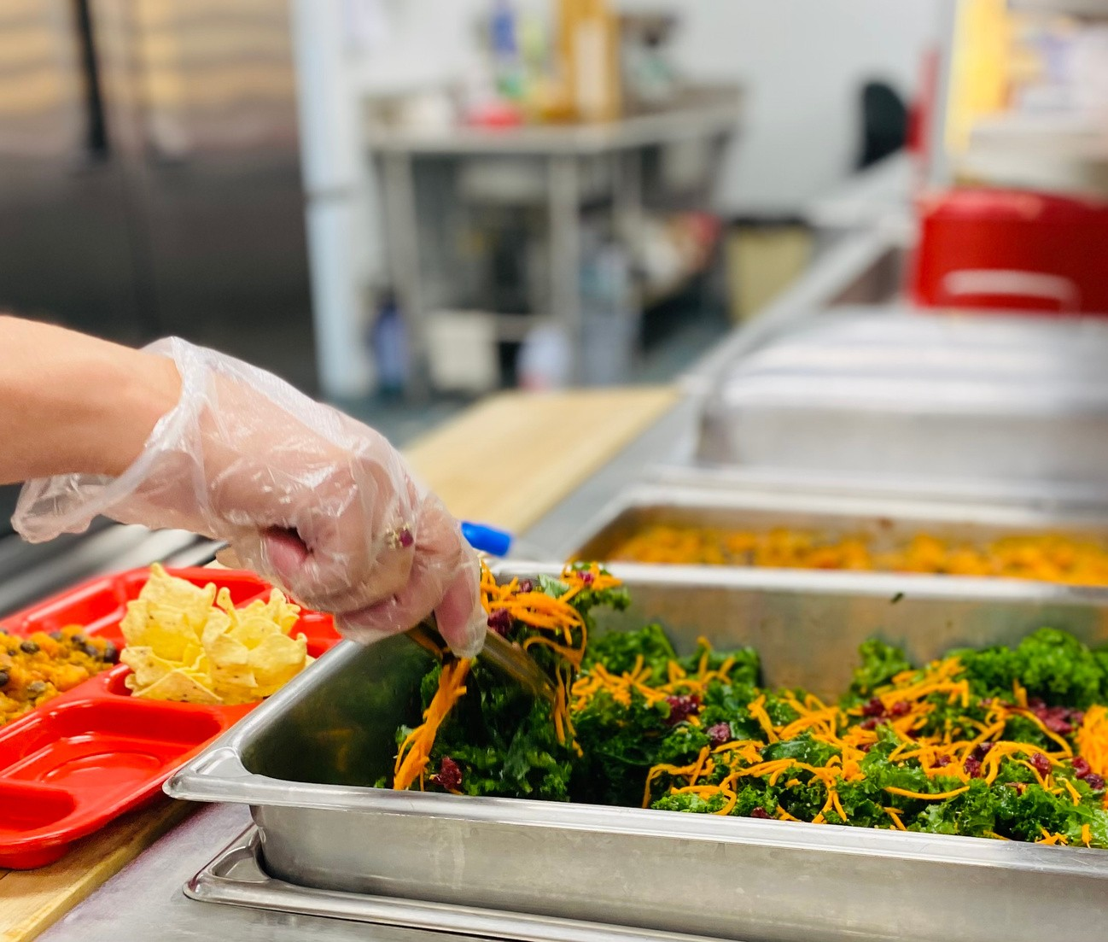

WHY BATCH COOK?
Preserves food quality Reduces food waste
Allows for consistent food access and choices
Photo courtesy of Onteora CSD
Notes:
Batch cooking preserves food quality, reduces food waste, and allows students to have the same access to all food choices throughout the meal period.
Batch cooking increases the flexibility to cook more food when needed.
If a menu item is more popular than expected, or participation increases for a certain meal, staff can easily increase the number of batches prepared.
Having the ability to do this ensures that the students in later meal periods have access to the same food choices as the students in the first meal period without impacting the quality of the food served.

Slide 5
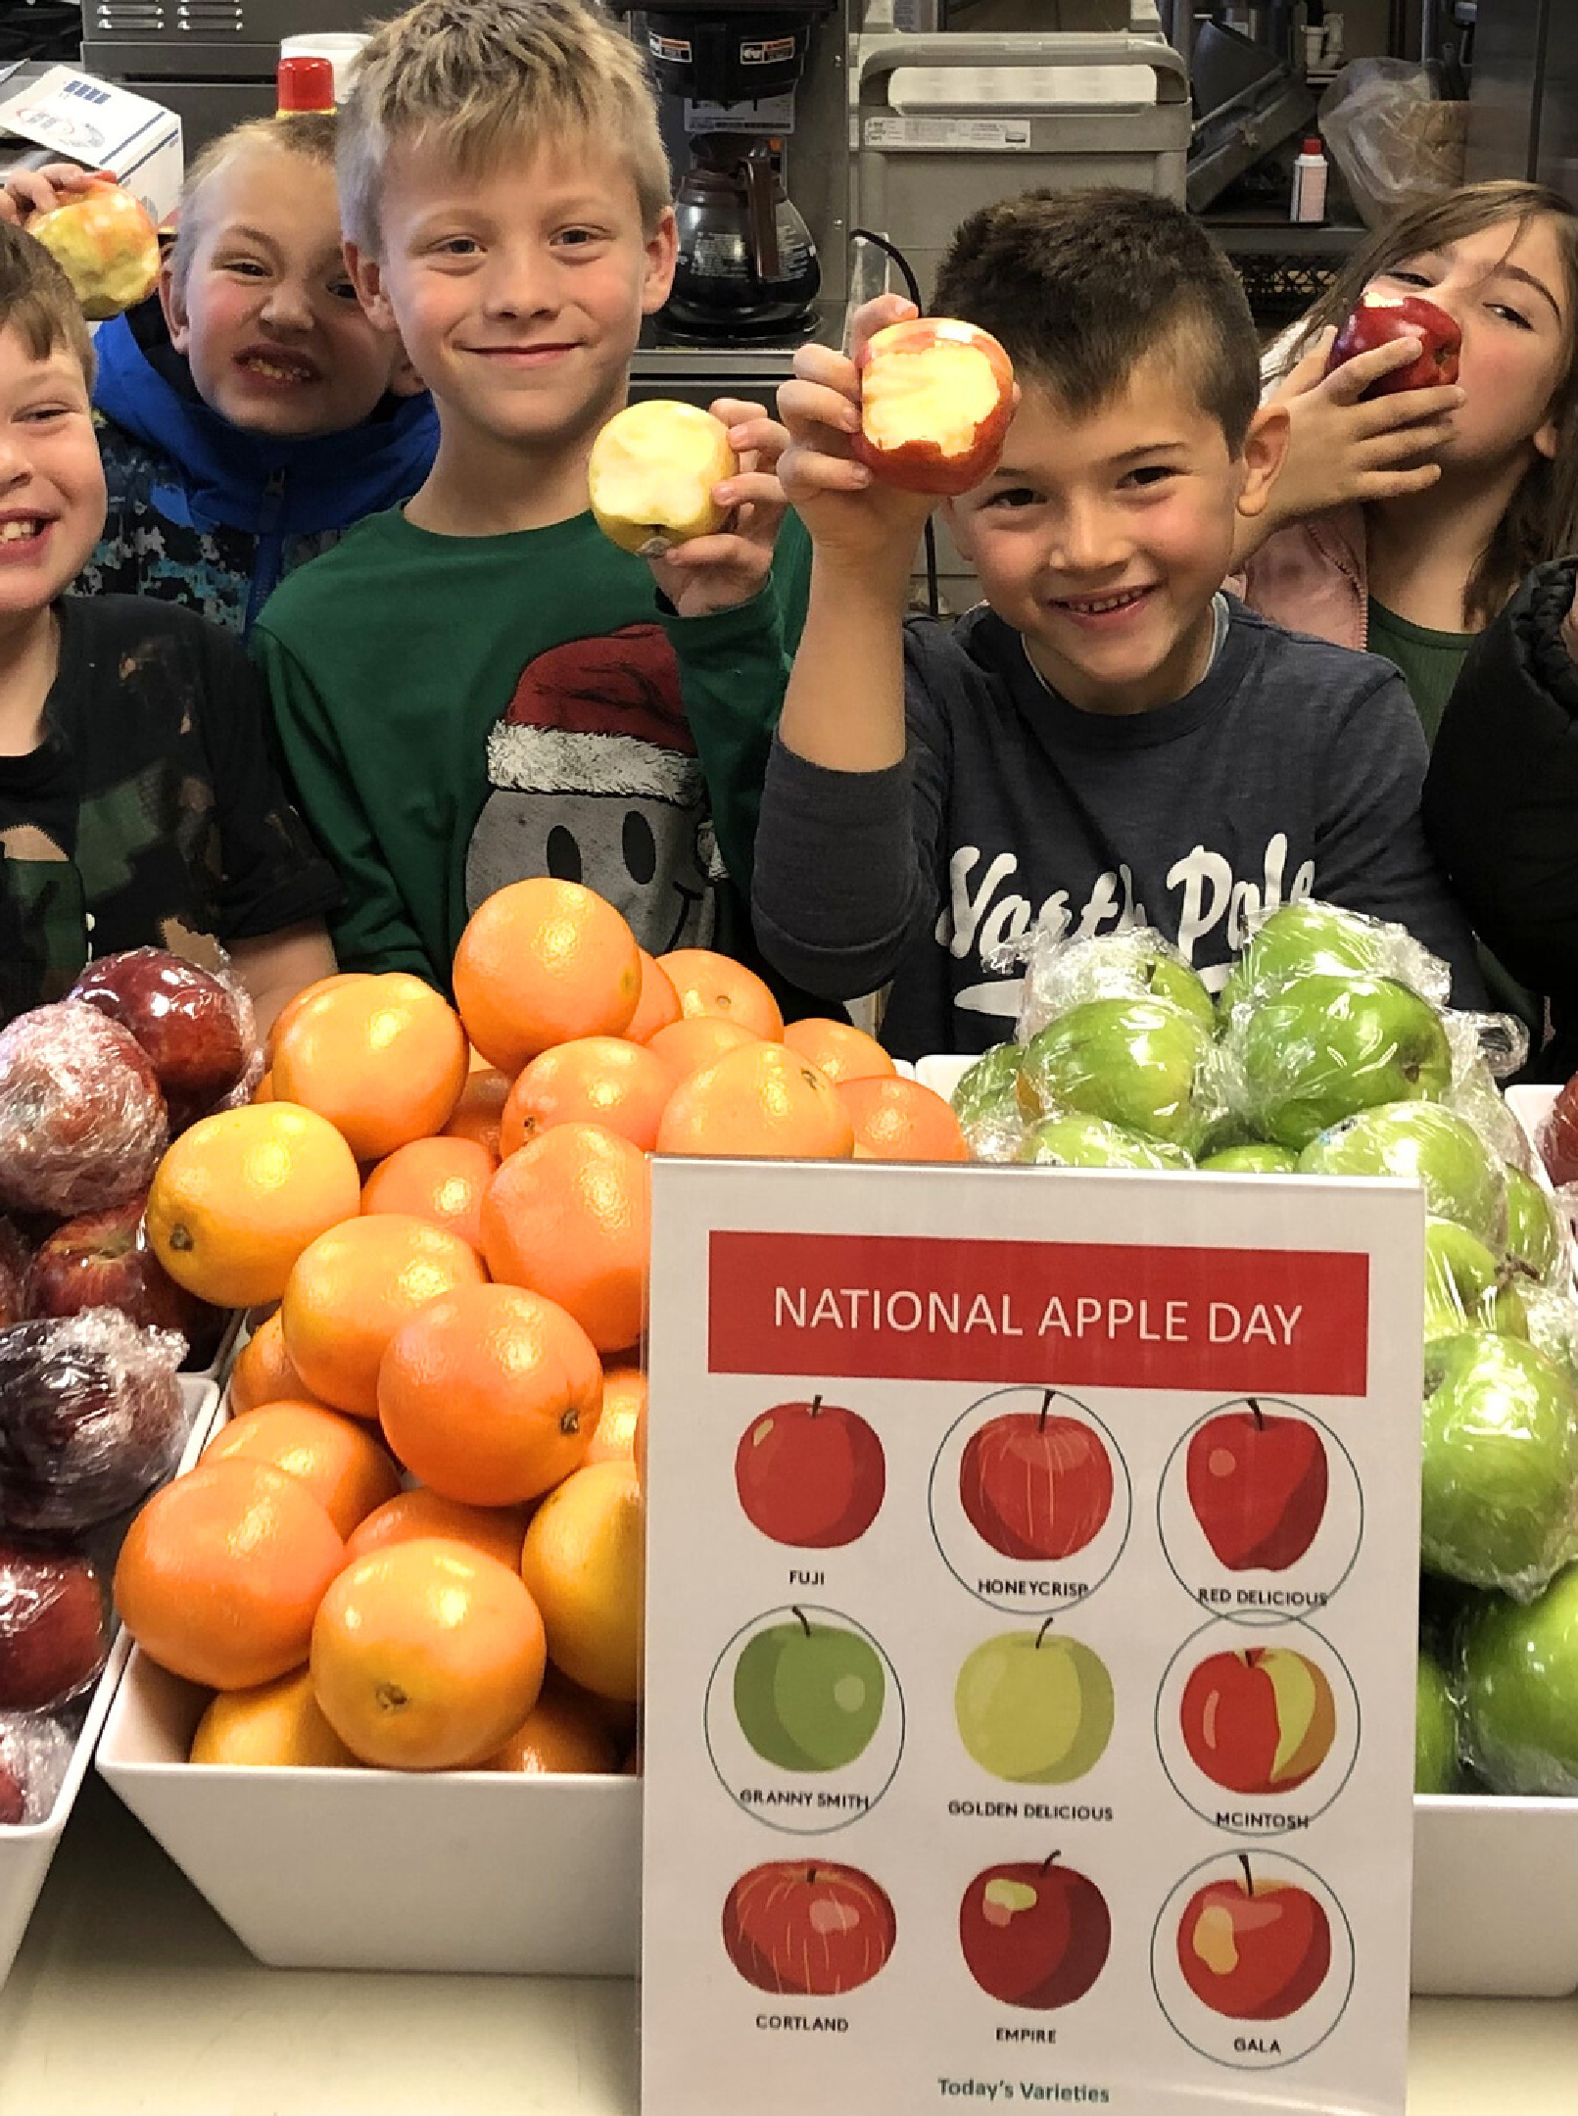

SERVING HIGH QUALITY FOODS
Customer satisfaction
Program participation
Program revenue
Photo courtesy of Charlotte Valley CSD
Notes:
Serving the highest quality foods will increase customer satisfaction which will increase program participation and program revenue.
Increasing program revenue is important since the Nonprofit School Food Service Account is self-sustaining, therefore, must be run like a business.

Slide 6
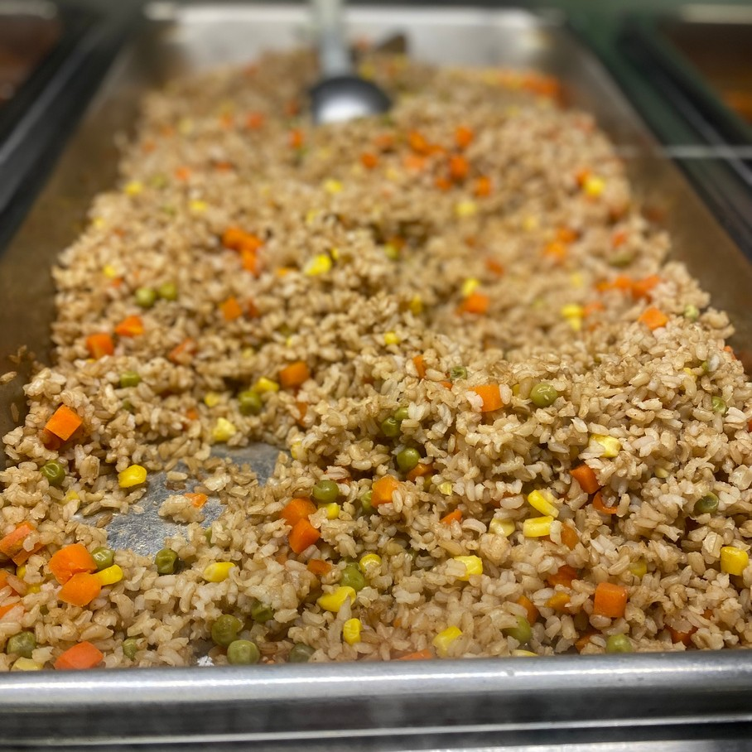
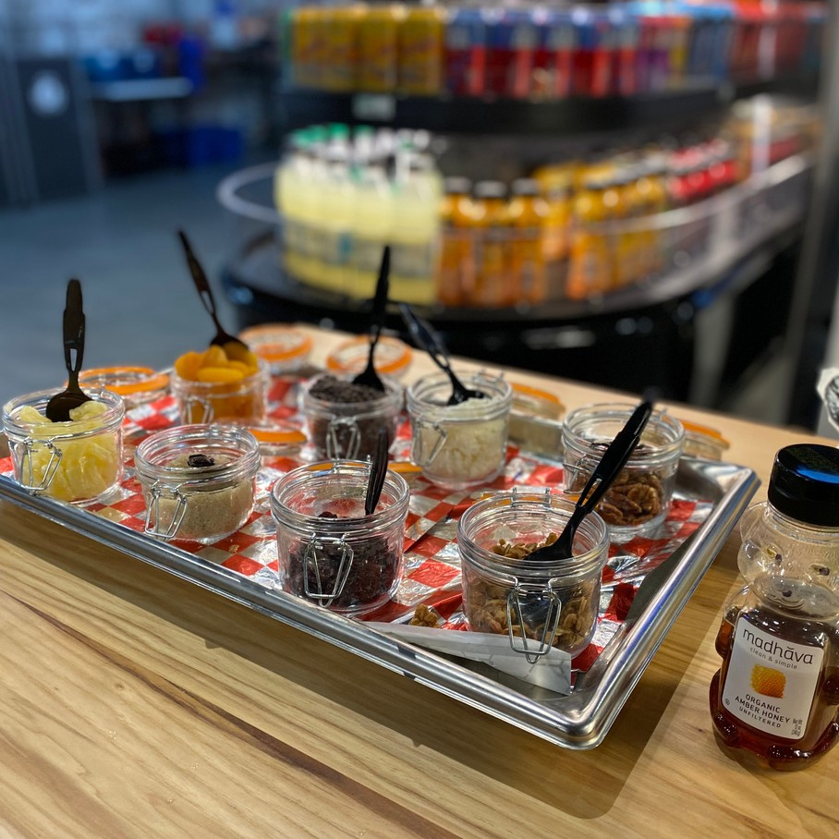
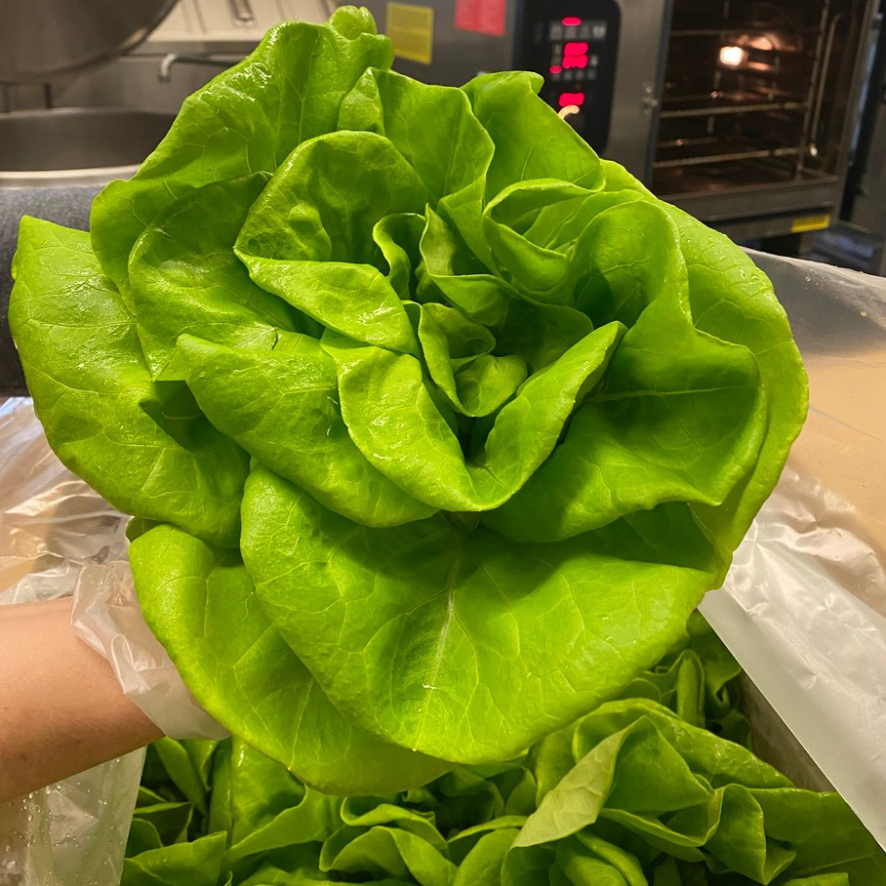
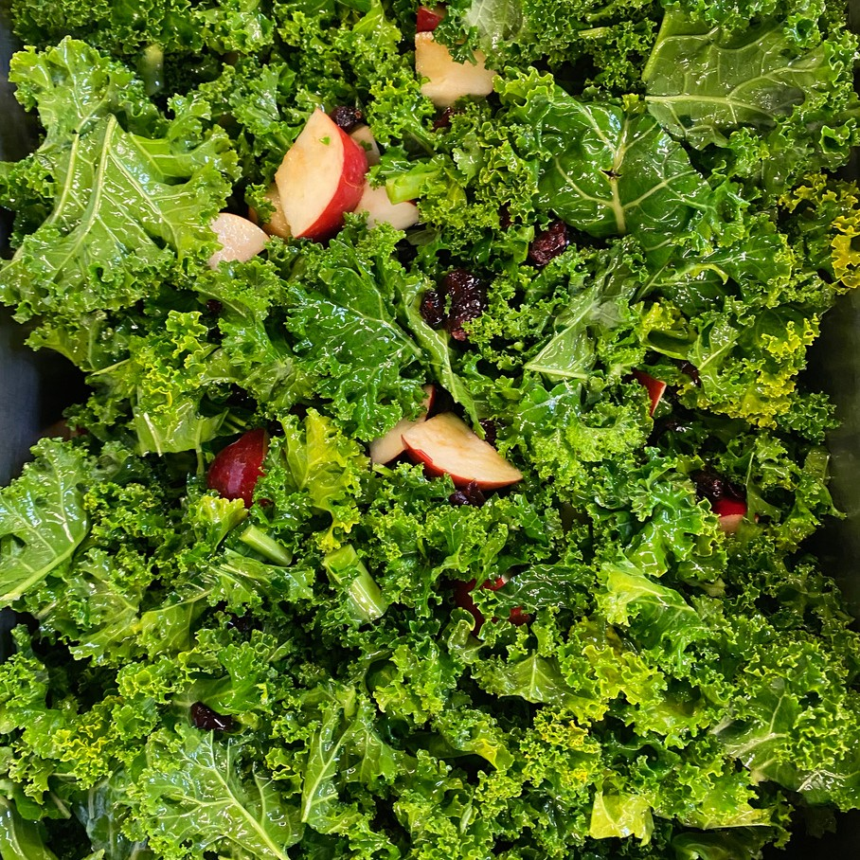

Flavor
Texture
FOOD QUALITY
Flavor
Texture
Appearance
Nutritional Value
Appearance
Nutritional Value
Photos courtesy of Buffalo City SD
Notes:
Holding foods for long periods of time will likely damage food quality and lead to unappealing changes in flavor, texture, appearance, moisture level, and nutrition value.
There may also be food safety implications when holding foods for extended periods of time.

Slide 7
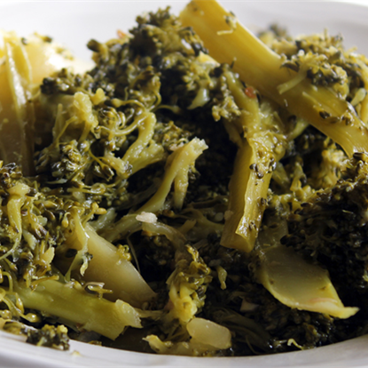

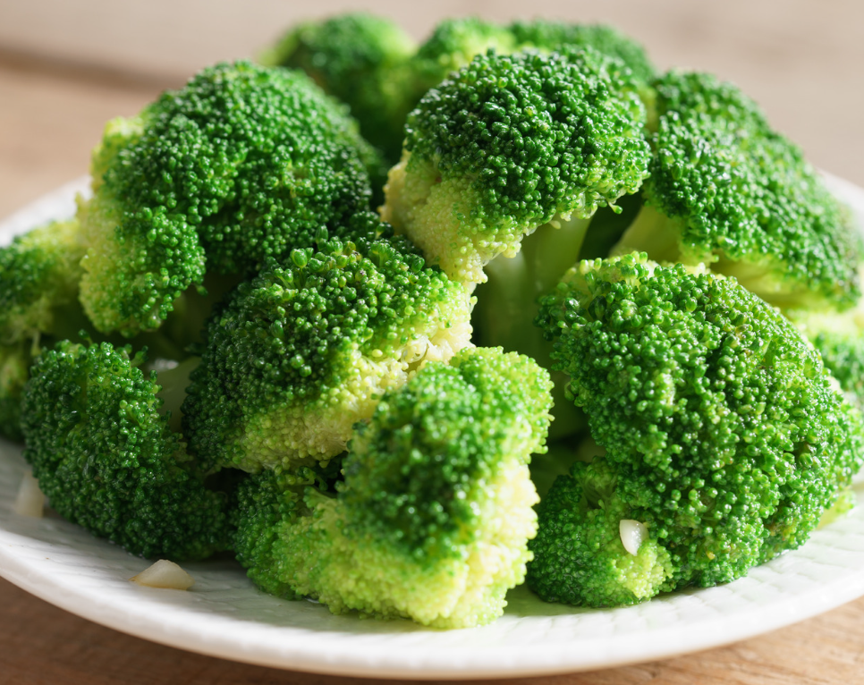


FLAVOR
Foods may become unpalatable due to:
Broccoli held in
holding unit too
long
Loss of flavor
Burnt or sulfur taste
Fresh steamed broccoli
Notes:
The flavor of menu items might be impacted when food items are held at high heat for extended periods of time or if they are over cooked. Overcooking and holding foods for an excess of time may lead to loss of flavor or an unpalatable taste.
Vegetables like broccoli, may even develop a sulfur odor or taste.

Slide 8
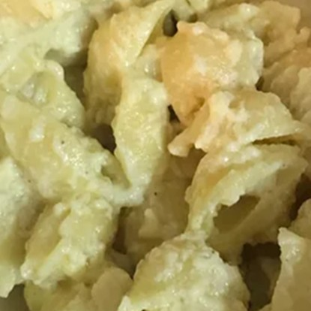


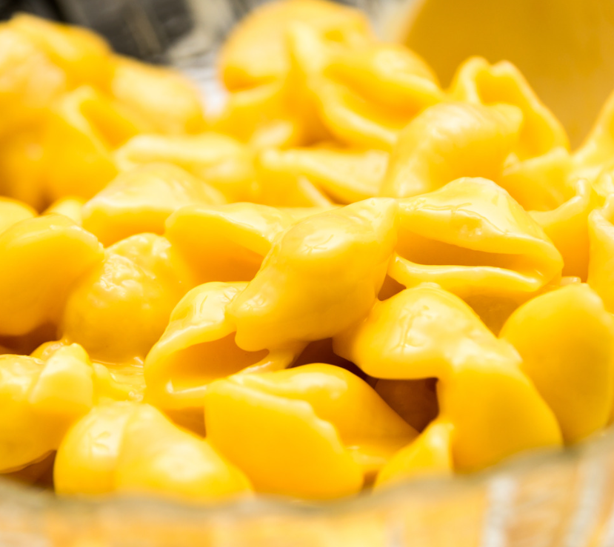
TEXTURE
Texture may become unappealing due to:
Overcooked Mac and Cheese losing texture
Soft foods becoming dry, hard, or overly crisp
Crisp foods becoming soggy or limp
Foods sticking together and becoming clumpy/lumpy, rubbery, or mushy
Freshly cooked Mac and Cheese
Notes:
Soft foods can become dry, hard, or excessively crispy if they are held at high heat for too long.
Food items that are meant to be crispy may become soggy or limp.
Additionally, some foods may stick together, causing them to become clumpy, lumpy, rubbery, or mushy.
You can see from the top picture that the cheese sauce has started to break and dry out.
This likely created an unappealing mushy and starchy texture.

Slide 9
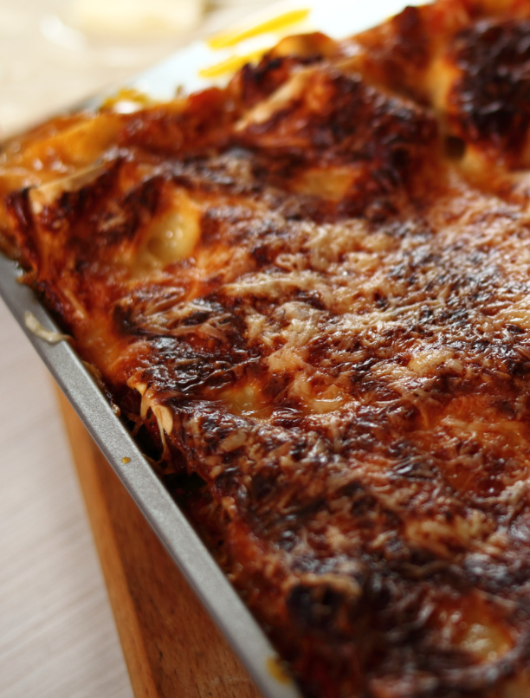
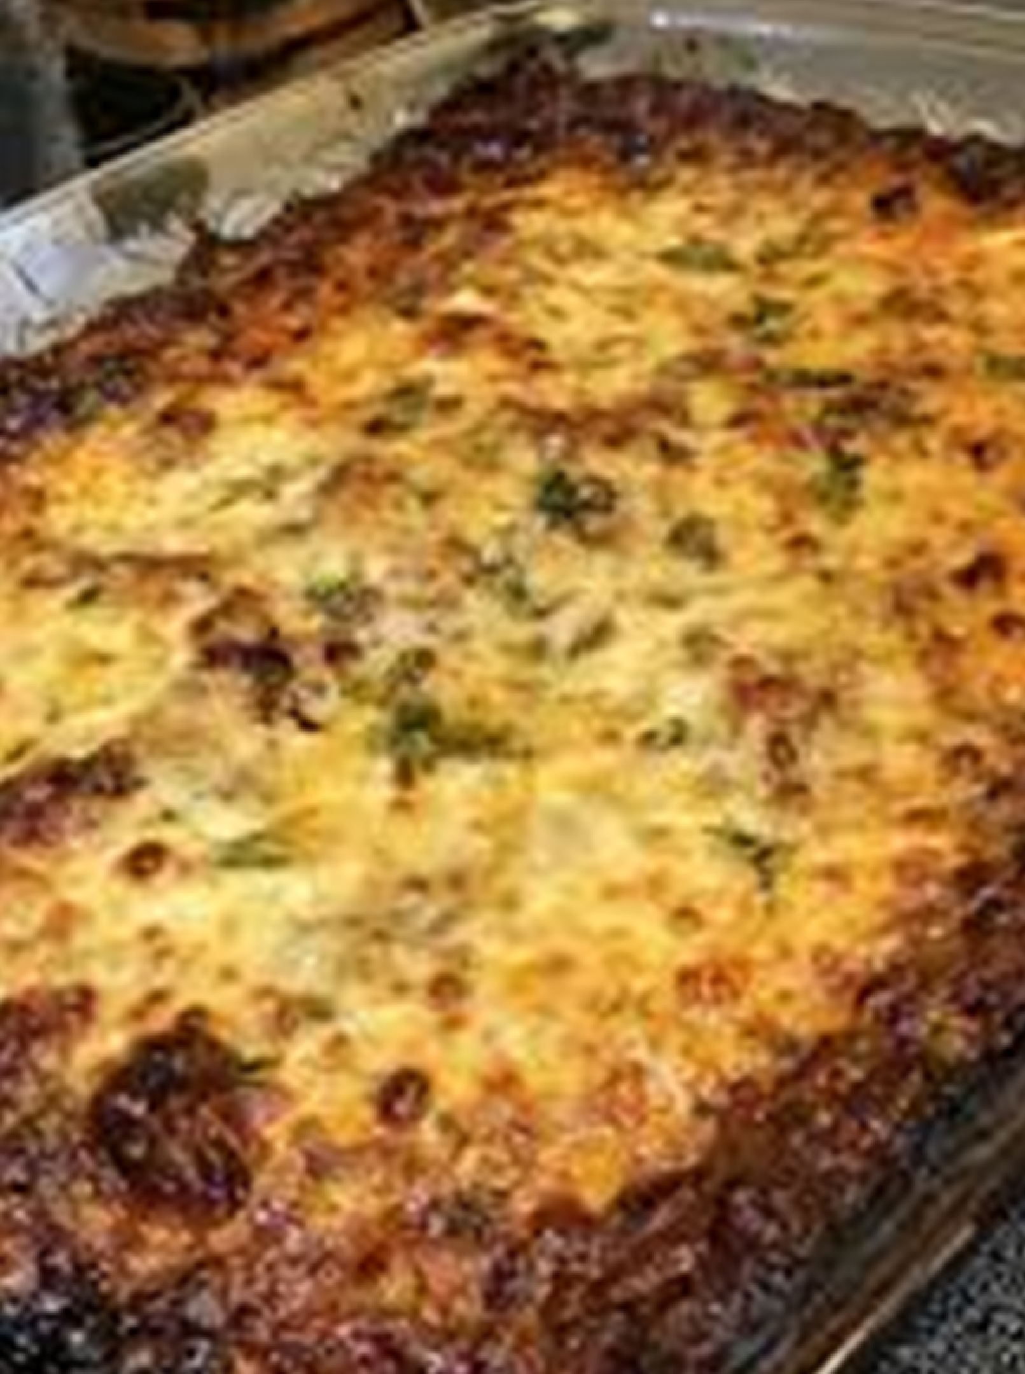

APPEARANCE
Holding foods at high heat can change their appearance
Foods may change color when burnt or overly dry
Notes:
Holding foods at high heat can also change the appearance of the menu item.
In this photo, the lasagna is burnt around the edges and does not look appetizing.
The cooking time and temperature on standardized recipes must be followed exactly to ensure the meal is not overcooked.
To help improve appearance of food, food service staff can be creative with batch cooking by displaying an assortment of different and colorful food items on the tray. The presentation of the food on the tray/plate will entice students to try different menu items and encourage students to purchase school meals.
Remember, if the food is not appealing to you, the students will be less likely to try it.
The focus should be on the quality of food to encourage students to purchase and eat the school meals.
If a SFA has an excess fund balance, this is a great way to purchase higher quality food products and incorporate fresh, local foods into the menu.

Slide 10
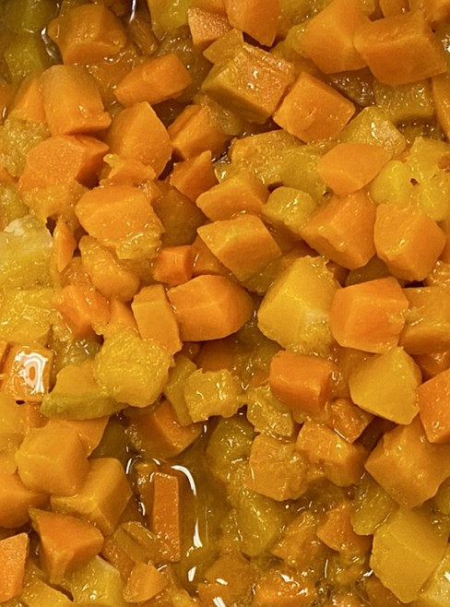

NUTRITIONAL VALUE
Holding foods at high heat can destroy certain vitamins and minerals
Vitamins C and B, protein, potassium, magnesium, and calcium
Notes:
In addition to changes in flavor and texture, over cooking and holding foods at a high temperatures can change certain nutrients contained in the food.
Many nutrients like Vitamins C and B, protein, potassium, magnesium, and calcium decrease when held for extended periods at high temperatures or in steamers.

Slide 11
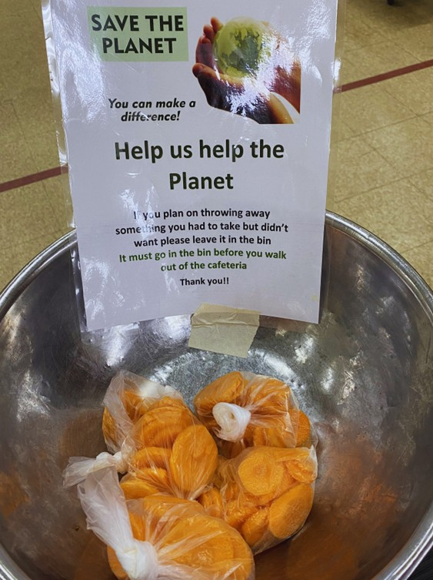

WASTE REDUCTION
Allowing staff to prepare amount of food based on participation
Producing better quality food
Photo courtesy of Saranac Lake CSD
Notes:
Batch cooking reduces waste by preventing over production of food and improving food quality.
With better flavor, texture, and appearance students are less likely to discard meal items.
If food is cooked all at once, you risk preparing more food than needed when a food item is not as popular as you thought, or participation is lower than expected.
Reheating extra, previously-cooked food to serve the next day will impact the quality of the product and create potential food safety risks; which usually leads to the food being recorded as leftover and discarded.
Allowing staff to prepare the amount of food based on participation will prevent the over production of food and reduce waste.

Slide 12
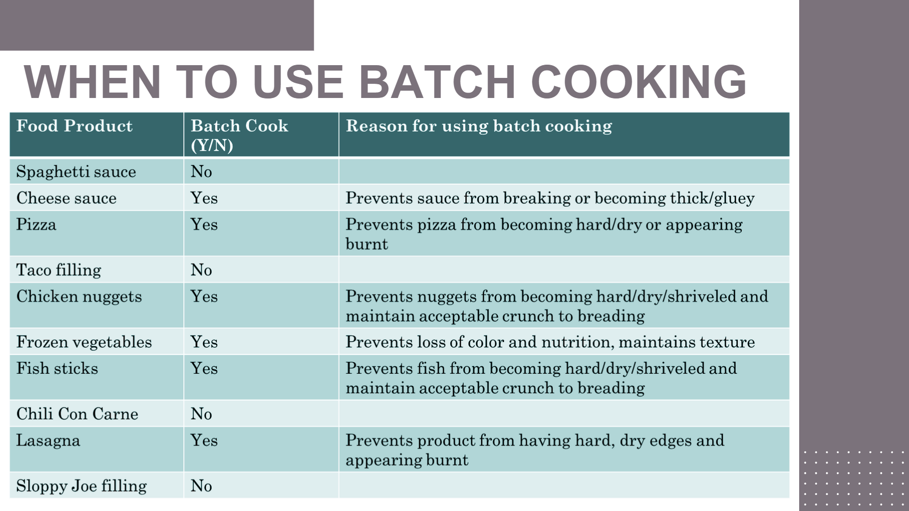
WHEN TO USE BATCH COOKING
Notes:
As the menu planner begins planning and determining when to batch cook, it is helpful to look back at the reasons why you should use batch cooking and ask yourself these questions:
Would holding the food item at high temperatures:
Change the flavor?
Change the texture?
Change the appearance?
Or destroy the nutritional value?
If the answer is yes to any of these questions, you should use the batch cooking method.
This slide illustrates several commonly served food items and the reasons why batch cooking should be used.

Slide 13
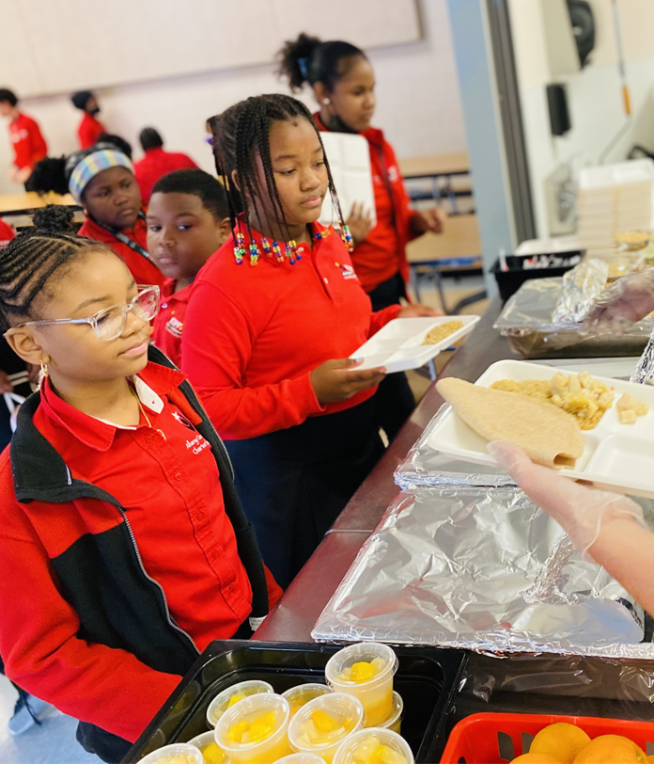
TIME VS. TEMPERATURE
Hot holding equipment is not designed to hold large amounts of food at consistent, safe, and palatable temperatures for extended periods of time
Photo courtesy of Kipp Troy Prep Charter School
Notes:
Most hot-holding equipment is not designed to hold large amounts of food at a consistent, safe, and palatable temperature for extended periods of time.
When monitoring temperatures of foods being held, equipment will always have “hot spots” and other areas that are cooler.
Over time, some of the cooler spots may not maintain safe holding temperatures.
Some food items are also more palatable at a temperature that is quite a bit higher than safe holding temperatures.

Slide 14
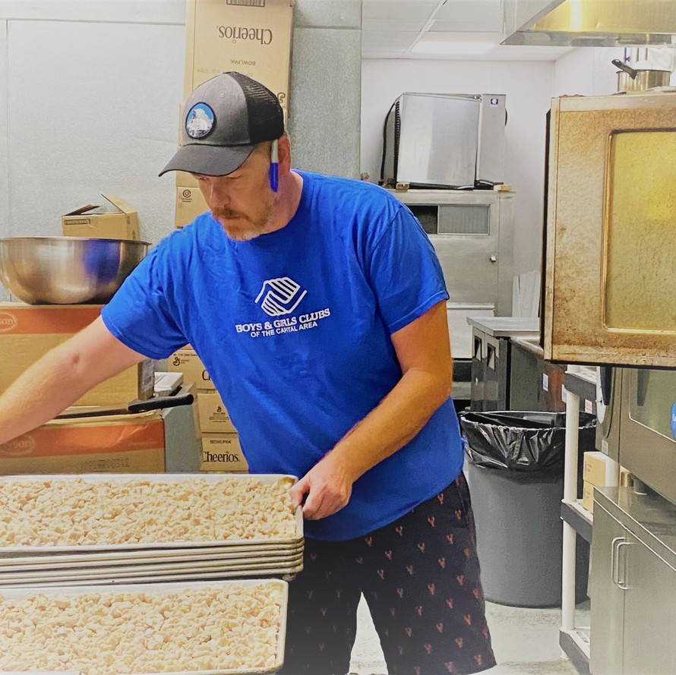

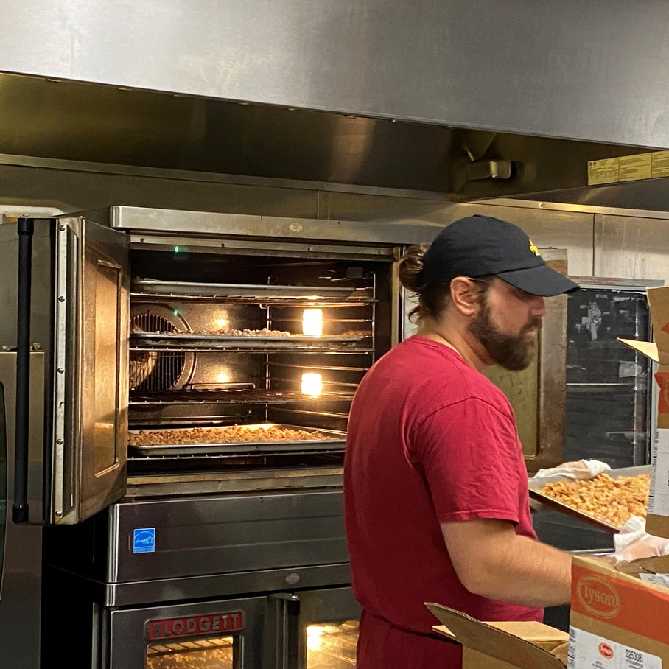
EQUIPMENT
Equipment for batch cooking:
Tabletop steamers
Rolling racks
Hotel/Sheet pans
How to purchase equipment:
Food Equipment Grant
Excess fund balance
Photo courtesy of the Boys & Girls Club of the Capital Area
Notes:
Investing in equipment to assist with batch cooking such as tabletop steamers, rolling racks, and additional pans will pay off when you see participation increasing.
SED offers an equipment grant to assist schools with needed equipment to help the school meal programs.
Additionally, if an SFA has an excess fund balance, purchasing equipment with those funds can make batch cooking easier for staff.

Slide 15

QUESTIONS?
Child Nutrition Training Team: cntraining@nysed.gov
Child Nutrition Program Office: 518-473-8781
Contact CN Representatives for questions specific to your SFA
Notes:
You may always contact the Training Team with additional questions at:
cntraining@nysed.gov
Or contact your CN Representative for questions specific to your SFA
Thank you!

