Slide 1
NYSED
OFFICE OF CHILD NUTRITION
NYS UNIVERSAL FREE SCHOOL MEALS
June 2025
Notes:
Welcome to the Universal Free Meals webinar hosted by the New York State Education Department Office of Child Nutrition.
Presenting today is Stacey Sullivan. Jamie McMillian and Tara Webster will answering questions.
Following today’s presentation, you will receive an email containing the slides from today’s webinar. This webinar is being recorded and will be available for future viewing in the next couple of weeks.
If you do not receive them, please email CNTraining@nysed.gov. Additionally, a copy of today’s webinar will be posted to the Child Nutrition website.

Slide 2
QUESTIONS?
Type into the Q&A chat box
Sandy Creek CSD
Notes:
If you have any questions throughout the presentation, please use the Q&A box to type and send them to our staff. We will answer questions at the end of the presentation.

Slide 3
AGENDA
Topics we will discuss:
Intro to NYS Universal Meals
Requirements for Participation
How to Meet Program Requirements
What to Do Now
Frequent Q & As
Questions
Broome-Tioga BOCES
Notes:
Today we will be discussing the New York state universal free school meals program, the requirements of the program and how to meet those requirements,. We will discuss what you need to do now to prepare, we will go through some questions that we have received and then answer questions that you have typed in to the Q&A box.

Slide 4
NYS UNIVERSAL FREE
SCHOOL MEAL PROGRAM
Beginning in the 2025-2026 school year
All NYS School Food Authorities (SFAs) are required to provide reimbursable school meals at no cost to all students
SFAs receive “free rate” reimbursement for all meals
Notes:
The 2025-2026 Executive Budget amended New York State Education Law by adding Section 915a Universal Free School Meals. Beginning in school year 2025-2026, New York State School Food Authorities (SFAs) participating in the federal school lunch and/or breakfast programs are required to provide reimbursable school meals at no cost to all students. The state will reimburse SFAs up to the combined state and federal reimbursement rate for a free meal for each federally reimbursed reduced-price and paid meal claimed. Meaning, the total reimbursement for each meal served will be equal to the free rate.

Slide 5
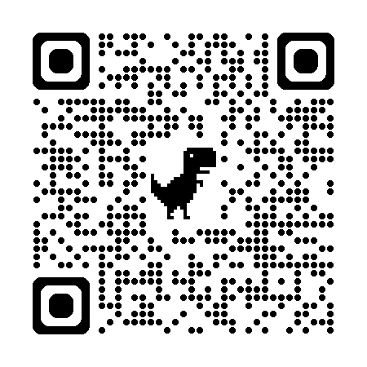
APPLYING TO BE A NEW SFA?
Applications due
July 31, 2025
Application Request
New SFA Webinar
Wednesday, June 18th @ 1 pm
Registration
Notes:
Schools and districts not currently enrolled in federal meal programs must apply to the New York State Education Department, Office of Child Nutrition by July 31, 2025, to participate in the 2025-2026 school year to provide free school meals.
Application submission deadline was extended to accommodate additional schools looking to participate in Universal Free School Meals
However, this creates a tight processing window.
Early submissions are encouraged—complete and accurate applications are processed more quickly.
The CN office will review applications and email requests for missing or inaccurate information. Responses are required within 5 days to continue processing.
Applications from non-responsive organizations will be abandoned and not approved.
The CN office is available for questions and guidance—reach out for assistance!
Scan the QR code on the left to request an application. Child Nutrition will be hosting a New SFA webinar on June 18th, at 1pm. Scan the QR code on the right to sign up for the webinar.

Slide 6
What is Free in Universal Free Meals?
All federally reimbursable NSLP/SBP meals served
What is NOT Free ?
Meals/Food not eligible for NSLP/SBP federal reimbursement
Seconds
A la carte sales (including milk)
Adult meals
Snacks
Smart Snacks
Meals/food provided to students that do not attend a participating school:
homeschooled students
virtual school students
Notes:
In the Universal Free Meal Program, students at participating schools are eligible to receive one reimbursable breakfast and lunch at no cost. However, any items outside the reimbursable meal—such as second lunches, à la carte selections, or meals that do not meet program requirements—must be charged appropriately.
It’s important to note that homeschooled and virtual school students are not included in this program, as they are not eligible to participate in federal meal programs.
Additionally, as a reminder, while a second breakfast may be claimed, SFAs cannot intentionally prepare extra food to accommodate second breakfasts.

Slide 7
NYS UNIVERSAL FREE SCHOOL MEALS
SFA Requirements
Maximize Federal Reimbursement
Promote SNAP
Maximize the Number of Students Eligible for federal free meals
Hoosic Valley CSD
Notes:
To participate in the Universal free school meals program, School Food Authorities are required to Maximize federal reimbursement, Promote SNAP, and Maximize the number of students eligible for federal free meals. We will now dive into how school food authorities will meet these requirements.

Slide 8
MAXIMIZE FEDERAL REIMBURSEMENT
Community Eligibility Provision (CEP)
Maximize CEP school grouping
Provision 2
Residential Child Care Institutions
without day students- continue standard counting and claiming
with day students - operate Provision 2
Notes:
Schools must operate in the federal free meal provision that maximizes federal funds at each at school
So lets start with how to maximize federal reimbursement
Eligible schools must participate in the Community Eligibility Provision (CEP) and SFAs must maximize participation in CEP through school groupings where possible. This means that if a school that is not individually eligible for CEP can be combined one or more eligible schools to form an eligible group, that should be done.
Any remaining schools that can’t fit into a CEP group must operate in Provision 2, which we will talk about in a few slides.
As for Residential Child Care Institutions
-Those without day students should continue standard counting and claiming as non-day students receive free federal meals.
-RCCIs with day students must operate Provision 2

Slide 9
COMMUNITY ELIGIBILITY PROVISION (CEP) with
Universal Free School Meals
Serve both Breakfast & Lunch
Receive “free rate” reimbursement for all meals claimed
Identified Student Percentage (ISP) 25% or more
Entire SFA​
Group of RAs​
Individual RA​
4 year cycle
Identified Students
DCMP Students
DCMP Extension Students
Other Categorically eligible Students
homeless-migrant-foster-runaway- headstart/evenstart
Identified Students
X
100
= ISP
Enrolled Students
Notes:
- The Universal Free School Meals Program replaces the NYS CEP Subsidy previously provided.
- The federal eligibility criteria for CEP remains unchanged.
- To qualify for CEP, an SFA, Group of RAs, or Individual RA must have a cumulative Identified Student Percentage (ISP) of at least 25%.
- The Universal Free Meals Program functions identically to the CEP Subsidy, offering additional reimbursement for federal paid-rate meals to match the federal and state combined free rate.
- SFAs should strategize on CEP implementation to maximize benefits for the greatest number of students.
As a reminder, Identified students include:
- SNAP and certain Medicaid recipients verified through electronic Direct Certification Matching Process (DCMP).
- Students in the same household as SNAP or Medicaid recipients (Extensions).
- Students eligible via Other Source Categorical Eligibility, which includes :
- Homeless students identified by the LEA or shelter official,
- Migrant students confirmed by State/local programs or homeless liaison,
- Runaway students receiving assistance through Runaway and Homeless Youth Act programs,
- Foster children under State care or court placement, and
- Students enrolled in a Federal Head Start or Even Start program.
- Important Note: Students qualifying for free meals through school meal applications are not included in the ISP, even if a SNAP number is provided.

Slide 10
EVALUATING ISP GROUPS To maximize federal funding through CEP
RA | RA Enrollment | RA ISP | Group 1 | Group 2 | Group 3 | Group 4
Bear ES | 1200 | 34.27 | 22.45 | 25.74 | 34.27 | 25.06
Lainey MS | 300 | 17.21 |  |  | 16.53 | 17.21
Blue HS | 750 | 15.84 |  | 15.84 |  | 25.06
CEP Enrollment |  |  | 0 | 1,500 | 1,200 | 1,950
Notes:
This is an example of how to evaluate potential CEP groups to determine how to maximize CEP participation. On the slide there are 3 RA’s all with different enrollments and ISP’s. The red indicates a lower than 25% ISP, which means it is not eligible for CEP.
Individually, Bear ES has an RA ISP of 34.27, Laney MS’s ISP is 17.21 and Blue HS is 15.84. In order to maximize federal reimbursement, evaluating the groupings of the schools is needed to determine which grouping would allow for the most students to qualify for CEP.
Group 1- Grouping all three schools results in an ISP of 22.45, which is below the required 25% ISP, making a group of all three schools ineligible for CEP.
Group 2- If Bear ES and Lainey MS are grouped together, this would result in an ISP of 25.74 for those two schools, which means they would both qualify for CEP and Blue HS would not. Based on the enrollment of the two schools, 1500 students would qualify for CEP.
Group 3- If Lainey MS and Blue HS are grouped together, this would result in an ISP of 16.53 for those two schools, which means they would NOT qualify for CEP however, Bear ES on it’s own qualifies. Based on the enrollment of Bear ES, 1200 students would qualify for CEP.
Group 4 - If Bear ES and Blue HS are grouped together, this would result in an ISP of 25.06 for those two schools, which means they would both qualify for CEP and Lainey MS would not. Based on the enrollment of the qualifying schools, 1950 students would qualify for CEP. This would leave Lainey to operate in Provision 2.
Using group 4 would allow for the most students to qualify for CEP thus maximizing the federal reimbursement.

Slide 11
Truxton Academy Charter School
PROVISION 2 (P2)
Serve Lunch and/or Breakfast
First year = Base year
4 year cycle
Extensions Available
Meals served in base year and non-base years are provided at no cost to students
Notes:
Now, we’ll discuss Provision 2 (P2) and its role in the NYS Universal Free School Meals Program. Schools unable to participate in CEP must enroll in Provision 2.
P2 allows SFAs to provide breakfast and/or lunch at no cost to all enrolled students.
Schools that only serve lunch and do not participate in breakfast cannot qualify for CEP and must implement P2 instead.
P2 Uses a base year to simplify meal counting and claiming procedures and Operates on a four-year cycle, reducing administrative burden.
SFAs must apply for P2 participation and gain approval from the New York State Education Department (SED) before implementation.
More details, including the application process, can be found by scanning the QR code on the slide. This brings you to the Provision 2 webpage

Slide 12
P2 Operations with
Universal Free School Meals
Non-Base Years
Base Year
Count and Claim total meals served
Monthly funding levels established in the base year are used in the subsequent three years
Make Individual Student F/R eligibility determinations
DCMP & Extensions
Other Categorically Eligible
Free/Reduced Income Applications
Use Benefit Issuance System to Count & Claim Meals by Free, Reduced, and Paid Categories
Conduct Verification
SED reviews certifications
ALL Years
Provide all students free meals
Receive “free rate” reimbursement for all meals claimed
Notes:
During the first year of P2, the school serves all student meals at no charge regardless of their free, reduced price or paid eligibility category. However, the SFA is required to make individual student eligibility determinations for free and reduced-price meals (income applications, direct certification, other source categorically eligible) and conduct verification procedures. Meals are counted at the point of service and claimed monthly by category.
Since base year claims are the source of subsequent year claiming, it is essential that base year eligibility certifications, meal counts, and funding levels are accurate. During the base year, SED will conduct a review of certifications and federal benefit issuance. This review may be conducted in conjunction with the Administrative Review or through a desk audit (on-site or off-site).
Monthly funding levels established in the base year are used in the subsequent three years.
At the end of the 4-year cycle, a 4 year extension, to allow the base year funding levels to continue will be provided when the income level of the school's population, as adjusted for inflation, has remained stable, declined or had only negligible improvement since the base year. If an extension cannot be provided, the affected schools operate a streamlined base year, or start a new base year.
With Universal free meals, the State reduced-price and paid reimbursement rates will provide the difference between the federal reduced and paid rates and free rate.

Slide 13
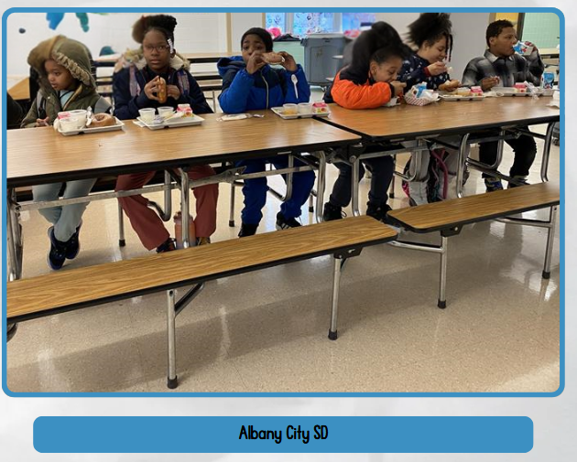
APPLICATON REMINDERS
Only free and reduced price applications are needed
Families can be encouraged, but not forced to complete
Students that are directly certified or categorically eligible are determined fee without an application
Notes:
Some reminders about Applications:
Only free and reduced-price applications are required for meal eligibility – paid category applications are not required and have no purpose
Families can be encouraged to complete applications, but they cannot be forced to do so.
Students who are directly certified or categorically eligible are determined free without an application.

Slide 14
P2 – End of 4 year Cycle
Conduct DCMP with April 1 enrollment for each P2 building
Move buildings into CEP, if able
Remaining P2 Buildings:
Request to extend base year funding levels for 4 more years, or
Start a new base year
Cambridge CSD
Notes:
After 4 year cycle has ended SFA will need to determine if they qualify for CEP. RAs or groups of RAs with an ISP of at least 25% must move to CEP
If CEP criteria is not met, SFAs must determine if they should renew their Provision 2 status, or if they should request a four-year extension
An extension is only available once for each Provision 2 cycle, and may be possible if economics has decreased, or only increased slightly.
The extension to Provision 2 of the National School Lunch Program allows schools to continue using the base year funding levels for an additional four years. This means that schools can keep providing free meals to all students without needing to collect new household applications annually. The extension is granted if the income level of the school's population has remained stable, declined, or had only negligible improvement since the base year. If an extension isn't possible, schools must either start a new base year or conduct a streamlined base year to establish new claiming percentages.

Slide 15
SNAP OUTREACH
Families can apply
Online
MyBenefits.ny.gov
Access.nyc.gov
Paper Application
Local Department of Social Services
Application Assistance
SnapHelpNY.org
Notes:
SFAs must actively promote the Supplemental Nutrition Assistance Program (SNAP) to students and their parents.
SNAP provides monthly benefits to buy food at grocery stores, farmers markets, and other locations. SNAP helps families stretch their food budget so kids can get the nutrition they need to learn and grow.
With SNAP:
Families can supplement their grocery budget and buy more food for their family
There are many programs and benefits that children and families can automatically receive by participating in SNAP:
Children on SNAP are automatically eligible for Summer EBT benefits ($120 per eligible child to buy food during summer months)
Families on SNAP can take advantage of programs that provide extra food benefits for healthy produce (Double Up Bucks, Fresh Connect, Health Bucks, etc)
Families on SNAP with children under age 5 in the household are also eligible for WIC.
SNAP may also help a family obtain utility, mobile phone, or internet discounts
SNAP eligibility and benefit levels are based on several factors including (but not limited to) who lives in the household, household income and expenses, and immigration status.
Families can apply for SNAP online at MyBenefits.ny.gov, or access.nyc.gov in New York City. Paper applications are also available by calling the county Local Department of Social Services. Application assistance is available throughout the state through the Nutrition Outreach and Education Program (visit SnapHelpNY.org).

Slide 16
MAXIMIZE THE NUMBER OF STUDENTS ELIGIBLE FOR FEDERAL FREE MEALS
Conduct DCMP at least three times a year:
Beginning of School Year
December/January
April
Salem CSD
Notes:
To participate in Universal Free School Meals, All SFAs are required to maximize the number of students eligible for free school meals by Conducting DCMP at least three times a year to identify students eligible for free meals without requiring an application. At a minimum Sfas should plan to conduct DCMP
At the Beginning of the School Year: this Ensures newly enrolled students are included.
In December /January to Capture mid-year changes in student eligibility.
An again in April: to ensure you are capturing as many eligible students as possible and to determine eligibility and maximization of CEP
By conducting DCMP multiple times throughout the year, schools can increase the number of students automatically qualified for free meals, reducing reliance on applications and ensuring more families benefit from meal programs.

Slide 17
COMMUNICATION TO FAMILIES
Public Announcement/Media Release
Parent Letter
CEP
P2
Notes:
SFAs operating CEP and P2 must notify the media and parents regarding implementation prior to the start of the school year.
Templates for modified versions of the Public Announcement and Parent Letter can be found on the CNKC by searching: Special Provision Option Documents or by scanning this QR code.

Slide 18
What to Do NOW
to prepare for Universal Free School Meals
Add all programs and buildings
Evaluate CEP – maximize – reapply if needed
Apply to operate in P2 at remaining buildings
Notes:
To prepare for Universal Free School Meals, apply to operate all programs and buildings now to ensure comprehensive coverage. There is no longer a mid-year application window. To facilitate this transition, we have extended the current application deadline from June 30 to July 31, 2025. Additionally, all newly approved RAs must begin program operations at the start of the school year for which their application was submitted, ensuring consistency and alignment with program implementation timelines.
for new Ras Evaluate CEP:
Maximize participation to benefit the most students.
Reapply if necessary to optimize funding and eligibility.
Apply now for Provision 2 (P2) at remaining buildings where CEP is not an option.

Slide 19
FREQUENTLY ASKED QUESTIONS
Q: Is Provision 2 a state or federal program?
A: Provision 2 (P2) is a federal program under the National School Lunch Program and School Breakfast Program that allows schools to provide meals at no charge to all students. In New York State's Universal Free School Meals Program, P2 enables schools to offer free meals while minimizing administrative burdens, such as collecting income applications and determining meal benefits annually. This streamlined approach reduces paperwork while ensuring schools receive federal funding and state subsidies to support meal programs.
Notes:
Is Provision 2 a state or federal program?
Provision 2 (P2) is a federal program under the National School Lunch Program and School Breakfast Program that allows schools to provide meals at no charge to all students. In New York State's Universal Free School Meals Program, P2 enables schools to offer free meals while minimizing administrative burdens, such as collecting income applications and determining meal benefits annually. This streamlined approach reduces paperwork while ensuring schools receive federal funding and state subsidies to support meal programs.

Slide 20
FREQUENTLY ASKED QUESTIONS
Q: Please review counting and claiming for Provision 2 schools
A: Base Year:
Use Benefit Issuance System to Count & Claim Meals by Category
(Free, Reduced, and Paid)
Receive the “free rate” for all meals claimed
Non-Base Years:
Count and Claim total meals served
Receive the “free rate” for all meals claimed
Notes:
Please review counting and claiming for Provision 2 schools
For the Base Year:
Use Benefit Issuance System to Count & Claim Meals by Category
(Free, Reduced, and Paid)
Receive the “free rate” for all meals claimed
Non-Base Years:
Count and Clam total meals served
Receive the “free rate” for all meals claimed
Monthly funding levels established in the base year are used in subsequent three years

Slide 21
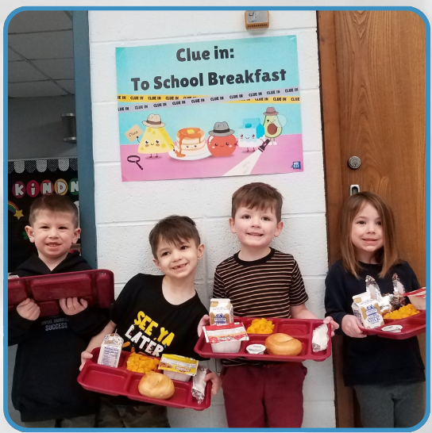
FREQUENTLY ASKED QUESTIONS
Q: If our entire SFA is currently operating under CEP-Do we need to do anything?
A: Yes.
Conduct DCMP using April 1 enrollment and establish ISPs for buildings
Reapply if necessary to maximize participation in CEP
Reapply for any buildings ending their cycle
Barker CSD
Notes:
If our entire SFA is currently operating under CEP-Do we need to do anything?
Yes.
Conduct DCMP using April 1 enrollment and establish ISPs for buildings
Reapply if necessary to maximize participation in CEP
Reapply for any buildings ending their cycle

Slide 22
FREQUENTLY ASKED QUESTIONS
Q: How does this affect private secondary schools who have not been affiliated with the CN Programs ?
A: Universal Free Meals is for all school participating in the National School Lunch and/or School Breakfast programs. Private secondary schools are eligible to participate if they are not-for-profit and are registered with the NYS Education Department as a school.
Notes:
How does this affect private secondary schools who have not been affiliated with the CN Programs ?
How does this affect private secondary schools who have not been affiliated with the CN Programs?
Universal Free Meals is for all school participating in the National School Lunch and/or School Breakfast programs. Private secondary schools are eligible to participate if they are not-for-profit and are registered with the NYS Education Department as a school.

Slide 23
FREQUENTLY ASKED QUESTIONS
Q: Are all schools required to participate in the federal lunch program?
A: The federal programs are optional programs and schools are not required to participate, however, in order for a school to participate in the Universal Free School Meals program they must participate in the federal National School Lunch and/or School Breakfast Programs.
Notes:
Are all schools required to participate in the federal lunch program?
The federal programs are optional programs and schools are not required to participate, however, in order for a school to participate in the Universal Free School Meals program they must participate in the federal National School Lunch and/or School Breakfast Programs.

Slide 24
FREQUENTLY ASKED QUESTIONS
Q: How does reimbursement work? Will all meals be reimbursed at the free rate?
A: YES. All meals will be reimbursed at the “free rate” of reimbursement.
Lunch Meal Claim Category | Federal Reimbursement | State Reimbursement | Total Reimbursement
Free | 4.54 | 0.0599 | 4.5999
Reduced | 4.14 | 0.4599 | 4.5999
Paid | 0.53 | 4.0699 | 4.5999
Notes:
How does reimbursement work? Will all meals be reimbursed at the free rate?
YES. All meals will be reimbursed at the “free rate” of reimbursement.
The rates on the slide reflect 2024-2025 reimbursement rates and will be updated when the new rates are released by the federal government in July. These rates are used to demonstrate the amount of federal and state reimbursement the SFA would receive for each reimbursable meal served. The SFA will receive the same total reimbursement for each federal free, reduced and paid meal claimed that is equivalent to the combined state and federal reimbursement rate for a free meal.

Slide 25
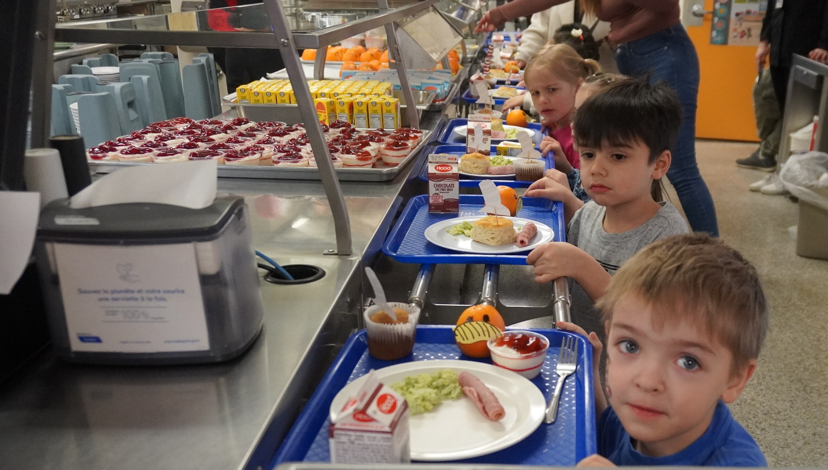
FREQUENTLY ASKED QUESTIONS
Q: Are meals required to be served 5 days per week?
A: Meals are required to be served when schools is in operation and students are there at meal service times.
Margertville CSD
Notes:
Are meals required to be served 5 days per week?
Meals are required to be served when schools is in operation and students are there at meal service times.

Slide 26
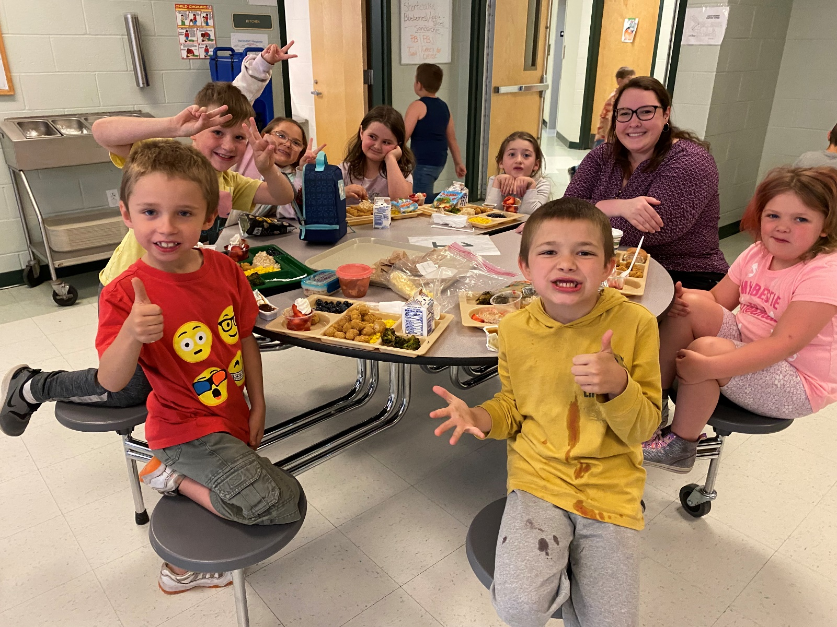
FREQUENTLY ASKED QUESTIONS
Q: Are students allowed to bring meals from home?
A: Yes, students are allowed to bring meals from home unless the school has a local policy that does not allow food from the outside.
North Warren CSD
Notes:
Are students allowed to bring meals from home?
Yes, students are allowed to bring meals from home unless the school has a local policy that does not allow food from the outside.

Slide 27
FREQUENTLY ASKED QUESTIONS
Q: Will SFAs still be required to conduct verification?
A: Schools operating in base year of Provision 2 are required to conduct verification of a sample of applications. Information on conducting verification is posted at the beginning of each school year.
Altmar-Parish-Williamstown CSD
Notes:
Will SFAs still be required to conduct verification?
Schools operating in base year of Provision 2 are required to conduct verification of a sample of applications. Information on conducting verification is posted at the beginning of each school year.

Slide 28
FREQUENTLY ASKED QUESTIONS
Q: Are all families required to fill out income applications?
A: Eligible families are strongly encouraged to submit free and reduced-price applications; however, families that do not qualify are not required to submit applications. Submission of applications is optional for families. SFAs operating Provision 2 should include the applications in material sent out at the beginning of the school year and as new students enroll throughout the school year. SFAs should have the application readily available for families.
Notes:
Are all families required to fill out income applications?
Eligible families are strongly encouraged to submit free and reduced-price applications; however, families that do not qualify are not required to submit applications. Submission of applications is optional for families. SFAs operating Provision 2 should include the applications in material sent out at the beginning of the school year and as new students enroll throughout the school year. SFAs should have the application readily available for families.

Slide 29
THANK YOU
NYSED Office of Child Nutrition
(518) 473-8781
cn@nysed.gov
www.cn.nysed.gov
Notes:
Thank you for participating in today’s webinar, please reach out to our office with any questions you have.

