Slide 1
Eligibility: Notification of Free/reduced Priced meals and Certification of benefits
SY 2023-2024
Presented by NYSED Office of Child Nutrition
Notes:
Welcome to the Eligibility webinar, hosted by the New York State Education Department Office of Child Nutrition.
Following today’s presentation, you will receive an email containing the slides for today’s webinar. If you do not receive them, please email CNTraining@nysed.gov
A copy of the webinar will also be posted and available on the CN website. As always, if you have any questions, please contact your Child Nutrition Program Representative or email CN@nysed.gov.

Slide 2
Acronyms
School Food Authority (SFA)
Recipient Agency (RA)
Direct Certification Matching Process (DCMP)
New York State Student Identification System (NYSSIS)
SED Delegated Account System (SEDDAS)
Community Eligibility Program (CEP)
Notes:
Throughout today’s discussion, there are acronyms that will be used.
Since not everyone is familiar with terms used throughout the Child Nutrition Programs, we thought it would be a good idea to go through them before we get started.
SFA is the School Food Authority which is the governing body which is responsible for the administration of the Child Nutrition Programs. In most cases, this is the school district.
The school buildings within the SFA are to referred to as Recipient Agencies or RAs.
DCMP is direct certification matching process. The DCMP provides SFAs access to direct certification data, which includes SNAP and Medicaid lists, as well as direct certification data that has been matched to New York State student records through the New York State Student Identification System (NYSSIS). In order to access NYSSIS, users must have a username and password through SED Delegated Account System (SEDDAS).
We will be referring to Community Eligibility Provision as CEP.

Slide 3
Today’s Agenda
Prototype Letters
Determining Eligibility
Categorical
Income applications
Benefit Issuance Document
Record Retention
Notes:
Today we will be reviewing:
Prototype Letters
Determining Eligibility- Categorical and Income applications
Benefit Issuance Document
Record Retention
All schools that participate in the National School Lunch Program and School Breakfast Program must make free and reduced-price meals available to eligible children.
Also, schools that participate in the Special Milk Program who have chosen to participate in the free milk option must make free milk available to eligible children.
Student eligibility is the foundation for the claim for reimbursement, so it is important to ensure that eligibility determinations are made accurately, and each student is receiving the correct benefits at the point of service.

Slide 4
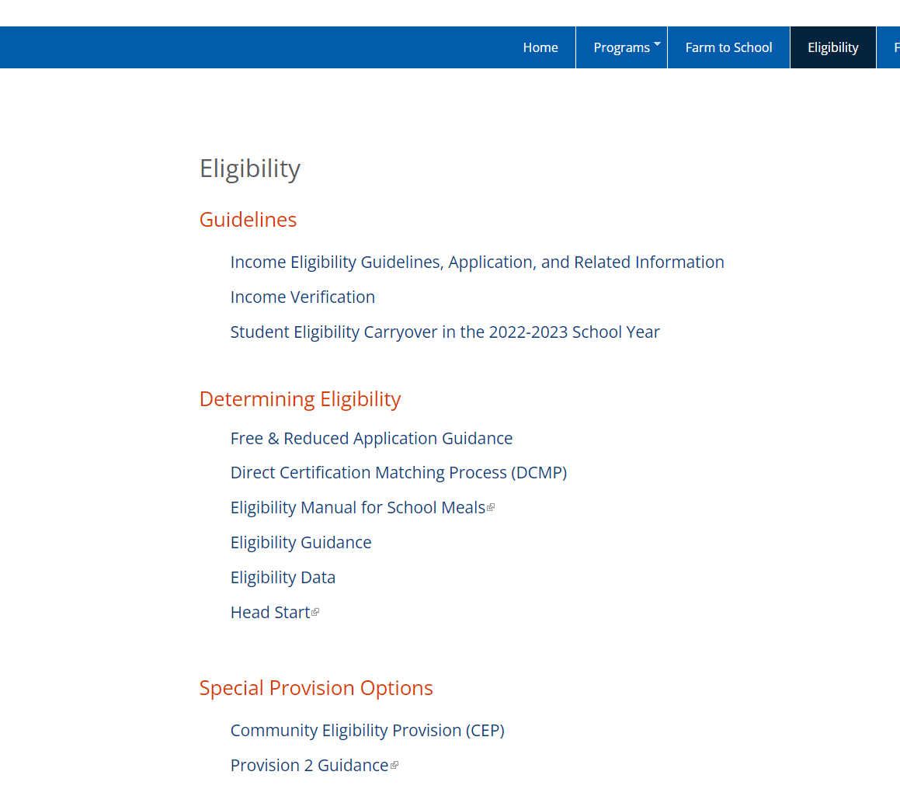
Eligibility Tab
Access the Eligibility Tab for:
Guidelines
Determining Eligibility
CEP and Provision 2 resources, templates letters and forms
Notes:
Prior to the start of each school year, SFAs should access the Eligibility tab found on the blue ribbon of the Child Nutrition Knowledge Center. This tab contains the information on the guidelines to be followed when establishing eligibility, resources used when determining eligibility and information on operating with a Special Provisions.
When SFAs are processing eligibility or conducting income verification, they should refer to the 2017 USDA Eligibility Manual for School Meals. This manual provides comprehensive information on federal requirements, policies, and procedures, and is intended to help SFAs accurately determine, certify, and verify children’s eligibility for free or reduced-price school meals.
In order to access the prototype documents, click on the Income Eligibility Guidelines, Application, and Related Information link, which we will discuss on the next slide.
The Special Provisions offered in NYS are Community eligibility Provision (CEP) and Provision 2. The Special Provision Options sections which contains CEP and Provision 2 resources, template letters and forms.
There is a comprehensive CEP webinar on our website, which can be accessed by clicking on the training tab. We highly suggest anyone interested in operating under CEP to watch the webinar. CN has a waiver from USDA allowing SFAs to submit CEP applications through August 31st, the application due date is usually June 30th.

Slide 5
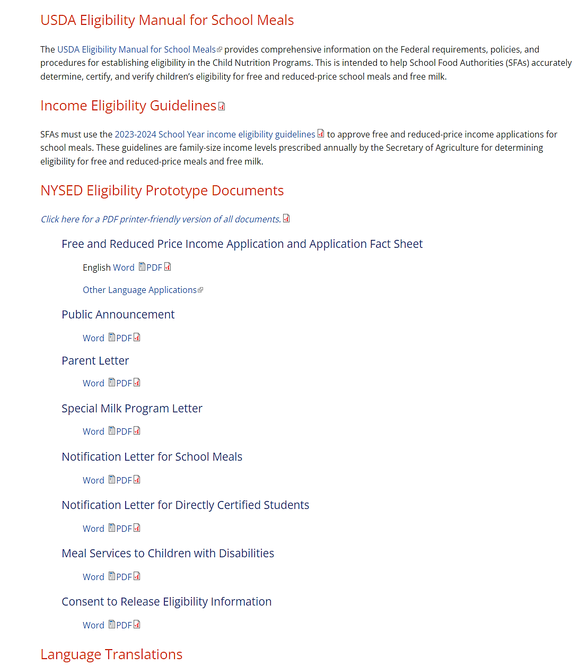
Income Eligibility Guidelines, Application, and Related Information
Income Eligibility Guidelines
Prototype Applications/Letters
USDA translation Forms
Notes:
Once the Income Eligibility Guidelines, Application, and Related Information link is clicked, the page includes the income eligibility guidelines for the 2023-2024 school year and the forms and guidance needed to process applications for free and reduced-price meals and/or milk. This information supersedes the previously issued New York State Education Department (NYSED) Policy Booklet.
The available prototypes include the Free-reduced Price application, public announcement, letters to send to families announcing the program and notification of eligibility and the consent to release information. Child Nutrition recommends the use of the provided prototype letters as they contain the required information and updated USDA non-discrimination statement.
There is also a link to USDA’s translated applications, which features foreign language translations of the Prototype Application. These are provided by USDA as a template to SFAs serving households where English is not spoken as a primary language.

Slide 6
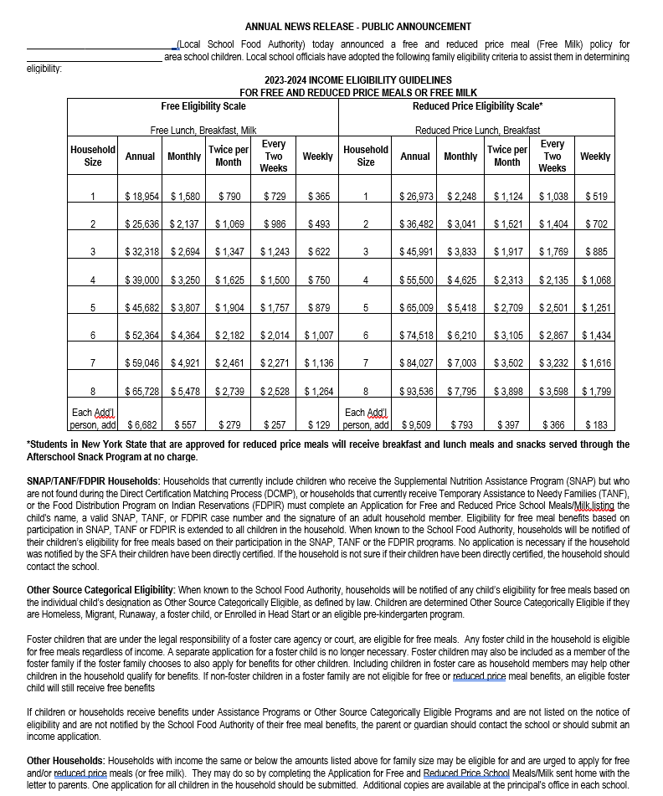
Prototype Letters
Public Announcement:
Send to:
Newspapers
Unemployment office
Major employers contemplating layoffs
Not required to pay for printing
Notes:
Prior to the beginning of each school year, the public must be notified that free and reduced-price meals and/or free milk programs are available at your SFA .
All SFAs that participate in the National School Lunch Program, School Breakfast Program, or Special Milk program must send the public announcement to local newspapers, local unemployment offices and to any major area employers that are contemplating large layoffs.
While you are required to send the public announcement, you are not required to pay to have it printed. Keep a copy of the announcement distributed along with a list of the locations that you distributed the announcement to.
SFAs cannot post the public announcement on the school website because it contains the free eligibility scale.
SFAs that operate the Community Eligibility Provision (CEP) or Provision 2, there is a prototype public announcement available on our website for you to use.

Slide 7
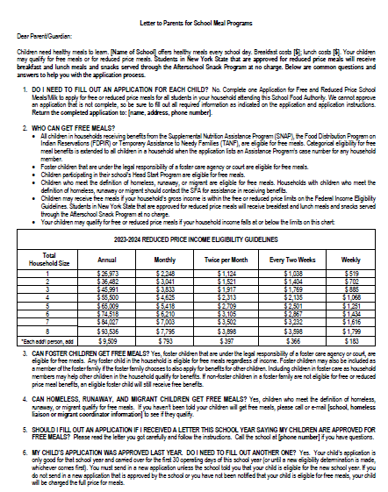
Prototype Letters
Parent Letter:
Distribute free and reduced-price income application to families
Provides instructions for families
Contains only reduced-price scale
Notes:
The parent letter is a document that must be distributed to all families within the SFA along with a copy of the free and reduced-price income application, unless the household has been directly certified. This letter provides instructions to families on completing the income application. If an SFA decides to use their own letter instead of the prototype, they must request approval from SED to ensure that all required components are included.
The parent letter is different from the public announcement because the parent letter can ONLY include the reduced-price income scale.
Please be aware that households who are enrolling new students at any time in the school year must be provided with the parent letter and free and reduced application form upon enrollment.
A copy of the parent letter that was distributed must be kept on file with other Program records for 3 years plus the current year.
For CEP and Provision 2 schools, we provide a template parent letter to use to notify the households that meals will be provided at no charge.

Slide 8
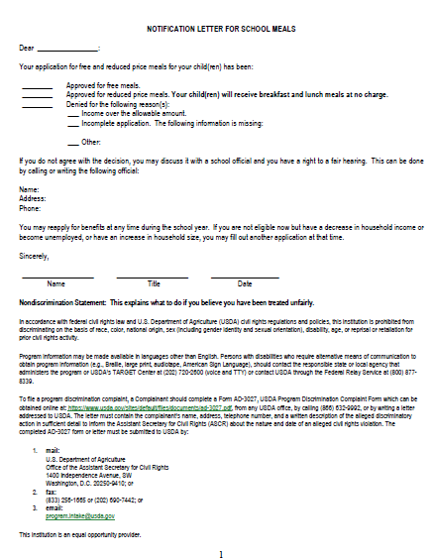
Prototype Letters
Notification Letter:
Families must be informed approval/denial applications
Denied program benefits must include explanation of hearing/appeals process
Written notification must be retained on file
Notes:
All households who submit applications must be informed of the approval or denial of their applications.
Written notification must be provided to each household denied program benefits in order to provide the household with the hearing and appeals process.
A copy of such written notification must be retained on file.
As mentioned previously, we strongly suggest SFAs use our prototype notification letter as it contains the correct information and updated USDA non-discrimination statement. This ensures letters sent out contain the correct and required information. Some common errors we see includes the letters in point-of-sale systems, are not updated or do not contain the correct information.

Slide 9
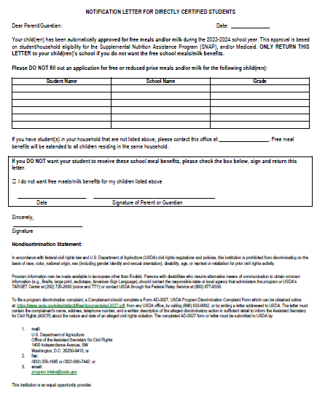
Prototype Letters
DCMP Notification Letter:
Must include:
Students eligible for free benefits
“No application is necessary”
Explanation of extended eligibility
Instructions notifying SFA of additional children in the household
Instructions notifying SFA if directly certified children want to opt out
Notes:
SFAs must notify households regarding eligibility established through direct certification.
The direct certification matching notification letter must include: a statement showing the child is eligible for free benefits, explaining that no further application is necessary; extended eligibility and how to notify the SFA of any additional children in the household not listed on the notification; and how to notify the SFA if free benefits for directly certified children are not wanted.
The notification of a child’s eligibility through direct certification may be done through e-mail if the SFA has an e-mail address for a parent or guardian.
If a family declines benefits, the student’s status must be categorized as “paid” and the family would be required to pay for meals.

Slide 10
Determining Eligibility
Methods of Determining Eligibility
Categorical Eligibility
Income Applications
Direct Certification (DCMP)
SNAP, Medicaid, extensions found on direct matching
Other Source Categorical
Migrant, runaway, homeless, foster, federal Head Start, through liaison/agency
Categorical Applications
SNAP, TANF, FDPIR case number, foster listed on application
Income Applications:
Income determines free or reduced status
Notes:
There are two methods of determining eligibility. The first method is Categorical eligibility which include Direct Certification and “Other Source” categorical eligible.
The second method is free and reduced-price income applications which include categorical applications and income applications. Categorical applications are reviewed based on SNAP, TANF, FDPPIR case numbers or foster eligibility. Income Applications are approved based on household income and family size.
SFAs must track how students are deemed eligible for free or reduced-price meals, for example categorical (SNAP or Medi) or application.

Slide 11
Categorical Eligibility
DCMP
Provides increased access free meals
Additional accurate reporting
Monthly SNAP and Medicaid data
DCMP Tutorial found on training tab of website
Direct Certification
1.
Access
NYSSIS here
2.
Log In
here
3.
Click to Agree here
Click to Accept here
Notes:
Direct Certification provides increased access to free meals for children entitled to receive free meal benefits and allow for more accurate reporting, better policy and decision making at the local, State and federal levels.
The State Match feature provides users with access to direct certification data including the Supplemental Nutrition Assistance Program(SNAP) and certain thresholds for Medicaid matched to New York State student records through the New York State Student Identification System known as NYSSIS. The NYSSIS system is already in-use by school personnel responsible for assigning unique IDs to students.
Sed receives SNAP and certain Medicaid data monthly from State partners which is matched to the SFA’s enrollment in NYSSIS.
Students must have a NYSSIS ID in order to conduct the state match. Students who do not have a NYSSIS ID can be searched using the roster upload feature where one student at a time or an entire roster can be uploaded to match to Direct Certification data.
You can access the direct certification data by clicking the “Business Portal” link on the Child Nutrition Knowledge Center website. This will take you to the NYSED Application Business Portal website. This is a site separate from the Child Nutrition Knowledge Center and requires another user id and password separate from the one you use for CNMS.
A Delegated Administrator in your district will have to create an account and grant entitlements for this application. If you do not know who the delegated administrator is in your district, please reach out to your Child Nutrition representative.
A tutorial is on the CN website navigating and matching students via the NYSSIS system is available on the Child Nutrition Knowledge Center under the Training tab
All public and nonpublic schools that participate in the National School Lunch Program and/or School Breakfast Program are required to complete the DCMP.
SFAs using standard counting and claiming must conduct DCMP a minimum of three times a year:
Once as close to the beginning of the school year as possible;
Another by or near November 30
And the third by or near February 28.
SFAs implementing the CEP district-wide or Provision 2 must conduct the DCMP once annually.

Slide 12
Extension of Free Meal Benefits
All children in a household with at least one child or household member who receives benefits from an Assistance Program are eligible for free meals
SFAs can use school enrollment records to validate the household address & maintain documentation on file
Notes:
If one child in the household receives benefits through an assistance program all students living in the household are eligible for free school meals, regardless of whether the children are related.
To extend eligibility, the SFA may use school enrollment records to identify additional children that live in the same household as a child identified through the DCMP.
If a student has been identified as living in the same household as a student that has been directly certified, the SFA will need to keep the enrollment records on file and provide free meal benefits without further application.
The students who qualify as having extended eligibility are considered directly certified extensions for reporting purposes.

Slide 13
Categorical Eligibility
Other Source Categorical
Migrant Students: Identified by State or local Migrant Education Program (MEP) coordinator
Runaway Students: Identified by the local education liaison as receiving assistance through a program under the Runaway and Homeless Youth Act
Homeless Students: Homeless Liaison or homeless shelter may deem a student homeless (McKinney-Vento Act www.nysteachs.org)
Foster Child: Care and placement is the responsibility of the State
Head Start/Even Start: Child enrolled in Federal Head Start/ Even Start Program
Notes:
Other Source Categorical refers to those students certified for free meals certified through a liaison or agency. “Other source categorical eligibility” cannot extend to all the students living in the household. If your SFA receives an application from the family, you would certify the other students based on the information on the application.
The state or local Migrant education Program coordinator must confirm the child’s eligibility for Migrant Students.
Runaway students should be identified by the local education liaison when receiving assistance through a program under the runaway and homeless youth act.
Homeless students must be deemed eligible by the Homeless Liaison or by a homeless shelter. The website www.nysteachs.org identifies the homeless liaison for each public school district. Non-public schools should contact the liaison designated for their public district. These officials may provide you with a list of students. The list must be dated and signed by coordinator, liaison or provider – List is sufficient- no applications needed.
A foster child is a child whose care and placement is the responsibility of a State or local welfare agency or who is placed by a court with a caretaker household. This applies only to foster children who are formally placed by the State welfare agency or court. It does not apply to informal arrangements, such as caretaker arrangements or to permanent guardianship placements, which may exist outside of or as a result of State or court-based systems. A child may still be considered a foster child if placed with relatives provided the placement is made by the State or local foster care system or courts. The State must retain legal custody of the child --whether placed by a welfare agency or a court -- in order for a child to be considered categorically eligible for free meals.
Students attending a federally funded Head Start program are categorically eligible for free meals. However, any siblings of Head Start students ARE NOT categorically eligible because no extension of eligibility exists for these students.

Slide 14
Application Eligibility
Categorical Applications
Application lists SNAP/ TANF/ FDPIR case numbers, everyone in the household is automatically eligible for free meals
Marc Black
Tori Lawless
Courtney Lawless
Cintron Elementary
Riverdale Middle School
Riverdale High School
4/ Mrs. Rivette
7/Mr. Jones
10/Mr. Haskell
Marc Black
F123456789
Foster Child on application is categorically eligible for free meals
Marc Black
Tori Lawless
Courtney Lawless
Cintron Elementary
Riverdale Middle School
Riverdale High School
4/ Mrs. Rivette
7/Mr. Jones
10/Mr. Haskell
X
Notes:
The SFA should never deny benefits for a family that has a valid SNAP case number on the application when it is not found electronically. These families are automatically eligible for free meal benefits.
SFAs should be familiar with what their local assistance program case numbers looks like. SFAs cannot accept the 16-digit number found on EBT cards or the 9-digit social security number in place of the assistance program case number.
Also, Medicaid numbers are not automatically eligible for free meals unless found on the Direct Certification Matching.
A foster child is categorically eligible for free meals and may be included as a member of the foster family if the foster family chooses to also apply for benefits for other children.
Including children in foster care as household members may help other children in the household qualify for benefits.
If non-foster children in a foster family are not eligible for free or reduced-price meal benefits, an eligible foster child will still receive free benefits. This definition does not apply to informal arrangements or permanent guardianship placements that may exist outside of State or court-based systems

Slide 15
Application Eligibility
Income Applications
Qualify based on the current income eligibility guidelines
Take at face value
Approved student(s) remains eligible for entire school year
Families may apply throughout the school year
Only complete applications may be approved
Notes:
The free and reduced priced meal family application is used to provide meal benefits to students who qualify based on income.
Income Eligibility is a method to provide benefits to a child whose household qualifies based on the current year income eligibility guidelines set by USDA.
The reviewing official will review the income application to determine which level of benefits the child/children qualify for by using the income eligibility guidelines. The income eligibility guidelines are located under the Eligibility Guidelines in the Eligibility tab of the Child Nutrition Knowledge Center.
Every year, new income eligibility guidelines are released by USDA. The reviewing official must ensure they are using the most current guidelines each school year when approving applications
All applications must be taken at face value and once approved, the student would remain eligible for the entire school year even if the household income increases. Families can submit applications at any time during the school year or report a loss of income to qualify. If a household reapplies and is approved for greater benefits, the SFA does not have to ask the family for proof of income unless the family was selected for the income verification process.
Only complete applications can be approved for meal benefits. Applications missing required information must be denied if the missing information cannot be obtained by a phone call or email to the family. To be considered complete, an application must include the required information. The SFA should make reasonable efforts to contact the household to obtain or clarify required information. All contact with families regarding eligibility can and should be documented on the application.
A complete income application must provide:
• Names of all household members;
• Amount, source, and frequency of current income for each household member;
• Signature of an adult household member; and
• For income applications: Last four digits of the social security number of the adult who signed the application, or an indication that the household member does not have one.

Slide 16
Determining Eligibility
Eligibility Carryover:
Prior year’s eligibility may be carried over for the first 30 operating days of the new school year or until new eligibility is made
Operating days are days the school is in session
A new eligibility determination supersedes the carryover
Applications must be processed within 10 operating days
Notes:
Eligibility from the prior year must be used to determine eligibility for the first 30 operating days of the school year, or until a new eligibility determination is made in the current school year, whichever comes first
Carryover allows families time to submit an application while children can still be fed based on the previous year eligibility status. While not required to issue a notification about the carryover period, school officials are encouraged to clarify for families that the carryover will end after 30 operating days. School officials should inform affected families that they must submit a new application for meal benefits to re-establish their child’s eligibility before the end of the carryover period.
Once a family submits an application, the new determination supersedes the carryover eligibility and must be implemented within 10 operating days of receipt.

Slide 17
Determining Eligibility
To use flexibility SFAs must:
Notify their CN Representative
Exercise the flexibility consistently:
for all eligibility methods
for all students in participating schools /programs
Document the effective date used
Refund any money paid for reimbursable meals prior to the eligibility determination
Flexibility for Effective Date
Income Application
Allows the date of submission of the application rather than the date of approval of the application
DCMP
Allows date a student was first identified as a direct match rather than the date the SFA access file.
Notes:
Children are eligible for free or reduced-price meal benefits on the date their eligibility is determined; however, flexibility exists to allow SFAs to move the effective date of eligibility to an earlier date under certain circumstances. This applies to both traditional household applications and direct certification.
SFAs may establish the date of submission of an application as the effective date of eligibility, rather than the date the official approves the application. This flexibility applies only to complete applications containing all required information at the time of submission.
When using this flexibility while conducting the Direct Certification Matching Process, SFAs may consider the effective date of eligibility for free school meals to be the date that first identified the student as a direct match as the effective date of eligibility, rather than the date the SFA accesses and processes the automated data matching file into their local point of service system. The effective date of eligibility is located on the column “DC Eligibility Date”.
If an SFA chooses to adopt the new flexibility policy, they must do the following:
1. Notify their Child Nutrition Program Representative of their intent to use this flexibility
2. Do so consistently for all eligibility methods
3. Exercise the flexibility for all students across the participating schools and programs
4. Document the effective date used, such as a date stamp, to document the date lists or letters from other agencies were received, or the documented and traceable run date of automated match files or recipient benefit files from another appropriate agency
5. Refund any money paid for a reimbursable meal or milk prior to the eligibility determination

Slide 18
Benefit Issuance Document
Master List of all eligible free and reduced-price students
Must keep a current list of updates/changes
Retain hard copy of master list at point of service
Sample Benefit Issuance Document
Last Name | First Name | Benefit Status | Method of Certification | Date of Certification | School Name | Selected for Verification
Smith | Bob | A | Application | 8/20/2023 | Fox Elementary | N
Jones | Aaron | B | Application | 9/14/2023 | Fox Middle School | Y
Day | Jenny | A | SNAP | 8/20/2023 | Fox Elementary | N
Williams | Mary | A | MEDI | 8/20/2023 | Fox High School | N
Notes:
SFAs are required to maintain a benefit issuance document listing all students that are eligible for free or reduced-price meals. The benefit issuance document may be maintained manually as a roster or may be updated electronically in a Point of Service System. It is extremely important that your benefit issuance document reflects accurate eligibility determinations. The Benefit Issuance Document is used to ensure students are receiving the benefits they were certified for and is used to report the number of students eligible by each of the different categories of eligibility, free, reduced price and paid.
Your benefit issuance document should indicate how each student was deemed eligible. The benefit issuance document should note the date the child was approved for the benefits. Student eligibility is confidential information and must be coded to prevent overt identification. SFAs should use codes to indicate free or reduced such as A & B or 1 & 2. When coding rosters, SFAS may not use the letters F or R for free/reduced.
Benefit issuance must be kept current. You must update the document when students leave or change category. The SFA should always have a hard copy of the benefit issuance document near the cash register so cashiers can refer to it during system failures, a building (RA) closure where students go to another building, or a natural disaster.

Slide 19
All Child Nutrition documents:
Must be filed for 3 years plus the current school year
Application documents contain private information
Keep in a secure location
Notes:
All child nutrition documents must be kept on file for three years plus the current school year. Applications are confidential and should be kept in a secure area with limited access.

Slide 20
Questions
Child Nutrition Program Administration
518-473-8781
cn@nysed.gov
Notes:
We will now take questions on anything discussed during today’s Eligibility webinar.
Again, please use the Q&A box in the lower corner to type and send it into our staff to which we will answer for all viewers to hear. Please remember you may always contact your CN representative for questions specific to your SFA or on other topics not discussed during todays webinar.

