Slide 1
Expansion of the Community Eligibility Provision in New York State
There will be no sound until the presentation begins
Notes:
Welcome to the Expansion of the Community Eligibility Provision in New York State Webinar, hosted by the New York State Education Department Office of Child Nutrition.
Presenting today is_______________, and answering questions are ___________________.
Following today’s presentation, you will receive an email containing the slides from today’s webinar.
If you do not receive them, please email CNTraining@nysed.gov. Additionally, a copy of today’s webinar will be posted to the Child Nutrition website.
If you have any questions throughout the presentation, please use the Q&A box to type and send them to our staff. We will answer all questions at the end of the presentation.

Slide 2
Agenda
Benefits
Federal Expansion
Reimbursement
23-24 Mid-year CEP Election
CEP Groups/Eligibility
Application Process
Counting & Claiming
Key Points
Alternate Income Form
Snack
Notes:
During today's webinar, we will explain CEP and the benefits of school participation in CEP, discuss the recent regulatory change to CEP and how this change, combined with the CEP State subsidy allow more schools the opportunity to provide free meals to all students, as well as walk through the process of determining eligibility, completing the application, and guidance on implementation.

Slide 3
Acronyms
CEP- Community Eligibility Provision
SFA- School Food Authority (school district)
RA- Recipient Agency (school building)
ISP- Identified Student Percentage
SNAP- Supplemental Nutrition Assistance Program
DCMP- Direct Certification Matching Process
Notes:
Throughout today's webinar, there are acronyms that will be used.
Since not everyone is familiar with terms used throughout the Child Nutrition Programs, we thought it would be a good idea to go through them before we get started.
We will be referring to Community Eligibility Provision as CEP.
SFA is the School Food Authority. The SFA is the governing body which is responsible for the administration of the Child Nutrition Programs. In most cases, this is the school district. The school buildings within the SFA are to referred to as Recipient Agencies or RAs.
Identified Student Percentage is referred to as ISP, which we will be discussing the meaning of this in detail. SNAP is Supplemental Nutrition Assistance Program. DCMP is direct certification matching process. DCMP provides SFA's with access to SNAP and Medicaid data.

Slide 4
Why Participate in CEP?
Reduces Administrative Paperwork and costs
No school meal income applications
Increases School Meal Participation
Improves Efficiency
No income verification
Free Breakfast and Lunch for all Students
Eliminates Unpaid Meal Debt
Improves Learning Environment
Notes:
CEP is a meal service option which allows qualifying schools to provide free breakfast and lunch to all students without the burden of collecting and processing school meal applications for free and reduced-price meals.
The benefits of CEP are many, in addition offering free meals to all students, schools operating CEP benefit from increased in participation in both breakfast and lunch, meal service efficiency and an overall reduction in the administrative requirements for operating Child Nutrition Programs. As a result, CEP schools can focus on feeding children healthy meals.

Slide 5
Federal Expansion of CEP: Minimum ISP: 25%
Identified Students
DCMP matches & Extensions:
SNAP
Medicaid
Other Students certified for free meals:
Certified Foster children
Headstart/Evenstart
Migrant
Runaway
Homeless
Extension of DCMP to siblings/household members
x
Identified
Student
Percentage
100
=
Enrollment
Notes:
On September 26, 2023, USDA released a Final Rule that amends the CEP regulations by lowering the minimum eligible identified student percentage from 40 percent to 25 percent.
ISP is the percentage of enrolled students in the potential CEP participating RA, Group of RAs , or the entire SFA identified as eligible for free meals without the use of household applications. Identified students are those directly certified for free meals through the electronic matching process as SNAP or Medicaid recipients, the siblings or household members of those electronically matched students, homeless children identified by the Homeless Liaison, Head Start/Evenstart participants, Migrant or Runaway youth, and foster children certified directly by the State or local foster agency
It is important to remember that universal Pre-K, or UPK programs, are not categorically eligible and are not included unless UPK students can be directly certified. Students who are eligible for free meals based on submission of school meal applications are NOT included in the ISP, even if the application includes a SNAP number.

Slide 6
CEP Reimbursement
Federal
% of meals reimbursed at federal free rate =
ISP x 1.6
% of meals reimbursed at federal paid rate =
100 – (ISP x 1.6)
State
For federal free rate meals: same rates as standard counting and claiming meals
For federal paid rate meals:
total free rate
- federal paid rate
Local
any
remaining
costs
Notes:
Funding for CEP meals is provided through both federal and state funds.
The amount of federal funding is based on the SFA/group of RAs/individual RA ISP multiplied by 1.6.
ISP x 1.6 = percentage of meals reimbursed at the federal free rate, not exceeding 100 percent. The remaining meals are reimbursed at the federal paid rate.
For all meals reimbursed at the federal free rate, the state free reimbursement amount for breakfast and lunch are the same rates applied to standard counting and claiming meals.
Beginning with school year 2023-2024, the State paid reimbursement rate will provide the difference between the total free and the total paid rate for CEP meals reimbursed in the paid category. This will ensure that all CEP meals are reimbursed at an amount equal to the total free reimbursement rate. This additional funding will only be provided for the portion of meals served in schools participating in CEP for which the SFA receives the federal paid rate of reimbursement.
The amount received in federal and state reimbursement is meant to cover the cost of providing meals through CEP. Should meal costs exceed the total federal and state reimbursement amount, SFAs must cover any remaining meal costs from another source. General fund donations or other non-federal funding would be needed if the cost of implementing the CEP is higher than the reimbursement received for CEP meals. Expenditure of additional non-federal funds is not required if all operating costs are covered by the Federal and state assistance provided.

Slide 7
CEP Reimbursement Using 23-24 rates, under 60% lunch, non-severe need breakfast
Meal | Category | Federal | State | Total
Lunch | Free | 4.33 | 0.0599 | 4.3899
 | Paid | 0.48 | 3.9099
Breakfast | Free | 2.28 | .1013 | 2.3813
 | Paid | 0.38 | 2.0013
Notes:
This slide shows an example of lunch and breakfast CEP meal reimbursements. In the end, all lunch meals receive the same amount of reimbursement, equal to the free lunch rate, and all breakfast meals receive the same amount of reimbursement, equal to the free breakfast rate. The difference is in the amount paid by federal reimbursement, and the amount paid by the state subsidy. The percentage of meals that are claimed in the free category receive most funding from federal reimbursements, where the meals reimbursed in the paid category receive most reimbursement from state subsidy.

Slide 8
2023-2024 Mid-year CEP Election
Apply by December 15, 2023
Use April 1, 2023 Enrollment & DC data
or October 6, 2023 Enrollment & DC data
Start CEP first full month after approval
Allow 2 weeks for application processing and approval of complete and correct submission
2-Step application process
Notes:
The application window is now open for mid-year election of CEP. Any SFAs may choose to reapply to change ISPs, regroup RAs or add additional RAs. Applications must be submitted to SED by December 15th to participate mid-year.
The links to the Application and instructions can be found on the CEP Expansion memo posted on the Child Nutrition website and was also sent via email prior to todays presentation. If for some reason you cannot locate it, please email Cntraining@NYSED.gov
The application process requires schools to provide full enrollment records to support the ISP. The 2-step submission process allows enrollment data to be securely transferred to the Child Nutrition Office.
The first step is emailing the completed CEP Application, which includes the completed Affirmation and Policy Statement Amendment tabs to CN@nysed.gov. Once this is submitted, an email will be sent with instructions on accessing NYSEDs CEP SharePoint folder. The second step is uploading the enrollment records to the secure server. Please do not include the enrollment records/master list within your initial email to the CN office as it contains confidential personal identifiable information.
For this mid-year election period, the number identified students and the number of total enrolled students must be based on April 1, 2023 . If April 1, 2023 data is not available October 6, 2023 enrollment and DC data can be used.
Allow 2 weeks for application processing and approval of a complete and correct application. Submissions that are incomplete and/or incorrect will result in approval delays.
SFAs will receive an email notification once the CEP application is approved. The approval email also includes links to templates that SFAs can use to notify families of CEP participation, as notification is required.
Schools can implement CEP elections at the beginning of the month following approval. CEP cannot begin mid-month. For example, an SFA approved on November 17, 2023, must wait until December 1, 2023 to implement CEP.

Slide 9
CEP Groups
At least 25 percent of students certified for free meals without an application:
Entire SFA
Group of RAs
SFAs determine groups
Allows RAs that individually fall below 25% to participate
Multiple Groups and/or Individual RAs
All RAs within the SFA are included in calculation
Allows RAs that individually fall below 25% to participate
Individual RA
Notes:
SFAs should determine how to implement CEP to maximize the benefit to the most students.
Again, to be eligible for CEP, an SFA, Group of RAs, or an Individual RA must have a cumulative identified student percentage, referred to as ISP, of at least 25% .

Slide 10
CEP Grouping Examples
RA | ISP | Average ISP by Group | CEP Eligible?
North ES | 22.3 | 25.2 | Yes
South MS/HS | 28.1
RA | ISP | Average ISP by Group | CEP Eligible?
Purple ES | 33 | 24.3 | No
Yellow MS | 21
Blue HS | 19
Notes:
Here are some examples of how SFAs can group schools to participate in CEP.
In the first example, North ES does not qualify based on it’s individual ISP but South MS/HS does qualify. The SFA can group both schools together in order to maximize federal reimbursement and elect CEP in both RAs.
In the second example, the three RAs grouped together do not qualify based on the average ISP, however, Purple ES can be grouped with either Yellow MS or Blue HS in order for 2 of the RAs to be eligible for CEP.

Slide 11
Step 1: CEP Application
Notes:
The CEP application is an excel document that will automatically calculate the ISP for each RA once all the information is entered. Schools complete the green sections, which includes all data used to calculate the ISP- DCMP, foster, homeless, migrant and runaway. All RAs electing CEP must be included on the application.

Slide 12
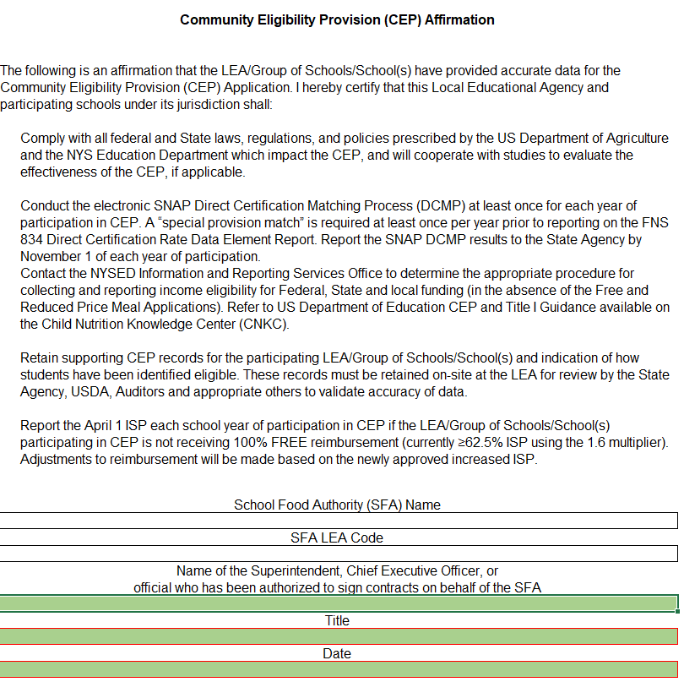
Step 1: (cont’d) Affirmation Form
Notes:
The application also includes multiple tabs at the bottom that must be completed. The Affirmation tab must be electronically signed by a school official that has authorization to sign on behalf of the school district, such as the Superintendent or Chief Executive Officer, attesting that all data is true and accurate.

Slide 13
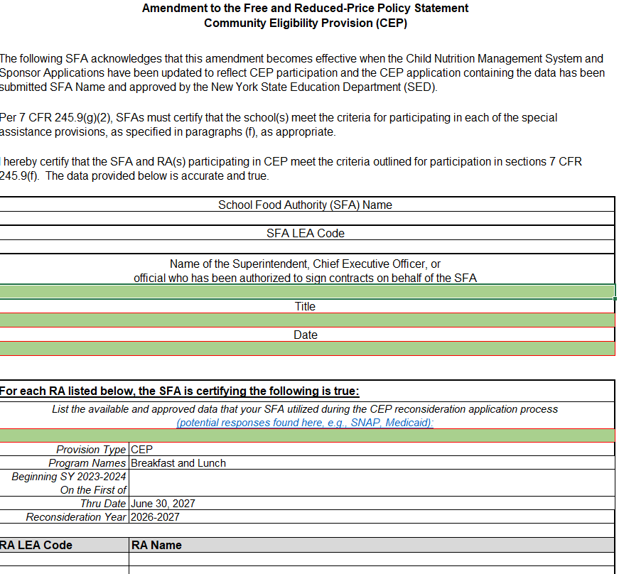
Step 1: (cont’d) Policy Statement Amendment
Notes:
Since operating under CEP requires changes to the SFAs free and reduced-price policy statement, a signed Policy Statement Amendment must accompany the application. Again, the SFA must fill in all green boxes. The Policy Statement Amendment is found under the third tab of the CEP Application.

Slide 14
School C RA ISP
Total Combined ISP for all 3 RAs
Federal Claiming Percentages:
Free-44.16%
**Paid-55.84% (Receive additional NYS subsidy)
Notes:
Let’s now go through an example to show how the identified students, qualifications and claiming all work.
This is a copy of a completed CEP application. If you look at the top chart with the green shaded boxes, the RAs listed are either your entire SFA or a group of your RAs. You will fill in the green shaded boxes with your RA name(s) that are applying, LEA codes, enrollment and number of identified students for each category. The remaining unshaded sections will fill for you.
For the first RA, named School A, they have an enrollment of 200 students in the entire RA. 35 of these students were found on the DCMP as having SNAP benefits, 2 are siblings or other household members that attend this same RA but weren’t found on the DCMP so they are an extension of eligibility, 1 is a foster student, 1 is a homeless student and 25 are Medicaid students found on the DCMP. This adds up to a total of 64 identified students. This 64 is then divided by the RA enrollment of 200 and multiplied by 100 to get a RA ISP of 32%.
Now lets take a look at School C. In box #10 it shows that they have a total of 21 identified students at that RA from their students found through SNAP, Medicaid and extensions with a total Identified Student Percentage of 14%, which is less than the required 25% minimum but because they are grouped with the other RAs, the total identified student percentage combined is at 27.60% which makes this grouping eligible for CEP. The Child Nutrition Management System will then separate out the counts into the free and paid meal counts based on the CEP claiming percentage. In the example, 44.16 percent of meals will be reimbursed at the federal free rate and 55.84 percent will be reimbursed at federal paid rate. The 55.84 percent will receive the state subsidy.

Slide 15
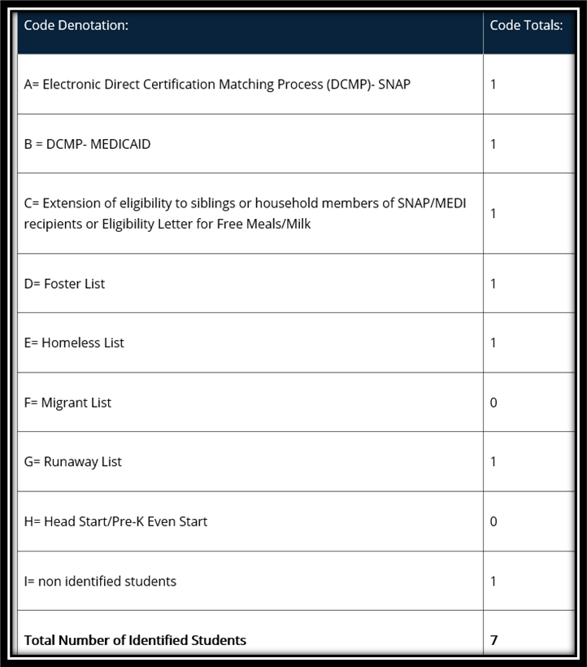
Step 2: Sample Coded Student Enrollment Record/ Master List
Exhibit A
Exhibit B
This data should be organized by qualifying RA.
The enrollment record/master list must include ALL students and be coded to indicate which students were identified to be eligible for the CEP.
Notes:
Step 2 is uploading the entire student enrollment records/master list enrollment data for each RA on the application. The enrollment record/master list must include all students and be coded to indicate which students were identified to be eligible for the CEP based on: SNAP/Medicaid Direct Certification Matching Process (DCMP), extension of direct certification eligibility to other household member, foster, migrant, runaway, homeless, and Head Start/Even Start. The student enrollment and identified students by category should match your CEP application.
A sample code denotation and totals is shown in exhibit A while a sample coded student enrollment record/master list is shown in exhibit B.
Schools must retain these records used in the development of the ISP during the entire period CEP is in effect. In addition, the ISP documentation must be retained for three years after submission of the final claim for reimbursement under that claiming percentage. All other standard record keeping requirements continue to apply.

Slide 16
Counting & Claiming
Keep separate breakfast and lunch counts (POS System)
Claim only reimbursable meals
The CNMS system will separate counts by CEP Claiming Percentage
CEP State Subsidy included in State Reimbursement amount
Notes:
Schools participating in CEP must provide access to both breakfast and lunch for all students during each school day.
Rather than taking a meal counts by free, reduced and paid categories for both breakfast and lunch each day, participating CEP schools will take a total count of reimbursable lunches and a total count of reimbursable breakfasts. Serving lines must be adequately supervised to ensure that all meals claimed for reimbursement meet meal pattern requirements, and that reimbursement is only claimed for one meal per student per meal service, with the exception of second breakfasts permitted when breakfasts are leftover. For this reason, schools are encouraged to maintain meal counts using an accurate Point of Sale, or POS system, that has a proven track record of reliability and security.
When an SFA submits meal claims each month, the total reimbursable meal counts for each RA will be entered. The Child Nutrition Management System will then separate out the counts into the free and paid meal counts based on the CEP claiming percentage. The percent that goes into the paid rate will automatically receive the additional CEP state subsidy. The CEP state subsidy will be included in the amount of state reimbursement , it will not be indicated or paid separately.

Slide 17
Key Points
CEP is for 4 years with the optional 1-year grace year
If the ISP increases after the initial year, a new CEP application can be submitted, starting a new 4-year cycle
RAs participating in CEP must offer breakfast and lunch
RCCI’s are not eligible for CEP
In order to full maximize CEP, schools should try to capture as many students as possible in the ISP. This will help to ensure the longevity of the state subsidy.
SFAs must continue to conduct DCMP
Notes:
Some key points to remember in regard to the CEP are:
CEP is for 4 years, with an option 1-year grace period. An SFA in year four of their CEP cycle with an ISP of at least 15 percent but less than 25 percent are permitted to continue to use the CEP for an additional fifth year, called the grace year. The grace year eligibility must be based on the ISP enrollment of year four. The reimbursements provided in the grace year will be generated by the year four ISP. The grace year is optional and is a local decision.
SFAs can reapply after the initial year if the ISP increases or if more schools can qualify. All RAs operating with CEP must participate in both the National School Lunch Program and the School Breakfast program. Residential Child Care Institutions, may not participate in the CEP. In order to fully maximize CEP, schools should capture as many students as possible in the ISP. This will help to ensure the longevity of the state subsidy.
While we encourage SFAs to conduct DCMP monthly, you are required to conduct at least one direct certification data match in the 2023-24 school year in order to report the number of SNAP and Medicaid matched eligible by RA to SED for federal reporting purposes.

Slide 18
Collection of Income Information
Schools may collect family income information using an alternative collection form for other federal, state, and local funding
Notes:
Since SFAs often use free and reduced price data as a proxy for many education and other purposes in New York State, CEP SFAs may opt to collect family income data using the CEP and Provision 2 household income form that is provided to SFAs after they are approved for the CEP. While DCMP should always be used as the first step in establishing student economic need, students not found in the DCMP may benefit from this collection.
DCMP efforts may be charged to the Child Nutrition Programs as the DCMP is required in all years of CEP participation for federal reporting purposes, however the collection and certification of the CEP and P2 Household Income Form or other SFA created form, is not a chargeable activity as the data collected from these forms is not being used for Child Nutrition Program purposes. Certification activities other than the DCMP must be supported/funded by the General Fund or other alternative non-federal funding.

Slide 19
What about SNACK?
Determine Snack Area-eligibility status :
“Snack Needy” status indicated by RA in CNMS
If Yes, claim all snacks “Free”
If No, claim snacks by CEP claiming percentages
Notes:
Participation in CEP does not automatically qualify a school to receive full free reimbursement for snacks. Snack eligibility rules still apply. Therefore, CEP schools must demonstrate they are area-eligible to receive all snacks at the federal free rate of reimbursement. Non-area eligible schools must claim snacks using the CEP claiming percentage.
For example, if the school has a CEP claiming percent of 64% in the free category and 36% in the paid category (ISP of 40%), then 64% of the snacks claimed will be reimbursed at the free rate, and 36% of the snacks will be reimbursed at paid rate.
Schools that are not snack needy are responsible for manually applying their CEP claiming percentage to their total monthly snack count when placing the snack claim for reimbursement in the CNMS.

Slide 20
Questions?
Contact Information:
Child Nutrition Program Office: (518)473-8781
CN Representative for questions specific to your SFA
Notes:
This concludes the presentation portion of the CEP webinar. We will now take questions on anything discussed during today’s webinar. Again, please use the Q&A box in the lower corner to type and send it in to our staff to which we will answer for all viewers to hear. Please remember you may always contact your CN representative for questions specific to your SFA.

