Slide 1

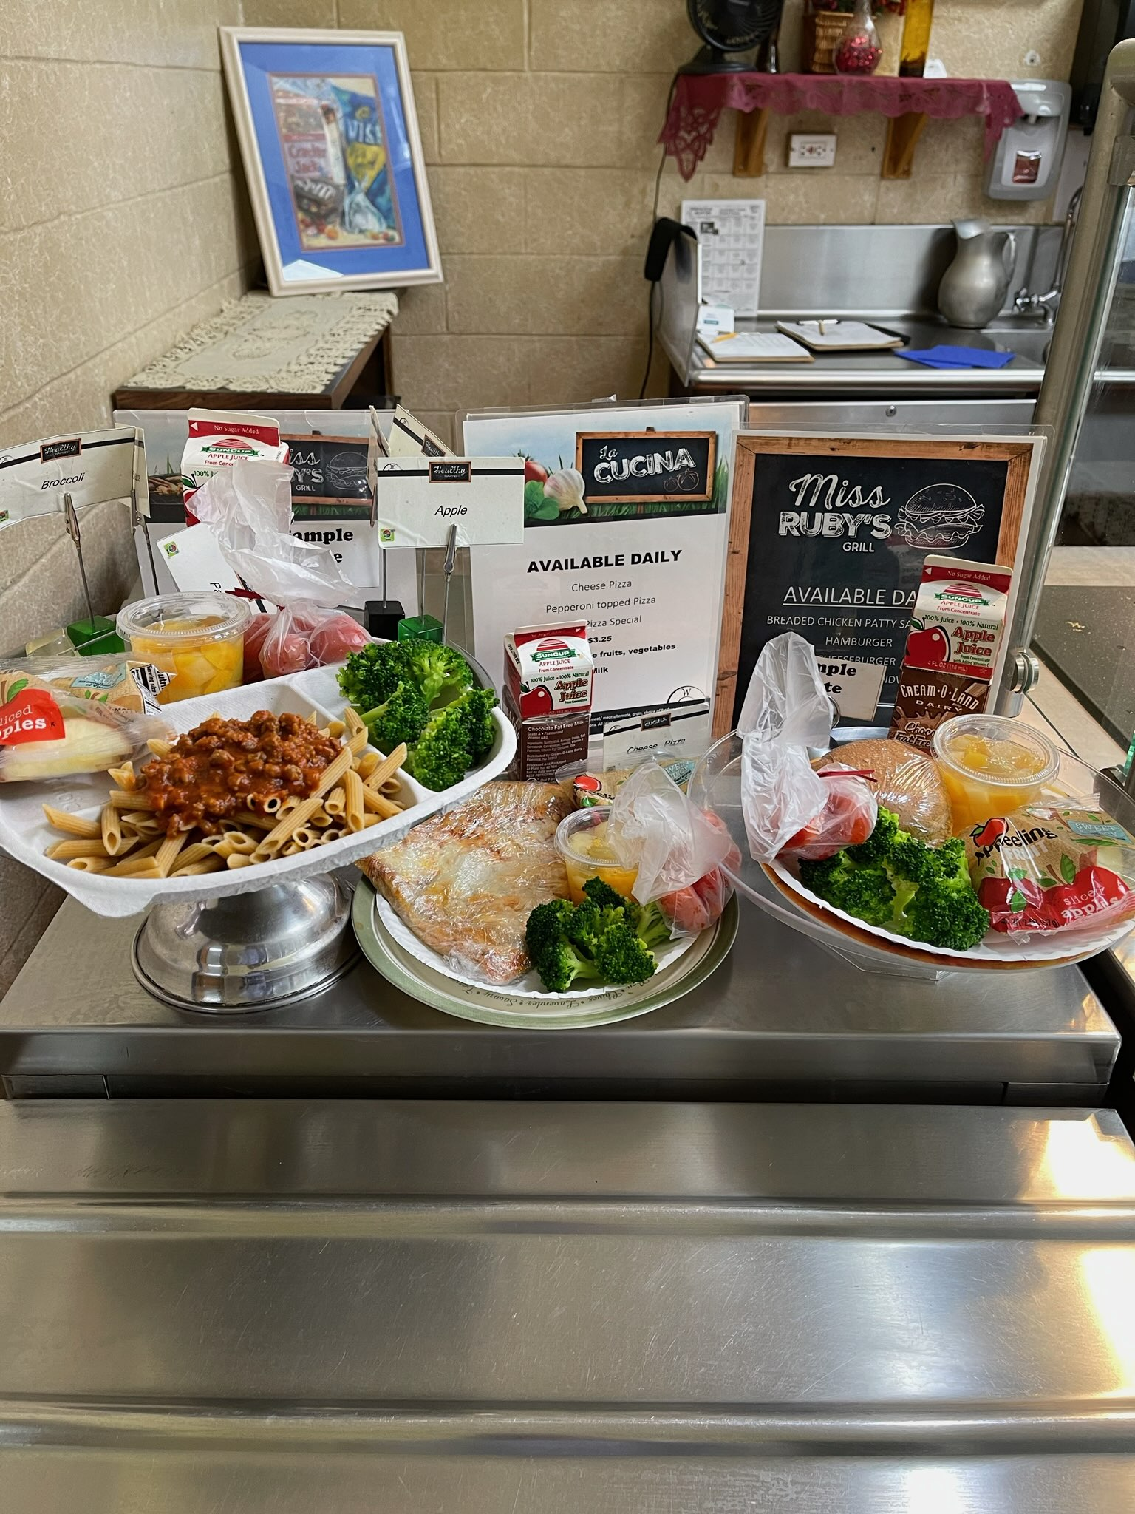
Courtesy of Huntington CSD
Notes:
Welcome to the webinar, Deep Dive into Meal Pattern- A comprehensive training intended for cooks/cook managers, servers, and point of service staff.
This webinar is hosted by the New York State Education Department, Office of Child Nutrition, and provides 2 credit hours of Professional Standards training towards your annual requirements.
If you have any questions during the presentation, please type them into the question box. We will review them at the end.
Following today’s presentation, you will receive an email containing the slides for today’s webinar. If you do not receive them, please email CNTraining@nysed.gov
A copy of the webinar will also be posted and available on the CN website. As always, if you have any questions, please contact your Child Nutrition Program Representative or email CN@nysed.gov.

Slide 2

Notes:
This training will review Meal Components, Production Records, Standardized Recipes, crediting food items, and Offer vs. Serve.

Slide 3
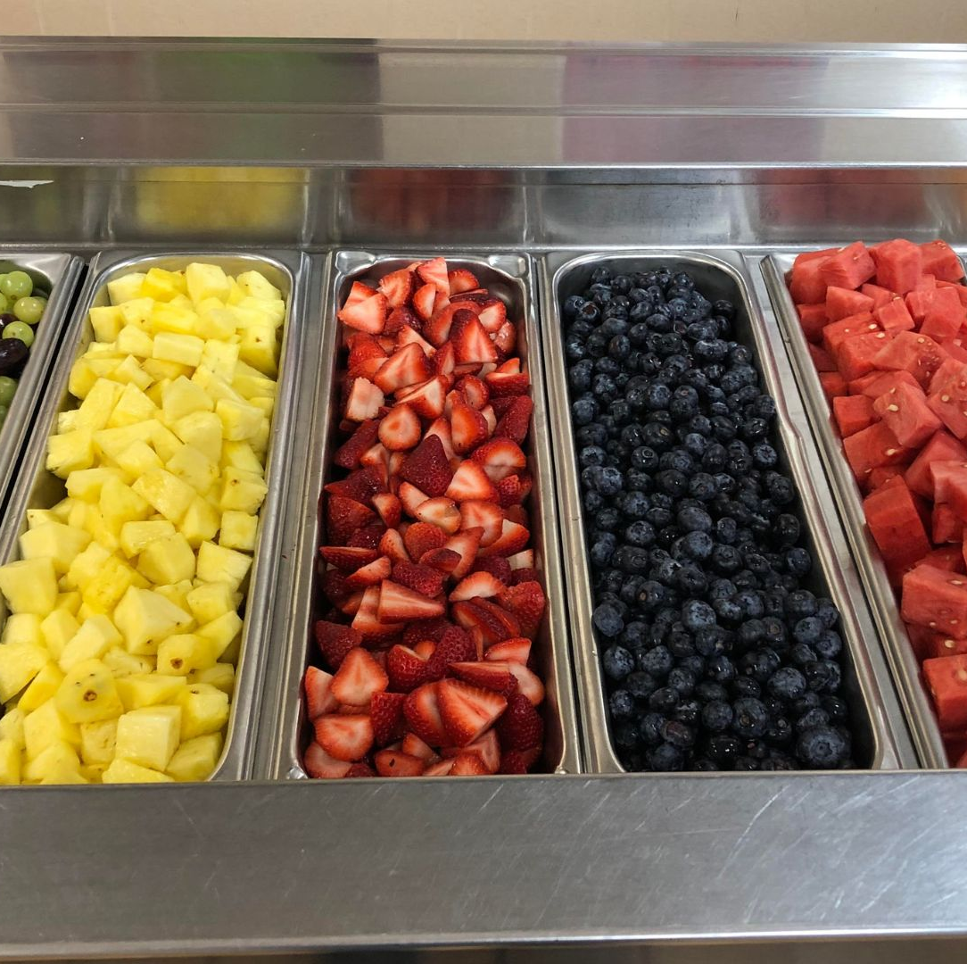
Food-Based Menu Planning
  Component: One of the five food groups that comprise a reimbursable meal
  Food group components must be served in specified daily and weekly amounts
  Food Item: Specific food offered within
  the components
Courtesy of Charlotte Valley CSD
Notes:
The meal pattern that all schools must follow for breakfast and lunch is called the Food Based Menu Plan.
The Food-Based Menu Planning approach uses meal patterns according to specific age/grade groups as menu planning tools.
Schools must plan menus for breakfast and lunch that meet both daily and weekly requirements for 5 food components relative to each age/grade group being served.
A food component is one of five required food groups that comprise a reimbursable meal. The food based menu plan requires that meal components be offered and served in specified daily and weekly amounts for breakfast and lunch which we will discuss in more detail.
During todays training, you will also hear us refer to food items.
A Food item is a specific food within a component, for example: within the grain component, food items would be things such as a 1 oz equivalent serving of cheerios or a slice of toast.

Slide 4
Age/Grade Groups
SBP
NSLP
K-12
K-8 and 9-12
K-5, 6-8 and 9-12
K-8 and 9-12
K-5, 6-8 and 9-12
Production Records must demonstrate compliance with, and differentiate between, all age/grade groups being offered
Notes:
Menu planners must offer meals in accordance with the age/grade groups that are being served. Each age/grade group has its own meal pattern requirements that must be followed to ensure students are offered meals according to their dietary needs.
The required age/grade groupings are K-5, 6-8 and 9-12 and the requirements for each age/grade group differ at breakfast from lunch. However, you can see noted on the slide, there are overlapping requirements that allow menu planners flexibility when serving students in multiple age/grade groups. This will also be evident on the next slide where we will show you the specific meal pattern requirements for each age/grade group.
Due to overlapping requirements, Menu planners serving students in grades K-5 and 6-8, have flexibility to offer one k-8 menu that meets the requirements where the two age/grade groups overlap both breakfast and lunch. Further flexibility is provided at breakfast that allows one menu plan for grades k-12 to be offered.
Menu Planners can decide to structure their menus utilizing the age/grade groups that will work best for their school’s specific circumstances.
Menu planners must demonstrate compliance with the age/grade groups that are being served through production records. The production records must clearly document and show the different portion sizes and components being offered to each group. We will cover production records further during this webinar.

Slide 5
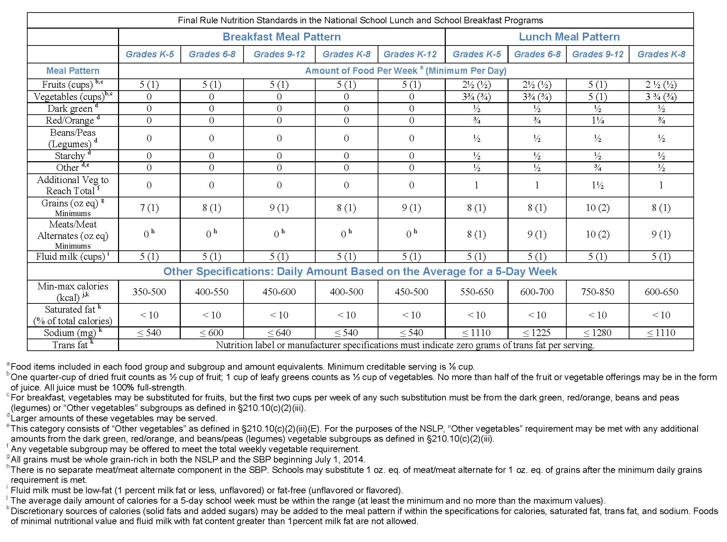
Meal Pattern Chart
Notes:
This is the meal pattern chart for both breakfast and lunch separated by age/grade group. The meal patterns have been developed to align with The Dietary Guidelines for Americans.
The weekly requirement is listed first, and the daily requirement is listed in parentheses as shown for each component. For an example, look at the grain requirements for lunch. You will see that at least one grain equivalent must be offered to the K-8 age/grade group daily and over the course of a week they must be offered 8 grain equivalents. The 9-12 age grade group must be offered 2 grain equivalents daily and 10 over the course of a week.
In addition to the meal component requirements, At lunch there are daily and weekly vegetable component requirements. You can see how the totals are broken down into each vegetable category’s weekly requirement- Dark Green, Red/Orange, Beans/Peas/Legumes, Starchy, and Other. Over the course of a week the variety of vegetable subgroups must be offered in at least the minimum quantities, to contribute towards the total daily and weekly vegetable requirements. We will discuss this in more detail.
This chart also shows the dietary specifications for each age/grade group which are: calories, saturated fat, sodium and trans fat. Schools are required to meet the calorie, sodium, saturated fat and trans fat requirements as a per meal average over the course of the week.
At the very bottom of the chart, you will notice footnotes which are represented by letters a through k. These footnotes give specific guidance regarding the noted component.
REMEMBER- This chart does not define what comprises a reimbursable meal. The Chart specifies minimum quantities of each component that must be OFFERED for each age/grade group at Breakfast and Lunch

Slide 6
Overlapping Age/Grade Groups
Breakfast
Lunch
K-5
350 – 500 Calories
9-12
450 – 600 Calories
6-8
400 – 550
Calories
K-5
550 – 650 Calories
9-12
750 – 850 Calories
6-8
600 - 700
Calories
Overlap for calorie ranges is
450 – 500 calories
Overlap for calorie ranges in K-8 is
600 – 650 calories
Notes:
These overlaps are determined by the established calorie ranges for each grade group. If calorie ranges overlap, the Meal Patterns can be combined.
Keep in mind that when meal patterns are combined to the greatest extent, as demonstrated here, the allowable calorie range is limited significantly to a range of 50 calories.
As we already discussed, At Lunch, grades 9-12 must be served a separate menu due to their minimum calorie requirement NOT over lapping with grade K-8 or 6-8.

Slide 7
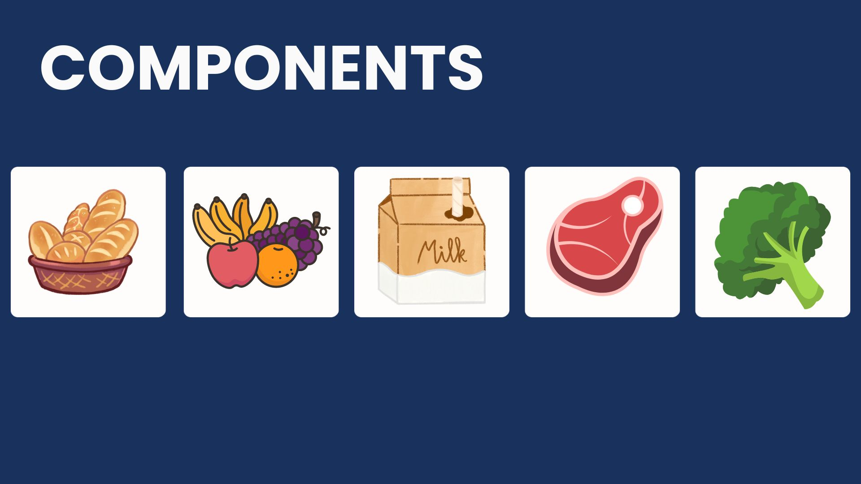
Lunch
Breakfast
Notes:
The 5 food components are: fruits, vegetables, grains, meat/meat alternates, and milk.
All five food components must be offered in minimum required portion sizes for lunch. For breakfast, 3 food components must be offered. We will discuss the specific requirements for breakfast and lunch in more detail

Slide 8
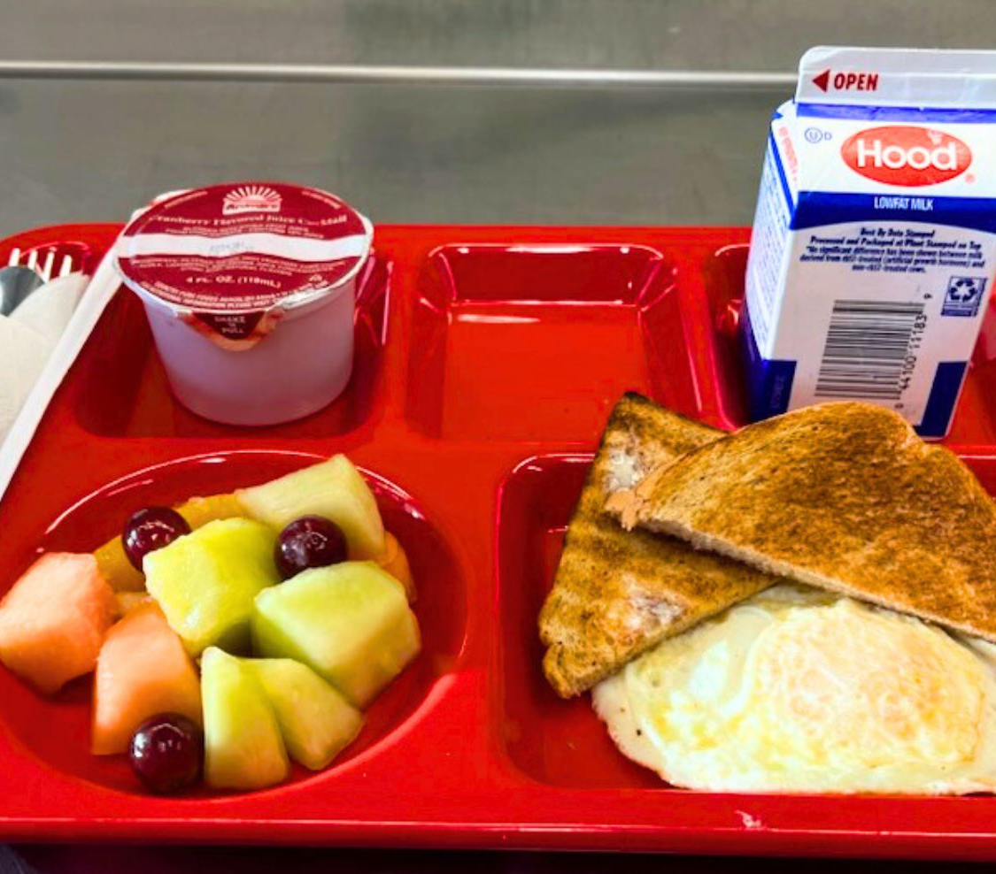
Breakfast Component Requirements
  3 Components:
Fruit/Vegetables
Grains
Fluid Milk
Daily & Weekly minimum required portion sizes per age/grade group
Courtesy of Wells CSD
Notes:
At breakfast, the three food components that must be offered are: Fruit, Grains, and Fluid Milk.
For breakfast only, menu planners may choose to offer vegetables to meet the fruit component requirement.
These 3 food components must be offered in at least the minimum required quantities for each age/grade group each day and there are also weekly minimum requirements that must be met. These portion size requirements can be found on the meal pattern chart we displayed previously.

Slide 9
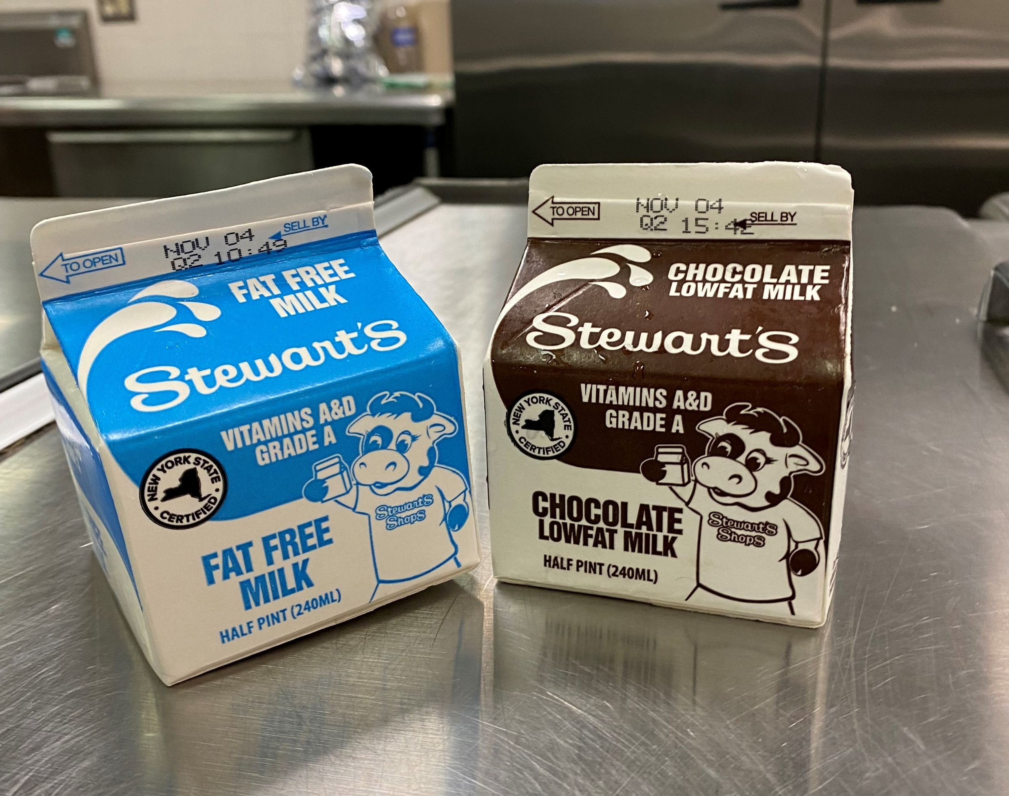
Fluid Milk Component
1 cup unflavored milk must be offered daily at Breakfast & Lunch
Must be 1% or fat-free
Must offer a variety of at least 2 types milk
1% or fat-free flavored milk may be offered
Courtesy of Schuylerville CSD
Notes:
At least 1 cup of fluid milk must be offered to all students daily, and 5 cups of milk over the course of the week for all age/grade groups.
Additionally at least two different variety's of fluid milk must be offered each day. Menu planners are required to offer Unflavored milk, either fat-free or 1%, at breakfast and lunch and may also choose to offer flavored milk, either 1% or fat free.
Even if a smoothie is offered and milk is included in the smoothie, two fluid milk choices must be available to all students.
Lactose free or reduced lactose milk may be substituted for students with lactose allergies/intolerance (fat free or low fat 1%)

Slide 10

Fruit & Vegetable Component- Breakfast
Breakfast Minimum Requirements
Lunch Meal Pattern
Age/Grade Group | K-5 | 6-8 | K-8 | 9-12
Amount per Week (Minimum per Day) | Amount per Week (Minimum per Day)
Fruit (cups) | 2 ½ (½) | 2 ½ (½) | 2 ½ (½) | 5 (1)
*no more than half of the fruit or vegetable offering over the course of a week may be in the form of juice
Notes:
At breakfast, SFAs must offer at least one full cup of fruit and/or vegetables for all age/grade groups each day.
As we previously stated, the vegetable component is not required at breakfast however, it can be substituted for fruits.
Menu planners may offer 100% fruit juice towards the fruit component, however, no more than half of the fruit or vegetable offering over the course of a week may be in the form of juice. Since menu planners have to offer 1 cup fruit/vegetable each day and 5 cups per week, the menu planner may offer 4 fl. oz. of juice everyday.

Slide 11
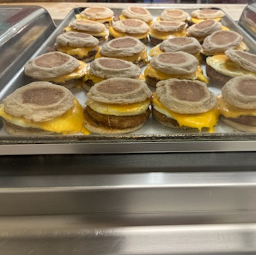
Grain Component at Breakfast and optional Meat/Meat Alternate (M/MA)
A minimum of 1 oz. eq. grain must be offered to each age/grade group daily
  Meat/Meat alternate (M/MA) Optional
80% of grain items offered must be whole grain-rich
No grain-based dessert limit for breakfast
Courtesy of Wells CSD
Notes:
The minimum daily requirement for the grain component at breakfast is that at least 1 oz. eq. grain be offered for all age/grade groups. SFAs should also consult the Food Based Meal Pattern chart for weekly requirements for each age/grade group.
Also, as we just learned, the meat/meat alternate component is not required to be offered at breakfast. However, meal pattern flexibility allows for the menu planner to offer a meat/meat alternate component at breakfast provided that at least 1 oz equivalent of the grain component is also offered to students.
Using this flexibility, a meat/meat alternate may be offered as a component and if selected by a student, may contribute as a food component toward a reimbursable meal. We will discuss reimbursable meals more during the offer vs serve next.
For example: If the menu planner would like to offer eggs and count them as a component, they would have to offer 1 oz. eq. grain with the eggs, such as a slice of toast, bagel, or English muffin. The student would not have to select the grain but would have to be offered the grain as an option to select with the eggs.
This flexibility is optional and menu planners do not have to use it. However, we want to again stress that if a meat/meat alternate is offered as a component at breakfast then at least 1 oz. eq. of a grain component must be offered first.
Additionally, At least 80% of the grains offered at breakfast must be whole grain rich and the remaining grains must be enriched.
There is no grain-based dessert limit for breakfast, however, certain types are not allowable at breakfast as listed in the footnote on the meal pattern chart

Slide 12
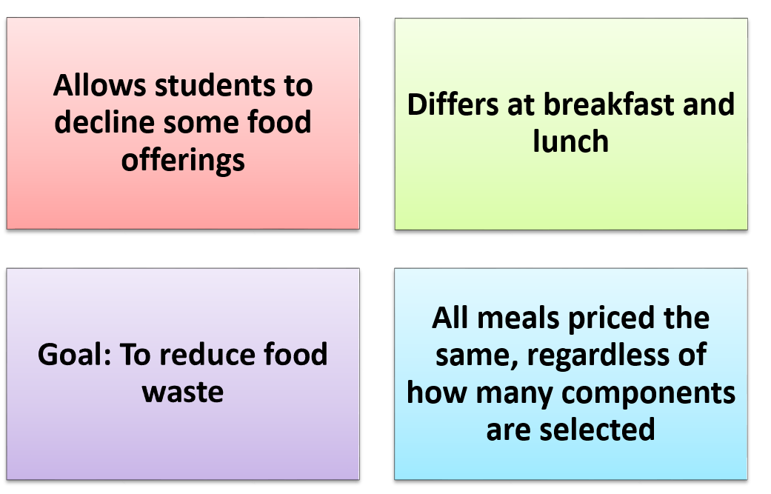
Offer Versus Serve
Notes:
Offer vs. Serve is a concept that applies to menu planning and the meal service. Offer vs. Serve allows students to decline some of the food offered in a reimbursable breakfast. The goals of Offer vs. Serve are to reduce food waste and to permit students to choose the foods they want to eat.
Allowing choices within the components is not considered Offer vs Serve. Offer vs Serve allows Students to decline some of the components being offered when selecting their meal.
Offer Versus Serve does not affect the meal’s unit price established by the SFA.
The goal of Offer vs. Serve is to eliminate food waste.
We continue to encourage schools to offer a variety of food choices to students; this increases the likelihood that students will select the foods they prefer, which increases consumption and reduces waste.

Slide 13

Offer vs Serve at Breakfast
OVS is optional for all age/grade groups at breakfast
Schools must offer all 3 components (grain, milk, fruit/vegetable)in at least the minimum required amounts
Schools must offer at least 4 food items from the 3 components
Students must select at least 3 food items, with one of the food items being at least ½ cup of fruit or vegetable
Notes:
A food item is a specific food offered within the three food components.
For the purposes of Offer vs. Serve, a school must offer at least four food items from the three required food components (fruits, grains, milk).
Under Offer vs. Serve, the student must select three food items, including at least ½ cup of fruits or vegetables, to have a reimbursable breakfast.
Offer Versus Serve is optional at breakfast for all age/grade groups.
For Breakfast, menu planners may use the K-12 age/grade group for all students. Another choice is to use K-5, 6-8, K-8, and 9-12. Most schools choose to do K-12 because it is easier when all students receive the same portion amounts.

Slide 14

Crediting Different Size Grain Items at Breakfast what is considered 1 item?
Component | Ounce Equivalents | Items
 | 1.0-1.99* | 1 item
 | 2.0-2.99* | 1 or 2 items
Notes:
At breakfast 1 food product may credit towards more than one item at breakfast. We know foods such as muffins and bagels can be purchased in different sizes. For this example, we will be looking at muffins.
If a food item is anywhere from 1.0 to 1.99 oz. eq. then the item credits as 1 item
If an item is 2.0-2.99oz eq. it may credit as 2 items if the menu planner chooses to do so.
Another Example:
A bagel that credits as 3 oz. eq. may be counted as 3 food items.
Note: Always remember to round down to the nearest ¼ oz. eq when determining how a food product credits, then round down when determining how many items the product will credit as at breakfast.
** Example: If a product is 1.88 oz. eq., the menu planner would round down to 1.75 oz. eq., which would then credit as 1 item.

Slide 15

Now Let’s Play!!
Notes:
Now that we have recapped the requirements and reviewed how Offer vs Serve works , let’s play a few quick rounds of MEAL or NO MEAL:
You will first be given a menu for a specified age/grade group. Use what we just learned to determine if the menu meets meal pattern requirements for the meal being served.
Next, you will be shown a tray a student selected, and you will determine if the meal is reimbursable.

Slide 16

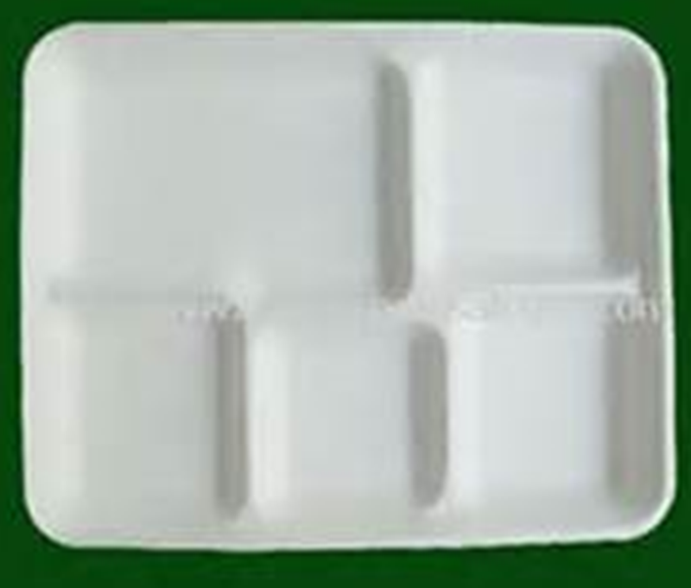
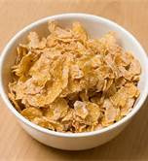


Menu Offered
Grain/Meat (Meat Alt.):
WG Cereal (1oz. Eq.) + Yogurt 1oz. Eq. (4oz)
Fruit/Vegetable:
Peaches (1C)
Milk:
1% White Milk or Fat Free Chocolate Milk (8oz)
Grapes (1/2C)
Chocolate Milk – 8oz.
Cereal 1oz. eq.
Milk – 8 fl. oz.
Yogurt – 4 oz. = 1oz. Eq
Pita Bread – 2oz.
Sweet Potato (1/2C)
Grades K-12
Notes:
This Breakfast menu on the left is for grades K-12. They are being offered a 1oz equivalent of Whole Grain cereal, as well as 1oz equivalent of yogurt
They are being offered 1 C of fruit. And a 1 cup serving of milk with an option between 2 milk varieties.
Does this menu include all of the components in their minimum required amounts and have 4 items to choose from for grades K-12?....... Yes
Does the students breakfast tray on the right make up a reimbursable meal? NO, They are missing the required ½C of fruit needed to make this.

Slide 17
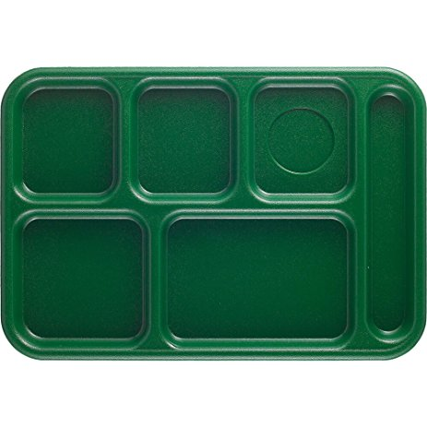
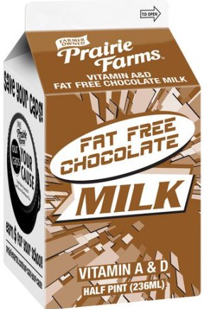
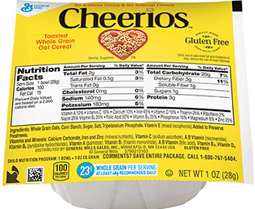

Menu Offered
Grain/Meat (Meat Alt.):
WG Cereal (1oz. eq.) + Yogurt 1oz. eq. (4 oz.)
Fruit/Vegetable:
Peaches (½ C)
Juice Variety 4 fl. oz.
Milk:
1% White Milk or Fat Free Chocolate Milk (8 fl.oz)
Chocolate Milk – 8 fl. oz.
Cereal 1 oz. eq.
Yogurt – 4 oz. = (1oz. Eq.)
Pita Bread – 2oz.
Grades K-12
Notes:
This Breakfast menu on the left is for grades K-12 . They are being offered a 1oz equivalent of Whole Grain cereal, as well as 1oz equivalent of yogurt
They are being offered a half a cup of peaches and a half a cup of juice
As well as 2 milk varieties.
Does this menu include all of the components in their minimum required amounts and have 4 items to choose from for grades K-12?....... Yes, all required components are offered and at least 4 items from those components are offered.
Does the students breakfast tray on the right make up a reimbursable meal? NO, They are missing the required ½C of fruit needed to make this. Remember, every meal must contain at least a ½ cup of fruit or vegetable to be considered complete.

Slide 18
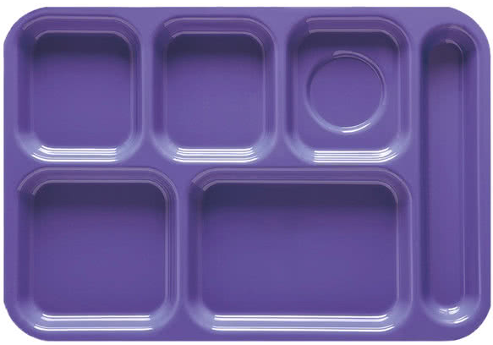
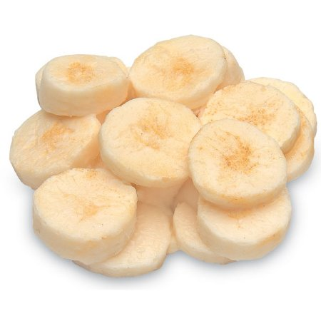
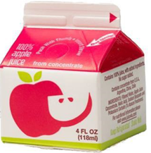
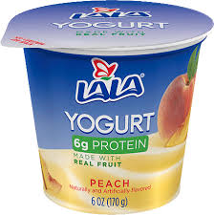
Menu Offered
Grain/Meat (Meat Alt.):
Bagel (2 oz. eq. , 2 items)
Breakfast Sandwich 4 oz. eq. G, 2 items
Yogurt 1 oz. eq. G, with Graham Crackers 1oz. eq. G
Fruit/Vegetable:
Bananas (1/2 C)
Juice Variety (4 Fl. oz.)
Milk:
1% White Milk or Fat Free Chocolate Milk (8oz)
Bananas-
½ cup
Grapes (1/2C)
Chocolate Milk – 8oz.
Apple Juice-4 Fl. oz.
Yogurt- 1 oz. eq.
Pita Bread – 2oz.
Sweet Potato (1/2C)
Grades K-12
Notes:
This Breakfast menu on the left is for grades K-12 . They are being offered multiple choices in the grain component. A 2 ounce equivalent bagel counting as 2 items, a breakfast sandwich counting at 2 items, or Yogurt with Graham Crackers each being a 1oz equivalent of Grain.
For fruit they are offered a half a cup of bananas and a half a cup of juice for 1 cup total fruit offering
As well as 1 cup of milk with a choice from 2 milk varieties.
Does this menu include all of the components in their minimum required amounts for grades K-12?....... Yes
Does the students breakfast tray on the right make up a reimbursable meal? Yes! The menu planner chose to allow each ½ cup serving of fruit to count as one item. This meal consists of at least 3 items, ncluding at least a ½ cup of fruit.

Slide 19
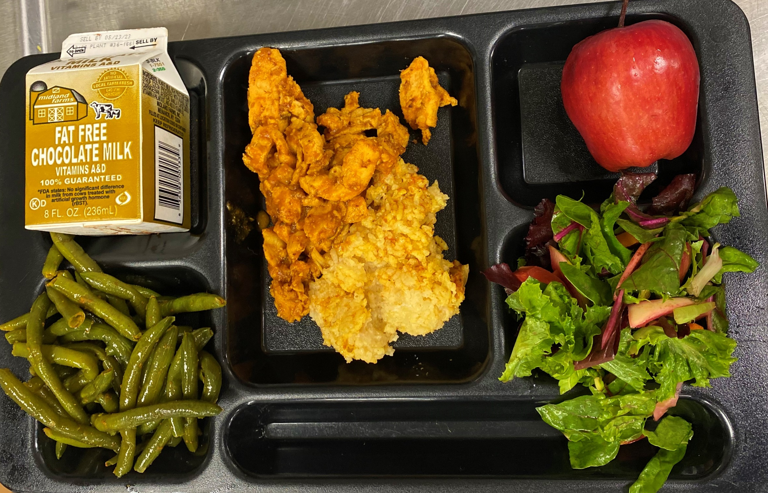
Lunch Component Requirements
Lunch Meal Components
Fruits
Vegetables
  Dark green
  Red/orange
  Beans/legumes
  Starchy
  Other
Grains
Meats/Meat Alternates
Fluid Milk
Courtesy of Cambridge CSD
Notes:
Now we will move on and discuss the requirement of the lunch meal pattern. There are 5 meal components that must be offered at lunch. They are: fruit, grains, meat/meat alternates, fluid milk and vegetables. Additionally, the vegetable component at lunch requires that five vegetable subgroups be offered over the course of the week in at least minimum required portion sizes. We will discuss the vegetable subgroup requirements in a few slides
Schools must always offer all five food components in at least the minimum required quantities for the age/grade groups being served.

Slide 20
Fluid Milk Component
1 cup unflavored milk must be offered daily at Breakfast & Lunch
Must be 1% or fat-free
Must offer a variety of at least 2 types milk
1% or fat-free flavored milk may be offered
Courtesy of Schuylerville CSD
Notes:
The fluid milk requirement for lunch is the same as for breakfast that we previously discussed. At least 1 cup of fluid milk must be offered to all students daily, and 5 cups of milk over the course of the week for all age/grade groups.
Additionally at least two different variety's of fluid milk must be offered each day. Menu planners are required to offer Unflavored milk, either fat-free or 1%, at breakfast and lunch and may also choose to offer flavored milk, either 1% or fat free.

Slide 21
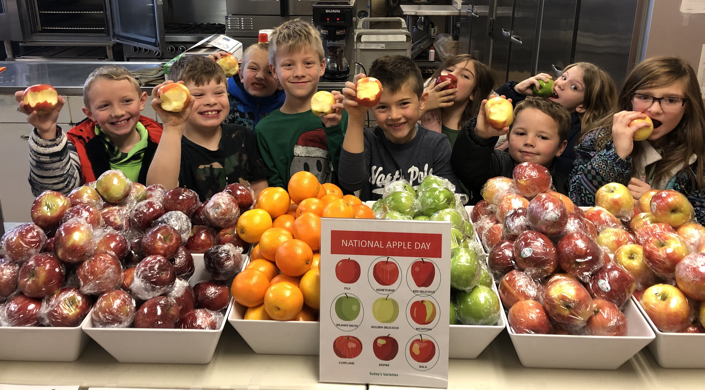
Fruit Component- Lunch
Courtesy of Charlotte Valley CSD
Lunch Minimum Requirements
Lunch Meal Pattern
Age/Grade Group | K-5 | 6-8 | K-8 | 9-12
Amount per Week (Minimum per Day) | Amount per Week (Minimum per Day)
Fruit (cups) | 2 ½ (½) | 2 ½ (½) | 2 ½ (½) | 5 (1)
Notes:
The K-8 age/grade groups must be offered at least 1/2 cup of fruit daily, 2/12 cups per week and the 9-12 age/grade group must be offered at least 1 cup daily and 5 cups over the week.
Canned Fruits generally credit based on volume served, and depending on the type of fresh fruit, it may credit differently from each other. The menu planners should use the Food Buying Guide for the most accurate crediting. Food buying guide will be reviewed in greater detail later.
Dried fruit is an exception because dried fruit counts double the volume served. For example, ¼ cup of raisins will credit as ½ cup for the fruit component.
No more than half of the fruit and/or vegetable offerings can be in the form of juice. Please remember this is not a daily restriction, it is based on the weekly requirement.
For example: If the menu planner offers 1 cup of fruit per day for 5 days , the menu planner may offer 4 fl. oz. of juice everyday.
Menu planners can offer ½ cup pears and 4 fl. oz. of juice to equal 1 cup of fruit.
Every student must choose a ½ cup of fruit or vegetable with their meal to count the meal as reimbursable.

Slide 22
Vegetable Component- Lunch
Charlotte Valley CSD
Lunch Meal Pattern
Age/Grade Group | K-5 | 6-8 | K-8 | 9-12
Amount per Week (Minimum per Day)
Vegetables (cups) | 3 ¾ (¾) | 3 ¾ (¾) | 3 ¾ (¾) | 5 (1)
Dark Green
Beans/Peas (Legumes)
Other
1 cup leafy greens = ½ cup equivalent
Can not use as a meat alternate in the same meal
Can use extra Dark Green, Red/Orange, Beans/Peas (legumes) as other vegetable
Notes:
For the vegetable component, The minimum amount of vegetable required for age/grade groups K-5, 6-8, and K-8 is ¾ cup per day and 3 ¾ cup per week. The minimum amount of vegetable required for grades 9-12 are 1 cup daily and 5 cups per week.
Vegetables generally credit based on the volume served, however there are a few exceptions:
Raw leafy greens credit as one half of the volume served. For example, if the menu planner is offering 1 cup of romaine, this only credits as ½ cup creditable vegetable. Please keep in mind that cooked greens such as cooked spinach will credit based on actual volume served.
Menu planners should use the Food Buying Guide for the most accurate crediting.
Beans/Legumes/dried peas may be offered as a meat/meat alternate or as a vegetable; however, one serving may not count towards both food components in the same meal.
Every student must choose a ½ cup of fruit or vegetable with their meal to count the meal as reimbursable.

Slide 23
NSLP Vegetable Subgroups
Lunch Meal Pattern
Meal Pattern | Grades K-5 | Grades 6-8 | Grades K-8 | Grades 9-12
 | Amount Per Week
Dark green | ½ | ½ | ½ | ½
Red/Orange | ¾ | ¾ | ¾ | 1 ¼
Beans/Peas (Legumes) | ½ | ½ | ½ | ½
Starchy | ½ | ½ | ½ | ½
Other | ½ | ½ | ½ | ¾
Additional Veg to Reach Total | 1 | 1 | 1 | 1 ½
Notes:
The vegetable component also requires that weekly servings of 5 vegetable subgroups are offered. This means that over the course of the week, the minimum required amount of each subgroup must be met according to the age/grade group, but that on any given day there are no specific vegetable subgroup requirements.
The vegetable subgroups required each week consist of: dark green, red/orange, beans/peas (legumes), starchy, and the “other” vegetable subgroup
The “other” vegetable subgroup is a distinct grouping of food items. Examples of vegetables that are in the “other” vegetable subgroup are Celery, Cucumbers, and green beans.
SFAs are allowed to substitute vegetables from the dark green, red/orange, or beans/peas(legumes) for the “other” vegetable subgroup if they desire. However, menu planners may NOT substitute starchy vegetables for the “other” vegetable subgroup.
Menu planners must keep in mind that they can not always use the minimum amounts of the vegetable subgroup to meet the daily and weekly vegetable requirements. Menu planners must offer additional vegetables to reach the daily and weekly minimum requirements. Additional vegetables may come from any vegetable subgroup to meet the weekly total.
For example: If ½ cup broccoli is offered on Monday, the menu planner is meeting the dark green vegetable subgroup for the week, however, the menu planner would be short for the daily minimum requirement for vegetables. This is because menu planners must offer at least ¾ cup of a vegetable per day for Grades K-5 and 6-8 and 1 cup of a vegetable per day for grades 9-12.
**Note: vegetable subgroup adjustments for weeks less than 5 days or more than 5 days can be found on the School Week Meal Component Adjustment Chart.

Slide 24
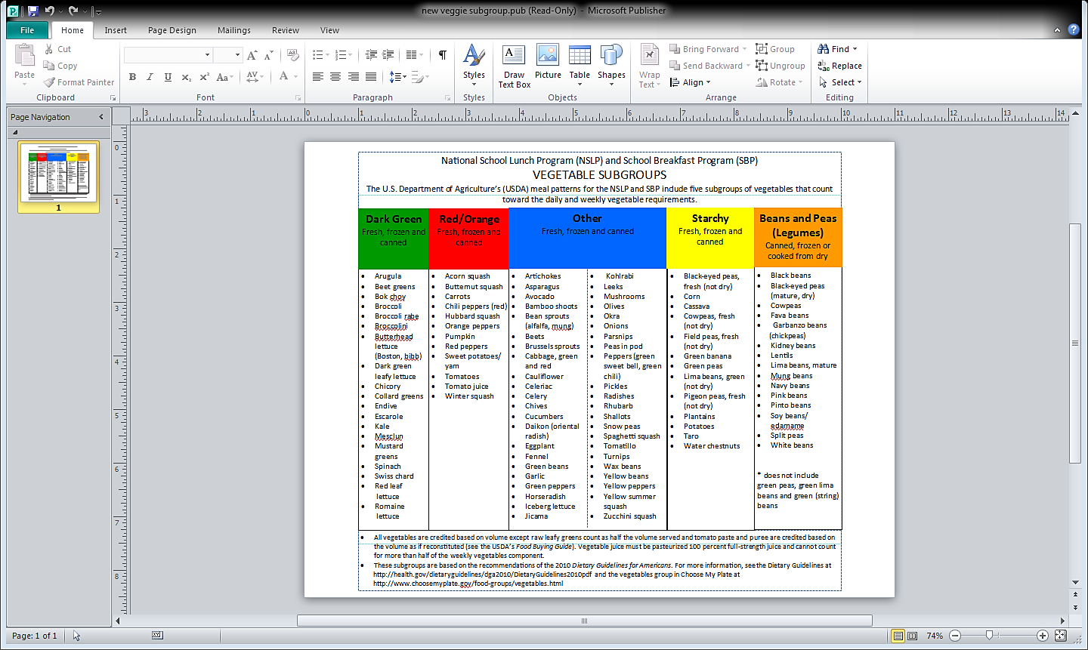
Notes:
As we discussed, there are 5 vegetable subgroups that must be offered to students in the minimum required portion size over the course of the week. This chart shows the different vegetable subgroups and specific vegetables which fall into each category. The vegetable subgroups must be offered to all students and with all main and alternate meals. One common mistake is that the menu planner will offer the vegetable subgroups with the main entrée but not ensure the alternate meals are also planned to meet the weekly subgroup requirements.
Another common mistake is counting vegetables towards the wrong subgroup. For example, green beans and green peas are commonly used toward the beans/pea/legumes vegetable subgroup. However, Green peas are a starchy vegetable and Green beans are in the “other” vegetable subgroup.
Menu planners must ensure that if substitutions are made, the vegetable subgroup requirements are still met. If a substitution is required, we recommend substituting from the same vegetable subgroup if possible, in order to ensure all vegetable subgroups are being offered in the minimum required amounts and ensuring staff are properly trained to do this.

Slide 25
Grain Component- Lunch
Lunch Minimum Requirements
Lunch Meal Pattern
Age/Grade Group | K-5 | 6-8 | K-8 | 9-12
Amount per Week (Minimum per Day) | Amount per Week (Minimum per Day)
Fruit (cups) | 2 ½ (½) | 2 ½ (½) | 2 ½ (½) | 5 (1)
Grain (oz. eq.)
8
8
8
10
(2)
Notes:
Grains must be offered in at least the minimum amounts every day and must also meet weekly minimum requirements. For grades k-8, at least 1 ounce equivalent of grain must be offered daily and at least 2 oz equivalent of grain must be offered daily for grades 9-12.
Menu planners will use exhibit a grain equivalent chart to determine how grains credit or may use a product formulation statement from the products manufacturer. We will discuss crediting further in the webinar.

Slide 26
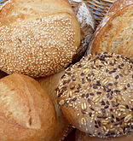
Lunch Grain Component
Must be offered at lunch
Must meet daily and weekly minimum requirements
A maximum of 2 oz. eq. grain-based desserts per week at lunch
-80% of the grain products offered over the course of a week MUST meet the requirements of being Whole Grain Rich (WGR).
-The remaining weekly grains MUST be enriched
Notes:
Additional grain requirements include that 80% of the grains offered in a week must be whole grain rich. The remaining grains served must be enriched.
Using the 80% transitional standard provides Flexibility for Program operators to offer enriched grains when whole grain-rich items are not available or when the WGR item is not accepted well by students. We will be reviewing how to determine if your menu is meeting this standard at the end of this presentation.
Additionally, no more than 2 oz equivalent of a grain-based dessert may be offered as the grain component over the course of the week.

Slide 27
M/MA Component- Lunch
Lunch Minimum Requirements
Lunch Meal Pattern
Age/Grade Group | K-5 | 6-8 | K-8 | 9-12
Amount per Week (Minimum per Day) | Amount per Week (Minimum per Day)
Fruit (cups) | 2 ½ (½) | 2 ½ (½) | 2 ½ (½) | 5 (1)
M/MA (oz. eq.)
8
9
9
10
(2)
Notes:
This slide shows the Meat/Meat Alternate component for lunch and the minimum requirements.
Once again, the Food Buying Guide on the USDA website is essential for crediting.
As a reminder, meat alternates (such as beans) cannot be credited as a meat alternate and a vegetable in the same meal.

Slide 28
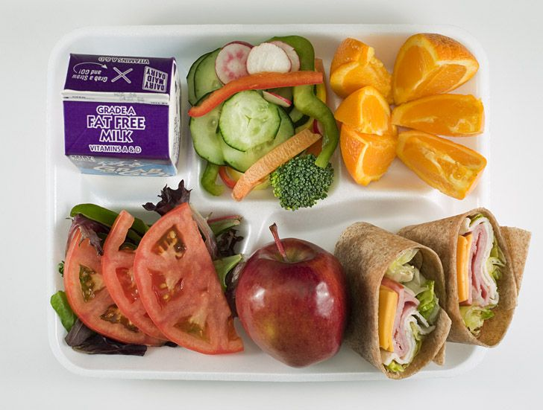
Offer vs Serve at Lunch
Offer vs. Serve is required for students in the 9-12 age/grade group
must offer all 5 components in at least the minimum required amounts
Students must select at least 3 food components
Students must take a minimum of a ½ cup of fruit or vegetable
Notes:
For lunch, Offer vs. Serve is required for the 9-12 age/grade group and is optional for all other age/grade groups at lunch.
Under Offer vs. Serve, you must offer all 5 lunch components in at least the minimum required amounts for each age/grade group.
Students must select 3 of the components, with one being a ½ cup of fruit or vegetable.
When selecting the 3 components, the student must have 2 full components along with at least ½ cup of fruit or vegetable in order to be considered a reimbursable meal.
For example:
A student in the K-5 age/grade group selects ½ cup carrots and a 2 oz. eq. hamburger on a 1.5 oz. eq. whole wheat bun. This would be considered reimbursable.
A student in the 9-12 age/grade group selects ½ cup carrots and a 2 oz. eq. hamburger on a 1.5 oz. eq. whole wheat bun. This would not be considered reimbursable because the grain is not a full component. The grain must be 2 oz. eq. for the 9-12 age/grade group.

Slide 29
Now Let’s Play!!
Notes:
Now that we have learned the requirements for lunch and reviewed how Offer vs Serve works , let’s play a few quick rounds of DEAL or NO DEAL:
You will first be given a menu for a specified age/grade group. Use what we just learned to determine if the menu meets meal pattern requirements for the meal being served.
Next, you will be shown a tray a student selected, and you will determine if the meal is reimbursable.

Slide 30
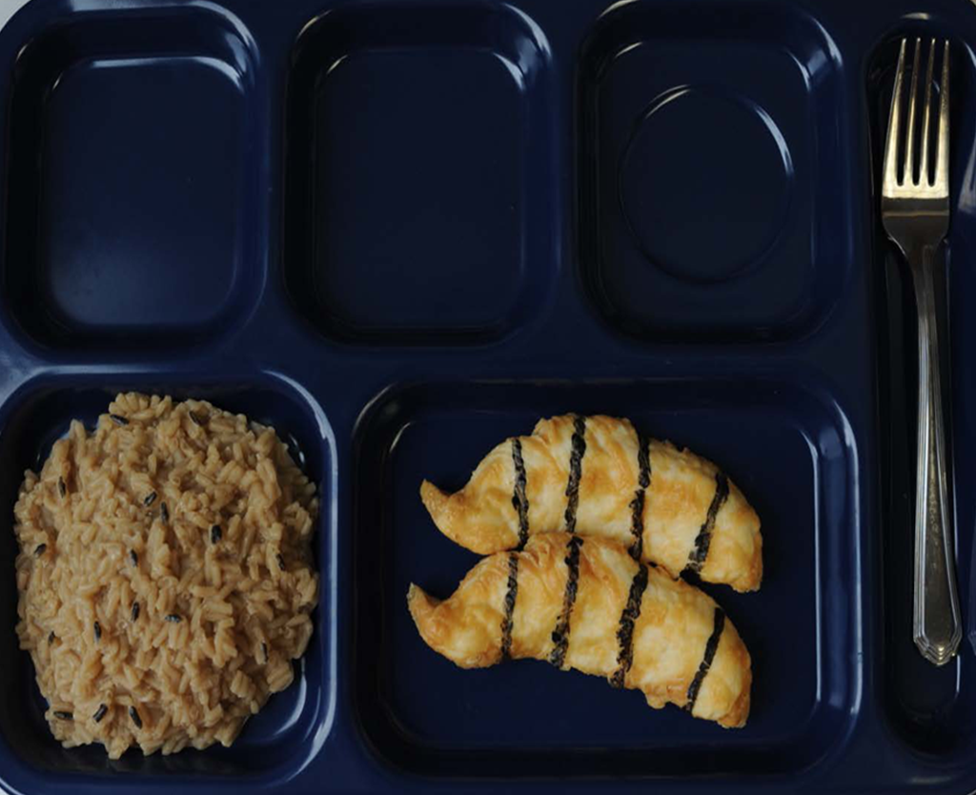
DEAL
Menu Offered
Grain:
Brown Rice (1/2 Cup cooked) 1 oz. eq.
Meat/Meat Alternate:
Grilled Chicken (2 oz. eq.)
Vegetable:
Broccoli (½ C) + Carrots (½ C)
Fruit:
Applesauce (½ C) + Banana (½ C)
Milk:
1% White Milk or Fat Free Chocolate Milk (8 fl. oz.)
Rice- ½ C
Chicken – 2 oz. eq.
Grades K-5
Notes:
On the left here is the Lunch menu is for grades K-5. They are offering a 1oz eq. of Brown Rice
2oz of Grilled Chicken
Half a cup of broccoli and half a cup of Carrots
They are offering half a cup of applesauce and a half a cup of banana
And they are offering 2 choices of milk.
Does the menu include all of the components in their minimum required amounts for ages/grade K-5? ………. Yes!
The image on the right here is a students Lunch tray.
Is this a reimbursable meal? …………….. No.
We can see here the minimum requirement of ½ C of fruit or vegetable is not present on the tray, so this would not be counted as reimbursable.
The grain is one full component, the chicken is also a full component. The student must select two full components plus at least ½ cup of a fruit or vegetable. If the student goes back and grabs a ½ cup of a fruit or vegetable then this would be able to be counted as reimbursable meal.

Slide 31
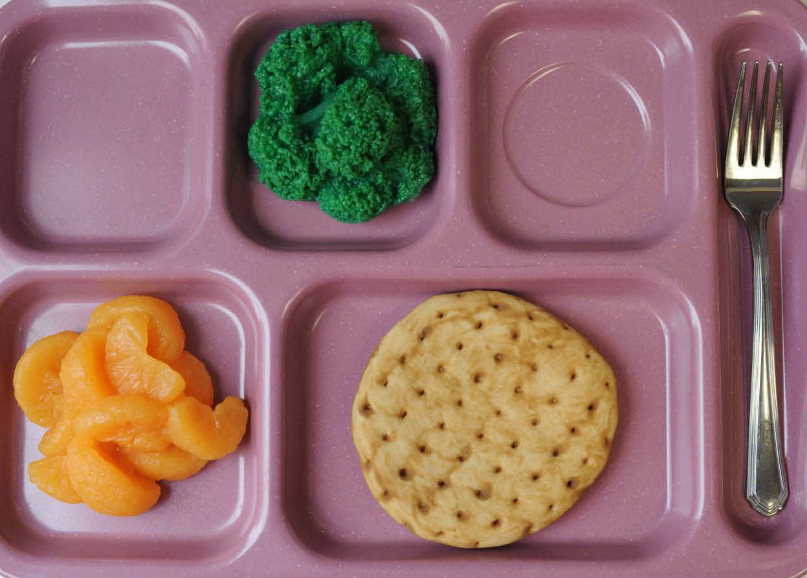
DEAL
DEAL
Menu Offered
Grain:
WG Pita Bread (2 oz. eq.)
Meat/Meat Alternate:
Grilled Chicken (2 oz. eq.)
Vegetable:
Broccoli (½ C) + Carrots (½ C)
Fruit:
Oranges (½ C) + Banana (½ C)
Milk:
1% White Milk or Fat Free Chocolate Milk (8 fl. oz.)
Broccoli ½ C
Pita Bread – 2 oz. eq.
Oranges ½ C
Grades 7-12
Notes:
Here the image on the left is a lunch menu for the grade group 7-12. and the image on the right is the Students Lunch tray selection. In this slide to determine if this is a compliant meal the menu planner and food service staff should pay close attention to menu being offered.
Does the lunch menu include all of the components in their minimum required amounts for this age group? No.
We have a mixed grade group in this building for lunch which is Grades 7-8 and 9-12. Menu planners must separate out the age/grade groups. The 7 and 8 graders must use the 6-8 menu plan or K-8 menu plan.
The 9-12 age/grade group has larger portion sizes and must follow the 9-12 age/grade group meal pattern.
This separation of age/grade groups must also be documented on the production records.
Now, is the lunch tray on the right a reimbursable meal. The answer is Yes for grades 6-8 and NO for grades 9-12.
Grades 6-8 only need a half a cup of fruit daily at lunch. If you count the ½C of oranges(fruit) as the first full component and then 2oz. Eq. of grain being your second full component, your third component would be the ½C of broccoli as the required ½ C of fruit/vegetable. Therefore making this a reimbursable meal for the 6-8 age/grade group.
However,
For grades 9-12 this would not be a reimbursable meal. This is because for grades 9-12 you are required to offer 1C of fruit and 1 cup of vegetables daily.
If you count the broccoli as your ½ C of required fruit/vegetable, you would then need two other FULL components. The pita bread would still count as one full component, but because the fruit is only a ½ C you would not be able to count it as the remaining FULL component unless it was at least 1 cup portion.

Slide 32
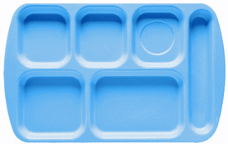
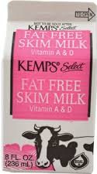
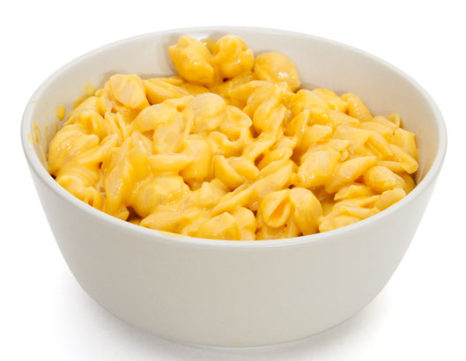
DEAL
DEAL
Menu Offered
Grain:
Pasta (1 Cup cooked) 2 oz. eq.
Meat/Meat Alternate:
Cheese (2 oz. eq.)
Vegetable:
Broccoli (½C) + Carrots (½C)
Fruit:
Apples (1 C) + Banana (½C)
Milk:
1% White Milk or Fat Free Chocolate Milk (8 fl. oz.)
Milk– 8 fl. oz.
Bananas– ½ C
Mac & Cheese– 2 oz. eq. MA 2 oz. eq. G
Grades 9-12
Notes:
This Lunch menu on the left is for grades 9-12 only. They are being offered a 2oz equivalent of Whole Grain Pasta, a 2oz equivalent of Cheese as their meat alternate
They are being offered 1 C of vegetable, and 1 and a half cups of fruit. And 2 milk varities.
Does this menu include all of the components in their minimum required amounts for grades 9-12?....... Yes
Does the students lunch tray on the right make up a reimbursable meal? Yes, There are 4 components and a ½ cup of fruit.

Slide 33
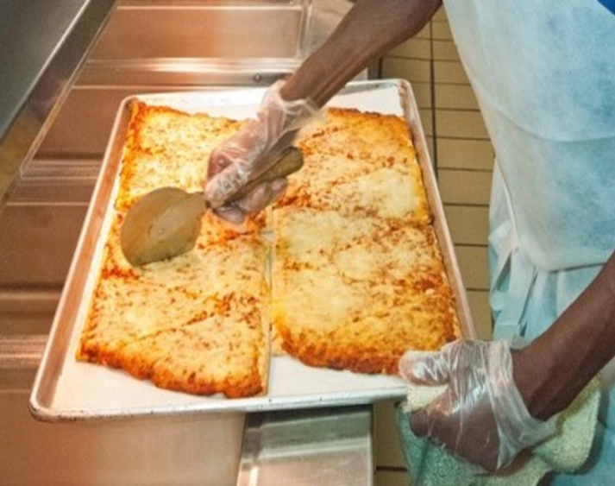
Alternate Daily Meals
Alternative meals at lunch and breakfast must comply to Meal Pattern requirements
Daily Alternate meals must offer the minimum requirements
Notes:
Most schools offer alternate daily meals. This is not required but having additional choices adds variety to your menu and gives students choices. Giving students more choices generally increases student participation, which in turn, increase Program revenue.
Determining that daily meal pattern requirements are met for the alternate daily meal choices is pretty straight forward. Does the alternate choice offer meal components in the minimum quantities specified on the meal pattern chart, for the age/grade groups being served? Determining if daily alternate meals meet weekly requirements adds a little twist to the way the menu must be structured to ensure compliance.

Slide 34
Monday | Tuesday | Wednesday | Thursday | Friday
Hamburger 2 oz. eq. grain Bagel w/Yogurt 2 oz. eq. grain Pizza 1.5 oz. eq. grain | Chicken Patty on a bun 2 oz. eq. grain Ham & Cheese Sandwich 2 oz. eq. grain Pizza 1.5 oz. eq. grain | French Toast sticks w/Sausage 2 oz. eq. grain Nachos 2 oz. eq. grain Pizza 1.5 oz. eq. grain | Chicken Nuggets 1 oz. eq. grain Turkey & Cheese Wrap 2 oz. eq. grain Pizza 1.5 oz. eq. grain | Pizza Supreme 2 oz. eq. grain Grilled Cheese 2 oz eq grain Pizza 1.5 oz. eq. grain
Example
Lunch
K-5
Menu
Notes:
Here is an example of ensuring enough weekly grain component is menued for K-5 Lunch.
In this slide we identified the lowest creditable amount of grain offered each day. Be aware the lowest amount may not necessarily be from the same reimbursable meal. As you can see here, the chicken nuggets on Thursday have the lowest creditable amount not the pizza.
Next, we will calculate the minimum weekly grain offerings using the lowest creditable amounts identified which totals 7 ounce equivalents.
The required minimum weekly amount of grain ounce equivalents for grades K-5 is 8 ounce equivalents.
While this menu meets the minimum daily requirement of 1 ounce equivalent grain, the minimum weekly grain is deficient by 1 ounce equivalent.
Although there are many ways the menu planner can correct this menu to be in compliance with the weekly requirement, one option would be to serve a daily pizza that credits as 2 ounce equivalents of grain.
This process should be used to check all weekly minimums.

Slide 35
Additional Meal Requirements
Water Availability
Water must be made available in all locations where meals are served and intended to be consumed on-site.
Signage
What constitutes a reimbursable meal
Students must select minimum ½ cup fruit or vegetable
“And Justice For All” Poster
Notes:
Water must be made available in all locations where meals are served and intended to be consumed onsite.
Signage for breakfast and lunch needs to include what constitutes a reimbursable meal, and the requirement to select at least ½ cup of fruit or vegetable. The SFA is also required to post the USDA And Justice For All poster at all food service locations.

Slide 36
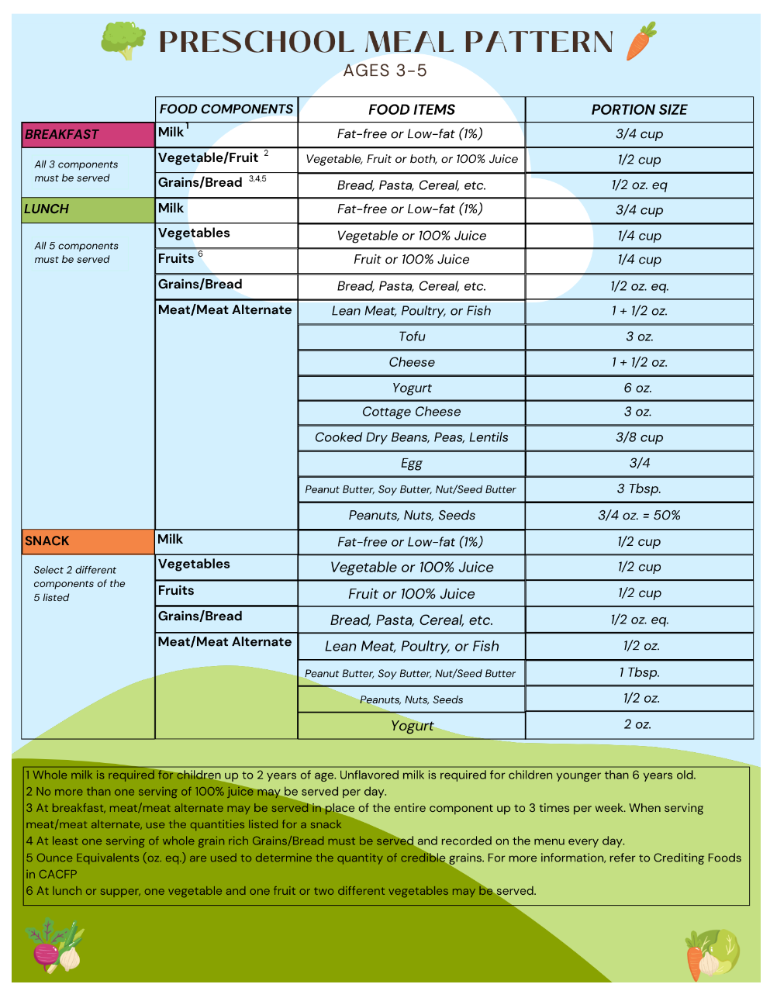
Prekindergarten &
Preschool Meal Pattern
Preschool Meal Pattern MUST be followed when preschool students are served:
  In a different area than older students (such as in their classroom); or
  At a different time than older students.
Cannot elect OVS
Production Records Required
Find More Information at:
https://www.cn.nysed.gov/content/preschool-meal-pattern
Notes:
Moving on to the preschool meal pattern. When operating a preschool or prekindergarten program, you must know when to use the preschool meal pattern requirements.
The preschool meal pattern must be followed when serving preschool students unless the students are co-mingled with older students.
One big difference between the preschool meal pattern and that of the older grade group meal patterns is that the preschool meal pattern has smaller minimum portion sizes. The meal pattern also sets limits on sugars provided to students. For instance, in the preschool meal pattern: no flavored milks are allowed; most grain-based desserts are not creditable; and sugar limits are in place per portion for cereals and yogurts.
A few more notes on the preschool meal pattern: offer versus serve is not allowed (meaning all required components must be served in minimum quantities to all students); there are no dietary specifications for the preschool meal pattern; and production records must be maintained.
Further guidance on the preschool meal pattern can be found on Child Nutrition Knowledge Center under the Program tab, at National School Lunch, then click on Menu Planning.

Slide 37
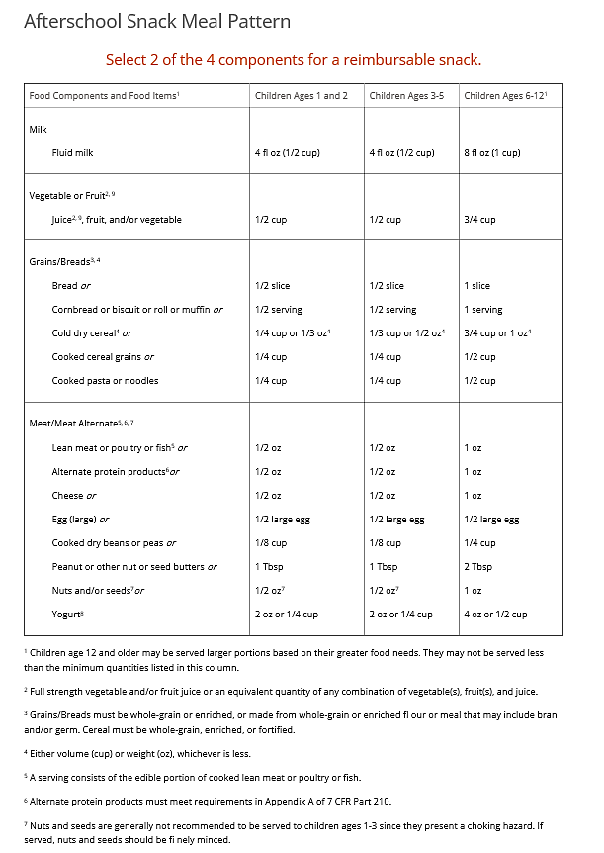
Afterschool Snack Meal Pattern
A reimbursable snack must contain two different components from the following four components:
  Milk - 8 fluid oz.
  Fruit/vegetable- 3/4 cup
  Meat/meat alternate- per snack meal pattern chart
  Grains/breads-per snack meal pattern chart
100% Juice may not be served when milk is the only other component *
** SFAs are recommended to served larger portions for older children (ages 13-18) based on greater caloric needs
Find More Information at:
http://www.cn.nysed.gov/afterschool-snacks
Notes:
The Afterschool Snack Program (ASP) is an extension of National School Lunch Program (NSLP) and may be administered by participating School Food Authorities(SFAs). The SFA must administer an afterschool care program which provides children with regularly scheduled activities in an organized, structured, and supervised environment; and include educational or enrichment activities.
The After School Snack Program has its own distinct meal pattern requirements which include required components and minimum portion sizes. As shown here.
A reimbursable snack must contain two different components from the following:
•Milk – 8 fluid ounces
•Fruit or vegetable – ¾ c is the minimum requirement.
•Meat/Meat Alternate – Minimum Serving Size per Meal Pattern chart
•Grain – Minimum Serving Size per Meal Pattern chart
** Note that juice may not be served when milk is the only other component offered.
In Afterschool Snack there is no Offer versus Serve option, the child must be served two full components.

Slide 38
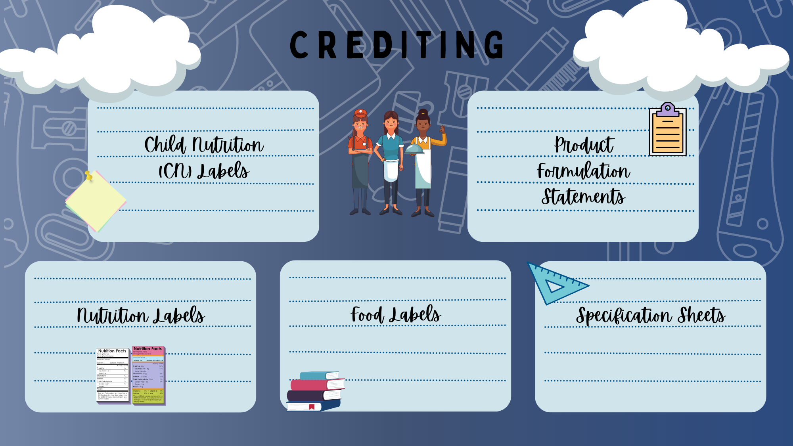
Notes:
There are multiple types of crediting documents used in substantiating how food items credit towards meal pattern requirements. Since there are multiple types and the formats of some of the documents may differ, it doesn’t hurt to review what information you will be looking for on each type of document and what each validates.
-Child Nutrition Labels are the most recognizable and always look the same. When an item has a CN label, it is readily observed on the food item packaging. The label contains a description of each component and how it credits towards meal pattern requirements per portion. The crediting information is contained within a bold black border and the border contains the letters CN on each side of the border. The manufacturer may also place the CN label information on other written documentation provided to the vendors or to the schools.
-Product Formulation Statements are a statement from the manufacturer which contains crediting information indicating how each component provided by one portion of the product credits towards meal pattern requirements. Product Formulation Statements are signed off by a designated official from the manufacturer.
-Nutrition Fact Labels can be used for items such as gain products being credited by using exhibit A, milk, fruit, or vegetables. Nutrition Fact labels cannot be used to credit combination foods (such as chicken nuggets).
When crediting grain items SFAs can used Exhibit A or creditable grains (product formulation statement), whichever works better for the school. We will look at this in more detail in upcoming slides.
-Food Label- a regular food label is maintained on file for fresh foods that are credited utilizing the Food Buying Guide. These identify the exact type of product being used and the state of the product at time of purchase
- For example: 80/20 raw ground beef, boneless skinless raw chicken thighs
Now for a word about product specification sheets- not all product specification sheets contain crediting information. They all contain general information regarding how the item is packaged etc., but there is no uniformity in the industry that dictates that crediting information must be included or how and where that information may or may not be included. So, look carefully when providing a specification sheet as crediting documentation and be sure that it actually contains crediting information.
Now, let’s look at examples of each.

Slide 39
Acceptable Milk Substitutions
Notes:
As required by law, SFA’s must make reasonable modifications to a meal, including providing special meals at no extra charge, to accommodate disabilities that restrict a child’s diet.
Program regulations require SFA’s to provide modifications for children with disabilities on a case- by – case basis only when requests are supported by a written statement from a state-licensed healthcare professional, such as a physician or nurse practitioner.
Meals that do not meet the program meal pattern are not eligible for reimbursement unless supported by a medical statement.
SFA’s may choose to accommodate requests related to a disability that are not supported by a medical statement if the requested modifications can be accomplished within the program meal pattern.
Milk substitutes must have the same nutritional value as cows' milk, as outlined in the chart.

Slide 40
Breakfast & Lunch Fruit Component
Fresh
Canned
Frozen
Dried
Juice
Use Food Buying Guide for Crediting
In light syrup or water
with or without added sugar
¼ cup dried fruit = ½ cup
No more than ½ fruit over course of week can be in juice form
Notes:
Menu planners may choose to offer fresh, frozen, canned, dried or 100% fruit juice to meet the fruit component requirements. When offering fresh fruit, SFAs should refer to the food buying guide for how the fresh fruit credits. Canned fruit must be in light syrup or water, and frozen fruit ay be offered with or without added sugar. Dried fruit credits as twice the volume served. For example, a ¼ cup raisins credit as a ½ cup of the fruit component. And 100% juice may be offered however, no more than ½ the fruit component may be offered in the form of juice over the course of the week.

Slide 41
The Definition of a Whole Grain Rich Product
Examples of Whole Grains
Examples of Non-Whole Grains
Whole wheat, white whole wheat
Oat
Barley (hulled and dehulled, but not pearl)
Whole Grain Corn
Brown rice
Rye
Quinoa
Amaranth
Buckwheat
Corn meal
Grits (hominy, corn)
Flour (wheat, all-purpose, unbleached, bromated, enriched)
Rice (white, jasmine, basmati)
Pasta (semolina, farina, durum)
Couscous
Enriched rice
Rice flour
“Multigrain”
*There are updated memos regarding the crediting of Corn masa, corn flour, and cornmeal, hominy, grits, and popcorn.
Notes:
As we already covered, at least 80% of the grain products offered on the menu over the course of a week must be whole grain rich. Grain products that qualify as whole grain rich are 1.) foods that contain 100% whole grain or 2.) contain a blend of whole grain meal and/or flour and enriched meal and/or flour of which at least 50% is whole grain.
This slide shows some examples of grains that are whole grains (listed on the left) and grains that are not whole grains (listed on the right).
For more information, refer to the USDA Whole Grain resource manual which is on our website located on the Child Nutrition Knowledge Center under the Food Based Menu Planning tab and under the heading “ food crediting”.

Slide 42

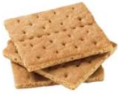
Grain Based Desserts
Allowed for Lunch and Breakfast
Allowed for Lunch
Brownies
Cookies
Pie crusts for dessert pies, cobblers, fruit turnovers
Cakes
Rice pudding and sweet bread pudding
Sweet Crackers (example: animal crackers and graham crackers)
Doughnuts
Cereal bars
Granola bars and breakfast bars
Sweet rolls, pastries, toaster pastries, and sweet scones (example: blueberry, raisin, and orange cranberry)
Quick breads
Notes:
Grain based desserts include items such as brownies, cookies, sweet crackers such as animal and graham crackers, cereal bars, quick breads and others noted on the slide. As we mentioned, grain based desserts must be limited to no more than 2 oz eq over the course of the week at lunch. For example, the lunch menu may include a 2-oz eq grain-based dessert once per week or a 1-oz eq grain-based dessert twice per week. There is no required limit for grain-based desserts at breakfast however, as we mentioned, there are certain grain-based desserts that are not allowed at breakfast as noted on the meal pattern chart and shown on the slide.
SFAs will use exhibit a when crediting grain based desserts which we will review later in this presentation. On Exhibit A, you will see that it is broken down into Groups, from A through I. Grain-based desserts can be found in Groups B-G. These items have superscripts 3 and 4. Items with a superscript 4 are items allowed for both breakfast and lunch. Items with a superscript 3 are allowed only for lunch.

Slide 43
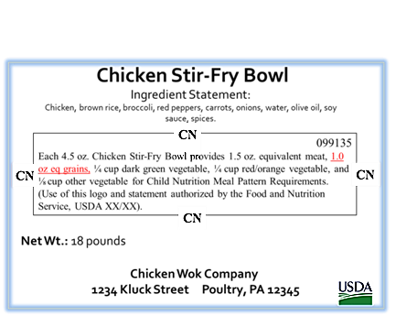
Child Nutrition (CN) label
Notes:
To credit commercially made food products, SFAs must obtain appropriate documentation to indicate how the products credit toward the USDA Meal Patterns. The manufacturer’s documentation must include what Meal Pattern components are provided by the product and how each serving of the product credits towards the Meal Pattern Requirements for each component provided.
The most recognizable of all documentation is the Child Nutrition (CN) Label. This will always look like this example. . A CN label statement clearly identifies the contribution of a product toward the meal pattern requirements. A CN labeled product will always contain the following:
-The CN logo, which is a distinct border;
-The meal pattern contribution statement
-A unique 6-digit product identification number, which is assigned by FNS, appearing in the upper right-hand corner of the CN logo;
-The USDA/FNS authorization statement
-The month and year of final FNS approval appearing at the end of the authorization statement
Not all products have a CN label. This certification is not required, and it requires manufactures to participate in additional monitoring and pay an additional fee.

Slide 44
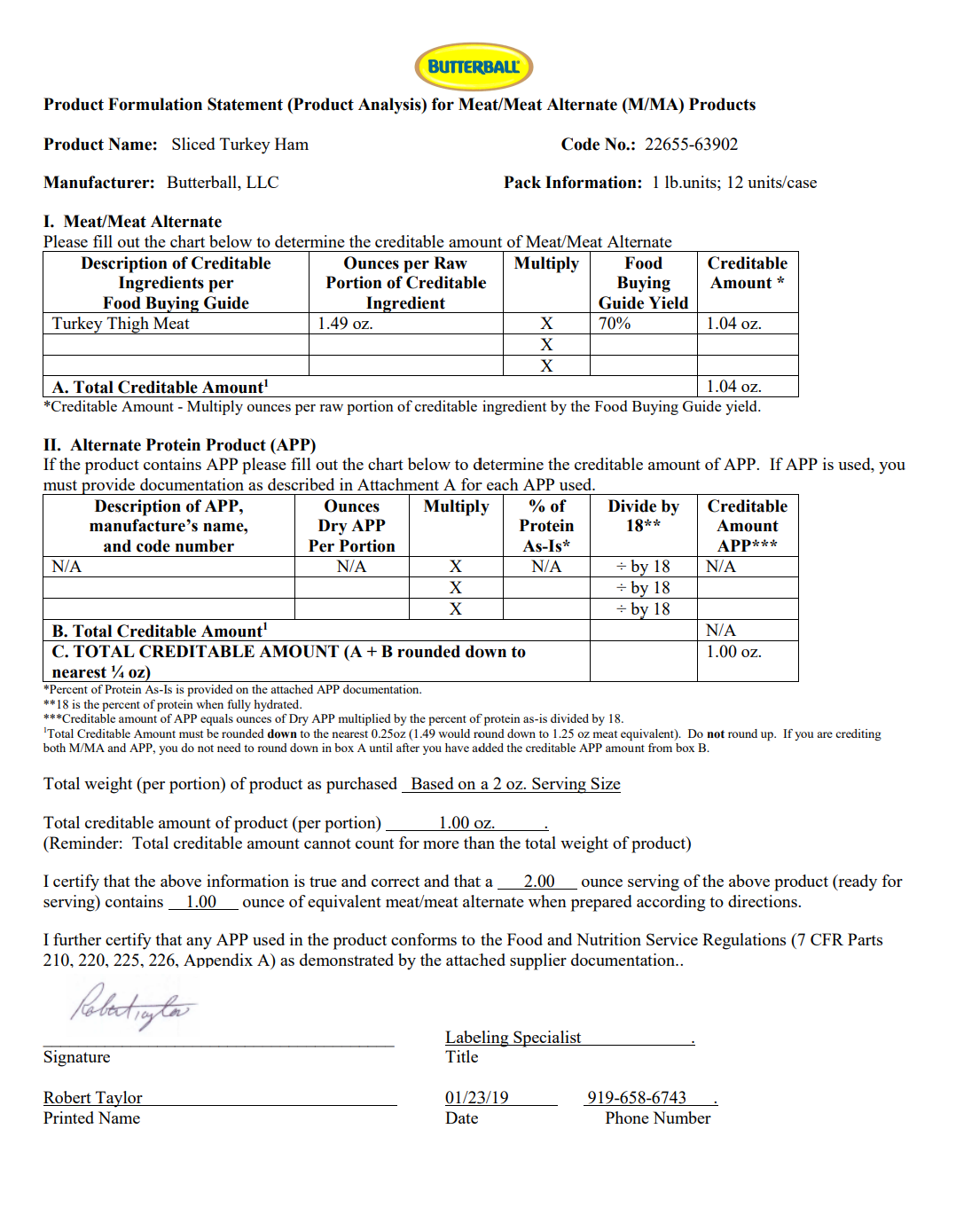
Product Formulation Statement
(PFS)
Notes:
When SFAs purchase a processed product without a CN label, they will have to obtain a completed, signed and dated Product Formulation Statement from the manufacturer for accurate crediting purposes.
Product Formulation Statements may have slightly different formats but will contain the same information as shown in this example. A Product Formulation Statement will provide specific information about how the product credits to meet the meal patterns. It will include the name of the product, the code number, the manufacturer’s name, the serving size, and then will list the meal pattern component(s) contributing to meal pattern requirements and will show how the manufacturer determined the meal pattern contribution from each component listed. You will also find the signature and contact information for the designated official from the manufacturer, certifying that this statement is true and accurate.
In this example, we are looking at a deli turkey PFS. Here you will notice that the product is made from turkey thigh meat and contains no other Alternate Protein Product (APP). In this example notice that the serving size is 2 ounces and that this contributes 1 oz equivalent M/MA.
Deli meats, patties (hamburger, sausage, egg, etc.), processed meats such as processed and cooked chicken strips, diced chicken, less than 100% meat hot dogs etc. all require CN labels or PSFs. These products contain other types of fillers and binders in addition to meat. Therefore, products like this will not credit ounce per ounce.

Slide 45
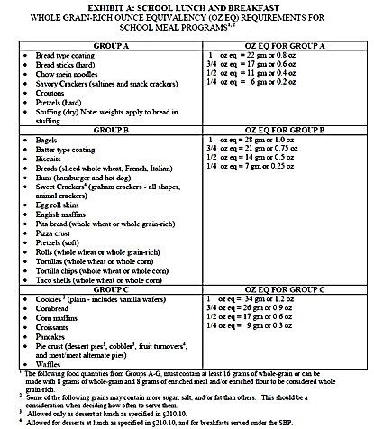
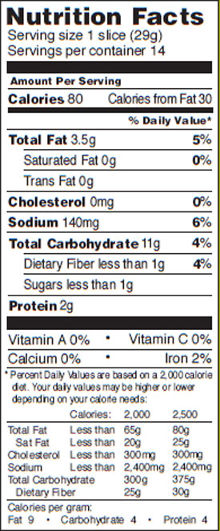
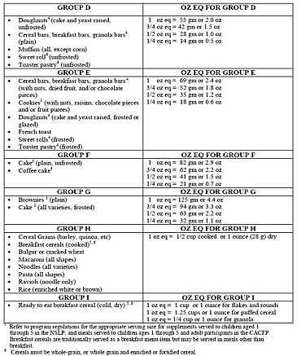
Exhibit A
Exhibit A can be used to credit grains
Using Exhibit A (Example):
  Locate the correct category for the grain item on Exhibit A Group B
  (28g)
  Use the per serving weight of the product found on the nutrition fact label (29g)
  Divide the weight of the product by the ounce equivalent column in Exhibit A (29/28 = 1.036)
  Always round down to the nearest quarter! (1 oz eq)
Notes:
Exhibit A can be used to determine the grain ounce equivalent per serving. To use this chart, locate the correct category for the grain item. In this example, bread is found in group B. 1 oz equivalent for all items in Group B weight 28 grams. Product formulation statements may also be used instead of Exhibit A.
Next, look at the nutrition fact label and determine the weight of the product per serving. The nutrition fact label states that one slice of bread weighs 29 grams.
To calculate how many ounce equivalents one slice of bread will equal, we divide the product weight by the number found in the ounce equivalent column of Exhibit A.
In this example, we determined that for an item listed in Group B, a 1-ounce equivalent weighs 28 grams, so we divide 29 by 28 and get 1.036.
Always rounding down to the nearest quarter-ounce equivalent, our product is a 1-ounce equivalent.

Slide 46
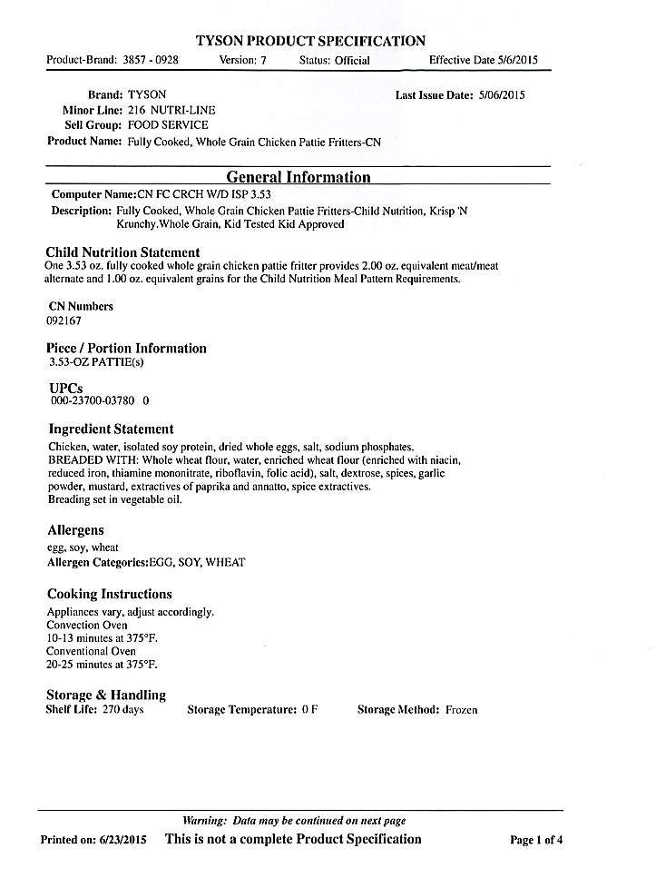
Product Specification Sheet
Child Nutrition crediting information
  Some specification sheets contain this information
Notes:
Product Specification Sheets can be confusing. The specification sheets generally are descriptions of the product, including codes related to the product and what product line it is in and how the product is packed and loaded on pallets. Specification sheets are not required to contain CN information. In this example you can find the CN information easily. In other instances, the information could be hiding in a paragraph of information, or the crediting information may not be there at all. Sometimes the specification sheet will only inform you that the CN information is available. In that case, you would have to obtain the documentation separately ( a CN label or PFS) and print it out for your files.

Slide 47
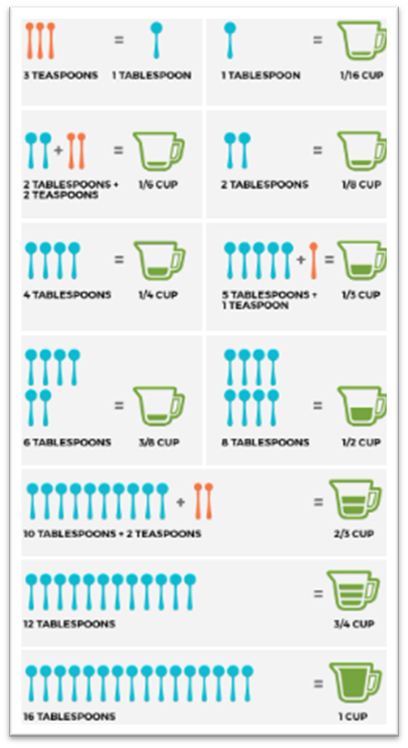
Standardized Recipes
Required by regulations
Demonstrate meal pattern requirements are met
Show crediting information per serving
Notes:
To credit foods prepared in your kitchen toward the USDA meal patterns, school food authorities (SFAs) must maintain standardized recipes that document the crediting information per serving. Standardized recipes are written instructions used to prepare a known quantity and quality of food. Standardized recipes are required by regulation and must be developed for all menu items containing more than one ingredient.

Slide 48
Benefits of Standardized Recipes
Ensure Consistent Food Quality
Produce Predictable Yield
Increase Customer Satisfaction
Support Efficient Purchasing Procedures
Aid Inventory Control/Assist with Food Cost Control
Assist with Labor Cost Control
Increase Employee Confidence
Validate Nutritional Standards are being met
Result in Successful Completion of Administrative Reviews
Notes:
Using standardized recipes provides many benefits to school foodservice operations. Today we will be focusing on how recipes help you plan your menus and help validate that planned food items meet Meal Pattern requirements. An Administrative Review cannot be completed if recipes are missing information or provide inaccurate information on ingredients, yield, or serving size. Administrative Reviews require standardized recipes to ensure that the nutrient analysis is accurate and that nutritional values and meal component contributions per serving are valid and consistent.
As a brief review, we will touch on the other benefits standardized recipes provide:
Consistent Food Quality- The use of standardized recipes ensures that menu items will be consistent in quality each time they are prepared.
Predictable Yield- The planned number of servings will be produced by using standardized recipes to help reduce overproduction or prevent shortages of servings on the line.
Customer Satisfaction- Well-developed recipes that appeal to students are an important factor in maintaining and increasing student participation levels.
Efficient Purchasing Procedures- Purchasing is more efficient because the quantity of food needed for production is easily calculated from the information on each standardized recipe.
Inventory Control/Food Cost Control- The use of standardized recipes provides predictable information on the quantity of food inventory that will be used each time the recipe is produced and provide consistent and accurate information for food cost control.
Labor Cost Control-Written standardized procedures in the recipe make efficient use of labor time and allow for planned scheduling of foodservice personnel. Training costs are reduced because new employees are provided specific directions for preparation in each recipe.
Increased Employee Confidence- Employees feel more confident in their jobs because standardized recipes eliminate guesswork, decrease the chances of producing poor food products, and prevent shortages of servings during meal service.

Slide 49

Production Records
Required by regulations
Documents compliance with meal pattern requirements
Completed daily for all buildings
Reflect age/grade groups
Courtesy of Schalmont CSD
Notes:
Production records provide a daily written history of the food planned, prepared and served in your establishment, therefore are the document used to demonstrate that adequate amounts of all required meal components were planned and served in at least minimum portion sizes each day, to prove compliance with meal pattern requirements. Production records and standardized recipes work hand in hand in to maintain Program compliance,. They assist in validating meal pattern compliance and maintain efficient and consistent Program operations. Best practice is to have production records cross reference the corresponding recipes.

Slide 50
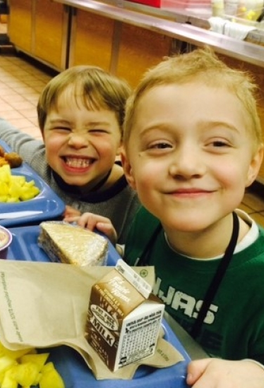
Advantages of Production Records
Planning & forecasting tool to assist a successful food service operation
Provides a written history to evaluate customer preference & improve menu planning
  Minimizes overproduction and food waste
  Improves participation
Provides a daily written history of the food planned, prepared & served
Can add comments to document changes
Notes:
SFAs should encourage staff not to think of production records as something “I must do” but rather an important tool in their daily process of providing meals.
We understand all of the challenges with the meal pattern but accurate and complete production records are essential.
Production records are an excellent planning and forecasting tool that will help with a successful food service operation.
They provide a written history that can be used to evaluate customer preference and improve menu planning. Staff are able to determine what entrees students prefer and which entrees don’t sell well.
Production records allow staff to determine how much of each food item is typically used. Being aware of the quantity of food that is usually consumed helps minimize overproduction and food waste. This will help cut down on program costs which helps maintain a financially successful program.
Production records provide a daily written history of the food planned, prepared, and served.

Slide 51

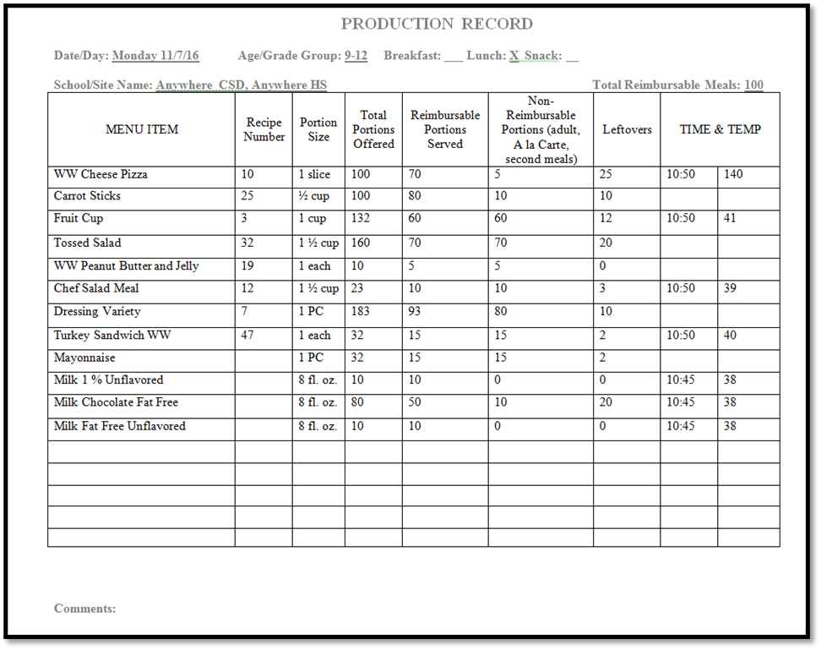
Production Record Required Elements
Required
1. Date/Day/School/Age Grade Group/Meal/Total Reimbursable Meals
2. All food items on the reimbursable menu
  Includes ALL offered components
  Includes ALL daily menu options
  Includes condiments & toppings
  *Missing a component may result in fiscal sanctions
3. Quantity prepared for each food item
4. Portion size
5. Total portions offered
6. Reimbursable portions served
7. Leftovers
Notes:
The production record must include all food items offered on the reimbursable menu. This includes ALL offered components, menu items and daily alternate meals. All 5 components must be on production record: Meat/meat alternate, grain, fruit, vegetables, milk. If ALL components are not included on the production record fiscal sanctions may be assessed.
Production records must also include ALL daily menu options. This includes any daily alternate meals, such as, a salad meal, deli meal, salad bar option, or sandwich option. Production records must also include ALL condiments and toppings offered that day. These are important for the nutrient analysis.
The quantity prepared of each food item must also be listed on production records.
It is best to be specific when recording prepared quantities. Instead of documenting that one #10 can of canned vegetables were opened, it is a best practice to relate the quantity prepared with the actual portion served, for example, twenty ½ cup portions.
The portion size is the amount of the item that is available to each student. Portion sizes must be documented and differentiated on the production record as there are specific portion requirements for each age group served.
The number of portions offered is the amount of each item expected to be served.
The number of reimbursable portions served must be recorded on production records. Reimbursable portions served are the number of portions of each food item that is actually served for a reimbursable meal. The reimbursable portion column must be completed for each menu item. This includes the main entrée, vegetables, fruit, milk, and condiments.
The number of a la carte and non reimbursable portions served must be recorded and differentiated from the reimbursable meals column. This information is important when calculating the SFA’s non-program food costs. This column includes adult meals, second student meals, snacks, and extra menu items that are not included in the reimbursable meal.
The number of leftover portions must be recorded before anything is discarded. Tracking leftovers helps prevent overproduction for future meals. This information is also important if leftovers are utilized the next day. Salad bar leftovers may be estimated.

Slide 52
Production Record Best Practices
1. Include recipe numbers
2. Use the Comments and Notes area
3. Use volume measurements unless weighing food items
Notes:
A few best practices to keep in mind are:
Including recipes numbers- this is a reference between production records and the standardized recipe. This also in simplifying production records. For example, you can list the recipe number for a chef salad and then simply record the number of salads served, instead of having to list each ingredient in the salad on the production record separately.
The comments and notes section of the production record is a great place where the SFA can communicate any changes in meal service. For example, maybe the meal counts are higher or lower than normal and in the comments, you can note why that is. Sometimes factors such as class trips, weather, or illness; and comments made by students provide valuable written history for the future. These factors can help to spot trends, evaluate what works best with your students, and help you decide what to change. Recording this information is helpful when you refer back to already completed production records for future forecasting.
When measuring and documenting quantities of food, it is a best practice to use volume measurements unless you are weighing items. This means using cups for fruits and vegetables and ounces equivalents for grains and meat/meat alternates.

Slide 53
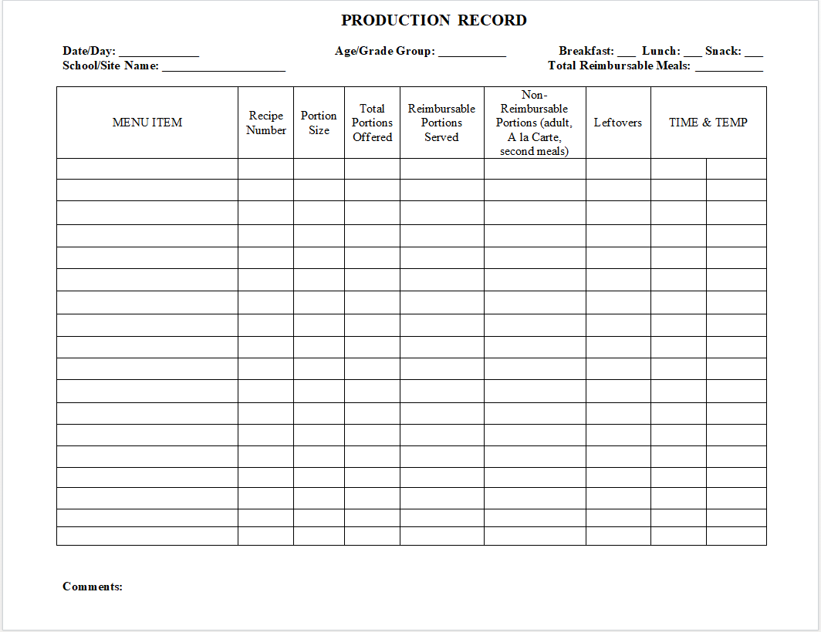
Production Record tEMPLATE
Notes:
This is the “Simple Production Record” template. You will find this template as well as another more detailed template on the Child Nutrition website under menu planning for NSLP.
SFAs are not required to use this template but if SFAs decide to use their own production record, all required elements must be on it.
53

Slide 54


When to complete Production Records
Complete before meal service:
School / Site Name
Date/ Day
Age / Grade Group
Service (Breakfast / Lunch / Snack)
Menu Item
Recipe Name
Portion Size
Total Portions Offered (#)
After Meal Service:
Reimbursable Portions
Non-Reimbursable Portions
Leftovers
Time / Temperature (Optional)
Comments / Notes
Notes:
Certain information on a production record can be completed before meal service begins
This information includes the name of the school or service location, the date, the type of meal service; breakfast, lunch or snack; the age/grade group being served; the name of the menu (or food) item; including condiments, recipe names and numbers, the portion sizes, and the total number of portions being offered.
Again, condiments must be included on the production records.
The total portions offered and the portion size can be completed ahead of time and ensure that the portion size meets the required minimum portion size for the age/grade group being served.
After meal service is complete the actual number of reimbursable meals served, the non-reimbursable portions served; including a la carte, second and adult meals, leftovers, time and temperature, and total reimbursable meals served. It is also important to note if any substitutions were made or any comments regarding feedback from the meal service.
Completely information before the meal service will save time during the rush of the day
54

Slide 55

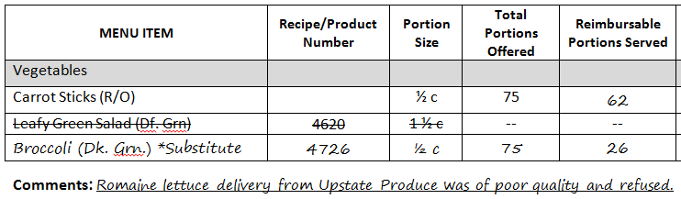
Substitutions
Vegetable sub-groups
  Ensures appropriate substitutions
  Substitute within the same vegetable subgroup
    Example: Romaine Salad replaced with broccoli
Notes:
All menu items served to students must be included on the production record, even if it is a last minute change.
The menu must offer five different vegetable subgroups of vegetables that count toward the daily and weekly vegetable requirements. It is important to know which vegetables are in each vegetable subgroup when making substitutions to the menu.
For example, if a raw Leafy Green romaine salad is on the menu, but romaine lettuce is not available, the salad should be substituted with another vegetable from the dark green vegetable subgroup, such as broccoli. Substitutions must also be documented in the notes and comments section of the production record to support the claim for reimbursement.
SFAs should always have a backup vegetable for emergencies.
The vegetable subgroup chart can be found under Nutrition Standards in the National School Lunch and Breakfast programs in the Food Based Menu Planning tab on the Child Nutrition Knowledge Center website.

Slide 56


Common Errors
Missing/ Incomplete production records
Not separating age/grade groups
Portion sizes
Listing “vegetable”
Incorrect vegetable subgroup substitutions
Weight vs volume
Notes:
This is a list of the common errors founds during Administrative Reviews.
Missing productions records: SFAs are not filling them out for each meal service. Production records are required for breakfast, lunch, and after school snack.
Incomplete production records have been found to be missing food items, not adding condiments and milk variety to the production records, serving size is not listed, not listing daily alternative meals and not completed after the meal service.
Age/ grade groups need to be separated on productions records because there are specific portion requirements for each group served.
Portion size is the amount of the item that is available to each student and it must be listed for ALL items. For example, if serving chicken nuggets, write 5 nuggets versus 1 pan. This ensures that the meal pattern is being met for each age/grade groups.
When a production records just list “vegetable” this does not show what vegetable subgroup is being served during the meal service.
When making a vegetable subgroup substitution, make sure the vegetable being substituted falls under the same group. For example, if carrots are listed on the menu,you could switch to sweet potatoes.
When completing production records, weight verses volume will change the number of calories.
Next….let’s try to demystify crediting documents

Slide 57

Questions?
Contact Information
Training Team: cntraining@nysed.gov
Child Nutrition Program Office: 518-473-8781
CN Representative for questions specific to your SFA
Notes:
We will now allow time for you to ask any questions on the information presented in the webinar today.
You may always contact the Training Team with additional questions at:
cntraining@nysed.gov
Or contact your CN Representative for questions specific to your SFA

