Slide 1

Fiscal Management Refresher
Review of General Topics Pertaining to the Child Nutrition Audit Unit
September 2023
Notes:
Welcome to the Fiscal Management Refresher webinar, hosted by the New York State Education Department Office of Child Nutrition. On the next slide we will review the agenda and topics being presented today. Presenting today from our audit team is Rick Canfield and Jen Bear will be answering questions at the end of the presentation.
If you have any questions during the presentation, please type them into the question box. We will review them at the end.
Following today’s presentation, you will receive an email containing the slides for today’s webinar. If you do not receive them, please email CNTraining@nysed.gov
A copy of the webinar will also be posted and available on the CN website. As always, if you have any questions, please contact your Child Nutrition Program Representative or email CN@nysed.gov.

Slide 2
Today’s Agenda
Maintenance of the Non-profit Food Service Account
Direct and Indirect Costs
Requirements for Financial Reporting
Excess Fund Balance & Negative Fund Balances
Non-program Food Pricing
PLE Exemption
Notes:
Here is today's agenda. (Presenter Pause)

Slide 3
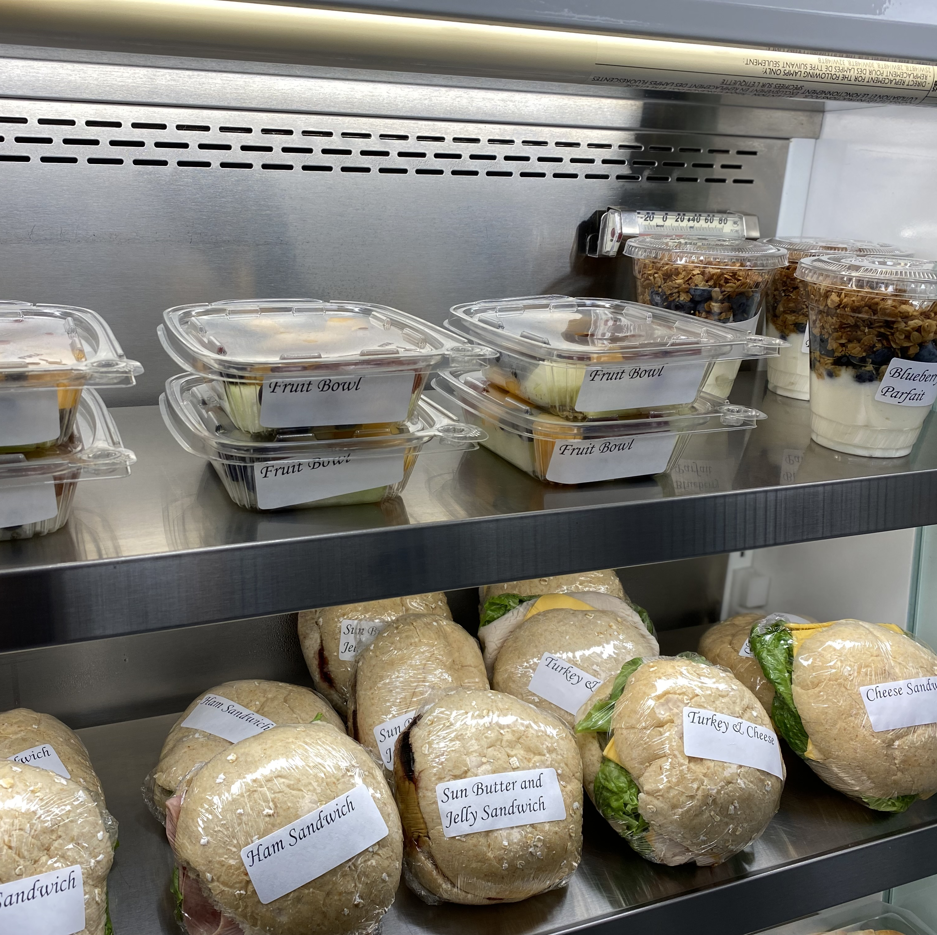
Non-program Food
Non-reimbursable foods and beverages purchased using funds from the nonprofit school food service account
Annual Requirement: Non-Program Food Revenue Tool
Courtesy of Onteora CSD
Notes:
USDA defines non-program foods “as those foods and beverages sold in a participating school other than reimbursable meals and meal supplements that are purchased using funds from the non-profit school food service account.
Non-program foods include a la carte items (such as snacks, milk purchased separately from a meal, etc.) and also adult meals. They also include items purchased with non-profit school food service account funds for vending machines, fundraisers, school stores and for catered and vended meals.”
SFAs are required to ensure that all revenue from the sale of nonprogram foods accrues to the non-profit school food service account; and revenue available to support the production of reimbursable school meals does not subsidize the sale of nonprogram foods. Therefore, each year, SFAs must assess their revenue from program food (reimbursable meals) and nonprogram food (non-reimbursable meals) to ensure that nonprogram food revenue generates at least the same proportion of revenue as it contributes toward total food costs.
For example, if the costs of nonprogram food are 25 percent of the SFA’s total food costs, then the amount of revenue generated from the sale of these nonprogram foods must be at least 25 percent of the total revenue in the school food service account.
The Nonprogram Food Revenue Tool is an excel tool which was developed by USDA for SFAs to determine compliance with the nonprogram food revenue requirements.

Slide 4
Measuring Compliance with the USDA Nonprogram Revenue Tool
Notes:
The Non-Program Food Revenue tool is displayed here and can be found on the Child Nutrition Knowledge Center website. Locate Popular Topics, then find Nonprofit School Food Service Account. The tool will calculate the minimum amount of revenue from non-program foods that is needed to meet the requirement. The tool will also calculate the additional revenue, if any, needed to comply.
If the food cost ratio is higher than the revenue ratio, the nonprofit school food service account is subsidizing the cost of nonprogram foods and the SFA must revise its nonprogram food pricing structure to increase the revenue to ensure the revenue ratio is greater than or equal to the food cost ratio. Alternatively, the SFA could provide non-federal funds in the amount of the revenue shortfall to the nonprofit school food service account.
There are a range of actions an SFA may take to adjust prices, including:
If multiple nonprogram foods are sold as a unit and are also offered as a reimbursable meal, price the nonprogram food unit above the cost of the reimbursable meals.
Selectively increase the prices of some but not all nonprogram foods items (i.e. not raise the prices for a la carte fruits and vegetables but raise prices for other a la carte foods).
Review sales records and increase the prices of the more popular items.

Slide 5
Adult Meal Pricing
Free Student Lunch Total Reimbursement
($4.39 - $4.60)
+ Per meal value of USDA Foods
($.37)
= Minimum Adult Price
($4.76 - $4.97)
Notes:
As the SFA completes their annual review of Nonprogram food pricing, they must also evaluate adult meal prices to ensure that program funds are not subsidizing adult meals and that the SFA is charging at least the minimum required price for the school year.
SED issues a memo annually which details the minimum prices that must be charged for adult meals.
This shows the formula used in calculating the minimum adult meal price. The current rates are shown on the screen. The prices are shown as a range since the free reimbursement rates are different based on SFA operations.
It is important to remember that adult meals are non-program food and must be paid for at the time of service.

Slide 6
Non-Profit Food Service Account
Costs must be allowable, allocable and reasonable
Used only for the operation and improvement of the school food service
Meet annual financial reporting requirements
2 CFR 200: OMB’s Uniform Administrative Requirements, Cost Principles, and Audit Requirements for Federal Awards for non-Federal entities
Notes:
The non-profit food service account must be maintained separately from other accounts within the SFA. This can be done by creating a separate food service account or by setting up codes that track all revenue and expenses for the school food service program separately from these other accounts, such as the General fund.
All reimbursements and other revenues from all food service operations conducted by the SFA, principally for the benefit of school children, must be retained and used only for the operation or improvement of the nonprofit school food service. Therefore, the SFA must maintain a non-profit food service account to accomplish two goals:
1) To ensure that the school food service operates on a nonprofit basis, and
2) To safeguard assets of the school food service and ensure that they are used only for
authorized purposes.
These systems are monitored through annual financial reporting through the ST-3 for public schools and the Cash Analysis for non-public schools, charter school, jails and RCCIs.
All school food authorities are expected to adopt financial practices that align to all applicable regulatory guidance. The cost principles, coupled with school meal program regulations and policy, provide guidance as to what types of costs are allowable charges to the non-profit food service account, and whether these costs are allocable as direct or indirect charges. Regardless of whether a cost is allocable as indirect or direct, it must first be allowable.

Slide 7
Direct Costs
Exclusively attributable to the nonprofit school food service
Food, wages and salaries of the staff working in the school food service and supplies specifically used in the school food service.
Substantiated through written documentation
Treated consistently across all programs
Notes:
Direct costs are incurred specifically for a program or other cost objective and can be readily identified to the school food service. Examples of direct costs include, but are not limited to food, wages and salaries of the staff working in the school food service, and supplies specifically used in the school food service.
Costs must be substantiated through written documentation such as time cards, invoices, and receipts.
An SFA should ask the following questions to determine whether labor costs are exclusively attributable to the school food service:
What are the job functions of an employee? Does he/she work exclusively in food service?
Does the employee also perform work not related to the school food service? Does the SFA have a process for documenting the distribution of that employee’s time among cost objectives.
As an example, some SFAs document the hours that custodians work cleaning food service areas such as the kitchen, food preparation, and food serving areas through a time reporting system. The time reporting system provides the exact hours a custodian cleans the food service area and the rest of the school. The SFA then charges the custodial expenses for cleaning the school food service area as a direct expense. Alternatively, the custodial expenses may be charged as an indirect cost to the school food service by including them in the indirect cost pool if a methodology or process for determining this item’s direct relation to the school food service operations is not available.
The key point is that custodial expenses may be charged as a direct or indirect cost, as long as it is treated consistently in all activities of the SFA. An SFA may not charge custodial expenses as a direct cost to the school food service (e.g., through a time reporting system) and as an indirect cost for other programs.

Slide 8
Indirect Costs
Expenses that are incurred for the benefit of multiple programs or functions and are necessary for the general operation of Child Nutrition Programs but cannot be directly attributable to the program
Payroll Services, Gas, Electricity, Sewer, Water, Trash
Treated consistently across all programs
Non-restricted indirect cost rate used for the Child Nutrition Programs
Notes:
Indirect costs are incurred for the benefit of multiple programs, functions, or other cost objectives and therefore cannot be identified readily and specifically with a particular program or other cost objective. Indirect costs typically support administrative overhead functions such as fringe benefits, accounting, payroll, purchasing, facilities management, utilities, etc.
Costs to the food service account must be consistently treated as direct or indirect without double dipping.
The SFA in general, and school food service in particular, need utilities such as electricity and gas to operate. While utility costs are often treated as indirect costs, they may be charged as a direct cost if there is a methodology to quantify exactly how much energy was utilized to prepare and serve meals. For example, the use of a separate utility meter for school food service would provide such quantification. The main point to note is that charges like utilities can be allocated directly or indirectly, depending on whether a methodology exists to specifically identify the amount of utilities attributable to the school food service.
It is unallowable to bill the non-profit food service account for indirect costs that were paid from the general fund in prior years unless an agreement exists to show that the district had been “loaning” the non-profit food service account funds to cover the indirect costs in one or more prior years.
Two types of indirect cost rates are used with programs funded through the New York State Education Department; the restricted rate and non-restricted rate.
The non-restricted indirect cost rate is used for Child Nutrition Programs as reimbursements for child nutrition programs are meant to supplant (not supplement) program costs.
SED's Grants Finance office notifies public SFAs and BOCES of their non-restricted indirect cost rate annually.
SED does not have a negotiated unrestricted indirect cost rate for non-public SFAs and Charter schools; therefore, in accordance with 2 CFR 200.414 (f), these entities can elect to charge a de minimis rate of 10% of modified total direct costs (MTDC).

Slide 9

Calculating Indirect Costs
Apply the SFA's indirect cost rate to the modified total direct cost (MTDC) base
The MTDC is all direct salaries and wages, applicable fringe benefits, materials and supplies, services, travel, and up to the first $25,000 of each subaward
MTDC excludes food, equipment, capital expenditures, rental costs, tuition remission, scholarships and the portion of each subaward above $25,000
USDAs Indirect Cost Guidance
  https://www.fns.usda.gov/cn/indirect-cost-guidance
Notes:
Indirect costs are calculated by applying the SFAs indirect cost rate to the modified total direct cost base. These funds are used to support the central administrative costs.
The modified direct cost base is the total direct costs of the program, minus food, equipment, capital expenditures and the portion of each subcontract exceeding $25,000.
USDAs Indirect Costs Guidance can be accessed from the Child Nutrition website and is a resource to help SFAs better understand the nature of direct and indirect costs and their role in the operation of the Child Nutrition Programs.

Slide 10
10 % De Minimis
For use by non-public SFAs
Applied consistently
Calculated correctly
Distorting Items must be excluded
This includes food
Notes:
The de minimis rate of 10% of MTDC is allowable for use indefinitely and must be used consistently across all federal awards.
In accordance with USDA’s Indirect Costs Guidance, and with confirmation from USDA's Food and Nutrition Service (FNS) office and The Office of Management Budget (OMB), additional direct costs, considered “distorting items”, must be excluded because they do not generate or benefit from the administrative overhead in the same manner as wages, salaries, etc.
Distorting items include (but are not limited to):
• Program and non-program food costs
• Equipment purchases and other capital expenditures
• Other costs being charged as direct expenses to the non-profit food service account such as utilities and rental costs,
• Subawards beyond the first $25,000; vendor contracts and Food Service Management Companies are not considered subawards.
The full cost of vendor contracts or Food Service Management Company contracts for food/meals would be considered food costs and therefore, distorting and excluded from the MTDC. Costs incurred by the vendor to provide the meal, such as labor, supplies, utilities, packaging, storage, etc., are included in the procured per meal contract price. Additional overhead charges that the school may incur once the vendor delivers the meals to the school are already being calculated as direct or indirect costs. An SFA cannot claim overhead of the vendor as a cost.
Once the Modified Total Direct Cost (MTDC) base has been determined, the SFA would multiply the Indirect Cost rate of 10% times the MTDC to determine what indirect cost amount to charge the nonprofit food service account for the school year.
Pursuant to federal regulations governing the Child Nutrition Programs, SFAs and Sponsors must maintain program records to support the non-profit food service account. This includes documentation demonstrating how they determined the Modified Total Direct Cost (MTDC) for which they applied the 10% De Minimis to.
If you have questions and need additional guidance on calculating the 10% De Minimis, contact the Audit team at CNAudit@nysed.gov.

Slide 11
Employee Timekeeping
Salary and wage expenses must be correctly charged to the nonprofit food service account.
SFAs must have a timekeeping record system that accurately reflects the work performed by employees.
The timekeeping record system must:
Frequency of pay must be in compliance with New York State Labor Laws
This information can be found on the NYS Department of Labor website at: https://dol.ny.gov/frequency-pay
Be supported by a system of internal controls that provides reasonable assurance the charges are allowable, accurate, and properly allocated
Be incorporated into the SFA’s official records that include a hand signature by the employee and the supervisor certifying the accuracy of the records
Comply with the established accounting policies and practices put in place by the SFA to ensure program integrity.
Document actual hours worked, not estimated hours, for both hourly and salaried employees compensated by the SFA for each pay period, integrating compensation provided by CN funds and non-CN funds.
Document the distribution of the employee’s salary or wages among specific activities or cost objectives if the employee works on CN and non-CN projects
Notes:
SFAs are expected to ensure that salary and wage expenses are correctly charged to the nonprofit food service account. SFAs must have a timekeeping record system, paper or electronic, that accurately reflects the work performed by employees for the nonprofit food service program.
The timekeeping record system must meet the following requirements:
Be supported by a system of internal controls which provides reasonable assurance that the charges are accurate, allowable, and properly allocated.
Be incorporated into the SFA’s official records that include a hand signature by the employee and the supervisor certifying the accuracy of the records.
Comply with the established accounting policies and practices put in place by the SFA to ensure program integrity.
The timekeeping record system must provide the following information:
Actual hours worked, not estimated hours worked, for both hourly and salaried employees compensated by the SFA for each pay period, integrating compensation provided by CN funds and non-CN funds.
Distribution of the employee’s salary or wages among specific activities or cost objectives if the employee works on CN and non-CN projects.
Staff must be paid according to New York State Labor Laws.
Clerical and other workers must be paid at least twice per month
Manual workers for non-profit entities must be paid in accordance with their agreed terms of employment, but not less frequently than semi-monthly
Additional information can be found on the NYS Department of Labor website listed on the slide.

Slide 12
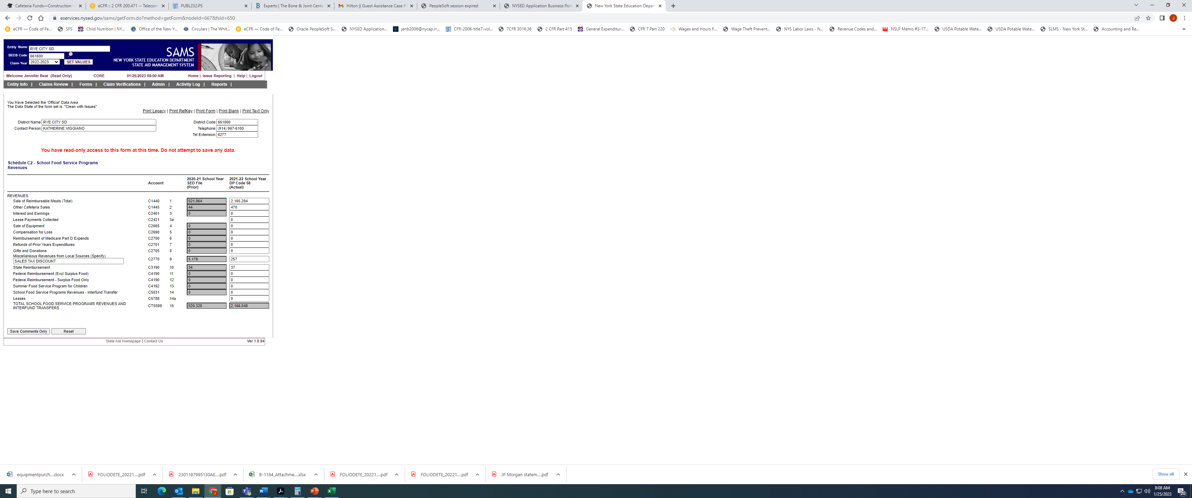
Reporting Requirements for
Public SFAs
ST-3 reported through State Aid Management System (SAMS)
  The State Aid Office Contact Information:
  Phone: (518) 474-2977
  Email: OMSSAMS@nysed.gov
Reported Annually
Reimbursable Meals only
Adult meals, A la Carte, Catering, etc.
Notes:
SFA’s have annual financial reporting requirements. Generally an SFA’s Business Office completes and submits the annual financial reporting. The report the SFA completes is dependent upon the public or non-public status of the SFA.
Public school districts must complete the ST-3 schedules for the C Fund (cafeteria fund) through the State Aid Management System, also know as SAMS. If you have questions regarding the information you are utilizing to complete the form, one of our Child Nutrition Auditors can assist you. If you have questions regarding the site and submission, direct your questions to the State Aid Office noted on the slide.
The food service department and business office should work together to manage a district’s program from both a nutritional and a financial standpoint. The ST-3 can be a useful tool in budgeting, forecasting and analyzing whether the expenses of the operation are being managed within the revenues received.
In reviewing the ST-3’s this year, our audit team has found instances where the revenue from reimbursable meals as well as the revenue from adult meals, a la carte, catering, etc., have been combined and the total entered into the first line, “Sale of Reimbursable Meals”. Please note, there are two separate lines to report these sources of revenue, highlighted above.
We will now look at the cash analysis.

Slide 13
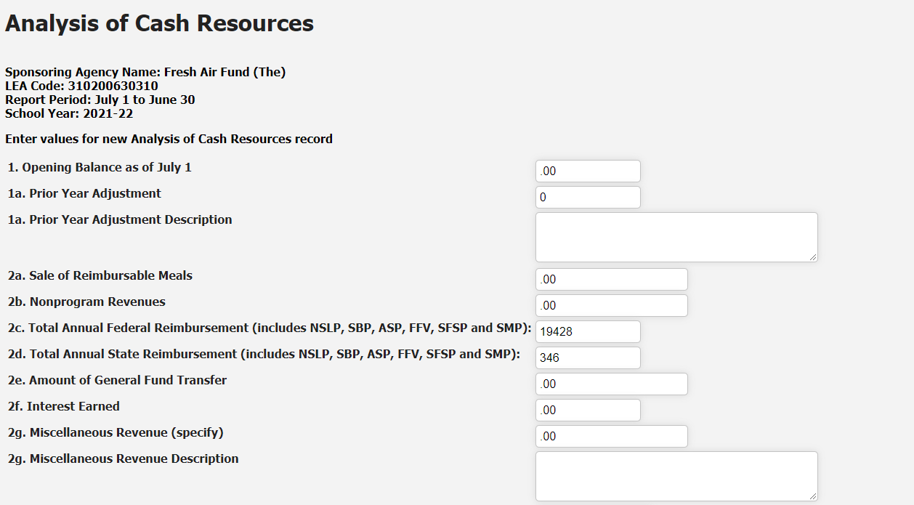
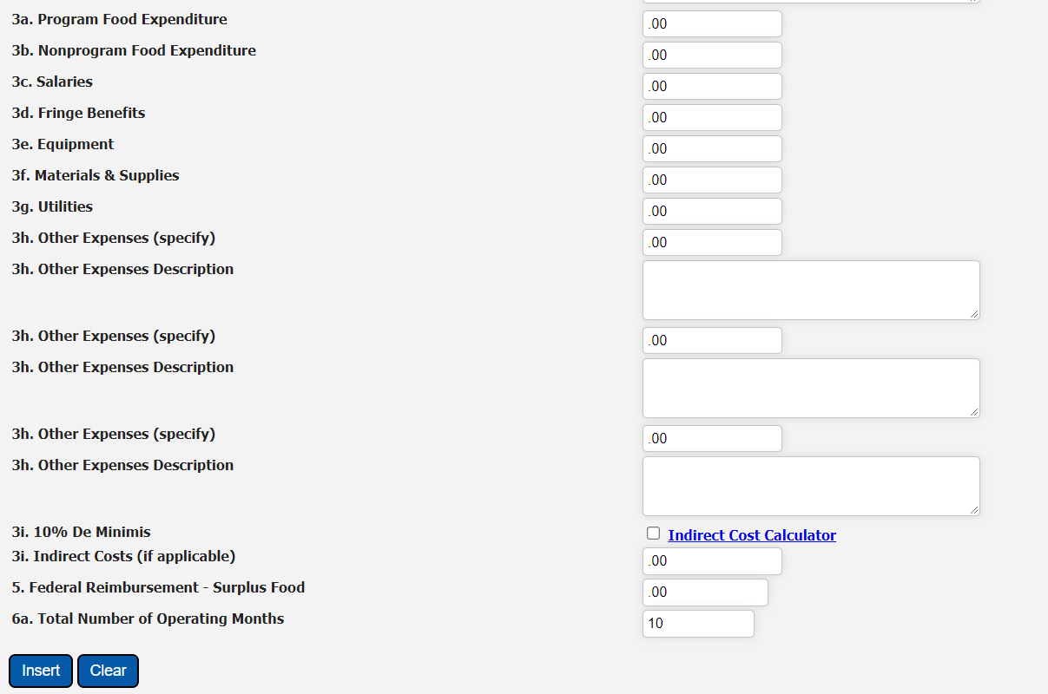
Reporting Requirements for Non-public SFAs, Charter Schools and RCCIs
Cash Analysis
Reported through the Child Nutrition Management System (CNMS)
Reported Annually
Submission Deadline: September 30
Notes:
Non-public schools, charter schools, and Residential Child Care Institutes must annually complete a statement of cash analysis. Non-public SFAs and charter schools must also submit copies of their balance sheet and profit & loss statement at the time they submit their Cash Analysis. The Audit team may request additional documentation to justify costs reported.
All revenue and expenses of the non-profit food service account must be reported for the time period, July 1 to June 30. This includes SFAs revenues and expenses from summer food service program operations.
Once submitted the Child Nutrition Audit team will review these financial reports to determine if costs were reported correctly and to calculate each SFAs net cash resources. SFAs cannot have a fund balance in excess of 3 months average expenditures and cannot transfer funds out of the nonprofit school food service account to support other non-food service-related expenses.
SFAs with more than 3-months average expenditures are considered to have an excess fund balance.

Slide 14
Excess Fund Balances
  Schools must spend down their excess funds by June 30th of the current school year
    Extensions beyond the June 30th deadline will be granted on a case-by-case basis
    Adjustments can only be made by school submitting a new plan for approval
  Program funds must be used only for program purposes – improving the quality of food served, or purchasing needed supplies, services, or equipment
  Schools should not start implementing their spend down plan until approved by CN Audit
    Unallowable costs will need to be replenished
  Excess Fund Balance is not a separate account
Notes:
To maintain the nonprofit status required for the food service account, the fund balance (net cash resources) of the account must not exceed three month's average expenditures at any time. SFAs with more than 3-months average expenditures are considered to have an excess fund balance and must implement a plan to resolve its excess fund balance.
SFAs with excess fund balances will receive an e-mail notification from the Audit Team which will include the process for submitting your excess fund balance spend down plan.
The audit team will review each plan and SFAs will be notified when their proposed plan has been approved. Once approved adjustments can only be made by the school submitting a new plan for approval.
If an SFAs plan or part of a plan is denied, the SFA will have the opportunity to submit a new or adjusted proposal.
Schools must spend down their excess funds by June 30th of the current school year. Extensions beyond the June 30th deadline may be granted on a case-by-case basis.
Program funds must be used only for program purposes – improving the quality of food served, or purchasing needed supplies, services, or equipment.
Please keep in mind that a school should not start implementing their spend down plan until it has been approved by the Audit team. Additional factors may contribute to the calculation of the excess fund balance.
If there are costs that have not been approved and are found to be unallowable, the school will be required to reimburse their nonprofit food service account.
Your excess fund balance is not a separate account from your nonprofit food service account. This is simply the amount of the nonprofit food service account that is in excess of your 3 month average expenses.

Slide 15
Meal and Meal Quality Improvement – offer a wider variety of fresh local fruits and vegetables; offer entrée items that may otherwise be cost-prohibited like higher quality cuts of meat
Service and Atmosphere – invest in marketing materials like digital signage and banners; upgrade the hardware of your POS system; redesign and purchase new serving lines that keep food hotter or colder and allows for better merchandising
Staffing – hire additional food service staff to expand menu offerings and do more scratch cooking; increase staff wages or offer bonus/incentives to staff if wage increases are not sustainable; hire a maintenance technician and/or custodian for food service
Equipment – replace small equipment and small wares; replace big kitchen equipment and upgrade for efficiency, for example purchasing a combi oven; increase storage capacity by adding refrigerator/freezer units; invest in reusable trays; buy a salad bar or refrigerated buffet table; purchase equipment to offer alternative and innovative meal deliver models like Breakfast in the Classroom or Grab & Go Breakfast
Staff Training and Professional Development – Offer a training for your management-level staff; provide additional training and professional development for staff as it relates to improving the food service program and to meet professional standards requirements
Nutrition Education- launch a “harvest of the month” club, start a school garden, have cooking demonstrations to highlight menu items
Allowable Costs for Spending Down Excess Funds
Notes:
This slide lists some examples of allowable costs that can be part of your SFAs spend down plan, including, but not limited to, improving the quality of the meal, purchasing kitchen equipment, hiring additional staff and nutrition education.
Additional detail on allowable and unallowable costs can be found on our Child Nutrition website under the Financial Management Tab.

Slide 16
Unallowable Uses of Excess Funds
  Capital Improvement Projects
  Costs associated with remediation or repair to a school building (i.e. plumbing, heating, air conditioning) that would add to the permanent value of the school building
  Multi-year Projects
    Allowing net cash resources to build up in the food service account for an extended period to save for a future project is unallowable. If the proposed expenditure project is a construction project, construction projects are typically not allowable.
  Carry-over of Excess Funds for Multiple Years
    To maintain the nonprofit status required for the food service account, the fund balance (net cash resources) of the account must not exceed three month's average expenditures at any time.
Notes:
Program regulations at 7 CFR §201.14(a) and §220.7(e) require that revenues received by the nonprofit school food service are to be used only for the operation or improvement of such food service, except that, such revenue shall not be used to purchase land or buildings unless otherwise approved by the FNS, or to construct buildings.
Historically, FNS has not approved the cost of building purchases because program funds are made available to help support the costs of nutritional benefits for children in school settings and not to construct school related facilities. The goal is to ensure that an SFA maintains the necessary funding to operate the program as required by the SMPs’ authorizing legislation and regulations, and that the NSFSA is not used to cover major expense that should be borne by the school district’s general funds (i.e., capital infrastructure costs).
The costs of building a kitchen are analogous to the costs of constructing school buildings, which historically have been borne by the school district with general or capital improvement funds. Similarly, such capital infrastructure costs should be borne by the school district just as the school building and its contents should be.

Slide 17
Negative Fund Balance
SFAs cannot carry negative fund balances from year-to-year
Negative fund balances are an indication of bad debt, which is an unallowable expense
Documentation must be provided showing a transfer from another fund, such as the general fund
Notes:
A negative fund balance exists when all net cash resources have been depleted, and the resulting negative balance constitutes a liability to the organization. Any negative balance in the account at the end of the year must be cleared by funds from non-federal sources, such as the general fund. A school food authority cannot carry a negative fund balance (Net cash resources) into the next school year.
As stated previously, the CN Audit team will review SFAs ST3 or Cash Analysis financial reports to determine if costs were reported correctly and to calculate net cash resources. SFAs with a negative fund balance will receive an e-mail notification requesting documentation showing a transfer from another fund, such as the general fund, to the non-profit food service account. Additional technical assistance and guidance will be provided as necessary.

Slide 18
Paid Lunch Equity (PLE) Exemption
2023-24 SY ONLY
SFAs with a positive or zero balance in their non-profit food service account as of June 30, 2022 may be exempt from PLE
  Elect on SFAs Annual Information Page in CNMS
SFAs utilizing the PLE Exemption can:
  use their nonprofit school food service account funds to reduce the average price charged for paid lunches
  use federal funds within the non-profit food service account to pay off any outstanding meal debt incurred in the current school year
    Can’t be used to pay off outstanding debt that incurred in previous school years
Notes:
Per Section 752 of Division A of the Consolidated Appropriations Act, 2023 (PL 117-328), for School Year 2023-2024, only SFAs that had a negative balance in the nonprofit school food service account as of June 30, 2022, are required to establish a price for paid.
SFA’s with a zero or positive balance in their non-profit food service account as of June 30, 2022 are exempt from the PLE requirements. This means that these SFAs may use their nonprofit school food service account funds to reduce the average price charged for paid lunches. SFAs may reduced the price to zero and not charge paid students for meals for the 23-24 school year only.
Schools should carefully review their budgets before adjusting their paid lunch prices in SY 2022-23. Some considerations include:
Reimbursement is still based on eligibility of the child;
Increased food costs; and
Fluctuation in participation.
Meal quality should not decrease if a school decided to lower their paid lunch prices.
In addition, SFAs can use federal funds within the non-profit food service account to pay off any outstanding meal charges incurred in the current 23-24 school year; however, non-profit food service account funds cannot be used to pay off outstanding meal debt that incurred in previous school years. The SFA must ensure the SFAs non-profit FS account is reimbursed for all outstanding meal charges by no later than June 30th of each school year.
As a reminder, although paid lunch pricing requirements do not need to be met, SFAs will still need to report their prices in CNMS. If your SFA is not charging for meals because you are utilizing the PLE waiver, you must enter “0” in the price field. Instructions for completing your SFA Annual Renewal and electing the PLE exemption and reporting prices are posted on the Child Nutrition website.

Slide 19

Questions
Contact Information
Audit Team: cnaudit@nysed.gov
Training Team: cntraining@nysed.gov
Child Nutrition Program Office: 518-473-8781
CN Representative for questions specific to your SFA
Notes:
Thank you for participating in this webinar today. Now we will answer the questions that have been submitted throughout today’s presentation.
You may always contact the Training Team with additional questions at:
cntraining@nysed.gov
Or contact your CN Representative for questions specific to your SFA

