Slide 1


Food Allergy Management for School Nutrition Professionals
1 hour Professional Standards Training
Notes:
This PowerPoint will contribute 1 hour towards Professional Standards training requirements. This training reviews Food Allergy Management for School Nutrition Staff.

Slide 2
1 in 13 Children has a Food Allergy
Notes:
Food allergies affect 1 in every 13 children in the U.S. This means roughly two students in every classroom.
Food allergies are on the rise. Just 30 years ago, food allergies were not even on the radar, but now the numbers are climbing. These numbers increased by approximately 50% between the year 1997-2011.
How common are reactions at school?
One in six children with food allergies will have an allergic reaction while at school.
In addition, one in four students who are given epinephrine, which is the medicine used to treat serious allergic reactions at school, had no previous history of food allergy.
So, what is a food allergy?

Slide 3
What is a Food Allergy?
The role of the immune system is to protect the body from germs and disease
A food allergy is a medical condition in which exposure to a food triggers a harmful immune response
When a person eats a food they are allergic to, the immune system attacks proteins in the food that are normally harmless.
  The proteins that trigger the reaction are called allergens.
Notes:
Food allergies are caused when the immune system mistakenly targets a normally harmless food protein as a threat and attacks it. This normally harmless protein is called an allergen.
A food allergic reaction can be very serious and may even cause death
There is no cure for food allergies. Strict avoidance of food allergens, early recognition, and management of allergic reactions to food are the important measures utilized to prevent serious health consequences.

Slide 4

Food Intolerance vs. Food Allergy
A Food Intolerance affects the Digestive System and is not Life Threatening
A Food Allergy affects the Immune System and can be Life Threatening
Notes:
People often confuse food intolerance with a food allergy, but they are different. We have discussed what a food allergy is, so lets see how an allergy differs from an intolerance.
Food intolerance is when a person cannot digest a certain food. We have all heard of lactose or milk intolerance, right?
An intolerance may cause some of the same symptoms as an allergy, but an
intolerance does not involve the immune system and is not considered life-threatening.
Food allergies involve the immune system and can be life threatening. We will be reviewing food allergy symptoms later in this presentation.
Physicians test for the indicators of food allergies and diagnose food allergies.
Food allergies and food intolerances need to be taken seriously.

Slide 5

What is
Celiac Disease?
Autoimmune Disease
Triggered by eating gluten-contained in wheat, rye, and barley products
Damages the small intestine
Interferes with nutrient absorption
Symptoms vary
Notes:
Food Service Professionals should also be familiar with Celiac disease.
Celiac disease is an autoimmune disease. When people with celiac disease eat foods containing gluten, their immune system responds by damaging the delicate lining of the small intestine. Gluten is a protein found in wheat, barley, and rye. Symptoms vary or there may be no symptoms at all. Possible symptoms can include: nausea, vomiting, heartburn, diarrhea, gas, cramping, itching, skin rash, fatigue, malnutrition, and weight loss.
It is important to know that other grains may not be gluten free due to being processed on the same machines as wheat, barley, and rye; with the most common grain being oats. For oats to be gluten free, they have to be Certified Gluten Free.
If left untreated, people with celiac disease are at-risk for serious health consequences. The only treatment for Celiac disease and the inflammation of the small intestine caused by gluten protein exposure is a life long gluten free diet.

Slide 6
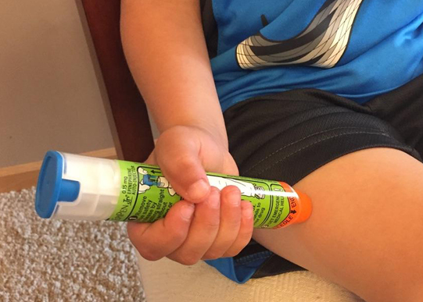
What is Anaphylaxis?
A severe, life threating reaction
Requires immediate response and medical attention
Notes:
The most dangerous allergic reaction is called anaphylaxis. This is a severe, life threatening allergic reaction which requires immediate response and medical attention.
We have discussed how common food allergies are and the serious implications these allergies have for the students you serve daily. It is clear that food allergies, and particularly anaphylaxis, are a real threat. So what can we do as food service professionals?
In the next slides we will be discussing allergens and the precautions that you, as a Food Service Professional, will need to utilize when ordering, receiving, storing, preparing, and serving students with food allergies. It is everyone’s responsibility to create an environment where students with food allergies can be safe.

Slide 7
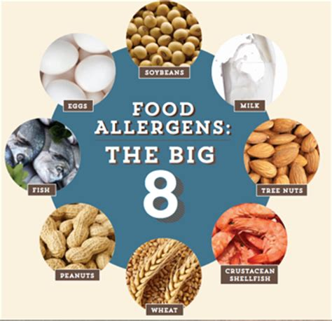
What Foods Cause Allergic Reactions?
Most are caused by 8 Foods (“The Big 8”)
Notes:
While more than 160 foods can cause allergic reactions in people with food allergies, the law identifies the eight most common allergenic foods. These foods account for 90 percent of food allergic reactions, and are the food sources from which many other ingredients are derived. “The Big 8” allergenic foods are milk, eggs, peanuts, tree nuts, wheat, soybeans, fish, and shellfish.
To help Americans avoid the health risks posed by food allergens, FDA enforces the Food Allergen Labeling and Consumer Protection Act of 2004 (the Act). The Act applies to the labeling of foods regulated by FDA which includes all foods except poultry, most meats, and certain egg products, which are regulated by other Federal agencies. The Act requires that food labels must clearly identify the food source names of any ingredients that are one of the major food allergens or contain any protein derived from a major food allergen.
As a result, food labels help us identify offending foods or ingredients so they can more easily be avoided by consumers with food allergies.
If a student has a documented allergy to a food other than the foods listed as the “Big 8”, thorough label reading and knowing each ingredient in the foods on your menu is a must. If you do not recognize the name of an ingredient in the food product, you should always check with your supervisor.
Now that we understand food allergies; let’s look at the steps you will take to ensure the students you serve are safe.

Slide 8

Food Allergy Identified Students
Students requiring meal modifications must be identifiable to staff
Staff must understand the meal modification required to each identified student
Notes:
The first step in the process is being able to identify students with food allergies and know what food(s) they must avoid.
Any food allergy or food intolerance could be considered a disability. Accommodations must be made at no additional cost to the student.
Disability must be determined by a State licensed health care professional who is authorized to write prescriptions (a Physician, Physician’s Assistant, or Nurse Practitioner) and a written statement must be provided to the school. The medical statement must include the food to be avoided (allergen), a brief explanation of how exposure to the food affects the child and recommended substitute(s). The school should retain copies of the statement when making meal modifications. Usually the School Nurse maintains copies of medical statements.
If the Child’s Individualized Education Program (IEP) or 504 plan includes the information required in the medical statement, or if the school obtains written medical verification of the impairment during the IEP/504 plan process, it is not necessary for the school to also obtain a separate medical statement. The 504 Plan refers to Section 504 of the Rehabilitation Act of 1973. This act applies to any entity receiving federal money and it applies to students with various medical conditions, including food allergies. Schools participating in Child Nutrition Programs receive federal money and must comply with the regulations in this Act and also to the USDA regulation 7 CFR 15b-Non Discrimination on the Basis of Handicap in Programs or Activities Receiving Federal Financial Funds.
If the medical statement is provided and does not fully explain the modification needed, the school should immediately contact the child's parent or guardian and ask the family to provide an amended medical statement as soon as possible. However, clarification of the medical statement should not delay the school from providing the meal modification.
In addition, if the school receives a modification request outside the regular meal pattern before a child’s parent or guardian is able to submit the required medical statement, the school may not unduly delay providing the modification while awaiting the medical statement. Instead, the school should begin providing a reasonable modification to keep the child safe, and request the family provide a medical statement signed by a State licensed healthcare professional to support the meal modification as soon as possible.
Special Note: Health concerns or life style choices such as a preference that a child eat a specific diet because the parent believes it is healthier for the child are not considered a disability and do not require the school to make a meal modification.
Know your school’s procedures for Student Identification and meal modification:
Food Service must obtain up to date lists of all students with allergies and must update the records at the Point of Service. One best practice is to keep files with pictures of each student so students are easily identifiable.
All staff must be trained on proper procedures, including all substitute aids working in the kitchen and/or cafeteria. Each school will have different procedures developed for their facility’s needs and each student’s modifications will be individual to that particular student. If you are unsure of a procedure , always ask your supervisor.

Slide 9
Identifying Known Allergens
Best Practices for Food Identification Procedures:
Identification of allergens
Maintain food labels from each food served to a child with allergies
Maintain contact information of vendors to access food ingredient information
Maintain Allergen List- The list is a reference, staff must still check labels
Notes:
The next step is to identify known allergens in the inventory of food products within your kitchen.
Each student with a food allergy should have a medical statement on file. The medical statement will list the allergen(s) of concern for each student. A list of food allergies from each medical statement will identify the allergens which food service staff will have to be aware of when handling food.
It is important to keep food labels from each food product served to a child with allergies in case a problem is encountered after a child eats a particular food.
The School Food Authority(SFA) should always have a contact person from each food vendor who can readily obtain food ingredient information.
An allergen list will list all foods on the menu and the allergens contained in each food. The list is a useful and quick reference to use as a starting point but staff must still check labels and ingredient lists for all known allergens and possible hidden sources.
Allergens from hidden sources are ingredients you would not normally associate with a food. This is why thorough label reading is so important. The allergen list will change as food products change. Always check with your supervisor if you do not recognize the name of an ingredient on a food label.
Now let’s look at a few food labels to see how allergens are noted.

Slide 10
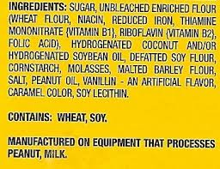
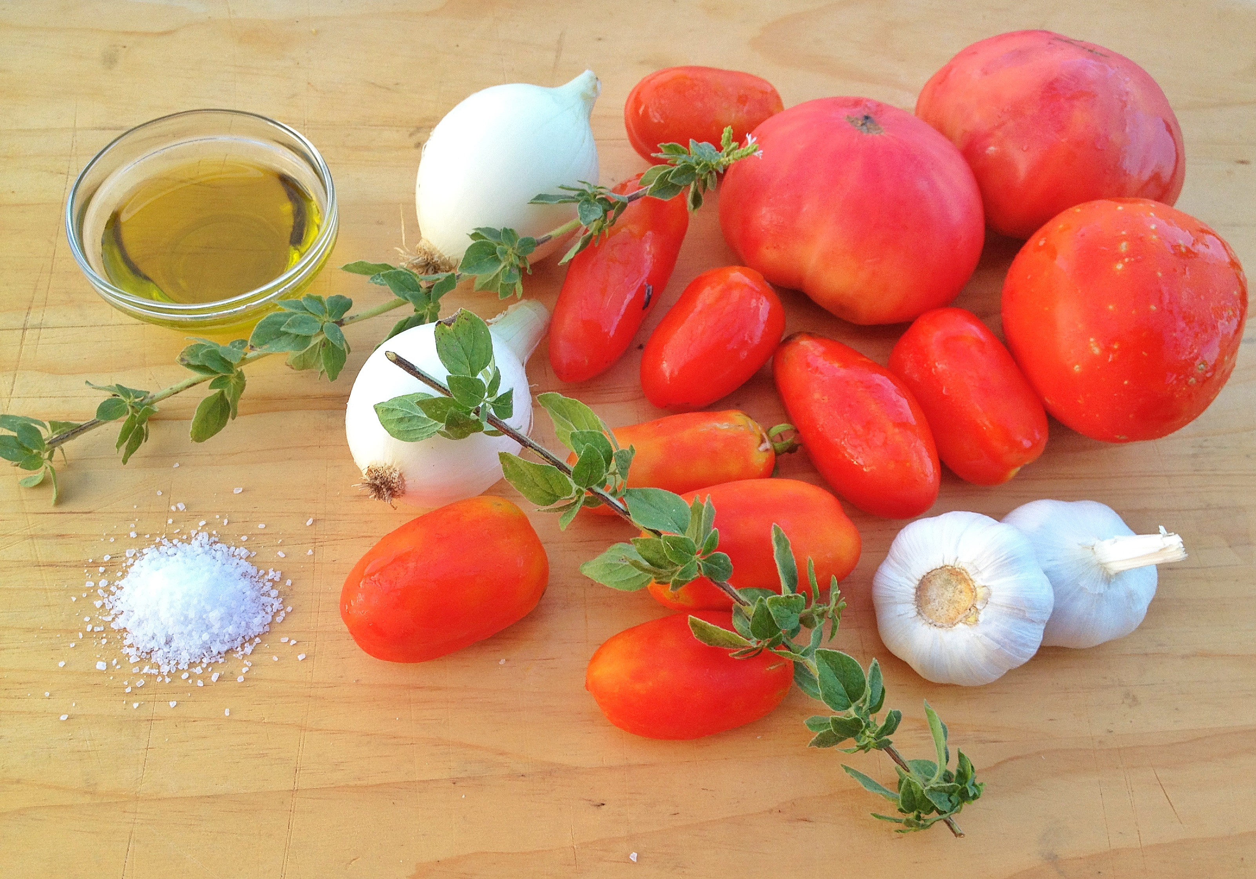
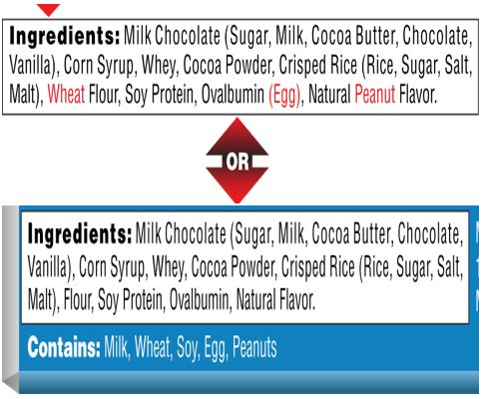
Know Your Ingredients!
Notes:
Now that allergies and allergens have been identified; cooks, prep staff, and service staff will have to know the food products and ingredients that they are working with. Many food products contain allergens. This means reading all food labels and knowing ingredients in recipes. This is true even if allergens have been identified on the allergen list because products can change and do change over time. Vendors may also substitute food products on orders for multiple reasons. Kitchen staff must be familiar how labels indicate allergens.
As discussed earlier, Foods containing one of the “Big 8” must note the allergen containing ingredients on food labels by law.
This slide shows examples of how allergens are listed on food labels.
Allergens can be listed in two ways :
-In plain language contained in the ingredient statement – allergens may be noted in parentheses or in a different color print after the ingredient containing an allergen- like the example in the top left label
OR
-Following the ingredient statement in a “contains statement” – a statement listing the allergens contained in the food product- like the example in the bottom left label.
In addition, allergens may be listed in a statement of how the product was manufactured or processed. This statement will name what allergens may have been introduced into the food product during the production of the food because of shared machinery or shared production space- like the label on the right.
Read every label, every time
Ingredients can change and some products may contain hidden allergens. As mentioned previously, look out for product substitutions. Vendors substitute products frequently and substitutes may contain different ingredients than the original product contained.
It is imperative that you know the ingredients in food products prepared in house. You should refer to recipes and ingredient labels. If you are unsure of a food product’s ingredients, always check with your supervisor.
Be aware of allergies students may have that are not covered by the mandated labeling regulations of the “Big 8”. This means any food item outside of the Big 8; in this case, thorough label reading is a must.

Slide 11
The Flow of Food in the Kitchen
What is Cross Contact?
Each process from receiving all the way to service of food can introduce an opportunity for cross-contact
Cross-contact occurs when an allergen is inadvertently transferred from a food containing an allergen to a food that does not contain the allergen
Cooking does not reduce or eliminate the chances of a person with a food allergy having a reaction to the food eaten
Notes:
It is time to review each step in the kitchen where the opportunity for cross- contact presents itself. Cross-contact occurs when an allergen is transferred to a food that does not contain that allergen. There are many opportunities for cross-contact to occur as food flows through the kitchen.
Cooking food does not reduce or eliminate the chances of the person with the allergy of having a reaction. As food service professionals, it is your job to learn all measures that can be taken to avoid cross-contact.
Let’s look at each point in the flow of food where there is a risk for cross-contact and what can be done to prevent the risk:
When storing food:
-Store allergen containing foods separately and clearly label foods.
When preparing food:
-Scrub down counters and tables with soap and water, using a fresh bucket of wash solution and cloth, before and after making food. Consider having a separate area for preparing allergen free food, if possible.
-Wash your hands with soap and water before touching anything else if you have handled a food allergen. Soap and water will remove a food allergen. Sanitizing gels or water alone will not remove an allergen.
-If you are making several foods, cook the allergy-safe foods first. Keep the safe foods covered and away from other foods that may splatter.
-Always put on a new apron when handling an allergen free food.
-Use utensils, cutting boards and pans that have been thoroughly washed with soap and water.
-Consider using separate utensils and dishes for making and serving safe foods. Some kitchens choose a different color to identify the safe kitchen tools.
-If you make a mistake, you cannot just remove an allergen from a meal. Even a small amount of cross-contact makes a food unsafe. The allergen free food product will have to be made again.
In the service area:
-Always identify special allergen free food orders- clearly label, hold separate from other foods , and hand the allergen free food directly to the student it was prepared for.
Here are things to always keep in mind when preparing an allergen free food:
*If you are unsure of anything at all regarding food preparation and service to children with food allergies, always check with your supervisor.
*Whenever you change tasks while preparing or serving an allergen free food order for a student, be mindful of the risk of cross-contact.
*If you think there may have been accidental cross-contact by splattering etc., always err on the side of caution and make the allergen free food again.
*If you have to make a menu change for a student with an allergy, always review the change with your Director or their designee.

Slide 12
Best Practices
Store allergen containing foods separately and clearly label foods.
Scrub down counters and tables with soap and water before and after making allergen free food (use a new bucket of wash solution and cloth).
Always wash your hands with soap and water before handling allergen free foods.
If you are making several foods, cook the allergen free foods first and keep foods covered and away from other foods that may splatter.
Always put on a new apron when handling an allergen free food.
Use utensils, cutting boards and pans that have been thoroughly washed with soap and water or use a separate set of equipment.
If you make a mistake, the allergen free food product will have to be made again
Always identify special allergen free foods prepared for a student- label the food clearly and hold it separate from other foods.
If a change of menu offering has to be made for a student with a food allergy, always check with your Director or their designee.
Notes:
To summarize, always store allergen containing foods separately and clearly label foods.
Scrub down the counters and tables with soap and water before and after making allergen free food. Always use a new bucket and cloths with wash solution.
You should always wash your hands with soap and water before handling allergen free foods.
If you are making multiple food items, always cook the allergen free foods first and keep foods covered and away from the other food.
Use utensils, cutting boards, and pans that have been thoroughly washed with soap and water or use a separate set of equipment.
If you make a mistake, the allergen free food product will have to be made again.
Always identify special allergen free foods prepared for a student. Always label the food clearly and hold it separate from other foods.
If there is a change in a menu offering for a student with a food allergy, always check with your director or their designee.

Slide 13

Recognizing an Allergic Reaction
Notes:
Even with strict adherence to policies and protocols, food allergy reactions may occur.
Food allergy symptoms usually develop within a few minutes to two hours after eating the offending food. This means students may exhibit the first symptoms of a reaction while they are in or near the cafeteria. There is no way to predict how severe a reaction will be. A very minor reaction may develop into a dangerous situation quickly. Also remember that past reactions are not definite predictors of how a future reaction may occur.
What do School Food Service Employees Need to Know?
•How to recognize an allergic reaction
•How to respond to an allergic reaction
Quickly recognizing symptoms is critical and can prevent dangerous health consequences.

Slide 14
Symptoms
  Skin rash, itching, hives
  Swelling of the lips, tongue or throat, trouble swallowing
  Shortness of breath, trouble breathing, wheezing
  Stomach pain, vomiting, diarrhea
  Anxiety and confusion
  Dizziness, feeling lightheaded, fainting
Notes:
Here are common symptoms to be aware of:
Skin rash, itching, hives
Swelling of the lips, tongue or throat, trouble swallowing
Shortness of breath, trouble breathing, wheezing
Stomach pain, vomiting, diarrhea
Anxiety and confusion
Dizziness, feeling lightheaded, fainting
Be aware that some students may exhibit symptoms who have never had a reaction in the past and have no documented allergies.

Slide 15
Common Descriptions Used by Children
  My tongue feels big
  There is something stuck in my throat
  My skin is itching
  My tongue is burning or hot
  My lips feel tight
  My tummy hurts
  My eyes are itching or burning
  My chest is tight
  It feels like something is poking my tongue
  Something is wrong or Something bad is happening
Notes:
Smaller children may not understand what is happening and will describe what they are feeling. Here are some common descriptions younger children may use:
My tongue feels big
There is something stuck in my throat
My skin is itching
My tongue is burning or hot
My lips feel tight
My tummy hurts
My eyes are itching or burning
My chest is tight
It feels like something is poking my tongue
“Something is wrong.” or “Something bad is happening.”

Slide 16
Responding Appropriately
  Seconds count, your quick action can save a life.
  Know your school district’s food allergy policies and procedures.
  Always call the school nurse or designee.
  Do not leave the student alone and do not send the student to the school nurse alone.
  Remain available to assist as directed.
  If you are the first staff to observe symptoms of a reaction; be available to speak with first responders.
Notes:
Recognizing that something is wrong and responding appropriately can save a life.
Ensure you know your school district’s food allergy policies and procedures.
Always call the school nurse or designee and never leave the student alone or send them to the nurse’s office alone.
If you were the first staff to notice symptoms, you will be helpful in describing the reaction to first responders.
Always be available to assist as directed. For example, if the nurse or designee has to inject epinephrine, they will need someone to call 911, other students may need to be cleared from the area, or first responders may need to be directed to the scene.

Slide 17

This concludes Food Allergy Management for School Nutrition Professionals
New York State Education Department
Child Nutrition Program Administration
(518)473-8781
CN@nysed.gov
Notes:
Thank you. This concludes Food Allergy Management for School Nutrition Professionals. Remember to record completion of this training for Annual Professional Standards Training requirements.
If you have any additional questions, please do not hesitate to contact us.

