Slide 1
Welcome
NYSED Child Nutrition Program Administration
2024-2025 Food Service Management Company (FSMC) Contract and Extension Training
**There will be no sound until the presentation begins
Notes:
Good afternoon- welcome to the New York State Education Department Child Nutrition Program Administration’s webinar on Food Service management company contracts and extensions. Presenting today is MaryBeth Sotir and answering questions is Stacy Roney and Jamie McMillian. A copy of today’s presentation was emailed to all registrants. If you did not receive a copy, please email Cntraining@nysed.gov.

Slide 2
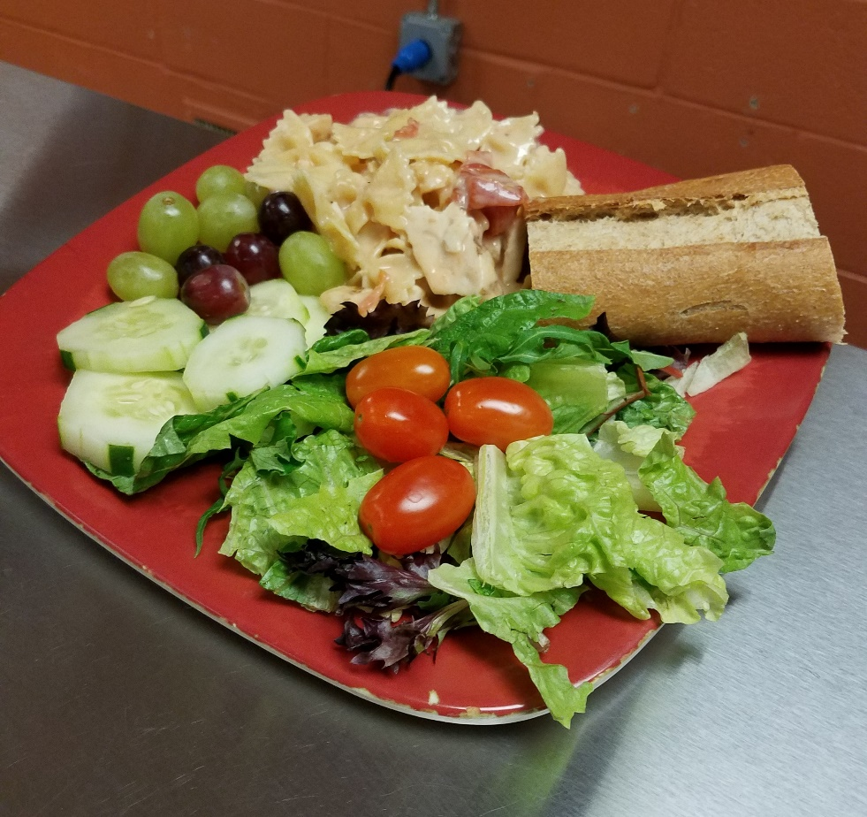
Today’s Discussions
Regulatory Requirements
Process Overview
Pre-bid Process
Bidding Requirements
Administering FSMC Contracts
FSMC Extensions
photo courtesy of Pinebush CSD
Notes:
During today’s presentation we will discuss the regulatory requirements that pertain to food service management company contracts and the entire process of obtaining and managing food service management company contract.

Slide 3
Food Service Management Company
NYS Operations:
What is it?
182 SFAs operate with a FSMC
17% of NYS total SFAs
A commercial enterprise, public or nonprofit organization, or an individual that enters into a contract with a school food authority to run any aspect of the food service operation, whole or in part.
Notes:
A Food Service Management Company, which we will refer to throughout this presentation as a management company, is a commercial enterprise, public or nonprofit organization, or an individual that enters into a contract with a School Food Authority, referred to as SFAs, to run any aspect of the food service operation. Contracting with a management company is different then contracting for vended meals. If the meals are prepared and dropped off by a vendor, then that would not be considered a food service management company.
In NYS there are a total of 1,083 School Food Authorities operating in the Child Nutrition Programs and of those 183 operate with a Management Company.

Slide 4
Regulatory Authority
Federal Regulations
7 CFR 210.16 – Food Service Management Companies
2 CFR 200 - Uniform Guidance for Federal Awards
New York State Regulations
Commissioner Regulations Part 114.2
General Municipal Law 103
Education Law 305.14a
Chapter 533, Section 924 of the Laws of New York
Photo courtesy of Kenmore Tonawanda UFSD
Notes:
The Child Nutrition Programs are regulated by both federal and state regulations. These regulations ensure program integrity, nutrition quality, and effective collaboration between SFAs and FSMCs and outlines important provisions related to management companies.
New York State law chapter 533, section 924, was passed in 2023, this law requires that all food service management companies must disclose ingredient list and nutritional information to school districts for all meals that in which they provide. The management company must also consolidate nutrition information for any meal that is comprised of separate individual ingredients. The SFA must publish the nutrition information on the school district’s public website.

Slide 5
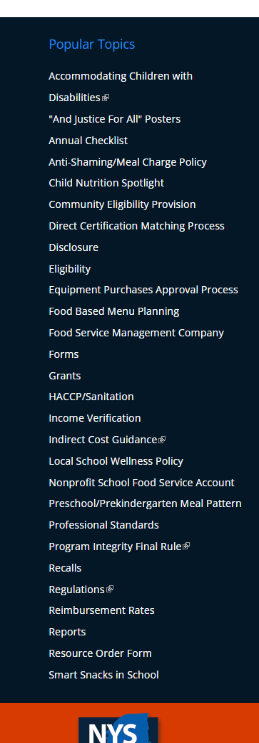
Memo/Prototype
Popular Topics > Food Service Management Company
Prototype Contracts – required
Type II – For SFA’s participating in our programs
Type II- FSMC contract extension (years 2-5)
www.cn.nysed.gov/fsmc
Notes:
The Child Nutrition office requires SFAs to use a prototype contract and extension. These documents are updated annually and posted on the Child Nutrition website. The prototype contract serves as the solicitation document as well as the executed contract.
The prototype documents that are to be used for the 2024-25 school year will be posted on the Child Nutrition website by the end of March.

Slide 6
Invitation For Bid (IFB)
State requirement
Awarded to lowest responsive and responsible bidder
Formal method of procurement resulting in a fixed price contract
Notes:
New York State regulations required that an Invitation for Bid, referred to as an IFB, must be utilized when obtaining a management company to operate school foodservice. An IFB is the type of solicitation used in a competitive sealed bidding. IFBs are awarded to the lowest responsive and responsible bidder and results in a fixed-price contract.

Slide 7
Fixed Price Contract
Price is fixed at the inception of the contract and guaranteed for a specific period of time
One-year contract with the option of 4 yearly extensions
Annual contract price has potential to increase based on the CPI-U
Notes:
Fixed price contracts results in a price that is set at the inception of the contract and guaranteed for a specified period of time. The contract is a one-year contract with the option of four annual extensions, the contract price has potential to increase annually based on the Consumer Price Index-Urban (CPI-U).

Slide 8
Process Overview
Pre-Bid Process
SFA prepares prototype solicitation
Approval sent to SFA
Bidding Process
Advertise the bid
Evaluate bids- lowest responsible/responsive bidder
Awarding Contract
Award Contract- Signed off by both parties
Approval sent to SFA
Submits to CN for approval
Open sealed bids
Submit to CN for final approval
Notes:
There are 3 steps the SFA must follow to obtain a food service management company. First is the pre-bid process, then the bidding process and the last step is awarding the contract. We will be going through each of these in detail beginning with the pre-bid process.

Slide 9
Pre-Bid Development
Provide bidders with enough information to submit an accurate and reasonable bid
Protect the financial and nutritional integrity of the SFA
Create a fair and equitable bidding process
Notes:
The first step of the process is complete the prototype in a manner that fits the SFAs needs. The goal is to provide bidders with enough information to submit an accurate and reasonable bid and create a fair and equitable bidding process all while protecting the financial and nutritional integrity of the SFA. The prototype is a large document that contains many different clauses that help sculpt program operations. The SFA should read through the entire protype to familiarize themselves with the included information.
The SFA must complete all section of the prototype as this will give management companies valuable information needed to understand how the SFA operates. This includes school building information, program participation, insurance requirements and performance security. The SFA also determines the party responsible for various program operations throughout the prototype. A few examples are the party responsible for Professionally cleaning of ducts, transporting USDA foods, equipment repairs
Fingerprinting employees.

Slide 10
Pre-Bid Process
Prior to bidding, SFAs need to decide on:
Option 1 or 2
Bid option 1 – 1 bid price for breakfast and lunch
Bid option 2 – separate bid price for breakfast, lunch and snack
Options A, B or C
Option A – Guaranteed return to the SFA
Option B – Break Even
Option C – General Fund Subsidy
Will factor in how a FSMC determines their bid price
Notes:
The next step in the pre-bid process is selecting how the SFA wants the food service management company to bid on the contract.
There are two bid options to choose from, the first Bid option is the management company bids only one price for both breakfast and lunch. The second Bid option is when the management company would bid a separate price for breakfast, lunch, and/or snack.
With both bid options, the SFA would also have to decide at the end of each contract year if the nonprofit food service account would have a guaranteed return, break even or a general fund subsidy.
The guaranteed return is the amount that is left in the nonprofit food service account at the end of the school year. The guaranteed return must remain in the school food service account.
With break-even, the SFA is not required to put additional funds in the nonprofit food service account at the end of the year. This would leave your food service account at a break-even and not in a deficit.
General fund subsidy is the amount that the SFA would put into the nonprofit school food service account to cover the cost of the programs.

Slide 11
Schedules
Schedule A
Menus and related materials
Schedule B
Food, Beverage and Smallware Product Specifications
Schedule C
Local Wellness Policy
Schedule D
Cost Responsibility Detail Sheet
Schedule E
Itemized Inventory List
Schedule F
HACCP/Food Safety Plan- Responsibility
Schedule G
Staffing Schedules and Related Information
Schedule H
Direct Diversion Receipt and/or WBSCM Requisition status report
Schedule I
Additional Schedules (calendar, map, forms)
Notes:
With the pre-bid, there are schedules that SFAs must complete. We will discuss schedules A (menu), Schedule B (specifications), Schedule G (staffing) and Schedule H (USDA Foods) in detail.
Schedule C-Local Wellness Policy- A copy of the SFAs local wellness policy is required.
Schedule D- the cost responsibility detail sheet. The SFA determines if they are responsible or if the management company is responsible for specific incurred costs. An example of this would be the USDA processing fee.
Schedule E – Itemized inventory list
Schedule F – Sets the party responsible for the HACCP based food safety plan.
Schedule G – Sets the staffing and benefit requirements
Schedule I – Allows the SFA to include any additional pertinent information.

Slide 12
Schedules Continued
Schedule A
Menu and Related Materials
Develop a 21 Day Menu
Information on meal pattern requirements can be found on Child Nutrition Knowledge Center
www.cn.nysed.gov
NYSED staff can offer technical assistance in menu development
Production Records
Standardized Recipes
Regulations allow for the SFA to request the FSMC to submit 21-day menu with their bid
Evaluation Plan
Components and Quantity
Dietary Specification
Affordability
Nutrition Requirements
Student appeal
Notes:
Schedule A is for the menu and related materials. Federal regulations require that the SFA includes a 21-day menu within the solicitation for each program the contract will cover. For example, if the SFA participates in both breakfast, lunch, and snack, there would need to be three separate 21-day menus. The management companies will use the provided menus to determine their bid price by calculating food costs.
If a SFA does not have the ability to develop a 21-day menu, they can request that the management company submits a 21-day menu with their bid. However, if this option is chosen, an evaluation plan must be included. The plan would demonstrate how the SFA will evaluate the submitted menu for components and quantity, dietary specification, affordability, nutrition requirements and student appeal. It is important to work with our office if you have any questions or concerns when evaluating menus.

Slide 13
Schedules
SCHEDULE G
Staffing requirements
Staffing levels by building
Experience
Education
Retain current staff
Notes:
SFAs have the flexibility to set quality bid specifications which include food and beverage procurement standards and staffing requirements. With this, you can choose to set the staffing levels you wish to attain by building, experience, or education OR if you have current staff that you wish to retain, this would be done during the pre-bid process.
In regard to the food and beverage standards- remember, you are the ones who know what your students like and the quality of food that you want served in your cafeteria.

Slide 14
Schedules Continued
Schedule B
Schedule H
Food, Beverage and Smallware Product Specification
Name of Product
Description
Quality
Brand Name “or equal to”
Portion Size
Direct Diversion Receipt and/or WBSCM Requisition status report
FSMC pre-credit the SFA for the value of USDA foods
FSMC must provide additional credit for any donated foods not accounted for in the fixed price per meal
Notes:
Schedule B is the section to set specifications for the food, beverage, and small wares. Specific brand names are not allowed to included in the specifications, however, if specific brand names are listed the specification must also include "or equal to".
Schedule B is the SFAs chance to set the quality product that would be served in the school buildings. If it is included it in the specification, then the management company must follow it.
Schedule H – USDA Foods, the SFA must include the amount of USDA foods entitlement. This information can be found in direct diversion receipt or web scam requisition status report. The management company will use this information to pre credit the SFA for the value of USDA foods.

Slide 15
Pre-Bid Process
Email completed pre-bid document to CN@nysed.gov
Include – updated prototype, all schedules, all amendments and all addendum
Send in 30 days prior to letting bids
SFA will be notified via email once the pre-bid has been approved or if additional information or changes are needed
Notes:
The pre-bid document must be reviewed by Child Nutrition prior to going out to bid. Once the pre bid is complete, email the completed prototype document including all schedules, amendments or addendums to CN@nysed.gov, at least 30 days prior to going out to bid.
SFAs will be notified via email of any required change. Once the pre-bid is approved an email will be sent notifying the SFA of approval and indicate that they may proceed with advertising the bid.

Slide 16
Questions?
Notes:
Before we continue and discuss the advertising and administering of the contract, we’re going to take a moment and answer any questions you may have thus far. If you’d like to ask a question, please use the Q&A box in the lower corner to type and send it in to our staff to which we will answer for all viewers to hear.

Slide 17
Bidding Process
Advertise Bid
Must include time and place where bids will be received and publicly opened and read
At least 5 days shall elapse between first publication of advertisement and the date for opening and read
Bidder’s Conference
Private walk-throughs are not allowed
Sealed Bid
All bids submitted to the SFA must be sealed and cannot be opened until the specified time
FSMC cannot request an extension to the due date
Notes:
Once the SFAs pre-bid has been approved, the SFA can advertise the bid. The bid advertisement must include the time and place where the bids will be received and publicly opened and read. There must be at least 5 days between the first publication of advertisement and the date for the opening and reading. We highly suggest that you use more than the 5 days as we have seen situations where the newspaper did not run the advertisement on the correct date and the bid was only advertised for 4 days. If this was to occur, then the contract would be denied, and the process would need to be started from the beginning. To avoid such situations, our office suggest a 2 week timeframe.
Management companies are required to submit a sealed bid and all bids submitted to the SFA must be sealed and cannot be opened until the specified time. As we just stated, your bid advertisement will include all of this information. If you have a bidder’s conference, you want to include that information in the bid advertisement as well. A bidders' conference is when you invite all management companies to your school district to do a walk through of the facilities. If there are any questions, you can answer them during the conference however you would need to ensure that all questions and answers are sent to all management companies that attended along with those that are interested in bidding on your contract. It is important to note that Food Service Management Companies cannot have private walk-throughs or request an extension on the bid due date. If an extension of bid due date is required, the SFA must re-advertise the bid.
Remember, every decision must ensure the process is fair and equitable!

Slide 18
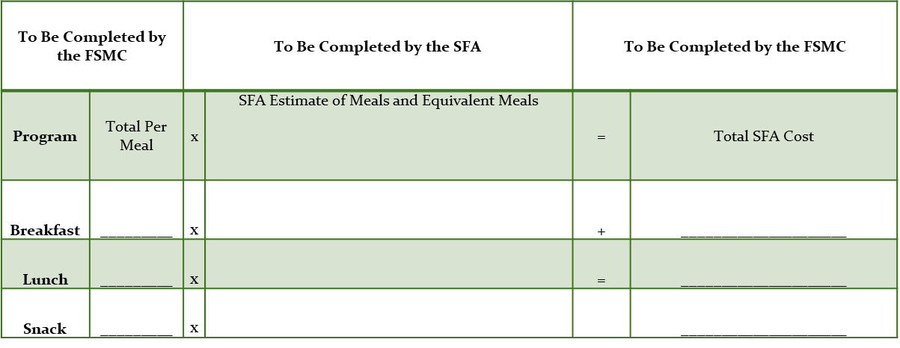
Bidding Process Continued
How to Determine Lowest Bidder:
Bid Option 2
Awarded to the lowest responsive and responsible bidder
Board minutes must be submitted if the lowest bidder was not awarded
SFA must be able to demonstrate why they were not responsive or responsible
Notes:
Once the bid has been advertised and bids have been sent in, it is time to award the contract to the lowest responsive and responsible bidder. If you do not choose the lowest bidder, you will need to supply board minutes and documentation that demonstrates why the lowest bidder was not responsive or responsible.
To determine which food service management company is the lowest bidder, you would look at the grand total provided on the bid by the companies. Shown on the slide is a screen shot of bid option 2- where the management company will add their per meal bid price and multiply it by the total estimate of meals and meal equivalents to get the total cost by program.
You also want to make sure that any other information requested in the bid was submitted by the management company, as this helps determine if the management company was responsive.

Slide 19
Bid Approval
Once SFA awards the bid and receives board approval, the bid must be submitted to NYSED for final approval
Submit one completed bid package to NYSED
cn@nysed.gov
Electronic signatures are allowed for the 2024-25 SY
SFA will be contacted if information is missing
Notes:
Once the contract is awarded to the management company, the contract must be signed by both parties. The final signed contract must be submitted to Child Nutrition for final approval. Our office will accept electronic copies with electronic signatures. Once the contract is approved, an email notification will be sent to the SFA. The management company should not be running any aspect of the program until the final approval is received.

Slide 20
Administering the Contract
SFA must provide oversight of the FSMC operations
Invoices
Meals + Meal Equivalents
USDA Foods
Procurement standards
Staffing requirements
21-day cycle menu
Any changes must be approved by SFA
Contract terms
Photo courtesy of Kenmore Tonawanda UFSD
Notes:
Now we're going to discuss the administering the contract. The SFA must have oversight of the management company and ensure contract terms are being followed. Invoices should be audited prior to issuing payment to ensure the SFA is being properly billed for meals and meal equivalents. Remember, you as an SFA will still play a big part in the operation of food service.
The SFA must make sure that the management company is utilizing the full USDA foods entitlement. The entitlement amount was included within the schedule in the pre-bid in which the management company pre-credited that amount when they developed the bid price. Any increase in the entitlement amount must be credited back to the SFA each year. In the rare event that the SFA did not use their entitlement, the SFA must credit the value back to the FSMC. This should be thoroughly investigated prior to crediting the FSMC and we suggest reaching out to our office prior when and if this situation arises.
The SFA should also ensure the management company is purchasing the products that were specified in the bid along with monitoring that the 21-day menu is being adhered to. Any changes that the FSMC makes to the menu must be approved by your SFA.
The same with staffing- you must ensure they are adhering to and following the contract. If the contract included a full-time manager, the SFA needs to ensure there is a full-time manager present at all times.
Lastly, as a requirement of operating in the Child Nutrition programs, you must purchase, to the maximum extent practicable, domestic commodities and products. Written within the contract is language that ensures the management company provides the SFA with nutrition fact labels and other documentation that validates compliance with the Buy American provision.

Slide 21
SFA Responsibilities
Establish an advisory board consisting of parents, students and staff to assist in menu planning
SFA retains control of the nonprofit school food service account
Conduct application, certification and verification procedures
Monthly claim for reimbursement
Notes:
As the SFA, you have several responsibilities when operating with a food service management company. As part of the federal requirements, you must establish an advisory board consisting of parents, students and staff to assist in menu planning. By creating an advisory board and getting outside stakeholders including students involved you will get a better understanding of what you can do to enhance both the contract and food service operations.
You also want to make sure that the SFA retains sole control of the nonprofit school food service account including submitting the monthly claims for reimbursement. While the management company is running the point of service and pulling information regarding reimbursable meal counts, it is the SFAs responsibility to review it all for accuracy prior to submitting through the Child Nutrition Management System (CNMS). While the management company can log into CNMS if they are granted a management company role to enter claims, the SFA representative must also log on to submit the claims to attest that the information is true and accurate.
The SFA is the also the entity responsible for all aspects of reviewing applications, certification and verification procedures.

Slide 22
SFA Responsibilities Continued
Conduct on-site visits (contract terms)
Establish internal controls
Updated FSMC penalties
1st Written Notification- $500 per day per school
2nd Written Notification- $750 per day per school
3rd Written Notification- $1000 per day per school
Document when FSMC is not following contract terms
Notes:
In addition to the responsibilities discussed on the previous slide, SFAs are required to conduct onsite monitoring throughout the school year to ensure that the FSMC is following the terms of the contract. The SFA also needs to establish internal controls and procedures for when and if corrective action is needed after an on-site visit.
If the SFA cites an issue and the management company is not following the terms of the contract, the SFA must give them written notification and a chance to fix the error. Penalties occur when the management company violates or breaches any terms of the contract and does not correct the identified issues within five operating days. If the management company is not working towards fixing the cited issue, then the SFA can assess the penalties. After a first written notification, the school can assess a penalty against the management company of $500 per day per school. After a second written notification, the penalty increases to $750 per day per school and after the third written notification, the penalty isa $1000 per day per school.

Slide 23
FSMC Responsibilities
Menus and meals served must meet program and bid specifications and requirements
1
Maintain accurate categorical point of service accountability counts/records
2
Train cashiers and staff
3
Submit monthly operating statement
4
Bill the SFA for number of meals plus equivalent meals multiplied by bid price
5
Notes:
While you, as the SFA have responsibilities, so does the management company. The management company's responsibilities are to make sure that the meals and menus they serve meet program requirements and that they follow the bid specifications and requirements.
The management company also needs to maintain accurate categorical point of service accountability, counts and records along with training all cafeteria staff including the cashiers on reimbursable meals.
Management companies are also required to bill for the number of meals plus equivalent meals multiplied by the bid price.
Lastly, management companies also need to submit monthly operating statements to the school district as stated in our contract. It is important to remember that what the management company is doing is still your responsibility as an SFA. You should understand and analyze all costs.

Slide 24
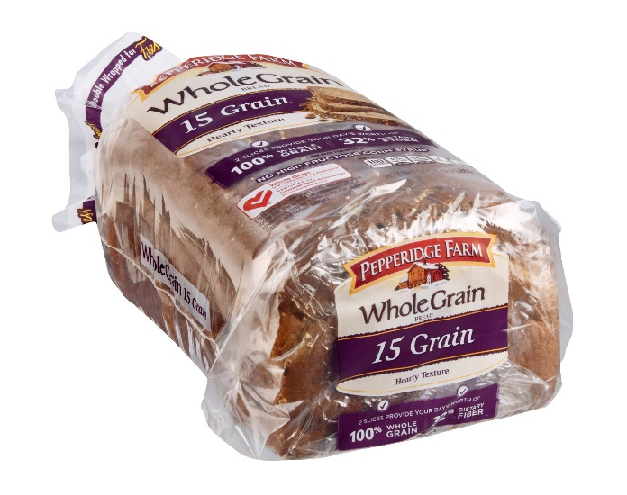
Federal Regulation 7 CFR Part 210.16
Make no payment for meals that:
Are spoiled or unwholesome at time of delivery
Do not meet meal pattern requirements
Do not otherwise meet the requirements of the contract
Notes:
7 CFR 210.16 states that SFAs should make no payment to food service management companies for meals that are spoiled or unwholesome at time of delivery, do not meet meal pattern requirements and/or do not meet the requirements of the contracts. For these meals, you will need to ensure that you recoup the funds from the management company as they entered into a contract that stated they would meet all federal meal pattern requirements.

Slide 25
Conversion Factor
A la Carte Conversion
The manner in which the value a la carte food items sold is converted into meal equivalents
The meal equivalents are then billed to the SFA at current bid price
2024-2025 A la Carte Conversion Rate
$4.77
Changes annually
Notes:
In the previous slide we spoke about meal equivalents. The amount of money generated from a la carte sales is converted to meal equivalent, using the conversion factor, and then billed back to the SFA based on the lunch bid price.
The conversion factor is calculated on free reimbursement plus the commodity rate. For 2024-2025 the a la carte conversion factor is $4.77

Slide 26
FSMC Contract Extensions
Each contract can be extended annually for up to 4 years
Price may be increased up to the CPI-U percentage
Use the previous month before the ending month (Contract ends June 30th, use May CPI-U)
The SFA is responsible for completing the extension
FSMC should not be completing the extension for the SFA
The SFA must ensure the extension is complete and accurate before submitting to NYSED
Must submit the FSMC Extension Checklist
NYSED is required to review and approve extensions
Notes:
Lastly, we will discuss FSMC extensions.
The contract can be extended annually for up to 4 years. The annual extension set the bid price for the extension year and may be increased based on the CPI-U. The CPI-U that is used is based on the month prior to the contract end date. For example, contracts ending June 30th would use the May CPI-U.
It is the SFAs responsibility to complete the food service contract extension and to determine whether you’re going to increase the bid price based on the service you received in the current school year. It is also the responsibility of the SFA to ensure the extension is complete and accurate before submitting it to our office. The required checklist is provided on the extension to help assist you in properly completing the document.
All extensions require a board member’s signature and once again, we are accepting electronic signatures and documents to be sent in via email.

Slide 27
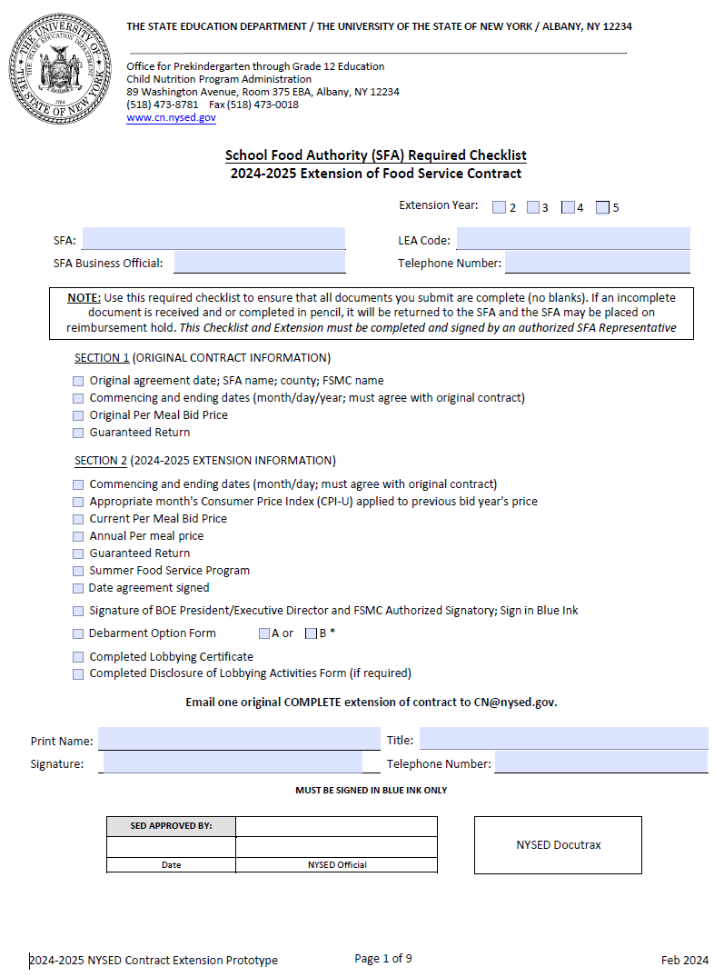
Extension Submission
Prototype Extension Form includes:
Checklist
Section 1 and 2
PDF automatically calculates the increase based on CPI-U
Debarment option A or B
Certificate of Lobbying
Notes:
Our office is in the process of posting the prototype extensions on our website. The extension should be available by the end of March. When completing the extension, the SFA will want to make sure all pages are complete, with the exception of the debarment forms. Only one debarment form must be completed.

Slide 28
Questions?
NYSED Child Nutrition Program Administration
(518) 473-8781
www.cn.nysed.gov
Notes:
That concludes our food service management company presentation. We will now take questions on anything pertaining to food service management companies, the contract, the pre-bid or the extension. Again, please use the Q&A box in the lower corner to type and send it in to our staff to which we will answer for all viewers to hear.

