Slide 1
Income Verification & Collection Report
Child Nutrition Program Administration
New York State Education Department
Notes:
Thank you for joining us for the income verification and collection report webinar.
Today’s webinar will contribute 1.5 Training Hours towards the professional standards training requirements.

Slide 2
Regulatory Authority
7 CFR
  Part 210– National School Lunch Program
  Part 215– Special Milk Program
  Part 220– School Breakfast Program
  Part 235– State Administrative Expense
  Part 245– Free and Reduced Price Eligibility
  Part 3016- Procurement for Public & Charter Schools
  Part 3019- Procurement for Non-Public Schools
  Part 3052- Audit Requirements
Public Law 111-296 (Healthy, Hunger-Free Kids Act of 2010)
2 CFR Chapter I, and Chapter II, Parts 200, 215, 220, 225, and 230- Uniform Administrative Requirements, Cost Principles, and Audit Requirements for Federal Awards; Final Rule
  Supersedes and streamlines requirements from OMB CIRCULARS A-87; A-122
Notes:
These are program regulations that are important for you to be aware of and familiarize yourself with.
It is important for you to keep current on federal and State regulations, policies, instructions and memos that are posted on the Child Nutrition Knowledge Center website to help ensure you have the most up to date information regarding the Program.
Today we are focusing on Income Verification specific to Part 245- Free and Reduced Price Eligibility.

Slide 3

Income Verification
Verification is an annual requirement that confirms the eligibility of free and reduced price meals under the NSLP and SBP
Confirmation of information provided on a free/reduced application:
  Income eligibility
  Child or household member is receiving assistance under SNAP, FDPIR, TANF
    Not required through the Direct Certification Matching Process (DCMP)
Verification must be completed by November 15th
  Includes changes in eligibility
SED prototype forms
  Review POS generated letters
Keep all supporting documentation on file
  Number of applications on file as of October 1st
  Number of applications that must be verified
  Documentation of confirmation review
  Summary of the verification process and results
Notes:
Federal regulations require that all school food authorities, or SFAs, that participate in the School Breakfast Program or the National School Lunch Program select and verify a sample of their approved free and reduced price meal applications that on file as of October 1st by November 15th of each year.
Verification is an annual requirement that confirms the eligibility of free and reduced price meals under the National School Lunch Program and School Breakfast Program.
Verification is only required when eligibility is determined through the application process, not through the Direct Certification Matching Process (DCMP).
Prototype forms and letters are available for use and are published in the income verification booklet. We strongly suggest SFAs use these forms to ensure they contain the most current and correct information. If you are using a computerized Point Of Sale system, it is important to ensure they are using the most up to date versions.
Like other program information, you are required to keep all supporting documentation of the verification process on file. This includes the number of applications the SFA has file as of October 1st, the number in which is required to verify, documentation that a confirmation review was conducted, and the summary of the process and all results.

Slide 4

Income Verification
Not required for:
  SFAs claiming paid reimbursement only
  SFAs only in the Special Milk Program
  RCCIs with no day students
  SFAs in Non base year Provision 2
  SFAs in Community Eligibility Provision (CEP)
These SFAs must however still submit and report information to SED
Notes:
Verification efforts are not required for:
Schools claiming students in the paid reimbursement category only.
Schools participating in the Special Milk Program only.
Residential Child Care Institutions (RCCIs) with no day students
Schools in the non-base years of Provision 2 or Schools operating in the Community Eligibility Provision (CEP).
However, even if you are exempt from conducting verification, you still have to report and submit information on the verification collection report to SED. We will go over the information you have to submit when we discuss the verification collect report in later slides.

Slide 5

Income Verification
SFAs have the option to begin the Verification process prior to October 1st
If SFA chooses this approach SFA MUST:
  Decide how often to sample applications
  Include only applications approved since the last sample was selected
  Select either 3% or 1.5% of approved applications as required by the sampling method each time
Notes:
SFAs are now allowed to begin the Verification process prior to October 1st. SFAs may begin verifying applications as soon as they start collecting them. By doing so SFAs will save time and energy and the applications won’t pile up all at once.
If an SFA chooses this approach the SFA MUST decide how often to sample applications.
Include only applications approved since the last sample was selected, and select either 3% or 1.5% of approved applications as required by the sampling method each time.

Slide 6
Income Verification Example
  Example: SFA conducting standard verification selects 3% of approved applications every two weeks from August 1st until October 1st
On October 1st: 1,894 were approved: 3% of 1, 894 (0.03 x 1,894)=57 Apps to be approved.
55 Applications were already approved so on October 1st LEA will need to randomly select 2 more apps
Time Frame | 8/1-8/13 | 8/14-8/27 | 8/28-9/10 | 9/11-9/24 | 9/25-10/1 | TOTAL
Approved applications in time frame | 703 | 455 | 296 | 273 | 167 | 1894
Applications selected for verification | 21 | 13 | 8 | 8 | 5 | 55
Notes:
For example, this SFA decided to start conducting standard verification every two weeks beginning August 1st until October 1st.
The SFA selected 3% of approved applications as you can see on the chart above.
On October 1st the SFA calculated that 1,894 applications were approved, you would then multiply 1,894 applications by 0.03, 57 applications needed to be approved.
By completing verification biweekly, the SFA has already verified 55 applications and is ahead of schedule, they only need to verify 2 applications by November 15th.

Slide 7

Step 1: Establish Sample Pool
Sample Pool: Total number of newly approved applications on file as of October 1
How to Determine your Verification Sample Pool: (Start October 1)
  Count # free and reduced applications, district-wide (pieces of paper)
  Include income applications,
  Applications listing a case number
  Applications with the foster child box checked but a letter or documentation from social service/placement agency was not submitted
Notes:
Step One in the Income Verification Process is to establish your verification sample pool.
To establish this sample pool, you must count the number of newly approved free and reduced applications on file for the entire local educational agency as of October 1st.
Please note foster children that are on a free/reduced application will be in the sample pool.

Slide 8
Establish Sample Pool
The following should not be included in your sample pool:
  Direct Certification Match
  Homeless, migrant, runaways, or Head Start children
  Foster children who are deemed eligible based on a letter from the State or local placement agency
  Carry-over applications from the previous year who have not yet submitted a new application
  Denied Applications
Notes:
SFAs should not include Direct Certification, Homeless, migrant, runaways, or head start children in the sample pool.
Also foster children who are deemed eligible based on a letter from a state/local placement agency must not be included in the sample pool.
Denied applications and Carry over applications from the previous year, who have not yet submitted a new application also, would not be included in the sample pool.
Do not include categorically eligible students in your verification sample pool such as:
Households that are directly matched through the direct certification matching process or those students who have been identified as living in the same household as the certified student that receives SNAP or Medicaid benefits.
Runaway or Homeless children who have been identified by your district’s McKinney-Vento school district liaison
Migrant children who have been identified by the district’s Migrant Education Program
Children participating in Head Start/Even Start
Foster children who are identified by a list or letters from the social services and voluntary placement agencies
Also, do not include any applications for students whose eligibility were carried over for the 30 operating days in your verification pool. These carryover applications are not to be verified in this school year because they were subject to verification in the prior year.
Lastly, do not include Denied Applications in your sample pool. Remember only newly approved free and reduced applications on file as of October 1st.

Slide 9

Step 2: Determine the Sampling Method
Your Response Rate from the last completed SY determines how you should conduct income verification for current SY
Error Prone Method
  Must be used if you had less than 80% response rate to verification last SY
    SED generate the list of LEA’s that had a greater than 80% response rate
    If your LEA is not listed, you must use this method
  Must be used if you are coming off Provision 2
  Must be used if you are in first year of operation
Alternate Options
  If 80% or more of households responded to income verification last SY, you can use either the error prone method OR 1 of 2 alternate options:
    Random Method
    Focused Method
Notes:
Step 2 is to determine the Sampling Method that you will use to verify the selected applications.
An SFAs response rate from the last school year will determine how you should conduct income verification for the current school year.
SED publishes a list of SFAs who had an 80% or greater response rate to income verification in the previous school year annually. If your SFA is listed, you can use the error prone, random or focused selection method.
If less then 80% of households selected responded to verification efforts last year or if you are a school in your first year of operation or if you are coming off of Provision 2 you must use Error-prone as your sampling method for the current SY.

Slide 10

Error Prone Method
Verify the lesser of 3% or 3,000 of applications that fall within $24/week, $100/month or $1200/year of the eligibility limit
Always round up
Do not verify more applications than required
When initially approving applications, it may be helpful to flag error prone applications to help facilitate the process.
Notes:
We are going to start with explaining the error prone sampling method.
With the error prone method, SFAs must verify the lesser of 3% or 3,000 of the approved applications on file as of October 1st. Applications to be verified must meet the definition of an Error Prone Application. Error Prone Applications are defined as those with a reported income within $24 per week, $100 per month or $1,200 per year of the applicable Income Eligibility Guidelines.
When approving free and reduced price applications, it may be helpful for the approver to mark, highlight or tag applications that meet the error prone definition.
This way when starting the income verification process and potentially finding out that the error prone sampling method needs to be used, the applications that are error prone have already been identified.

Slide 11

Error Prone Method
Example:
210 application forms are on file
Take 3% = 6.3 Round up to 7
Choose 7 error-prone applications to be verified
Suppose you only have 3 error-prone applications – what would you need to do?
Choose the remaining 4 using random method
Notes:
Lets look at the example on the screen, Say you have 210 new applications on file as of October 1st. Take 210 and multiply this by 3% which would equal 6.3.
It is important that you always round up. So you would round up to 7 applications to be verified.
You would then choose 7 error prone applications that meet the error prone selection method.

Slide 12
Random Method (Alternate 1)
Verify the lesser of 3% or 3,000 of the total number of approved applications on file as of October 1st selected at random
Random sample must include both:
    Income applications
    Categorical applications
      Applications that families indicated a SNAP/TANF/FDPIR case number or checked the foster box on the application but whose names do not appear on the direct certification matching list
Notes:
Now we will discuss the first alternate sampling method, the Random Method.
When using the alternate 1 method, SFAs must verify the lesser of 3% or 3,000 of the total number of approved applications on file as of October 1st.
The applications to be verified must be selected randomly. The random sample should include both income applications and categorically eligible applications. These include foster children applications where they checked the foster box but didn’t supply supporting paperwork or for children receiving SNAP/TANF/FDPIR benefits whose names do not appear on the direct certification matching list.

Slide 13
Focused Method (Alternate 2)
Verify the lesser of 1% or 1,000 of the total number of approved applications (income and SNAP/TANF/FDPIR or Foster applications) plus the lesser of .5% or 500 approved applications which reported a SNAP/TANF/FDPIR case number
Example:
  900 total approved applications
  600 approved with just a SNAP/TANF/FDPIR case number, 300 income applications
  Separate applications into two piles: income group and case number group
  .01 (1%) x 900= 9
    Select 9 error prone income applications to verify
  .005 (.5%) x 600= 3
    Select 3 applications with case numbers to verify
  12 total verified applications
Notes:
The Second Alternate Sampling Method is the Focused Method.
To determine the number of applications to be verified based on this method, you will take the lesser of 1% (or 1000) of the total number of approved applications selected from the income applications that are error prone and SNAP/TANF/FDPIR applications plus the lesser of .5% or 500 approved case number applications.
Lets simplify this by completing an example:
Let’s say we have 900 total SFA applications. First we would sort the applications into two piles—the income applications and the case number applications. From this we determine that we have 600 applications with a case number and 300 applications that was approved based on income. We would take 1% (or 1000) multiplied by 900 and get 9 applications to verify.
From the income applications pile, choose 9 applications to verify that are error prone. This should be easy since you have the error prone applications flagged already. If you don’t have enough error prone applications, select the error prone ones you have and the remaining ones choose randomly.
You will then have to verify .5% (or 500) of the case number applications. .5% multiplied by 600 gives you 3 case number applications to verify.
So all together a total of 12 applications will be verified.

Slide 14

Step 3: Select Applications to Verify
Select applications in accordance with the type of verification conducted
  Error Prone
  Random (Alternate 1)
  Focused (Alternate 2)
Always round up
  6.1= 7 applications
Do not verify any more or any less than required sample size
Check computerized systems for accuracy
Refer to the Income Verification Booklet for guidance
Notes:
After establishing your verification pool and determining the sample method you will then want to select the applications to verify.
Remember to always round up and to never verify any more or any less than the required sample.
If you are using a computerized system to assist you with the verification process, always double check your system to ensure that the correct number of applications to be verified is chosen. In past years we found that many SFAs who use computerized systems verified the wrong amount of applications due to wrong dates, glitches in systems or it not rounding up.
Refer to the current SY’s Income Verification Booklet posted on the Child Nutrition website for guidance.

Slide 15
Step 4: Confirmation Review
Take the applications that have been selected for verification and have them reviewed by a second reviewing official to ensure the application was initially approved correctly
Second reviewing official cannot be:
    FSMC employee
    Original reviewing official
    Original verification official
Confirmation Review is not required if computer software was used to approve applications
Notes:
After you have chosen your applications to verify, an individual other than the original reviewing official must review each approved application selected for verification to ensure that the initial determination was accurate.
This Second Reviewing Official cannot be a management company employee, the original reviewing official or the verification official.
A confirmation review is not required if a technology based Point of Sale system is used to approve applications.
Make sure documentation of the confirmation review is maintained on file with income verification paperwork.

Slide 16

Confirmation Review Outcomes
No change in status
  application was approved correctly
  SFA verifies application
Changed from Reduced to Free
  Immediately change benefits
  Notify household of change
  Verify application
Changed from Free to Reduced
  Do not change status
  Verify application
Changed from Free or Reduced to Paid
  Immediately notify household of change in benefits
  Do not verify application
  Select another free or reduced application to verify
  Conduct 2nd review of newly selected application
Notes:
During the confirmation review, if the second reviewing official finds that the application was originally approved correctly, the verification official would proceed with verifying the application.
If they find the application was incorrectly approved, one of the following actions must be taken:
2. If the status changes from free to reduced:
Do not change the child’s status
Proceed with verifying the application
3. If the status changes from reduced to free:
Make the increased benefits available immediately
Notify the household of change in benefits
Verify the application
4. If the status changes from free or reduced price to paid:
a. Immediately send the household a notice of adverse action
b. Do not verify the application
c. Select a similar application (example—another error prone application) to verify
d. Begin the verification process with the newly selected application. The second reviewing official must review the application

Slide 17

Step 5: Notify Household of Selection
Must notify households of selection
  Recommended to use SED prototype letters
Must inform households:
  The type of acceptable verification documentation to confirm current income
  That the household may provide proof that the child or any household member is receiving benefits under the Assistance Programs (SNAP/TANF/FDPIR) instead of providing income information
  The date the information must be provided by and that failure to respond by the deadline will result in termination of benefits
  Name of an SFA official who can answer questions and provide assistance
  A toll free number for parents to obtain assistance. This can be a local number within the district. It cannot be a long distance call
Notes:
After the confirmation review is complete, you now must notify households that they have been selected for verification. We highly recommend that you use the SED prototype letters enclosed in the Income Verification Booklet as these letters contain the correct format, wording and the most up to date version of the non-discrimination statement.
The notification letter must include:
The type of acceptable verification documentation to confirm current income.
The household may provide proof that the child or any household member is receiving benefits under the assistance program (SNAP/TANF/FDPIR) instead of providing income information.
The date that the information must be provided as specified by the SFA and that failure to respond by the deadline will result in termination of benefits.
Name of an official at the SFA who can answer questions and provide assistance to the households
A toll free number for parents to obtain assistance. This can be a local number within the district. It cannot be a long distance call.
Our office has seen on reviews last school year that SFAs are using old versions of verification letters that contain incorrect information such as requesting households to supply their social security numbers when submitting income proof, the letters containing the incorrect version of the non-discrimination statement and using old acronyms for program names like AFDC (Aid For Dependent Children) which was replaced by TANF in the 1990s.

Slide 18
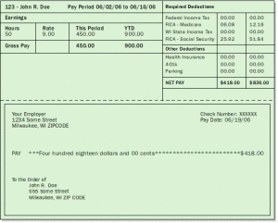
Step 6: Verification of Eligibility
SFAs must verify all sources of income during verification
Confirm income at the time of application beginning the month before they applied through the time the application is verified
Acceptable Documentation:
  Pay stub(s)
  W-2’s for self-employed only
  TANF or SNAP recertification letter with eligibility dates listed
    EBT card may not be accepted as documentation
  Collateral Contact (for ex. employer, pastor, etc.)
  Letter/documentation from Foster agency
  Direct Verification
SFAs must make at least 1 follow up attempt to contact families who do not respond to initial verification efforts
  May have third party assist with follow-up
Notes:
You must verify all sources of income during verification. Generally, the household is verifying the income that was listed on the application at the time it was submitted and approved
However, the household can verify its income for any point in time between the time the application was completed and when the documentation was requested. For example, they may submit income documentation showing they were eligible in September, or submit their current income, both would be sufficient.
Acceptable documentation would be: pay stubs, TANF/SNAP recertification letter with eligibility dates listed, documentation from a Foster Agency, or Direct Verification, and collateral contact such as an employer or pastor.
W-2 tax forms are acceptable but only if self-employed.
Please note that EBT cards may not be accepted as documentation.
If the household does not respond you must make one additional attempt (via letter, email, or phone call) DOCUMENT YOUR EFFORTS
SFAs must provide a toll free number for families to call for assistance with the process (on letter) they cannot be charged for the call
The SFA can hire a 3rd party to help w/this follow up. This third party may not be a Management Company employee!

Slide 19

Step 7: Results of Verification
Notify Families of the outcome of verification
  Use NYSED prototype letter
Changes in eligibility –
  Increase in benefits
    Must be made within 3 operating days (e.g. reduced to free)
  Decrease in benefits
    Families must be given 10 calendar days written notice (e.g. free to paid)
    Notice must include required information on denial letter
  Change Benefits must be made for ALL family members
NOTE:
  No response = benefits must be terminated
Notes:
If benefits will increase as a result of verification (for example going from reduced to free) – you must make the increase within 3 operating days
If benefits will decrease – you must give the household 10 calendar days written notice (ex. Reduced to paid)
Be sure to make changes for all household members.
If the household fails to respond, meal benefits must be terminated.

Slide 20

Households who do not respond:
SFAs must take the following written action:
  Benefits must be terminated
    10-calendar day advance notice (the 1st day is the day the notification is sent)
    This should be built into the verification timeline to be completed by November 15
The written notice must include:
  Change in benefits
  Reason(s) for change
  Right to appeal
  Appeal process
  Non-discrimination statement
  Reapplication process
Households that appeals within 10 calendar days:
  Must continue to receive benefits until decision is made by hearing official
Notes:
20
Any household which fails to submit requested verification documentation by the date specified by the SFA or submits verification information that does not support the initial determination of eligibility, must be sent a notice that benefits will be reduced or terminated in 10 calendar days.
SFAs must take the following actions if the household fails to cooperate with verification efforts:
SFAs must follow up with families who do not respond to initial verification efforts. SFAs may contract with a third party to make additional attempts to follow up with non-responders.
Prior to actual reduction in benefits or termination of benefits, 10 calendar days written advance notification must be provided to the household. The first day of the 10 calendar day advance notification must be the day the notice is sent to the household.
The notice must advise the household of a change in benefits, reasons for the change, the right of appeal, how and when the appeal must be filed, and that the household may reapply for meal benefits. If the household provides information that confirms their eligibility within the 10 calendar days, the family must continue to receive benefits. If there is no response, benefits must be terminated on day 11.
Reductions or changes in benefits must be extended to all children in the household who were originally determined to be eligible by information that no longer supports the benefit level. Households that appeal the reduction or termination of benefits within the 10 calendar day notice must continue to receive benefits until the decision of the hearing official is made.

Slide 21

Fragile Households
Fragile household: is one that may be having major hospitalization and/or health issues or tragic events
  SFAs may decline up to 5% of their verification sample and replace them with other approved applications when a fragile household is chosen
The SFA may:
      Skip over the “fragile” household’s application
      Document why the SFA passed over the “fragile” application
        Only in rare and necessary circumstances should this be used
      Select another application and begin the verification process
Notes:
21
The SFA may, on a case-by-case basis, replace up to 5% of the applications selected for verification. Applications may be replaced when the SFA believes that the household selected is a “fragile household” and would be unable to satisfactory respond to the verification request.
It is best practice to try and limit this to those rare cases where it is really necessary for example if you have a family who is up for verification but you know they have a household member who has been in the hospital for an extended period of time.
If you choose to exercise this option, you must document why you passed over the fragile application. Any application that is removed must be replaced with another approved application selected on the same basis (ex. Error prone application must be substituted for a withdrawn error prone application). The newly selected application must then have a confirmation review prior to being verified.

Slide 22

Direct Verification
Direct Verification is the confirmation of eligibility by using records from public agencies to verify assistance program participation.
  Purpose– Help reduce termination of eligible families who fail to return information when chosen for verification
  Intent–To validate a household’s eligibility
SFAs will:
Access Business Portal and click on New York State Identification System (NYSSIS)
SFAs will use the search tool to verify students eligibility
  Must match 3 unique identifiers (i.e. DOB, address, name)
  Keep a record of directly verified students on file for review
  Report data on Income Verification Collection Report (Attachment G)
Notes:
22
Direct verification is an optional method in order to help expedite the verification process. Direct Verification can be used for the sample selected for verification via the error prone method, the random sample, or the focused sample.
If so, SFAs must use Direct Verification prior to contacting families for verification documentation. If information obtained through this process verifies that the household is participating in the SNAP or Medicaid, no additional verification is required. The eligibility status of the child or children listed on the application is considered verified.
If information provided by the public agency does not verify eligibility, the LEA must proceed with regular verification activities.
SFAs must keep a record of directly verified students on file for review. Results of Direct Verification must be reported on the School Food Authority Verification Collection Report.

Slide 23
Verification for Cause
SFAs are obligated to verify all questionable applications
Applications verified for cause are in addition to the annually required verification process
  Restriction on sample size (over-verifying) does not pertain to verification for cause applications
Follow Income Verification procedures
Report those applications verified for cause and the results on the Income Verification Collection Report (Attachment G)
Notes:
Applications that are verified “for cause” are in addition to the annually required verification process.
SFAs have an obligation to verify all questionable applications.
SFAs must verify “for cause” those applications that are reported to be questionable, even if the reporting source of the information is anonymous.
The number of applications verified “for cause” and the results of those applications must be reported on the Verification Collection Report (Question VC1 on page 2 of the Attachment G, which we will go over later on in the presentation.
The applications “verified for cause” do not contribute toward your required sample size for the annual verification requirement. These applications are counted separately from your sample size.

Slide 24
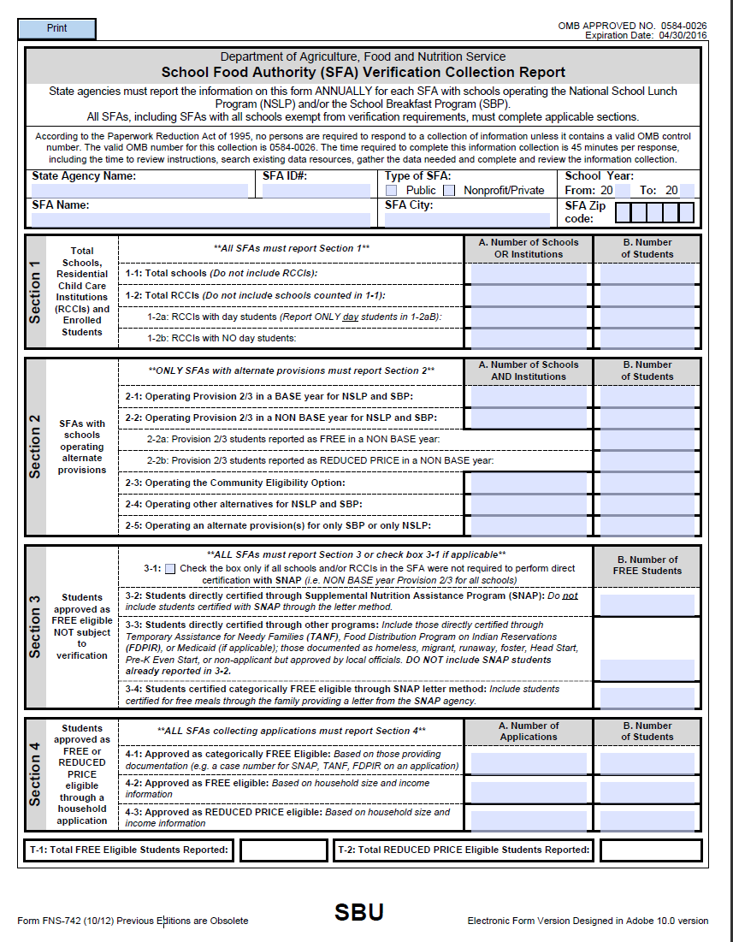
Income Verification Collection Report (Attachment G)
Must report data on verification using the Income Verification Collection Report
Start Verification Process by October 1st
Complete Verification Process by November 15
Submit Income Verification Report on CNMS by December 15.
Even those exempt from verification requirements must still complete the report.
  CEP and Provision 2 schools only need to complete section 2, 3-1 and 5-1 (if all schools in the SFA are under the Provision)
Notes:
Here is a screen shot of the verification collection report, also known as Attachment G.
SFAs must report all required data on the verification collection report.
Remember that you want to start the verification process on October 1st and have it completed by November 15th
SFA’s are required to submit the verification collection report by December 15th via the child nutrition management system. Failure to submit the report by December 15th will result in your Programs being placed on reimbursement hold. It is essential that the reports are submitted on time because SED has to report the results to USDA.
Even those schools exempt from verification requirements must still complete the report.
Community Eligibility Provision and Provision 2 schools only need to complete section 2 and mark 3-1 and 5-1 (if all schools in the SFA are under this Provision) and submit the form by December 15th.

Slide 25
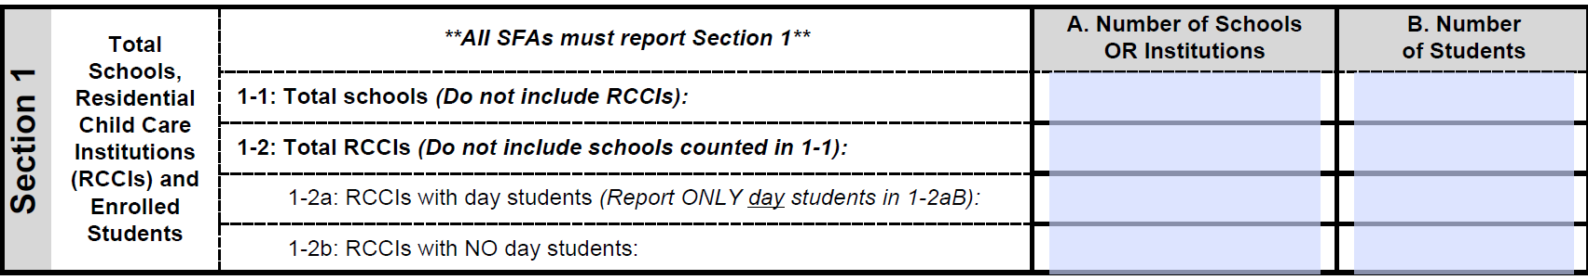
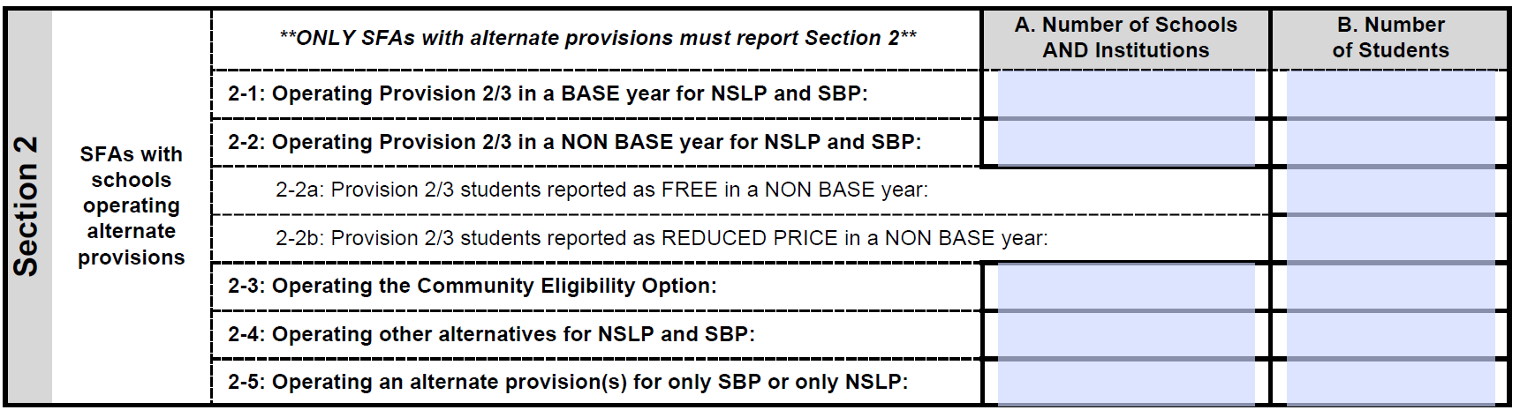
Verification Collection Report: Section 1 and 2
Section 1 will prefill once the October claim is submitted using the last operating day in October
Section 2 is only for SFAs or RCCIs who operate alternative provisions, this include Provision 2 and Community Eligibility Provision (CEP).
Notes:
This is what the top portion of the collection report looks like. We will now go through each section. The instructions on how to complete this are located in the Income Verification booklet.
Section 1 column A is the total number of schools in your SFA or Residential Child Care Institution (RCCI) and the B column is the total number of students.
When you go in to the system to file the report you will notice that this section will be prefilled. These numbers automatically pre-fill upon submission of your October claim.
If the numbers are not prefilled in here remember to enter the data using the last operating day in October. This makes it consistent with the claim for reimbursement. Remember that the October claim for reimbursement requires SFA’s to report number eligibles and enrollment as of the last operating day of October. For all other claim months you report the highest number of the enrolled free, reduced, and paid students.
Section 2 is only for those SFAs or RCCIs who operate alternative provisions (Provision 2) or the Community Eligibility Provision (CEP). Again,report students as of the last operating day in October.

Slide 26
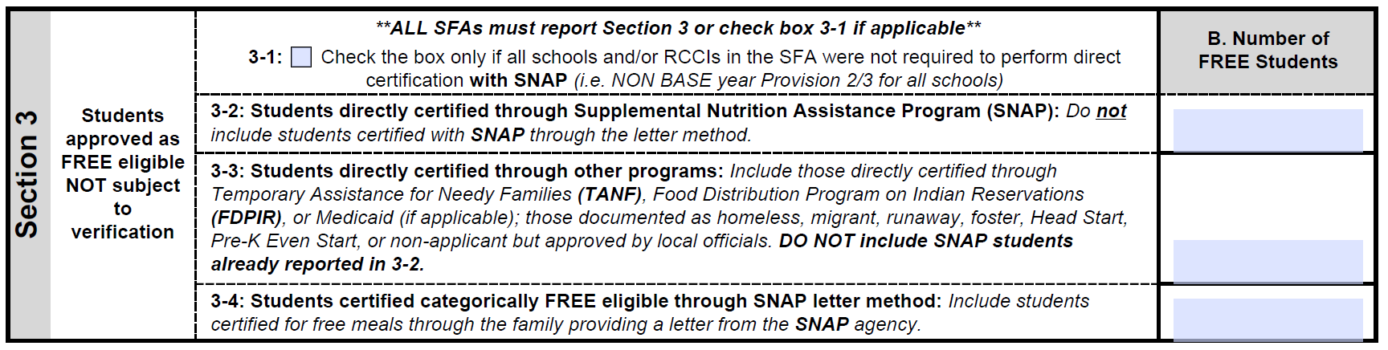
Verification Collection Report: Section 3
3-1 SFAs that are not required to perform direct certification check box 3-1
3-2 Students directly certified through SNAP ONLY or extension of eligibility
(most SFAs will have largest number here)
3-3 Students directly certified through TANF, Medicaid, FDPIR or extension of eligibility for these programs. Also homeless, migrant, runaway, documented foster children, Head Start
Students are to be reported only once
Use the last operating day in October when reporting data in section 3
3-4 Include ONLY students certified as Free based on a letter submitted by family from SNAP agency or extension of this eligibility
Notes:
Section 3 is where you are going to report your number of free eligibles that are not subject to the income verification process.
3-1: This box needs to be check marked if the SFA is not required to perform direct certification (i.e. RCCIs without day students, SFA-wide CEP or Provision 2 in a non-base year)
Remember that direct certification is the process by which the student is eligible based on documentation received directly from the applicable program (i.e. TANF, SNAP agency). This process eliminates the need for the household to submit an application.
Most SFAs will find that you will be reporting the largest number in 3-2 versus 3-3 and 3-4.
3-2: Include students directly certified with SNAP. If a student is directly certified with SNAP as well as with another program (i.e TANF, Medicaid), include the student in THIS SNAP count only since SNAP is the hierarchy. Also include any student in the SFA deemed eligible based on the extension of a household member who was directly certified with SNAP.
DO NOT include certifications from when a household submits a letter from the SNAP agency to document receipt of SNAP benefits.
3-3: Include students directly certified through programs other than SNAP such as Medicaid, TANF, FDPIR. Also include any student in the SFA deemed eligible based on extended categorically eligibility via an eligible student in the primary household who has been directly certified. DO NOT include Snap students already reported in 3-2 or to be reported in 3-4.
3-4: Include ONLY students certified as categorically FREE eligible based on a letter submitted by a household from the SNAP agency. Also include any student in the SFA deemed eligible based on extended categorical eligibility via an eligible student in the primary household who has been directly certified through the SNAP letter method.

Slide 27
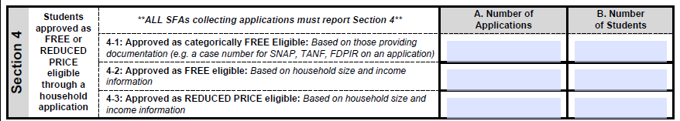
Verification Collection Report: Section 4
A. Number of applications refers to the number of household applications submitted
  4-1: Free eligible based on a case number written on an application or a foster child application where the household did not submit documentation verifying the foster child’s status
  4-2: Free eligible based on income information on an application
  4-3: Reduced eligible based on income information on an application
B. Number of students are the total number of students on all applications submitted (there may be more than one student per household application)
Notes:
Section 4 is for those students approved as Free or Reduced price eligible through a household application.
There are two columns to complete here. The A column refers to the number of applications on file as of October 1st. The B column refers to the number of students and this number is reported as of the last operating day in October.
Section 4-1 A and B: The number of applications approved as Free eligible based on documentation submitted on an application (Case number for SNAP, TANF, FDPIR written on an application or a foster child application where they did not submit a letter from the State or a placing agency). On file as of October 1st and for the B column, the number of students as of the last operating day in October approved Free eligible based on documentation submitted on an application (ex. Snap, TANF, FDPIR on an application). Include students in the SFA deemed eligible due to extended categorical eligibility via an eligible student in the primary household categorically Free eligible with Snap, TANF or FDPIR.
Section 4-2 A and B: The number of applications approved Free eligible based on income information submitted by the household on file as of October 1st and the number of students as of the last operating day in October approved Free eligible based on income information submitted by the household.
Section 4-3 A and B: Number of applications approved Reduced price eligible based on income information submitted by the household on file as October 1st and the number of students as of the last operating day in October approved Reduced price eligible based on income information submitted by the household.
To determine the number of applications to verify you would add up 4-1 A, 4-2 A and 4-3 A and multiply this number by 3%. Remember to always round up!

Slide 28
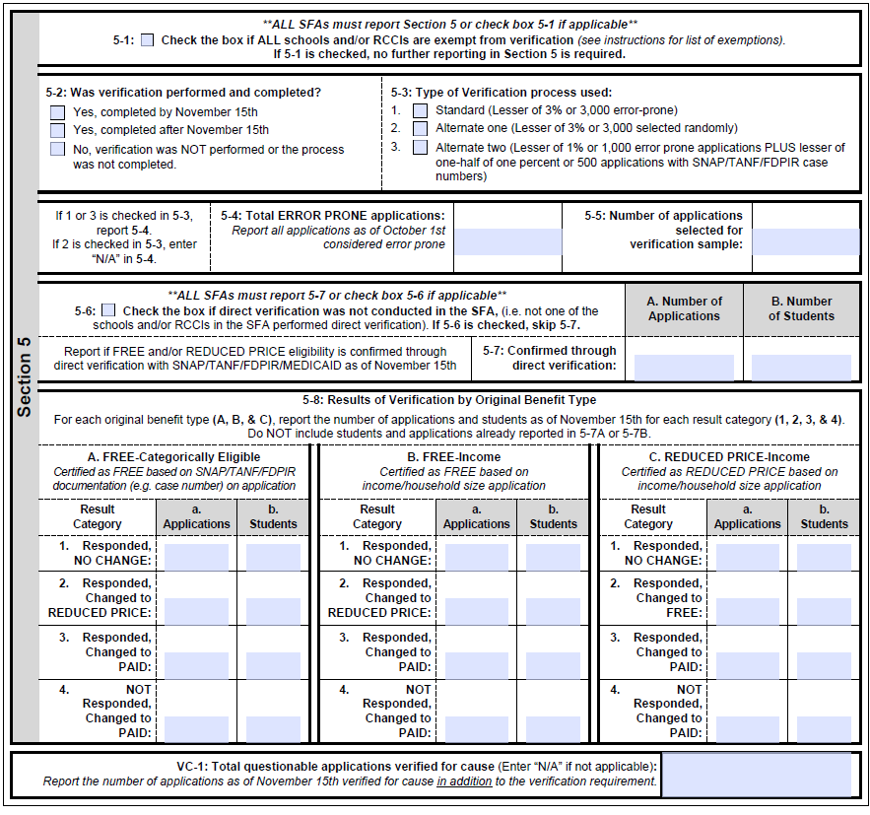
Notes:
This is Section 5 of the verification collection report.
For:
5-1: Check this box if all schools in your SFA or RCCIs are exempt from performing income verification (ex. RCCIS with no day students, all schools within the SFA are participating in CEP or Provision 2, etc.)
5-2: Indicate whether verification was performed and completed by the deadline of November 15th, after or not at all.
5-3: Select the verification sample method that was used:
1. Error Prone Method
2. Alternate 1 or Random Method
3. Alternate 2 or Focused Method
5-4: Indicate the total error prone applications on file as of October 1st.
5-5: Enter the total number of applications to verify.
5-6: Check this box if direct verification was not conducted at the SFA. Remember this is direct VERIFICATION not direct CERTIFICATION which we just discussed on slide 22.
If you conducted direct verification at your SFA, then do not mark 5-6 . Fill in the number of applications and students confirmed through direct verification in 5-7.
5-8: This section is where you would indicate the results of income verification. The different columns (Large A, Large B and Large C) indicate the different types of applications (A- free based on a categorical applications, B-free based on income, C-reduced based on income)
The small “a” and small “b” under each heading are the number of applications and students.
1. The household responded to verification and provided proof to show they would remain the same eligibility category they were initially qualified for.
2. The household responded to verification but the proof they provided determined they should now be receiving reduced price benefits.
3. The household responded to verification but the proof they provided determined they are not eligible for free or reduced price benefits.
4. The household failed to respond to the income verification therefore they were changed to paid.
The number of applications reported in 5-8 should include both the results of verification from the verification process and the results from any applications verified for cause reported in VC-1(Verification for Cause).
VC-1 : If applicable, report all applications verified for cause outside of the verification process and the results from any applications verified for cause.

Slide 29
Child Nutrition Program Administration
89 Washington Avenue, Room 375 EBA
Albany, NY 12234
(518) 473-8781
In accordance with Federal civil rights law and U.S. Department of Agriculture (USDA) civil rights regulations and policies, the USDA, its Agencies, offices, and employees, and institutions participating in or administering USDA programs are prohibited from discriminating based on race, color, national origin, sex, disability, age, or reprisal or retaliation for prior civil rights activity in any program or activity conducted or funded by USDA.
Persons with disabilities who require alternative means of communication for program information (e.g. Braille, large print, audiotape, American Sign Language, etc.), should contact the Agency (State or local) where they applied for benefits. Individuals who are deaf, hard of hearing or have speech disabilities may contact USDA through the Federal Relay Service at (800) 877-8339. Additionally, program information may be made available in languages other than English.
To file a program complaint of discrimination, complete the USDA Program Discrimination Complaint Form, (AD-3027) found online at: http://www.ascr.usda.gov/complaint_filing_cust.html, and at any USDA office, or write a letter addressed to USDA and provide in the letter all of the information requested in the form. To request a copy of the complaint form, call (866) 632-9992. Submit your completed form or letter to USDA by:
(1) mail: U.S. Department of Agriculture
Office of the Assistant Secretary for Civil Rights
1400 Independence Avenue, SW
Washington, D.C. 20250-9410;
(2) fax: (202) 690-7442; or
(3) email: program.intake@usda.gov
This institution is an equal opportunity provider.

