Slide 1
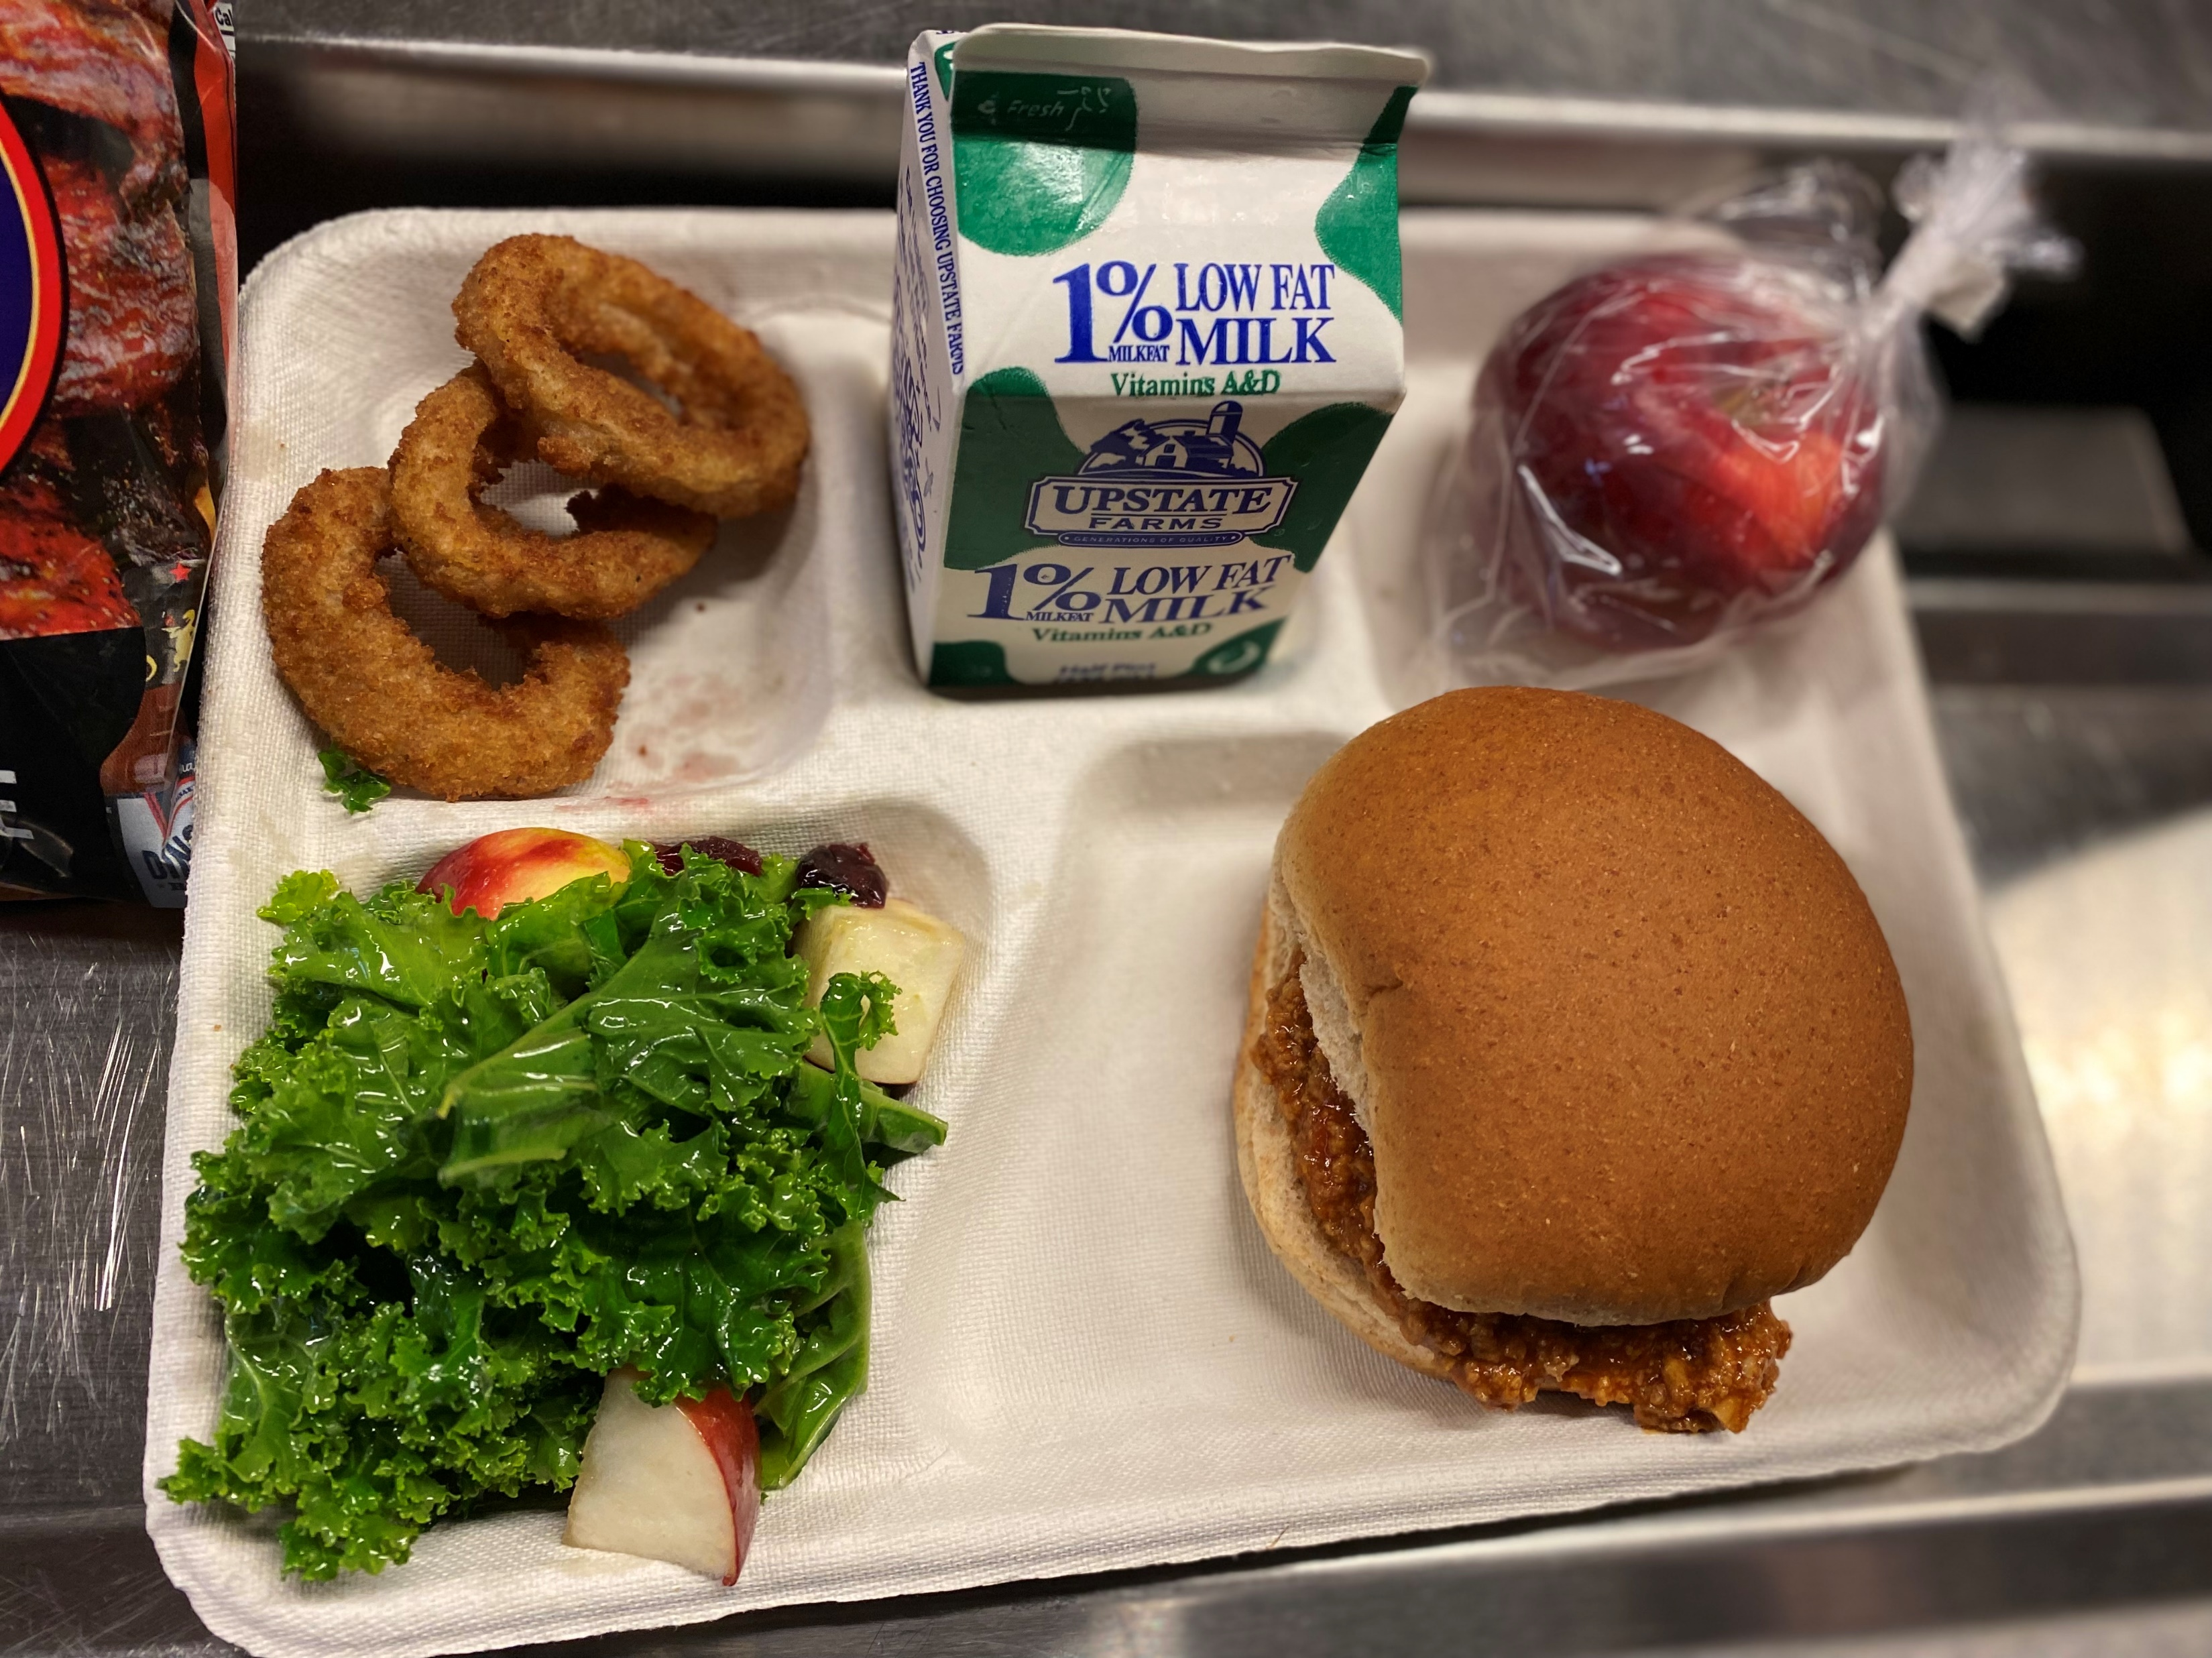
MEAL PATTERN Overview
An Overview of
Food-Based Menu Planning
Picture Courtesy of Buffalo City School District
Notes:
Welcome to the Meal Pattern Overview webinar, hosted by the New York State Education Department Office of Child Nutrition.
Following today’s presentation, you will receive an email containing the slides for today’s webinar. If you do not receive them, please email CNTraining@nysed.gov.
A copy of the webinar will also be posted and available on the CN website. As always, if you have any questions, please contact your Child Nutrition Program Representative or email CN@nysed.gov.

Slide 2
Picture Courtesy of North Colonie Central School District
Notes:
Today you will receive an overview that will give you a solid foundational understanding of:
Meal Patterns and Nutrition Standards
Food-Based Menu Planning
Dietary Specifications
Age/Grade Groups
School Week Meal Component Adjustments
Preschool Meal Pattern

Slide 3
Development of Meal Patterns & Nutrition Standards
Based on the Dietary Guidelines for Americans
More about the Dietary Guidelines for Americans:
Provide food-based recommendations to promote health
Help prevent diet-related disease(s) while meeting nutrient needs
Published every 5 years jointly by the Health and Human Services (HHS) and the USDA
Developed using evidence-based science
Notes:
The meal patterns and nutrition standards for the National School Lunch and School Breakfast Programs are aligned with, and were developed using, The Dietary Guidelines for Americans.
The Dietary Guidelines for Americans provides advice on what to eat and drink to meet nutrient needs, promote health, and prevent disease. The Health and Human Services (HHS) and USDA work together to update and release the Dietary Guidelines for Americans every 5 years. It is developed and written for a professional audience, including federal nutrition program operators.

Slide 4
Food-Based Menu Planning
Uses meal patterns, or age/grade groups
Refers to each of the required food groups as a Component
Components must be served in specified daily and weekly amounts
Foods offered within the components are called Food Items
Notes:
To comply with the established meal pattern requirements and nutrition standards, all SFAs must use the Food-Based Menu Planning approach when developing breakfast and lunch menus.
The Food-Based Menu Planning approach uses meal patterns according to specific age/grade groups as menu planning tools. Moving forward, I will refer to the age/grade groups as grade groups.
When working with Food-Based Menu Planning, there are components and food items.
A component is a required food group in a reimbursable meal. For breakfast, there are 3 required components; and with lunch, there are 5. These components must be served in specified daily and weekly amounts.
A food item is a specific food within those components. For example, whole grain-rich bread is a food item within the grain component.
Schools must plan menus for breakfast and lunch that meet both daily and weekly requirements for food group components and food items relative to each grade group being served.

Slide 5
Age/Grade Groups
SBP
NSLP
K-12
K-8 and 9-12
K-5, 6-8 and 9-12
K-8 and 9-12
K-5, 6-8 and 9-12
Production Records must demonstrate compliance with, and differentiate between, all age/grade groups being offered
Notes:
These are the grade groups established for breakfast and lunch.
As you can see, there are differences between the grade groups designated for each program. At breakfast, schools can choose to plan breakfast using a K-12 menu plan. This is not an option at lunch and there is no overlap with any other grade group for the 9-12 grades.
Menu Planners can decide to structure their menus utilizing the grade groups that will work best for their school’s operation.
Production records must be completed in such a way as to represent the different grade groups separately, showing compliance with each grade group’s meal pattern requirements.

Slide 6
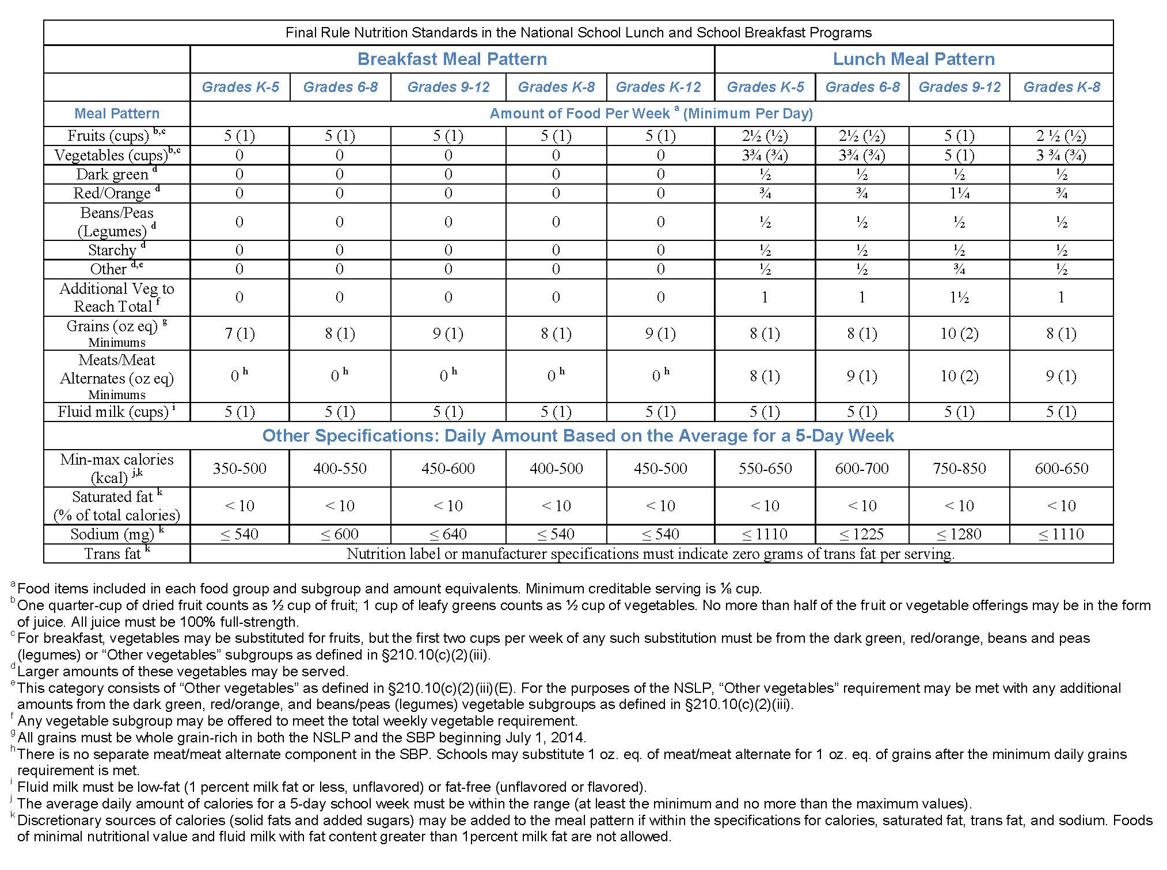
Meal Pattern Chart
Notes:
This is the meal pattern chart for both breakfast and lunch separated by grade group. It demonstrates the daily and weekly requirements.
When looking at the amount of food required for the components, the weekly requirement is listed first and the daily is listed after in parentheses.
For example, the grain component at lunch for the K-8 grade group displays a weekly minimum of 8 ounce equivalents and, in the parentheses, a daily minimum of 1 ounce equivalent.
The 9-12 grade group, however, must be offered 10 ounce equivalents over the course of the week and 2 daily.
The daily and weekly vegetable component at lunch is broken down further to account for the vegetable subgroups’ weekly requirements.
This chart also shows the dietary specifications for each grade group. These requirements are met on a per meal average over the course of the week.
At the very bottom of the chart, you will notice footnotes a-k which give additional guidance.

Slide 7
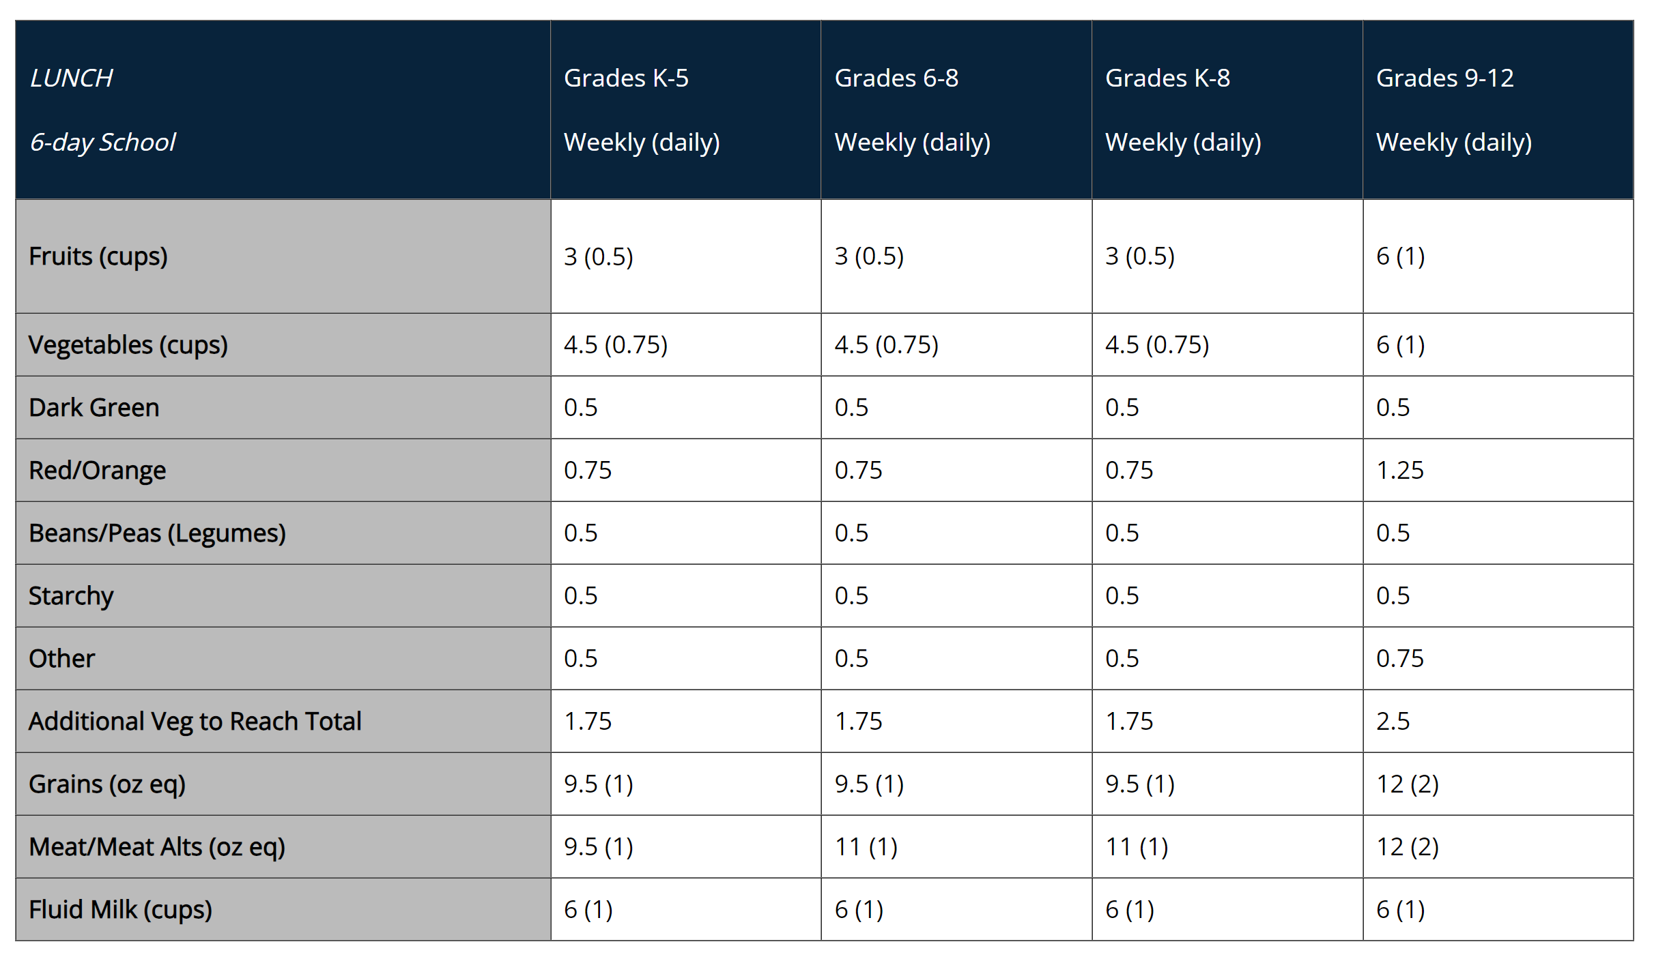
School Week Meal Component Adjustments
Notes:
For schools who operate more or less than 5 days per week on a regular basis, the weekly meal pattern requirements are adjusted.
To comply with meal pattern requirements, meal planners must adjust their weekly quantities. The full adjustment chart with these requirements is available on our website for schools who normally operate 3, 4, 6, or 7 days per week.
Again, this only applies to schools with regular operations more or less than 5 days per week. It does not apply to schools that normally operate 5 days per week, but have temporarily shortened weeks due to things such as vacations or holidays.

Slide 8
Dietary Specifications
SBP Meal Pattern
NSLP Meal Pattern
 | K-5 | 6-8 | K-8 | 9-12 | K-12
Min-max calories (kcal) | (350-500) | (400-550) | (400-500) | (450-600) | (450-500)
Saturated fat (% of total calories) | < 10 | < 10 | < 10 | < 10 | < 10
Sodium (mg) Target 1 | ≤540 | ≤600 | ≤540 | ≤640 | ≤540
Trans fat | Nutrition label or manufacturer specifications must indicate zero grams of trans fat per serving.
 | K-5 | 6-8 | K-8 | 9-12
Min-max calories (kcal) | (550-650) | (600-700) | (600-650) | (750-850)
Saturated fat (% of total calories) | < 10 | < 10 | < 10 | < 10
Sodium (mg) Target 1 | ≤1110 | ≤1225 | ≤1110 | ≤1280
Trans fat | Nutrition label or manufacturer specifications must indicate zero grams of trans fat per serving.
Notes:
The dietary specifications section of the meal pattern chart details the calorie ranges, sodium, saturated fat and trans fat requirements by program for each grade group. Since the dietary specifications are based on average daily amounts, these are unaffected by varying week lengths.
Menu planners must ensure that the limits on these specifications are met for each grade group being served.
As stated previously, menu planners do have a choice of how they will structure their menus, but they must use the established meal patterns. Whether it is separating grade groups by K-5, 6-8, 9-12 or by K-8 and 9-12, the menu planner determines which structure will best align with their school’s operation.
To understand why some meal patterns can be combined and others cannot, we will take a closer look at the calorie ranges for each grade group.

Slide 9
Overlapping Age/Grade Groups
SBP
NSLP
K-5
350 – 500 Calories
9-12
450 – 600 Calories
6-8
400 – 550
Calories
K-5
550 – 650 Calories
9-12
750 – 850 Calories
6-8
600 - 700
Calories
Overlap for calorie ranges is
450 – 500 calories
Overlap for calorie ranges in K-8 is
600 – 650 calories
Notes:
These overlaps are determined by the established calorie ranges for each grade group. If calorie ranges overlap, the Meal Patterns can be combined.
Keep in mind that when meal patterns are combined to the greatest extent, as demonstrated here, the allowable calorie range is limited significantly to a range of 50 calories.

Slide 10
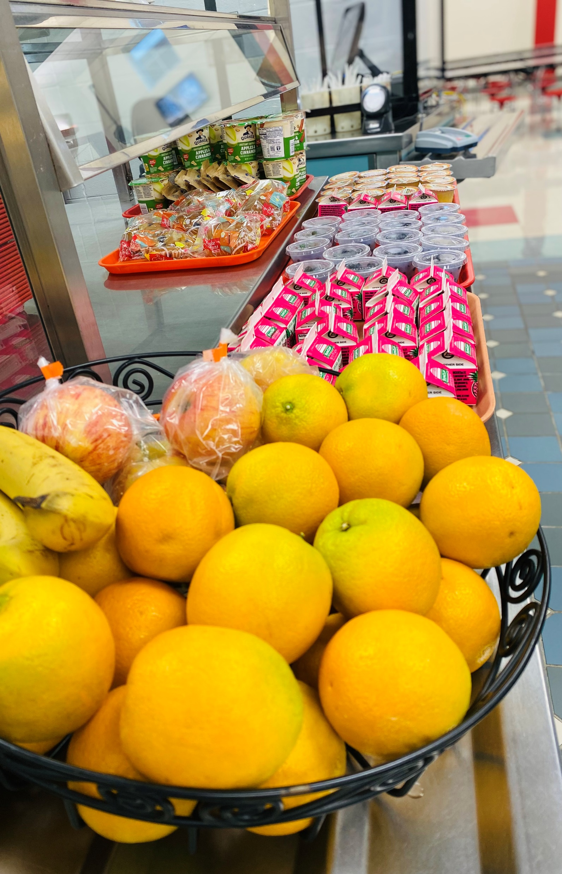
Breakfast Requirements
3 Components:
Grains
Fruits
Fluid Milk
Picture Courtesy of Onteora CSD
Notes:
Now we are going to concentrate on how to develop your menu to comply with the previously discussed standards and regulations.
Components at breakfast refer to three food groups that comprise reimbursable breakfasts. These components are:
Grains, with an optional meat/meat alternate;
Fruits, or vegetables as a substitute; and
Fluid milk.

Slide 11
Breakfast Optional Substitutions
Meat/Meat Alternate
Schools may substitute 1 oz. eq. M/MA in place of 1 oz. eq. Grains
Must offer at least 1 oz. eq. Grain
M/MA component is not required
Substituting Vegetables for Fruits
First 2 cups per week must be from the Dark Green, Red/Orange, Beans/Peas (Legumes), or Other subgroups before Starchy
Vegetable component is not required
Notes:
Although the meat/meat alternate and vegetable components are not required as part of the breakfast meal pattern, schools may substitute them as part of a reimbursable breakfast.
Using this flexibility in the meal pattern can increase variety in your menu, giving students more options and can promote more participation.
When menuing a meat/meat alternate in place of a grain, at least 1 ounce equivalent of grain must be menued first
Similarly, when menuing vegetables in place of a fruit, at least 2 cups of vegetables from the dark green, red/orange, legumes, or other subgroups must be menued during the week before a starchy vegetable.
The vegetable substitute will contribute towards the fruit component requirement.

Slide 12
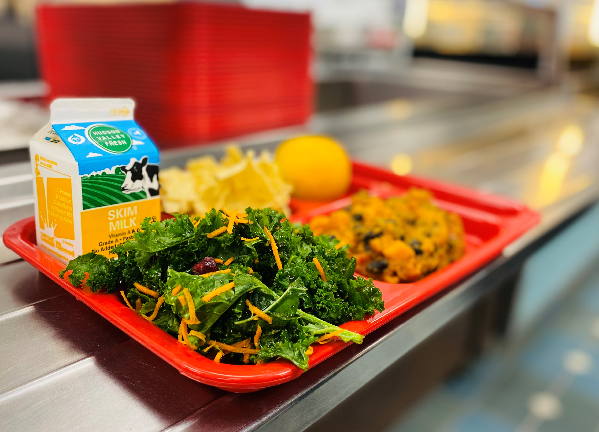
Lunch Requirements
5 Components
1. Fruits
2. Vegetables
Dark Green
Red/Orange
Beans/Peas (Legumes)
Starchy
Other
3. Grains
4. Meats/Meat Alternates
5. Fluid Milk
Picture Courtesy of Onteora CSD
Notes:
As for lunch, components refer to the 5 food groups that must be offered as part of reimbursable lunches. These are:
Fruits;
Vegetables, which include five vegetable subgroups;
Grains;
Meat/meat alternates; and
Fluid milk.
Minimum quantities of each vegetable subgroup, as seen on the Meal Pattern Chart, must be offered over the course of a week for each grade group.
These 5 vegetable subgroups are:
Dark Green;
Red/Orange;
Legumes;
Starchy; and
Other.

Slide 13
Notes:
At least 1 cup of unflavored fluid milk must be offered at breakfast and lunch each day for all age/grade groups. Additionally at least two different milk varieties must be offered each day. Menu planners are required to offer Unflavored milk, either fat-free or 1%, and may also choose to offer flavored milk, either 1% or fat free.
Cultured milk must be pasteurized fluid milk that meets State and local standards
Milk is not required to be selected for a reimbursable meal under offer versus serve.

Slide 14
Offer Versus Serve (OVS)
Breakfast
Optional for all age/grade groups
Offer at least 4 food items from the 3 components (Grains, Fruits, Milk)
Students must select at least 3 food items
One of which must be at least ½ cup fruit or vegetable
Selecting M/MA without selecting Grain is allowable
Notes:
The goal of offer versus serve is to reduce food waste while allowing students to choose the foods they want to eat.
At breakfast, OVS is optional for all grade groups.
All schools must offer the three breakfast components in at least the minimum daily required quantities.
Under OVS, at least four food items from the three required components must be offered. A reimbursable breakfast is only required to include at least three food items, with one being at least ½ cup of fruits or the substituted vegetable.
For the grain component, if a school menued a meat/meat alternate substitution for the grain, the student is not required to select both the meat and the grain. As long as the meat/meat alternate meets the daily minimum on its own, it can count as 1 of the 3 required food items.

Slide 15
OVS Lunch
Required for 9-12 age/grade group
Optional for younger age/grade groups
Students must select at least 3 of the 5 components
Selection must contain 2 full components and at least ½ cup fruit or vegetable
Notes:
At lunch, offer versus serve is required for the 9-12 grade group and is optional for all other grade groups.
All schools must offer all 5 lunch components in at least the minimum required amounts for each grade group.
Under OVS, students must select 3 of the 5 required components.
When selecting the 3 components, the student must have 2 full components along with at least ½ cup of fruit or vegetable in order for it to be considered a reimbursable meal.

Slide 16
OVS: Identifying a Reimbursable Meal
Reimbursable Meals | Non-Reimbursable Meals | OVS Rule Not Met
SBP: Toast (1 oz. eq.), Fat-free Milk (8 oz.), Apple (1/2 cup) | SBP: Toast (1 oz. eq.), Yogurt (1 oz. eq.), Fat-free Milk (8 oz.), | SBP: ½ cup fruit or vegetable must be selected
SBP: Toast (2 oz. eq.), Orange Slices (1/2 cup) | SBP: Toast (1 oz. eq.), Oranges Slices (1/2 cup) | SBP: 3 food items must be selected
NSLP: Chicken (2 oz. eq.), WG Bun (2 oz. eq.), Broccoli (1/2 cup) | NSLP: Chicken (2 oz. eq.), WG Bun (2 oz. eq.), Milk (8 oz.) | NSLP: ½ cup fruit or vegetable must be selected
NSLP: Broccoli (1/4 cup), Corn (3/4 cup), Orange Slices (1/2 cup), Yogurt (2 oz. eq.) | NSLP: Broccoli (1/4 cup), Orange Slices (1/2 cup), Yogurt (2 oz. eq.) | NSLP: 2 full components plus ½ cup fruit or vegetable must be selected
Notes:
These are a few examples of how to apply the rules of offer vs serve when determining if a meal is reimbursable or not.
The first two examples show how to identify a reimbursable meal when electing offer vs. serve at breakfast and the last two examples demonstrate lunch.
As you can see, the first meal selection includes three food items, one of them being at least ½ cup of fruit. However, in the second column, a similar meal has been selected but without the required fruit.
In the second breakfast example, you can see that the non-reimbursable meal has only selected 2 food items because only 1 slice of toast was selected. This meal would not be reimbursable under offer vs. serve because 3 food items need to be selected to be considered a reimbursable meal.
The first lunch example highlights the need for a student to select at least ½ cup of fruit or vegetable for a reimbursable meal.
With the second example, although 3 components were chosen, the student would need to select 2 full components along with the ½ up fruit or vegetable in order for it to count.
All food items selected must meet the minimum serving requirements for the grade group being served to constitute a selection within that component under offer vs. serve.

Slide 17
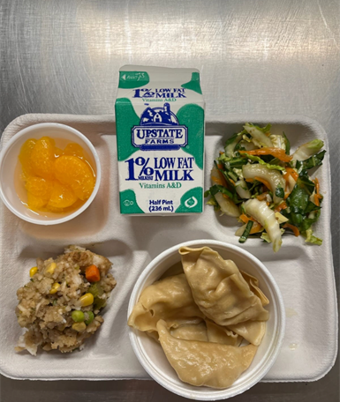
Alternate Daily Meals
Must Comply with Meal Pattern Requirements
Picture Courtesy of Frontier CSD
Notes:
Alternate daily meals are not required. However, having additional choices will add variety to your menu and could increase student participation.
When offering these daily meals, you must ensure that both your main offering and your alternate offering meet the daily and weekly minimum quantities specified on the meal pattern chart for the grade groups being served. As this is a common error, we will dive deeper into how to ensure these requirements are met.

Slide 18
Compliance with Weekly Requirements
Ensure the contribution of each component is accounted for in every meal offered.
Determine the lowest creditable amount offered each day.
Total the lowest creditable amounts to determine the weekly amount offered.
Reference the NSLP or SBP Meal Pattern chart to ensure compliance.
Picture Courtesy of Buffalo City School District
Notes:
When structuring daily alternate meals in your menu, it is crucial to calculate how all items are contributing to the required weekly minimum amounts.
This ensures compliance with meal pattern guidelines.
First, menu planners ensure every meal, including alternates, are counted as part of the weekly requirement determination and evaluate the amount offered of each component; meat/meat alternate, grain, fruit, and vegetable subgroups.
With every weekly menu item accounted for, the menu planner will need to determine the lowest creditable amount of each individual component daily, then total each day’s lowest creditable food item offered per component to calculate the total weekly contribution.
The menu planner will need to reference the meal pattern chart to confirm compliance with the weekly requirements per grade group.

Slide 19
Monday | Tuesday | Wednesday | Thursday | Friday
Hamburger 2 oz. eq. grain Bagel w/Yogurt 2 oz. eq. grain Pizza 1.5 oz. eq. grain | Chicken Patty on a bun 2 oz. eq. grain Ham & Cheese Sandwich 2 oz. eq. grain Pizza 1.5 oz. eq. grain | French Toast sticks w/Sausage 2 oz. eq. grain Nachos 2 oz. eq. grain Pizza 1.5 oz. eq. grain | Chicken Nuggets 1 oz. eq. grain Turkey & Cheese Wrap 2 oz. eq. grain Pizza 1.5 oz. eq. grain | Pizza Supreme 2 oz. eq. grain Grilled Cheese 2 oz eq grain Pizza 1.5 oz. eq. grain
Example
NSLP
K-5
Menu
Notes:
To take a closer look at this process, here is an example of ensuring enough weekly grain component is menued for K-5 Lunch.
In this slide we identified the lowest creditable amount of grain offered each day. Be aware the lowest amount may not necessarily be from the same reimbursable meal. As you can see here, the chicken nuggets on Thursday have the lowest creditable amount not the pizza.
Next, we will calculate the minimum weekly grain offerings using the lowest creditable amounts identified which totals 7 ounce equivalents.
The required minimum weekly amount of grain ounce equivalents for grades K-5 is 8 ounce equivalents.
While this menu meets the minimum daily requirement of 1 ounce equivalent grain, the minimum weekly grain is deficient by 1 ounce equivalent.
Although there are many ways the menu planner can correct this menu to be in compliance with the weekly requirement, one option would be to serve a daily pizza that credits as 2 ounce equivalents of grain.
This process should be used to check all weekly minimums.

Slide 20
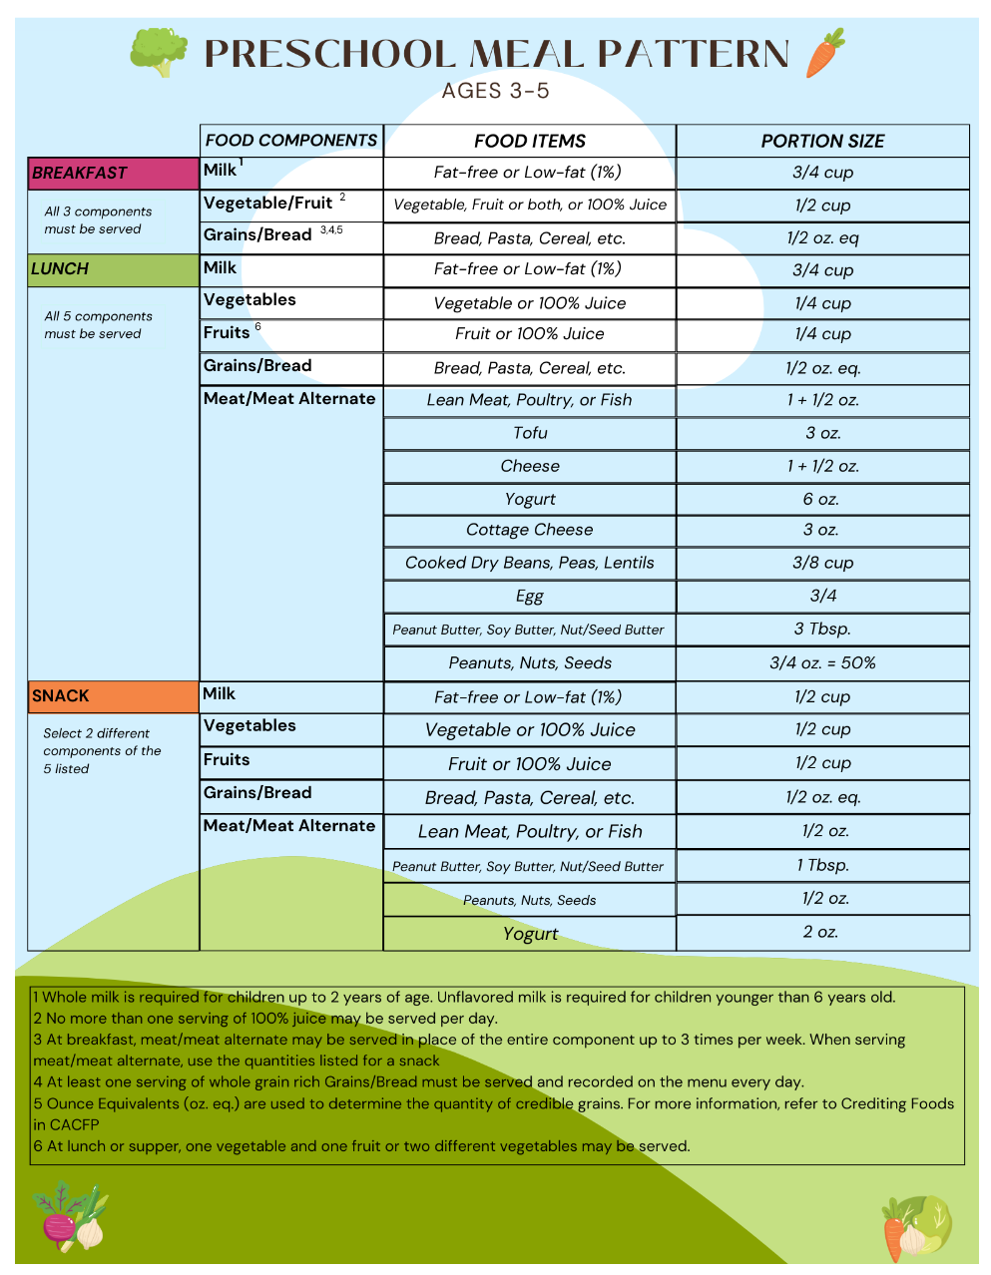
Prekindergarten &
Preschool Meal Pattern
Preschool Meal Pattern MUST be followed when preschool students are served:
In a different area than older students (such as in their classroom); or
At a different time than older students.
Cannot elect OVS
Production Records Required
Find More Information at:
https://www.cn.nysed.gov/content/preschool-meal-pattern
Notes:
Moving on to the preschool meal pattern. When operating a preschool or prekindergarten program, you must know when to use the preschool meal pattern requirements.
The preschool meal pattern must be followed when serving preschool students unless the students are co-mingled with older students.
One big difference between the preschool meal pattern and that of the older grade group meal patterns is that the preschool meal pattern has smaller minimum portion sizes. The meal pattern also sets limits on sugars provided to students. For instance, in the preschool meal pattern: no flavored milks are allowed; most grain-based desserts are not creditable; and sugar limits are in place per portion for cereals and yogurts.
A few more notes on the preschool meal pattern: offer versus serve is not allowed (meaning all required components must be served in minimum quantities to all students); there are no dietary specifications for the preschool meal pattern; and production records must be maintained.
Further guidance on the preschool meal pattern can be found on Child Nutrition Knowledge Center under the Program tab, at National School Lunch, then click on Menu Planning.

Slide 21
Preschool and Co-mingling
Meal patterns of the older grades (such as K-5) may be used when:
Preschool students are served meals in the same place at the same time as older grade groups;
It’s difficult to differentiate preschool students from older students; and
It’s operationally difficult to serve different sizes during a combined meal service.
https://www.cn.nysed.gov/content/preschool-meal-pattern
Notes:
Sometimes, schools must serve meals to a variety of grades at the same time. This is usually due to operational constraints, such as time and space. This practice is called co-mingling.
Co-mingling occurs when:
Preschool students and students from older grade groups (such as K-5, K-8, or K-12) are served meals in the same place at the same time;
It’s hard to tell the preschool students from older students; and
It would be operationally difficult to serve different foods or different amounts of foods during the combined meal service.
When these conditions are met, schools may offer the meal pattern of the older grades, such as K-5, to preschool students.
If you require more assistance or have specific questions, please reach out to your CN Representative.

Slide 22
Questions?
Child Nutrition Program Administration
cn@nysed.gov
(518) 473 – 8781
https://www.cn.nysed.gov/contact
Notes:
We will now take questions on anything discussed during today’s Meal Pattern webinar.
Again, you can use the Q&A box in the lower corner to type and send your question to our staff to which we will answer for all viewers to hear.
Please remember you will need to contact your CN representative for questions specific to your school operations or on other topics not discussed during todays webinar.

