Slide 1
Notes:
Welcome to the Customer Service and Marketing webinar hosted by the New York State Education Department Office of Child Nutrition.
Presenting today will be ___________________ and ________________, and ___________________.
___________________ and _______________________ will be answering questions.
The next slide will review the topics we will be presenting on today.
If you have any questions during the presentation, please type them into the question box. We will review them at the end.
Following today’s presentation, you will receive an email containing the slides for today’s webinar. If you do not receive them, please email CNTraining@nysed.gov
Additionally, a copy of the webinar will be posted to the CN website within a few weeks.
As always, if you have any questions, never hesitate to reach out to your Child Nutrition Program Representative or email CN@nysed.gov.

Slide 2
Notes:
We all have a good idea of what customer service means to us but let’s look at the definition of customer service….
Customer service is the act of taking care of the customer's needs by providing and delivering professional, helpful, high-quality service and assistance before, during, and after the customer's requirements are met.
Through out this presentation we will be sharing best practices and ideas that will assist SFAs with reaching to all potential customer. We will give ideas on getting the word out showing the value of the meals offered to students and provide them with what they want.

Slide 3
Notes:
Everyone in this slide are potential customers that have some sort of contact with food service staff on a regular basis.
It is so important to make sure to impress upon all potential customers that customer service is the number one goal. To meet this goal, it is important that you identify who your customers are and know what your customers want to eat.
Customer Service starts by communicating all the meals you offer. Communicating on the morning announcements with describing your menu using adjectives that make it sound delicious such as warm pancakes with syrup and chilled yogurt for breakfast or Sizzling Chicken fajitas with steamed rice. This could make a student that brought a meal from home think about the next day and trying the meal.

Slide 4
Notes:
Greeting students with a smile can go a long way. Create a welcoming environment by engaging with the customers and make the experience personal.
Ask how the student’s weekend went or if you know the student participates in a school activity, ask details.
Staff’s body language may set the tone as the student approaches. Ensure you are facing the student and making eye contact to show you are interested. Positive attitudes are contagious and can make the student’s meal more enjoyable.
Training staff in customer service is a key component in making the program successful.

Slide 5
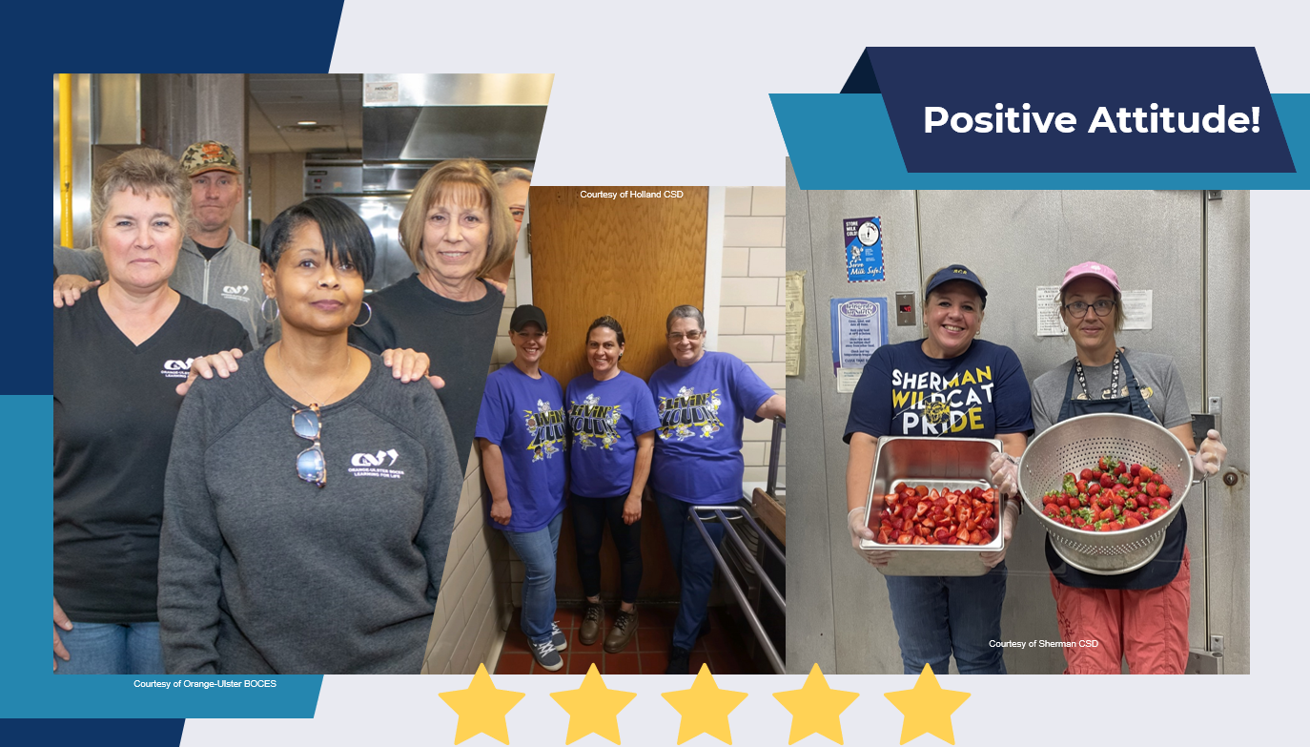
Notes:
The first thing customers notice when selecting a meal is the food service staff. How the staff serves food and interact with students determines whether students will continue to purchase school meals or bring meals from home. Engaging with students and displaying a positive attitude may convince students who normally bring meals from home purchase school meals or a la carte items.
A positive attitude is reflected in staff who are happy and confident in their role. Having happy, confident staff members require that staff is adequately trained, have the tools to do their jobs, and know that their hard work is recognized and appreciated. It can be something as simple as a “thank you” by showing appreciation for a job well done.

Slide 6
Notes:
Good customer service requires that service be the focus during meal periods.
Staff should be ready to set up all meal stations for the start of meal service and this will set the tone for the day. Customers do not like waiting in slow moving lines or waiting for meal service to start if staff is running late. If the food service line is not ready or not being attended to, will send a bad message to the customers.
It is important for staff to be attentive to their customers. This not only means serving meals but also interacting with customers and ensuring that they are receiving everything they need. Staff can encourage the student to select healthy options or remind the student to take food items to complete a reimbursable meal. It is important to know your customers in case students have food allergies or need other accommodations.
.Staff members should be ready to support the service line, if needed. Staff should be ready to assists the food service lines by restocking food items, batch cooking, or cleaning in between meal periods even if it is not their primary duty.
Keeping the food service line running smoothly, without a break in service, will keep customers happy and wanting to return.
Every customer should have the similar experience going through the food service line, whether they are the first customer or the last. This means food should be stocked with enough food for all students. The last student should not be served food that has been held for hours in a warmer or reheated. Batch cooking is one way to ensure that the customers experience is positive and will encourage students to participate.

Slide 7
Notes:
Students eat with their eyes! Displaying food items on the food service line will attract customers to purchase school meals.
There are new menu items, cooking techniques, and staff who are trained to make delicious nutritious meals. Staff can display the food items on a tray and showcase it by enticing students with the food aroma and presentation.
Serving appealing meals will increase participation and get the word out to other customers.
Meal presentation is a key component with introducing and marketing new or healthy options to students. This can play a big role in whether students will be inclined to consume them. Meals should appeal to all five senses.
Ask yourself the following questions before putting a new item on the menu:
Does the food look delicious? How can staff make it more appealing. Ensure there a variety of colors on the tray and not all the same color.
The smells of the kitchen can fill the cafeteria and hallways and lure hungry students to the cafeteria. For example, a fresh baked muffin for breakfast when students are arriving to school may bring in more students.
Food items should be fresh, crisp and appealing. The meal should always have fresh products that are attractive. Apples with bruises or lettuce that is wilted will make the meal less appealing and taste good.
The texture and food quality should always be consistent. For example, the French fries should be crisp and not soggy. Batch cooking and proper holding methods for food will help keep the food quality be consistent and delicious.
Appealing meals will increase participation and gain revenue for your program.

Slide 8
Notes:
Signage should be clear on what entails a reimbursable meal. Signage can be a powerful marketing tool which shows the students all the meal options offered. The signage assists students on what to select to receive a reimbursable a meal.

Slide 9
Notes:
Setting up appealing displays in addition to the normal signage may increase participation. Staff can set up sample plates to let the customer know what their meal will look like if they select a full reimbursable meal, Be creative and use photos, props, or other methods to catch your customers’ attention and make the meals look appealing.
This is a fantastic way to showcase the meals and market your Program.

Slide 10
Notes:
The menu should be attractive and catchy with bright colors and information about meals and special events.
As you can see, this lunch menu informs customers of available meal options everyday but also provides other important information. Menus can give information on the student’s food service account and can inform families about adult and student meal prices. The menu also give information on what students need to select to constitute a reimbursable meal. SFAs can add information regarding completing free and reduced applications as well as advertising upcoming events.
Look at these great menu examples.

Slide 11
Notes:
The primary goal of any school lunch program is to feed students' healthy meals. SFAs are self sustaining and must focus on revenue to keep the program running. The nonprofit food service account should run like a business to be successful.
If the nonprofit school food service account is losing money, the difference must be made up by using non program funds to make the account whole. Increasing participation will bring revenue into program. Also, find innovative ways of bringing revenue into the program including a la carte items or catering special events for the school or PTO.

Slide 12
Notes:
Many SFAs offer catering services to generate more revenue to the nonprofit food service account. Catering menus can be sent to the administration for special events and meetings as an alternative of purchasing off site meals.
School events can be catered and be more cost and time effective for the department and giving revenue back into the food service department instead of an outside entity.
Develop a catering menu utilizing products generally used and not too labor intensive for staff to make. The goal is to profit from sales and to serve nutritious healthy choices.
Here is an example of a catering menu from Mechanicville City SD.

Slide 13
Notes:
Farm to school is a great way to help local farmers and producers and provide nutritious and appealing foods.
The farm to school changes you put into place will benefit the students’ health, will make your food offerings look fresh and attractive, and will help the local economy.
There are different grant/funding options if you are looking to start a Farm to School program You can find this information on the Farm to School tab on our website.
SFAs may also have excess fund balance in the nonprofit school food service account. SFAs should be utilizing these extra funds to increase the food quality and purchasing local foods. SFAs can reach out to Cornell Cooperative Extension to assist with finding farmers for local products.

Slide 14
Notes:
Networking with other area schools and finding out what they do is an easy way to find ideas that may help your Program.
SFAs can research other districts menus and website. Since SFAs are not in competition with each other like area restaurants, it is a great resource. SFAs can meet with area districts and brainstorm for creative ideas and best practices to improve participation.

Slide 15
Notes:
Get the word out about the healthy meals your programs offer by sharing updates about new menu items, alternative meal options, or special events you are hosting.
SFAs can posting photos of complete meals on different platforms and show families all the options offered.
SFAs can use social media and other forms of free advertisement to display meals and information. Students, school staff, parents and community members can see all the great things served at your school.
Advertising and promoting your meal programs does not have to be costly or time consuming.
Use the schools Facebook, Instagram, Twitter accounts to promote your programs.
The school website is a great platform to display meals and demonstrate all the meal options offered
Using school announcements is a great way to communicate the menu options to school staff and students
Develop and display colorful, informative flyers and posters and post them in the school or send home to families
Do not assume that families are aware of meal availability at school.
It is important to notify families where and when meals are available. Parents may not know what types of meals are available for their children so do not assume they know this information. It is a good practice to demonstrate the economic value school meals provide to students and parents. Families can purchase schools' meals to save time for parents. Ensure families know of how nutritious school meals are and how much food items they can get with a complete meal.

Slide 16
Notes:
SFAs must stay up to date on current trends and students’ preferences as they compete with restaurants and fast-food establishments. Promote menu items so the customers can choose them easily and quickly, so it is more convenient. Some SFAs do not allow students to leave the school campus or receive delivered meals from outside sources. If your SFA allows students to leave the school campus or receive delivered meals, meet with the administration and try to persuade them to not allow it to help generate more revenue to your food service operation.
Some schools use similar packaging to fast food establishments to make it look more appealing to students. Also, food stations where the students can build their own meals at the station are a popular option.
Burrito Bowls, Sandwich/sub stations, and a Hibachi style stations are just some creative ideas that GST BOCES offers at their sites.

Slide 17
Notes:
Some SFAs use alternate service options to increase participation by providing easier access to meals.
Here are some examples of a breakfast cart at Troy CSD, where students can purchase a meal and take it to their classroom.
Buffalo CSD offers a food truck option which that parks outside of schools so students can take a meal quickly before going into the school.
Bais Yaakov Academy for Girls utilizes a family style meal service option which offers all the menu items for a complete meal. This SFA prepared the table so it was inviting and appealing.

Slide 18
Notes:
Special events at your SFA make it fun for students and help increase participation. SFAs can use theme days to make each day a little different. SFAs can also create special menu items to attract the student's attention like Shenendahowa CSD did with the National Ranch Day. Ensure you promote these special events to the students and families!

Slide 19
Notes:
Contests are another great way to get students interested in the meal service. Students love competitions especially if they can win small prizes or special desserts. Contests are always strong motivators.
SFAs can decorate their service line like Sandy Creek CSD with giving out golden tickets for the Willy Wonda and the Chocolate Factory theme.

Slide 20
Notes:
Promote events in a fun way and drum up enthusiasm as well as demonstrating to students to make healthy choices. Taste Tests are a great way to entice students to taste new menu items.
When a new recipe is developed, offer samples a couple weeks before you add it to the menu. Students will remember they enjoyed it and will be more willing to try it when it is offered.
Staff can talk to the students and let them know the ingredients and how it is cooked or prepared. If the meal includes local products, let the kids know about it and where it came from.
Communication is imperative and students’ feedback help evaluate the meals so SFAs can keep improving their menu.
Student feedback might be informal such as a “thumbs up” or “thumbs down” count during a taste test or can be more formal, like a survey or results taken during a meeting. Some SFAs give out stickers that read, “ I tried it” or “ I like it”. Students enjoy this and it a great method to gather feedback.

Slide 21
Notes:
Student and family feedback is a great way to evaluate meeting the needs of your customers . Collecting data.from surveys is a great option as long as it is not time consuming.
Feedback is very valuable and solicited in many ways including, suggestion boxes, small committees, informal conversations between staff and students in the cafeteria or from trusted student influencers.
A parent advisory council, engaging with parents at school events, and listening to students are all way to gather parent feedback.
When students’ thoughts are asked during the menu development process, they feel appreciated and excited. Students feel respected when their opinions are taken into consideration.

Slide 22
Notes:
School staff are always welcome to attend School Board meetings, PTO meetings, or open houses.
Being present at these gatherings and activities fosters open communication between families and students and helps them get familiar with the food service program.

Slide 23
Notes:
Staff has valuable insight into student expectations and needs. Staff members are crucial to the success of your program because they are the ones that know the students taste the best. Staff participation improves morale and provide innovative ideas for meal service. If the staff is happy and the cafeteria setting is exciting, students will be more likely to participate. Everyone will want to take part in the fun!
Here are some examples of Mechanicville City SD foodservice staff having fun during Thanksgiving and Saratoga CSD having a Dr. Suess theme day.

Slide 24
Notes:
It is important to make the atmosphere warm and inviting. Try creating a new cafeteria name using a catchy slogan or mascot name. This will make the cafeteria more like a restaurant then a school setting.
Here are some examples of attractive designs that Broome Tioga BOCES and Newcomb CSD created for their cafeteria.
We will now turn it over to our guest speaker Deb Mackey from Mechanicville CSD. Thank you, Deb for participating on today’s webinar.

Slide 26
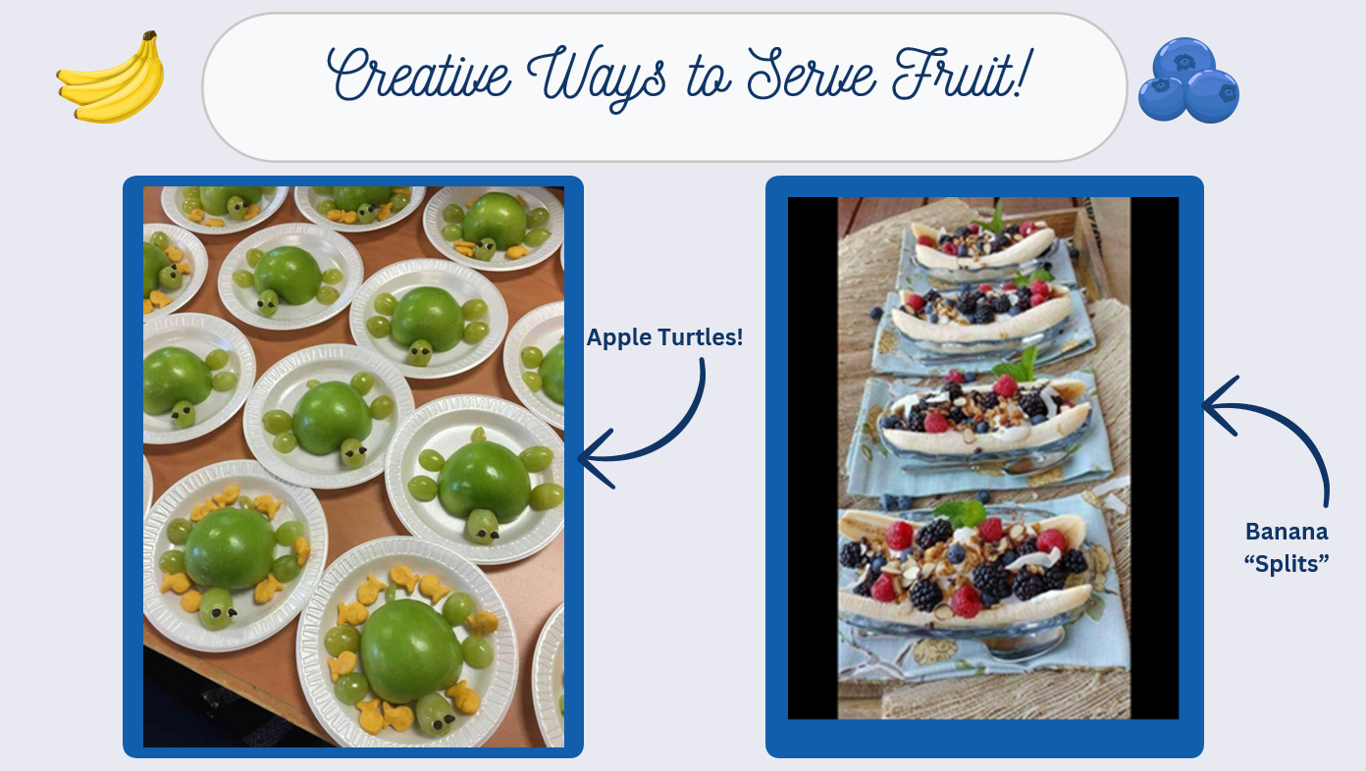

Slide 29
