Slide 1
T
NYS Education Department
Summer Food Service Program (SFSP)
Meal Service
A
O
U
M
P

Slide 2
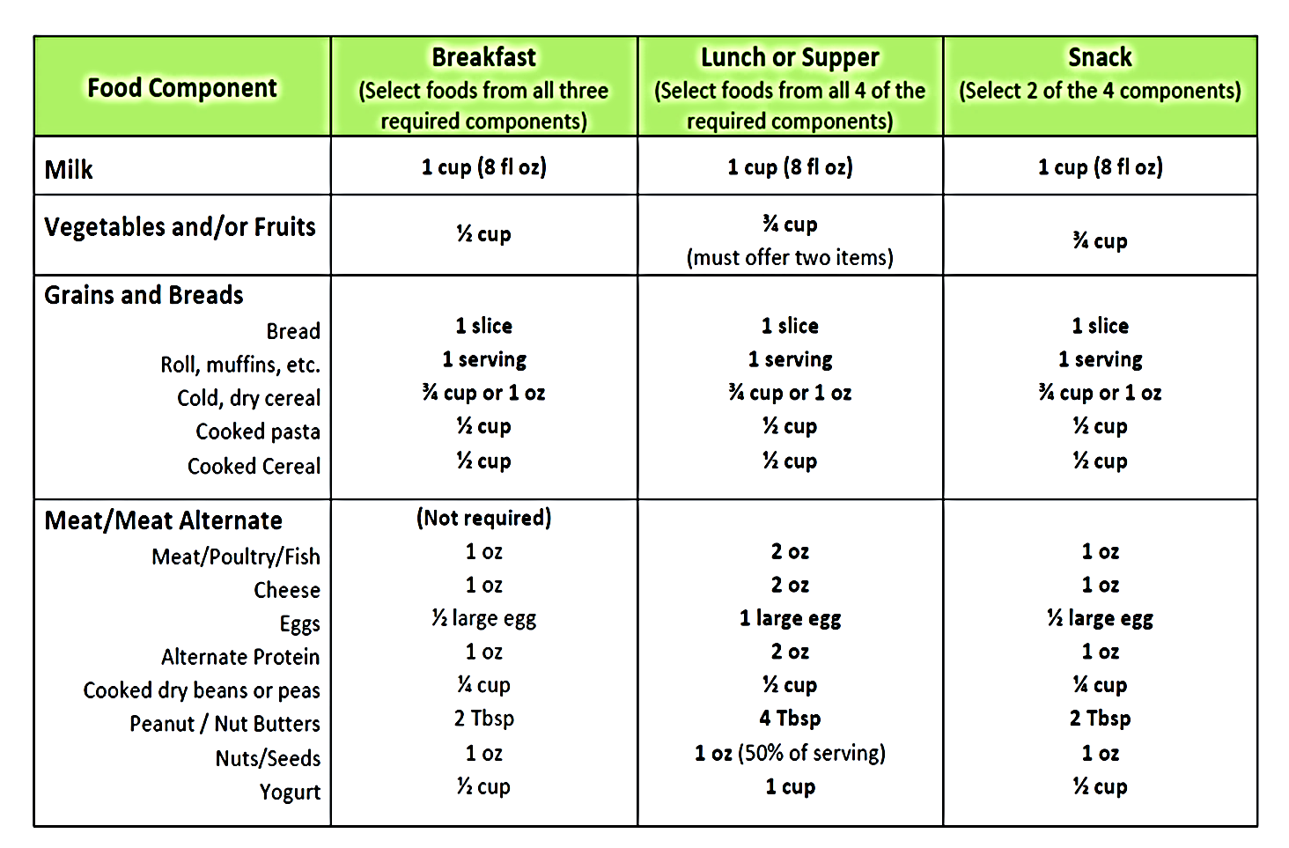
SFSP Meal Pattern
PRESENTATION PARTY PRINCIPLES
Notes:
This is the Summer Food Service Program meal pattern which can be found in the Nutrition Guide Manual.
Notice milk, fruit/veg, and grains are required for breakfast, lunch, and supper. Lunch and supper must contain a meat/meat alternative.
Snack can be any two components, as long as they are not the same. Example: Can not have an orange and orange juice.

Slide 3
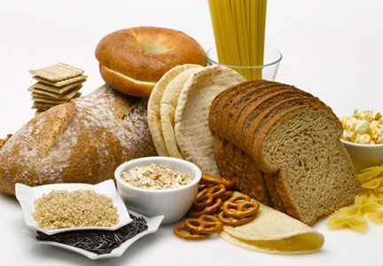
Meal Pattern Requirements
Grains:
Required at breakfast and lunch/supper
May be one of the two components of snack
 | Breakfast | Lunch/Supper | Snack
Grains Bread Roll, Muffins, etc. Cold, dry cereal Cooked pasta Cooked cereal | 1 slice 1 serving ¾ cup or 1 oz. ½ cup ½ cup | 1 slice 1 serving ¾ cup or 1 oz. ½ cup ½ cup | 1 slice 1 serving ¾ cup or 1 oz. ½ cup ½ cup
Notes:
Whole grain products are not required on the SFSP meal pattern but the goal is to serve nutritious meals and be consistent with what the kids are receiving at school. Grains offered must be whole grain or enriched.

Slide 4
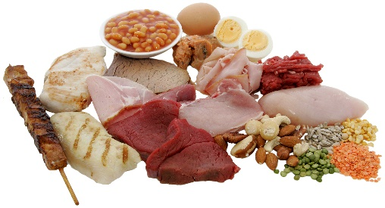
Meal Pattern Requirements
Meat/Meat Alternatives:
Required at Lunch/Supper
May be one of the two components of snack
Optional for Breakfast
 | Breakfast | Lunch/Supper | Snack
Meat/Meat alt. Meat/Poultry/Fish Cheese Eggs Alternate Protein Cooked dry beans/peas Peanut/Nut Butter Nuts/Seeds Yogurt | Not Required 1 oz. 1oz. ½ large egg 1 oz. ¼ cup 2 Tbsp. 1 oz. ½ cup | Required 2 oz. 2 oz. 1 large egg 2 oz. ½ cup 4Tbsp. 1 oz. (50% of serv) 1 cup | Not Required 1 oz. 1oz. ½ large egg 1 oz. ¼ cup 2 Tbsp. 1 oz. ½ cup
Notes:
Note that meat/meat alternate is not required at breakfast but, if served, must be at least 1 oz equivalent of meat/meat alternate.
Meat/meat alternate is required at lunch and supper in a 2 oz serving.
It can be one of the 2 components of snack but is not required.
If serving meat alternates, make sure you are providing a large enough serving size to meet meal pattern requirements.
Example: If a peanut butter sandwich is served at lunch or dinner you would need to have 4 tablespoons of peanut butter to equal 2oz of meat alternate equivalent if that is the only meat/meat alternate you are offering.

Slide 5
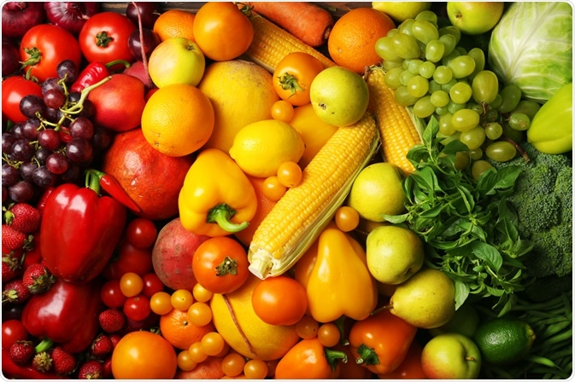
Meal Pattern Requirements
Vegetables/Fruit:
REQUIRED at breakfast and lunch/supper
Must be two items at lunch/supper = total ¾ cup
May be one of the two components at snack
Minimum creditable serving = 1/8 cup
If serving juice, 100% fruit/vegetable juice is required
E
Notes:
The fruit & veg. component is required at breakfast, lunch, and supper.
Must be two items at lunch/supper totaling ¾ cup.
Could be ½ cup strawberries and ¼ cup cucumbers. Doesn’t have to be one fruit and one veg. it can be any combo.
It must be at least 1/8 cup to count as creditable.
If Juice is being served, it must be 100% fruit juice.
Serve fruits and vegetables that are fresh and in season whenever possible.

Slide 6
Meal Pattern Requirements
Milk:
8oz serving required at breakfast, lunch and supper
May be one of the two components chosen for snack
Allowable milk options:
Unflavored or flavored
Fat free, low-fat, reduced fat, whole
Lactose-reduced, lactose free
Notes:
An 8 oz serving of milk must be served with each meal.

Slide 7
Meal Pattern Requirements
Snack
Choose 2 DIFFERENT components
1 serving of milk
1 serving of vegetable or fruit or 100% juice (all 1 component)
1 serving of grain or bread
1 serving of meat/meat alternate
Grain-based sweet snacks (cakes, cookies, etc.) may not be served more than twice in a five-day week or more than three times in a seven-day week.
Notes:
For snack, the menu needs to offer at least 2 different components. Remember the vegetable, fruit, or juice is all considered to be one component.
Two components can not be apple juice and apple, or carrots and apples, or orange juice and oranges.
Milk and apple would be considered a reimbursable snack.

Slide 8
SFSP Approved Meal Service Styles

Slide 9
Requirements For All Meal Service Styles
All components must be prepared and served at the approved meal service time.
All components must be served at the same time.
Children must be present and prepared to eat at the approved meal service time.
Children consume the meals on-site in a congregate setting.
Trained site supervisor must be on site for the entire meal service.
Trained staff member takes a point of service meal count once all children have been provided all required meal components.
Meal count records maintained on-site.
Notes:
Regardless of which meal service style you choose to implement, there are requirements that apply to all types of meal service styles in the SFSP:
All components must be prepared and served at the approved meal service time.
All components must be served at the same time.
Children must be present and prepared to eat at the approved meal service time.
Children consume the meals on-site in a congregate setting.
Trained site supervisor must be on site for the entire meal service.
Trained staff member takes a point of service meal count once all children have been provided all required meal components.
Meal count records are maintained on-site and available for SED review at any time.

Slide 10
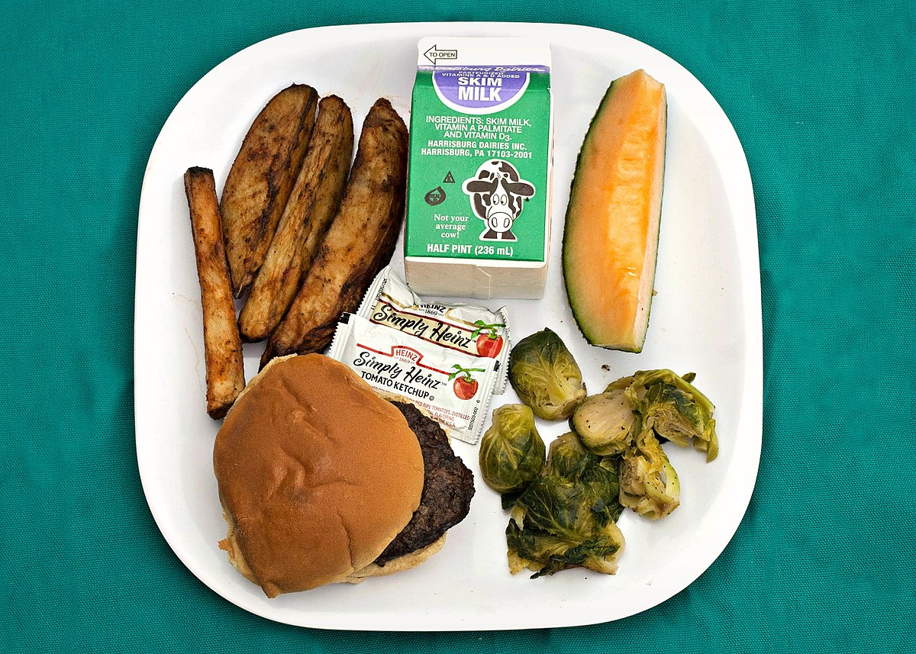
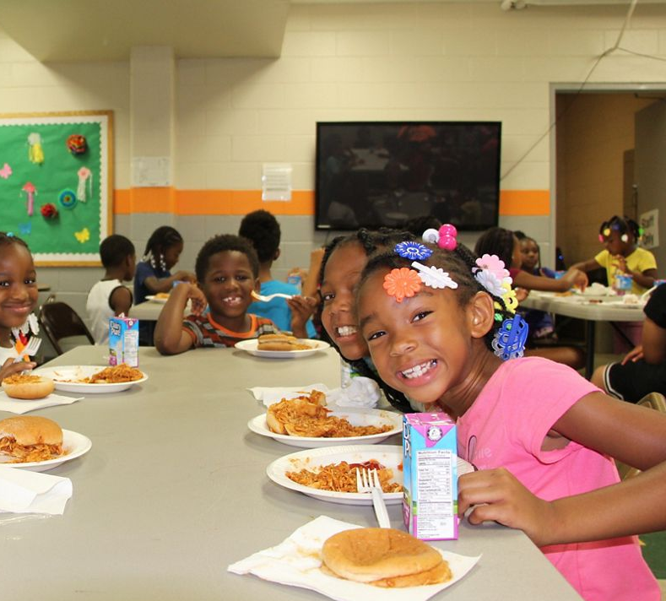
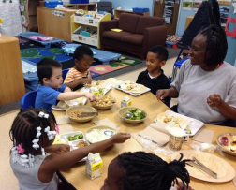
Approved Meal Service Styles
Tray Line
Pre-Plate
Pre-Set Table
Family Style
Notes:
There are 4 approved styles to serve meals to children in the SFSP:
Tray line - children go through the line and receive all required meal components by the time they reach the end of the line.
Pre set-table setting - all components on a plate at each place setting at the start of your approved meal svc
Pre plating means the required components are on plates which are then served to the children.
Family Style is when you are having the children eat like they would at home. Enough food is placed on the table for all children to have the required portion size of each component.
As a reminder, all meal components must be served at the same time no matter what meal service style is determined the best fit for your site.

Slide 11
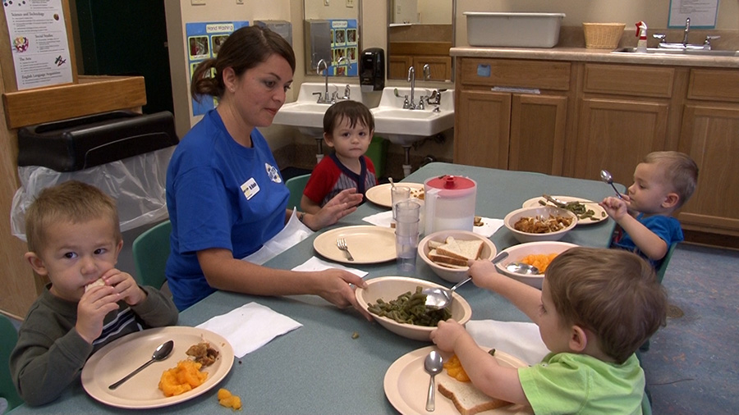
Family Style
A sufficient amount of food must be placed on each table to provide the required portions for all children at the table
T
I
Children should initially be offered the full required portion of each food component
Children are allowed the choice in selecting foods and the size of the initial serving
When a child does not initially accept the full required portion of a meal component, it is the responsibility of the supervising adults to actively encourage each child to accept the service of the full required portion for each food component of the meal pattern
Notes:
Serving meals family style can help children develop good eating habits through the personal example provided by supervising adults.
Camp and closed enrolled sites offer the best setting for implementing family style meals, provided that adults are available to assist children during the meal and staff and children are together for an extended period of time to provide a relaxed, stable environment conducive for teaching good eating habits. Family style meal service cannot be used at open sites.
A sufficient amount of food must be placed on each table to provide the required portions of each of the food components, as outlined in 7 CFR 225.16, for all children at the table and to accommodate Program adults supervising the meal service, if they eat with the children. • Children should initially be offered the full required portion of each food component. • When a child does not initially accept the full required portion of a meal component, it is the responsibility of the supervising adults to actively encourage each child to accept the service of the full required portion for each food component of the meal pattern. For example, if a child initially refuses a food component, or initially does not take the full required portion of a meal component, the supervising adult should offer the food component to the child again.
Cup or glass size must be large enough to hold the full minimum portion. Clear cups are recommended as they assist the supervising adult in seeing the fluid milk portion.
The point-of-service meal count should be taken at the time participants are seated at the table with all required components placed on the table.
Remember, only one meal for each child may be claimed for reimbursement, even if seconds are eaten. You cannot claim reimbursement for second servings of meals.

Slide 12
Offer Versus Serve
Allows children to decline item(s) at each meal
1 item at breakfast and 2 items at lunch and supper
Offer vs. Serve
Offer 4 items at breakfast; child must select 3 items
Offer 5 items at lunch and supper; child must select 3 items
Notes:
Provided SED’s waiver request is approved by the National office, OVS can be an option chosen by all sponsors at the time of renewal
All components must be offered in the full serving size and those taken must meet required minimum portion size.
May be implemented at breakfast, lunch, and supper. Not snack.
Children get to choose which component(s) to decline. Helps decrease food cost and waste.
Refer to Admin Guidance Manual for more info

Slide 13
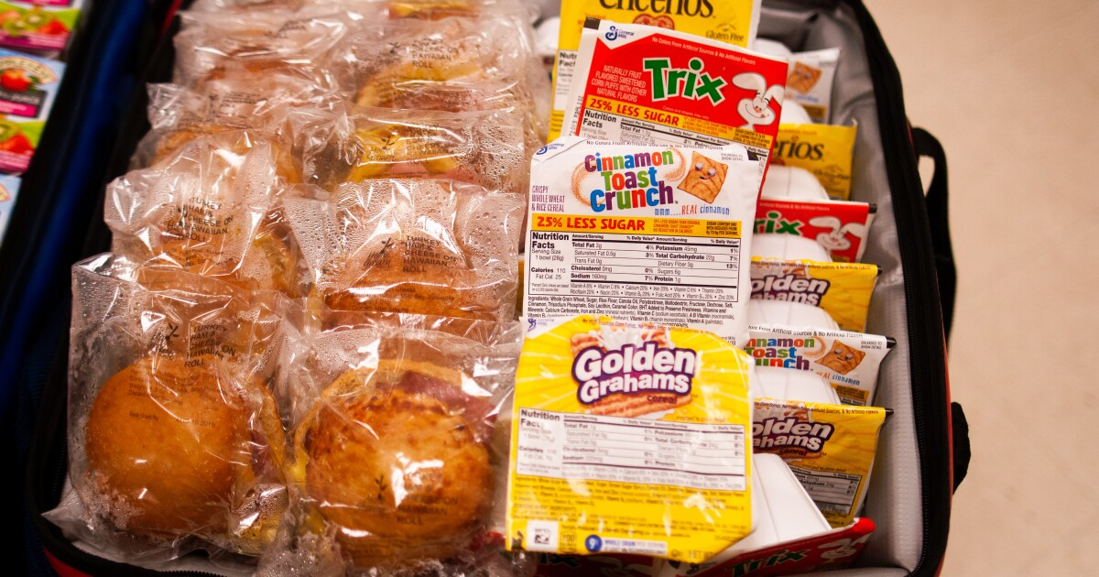
Breakfast

Slide 14
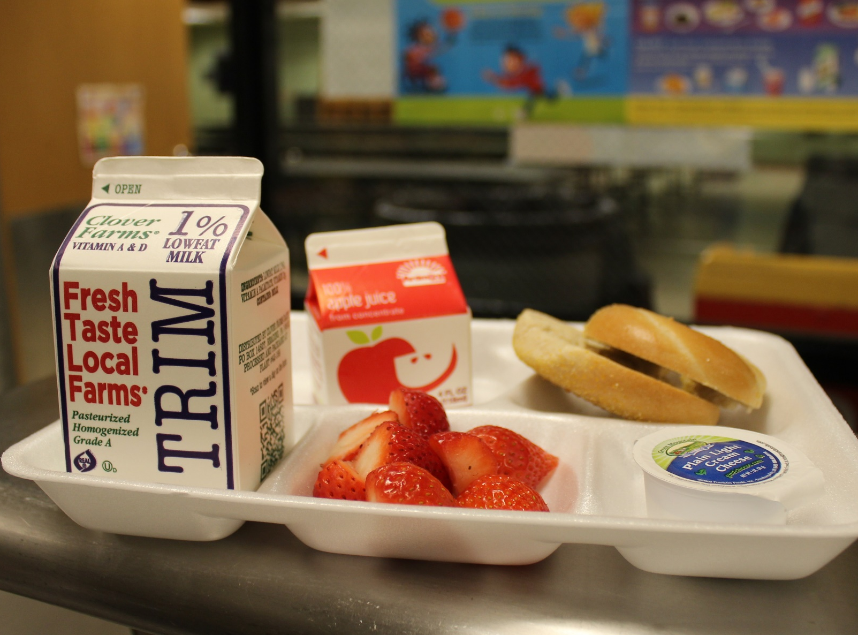
Breakfast Meal Pattern
MUST OFFER 3 COMPONENTS
Grain
Fruit/Vegetable
Fluid Milk

Slide 15
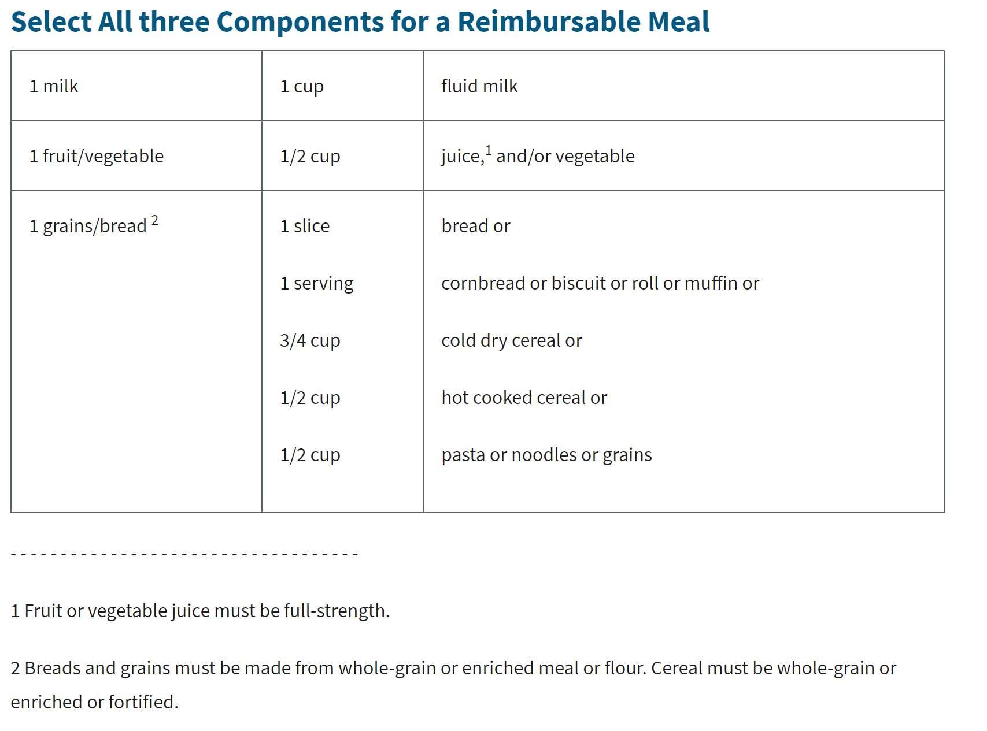
Breakfast Meal Pattern: 3 Required Components

Slide 16
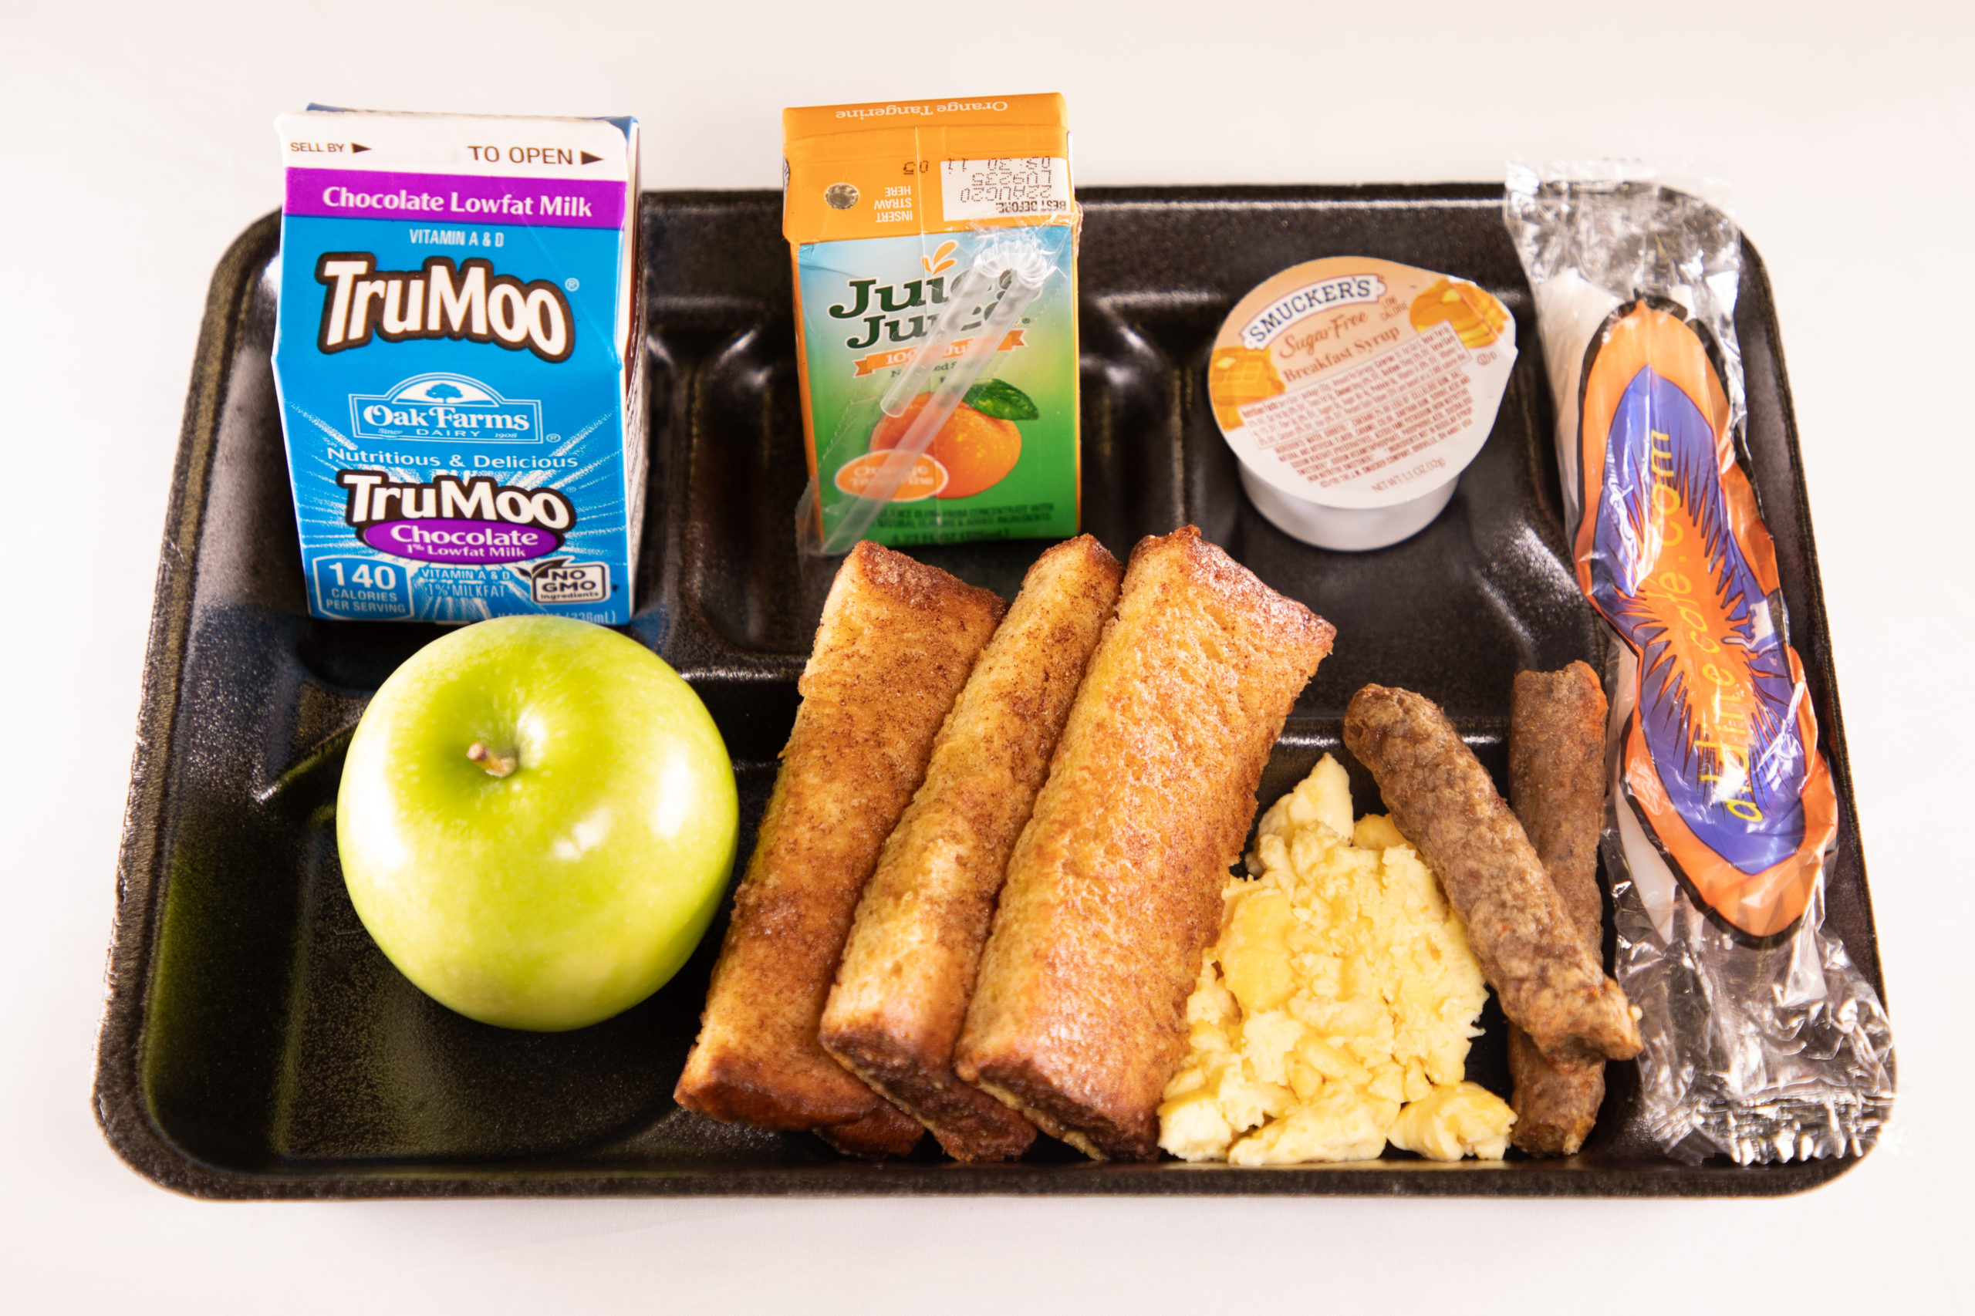
Offer vs Serve Breakfast
Must offer 4 food Items
1 serving of fruit/vegetable
1 serving of bread/bread alternative
1 serving fluid milk
1 additional serving of:
Fruit/Vegetable
Bread/Bread alternative
Meat/Meat alternative
Students must select 3 out of 4 items
*All items offered must be different from each other

Slide 17
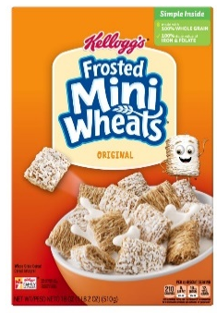
Reimbursable
Offer vs Serve Breakfast Examples
4 food items offered
3 food items selected
Notes:
For a reimbursable breakfast under OVS, a child may select:
Muffin, Cereal, and Apple; or
Muffin, Apple, and Milk; or
Cereal, Apple, and Milk; or
Muffin, Cereal, and Milk.

Slide 18
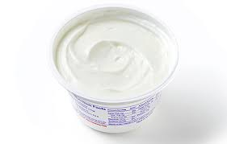
Offer vs Serve Breakfast Examples
4 food items offered
2 food items selected
Non-Reimbursable

Slide 19
Offer vs Serve Breakfast Examples
4 food items offered
2 food items selected
Non-Reimbursable

Slide 20
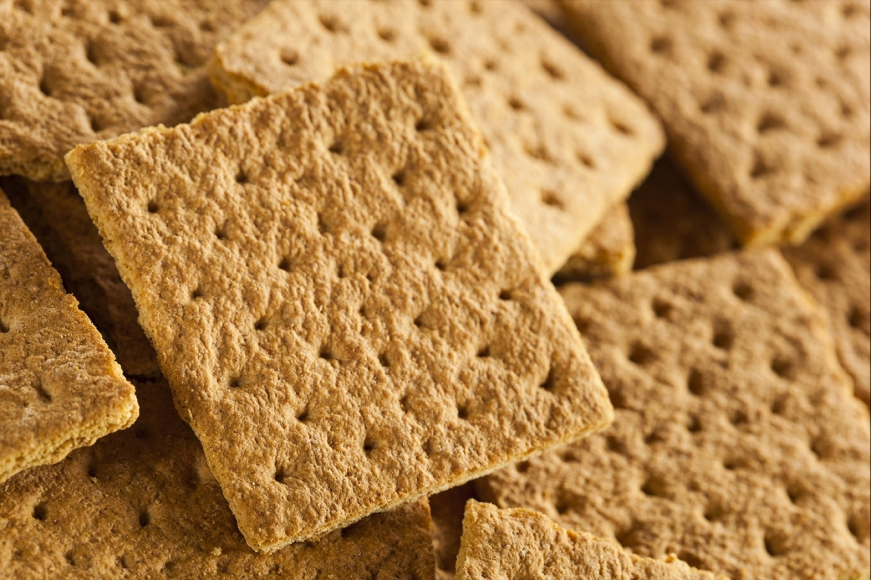
Offer vs Serve Breakfast Examples
4 food items offered
2 food items selected
Non-Reimbursable

Slide 21
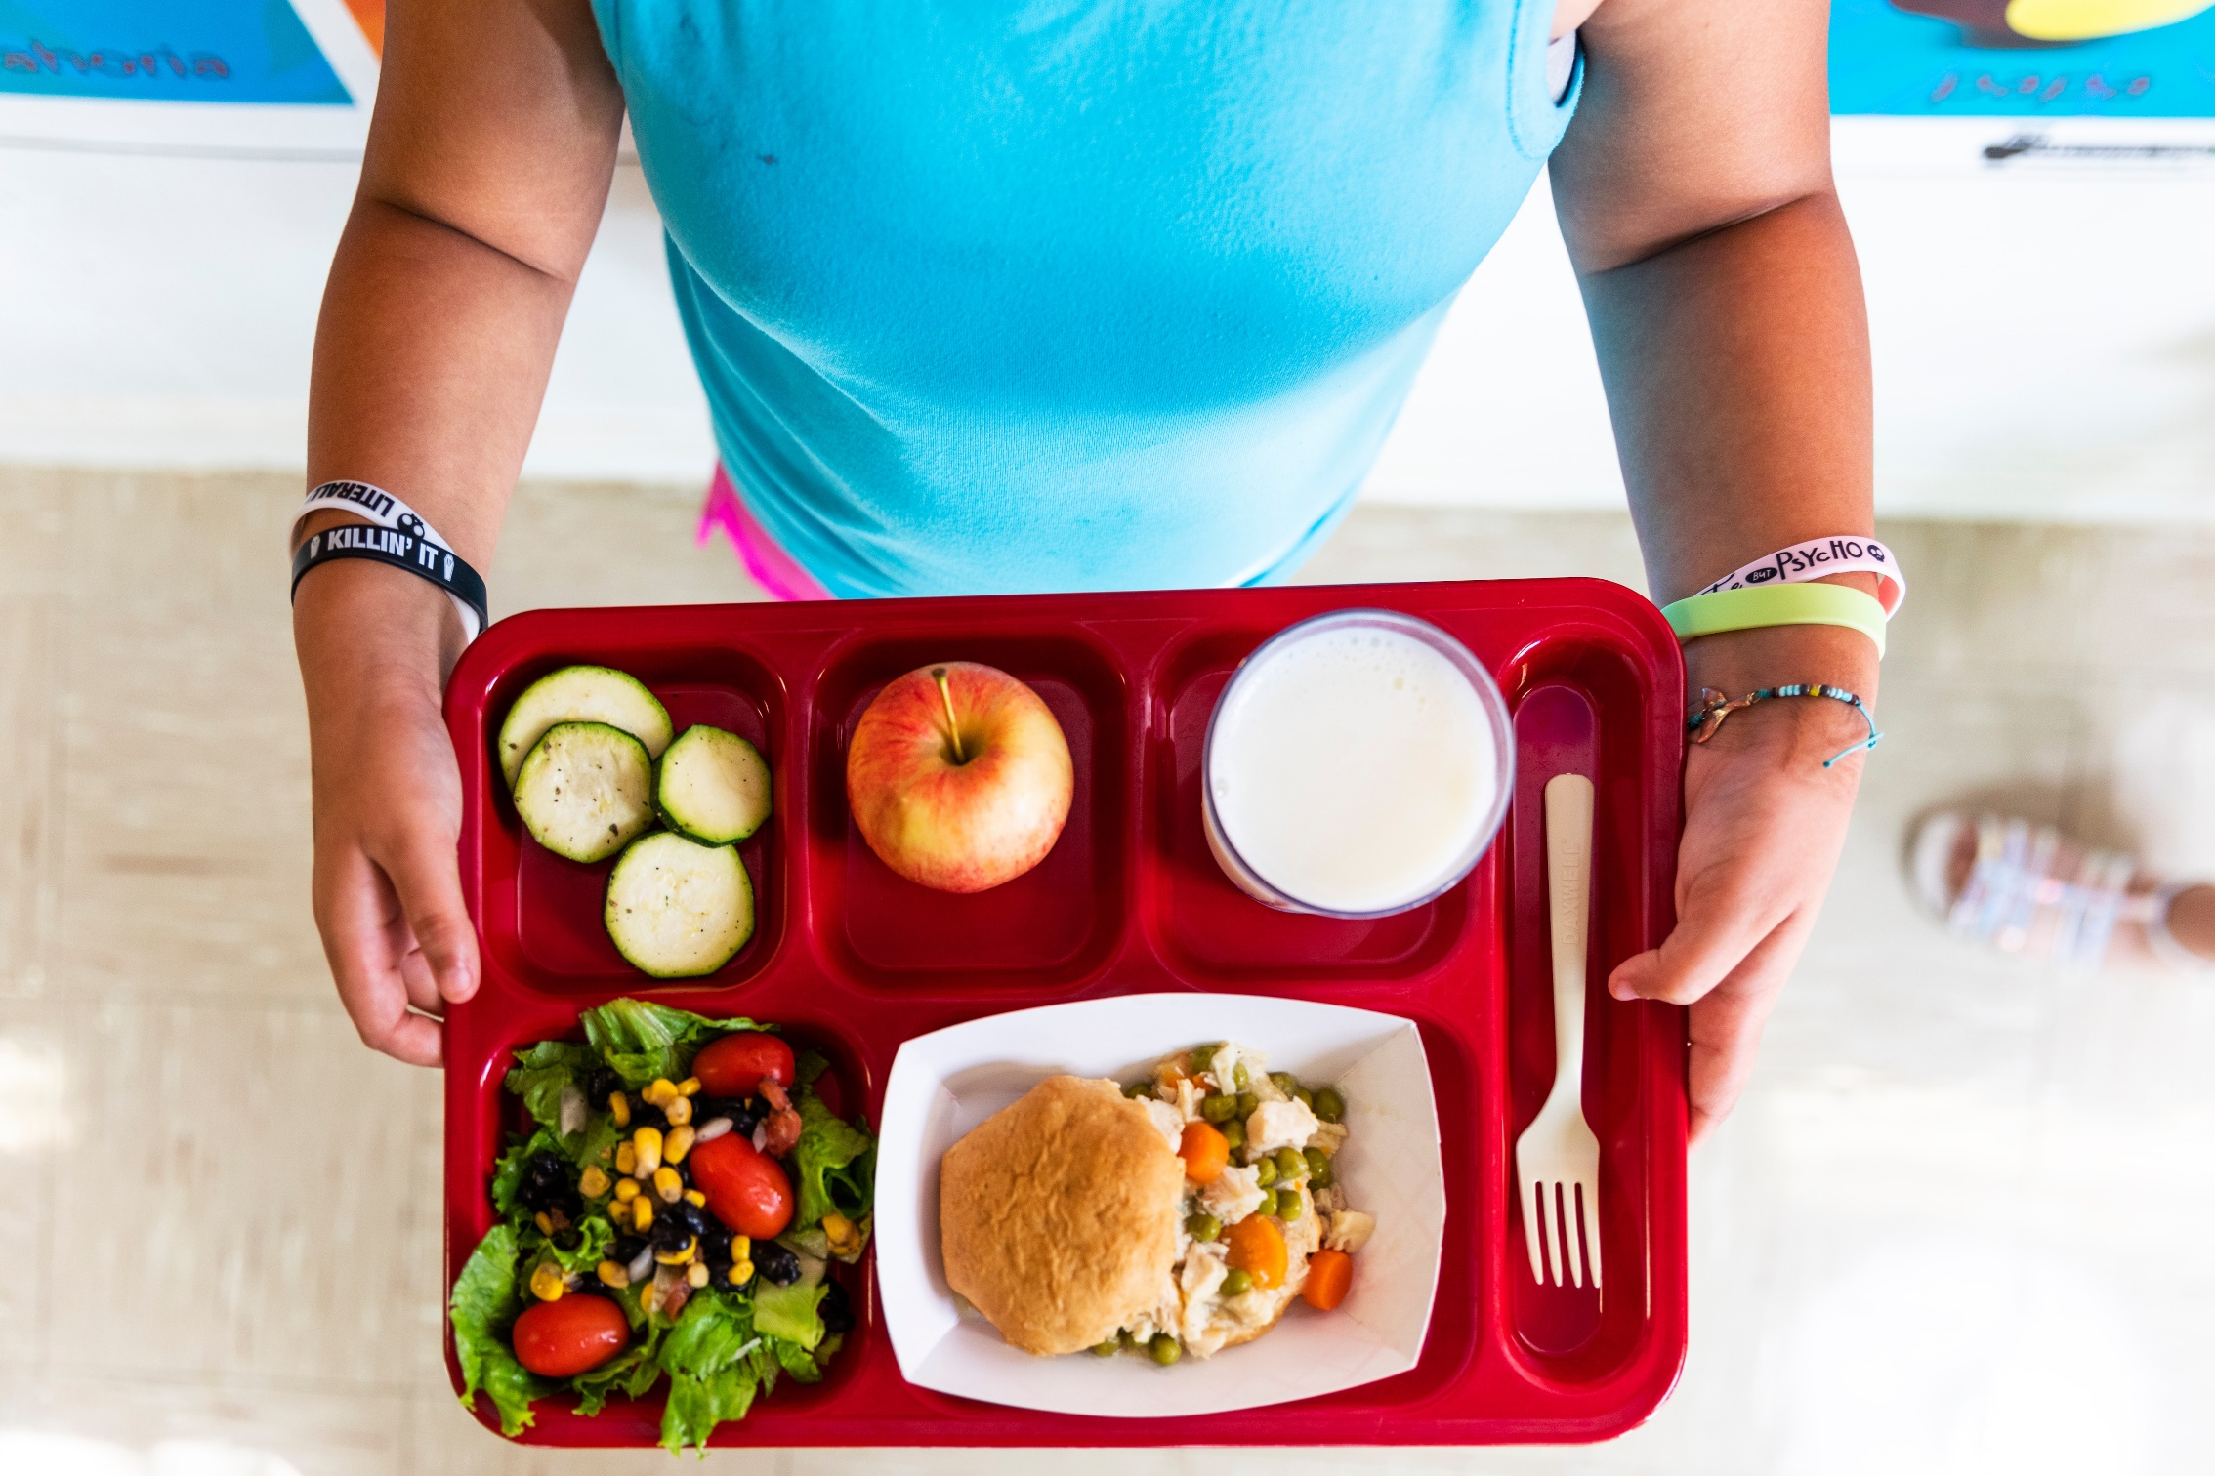
Lunch

Slide 22
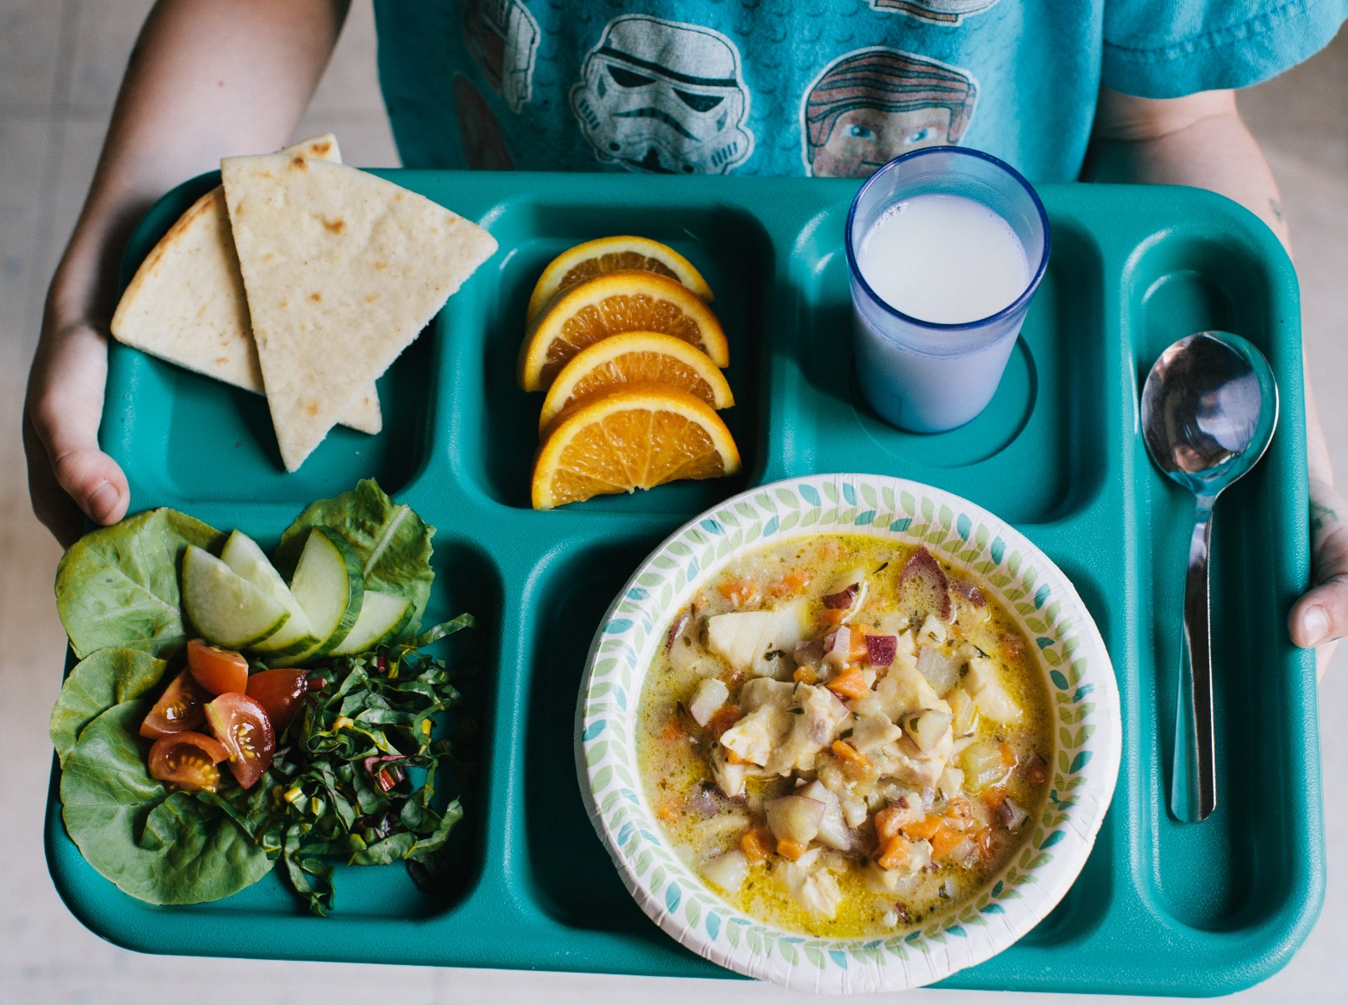
Lunch Meal Pattern
MUST OFFER 5 COMPONENTS
Grain
Meat/Meat Alternate
Fruit/Vegetable (2 servings)
Fluid Milk
STUDENT MUST SELECT 3 COMPONENTS

Slide 23
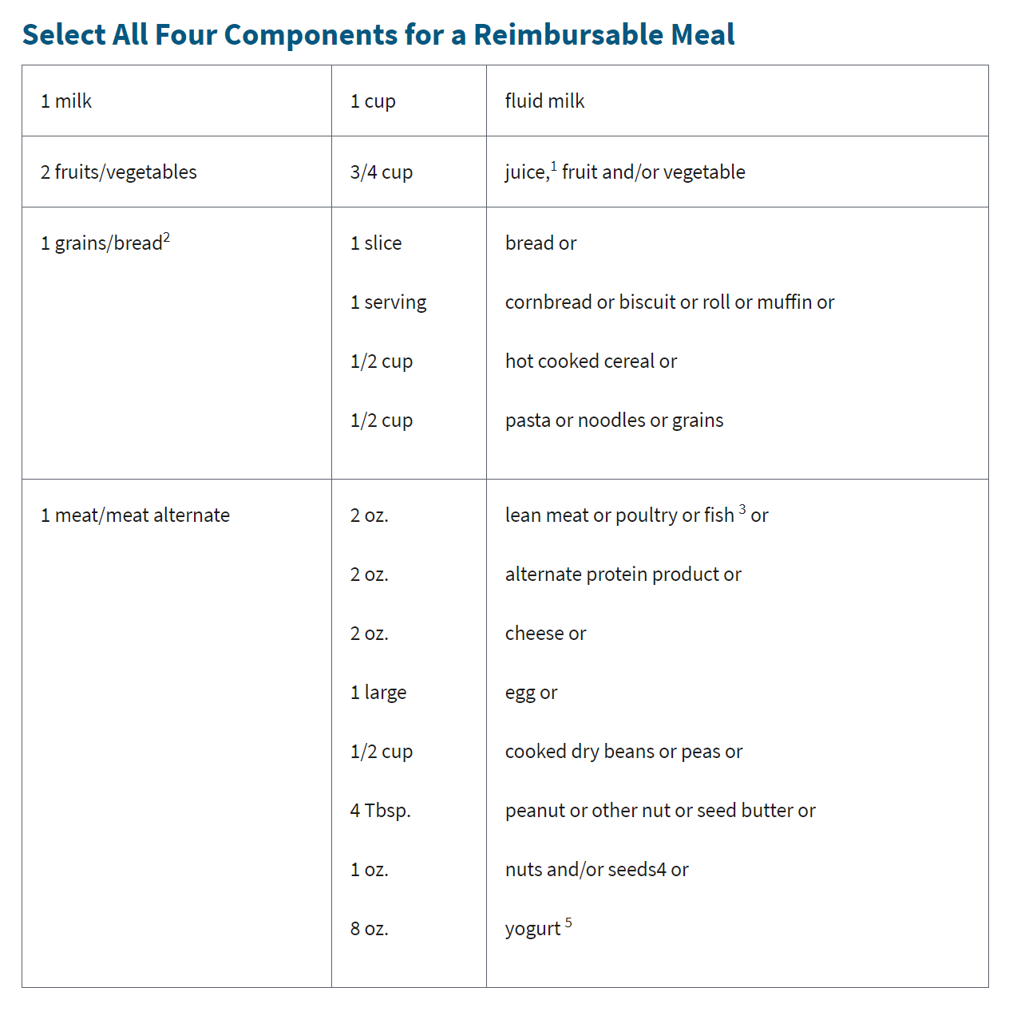
Lunch Meal Pattern: 5 Required Components

Slide 24
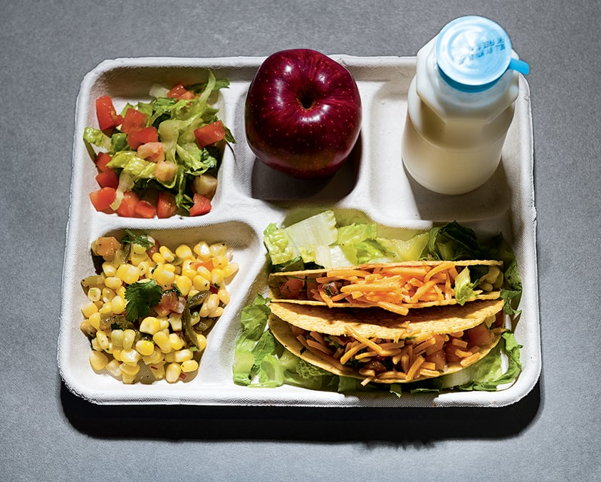
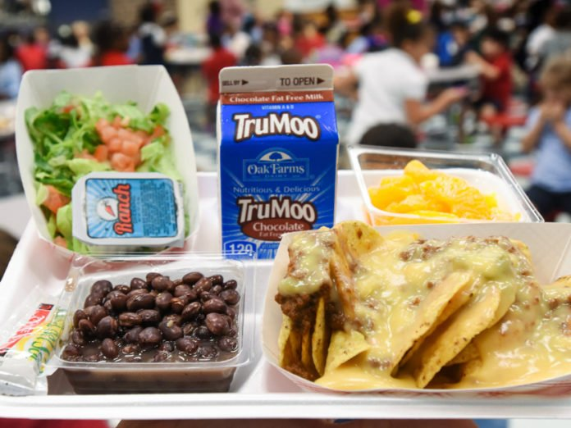
Offer vs Serve Lunch
Must offer 5 food Items
1 serving of Meat/Meat alternate
2 servings of fruit/vegetable (must be two different items)
1 serving of Bread/Bread alternative
1 serving fluid milk
Students must select 3 components
*All items offered must be different from each other

Slide 25
Offer vs Serve Lunch Examples
5 components offered
3 components selected
Chicken Nuggets has a CN label/Product Formulation Statement documenting that it credits as a serving grain and meat/meat alternate.
Reimbursable

Slide 26
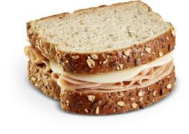
Offer vs Serve Lunch Examples
5 components offered
3 components selected
Reimbursable

Slide 27
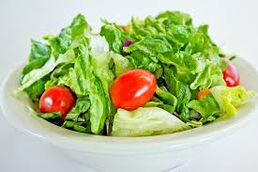
Offer vs Serve Lunch Examples
5 components offered
3 components selected
Reimbursable

Slide 28
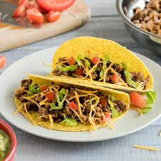
Offer vs Serve Lunch Examples
5 components offered
3 components selected
Reimbursable

Slide 29
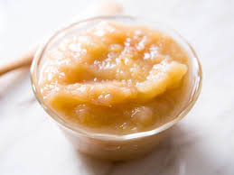
Offer vs Serve Lunch Examples
5 components offered
(Pizza has CN label showing 1 slice is the equivalent of 1 serving of grain and 2 oz m/ma)
3 components selected
Reimbursable

Slide 30
Offer vs Serve Lunch Examples
5 components offered
3 components selected
Reimbursable

Slide 31
Non-Reimbursable
Offer vs Serve Lunch Examples
5 components offered
2 components selected
Notes:
Some other reimbursable options are:
Chicken fingers, Rice, and Broccoli; or
Chicken fingers, Apple Slices, and milk; or
Chicken fingers, Broccoli, and Milk; or
Milk, Rice, and Broccoli.

Slide 32
Snack

Slide 33
Snack Examples:
Must Take Both Items; No OVS
Carrots Cheese Stick | Hummus Carrots | Apple Pretzels
Muffin Milk | Milk Yogurt | Orange Crackers
Strawberries Pretzels | Applesauce Graham Crackers | 100% Apple Juice Biscuit

Slide 34
Questions?
CNSFSP@NYSED.GOV

