Slide 1
Child Nutrition Free and Reduced Policy Statement Instructions

Slide 2
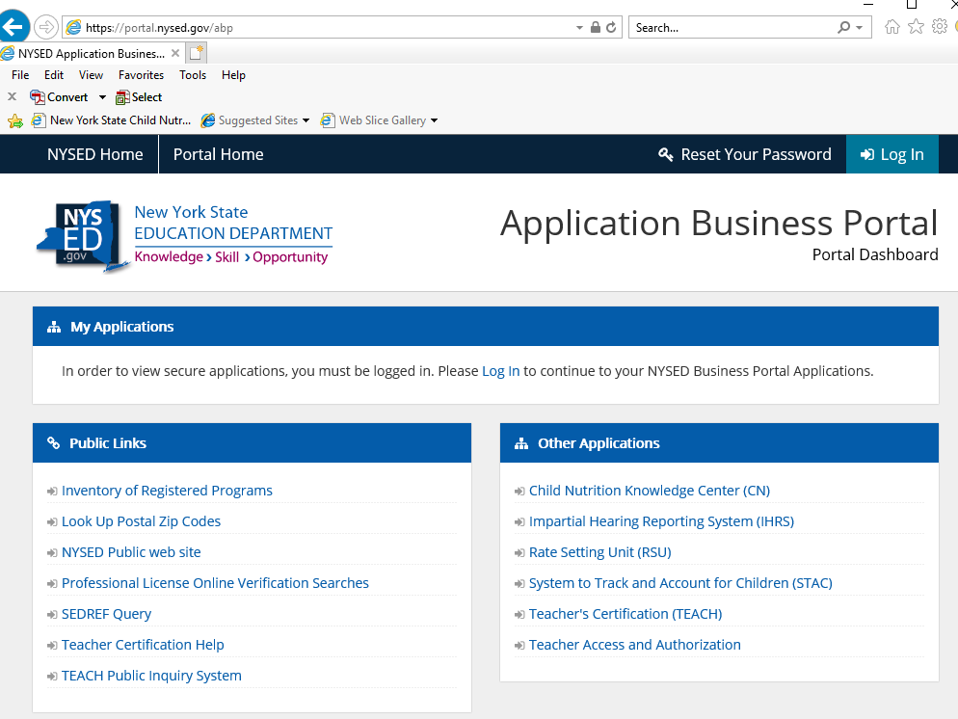
NYSED Applications
To start go to the NYSED Application Business Portal

Slide 3
Sign In – SEDDAS Credentials
The initial survey email will be sent to the delegated administrator for your SFA. They will then need to grant any user access to the SEDMON survey.
*This will be the same login information that you use for NYSSIS. *
Notes:
A step by step guide can be found by pressing Ctrl button and following the link to Entitling Users to SED Monitoring & Vendor Performance System (nysed.gov): https://www.p12.nysed.gov/seddas/guides/monitoring-vendor-performance-system-mini-guide.pdf

Slide 4
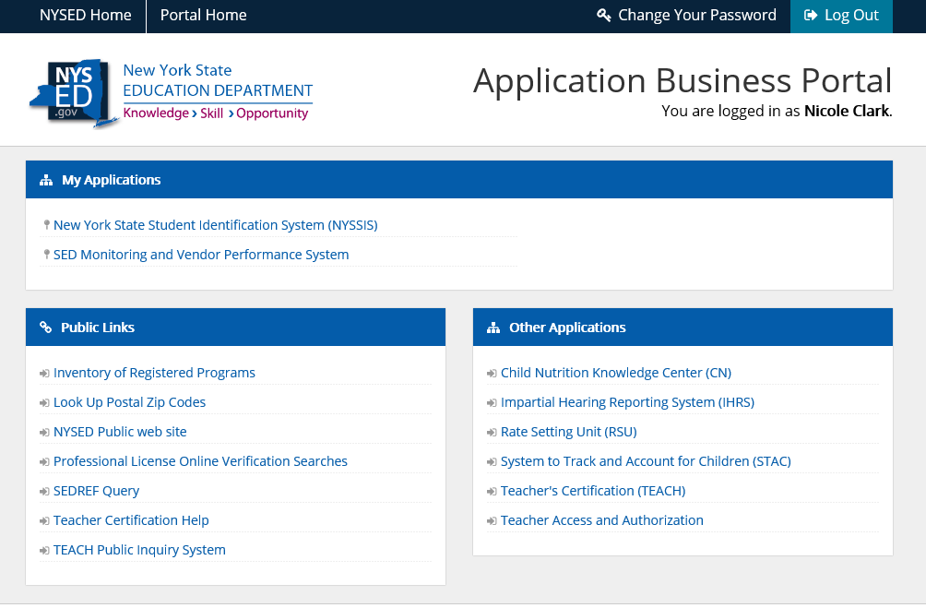
Choosing “my application”
Once logged in, under my applications click on SED Monitoring & Vendor Performance System under ‘My Applications’.

Slide 5
SFA Login Dashboard
SFA will find their Free & Reduce Price Policy Statement on their home dashboard.
To start the survey, click on view.

Slide 6
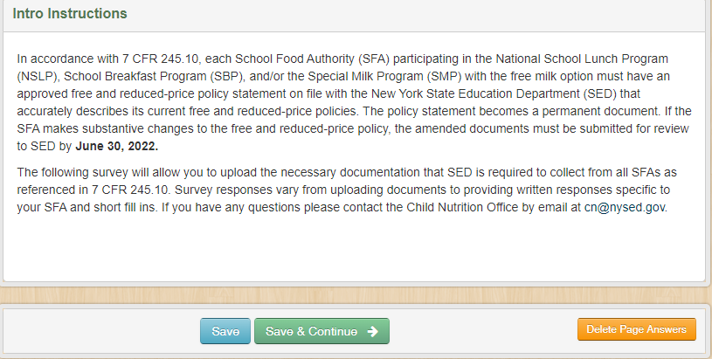
Introduction to survey
SFA will provide their information for questions 1-5. Each response is required to continue the survey.
After reading instructions click “Save & Continue” to continue to survey.

Slide 7
Policy Statement Information
SFA will complete questions 1-5.
Please note each response is required to continue the survey.
Click “Save & Continue” to continue to survey.

Slide 8
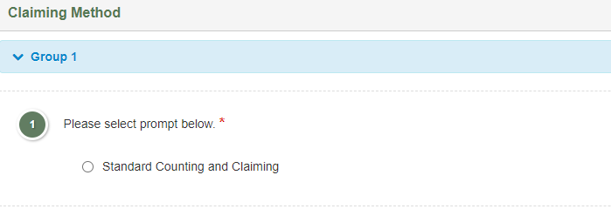
Claiming Method
SFA will select Standard Counting and Claiming
Click ‘Save & Continue’ to continue to survey.

Slide 9
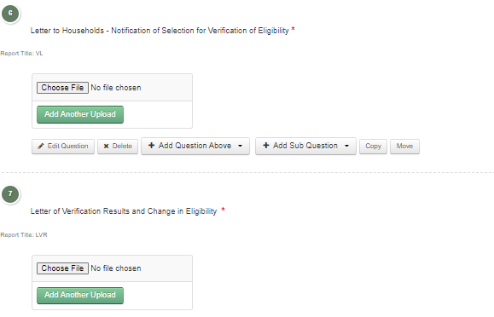
Standard Counting & Claiming Required Documents
SFA will upload the required documents completed with their SFA relevant information and certified the information provided.
Notes:
For documents 1-5 refer to 2022-2023 SY Income Eligibility Guidelines, Application, and Related Information Memo: http://www.cn.nysed.gov/content/eligibilityguidelines
For documents 6 and 7 refer to the Annual Verification Booklet : http://www.cn.nysed.gov/manual/verification-procedures#File

Slide 10
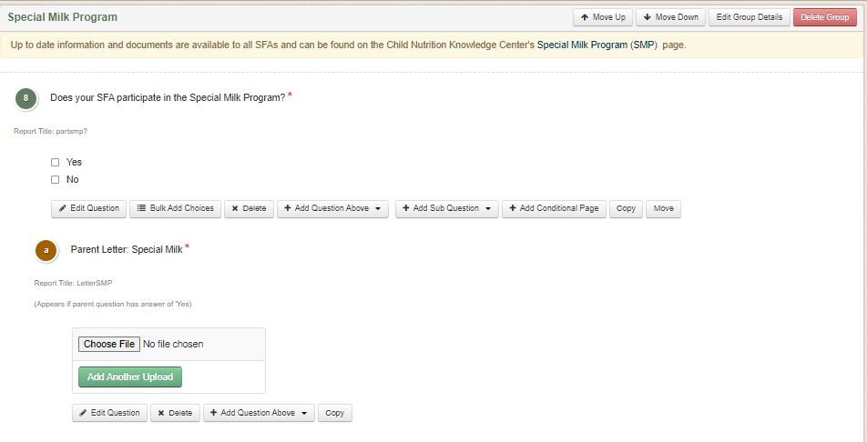
Special Milk Program
SFA will answer if any RA’s participate in the Special Milk Program.
If Yes- SFA are required to upload the Parent Letter: Special Milk

Slide 11
Special Provision Amendment
SFA will select the answer(s) that are applicable for their RAs.

Slide 12
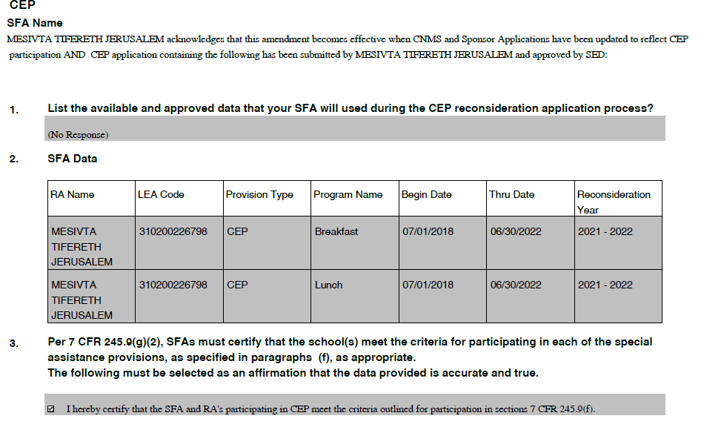
Special Provision Amendment CEP
SFA are required to list the available and approved data that will be used during the CEP reconsideration application process.
Your SFA CEP data will automatically prepopulate. If you are a new SFA this data will not appear until it is entered in the Child Nutrition Management System (CNMS).
SFA Name
SFA Name
SNAP, Medicaid, extensions, homeless
Notes:
Available and approved data for CEP:
SNAP recipients identified through the electronic direct certification matching process (DCMP)
Medicaid recipients identified through electronic DCMP
Extension of eligibility to siblings or household members of SNAP or Medicaid
Homeless children identified by the Homeless Liaison
Head Start/Evenstart
Migrant Youth
Runaways
Foster Children certified directly by the State or local foster agency

Slide 13
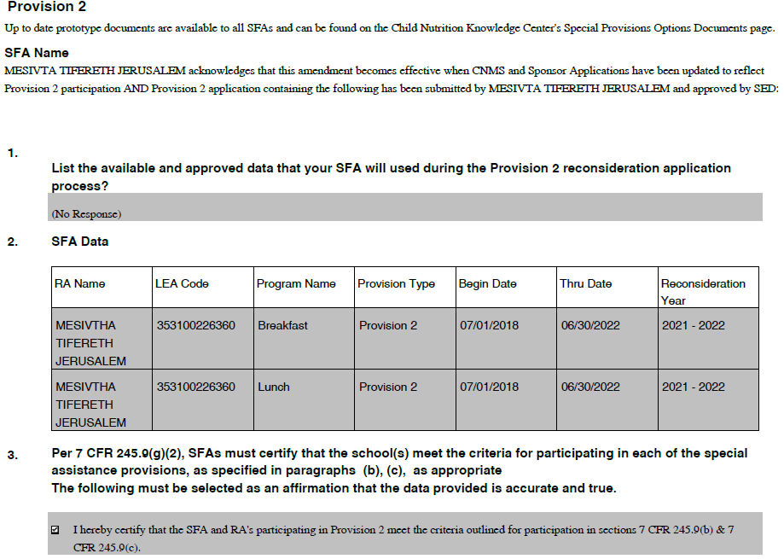
Special Provision Amendment P2
SFA Name
SFA Name
SFA are required to list the available and approved data that will be used during the P2 reconsideration application process.
Your SFA P2 data will automatically prepopulate. If you are a new SFA this data will not appear until it is entered in the Child Nutrition Management System (CNMS).
SFA Name
Each RA local SNAP data
Notes:
The available and approved data for P2 reconsideration application the SFA will provide the local SNAP data for each of their RA locations.

Slide 14
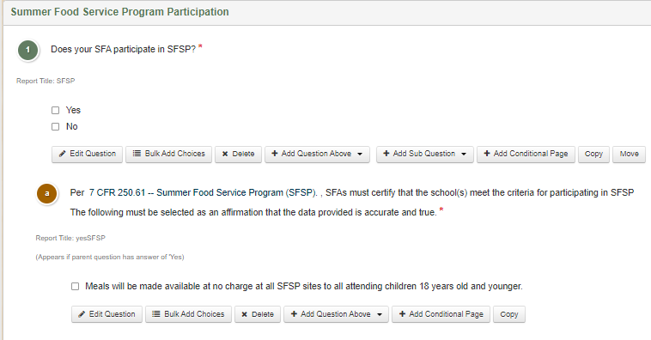
Summer Food Service Program (SFSP)
SFA will select if they participate.
If Yes- The SFA will certify they meet the criteria for participating in SFSP

Slide 15
NSLP, SBP and/or SMP Certification
SFA will certify the information provided is accurate and try for NSLP, SBP and/or SMP.

