Slide 1


Preschool Meal Pattern Training
1 credit hour
Professional Standard Training
Notes:
This CN snip it will contribute 1 credit hour towards Professional Standards.
This training is for program operators who serve students that are enrolled in Preschool, Pre-K, or Nursery school ages 3-5 years old.

Slide 2
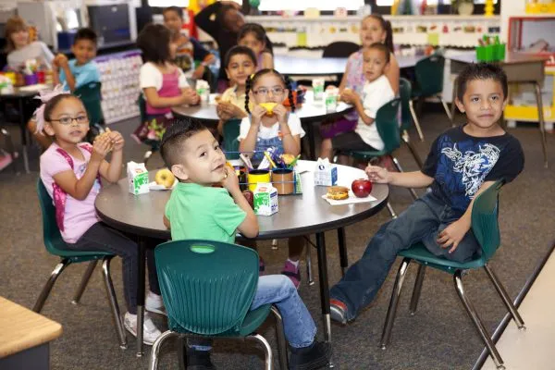
Preschool Meal Pattern
Preschool students who are co-mingled with K-5 students and are served meals at the same time and service area, may choose to follow the K-5 meal pattern
Preschool students that are not co-mingled with K-5 students must follow the preschool meal pattern
T
Notes:
Some schools serve meals to preschool students in the same service area, at the same time as the K-5 students.
Preschool students who are co-mingled with K-5 students may choose to follow the K-5 meal pattern. When Preschool students are not co-mingled with K-5 students, schools must follow the preschool meal pattern.

Slide 3
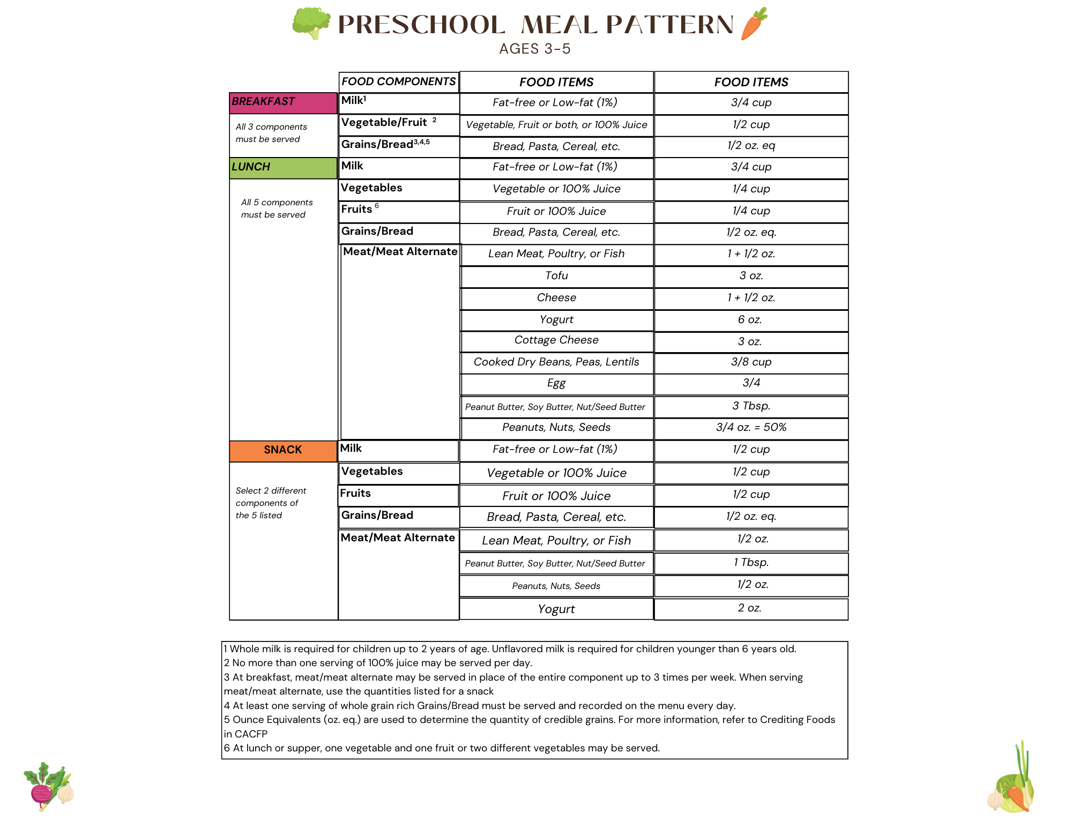
https://fns-prod.azureedge.us/sites/default/files/resource-files/ServingSchoolMealstoPreschoolers.pdf
Notes:
This is the preschool meal pattern chart that must be followed unless the preschool students are co-mingled with K-5.
Note that there are no dietary specifications for the Preschool meal pattern.

Slide 4
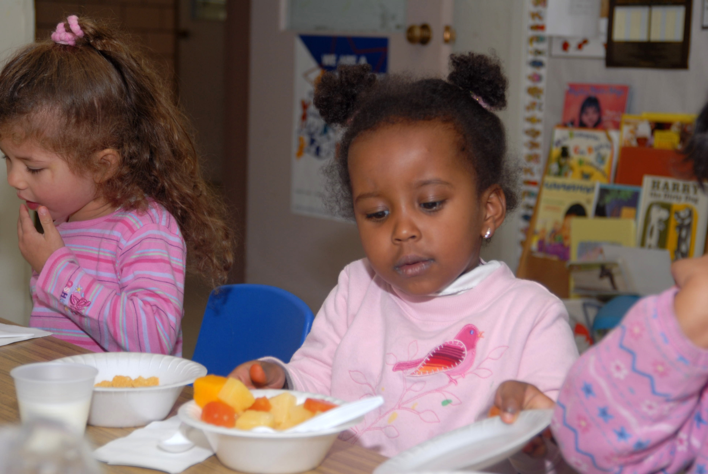
Preschool Meal Pattern
Offer vs. Serve
Offer vs Serve is not allowable in Preschool Meal Pattern
All meal components must be served in minimum quantities at each meal
All 3 components must be served in minimum quantities at breakfast
All 5 components must be served in minimum quantities at lunch
This Ph
Notes:
Offer vs Serve is not allowable in Preschool Meal Pattern
All meal components must be served in minimum quantities at each meal
All 3 components must be served in minimum quantities at breakfast
All 5 components must be served in minimum quantities at lunch

Slide 5
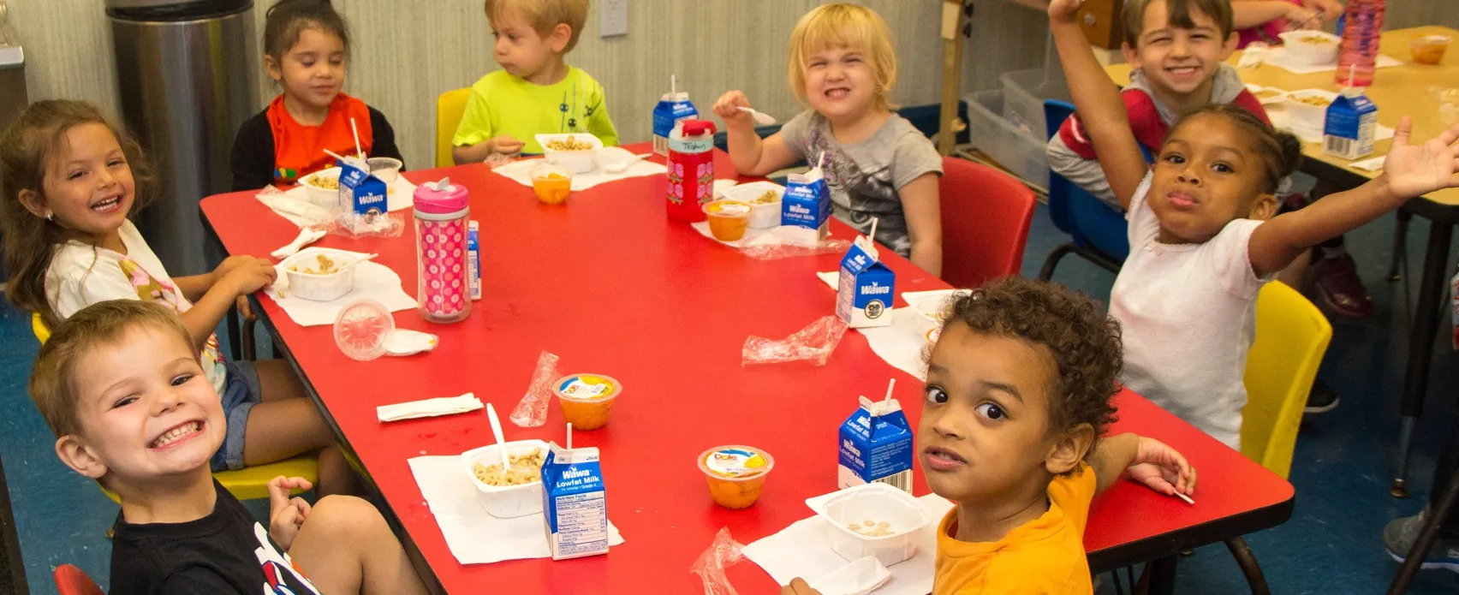
Preschool Meal Pattern
Grains:
All grains must be whole grain or enriched
At least one serving per day must be Whole Grain Rich
Cereals cannot contain more than 6 grams of sugar per dry ounce
  Ready to eat
  Instant
  Hot cereals
Grain Based Desserts are not creditable
Exception: Sweet Crackers are allowed
  Graham Crackers
  Animal Crackers
T
*Click here to find a list of allowable low sugar cereals on page 22 of the NYDOH Crediting Foods in CACFP guide
Notes:
All grains must be whole grain or enriched. Creditable grains include whole grains, enriched grains, bran, and germ. At least one serving per day (at either breakfast or lunch) must be Whole Grain Rich. For more information on whole grains, go to www.cn.nysed.gov, whole grains, and there will be a whole grain resource.
Cereals cannot contain more than 6 grams of sugar per dry ounce. This includes:
Ready to eat, instant, and regular hot cereals.
A list of low sugar cereals can be found in the Crediting Foods in CACFP guide on page 23.
Grain Based Desserts are not creditable in the preschool meal pattern. However, there is an exception: Sweet crackers (Graham Crackers, Animal Crackers) ARE allowed in the Pre-School meal pattern.

Slide 6
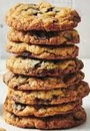
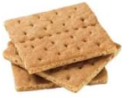
Grain Based Desserts
Not Allowable
Allowable
Brownies
Cookies
Sweet pie crusts
Doughnuts
Cereal bars
Granola bars and breakfast bars
Sweet rolls, pastries, toaster pastries, and sweet scones (example: blueberry, raisin, and orange cranberry)
Cakes
Rice pudding and sweet bread pudding
Sweet Crackers (example: animal crackers and graham crackers)
Muffins and quick breads (example: banana bread, zucchini bread)
Cornbread
Pancakes
Waffles
French toast
Savory scones (example: cheese and herb)
Notes:
As stated on the previous slide, grain-based desserts are not allowable in the Preschool meal pattern. This slide specifies what items are considered grain-based desserts that are not allowable and items that are exceptions or not categorized as grain-based desserts.
The following items are considered grain-based desserts and are not allowable:
Brownies
Cookies
Sweet pie crusts
Doughnuts
Cereal bars
Granola bars and breakfast bars
Sweet rolls, pastries, toaster pastries, and sweet scones (example: blueberry, raisin, and orange cranberry)
Cakes
Rice pudding and sweet bread pudding
Sweet Crackers, such as animal crackers and graham crackers are exceptions and are allowed. The following are not categorized as grain based desserts, therefore, are allowable:
Muffins and quick breads (example: banana bread, zucchini bread)
Cornbread
Pancakes
Waffles
French toast
Savory scones (example: cheese and herb)

Slide 7

Preschool Meal Pattern
Fruit and Vegetables:
Breakfast-Vegetables and fruit are one component. Schools may serve vegetables, fruits, or combination
Lunch-Vegetables and fruits are two separate components
Juice may count toward the entire vegetable component or fruit component for only one meal or snack per day
  Must be 100% full strength
Notes:
For Breakfast, Vegetables and fruit are one component. Schools may serve vegetables, fruits, or both. Fruit juices may be offered but must be 100% full strength.
For Lunch, Vegetables and fruits are two separate components. The menu planner would have to offer both fruit and vegetables. Note: There are no vegetable subgroup requirements in the preschool meal pattern.
Juice may count toward the entire vegetable component or fruit component at only one meal or snack per day.
Yogurt covered raisins are not creditable.

Slide 8

Preschool Meal Pattern
Meat/Meat Alternates(M/MA)
M/MA component is optional at breakfast
May substitute M/ MA for the entire grain component up to 3 times per week (regardless of the number of days in the week)
Yogurt cannot contain more than 23 grams of sugar per 6 ounces
Frozen, Drinkable yogurt products are not creditable
*Yogurt covered nuts are not creditable
Notes:
The meat/meat alternates component is optional for breakfast. Menu planners may substitute meat/meat alternates for the entire grain component up to three times per week (regardless of the number of days in the week).
For lunch you must offer a meat/meat alternate.
Yogurt cannot contain more than 23 grams of sugar per 6 ounces
Frozen, Drinkable yogurt products and Yogurt covered nuts are not creditable.

Slide 9

Preschool Meal Pattern
Milk:
Flavored Milk is not allowed
Milk variety is not required. Schools may serve one allowable milk to all preschoolers
Allowable milk types
Unflavored Fat-Free
Unflavored Low-Fat (1%)
Notes:
Flavored Milk is not allowed for preschool students. Schools may serve one allowable milk to all preschoolers. A variety of milk is not required.
Allowable milk types are unflavored Fat-Free and Low-Fat (1%).
The menu planner must offer at minimum 6 fl. oz. for breakfast and lunch.

Slide 10
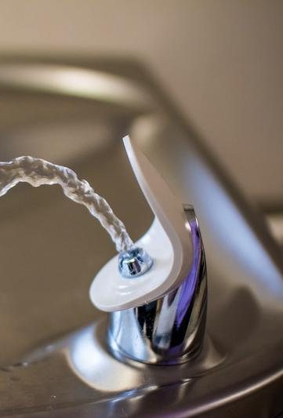
Water Availability
Free potable water must be available and easily accessible to students during breakfast and lunch
Water is in addition to milk – it is not in competition with milk, no beverage can compete with milk.
A drinking fountain that students have free access to can fulfill this requirement. If the area where students dine does not have access to a water fountain, the school can provide pitchers or water dispensers.
Notes:
Free potable water must be available to students during breakfast and lunch meal service. While drinking water must be made available to children during mealtimes, it does not have to be served alongside the meal. Water is not part of the reimbursable meal and may not be served instead of milk. Water is not in competition with milk and is not considered a beverage choice.
The SFA cannot charge for water and is not required to serve bottled water. Potable tap water is adequate to fulfill this requirement.
A drinking fountain in or near the dining area is acceptable to meet requirements, if students have free access to the fountain. If the room where students dine does not have access to a water fountain, the school can provide pitchers or dispensers of water for students to access.

Slide 11
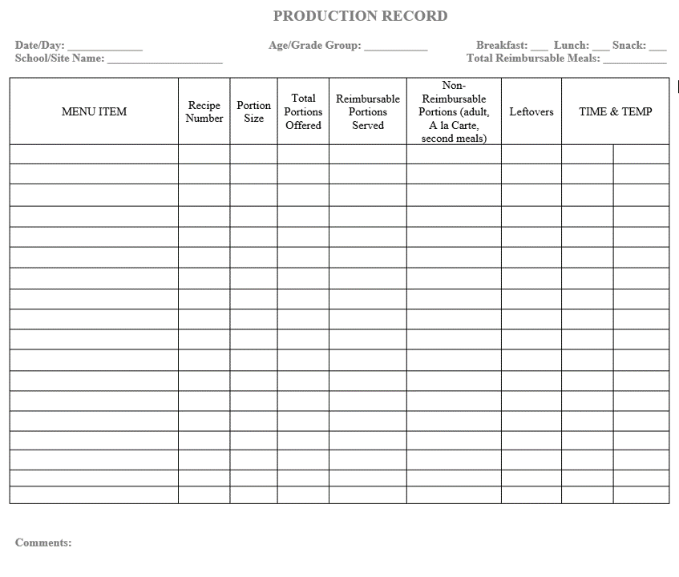
Preschool Meal Pattern Production Records
This Ph
Notes:
USDA regulations require that SFAs maintain daily production records for meals for preschoolers and grades K-12. Production records must show how the offered meals contribute to the required food components and food quantities for each meal served to each age/grade group every day.
Here is a sample production record template that you can find on our website: www.cn.nysed.gov. You may choose to use this one or create your own as long as it contains all the same information.

Slide 12
Preschool Meal Pattern
Counting and Claiming
Students must be observed receiving a reimbursable meal
Point of Service systems must:
  Produce an accurate count of reimbursable meals
  Prevent overt identification
  Serve all students in a uniform manner
This Ph
Notes:
Counting Pre-K meals for the monthly claim for reimbursement can be complex. Some schools have their preschool students come through the service line, some serve the meal in a classroom, some serve students by Kiosk Service line, or some do the Family Style method. Any of these circumstances, the meals must be counted at the point of service and designate where and when the Point of Service is.
The Point of Service is defined as where and when a child receives a reimbursable meal and is usually at the end of the line where meal counts are recorded by category, however, it will depend on the service model being used.
Each Point of service must ensure that accountability occurs when the child receives the meal and produce accurate counts of reimbursable meals by category. The point of service must prevent overt identification of free and reduced-price students, and ensure all students are treated in a uniform manner regardless of their category.
Overt Identification is defined as any action that may result in a student being recognized as potentially eligible for or certified for free and reduced-price meals.

Slide 13
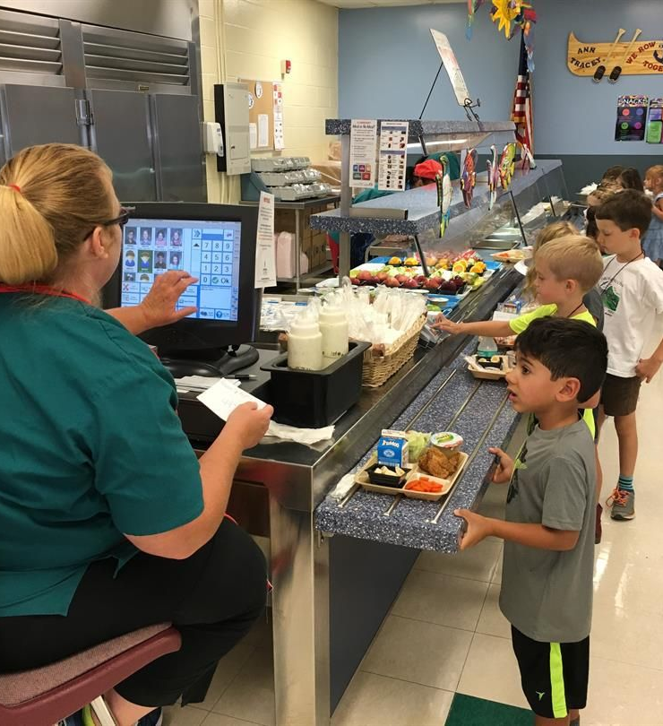
Preschool Meal Pattern
Counting and Claiming
Service Line Method
Students go through the service line and select all the required components, in at least the minimum quantities to comprise a reimbursable meal
Staff counts the reimbursable meal when they validate the student has all required components
Notes:
The service line method is where students come through a line and select food items and has a staff member present to account for the meals.
Students come through the line and select all required components in at least the minimum quantities to comprise a reimbursable meal.
The staff at the point of service will count each meal once they validate the student selected all the required components.

Slide 14
Preschool Meal Pattern
Counting and Claiming
Classroom Method
The SFA must develop a system to account for reimbursable meals once the students receives all required components
  Example: a roster or similar system
Meals may not be counted prior to staff delivering meals from the cafeteria
May not take Attendance Counts
Notes:
When meals are served in the classroom, preschool meals are delivered or picked up from the cafeteria and sent to classrooms by school staff.
Meals may not be counted and recorded when the meals are picked up or delivered from the cafeteria.
Meals must be counted at the point of service in the classrooms. The staff member will mark a roster or use a similar method to track the meals that the students select.
After meal service, the food service staff will collect all classroom counts and consolidate it along with the other cafeteria counts for each service.
Attendance counts are not allowed because the meal may not be counted until the students receives the meal.

Slide 15
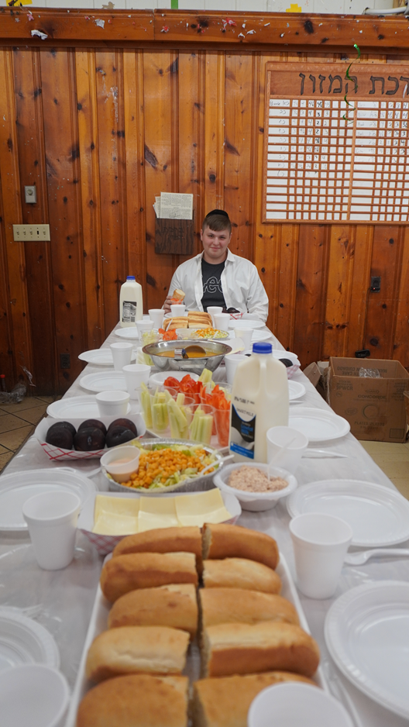
Preschool Meal Pattern
Family Style Service & Grab and Go Service Line
Grab and Go Service Lines
Family Style Service
Students come through the Kiosk line and select all required components, in at least minimum quantities
The cashier counts the reimbursable meal when they validate that the student has all required components
Un-staffed service lines are not allowed
Counting grab and go bags prior to service is not allowed
The SFA must develop a system to account for reimbursable meals once the students receive all required components
Staff marks roster after observing the students selecting the meal
Staff serves the students and then marks the roster
Attendance counts are not allowed
Courtesy of: Bais Yaakov Academy for Girls
Notes:
Grab and Go lines are typically a kiosk that is outside the cafeteria to help with students flowing through the lines faster.
Grab and Go meals must offer all the components in the minimum portion amounts. As the students go through the line and receive the grab and go meal, staff must be present to validate the student is taking the full meal and then record it.
Unstaffed service lines or counting grab and go meals prior to meal service is not allowed.

Slide 16

Questions?
Contact Information
Training Team: cntraining@nysed.gov
Child Nutrition Program Office: 518-473-8781
CN Representative for questions specific to your SFA
Notes:
If you have any questions, please reach out to the training team or your CN rep.
Thank you!
You may always contact the Training Team with additional questions at:
cntraining@nysed.gov
Or contact your CN Representative for questions specific to your SFA

