Slide 1

The Procurement Review Process
1 hour Professional Standards Training
Notes:
This PowerPoint will contribute 1 hour towards Professional Standards training requirements. This training reviews the procurement review process in the Child Nutrition Programs.
The Procurement Review can seem over whelming and much of the information requested for this review will likely come from the SFA’s Business Office. This presentation will break the process down and explain each step. Knowing what to expect and understanding what is being requested will take away the mystery surrounding procurement.

Slide 2

Procurement Review
Child Nutrition Program Administration
Notes:
The Administrative Review and the Procurement Review are two separate processes but will be conducted in the same cycle year. Expect to receive an email from the Child Nutrition Program Administration Office near the beginning of your SFA’s scheduled year of review. This email will explain that this is the year the SFA is scheduled for review and will be requesting an initial submission of information and documents for both the Administrative Review and the Procurement Review.
The initial Procurement information requested will require the SFA to complete the “Procurement Review Worksheet". This document is used by SED to collect information on the SFAs procurement practices.
The Procurement Review Worksheet details the procurement information the SFA conducted in previous school year. From the information provided, SED will select a sample of procurements/contracts to review. SFAs are also required to submit a copy of their Procurement Policy from the previous school year.
The completion of both documents may require collaboration with several SFA staff members. This could include the food service department, business office, purchasing agents and/or the superintendent. SFAs should contact their Child Nutrition Program representative if they have any questions.

Slide 3

Procurement Review Process
SFA completes Procurement Review Worksheet
SED selects a sample of vendors from each procurement method and requests additional documents for these vendors
SED completes procurement review and documents any findings, corrective action, and technical assistance
Notes:
As stated previously, the Procurement Review is conducted the same year as the Administrative Review. SED will be reviewing the SFA’s Procurement activities from most recently completed school year. The Procurement Review is generally completed off-site via email and phone.
SED developed a Procurement Review Worksheet that was sent to SFAs with your administrative review materials. In addition to responding to the instructions, SED will review your procurement tool: vendor names, goods and services provided, total amount paid to vendor, number of purchases from the vendor during the year, and number of bids received. Based on the SFAs responses, SED will ask for more documentation of specific purchases.

Slide 4
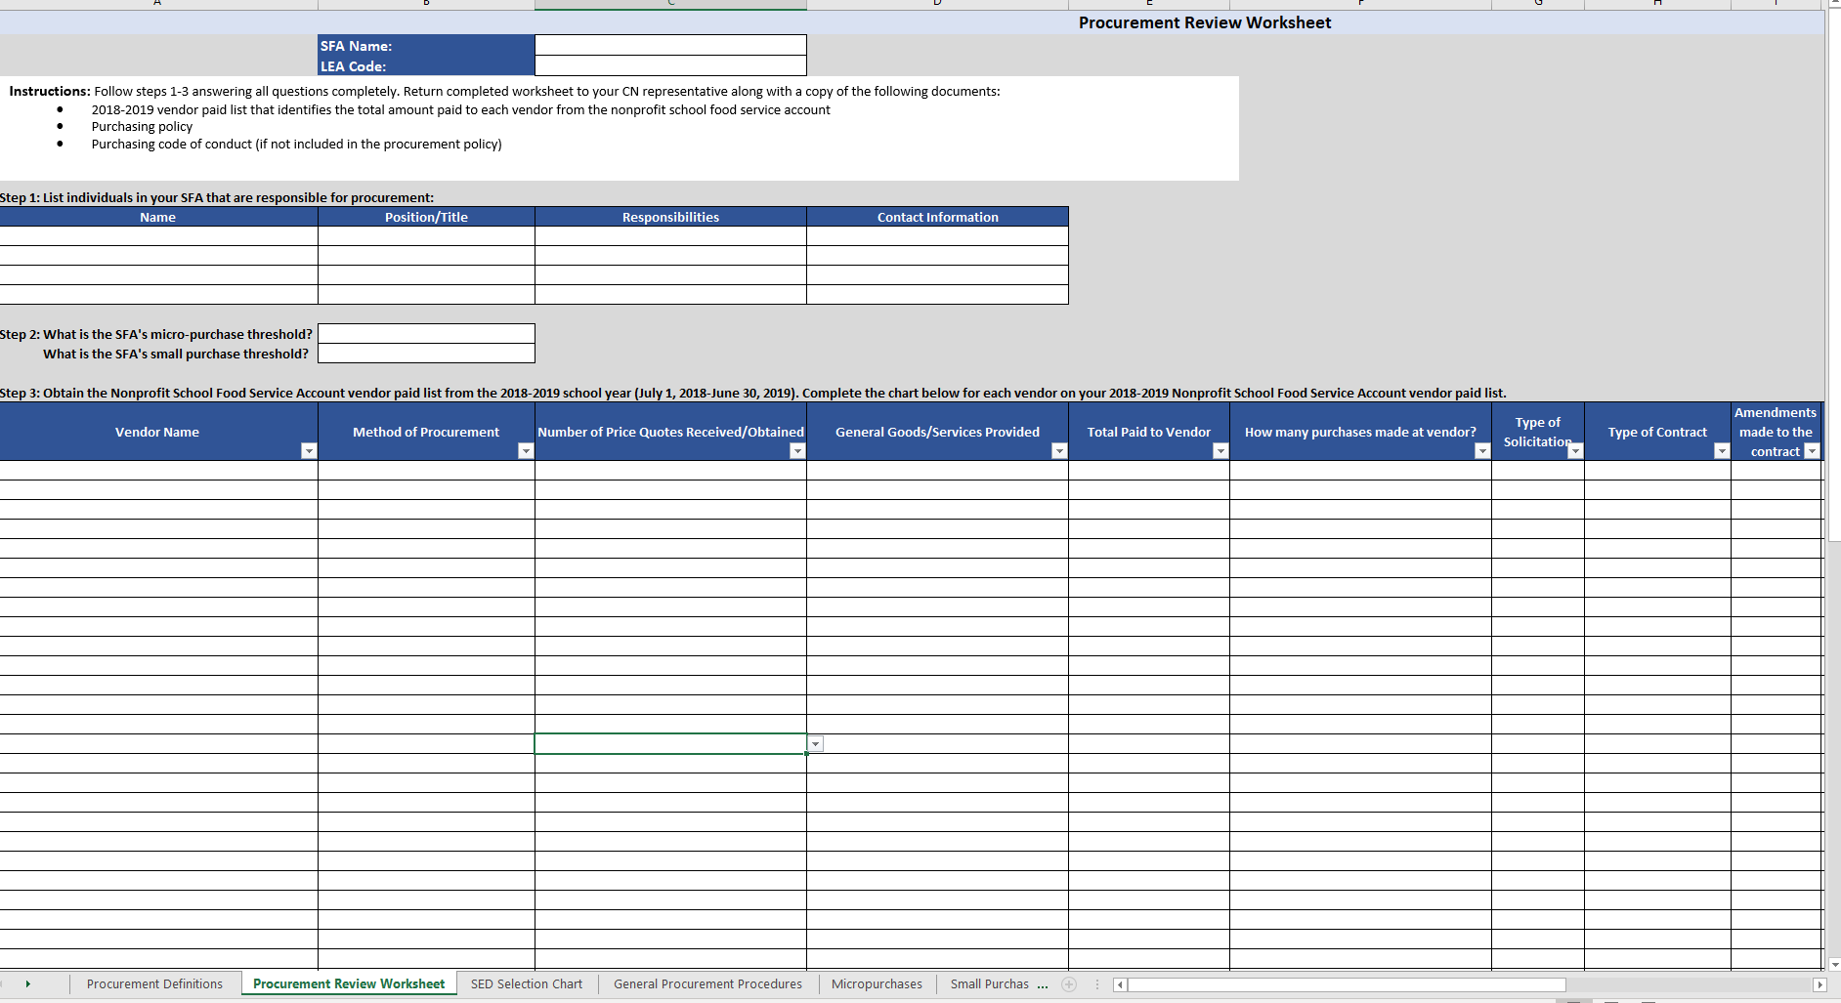
The Procurement Review Worksheet
Notes:
The Procurement Review Worksheet will be completed for the most recently completed school year. This will be the only tab on the Excel Tool that you will be completing. The rest of the form will be completed by your Representative as they go through the review process.
The worksheet will include all vendors the SFA procured goods or services from in the previous school year that appear on your vendor paid list. This will not include items such as association dues, postage, refunds to student accounts, annual licensing registration fees for software products already procured, and uniform allowances for staff. These items are not items that are procured.
Most of the columns on the worksheet have a dropdown box feature for you to answer the questions in the column with. When the dropdown feature is available, please use that to complete the information requested.
Do not forget to complete the information requested at the top of the worksheet.

Slide 5
Procurement Review Sheet
Documents to Submit
Purchasing Policy
Purchasing Code of Conduct
Vendor Paid List
Notes:
In addition to completing the Procurement Review Worksheet, SFAs must also provide SED with their Purchasing Policy and Purchasing Code of Conduct, if not included in the Purchasing Policy.
The vendor paid list is a report from the SFA accounting system that identifies all vendors paid from the nonprofit food service account, each payment made to every vendor, and summarizes the total amount paid to each vendor for the prior school year.
The Procurement Review sheet is due back to our office by October 31st.

Slide 6
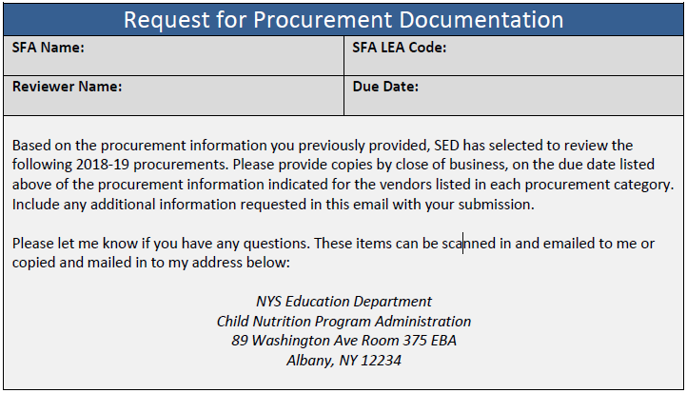
2018-2019 Request for Procurement Documentation
Notes:
Once SED receives the procurement review sheet, vendor paid list, purchasing policy and code of conduct, vendors will be selected and you will received a request for procurement documentation. You may send your documents via e-mail or mail them into the office at the address listed.

Slide 7
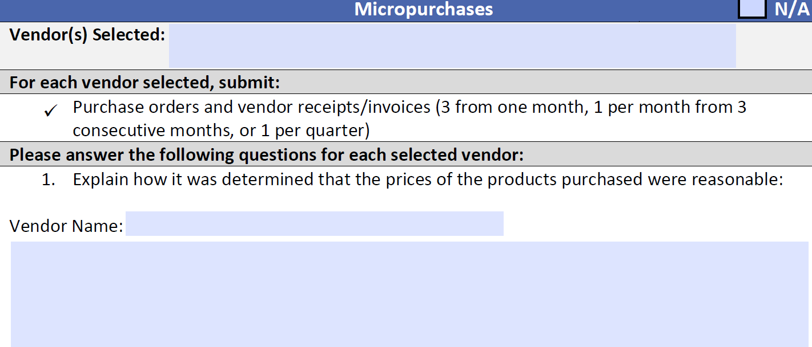
Micro Purchases
Purchases made without first soliciting competitive quotes (Must be under $50,000)
SED will request:
Purchase orders and vendor receipts/invoices (3 from one month, 1 per month from 3 consecutive months, or 1 per quarter)
SFA must explain how it was determined that the prices of the products purchased were reasonable
SFA must explain how purchases were equitably distributed among qualified sources
Notes:
Procurement by Micro-Purchase is the acquisition of supplies or services.
The Micro Purchase threshold at the federal level has been raised to $50,000.
Purchases made without first soliciting competitive quotes must be under $50,000.
To the extent practicable, micro-purchases must be distributed equitably among qualified suppliers.
SED will request:
Purchase orders and vendor receipts/invoices (3 from one month, 1 per month from 3consecutive months, or 1 per quarter)
SFA must explain how it was determined that the prices of the products purchased were reasonable
SFA must explain how purchases were equitably distributed among qualified sources

Slide 8
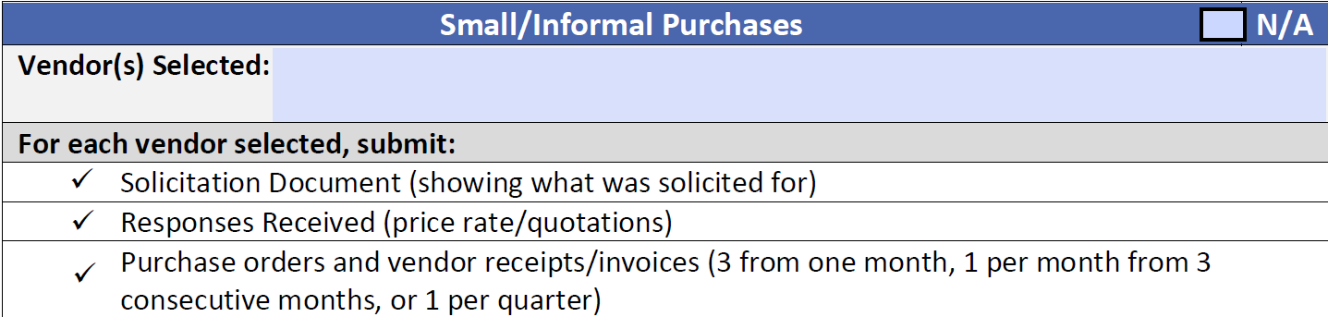
Small/Informal Purchases
Vendors were informally contacted for quotes prior to purchasing(must be below the small purchase threshold)
SED will request:
Purchase orders and vendor receipts/invoices (3 from one month, 1 per month from 3 consecutive months, or 1 per quarter)
Solicitation Document (showing what was solicited for)
Responses Received (price rate/quotations)
Notes:
The Small Purchase threshold at the federal level has been raised to $250,000. NY state limit is $20,000 for local government and public schools only. Purchases that will exceed the federal, state or local small purchase threshold must follow formal procedures.
Vendors were informally contacted for quotes prior to purchasing(must be below the small purchase threshold).
SED will request:
Purchase orders and vendor receipts/invoices (3 from one month, 1 per month from 3 consecutive months, or 1 per quarter)
Solicitation Document (showing what was solicited for)
Responses Received (price rate/quotations)

Slide 9
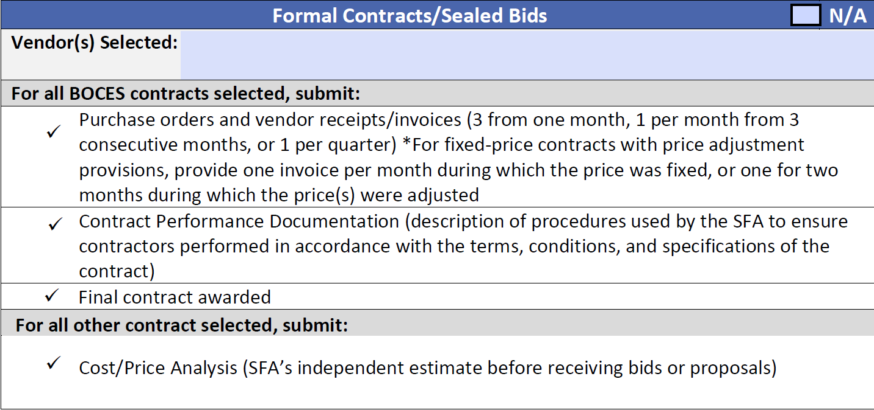
Formal Contracts
(BOCES & Other)
Notes:
Formal contracts consist of IFB’s and RFP’s, including BOCES contracts, Co-Ops, and food service management contracts. SED will request solicitation documentation based on who procured each formal contract (SFA, BOCES, Co-Ops, or food service management companies). Your SED reviewer will list the vendor’s chosen for review and your SFA will submit the required documentation according to how the contract was procured.

Slide 10
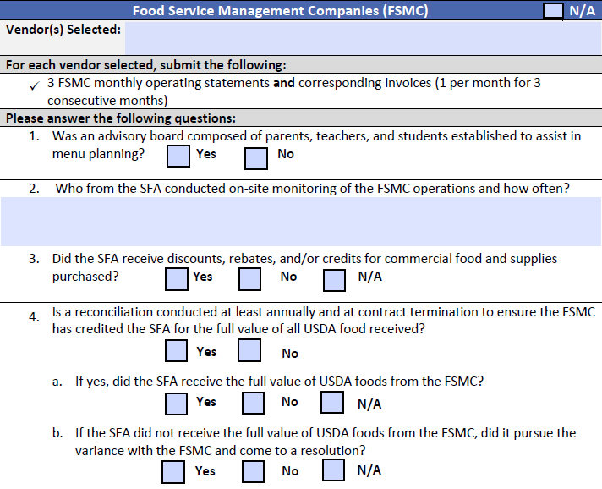
Food Service Management Company Contracts
3 Monthly Operating statements
Corresponding invoices (must be consecutive)
Value of USDA foods
Notes:
If your SFA operated under a food service management company during the previous school year, and SED has selected the vendor to review, you will be required to answer these questions on the vendor documentation request form, in addition to submitting 3 monthly operating statements and invoices.

Slide 11
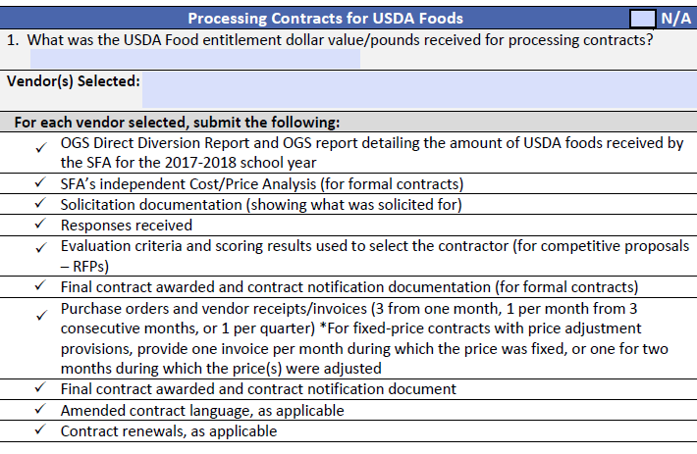
Processing Contracts
Vendors who were informally contacted for quotes prior to purchasing must be below the small purchase threshold
SED will request:
Purchase orders and vendor receipts/invoices (3 from one month, 1 per month from 3 consecutive months, or 1 per quarter)
Solicitation Document (showing what was solicited for)
Responses Received (price rate/quotations)
Direct Diversion sheet from OGS
Notes:
For processing contracts, you will be required to provide SED with your OGS direct diversion sheet along with the invoices and solicitation documents for your processors.

Slide 12
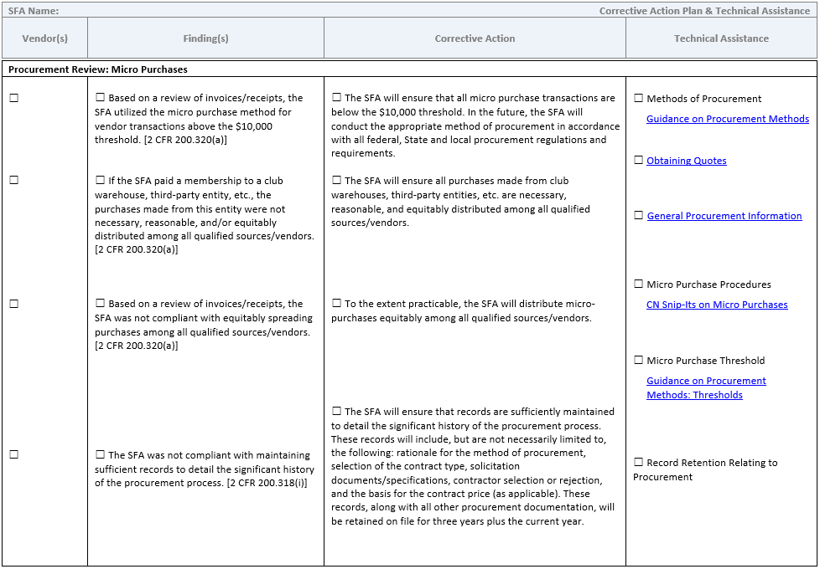
Corrective Action Plan (CAP) Form
Notes:
Upon completion of the Procurement Review, SFAs will be sent a Corrective Action Plan(CAP) form or formal letter that includes technical assistance and any corrective action that must be taken. This will look very similar to the CAP form that is provided at your Administrative Reviews.

Slide 13

Procurement Review Common Findings
Finding:
-The policy did not have a written code of conduct that provides disciplinary actions for violations by officers, employees, or agents
-The SFA did not take steps to ensure that small, minority, and women's business enterprises and surplus labor firms are used when possible.
-The SFA did not equitably spread purchases among all qualified sources when utilizing the micro purchase method
-The SFA did not monitor the FSMC through periodic on-site monitoring
-The SFA did not conduct procurement
Corrective Action:
-The code of conduct will provide for disciplinary actions for violations
-Ensure that small, minority, and women's business enterprises and labor surplus firms are used when possible during all procurement procedures
To the extent practicable, the SFA will distribute micro-purchases equitably among all qualified sources.
-Monitoring the activities of the FSMC to ensure the FSMC is meeting the requirements agreed upon in the management contract
-The SFA will ensure that proper procurement requirements are followed and executed in accordance with federal, State and local regulations and requirements when procuring goods and/or services. A detailed history of every procurement will be kept on file.
Notes:
Here are some common findings for the Procurement Review and what the Corrective Action is.
As always, if you have any questions, please reach out to your CN Representative.

Slide 14

If this seems overwhelming...
-Start early
-Ask questions
-Submit requested information by requested dates
-Be responsive
-Use your team to get prepared
Notes:
Submitting requested information for the procurement review and gathering the additional information requested to complete the review is a big job. Starting early and using the entire team to assist you, will help you get through this process. You will likely be working with the Business Office team to complete the Procurement Review Worksheet and to gather the requested documentation.
Always ask questions if something seems unclear or you do not understand what is being requested.
Procurement Reviews do not have to be a stressful experience. Preparing and working closely with your Business Office and your Child Nutrition Representative will make the process of the review go smoothly and will make this experience a time for learning and sharing ideas that can bring your Program to the next level of success.

Slide 15

This concludes the Procurement Review Process
New York State Education Department
Child Nutrition Program Administration
(518)473-8781
CN@nysed.gov
Notes:
Thank you. This concludes the Procurement Review Process.
Remember to record completion of this training for Annual Professional Standards Training requirements.
If you have any additional questions, please do not hesitate to contact us.

