Slide 1
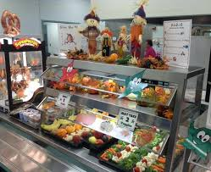
Signage

Slide 2
Identifying a Reimbursable Meal
Federal regulation at 7 CFR 210.10(a)(2) requires schools to identify the components of the reimbursable meal at or near the beginning of serving lines
Cheese Pizza
2 oz. eq. M/MA
2 oz. eq. Grain
Milk-8 Fl. oz.
1 % White
Fat-Free flavored
Fruit
Peaches-1/2 cup
Pears-1/2 cup
Vegetable
Broccoli-1/2 cup Corn-1/2 cup
Notes:
Students, servers and cashiers must be able to identify what constitutes a reimbursable meal.
Federal regulations require that all School Food Authorities(SFAs) must identify the food components of the reimbursable meal at or near the beginning of the serving line.
Identifying the components of the reimbursable meal reinforces nutrition education messages that emphasize selecting healthy choices for a balanced meal.
SFAs have the discretion to determine the best way to present this information on the serving line.

Slide 3
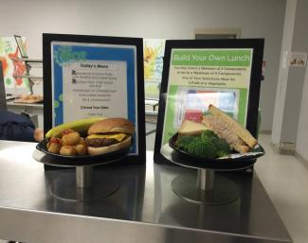
Signage
Signage and menus should provide clear information about allowable choices so students can easily determine what a reimbursable meal contains
Notes:
Signage should provide clear information about allowable choices for breakfast and lunch. This will help students easily build a reimbursable meal and is especially important to avoid problems at the point of service.
A good practice is to provide sample meal displays at or near the beginning of the service line. This will help students visualize reimbursable meals and also advertise the daily meal.

Slide 4
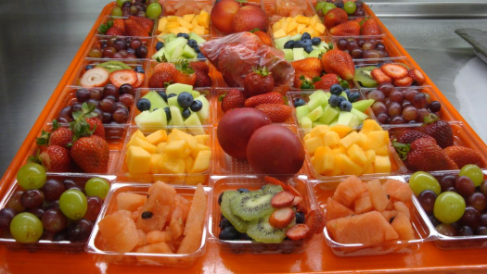
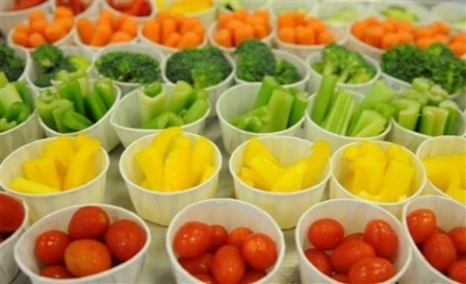
Signage
When implementing Offer vs. Serve, students must be able to identify what constitutes a reimbursable meal and recognize the components, which require selecting at least ½ cup of fruit or vegetable for breakfast and lunch.
Notes:
Signage must clearly state that a reimbursable meal must include 3 out of the 4 items at breakfast and at least 3 out of the 5 components at lunch.
Signage must also clearly state that a reimbursable meal must include at least ½ cup fruit and/or vegetable at lunch and breakfast.
Signage must make allowable choices clear to students. For example, if fruits are portioned in ½ cup sizes at a high school, the signage must state students may select 2 in order to meet the food based menu requirements of 1 cup for the 9-12 age/grade group.

Slide 5
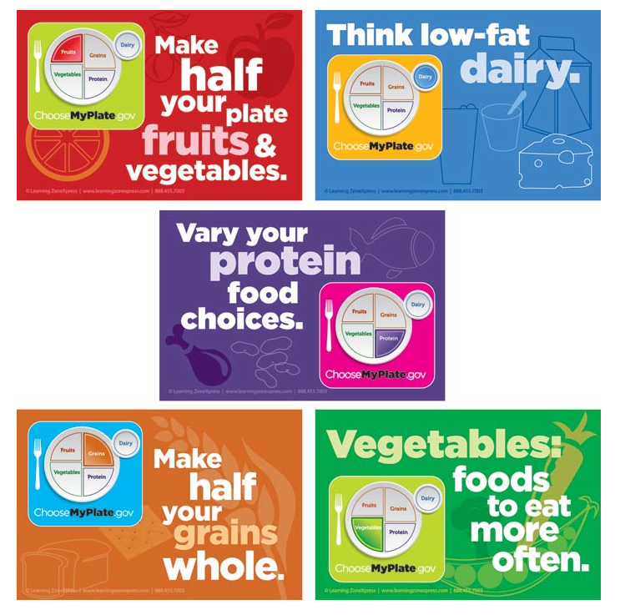
Available Resources
Signage and resources are available free of charge on the Child Nutrition Knowledge Center
  Fill out resource order form under the Forms tab
Notes:
There are many signage tools and resources available free of charge on the Child Nutrition Knowledge Center.
Locate the resource order form under the Forms tab on the Child Nutrition Knowledge Center to request posters, static clings, and other items available.

Slide 6
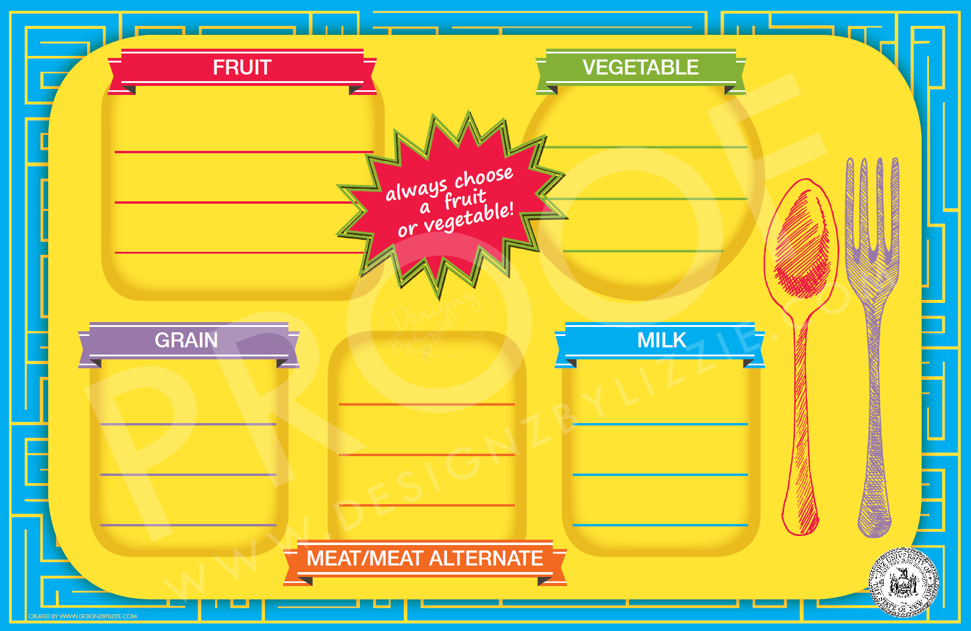
Signage
Notes:
This is an example of signage available on the Child Nutrition Knowledge Center that can be utilized to advertise the daily menu, identify the meal components, and specify the choices a student must make to build a reimbursable meal.
Posters can be laminated so dry erase markers can be used to change your menu choices daily. Tripods are also available to display signage.
Be sure to include ALL menu meal options on signage not just the daily entrée. If you have several entrees offered daily, post your signage in a permanent location to save time and energy.

Slide 7

Breakfast
Applesauce
Banana
Choose 3 out of 4 items
Assorted Cereal (may take 2)
Milk
1% White Fat-free White
Scrambled Egg
(May take egg with English muffin)
English Muffin (1 each)
Notes:
Here is a good example of signage for breakfast.
The menu should be very clear and explain the choices.
For example, 1 cup of fruit must be offered to all grades at breakfast. You can offer ½ cup portions of applesauce but on the sign tells students they can take 2 portions of fruit to meet the daily 1 cup minimum requirement.
You also want to make sure that students know what options go together. For example, students can take scrambled eggs and an English muffin or two cereals along with the fruit and milk choices.

Slide 8
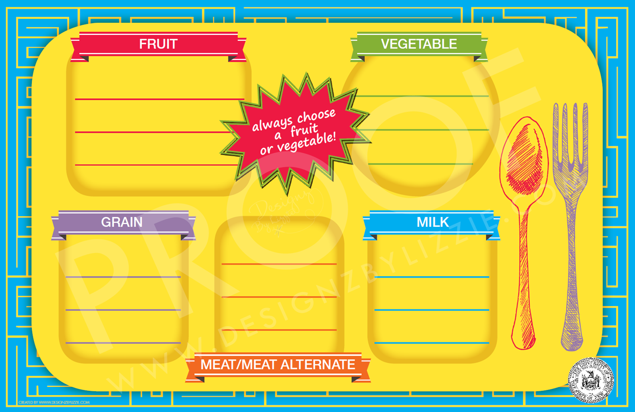
Lunch
Choose 3 of 5 components
Pears
1/2 cup
Orange-1/2 cup
Carrots-1/2 Cup
Broccoli-1/2 cup
Ham
Cheese
WG Kaiser Roll
1% Milk
Nonfat Choc
Nonfat Strawberry
WG Spaghetti with Dinner Roll
Meatballs
Notes:
Here is an example of good signage for lunch.
If Offer Versus Serve is implemented, the signage must also show that 3 of the 5 components are required for a reimbursable meal and that one of those 3 components must be a ½ cup of fruit or vegetable.
SFAs should make sure all information is clearly displayed on a sign.
Failure to implement clear signage can lead to findings on an Administrative Review.

Slide 9
Daily Signage
Daily Breakfast Entrees
Daily Lunch Entrees
Chef Salad Meal
Romaine Lettuce, Roasted Turkey, Ham, American Cheese **Fruit, Vegetable, Milk, and Dinner Roll offered
“Make your Own” PB&J
** Fruit, Vegetable, Milk offered
Always Choose 3 out of 5 components
Always choose ½ cup Fruit or Vegetable
Cereal Meal
** May always take 2!
Fruit/Juice Choice, Milk
Yogurt Meal
Yogurt, ½ Bagel,
Fruit/Juice Choice, Milk
Always Choose 3 out of 4 items
Always choose ½ cup Fruit or Vegetable
Permanent Signage for daily meal choices can save time and energy!
Notes:
SFAs that have menu options offered daily may want to consider posting permanent signage near the beginning of the service lines to save time and energy.
Again be sure when implementing Offer vs. Serve, students and staff are aware that students must choose 3 out of 4 items at breakfast, and, 3 out of 5 components at lunch. Add a reminder that a ½ cup fruit or vegetable at both breakfast and lunch must be selected in order for the meal to be considered reimbursable.
If we find incomplete meals are being offered, it will result in fiscal sanctions.

Slide 10
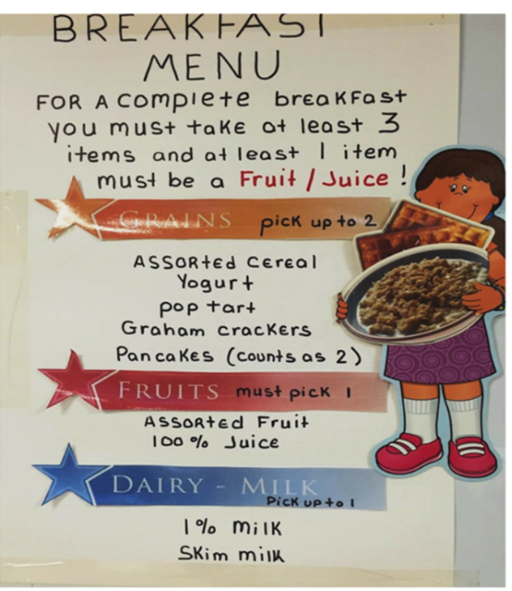
Breakfast Signage Examples
Notes:
Above, are good examples of breakfast signage.
Signage was provided by the following school: Mary Queen of Heaven School.

Slide 11
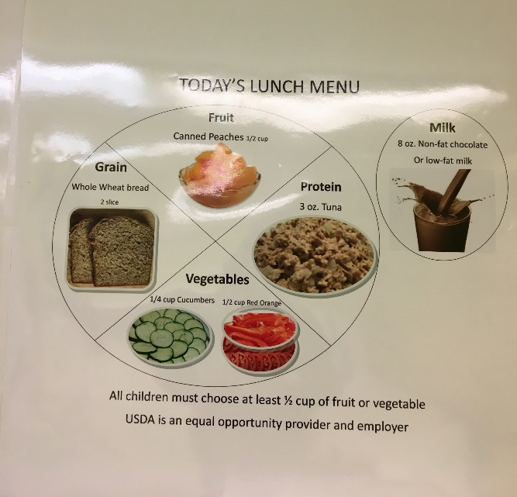
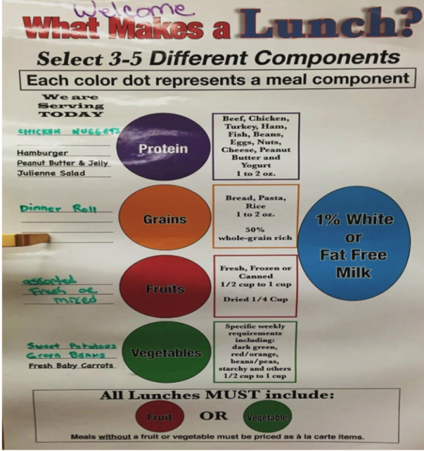
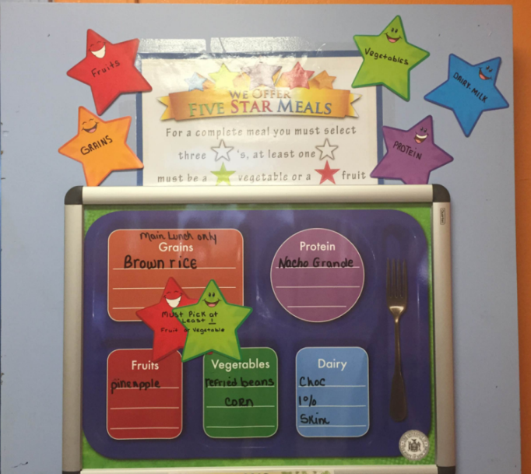
Lunch Signage Examples
Notes:
Here are some good examples of lunch signage shown above.
Signage was provided by the following schools (left to right) Gans Yisroel, Frontier CSD, Mary Queen of Heaven School.

Slide 12
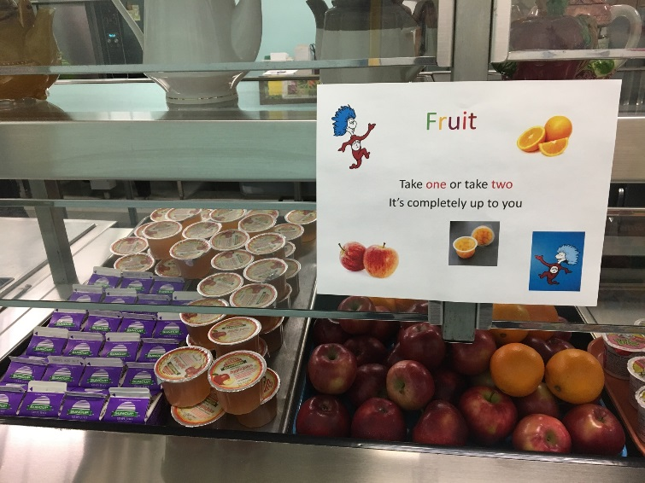
Signage Examples
Notes:
This signage was provided by the following schools (top to bottom): Onteora CSD, Pine Plains CSD

Slide 13

Important Reminders
Display ALL menu choices by ALL service lines
See Child Nutrition Knowledge Center for FREE resources
Change signage between meal services
Permanent signage for daily meals saves time and energy
If different age groups may select different quantities of food make sure to display adequate signage
There must be signage indicating reimbursable meals MUST contain:
  ½ Cup of Fruit or Vegetable
  3 out of 4 items at Breakfast
  3 out of 5 components at Lunch
Notes:
Important reminders to maintain a successful program include:
Remember to display ALL menu choices by ALL service lines.
All students, no matter what service line they enter need to be aware of all options.
SED has many resources available to SFA’s FREE of Charge, see Child Nutrition Knowledge Center for details.
Remember to switch signage between breakfast and lunch, to be sure students are aware of their options.
If there are menu items offered daily, you can display permanent signage to save time and energy.
If different age groups may select different quantities of an any particular item, be sure to display this with adequate signage.
Be sure to display signage indicating that 3 out of 4 items must be chosen and 3 out of 5 components at lunch much be chosen to make a reimbursable meal.
Signage must be displayed indicating a reimbursable meal must include a ½ cup of fruit or vegetable.

Slide 14

Questions?
Child Nutrition Program Administration
518-473-8781
CNTRAINING@NYSED.GOV
Notes:
If you have any questions, contact your Child Nutrition representative or email the training team. Thank you.

