Slide 1
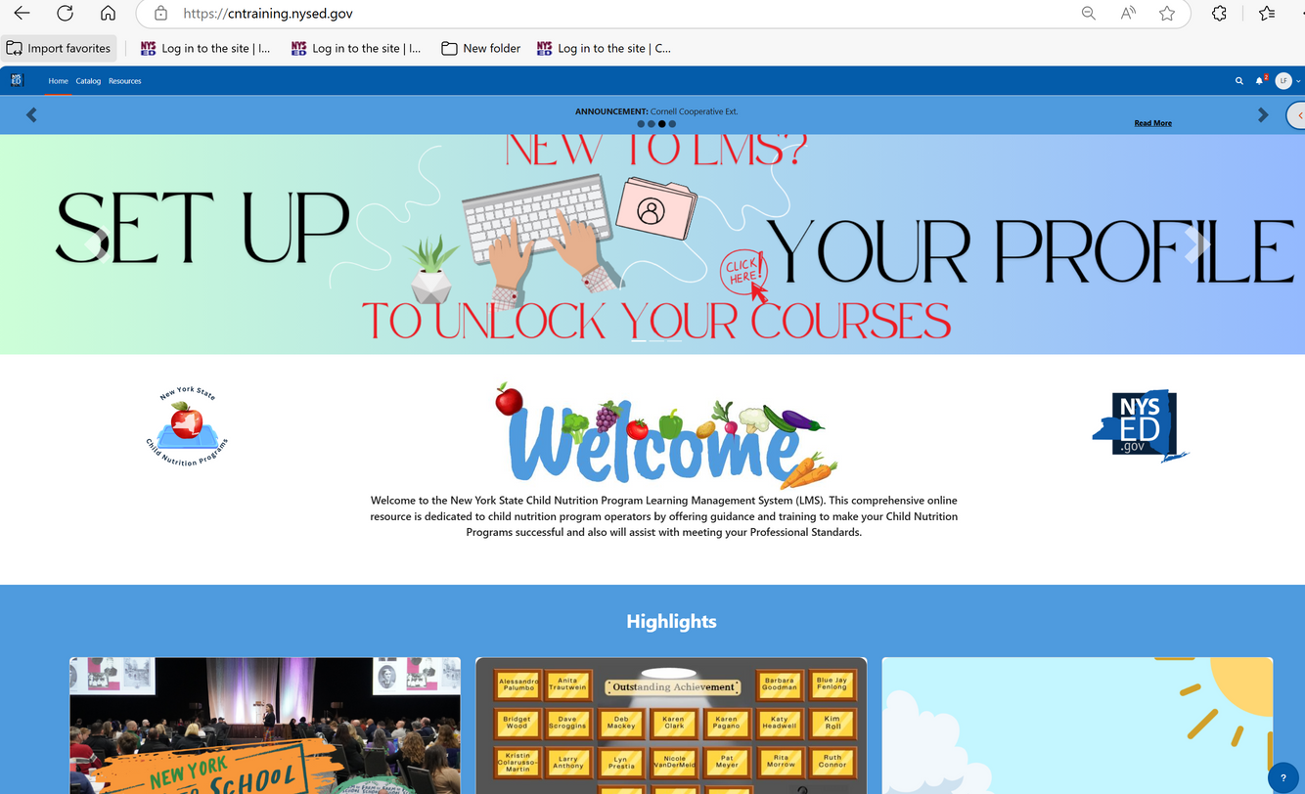



Learning
Management
System (LMS)
Webinar
NYSED Office of Child Nutrition
Notes:
Welcome to the Learning Management System Webinar, hosted by the New York State Education Department Office of Child Nutrition.
This session will provide an overview of the new Learning Management System (LMS) for Child Nutrition Programs, including how to get started and navigate the platform.
Presenting today is: [Insert Name]
Answering your questions will be: [Insert Name]
You should have already received an email with your login credentials and instructions for accessing and using the new LMS. If not, please reach out to us at CNTraining@nysed.gov.
Please note: Following today’s webinar, our office will host a series of LMS “office hours,” where schools can sign up for more personalized support, including one-on-one walkthroughs and detailed Q&A.
After today’s presentation, you will receive an email with a copy of the webinar slides.
If you don’t receive them, again, please email CNTraining@nysed.gov.
A recording of this session will also be posted to the Child Nutrition website.
If you have any questions during the presentation, please use the Q&A box to type and submit them to our staff. We’ll address as many questions as possible at the end of the webinar.

Slide 2
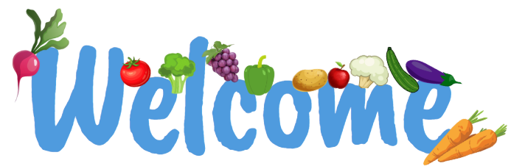
Introduction
Welcome to the New York State Child Nutrition Program Learning Management System (LMS). This comprehensive online resource is dedicated to Child Nutrition Program operators by offering guidance and training to make your Child Nutrition Programs successful and will assist with meeting your Professional Standards
Notes:
The Learning Management System is more than just a training platform — it's a centralized tool designed to support Food Service Directors in meeting key program requirements.
Here’s what the LMS includes:
A streamlined way to track and document annual professional standards for Food Service Directors and, in the future, kitchen staff. (Adding kitchen staff profiles is part of Phase 2.)
Access to recorded webinars and a growing library of interactive training modules we call Skill Builders.
A complete Administrative Review Toolkit with all required forms, checklists, and resources to help you prepare for reviews.
The ability to request in-person trainings directly through the platform.
Everything is organized in one place to help you stay compliant, confident, and connected.

Slide 3
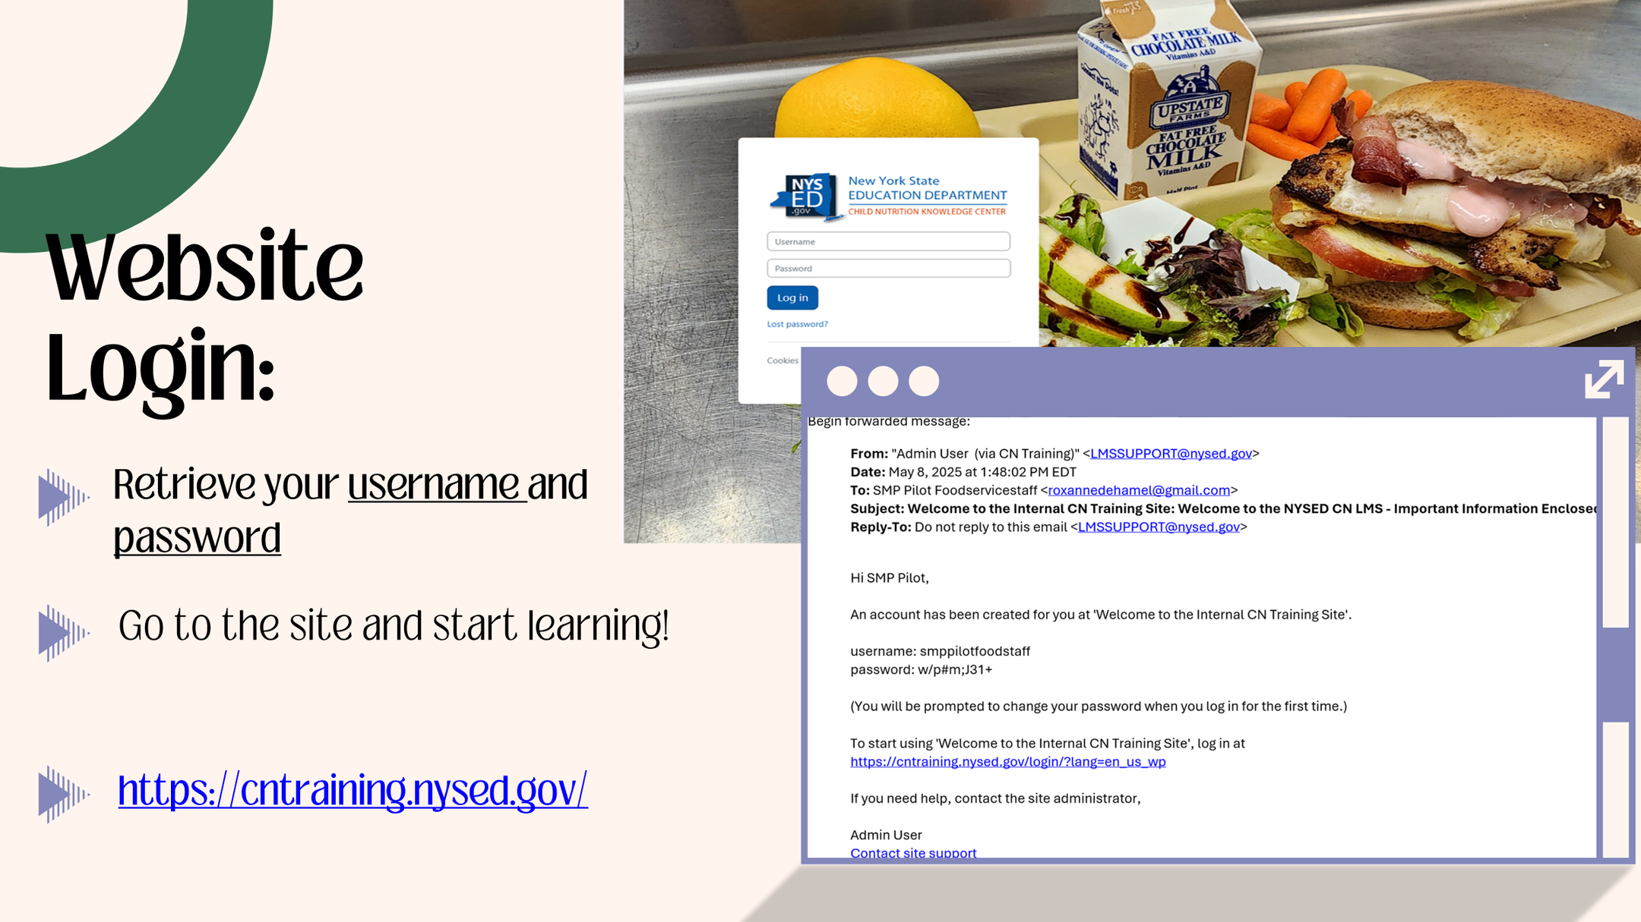
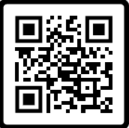
Website Login:
Retrieve your username & password
Go to the site and start learning!
https://cntraining.nysed.gov
Notes:
By now you should have received a separate email from LMSSUPPORT@nysed.gov with your login credentials (username and password).
The Email Subject will say: Welcome to the Internal CN Training Site: LMS for CN Operators – Important Information Enclosed.
If you did not receive the email, please contact us at CNTraining@nysed.gov as soon as possible
Once you have these credentials click on the link in the email to be redirected to the new LMS Website.
Enter your new credentials here!
Please note: your username is not your email address — it’s a system-generated name included in that message.

Slide 4
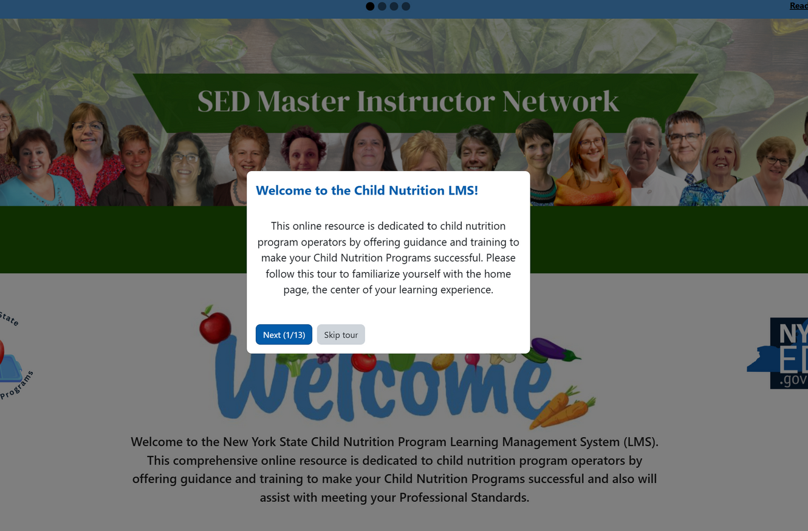


Your First Login:
Tour prompts will guide you through the website
Lead to essential links
Notes:
On your first login you will be prompted to take a tour and to set up your user profile. This setup ensures your experience is tailored to your role and the programs you participate in, respective to your SFA. This will walk you through all of the main functions and setup of the site like where to find key areas like your course catalog, announcements, and certificates.

Slide 5
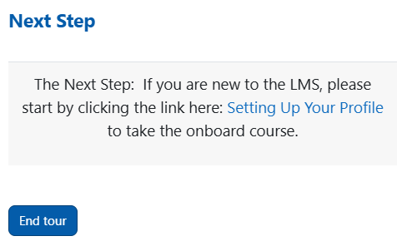

Setting Up Your User Profile:
If you are new to LMS, start here
Notes:
After you log in and complete the brief tour, your first task is to complete the course titled ‘Let’s Set Up Your Profile!’ This course is required, it collects important information like your name, job title, district or organization, and the programs you participate in, such as NSLP, SBP,or SFSP. Completing this course will unlock access to the rest of your training materials.
The tour will prompt you to this page, but if you missed it, you can click the link in the banner section of the home page.

Slide 6
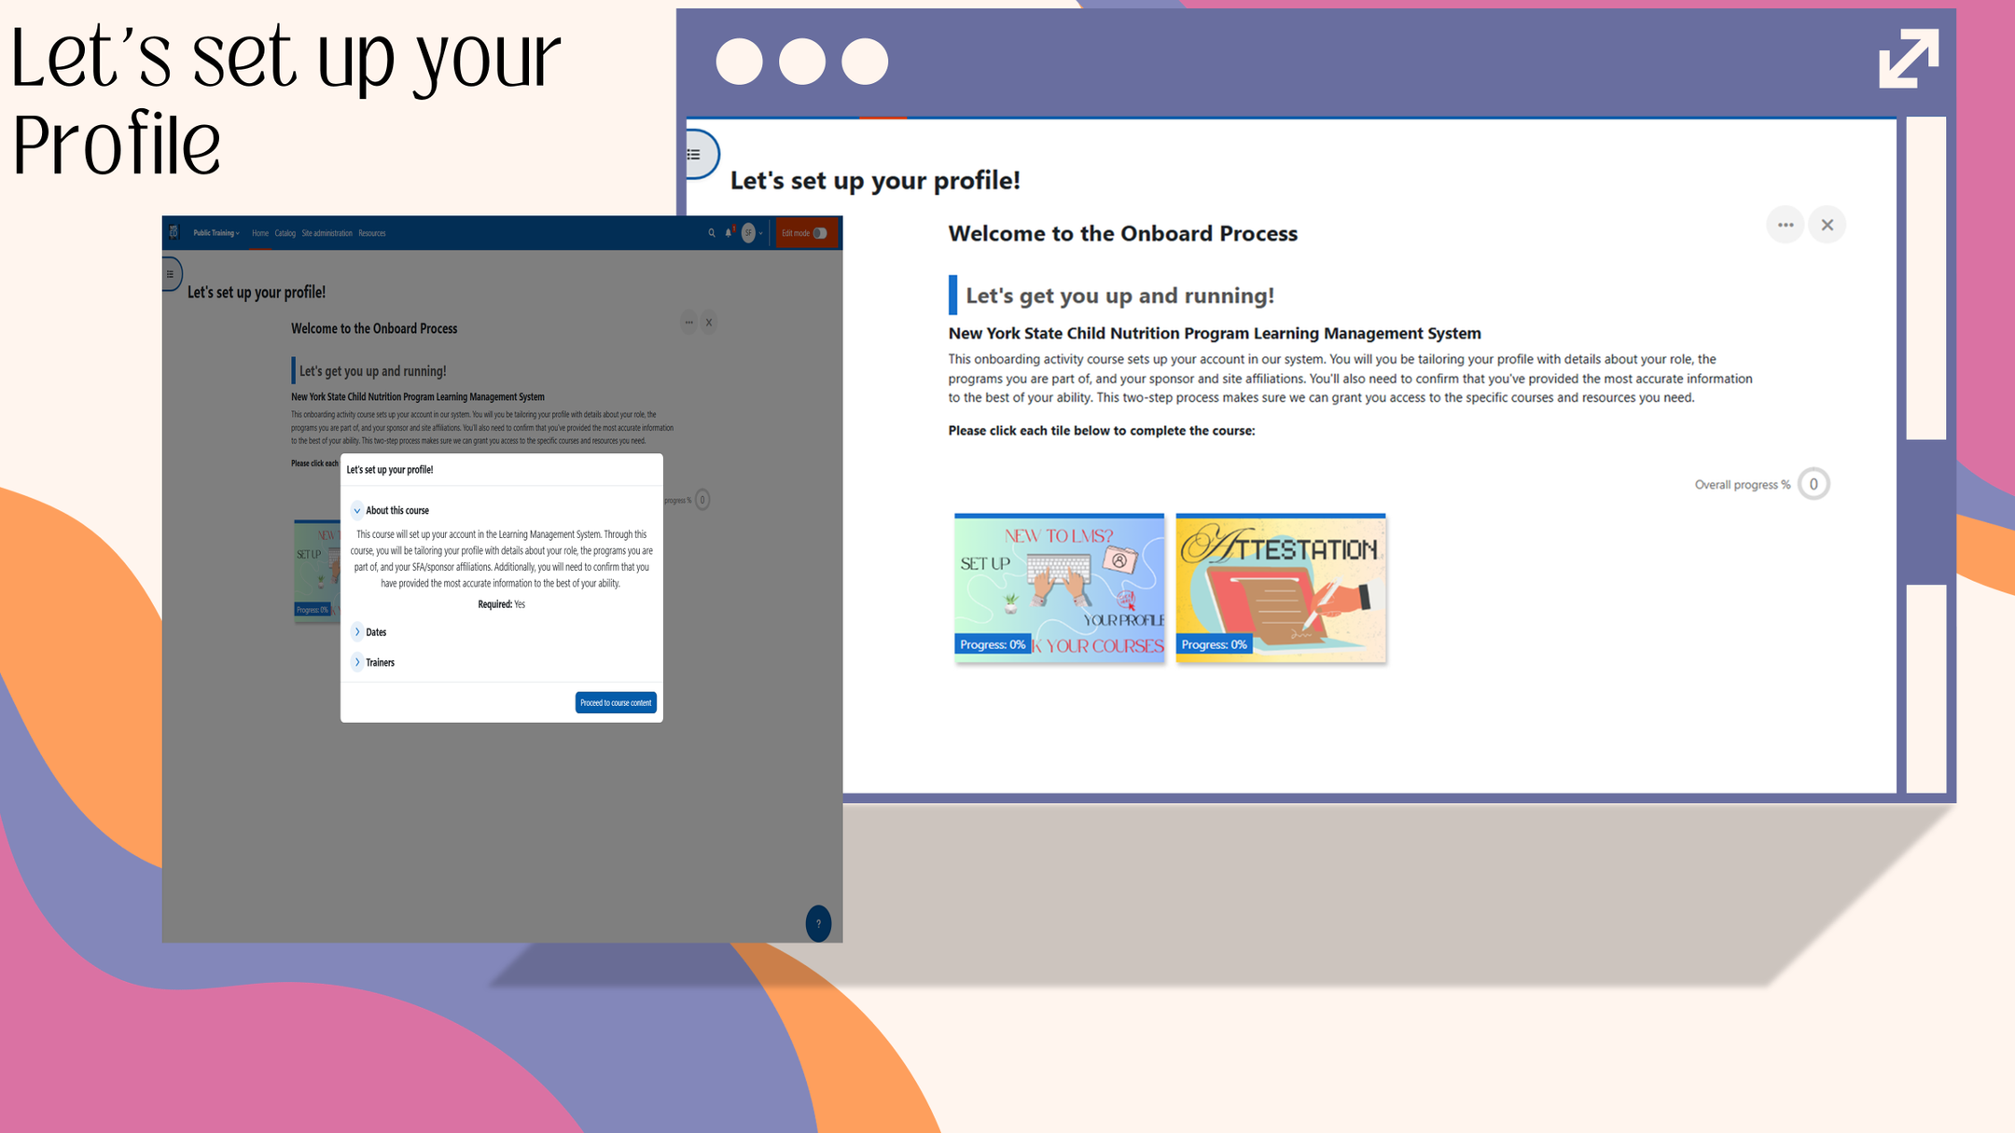
Notes:
Once you click ‘Proceed to Course Content,’ you’ll arrive at the Profile Setup page. This is where we’ll begin the two-step onboarding process that helps tailor the LMS to your role and the programs you work with.
To get started, click on the blue tile on the left labeled ‘Set up your profile.’ This is the first step.

Slide 7
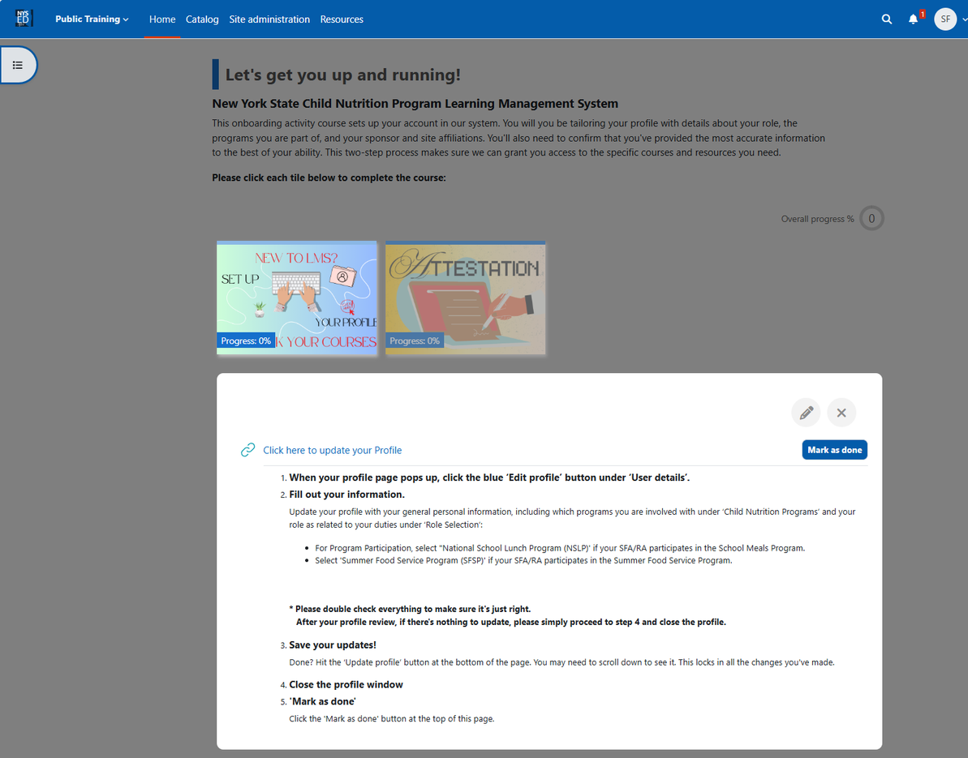


Setting up your profile
This course sets up your account in our system
Confirm (attest) it is accurate information
Two-step process ensures access to the specific courses and resources
Notes:
Here a pop-up will appear. select “Click here to update your profile” to continue.

Slide 8



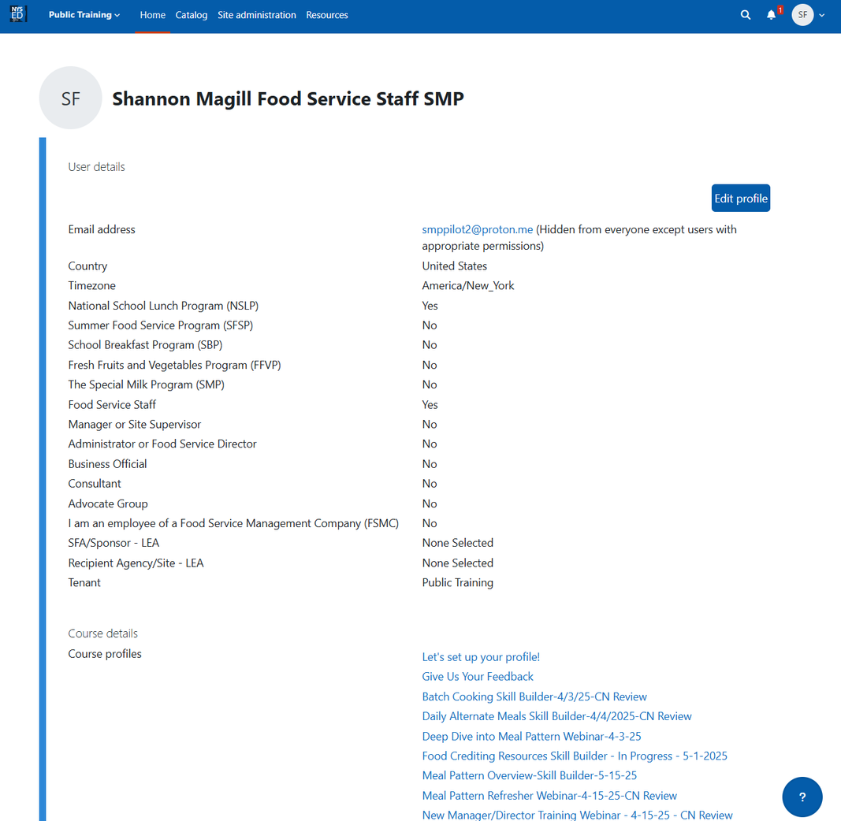
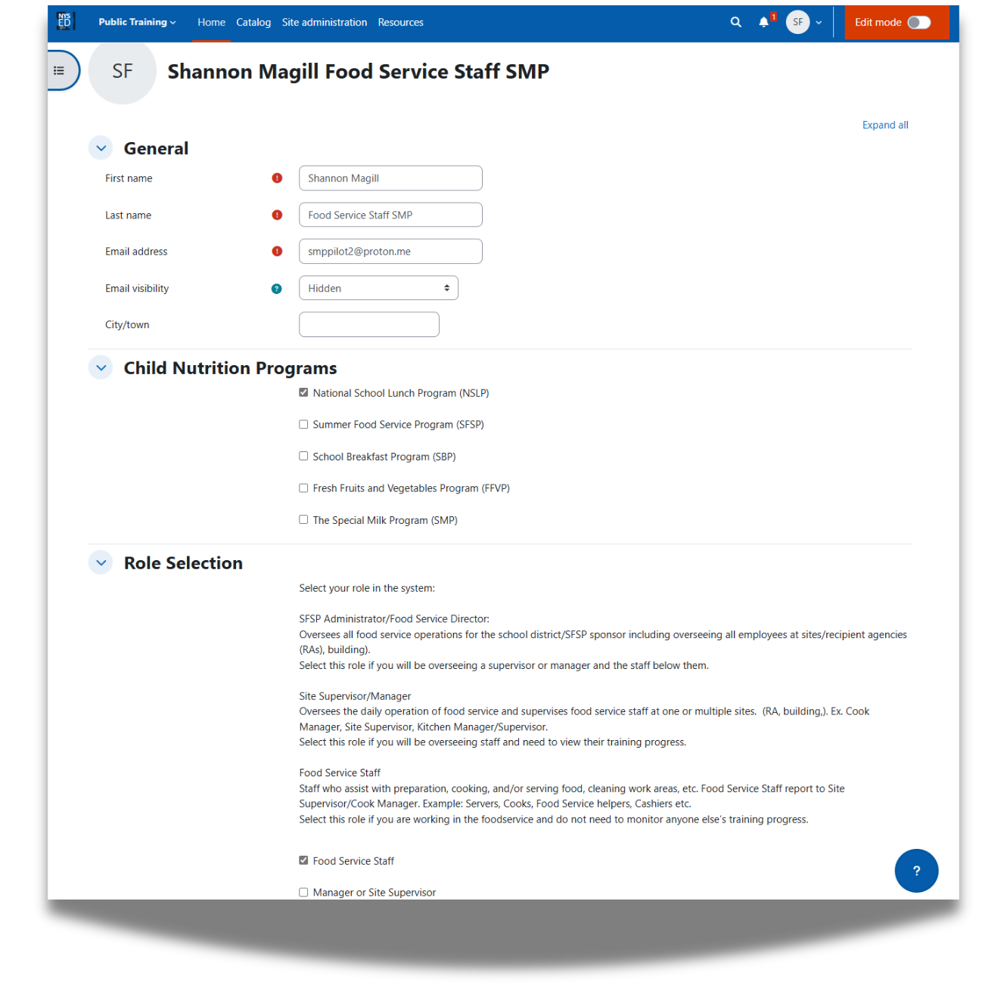


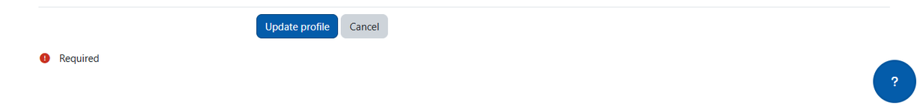
Notes:
Now you are on the profile page.
To complete your profile:
Click the Blue "Edit Profile" on the right-hand side and enter the following information:
Your School District or Organization Name
Check the boxes for the corresponding Programs you participate in, such as NSLP, SBP, SFSP, or FFVP
Your job role, for example, Food Service Director, Program Administrator, Manager or Site Supervisor
Your SFA and RA information, if applicable
Make sure you complete all fields as accurately as possible.
You will also want to check check to make sure all pre-filled information is correct.
This ensures that the trainings, tools, and resources recommended to you are relevant to the work you do.
Click "Update Profile" at the bottom of the page. You will receive a message "changes saved" at the top indicating that you successfully input the information. You may now X out of this window and direct yourself back to the main course page.

Slide 9
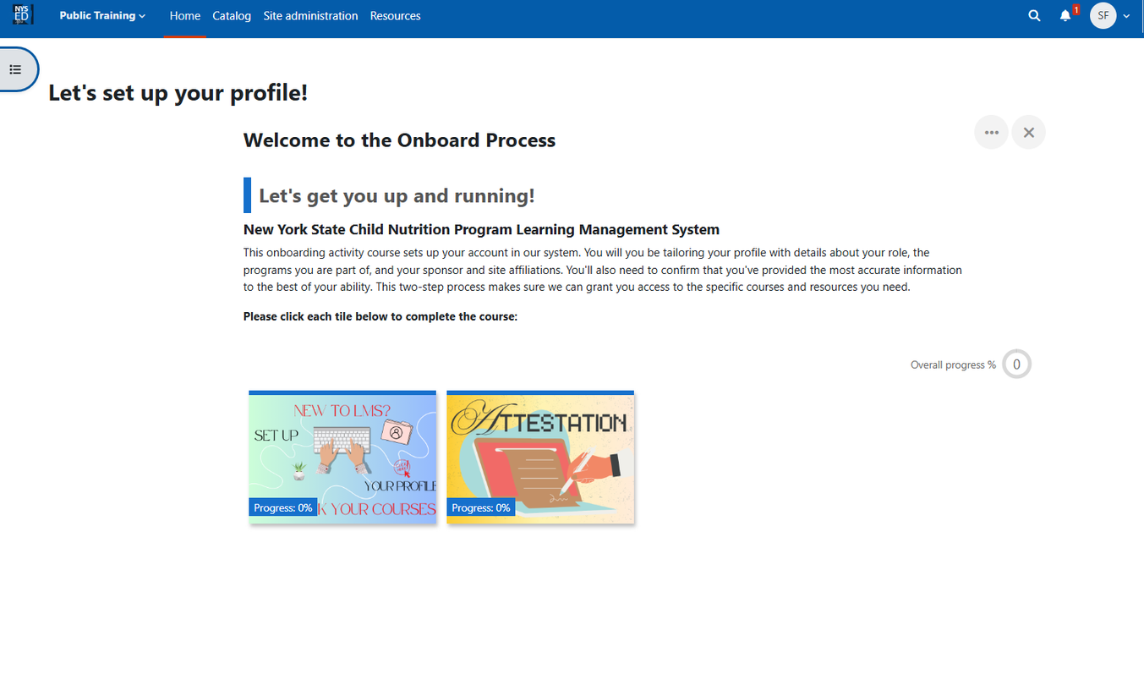
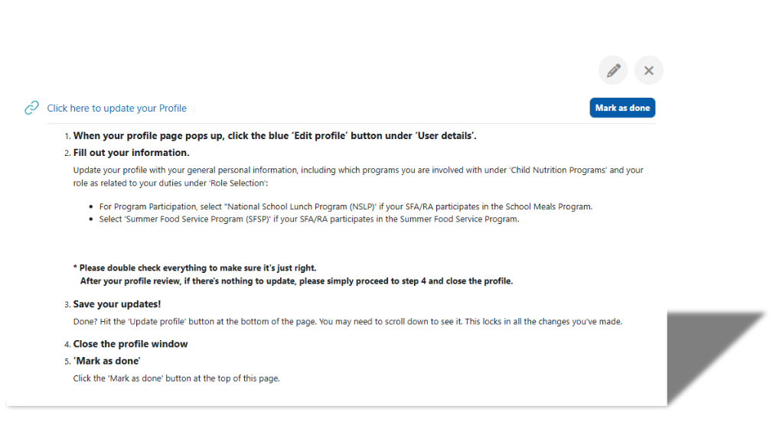

Setting up your profile
Click on: “Mark as done”
Notes:
Back on the main course page you will click the Blue Setup tile once more.
Now that you set up your profile you can click the blue "mark as done" button. This completes Step 1 of the process.

Slide 10
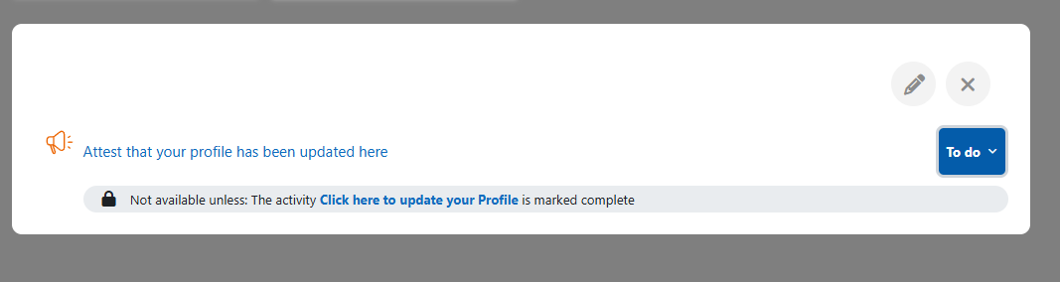
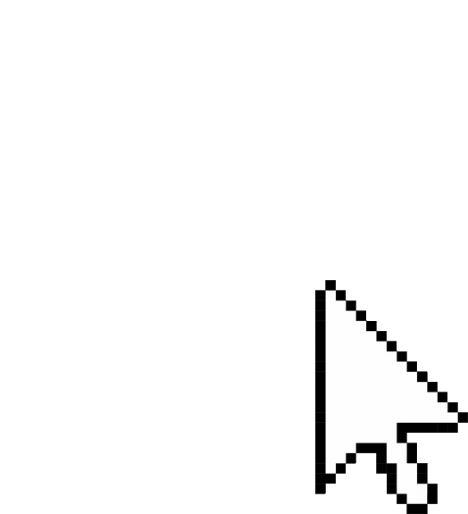
Setting up your profile
Click on: “Attestation”
Notes:
for step 2, click on the "Attestation" tile to the right and confirm everything you've entered on the profile is correct.
Then, select "attest that your profile has been updated here"

Slide 11
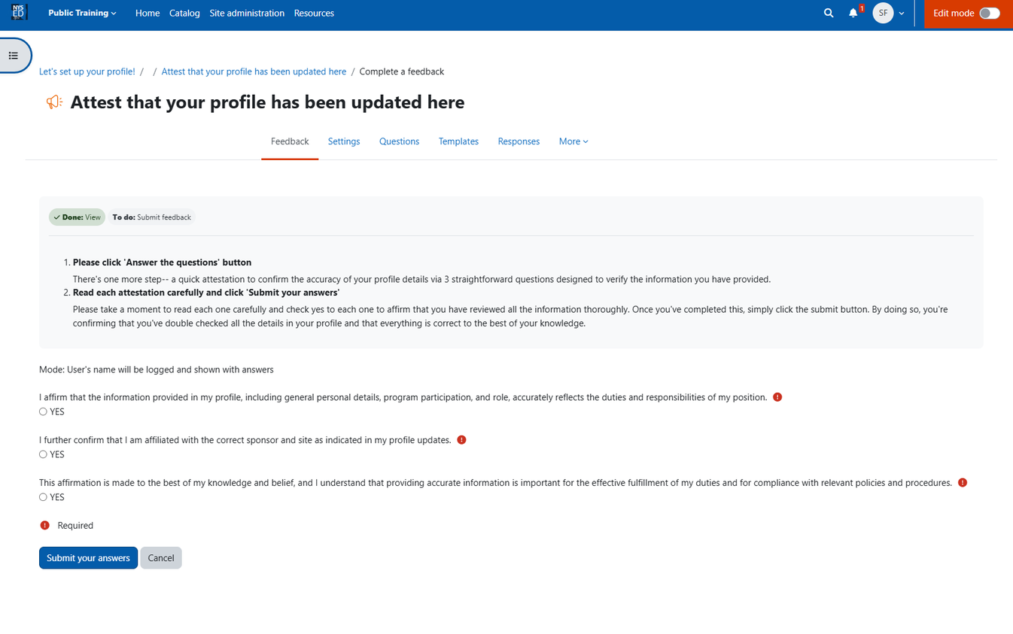

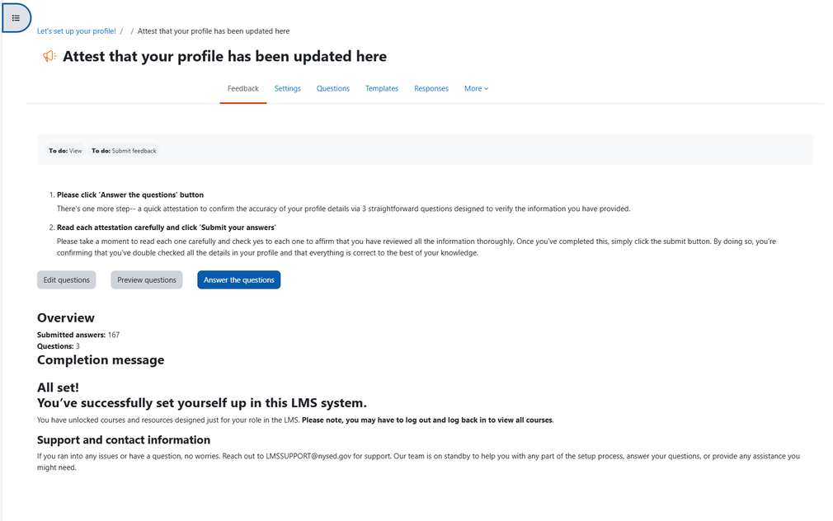
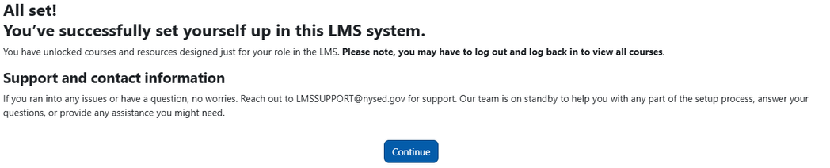
Setting up your profile
Notes:
On the next page click the "Answer the questions" button to continue
Select YES on all three questions to acknowledge that you attest that the information provided is accurate. By doing so you are confirming you have double checked all the details in your profile and it is correct. Once they are selected click on the blue "submit your answers" button on the bottom of the page.
This completes step 2 and you should receive a success message. To continue click on the continue on the bottom of the page to be redirected back to the main course page.
Your Profile Setup is now complete!

Slide 12
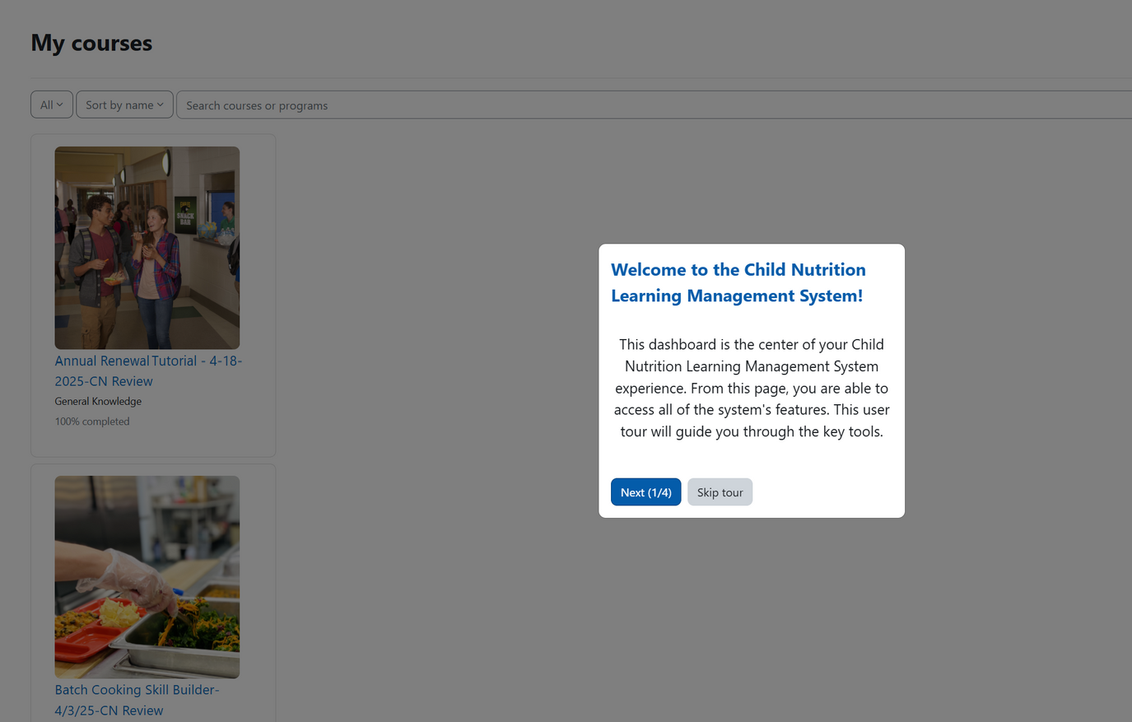
My Courses:
Will be directed to “My Courses” page
Enrolled courses specifically tailored to role within the Child Nutrition Programs
Notes:
You will then be directed to your "My Courses" page. Here, you will discover the courses in which you are enrolled in. They will be specifically tailored to your role within the Child Nutrition Programs.

Slide 13
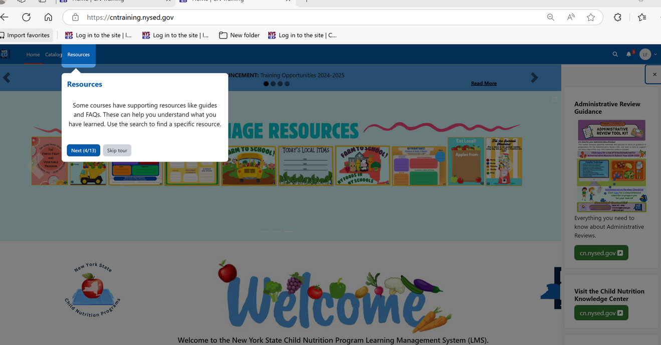
Complete LMS Site Tour:
After navigating the prompts on the “My Courses” page, go to the home page to finish the site tour
Guide to essential resources, including announcements, upcoming webinars, and training sessions
Notes:
After completing the prompts on the My Course Page, you can go back to the home page to finish the site tour. To return to the home page, go to the blue banner at the top of the page and select the "home" button on the left-hand side.
It is essential to complete the site tour as it will provide you with key resources, including announcements, upcoming webinars, and training sessions.

Slide 14
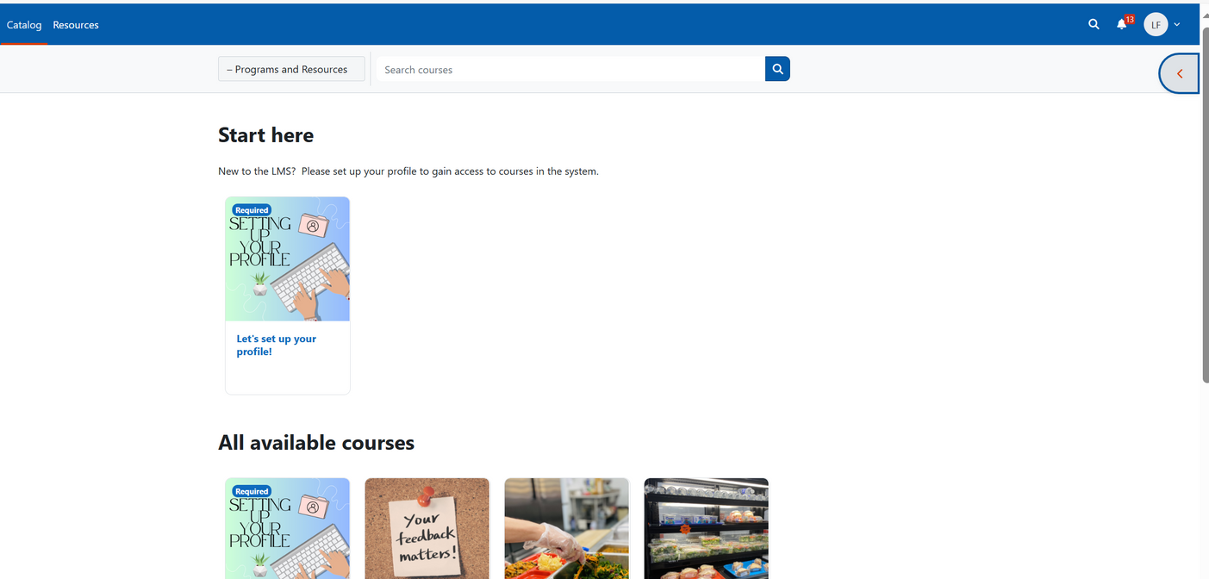

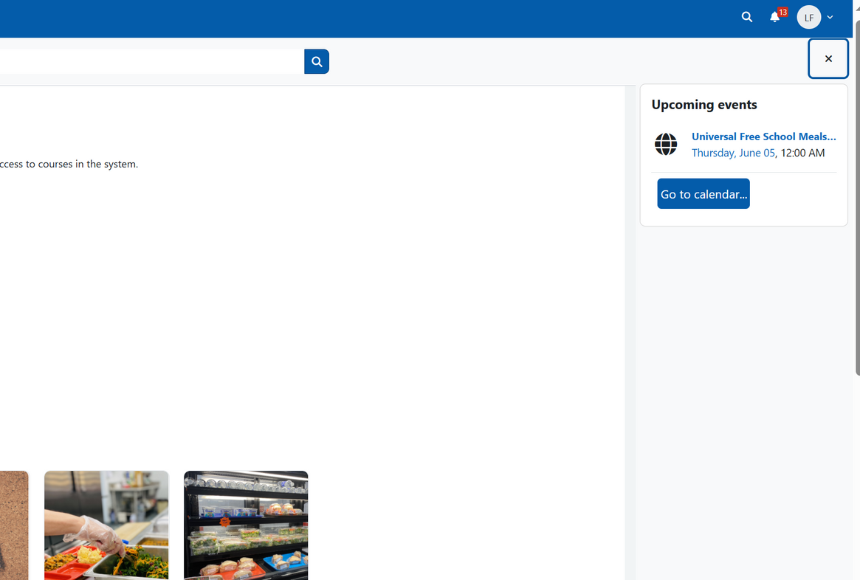

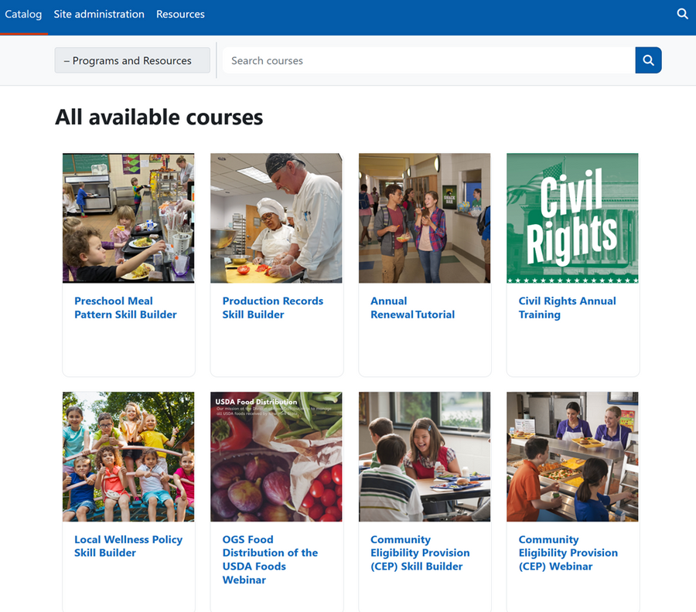

The Course Catalog:
View upcoming events and training sessions on this page
Click the arrow located in the top right corner to open the “tray”
Notes:
Next, let’s look at the course catalog. From the homepage, click on the ‘Catalog’ link in the blue banner at the top of your screen. That will take you to this page, where you can browse all the available trainings.
At the top-right corner of the screen. You’ll see a small gray arrow. When you click on it, it opens what we call the ‘tray’—a panel that shows any upcoming events or training sessions.
You can click ‘Go to Calendar’ to see the full schedule and register for upcoming webinars or trainings.
new or seasonal training opportunities and events will be posted here.

Slide 15
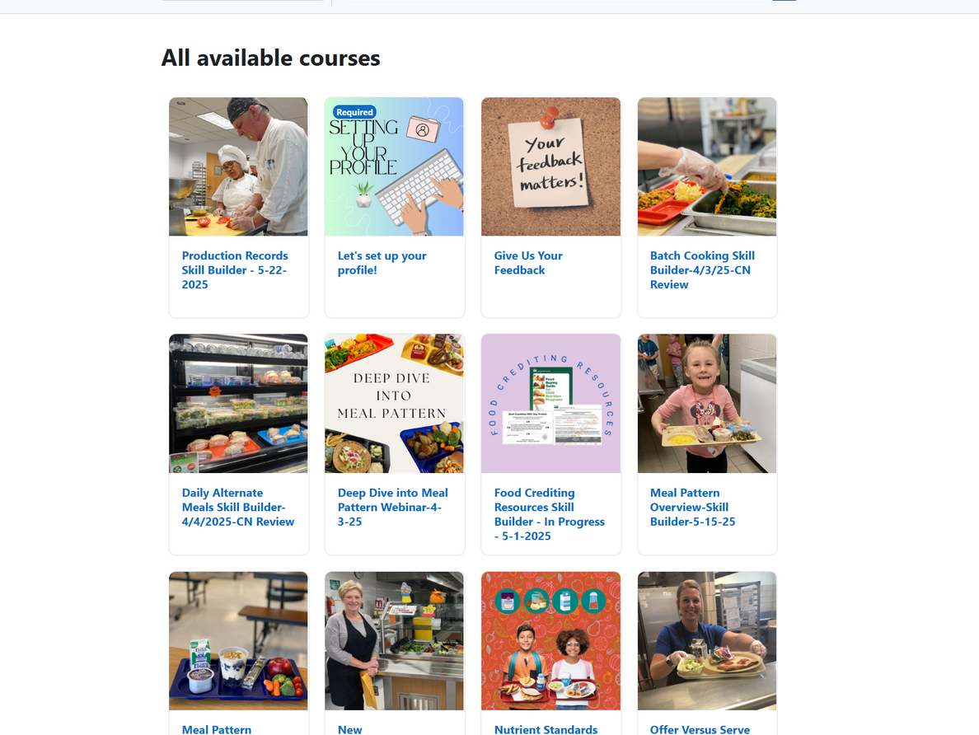
Completing Your First Course:
Once completed all site tours and user profile, you are ready to start learning!
Go to the catalog page and select courses you want to access
Notes:
Once you have completed all of the site tours and successfully completed setting up your profile, you are ready to start learning.
On the catalog page is where you will be able to select which course you would like to access.
There are different types of courses within the LMS, Skill Builders and Webinars. Webinars provide you with a video to watch on various topics that are conducted by Child Nutrition. Skill Builders are interactive, self-paced courses that provide you with valuable information.

Slide 16
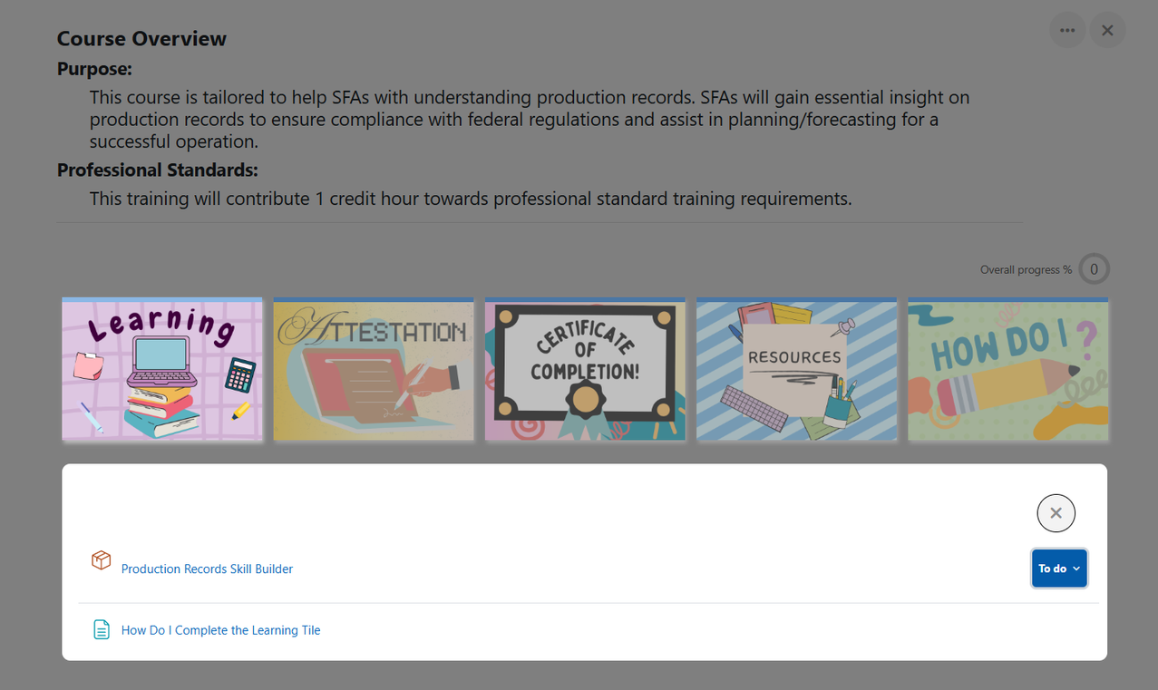
Completing Your First Course:
To access the course materials,
click: “Proceed to course content”
Navigate to the Learning tile
Click on the link that directs you to the skill builder or webinar
Notes:
To start, select on the course you wish to view. You will be prompt with an overview of the course, select "proceed to course content." You will see the course overview, purpose of the course, and Professional Standards training requirements. Next, you will see various tiles including Learning, Attestation, Certificate of Completion, Resources (if the course has them), and a "How do I?" tile.
The Attestation tile and Certificate of Completion cannot be accessed until a series of steps have been complete.
Select the learning tile to access the content, then click on the link that directs you to the skill builder or webinar.

Slide 17
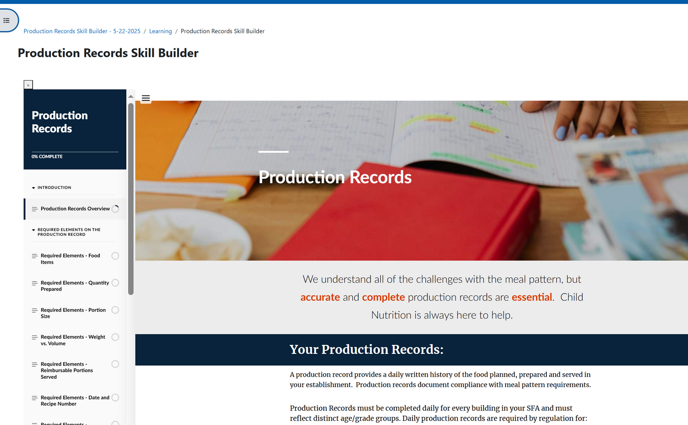
Completing Your First Course:
The course will subsequently load in the same window
Click the button labeled: “Start Training”
Notes:
The course will load within the same window, and you click on the button labeled "start training."
You will then see the content of training module. On the right-hand side, you will see various chapters of the course. You cannot move ahead to the next section and must be completed in order.
Within each course, there are various resources, activities, and knowledge checks to reviewed.
As a reminder, this is a self-paced course, meaning, you can return back to the course if needed at later time and it will bring you to where you last left off.

Slide 18
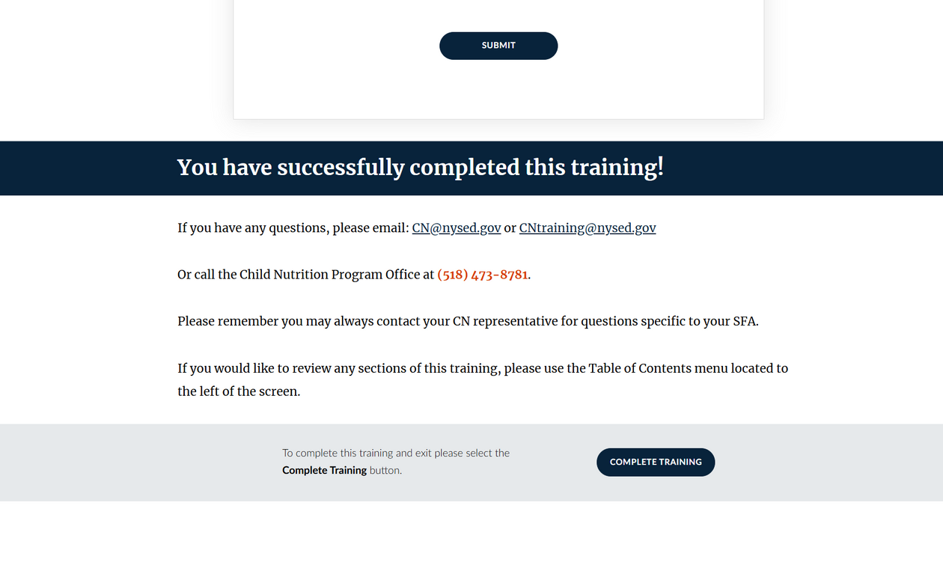
Completing Your First Course:
Upon finishing all course materials and knowledge checks, you will be at the conclusion of the course
Click: “Complete Training”
Notes:
Once you have worked your way through the course, reviewing materials, and knowledge checks, you will arrive to the conclusion of the course.
Click the "complete training" button to continue.

Slide 19
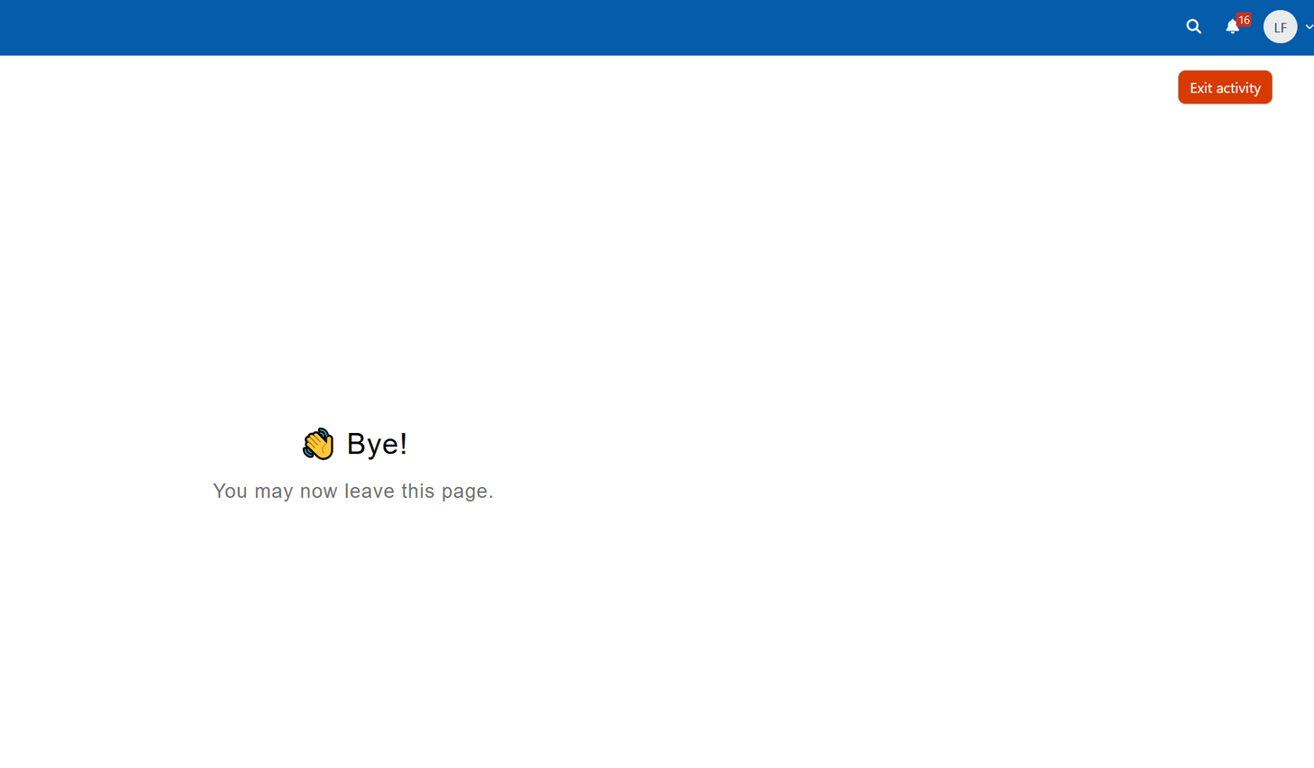


Completing Your First Course:
Do not close out of the window
Instead click: “Exit Activity” in the upper right-hand corner to return to the course dashboard
Notes:
It’s very important that you don’t close your browser tab or window when you finish the training. Instead, be sure to click ‘Exit Activity’ in the upper right-hand corner of the screen.
If you close out too early—before selecting ‘Exit Activity’—the system may not mark the course as complete. That means you might not be able to move on to the attestation step or access your certificate.

Slide 20
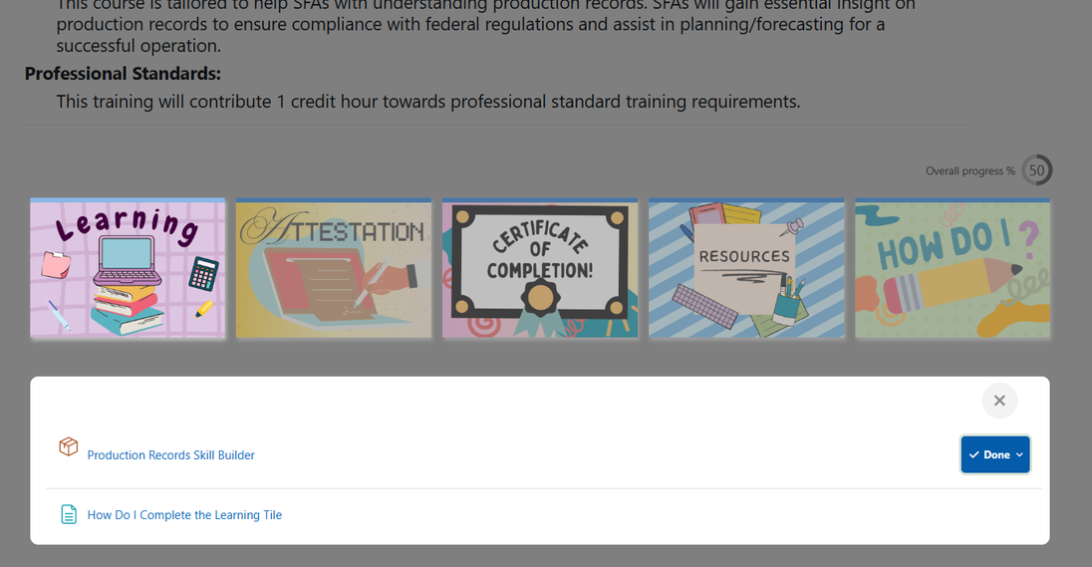
Completing Your First Course:
If you have completed all required course components, the Learning tile status should change to “Done”
Access the Attestation tile
Notes:
If you have completed all of the required components in the training module, the Learning tile status should change to "done." You will now be able to access the Attestation tile.
Please note: The Attestation tile cannot be accessed until the learning module has been successfully completed.

Slide 21
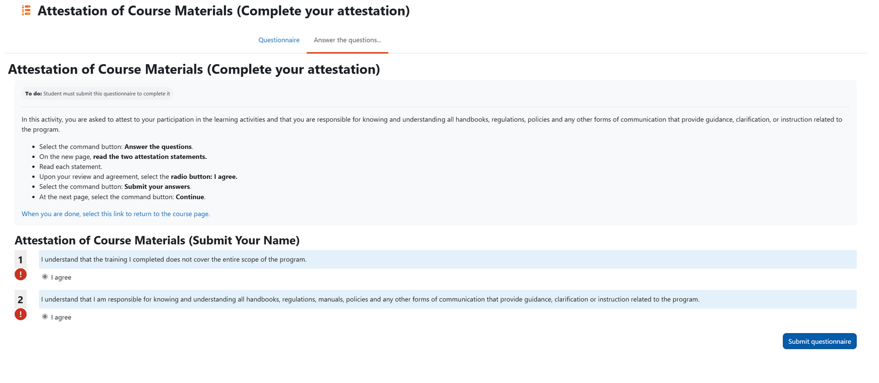

Completing Your First Course:
Navigate to the Attestation tile
Click the link which brings you to the attestation questions
Complete attestation and click:“Submit Questionnaire”
Notes:
At this point, you’ve completed the course content, so the next step is to complete the attestation.
Navigate to the Attestation tile, select the link, and follow the prompt to answer a brief set of questions.
Once submitted, this will mark the course as complete.

Slide 22
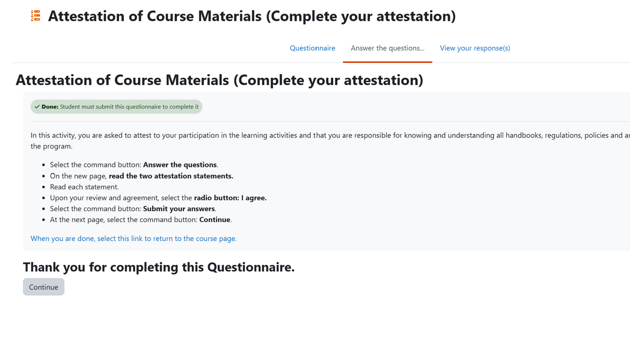
Completing Your First Course:
After submitting your attestation, the page will look like this
Click on the link which leads you back to the course page
Notes:
After submitting your attestation, the page will look like this. Click on the link to return back to the course page.

Slide 23
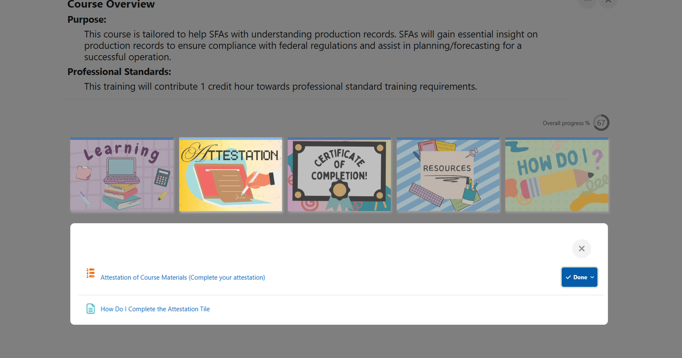
Completing Your First Course:
Once the questions are answered, the Attestation tile status will change to “Done” and you can access your certificate
Notes:
Once you have answered all the questions, the Attestation tile status should change to "done." This will allow you to access the certificate.
Note: The certificate of completion cannot be viewed until the Attestation has successfully been complete.

Slide 24
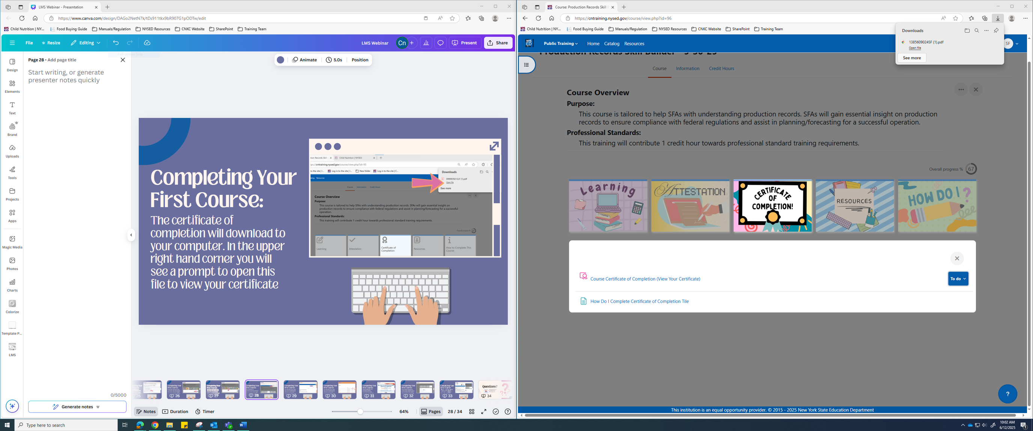
Completing Your First Course:
The certificate of completion will download to your computer
In the upper right-hand corner, you will see a prompt to open this file to view your certificate
Notes:
Your certificate will download to your computer. In the upper right-hand corner, you will see a prompt to open this file to view your certificate.
You can save the document to your computer or print it.

Slide 25
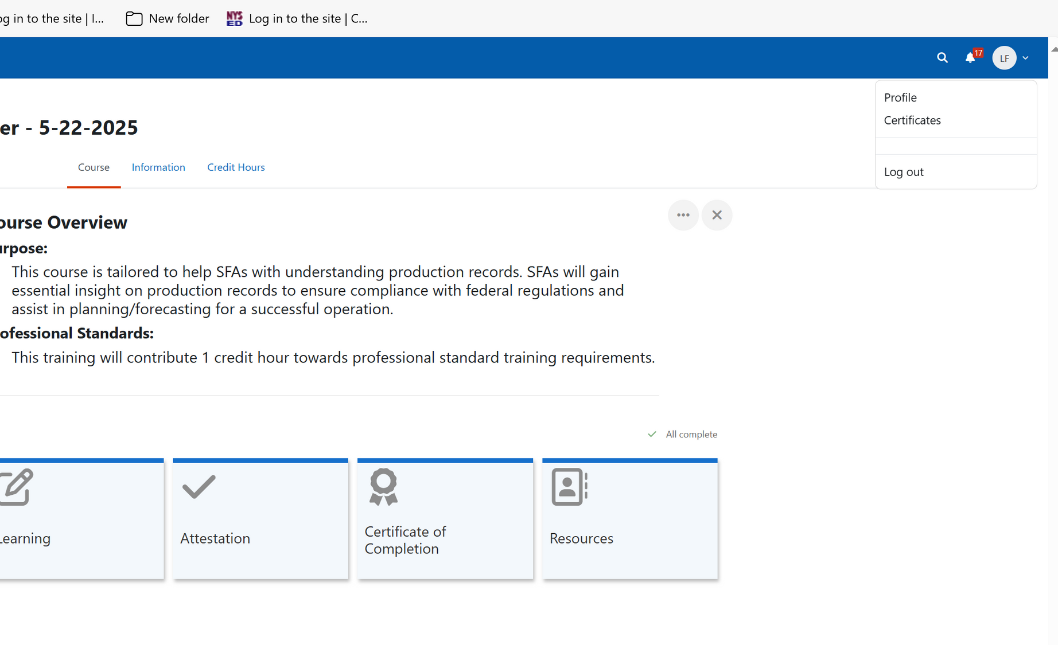

Completing Your First Course:
Access and view your certificate by clicking on your user initials in the upper right corner and navigating to the Certificates page
Notes:
You can also access and view your certificate by clicking on your user initials in the upper right corner, on the blue banner, and navigate to the Certificates page on the drop down.

Slide 26
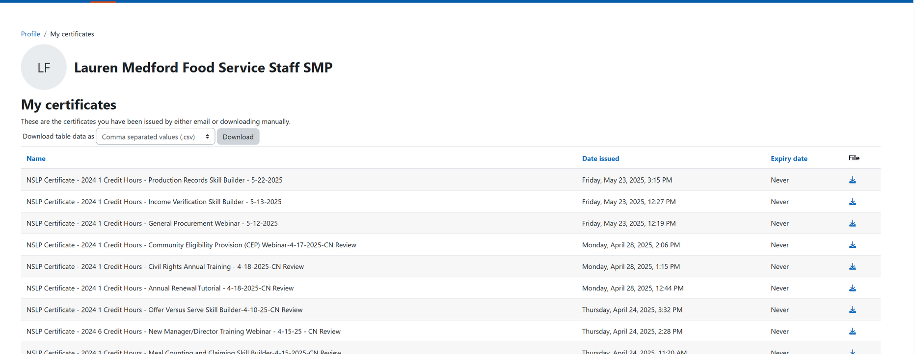

Completing Your First Course:
All of your certificates listed, date issued/completed, and the ability to download the document
On the right-hand side, under file, select the down arrow icon
Notes:
On this page you will see all of your certificates listed, date issued/completed, and the ability to download the document. On the right-hand side, under file, select the down arrow icon. The certificate will then download to your computer.
Another way to access certificates is through the notification bell on the blue banner in the top right-hand side of your screen.
To see if you have a notification, you will see a red number next to it.

Slide 27
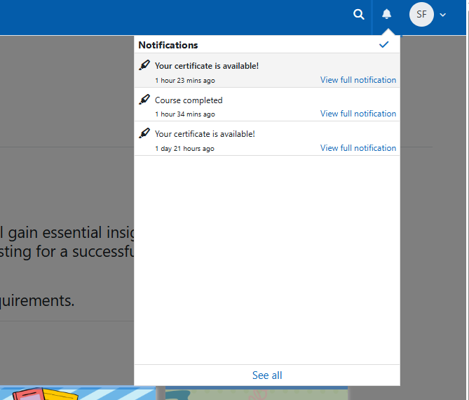
Completing Your First Course:
Notifications will tell you if your certificate is available and if you have completed the course
Notes:
When selecting the notification bell, you will be provided with a drop down menu.
Notifications will tell you if your certificate is available and if you have completed the course. You can click on the "your certificate is available" to bring you to all of your certificates.

Slide 28
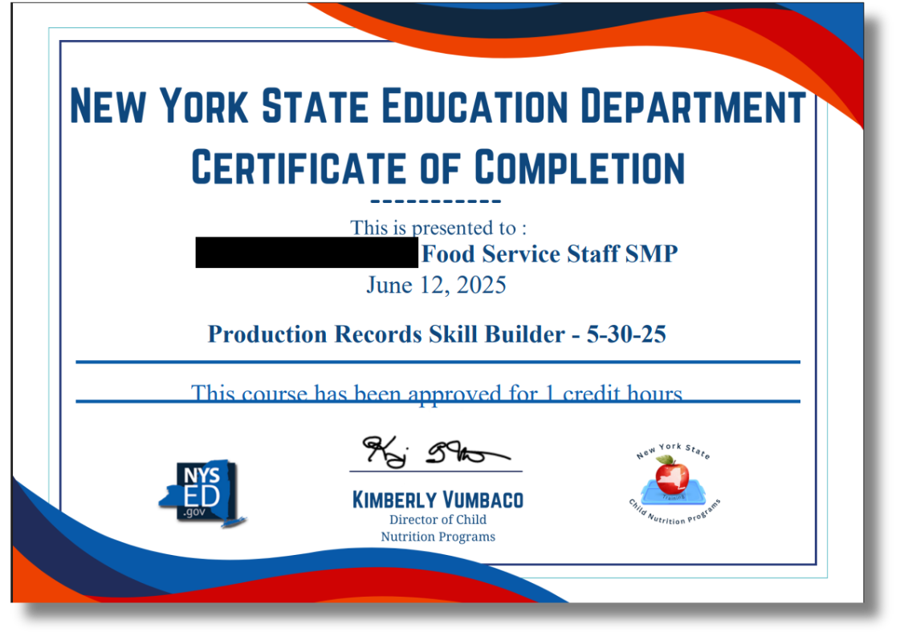
Completing Your First Course:
Enter Name
A certificate is received for each completed course
Notes:
This is an example of what your certificate of completion will look like.
While the design may change, each certificate will include the same key information: your name, the course title, the completion date, and the number of approved credit hours toward Professional Standards.
It’s a good idea to download and save each certificate for your records. As mentioned before the certificates will also remain available in your LMS account if you ever need to access them later.

Slide 29
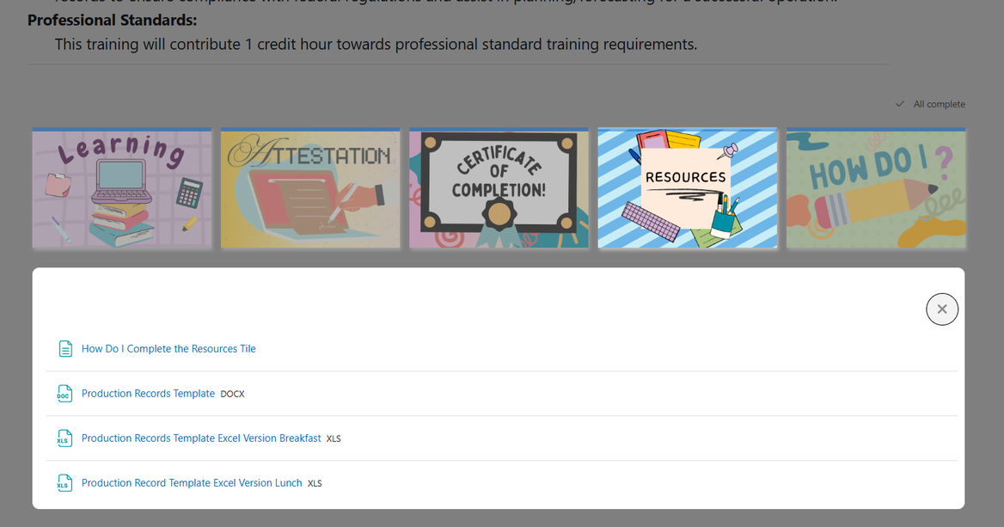

Completing Your First Course:
Before leaving the course page, access the “Resources” tile
Links to pertinent resources related to the course
Notes:
Each course also has a resources tile to provide users with various documents that correspond with each course. Though not required, these will assist you in maintaining the Child Nutrition Program requirements.
To access the resources, select any of the links provided. If you are unsure how to complete the resource tile, select the first link that states "How do I complete the resource tile." link

Slide 30
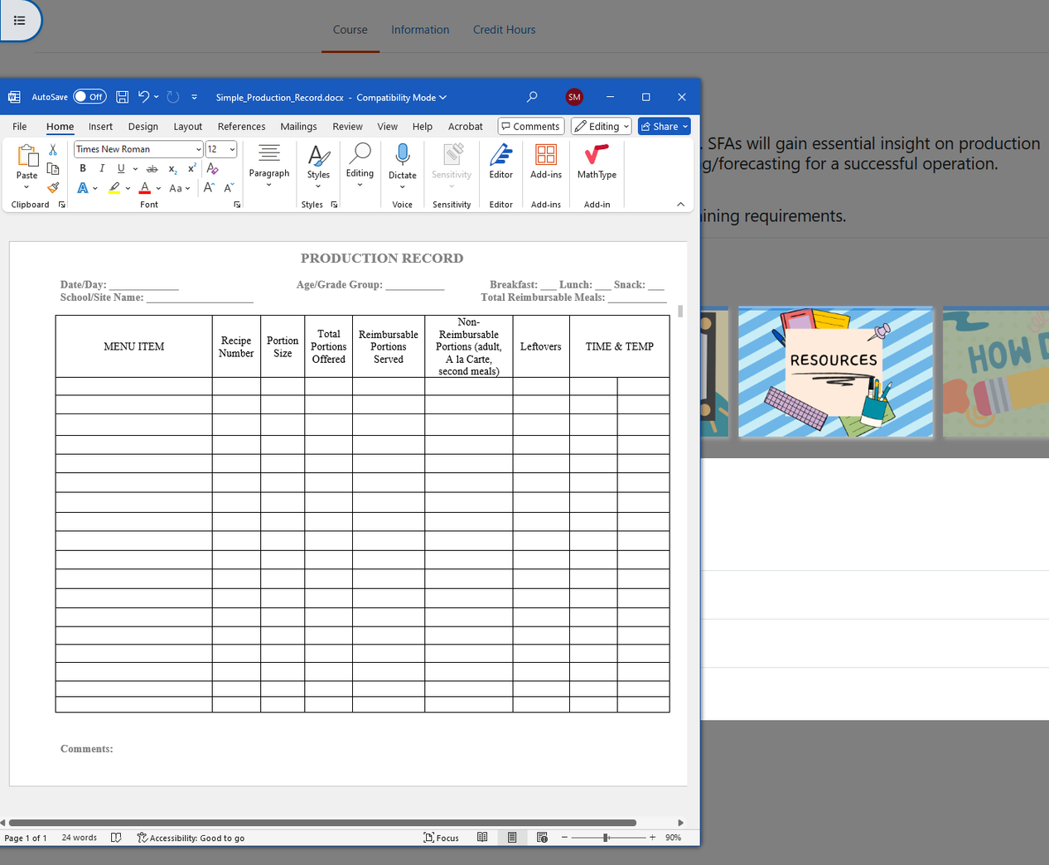
Completing Your First Course:
Links accessed through the “Resources” tile will either open in a new window or download supporting documents directly to your computer
Notes:
For example, in the Meal Pattern course, you might see a standard production record template listed under the Resources tile.
To access it, just click the link. Some files will open in a new browser tab, while others will download directly to your computer.
If it downloads, check your Downloads folder to open it.
If it opens in a new tab, you can simply close that tab when you're done—your course page in the LMS will still be open and you will be right where you left off.

Slide 31
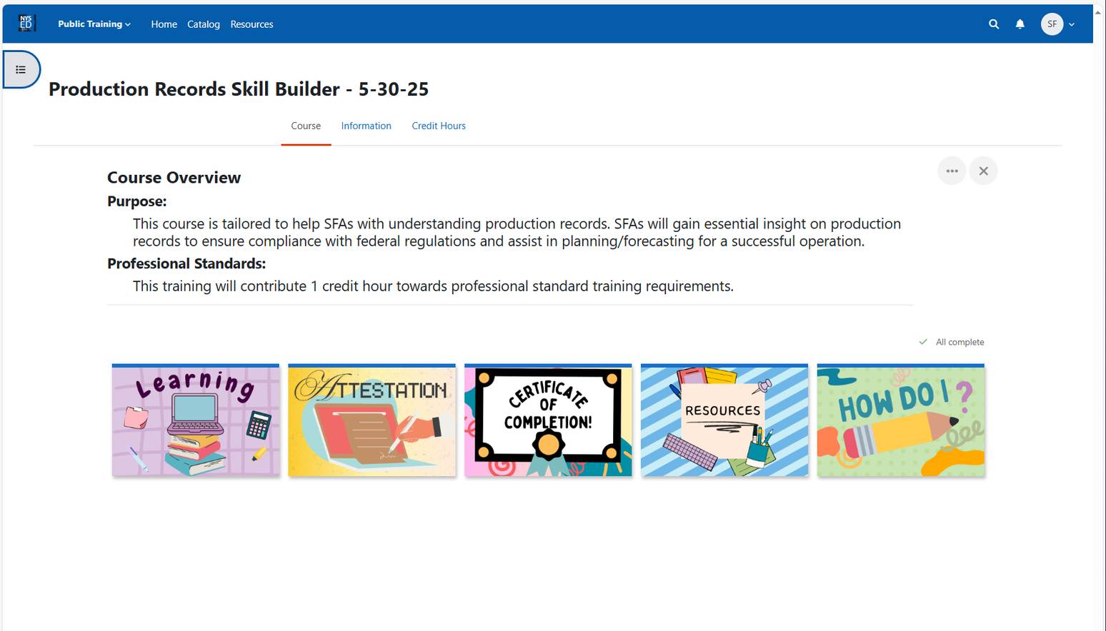
Course Completion:
Select “Home” to return to the homepage or “Catalog” to search for more courses
Notes:
Now that the course is complete, you can go to the blue banner and select "home" to return to the main page or select "catalog" to search for more courses.
More trainings, events, and sections will become available throughout the year. Check back often for the most up to date trainings and to register for upcoming webinars and events right through the LMS!

Slide 32
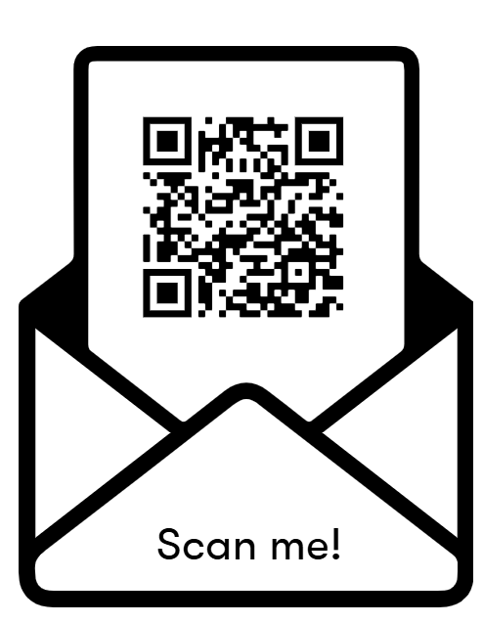


Need more help?
Office Hours:
Friday 6/20 1:00pm-3:00pm
Monday 6/23 1:00pm-3:00pm
Tuesday 6/24 10:00am-12:00pm
Notes:
Need more Help? register to join our Office Hours. We will be hosting office hours to walk food service directors who need more help signing on and getting starting this Friday June 20th, Monday June 23rd and Tuesday June 24th. See our Child Nutrition Training page to register or scan the QR code on this slide

Slide 33
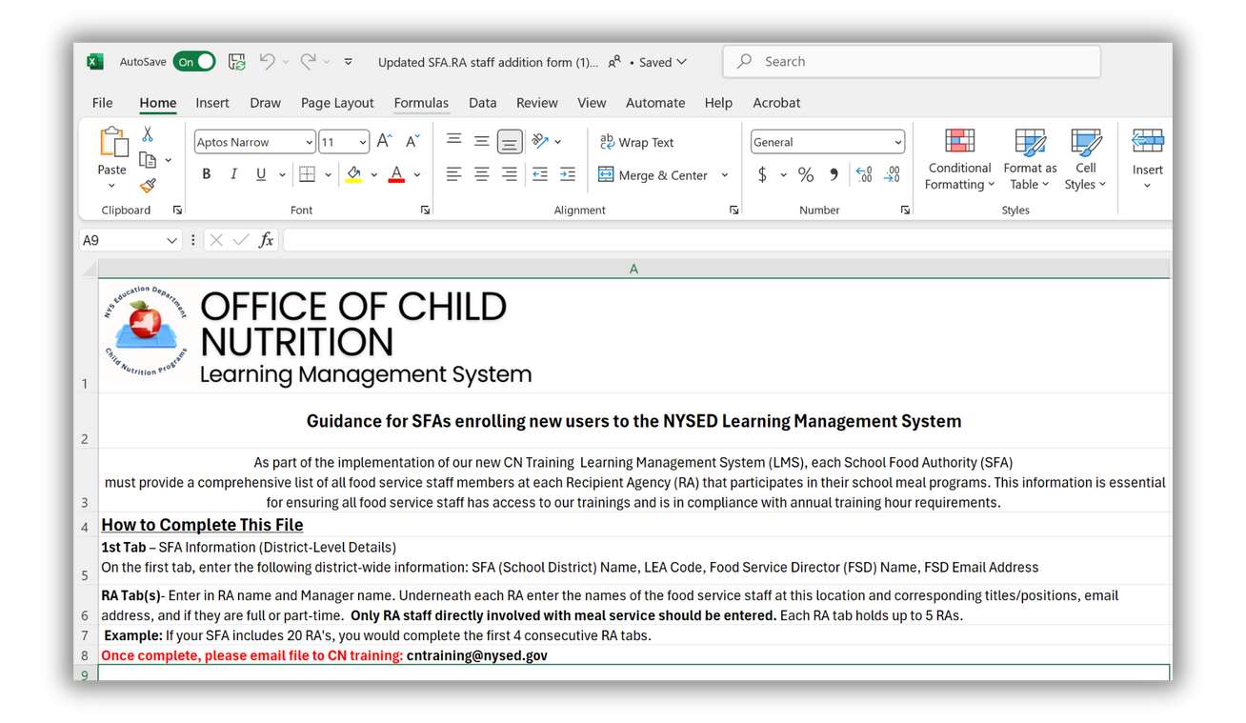

Phase Two: Setting Up Your Staff
Download and complete the Excel file attached to the email
Submit names, email addresses, and buildings for all kitchen staff
Once submitted, CN will send login credentials
Notes:
More to come for LMS: As part of Phase 2, we’ll be asking Food Service Directors to complete an Excel file listing your kitchen staff.
This file will be sent to you after you’ve signed in to the LMS and set up your own account.
You’ll be asked to provide each staff member’s first and last name, email address, and the building or buildings where they work.
This information allows the Child Nutrition office to bulk enroll each schools staff into the correct trainings based on their role and location.
It’s important that this is filled out clearly—especially for staff who work in more than one building. Please make a note of that on the form.
Once we receive the completed file, each staff member will receive their own login credentials. Again this will ensure they are enrolled in the courses meant for them and get proper credit for any trainings they complete.
It also gives you, as the Food Service Director, the ability to track the training progress across your schools.

Slide 34


Questions?
Send any questions to:
lmssupport@nysed.gov
CNtraining@nysed.gov
Notes:
This concludes the presentation. We will now take questions from the Questions and Answer box below. Please give us a moment as we review the questions that have previously come in.

