Slide 1
East Rochester CSD
Notes:
Welcome to the webinar, Meal Pattern Refresher Webinar. This webinar is a refresher on the meal pattern to assist FSD as well as food service staff for the beginning of the school year.
This webinar provides 1 credit hour of Professional Standards training towards your annual requirements.
Presenting today is Maddie Weekes Answering questions today is Caitlyn Parry.
If you have any questions during the presentation, please type them into the question box. We will review them at the end.
Following today’s presentation, you will receive an email containing the slides for today’s webinar. If you do not receive them, please email CNTraining@nysed.gov
This webinar will be recorded and be posted and available on the CN website.

Slide 2
East Hilton CSD
Notes:
Today you will receive an overview that will give you a solid foundational understanding of:
Meal Patterns and Nutrition Standard Updates
Food-Based Menu Planning
Dietary Specifications
Age/Grade Groups
School Week Meal Component Adjustments
Preschool Meal Pattern

Slide 3
Updates to Nutrition Standards
Meal Modification
The final rule explains in regulation that state licensed healthcare professionals and Registered Dietitians (RD/RDN) may substitute medical statements
Clarification on Potable Water Requirements
Adds the word “plain” to the potable water regulations to clarify this requirement
Professional Standards: Program Director Hiring Exemption
Medium or large LEAs may hire an individual without a Bachelor’s or Associate’s degree with at least 10 years of school nutrition program experience at the state agency’s discretion
Notes:
The USDA has updated the nutrition requirements in school meals to help strengthen the school meal programs to continue to help children lead healthier lives.
The meal modification policy has been expanded to allow healthcare professionals and registered dietitians to write statements for the request of meal modification on behalf of students with disabilities in the school meal programs and in CACFP.
There has been clarification on the potable water requirements. The final rule clarifies the existing requirement to include in regulation that schools must make “plain” potable water available during meal service with an implementation date of July 1, 2024.
At the state agency discretion, the final rule will allow medium or large LEAs to hire an individual without a bachelor’s or associate’s degree as a school nutrition program director as long as they have at least 10 years of school nutrition program experience.

Slide 4
Updates to Nutrition Standards
Allows nuts and seeds to credit for the full Meats/Meat Alternates (M/MA) component in all Child Nutrition Programs and Meals
Removes the 50% limit for nuts and seeds
Supporting Traditional Indigenous Foods
Allowing the substitution of vegetables for grains in Tribal Communities
Geographic Preference
Allow “locally grown,” “locally raised,” or “locally caught” to be used as a procurement specification
Notes:
The new standards have been updated to allow nuts and seeds to credit for the full meat/meat alternate component in all Child Nutrition Programs and Meals. This removed the 50% limit for nuts and seeds.
When substituting vegetables for grains in Tribal Communities, the new rule allows SFAs and schools that are tribally operated, operated by the Bureau of Indian Education, and that serve primarily American Indian or Alaska Native participants to serve vegetables to meet the grain requirement. This also allows Summer Food Service Sponsors (SFSP) and CACFP institutions to substitute vegetables for grains or bread. In addition, the regulations explains that traditional Indigenous foods may be served in school meals and encourages schools to serve traditional Indigenous foods.
The finalized rule will allow program operators to use “locally grown,” “locally raised,” or “locally caught” to be used as a procurement specification for unprocessed or minimally processed food items. The Buy American Provision limits circumstances for non-domestic food purchases. The product is listed on Federal Acquisitions Regulations (FAR) Non-available articles list and/or is not produced or manufactured in the U.S. in sufficient and reasonably available quantities of satisfactory quality OR a competitive bid reveals the costs of a U.S. product are significantly higher than the non-domestic product.

Slide 5
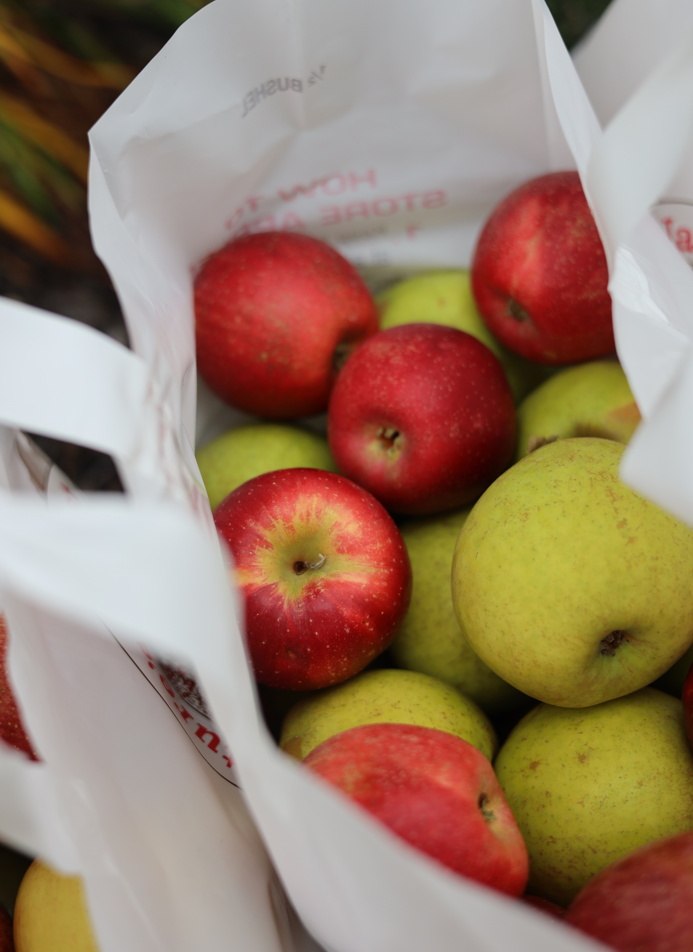
Buy American Provision
Exception documentation and reporting requirements
Procurement Procedures
Definition of “substantially”
Clarification of requirements for Harvested Farmed and Wild Caught Fish
Gradually Phases in 5% CAP on Non-Domestic Food Purchases:
Beginning in SY 2025-26- non-domestic food purchases cap will be 10%
Beginning in SY 2028-29- non-domestic food purchases cap will be 8%
Beginning in SY 2031-32- non-domestic food purchases cap will be 5%
Morristown CSD
Notes:
USDA classified in regulations the requirement for SFAs to maintain documentation to demonstrate the use of exceptions. Items found on the Federal Acquisitions Regulations Non-available articles list are exempt from the documentation requirement, but these items must be counted toward the cap on non-domestic purchases when that goes into effect.
SFAs are to include the Buy American provisions in all procurement procedures, solicitations, and contracts. Substantially was defined as using agriculture commodities that are produced in the United States” meaning greater than 51% of a food product must be grown domestically. Farmed fish must be harvested within the United States or any territory or possession of the United States. Wild caught fish must be harvested within the Exclusive Economic Zone of the United States or by a United States flagged vessel.
Updates to the Buy American Provision will be limiting non-domestic purchases to 5% in phases. Beginning in the SY 2025-26- there will be a 10% CAP on the total of non-domestic food purchases. In SY 2028-29- 8% cap and then in the 2031-32 SY, there will be a 5% cap on non-domestic food purchases. State agencies will have the discretion to allow an accommodation for temporary relief from this requirement.

Slide 6
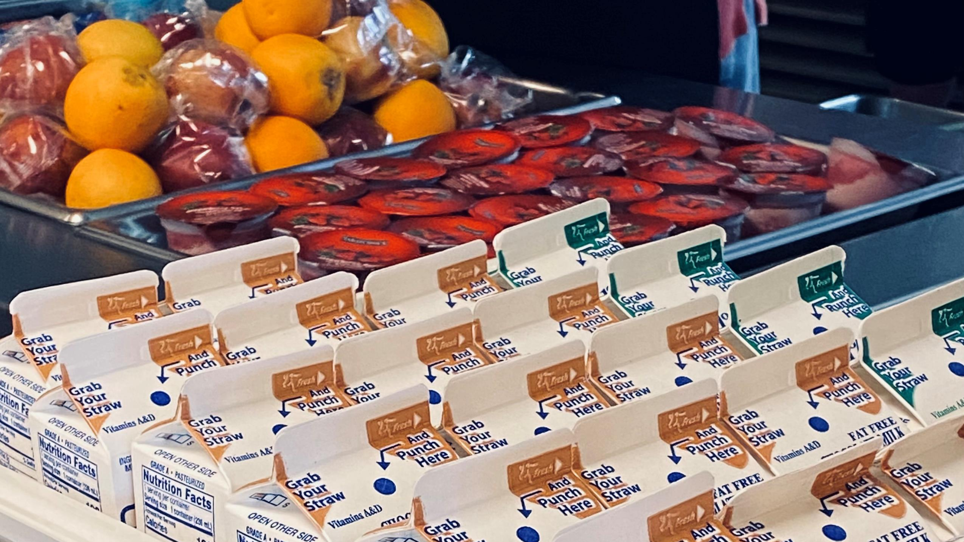
Added Sugar
May implement now SFAs are not required to implement until:
SY 2025-26
Added Sugars
Phase 1- Limit on high-sugar products
Breakfast Cereal: ≤ 6 grams per dry ounce
Yogurt: ≤ 12grams per 6 ounces (2grams per ounce)
Flavored Milk: ≤ 10 grams per 8 fl ounces
Phase 2- Implementing overall weekly limits
Milk
Continue to allow flavored and unflavored milk
Notes:
The meal pattern and nutrition standards for the National School Lunch and School Breakfast Programs are aligned and developed using The Dietary Guidelines for Americans.
The nutrition standards have been updated to comply with the 2020-2025 Dietary Guidelines for Americans. These new standards are effective beginning July 1, 2024; meaning, they can be implemented during the 2024-25 SY school year however they will not be enforced until the 2025-26 school year.
Added sugars are sugars that have been added to foods during processing. Starting on July 1, 2025, there will be a limit on the added sugars allowed in products. This includes breakfast cereals, yogurt, and flavored milk. Breakfast cereals cannot have more than 6 grams of added sugar per dry ounce. Yogurt cannot have more than 12 grams of added sugar per 6 ounces, in other words, 2 grams of added sugar per ounce, and flavored milk cannot have more than 10 grams of added sugar per 8 fluid ounces. Beginning in the 2027-28 SY, there will be a weekly limit on added sugars to less than 10% of calories during the week which will be an addition to the product limit.
Schools will continue to follow the standards for milk by offering at least two varieties of milk, with unflavored milk being required however schools will now have to follow the added sugar requirement which must be implemented by July 1, 2025. Flavored milk that is sold a la carte to K-12 students during lunch and breakfast must comply with the new rule. Flavored milk may not have more than 10 grams of added sugar per 8 oz in middle schools and 15 grams per 12 fluid ounces for high school students.

Slide 7
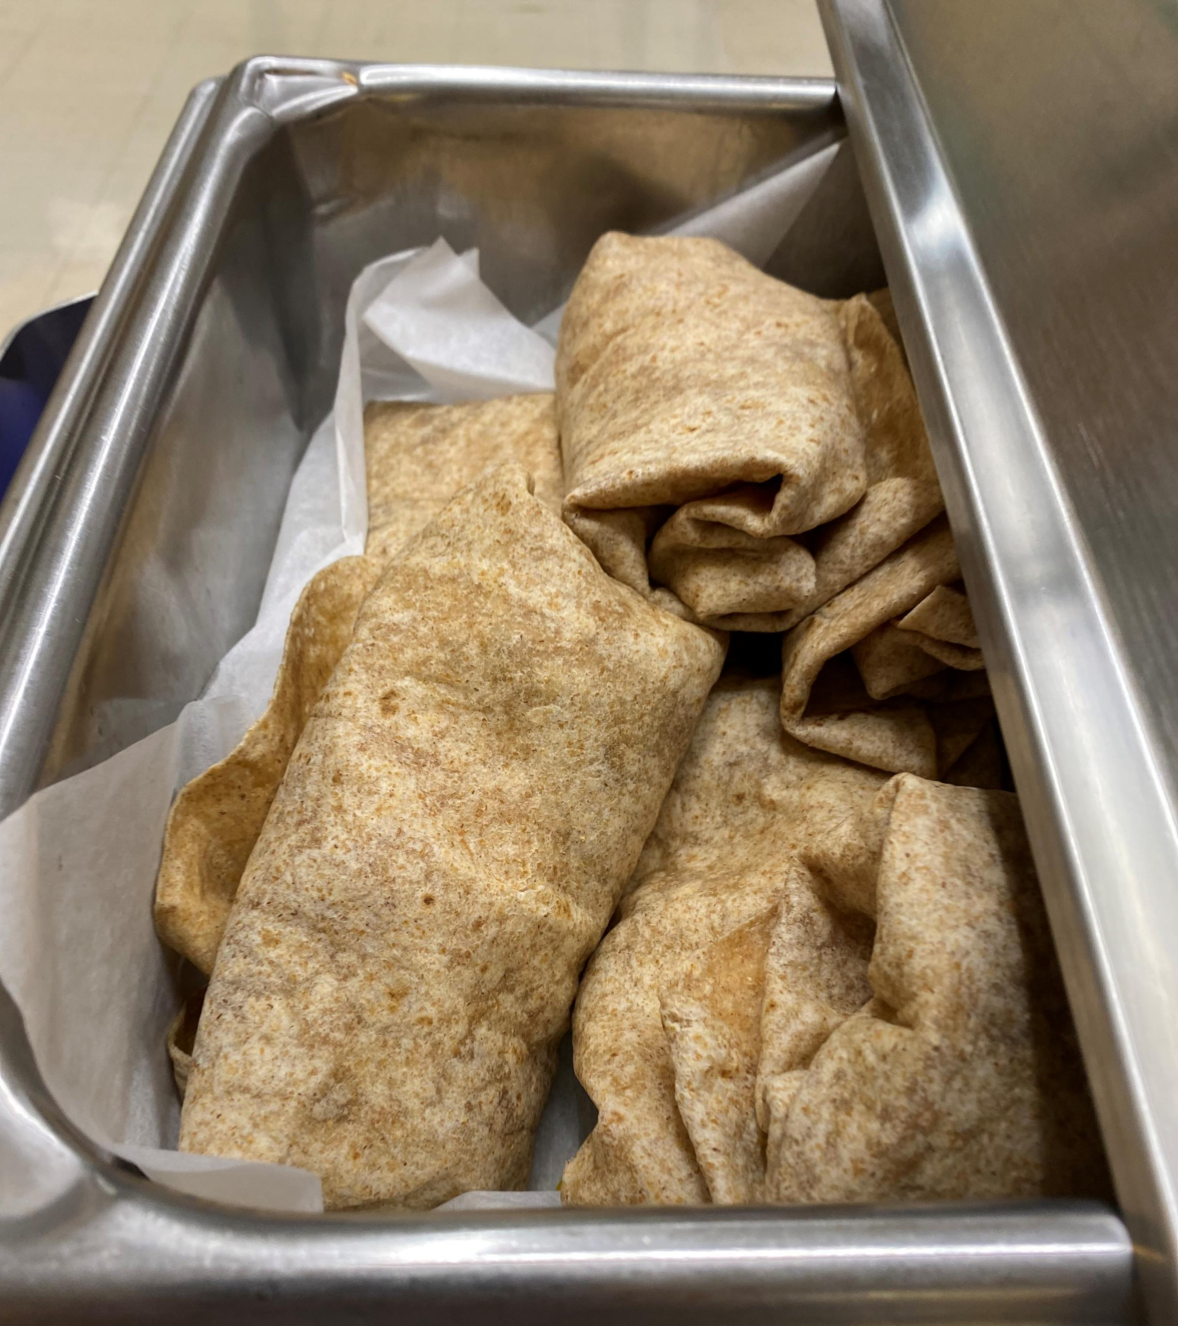
Grain
The grain requirement will maintain the current regulations
80% of grains offered throughout the week must be whole grain-rich
current definition has been added to regulations
Hudson City CSD
Notes:
The grain requirement will maintain its current regulation which indicates that 80% of grains offered throughout the week must be whole grain-rich. The new standards adds the current definition of “whole grain-rich” to regulations for the school meal programs and CACFP. Whole grain-rich is the terms designated by FNS to indicate that a grain content of the product is between 50% and 100% whole grain with any remaining grains being enriched.

Slide 8
Sodium
Beginning July 1, 2027
National School Lunch Program
Age/Grade Group | Current Sodium Limits | New Sodium Limits (July 1, 2027)
K-5 | ≤ 1,110mg | ≤ 935mg
6-8 | ≤ 1,225mg | ≤ 1,035mg
9-12 | ≤ 1,280mg | ≤ 1,080mg
School Breakfast Program
Age/Grade Group | Current Sodium Limits | New Sodium Limits (July 1, 2027)
K-5 | ≤ 540mg | ≤ 485mg
6-8 | ≤ 600mg | ≤ 535mg
9-12 | ≤ 640mg | ≤ 570mg
Notes:
Through the school year 2026-27, schools will maintain the current sodium targets. Beginning July 1, 2027, schools will be required to reduce the sodium in school lunch by 15% and 10% for breakfast throughout the week. While the SFA does not have to implement this rule until the beginning of the 2027-28 SY, it is encouraged for SFAs to gradually reduce sodium limits for the week. There is currently no sodium target per meal or per item.

Slide 9
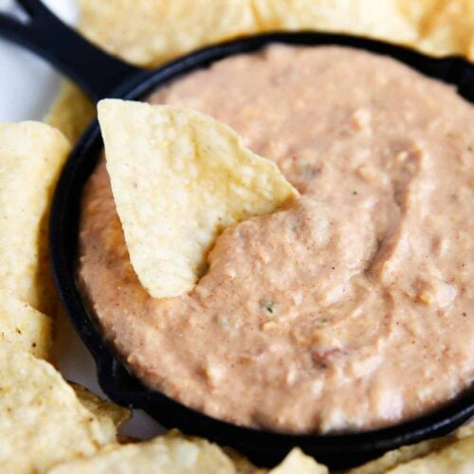
Smart Snacks
Bean dip is added to the list of foods exempt from the total fat standard in the Smart Snacks in school regulations.
Exemption applies to products marketed as hummus, as well as bean dips made from any variety of beans, peas, or lentils
Bean dip would continue to be subject to the saturated fat standard, as well as all other Smart Snacks in School requirements
Clarifies that both whole grain-rich and enriched grain entrée offered as part of a reimbursable school meal may qualify as an “entrée item” when sold as a “smart snack”
Notes:
For smart snacks, bean dip has been added to the list of foods that are exempt from the total fat standard. Exemption applies to products marketed as hummus as well as bean dips made from a variety of beans, peas, and lentils. Bean dips would continue to be subject to the saturated fat standards as well as other Smart Snacks in School requirements.
Whole grain regulations have been updated to clarify that both whole grain-rich and enriched grain entrée offered as part of a reimbursable school meal may qualify as an “entrée item” when sold as a “smart snack.”

Slide 10
Afterschool Snack
Aligns the National School Lunch Program and Afterschool Snack meal patterns for K-12 children with the CACFP snacks meal patterns
Must include 2 of 5 meal components
Notes:
The Afterschool Snack Program (ASP) is an extension of National School Lunch Program (NSLP) and may be administered by participating School Food Authorities(SFAs). The SFA must administer an afterschool care program which provides children with regularly scheduled activities in an organized, structured, and supervised environment; and include educational or enrichment activities.
The After School Snack Program has its own distinct meal pattern requirements which include required components and minimum portion sizes. The final rule indicated The NSLP afterschool snack standards aligns with the CACFP snack standards. Afterschool snack must include 2 of the 5 components and offer vs serve is not allowed.

Slide 11
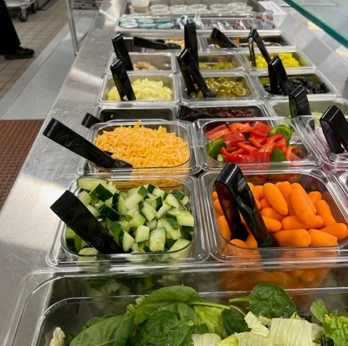
Food-Based Menu Planning
Uses meal patterns, or age/grade groups
Refers to each of the required food groups as a Component
Components must be served in specified daily and weekly amounts
Foods offered within the components are called Food Items
Mechanicville CSD
Notes:
To comply with the established meal pattern requirements and nutrition standards, all SFAs must use the Food-Based Menu Planning approach when developing breakfast and lunch menus.
The Food-Based Menu Planning approach uses meal patterns according to specific age/grade groups as menu planning tools. Moving forward, I will refer to the age/grade groups as grade groups.
When working with Food-Based Menu Planning, there are food components and food items.
A component is one of the five required food groups in a reimbursable meal. For breakfast, there are 3 required components; and with lunch, there are 5. These components must be served in specified daily and weekly amounts.
A food item is a specific food within those components. For example, 1 oz. equivalent of whole grain-rich bread is a food item within the grain component and ½ cup of an apple is a food item within the fruit component.
Schools must plan menus for breakfast and lunch that meet both daily and weekly requirements for food group components and food items relative to each grade group being served.

Slide 12
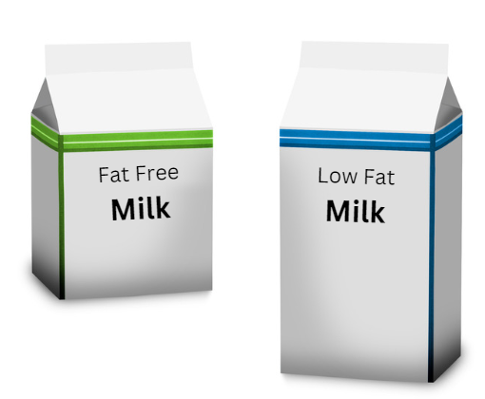
COMPONENTS
Breakfast
Lunch
Notes:
The 5 food components are: fruits, vegetables, grains, meat/meat alternates, and milk.
All five food components must be offered in the minimum required portion sizes for lunch.
For breakfast, 3 food components must be offered. The components are a grain or Meat/Meat Alternate or combination of both, Fruits/vegetables and Milk.
We will discuss the specific requirements for breakfast and lunch in more detail

Slide 13
Age/Grade Groups
SBP
NSLP
K-12
OR
K-8 and 9-12
OR
K-5, 6-8 and 9-12
K-8 and 9-12
OR
K-5, 6-8 and 9-12
Production Records must demonstrate compliance with, and differentiate between, all age/grade groups being offered
Notes:
These are the grade groups established for breakfast and lunch. The meal planner must offer meals in accordance with the appropriate age/grade group that is being served to ensure students are meeting their nutritional needs.
As you can see, there are differences between the grade groups designated for each program. At breakfast, schools can choose to plan breakfast using a K-12 menu plan. This is not an option at lunch because there is no overlap with any other grade group for the 9-12 grades.
Menu Planners can decide to structure their menus utilizing the grade groups that will work best for their school’s operation. Production records must be completed in such a way as to represent the different grade groups separately, showing compliance with each grade group’s meal pattern requirements.
Also, production records must include all food items offered on the reimbursable menu. This includes ALL offered components, menu items, and daily alternate meals, such as, salad meals, deli meals, salad bar option, or sandwich option. Production records must also include ALL condiments and toppings offered that day. All 5 components must be on production record: Meat/meat alternate, grain, fruit, vegetables, milk. If ALL components are not included on the production record fiscal actions may be assessed.

Slide 14
Overlapping Age/Grade Groups
SBP
NSLP
K-5
350 – 500 Calories
9-12
450 – 600 Calories
6-8
400 – 550
Calories
K-5
550 – 650 Calories
9-12
750 – 850 Calories
6-8
600 - 700
Calories
Overlap for calorie ranges is
450 – 500 calories
Overlap for calorie ranges in K-8 is
600 – 650 calories
Notes:
This slide demonstrates the overlap between the grade groups determined by the established calorie ranges for each grade group. Keep in mind that when meal patterns are combined to the greatest extent, as demonstrated here, the allowable calorie range is limited significantly to a range of 50 calories. The meal planner will need to determine how they will differentiate those 50 calories during meal service if K-8 is in the same service line as 9-12 graders.

Slide 15
Notes:
This is the meal pattern chart for both breakfast and lunch separated by each grade group. The meal pattern chart has been updated to meet the current nutritional standards.
This chart shows the weekly requirement listed first, and the daily requirement is listed in parentheses as shown for each component. For an example, look at the grain requirements for lunch. You will see that at least one grain equivalent must be offered to the K-8 age/grade group daily and 8 equivalents over the course of a week. The 9-12 age grade group must be offered 2 grain equivalents daily and 10 over the course of a week.
You will also see at lunch the total daily and weekly vegetable requirements. You will also see how the totals are broken down into each vegetable category’s weekly requirement- Dark Green, Red/Orange, Beans/Peas/Lentils, Starchy, and Other. Over the course of a week the variety of vegetable subgroups must be offered in at least the minimum quantities, to contribute towards the total daily and weekly vegetable requirements.
This chart also shows the dietary specifications which are: calories, saturated fat, sodium and trans fat.
There are also several footnotes which are represented by small letters a through k. These footnotes provide specific guidance regarding the noted component. We have updated the notes here at the bottom with a few of the new nutrition standards.
Specifically, the new standards establishes a combined grains and meats/meat alternates meal component in the SBP and removes the requirement for schools to offer 1.0- ounce equivalent of grains each day at breakfast. Schools may offer grains, meats/meat alternates, or a combination of both components to meet the minimum ounce equivalent in this combined meal component requirement. (This removed the requirement that schools must always offer grains each day before meat could be counted.) If the menu planner chooses, it can be implemented currently.

Slide 16
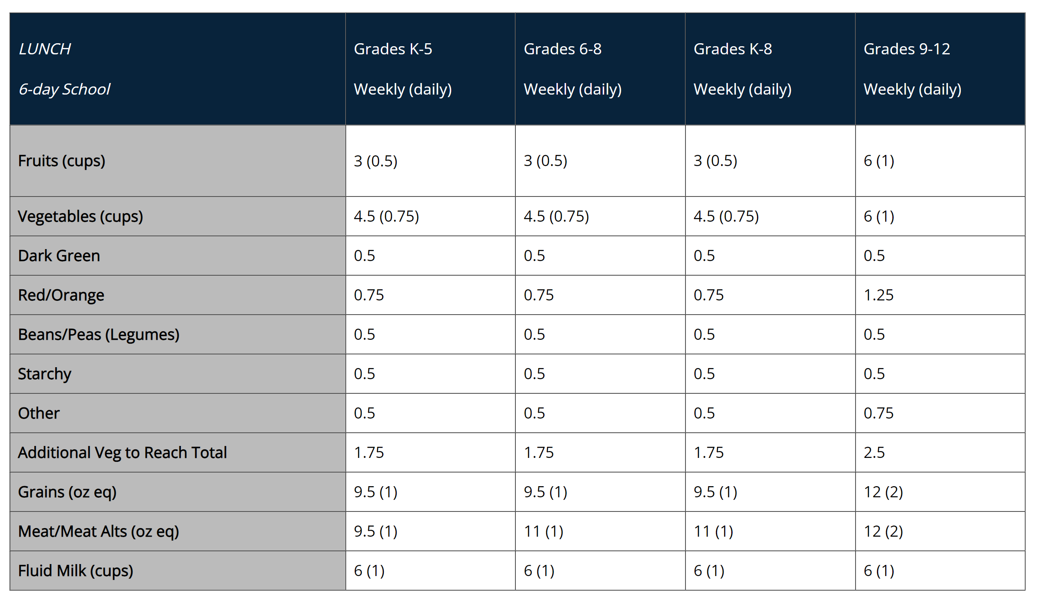
School Week Meal Component Adjustments
Notes:
For schools who operate more or less than 5 days per week on a regular basis, the weekly meal pattern requirements are adjusted.
To comply with meal pattern requirements, meal planners must adjust their weekly quantities. The full adjustment chart with these requirements is available on our website for schools who normally operate 3, 4, 6, or 7 days per week under Food Based Menu Planning tab.
Again, this only applies to schools with regular operations more or less than 5 days per week. It does not apply to schools that normally operate 5 days per week but have temporarily shortened weeks due to things such as vacations or holidays.

Slide 17
Dietary Specifications
SBP Meal Pattern
NSLP Meal Pattern
 | K-5 | 6-8 | K-8 | 9-12 | K-12
Min-max calories (kcal) | (350-500) | (400-550) | (400-500) | (450-600) | (450-500)
Saturated fat (% of total calories) | < 10 | < 10 | < 10 | < 10 | < 10
Sodium (mg) Target 1 | ≤540 | ≤600 | ≤540 | ≤640 | ≤540
 | K-5 | 6-8 | K-8 | 9-12
Min-max calories (kcal) | (550-650) | (600-700) | (600-650) | (750-850)
Saturated fat (% of total calories) | < 10 | < 10 | < 10 | < 10
Sodium (mg) Target 1 | ≤1110 | ≤1225 | ≤1110 | ≤1280
Notes:
The dietary specifications section of the meal pattern chart details the calorie ranges, sodium, saturated fat requirements by program for each grade group. Since the dietary specifications are based on average daily amounts, these are unaffected by varying week lengths. As of July 1, 2024, the final rule removed the synthetic trans fat dietary specification requirement.
Menu planners must ensure that the limits on these specifications are met for each grade group being served.
Menu planners do have a choice of how they will structure their menus, but they must use the established meal patterns. Whether it is separating grade groups by K-5, 6-8, 9-12 or by K-8 and 9-12, the menu planner determines which structure will best align with their school’s operation.
To understand why some meal patterns can be combined and others cannot, we will take a closer look at the calorie ranges for each grade group.

Slide 18
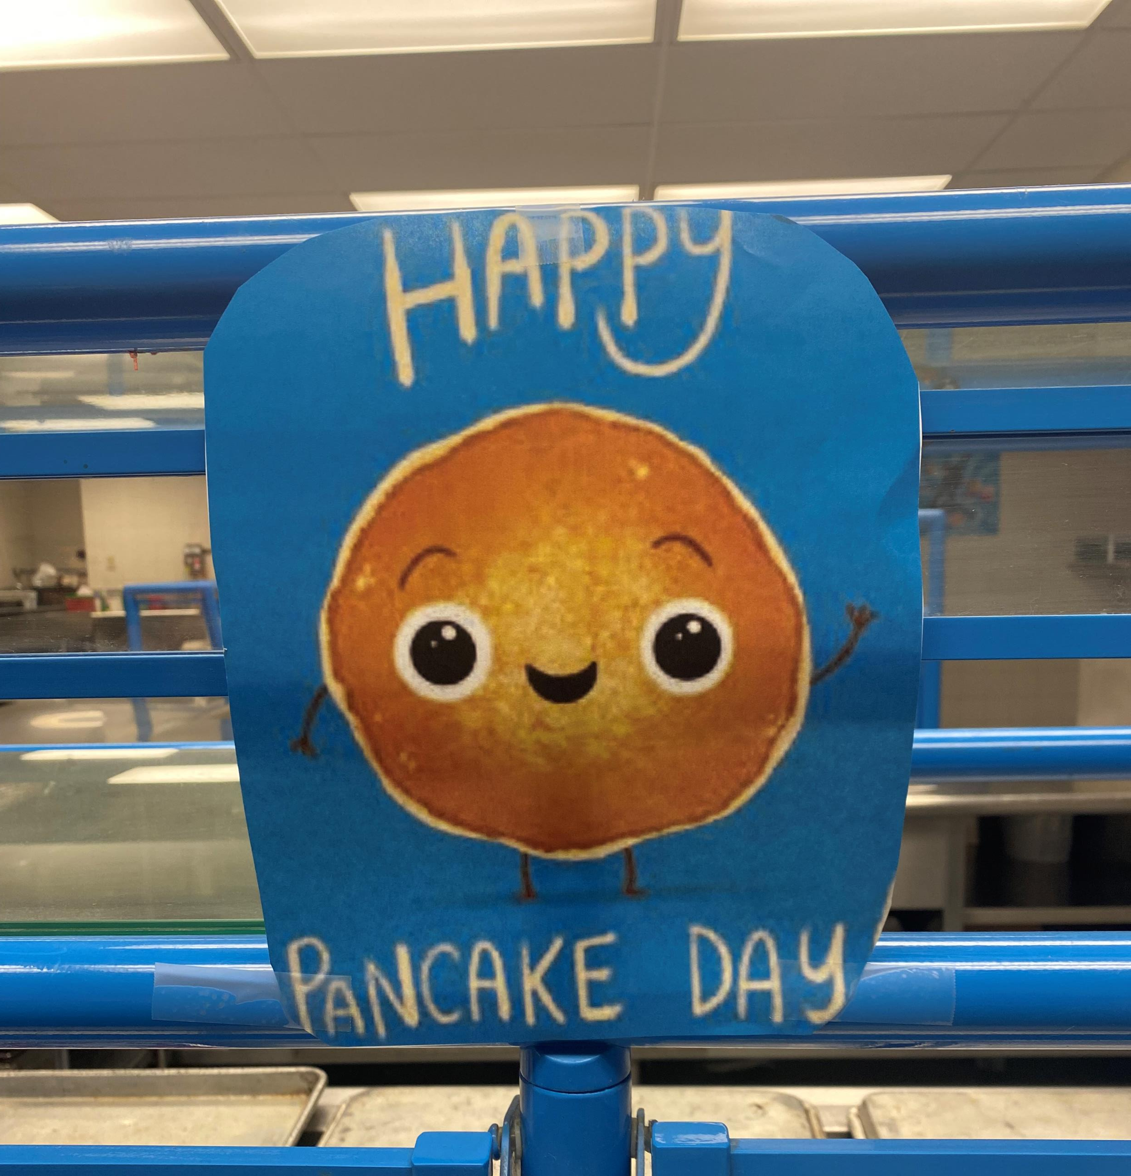
Breakfast Optional Substitutions & Updates
Meat/Meat Alternate
Schools may substitute 1 oz. eq. M/MA in place of 1 oz. grain without having to offer the grain first
M/MA component is not required
Substituting Vegetables for Fruits
Allows vegetables to be substituted for the fruit component
Vegetable component is not required
Beans/Peas (Legumes) subgroup has changed to Beans, Peas, Lentils
Schoharie CSD
Hartford CSD
Notes:
The breakfast requirements have been updated. On July 1, 2024, schools may offer grains, M/MA, or both. In other words, the menu planner may offer M/MA without having to offer grains first during breakfast in at least the minimum quantities for each grade group respectfully. This removed the requirement for schools to offer the 1.0-ounce equivalent of grains each day at breakfast.
Current regulations allow schools to substitute vegetables for fruits at breakfast, provided that the first two cups per week are from the dark green, red/orange, beans and peas, lentils, or other vegetable subgroups.
Vegetables may be substituted for fruit at breakfast. When substituting vegetables for fruit at breakfast and offering them one day per week the meal planner has the option to offer a vegetable from any of the vegetable subgroups. If substituting vegetables for fruit 2 or more days per week ,the first day can be from any subgroup however the second day must be from a different subgroup. For example, on Monday if you substitute a vegetable for fruit from the dark green category then on Tuesday the meal planner will need to provide a substitution from a vegetable subgroup other than dark green.

Slide 19
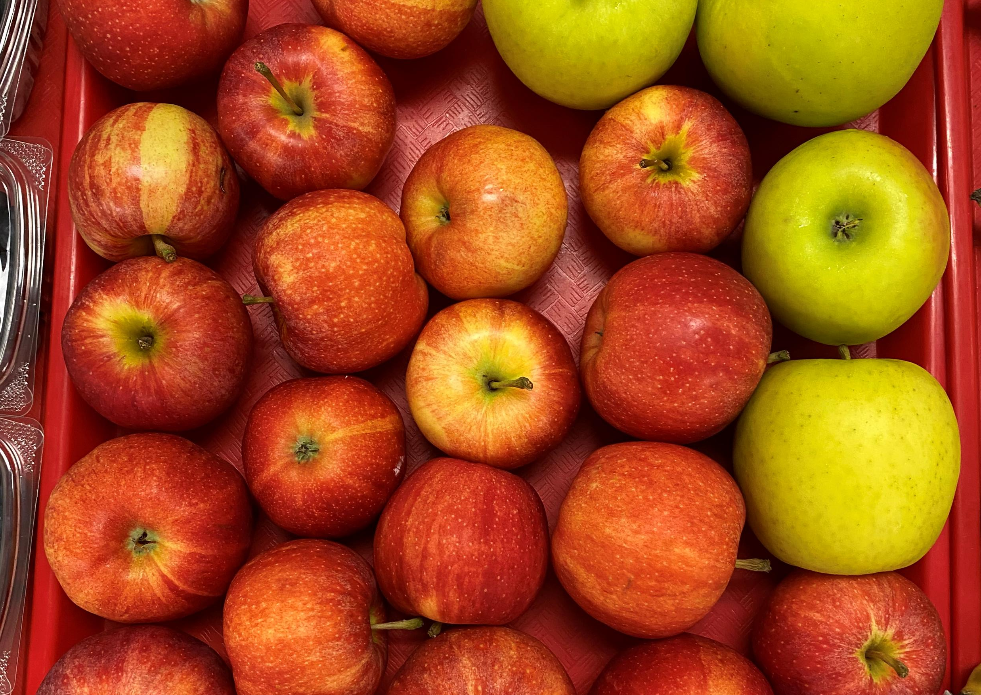
Breakfast Requirements
3 Components:
Grains/Meat & Meat Alternate
Fruits/Vegetables
Fluid Milk
Daily & Weekly minimum required portion sizes per age/grade group
Hartford CSD
Notes:
For breakfast, the menu planner must plan the menu to offer a grain, meat/meat alternate or a combination. Also, the menu must offer a fruit or vegetable or combination, and fluid milk. For breakfast only, menu planners may choose to offer vegetables to meet the fruit component requirement.
The meal planner must also ensure the daily and weekly offerings meet the minimum required portion sizes for the age/grade groups being served.

Slide 20
Fruit Component-Juice
Monday | Tuesday | Wednesday | Thursday | Friday | Weekly Total
Orange Juice 4 fl. oz | Grape Juice 4 fl. oz | Orange Juice 4 fl. oz | Apple Juice 4 fl. oz | Orange Juice 4 fl. oz | 20 fl. oz (2 ½ cup)
Sliced Berries ½ cup | Apple Slices ½ cup | Sliced Melon ½ cup | Fresh Oranges ½ cup | Fresh Grapes ½ cup | 2 ½ cup
 |  |  |  | Total: | 5 cups
Notes:
No more than half (or 50%) of the fruit or vegetable offerings over the course of the week may be in the form of juice. All juice must be 100% fruit or vegetable juice and ensure at least 1 cup of fruit/vegetable is offered daily. Please note the restriction for juice is calculated weekly and not daily for breakfast.
In the example here, the meal planner is offering two items within the fruit component daily totaling 1 cup per day. As you can see of the two items being offered throughout the week each day 1/2 is in the form of juice. This brings the weekly total of juice to 2 ½ cups and the weekly total of other type of fruit to 2 ½ cup. This meets the total weekly fruit requirement of 5 cup, and no more than 1/2 being juice.

Slide 21
Crediting Grain Items at Breakfast
Component | Ounce Equivalents | Items
 | 1.0-1.99* | 1 item
 | 2.0-2.99* | 1 or 2 items
Notes:
The menu planner will decide if an item should count as 1 item, 2 items, or more depending on the size and crediting of the item.
For example, at breakfast, a food item such as a bagel may count as multiple items.
In this example on the slide, we will look at a muffin. The menu planner will determine if the muffin will count as 1 item or 2 items.
If a food item is anywhere from 1.0 to 1.99 oz. eq., then the item credits as 1 item.
If an item is 2.0-2.99oz eq. it may credit as 2 items.
It is important to know how items credit before food service begins.

Slide 22
Exhibit A
Notes:
Exhibit A is a tool used for calculating grain ounce equivalents based on the weight of a grain product. Grain products have been divided into groups and each group credits towards the grain component differently. Please note that 80% of grains offered throughout the week must be whole grain-rich and the remaining grains enriched.
Crediting grains using Exhibit A may be used instead of CN label or product formulation statement if preferred.
Some documentation will list the products creditable grain amount. The menu planner may divide the creditable amount by 16 grams to determine the grain ounce equivalents ( 1 grain oz equivalent contains 16 grams of creditable grains).
In the event that Exhibit A produces a different grain oz. eq. than the CN label or product formulation statement, the menu planner may choose the method that works best for their operation.
Exhibit A can be found on the child nutrition knowledge center at the bottom of the page under Popular Topics, Food Based Menu Crediting, Food Crediting, Grain Requirements for the National School Lunch Program and School Breakfast Program

Slide 23
Offer Versus Serve (OVS) Breakfast
Optional for all age/grade groups
Schools must offer all 3 components (Grains/M/MA, Fruit/Vegetable, Milk) in required minimum amounts
Offer at least 4 food items from the 3 components
Students must select at least 3 food items
One item must be at least ½ cup fruit or vegetable
Selecting M/MA without selecting Grain is allowable
Notes:
The goal of offer versus serve is to reduce food waste while allowing students to choose the foods they want to eat. Offer vs Serve allows Students to decline some of the components being offered.
At breakfast, OVS is optional for all grade groups.
All schools must offer the three breakfast components in at least the minimum daily required quantities.
Under OVS, at least four food items from the three required components must be offered. A reimbursable breakfast is only required to include at least three food items, with one being at least ½ cup of fruits or the substituted vegetable.
For the grain component, if a school planned a meat/meat alternate substitution for the grain, the student is not required to select both the meat and the grain. As long as the meat/meat alternate meets the daily minimum on its own, it can count as 1 of the 3 required food items.

Slide 24
Breakfast Reimbursable meal?
Menu Offered
Grain/Meat (Meat Alternate):
WG toast (1 oz. eq) + 1 oz eq. vanilla yogurt (4 oz.)
Fruit/Vegetable:
4 fl. oz orange juice (1/2 Cup)
½ cup peaches
½ cup pears
Milk:
1 cup: 1% unflavored and fat free flavored milk
Grades K-12
Notes:
This breakfast menu on the left is for grades K-12. They are being offered 1oz equivalent of whole grain toast, as well as 1 oz equivalent of vanilla yogurt. For the fruit/vegetable component, ½ cup of orange juice, ½ cup of pears, and ½ cup of peaches are being offered in addition to 2 milk varieties in the milk component.
Does this menu include all the components in their minimum required amounts and have 4 items to choose from for grades K-12?....... Yes
Does the students breakfast tray on the right make up a reimbursable meal? …YES. Three items have been selected with one of those items being a half cup of juice

Slide 25
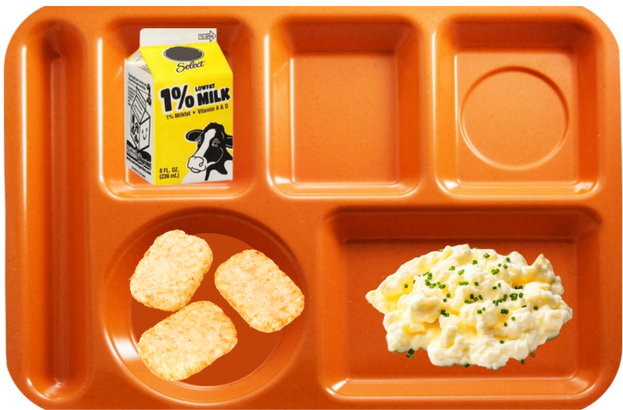
Breakfast Reimbursable meal?
Menu Offered
Grain/Meat (Meat Alternate):
WG toast (1 oz. eq)
1 oz eq. scrambled eggs
Fruit/Vegetable:
4 fl. oz apple juice (1/2 Cup)
½ cup hash browns
Milk:
1 cup: 1% unflavored milk and fat free flavored milk
Grades K-8
Notes:
This breakfast menu on the left is for grades K-8. They are being offered 1oz equivalent of whole grain toast, as well as 1 oz equivalent of scrambled eggs. For the fruit/vegetable component, ½ cup of apple juice, ½ cup of hash browns are being offered in addition to 2 milk varieties within the milk component.
Does this menu include all the components in their minimum required amounts and have 4 items to choose from for grades K-12?....... Yes
Is this a reimbursable meal? ….Yes… three items have been selected with one of those items being ½ cup of hash browns.

Slide 26
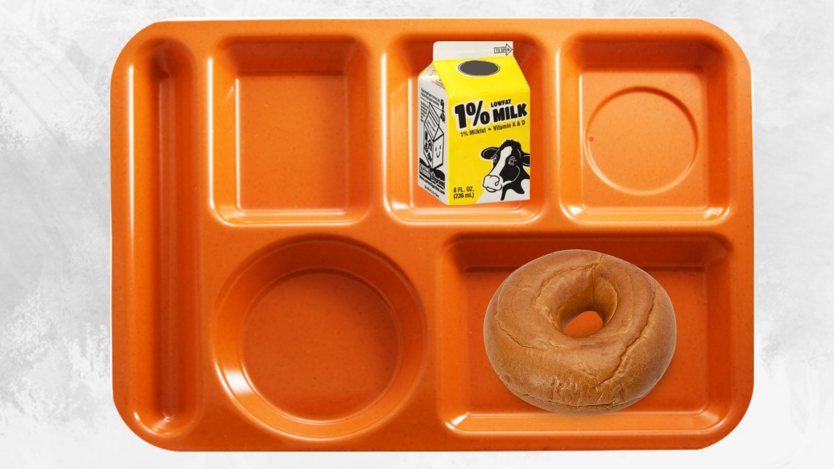
Breakfast Reimbursable meal?
Menu Offered
Grain/Meat (Meat Alternate):
WG bagel (2 oz. eq)
1 oz eq. peanut butter (2 TBSP)
Fruit/Vegetable:
4 fl. oz grape juice (1/2 Cup)
½ cup peaches
Milk:
1 cup: 1% unflavored milk and fat free flavored milk
Grades K-8
Notes:
This breakfast menu on the left is for grades K-8. They are being offered 2 oz equivalent of whole grain bagel, as well as 1 oz equivalent of peanut butter (2 Tablespoons). For the fruit/vegetable component, ½ cup of grape juice, ½ cup of peaches are being offered in addition to 2 milk varieties within the milk component.
Does this menu include all the components in their minimum required amounts and have 4 items to choose from for grades K-12?....... Yes
Is this a reimbursable meal? …. NO… Three items have been selected, the bagel counts has two items, plus the 1 cup of fluid milk however no fruit or vegetable has bee selected so this would not be a reimbursable meal.

Slide 27
Lunch Requirements
5 Components
1. Fruits
2. Vegetables
Dark Green
Red/Orange
Beans/Peas (Lentils)
Starchy
Other
3. Grains
4. Meats/Meat Alternates
5. Fluid Milk
https://foodbuyingguide.fns.usda.gov/
Hartford CSD
Notes:
As for lunch, components refer to the 5 food groups, that must be offered as part of reimbursable lunches. These are:
Fruit
Vegetables, which must include the five vegetable subgroups
Grains
Meat/meat alternates
Fluid milk
Minimum quantities of each vegetable subgroup, as seen on the Meal Pattern Chart, must be offered over the course of the week for each grade group.
These 5 vegetable subgroups are:
Dark Green;
Red/Orange;
Beans/Peas (Lentils)
Starchy
Other
Students must select 3 of the components with one component being ½ cup fruit or vegetable. When selecting the 3 components, the student must have 2 full components along with the ½ cup fruit or vegetable to be considered a reimbursable meal. Vegetables generally credit based on the volume served, however there are a few exceptions:
Raw leafy greens credits as one half of the volume served. For example, if the menu planner is offering 1 cup of romaine, this only credits as ½ cup creditable vegetable. Please keep in mind that cooked greens such as cooked spinach will credit based on actual volume served. Meal planners should also refer to the Food Buying Guide on the USDA website.
As previously mentioned, the Beans/Peas and Legumes subgroup has changed its name to Beans, Peas, Lentils. Effective July 1, 2024, schools are allowed to counts beans, peas, and lentils offered as a meat/meat alternate at lunch towards the weekly beans, peas, lentils subgroup requirement. Under this option beans, peas, and lentils would only could toward one overall meal component: the vegetable subgroup component OR the meat/meat alternate component.

Slide 28
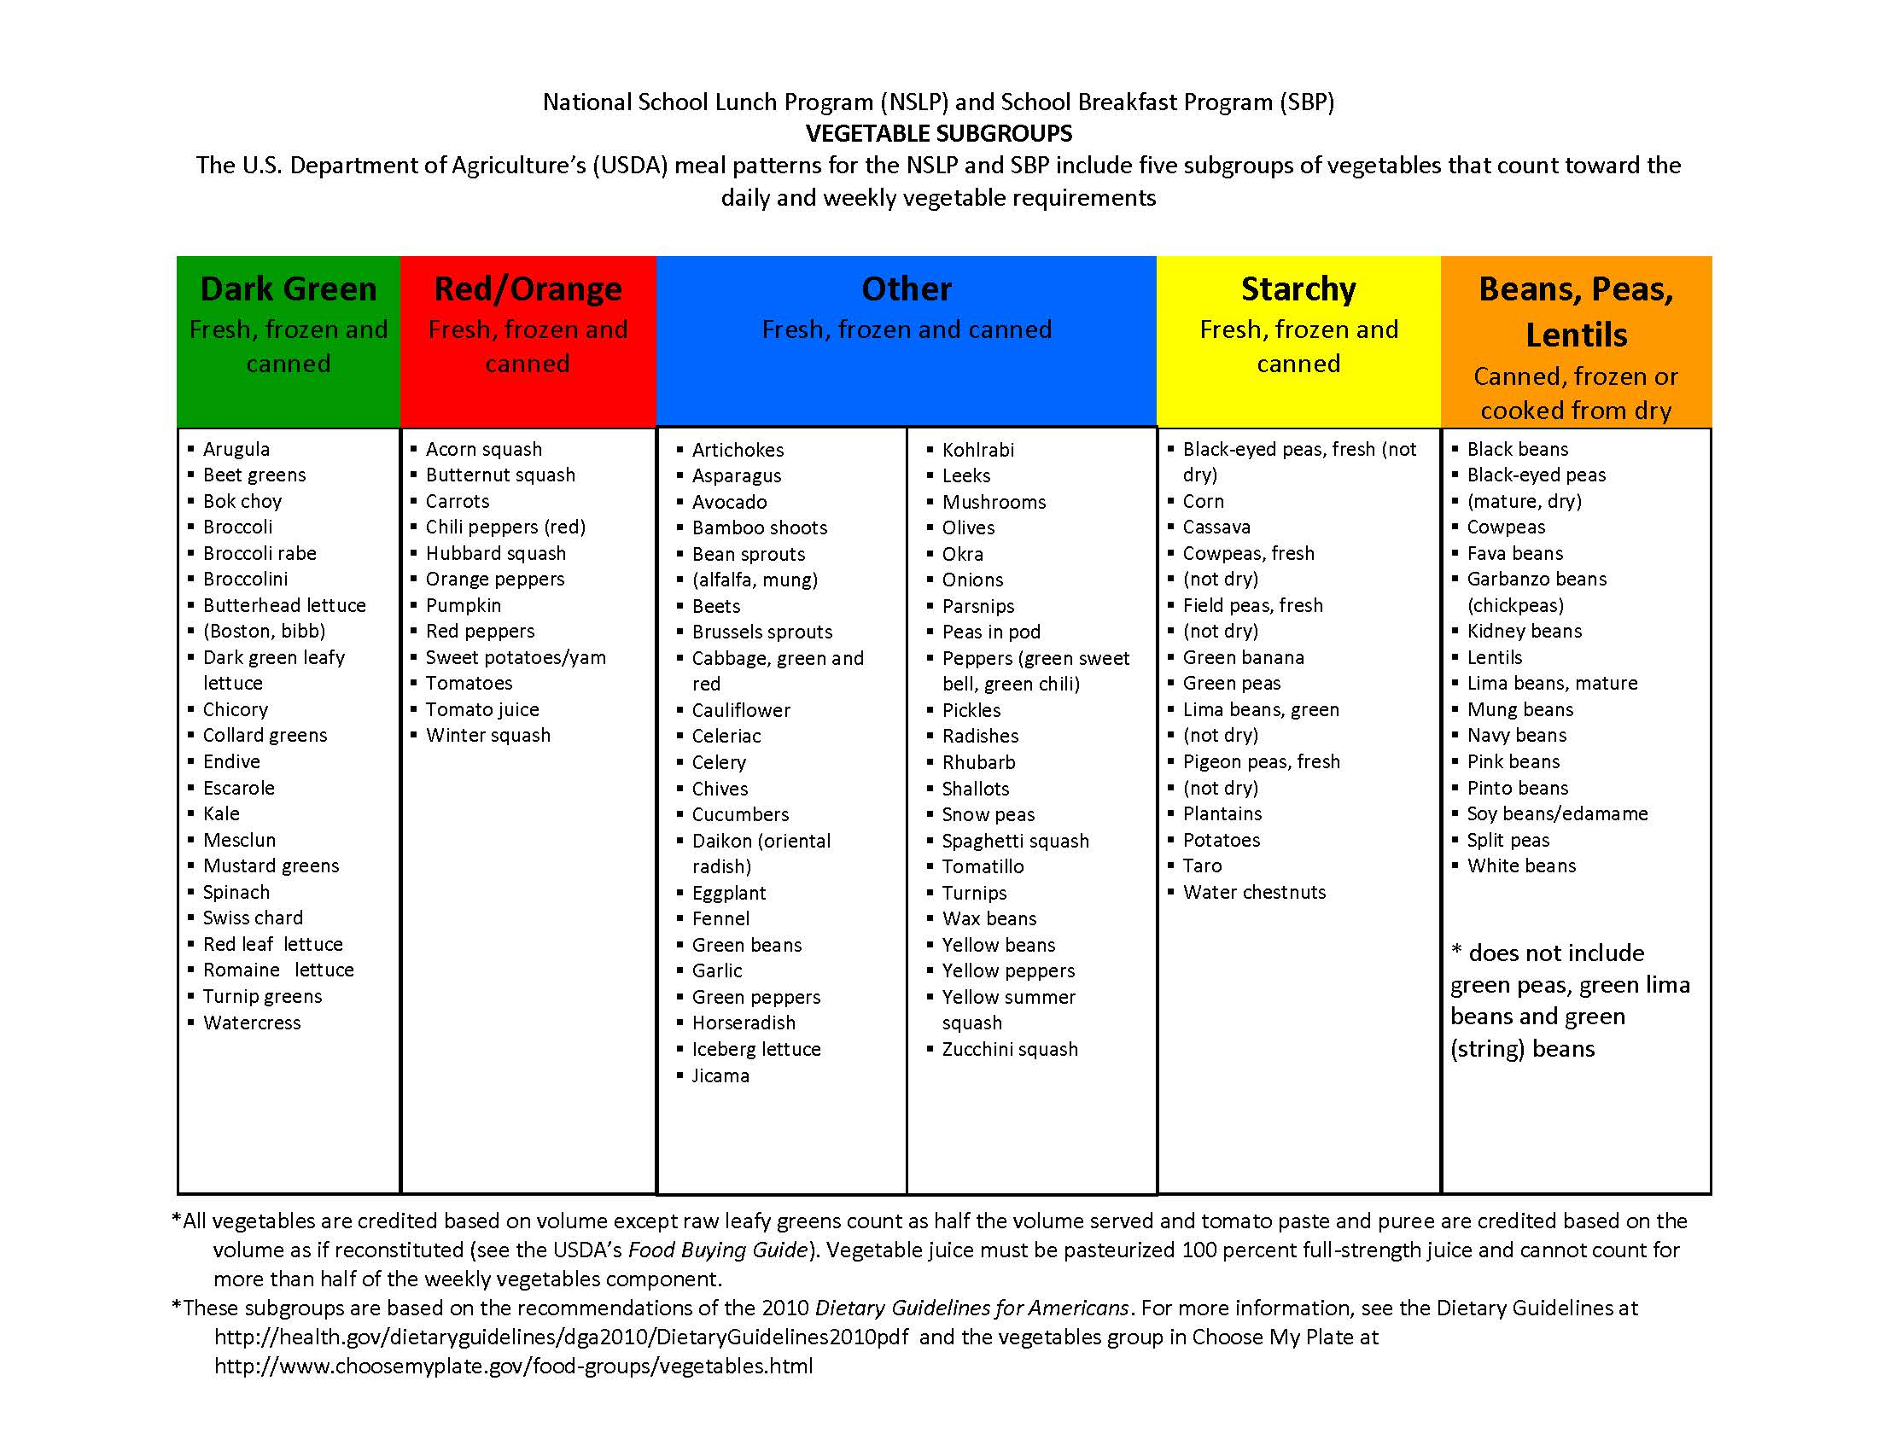
Notes:
There are 5 vegetable subgroups that must be offered to students in the minimum required portion size over the course of the week.
This chart shows the different vegetable subgroups and specific vegetables which fall into each category. The vegetable subgroups must be offered to all students and with all main and alternate meals. One common mistake is that the menu planner will offer the vegetable subgroups with the main entrée but not ensure the alternate meals are also planned to meet the weekly subgroup requirements.
Another common mistake is counting vegetables towards the wrong subgroup. For example, green beans and green peas are commonly confused and credited toward the beans/peas/lentil's vegetable subgroup. However, Green peas are a starchy vegetable, and Green beans are in the “other” vegetable subgroup.
Menu planners must ensure that if substitutions are made, the vegetable subgroup requirements are still met. If a substitution is required, we recommend substituting from the same vegetable subgroup, if possible, in order to ensure all vegetable subgroups are being offered in the minimum required amounts and ensuring staff are properly trained to do this.

Slide 29
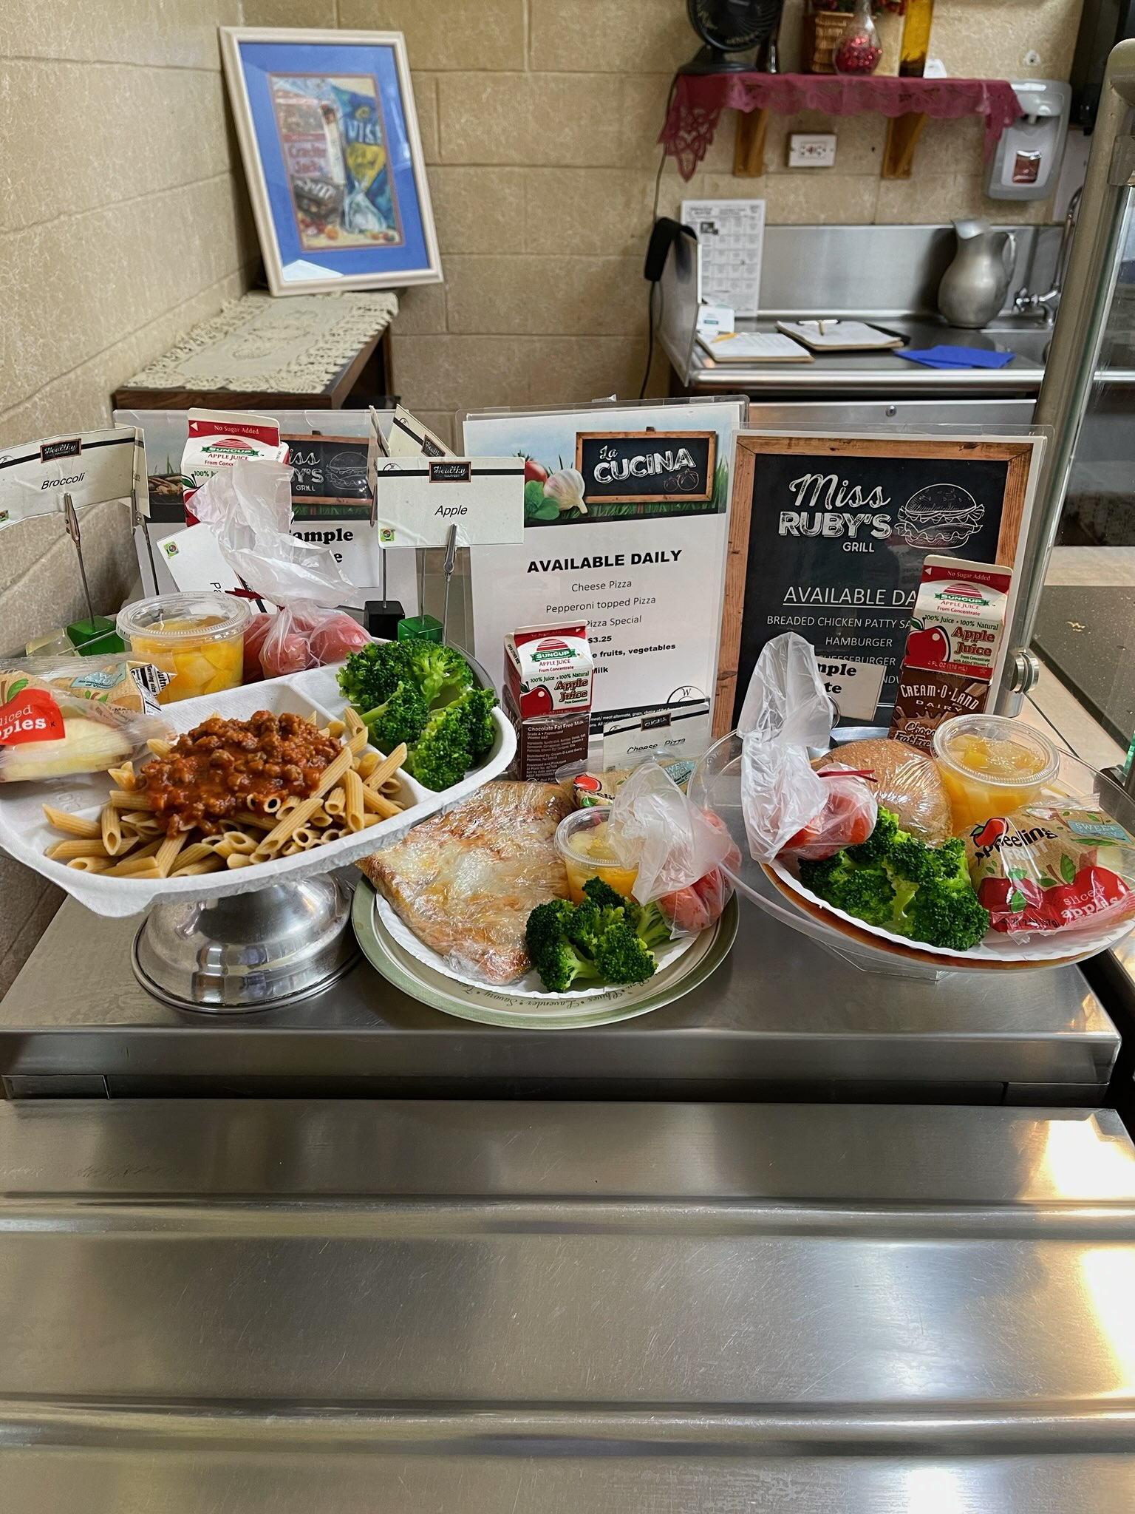
Offer vs. Serve Lunch
Offer vs Serve is required for students in the 9-12 age/grade group
Must offer all 5 components in at least the minimum required amounts
Students must select at least 3 food components
Students must take a minimum of a
½ cup of fruit or vegetable
Huntington CSD
Notes:
For lunch, Offer vs. Serve is required for the 9-12 grade group but is optional for all other grade groups.
Under Offer vs. Serve, you must offer all 5 lunch components in at least the minimum required amounts for each grade group.
Students must select 3 of the components, with one being a ½ cup of fruit or vegetable.
When selecting the 3 components, the student must have 2 full components along with at least ½ cup of fruit or vegetable to be considered a reimbursable meal.
A full component is the minimum required portion of each component for each grade group. For example, for a 9-12 menu, a 2 oz. eq. Chicken Patty on a 2 oz. eq. Bun. The chicken patty on a bun would be 2 full components because for the 9-12 grade group the menu planner must offer 2 oz. eq. grain and 2 oz. eq. M/MA.

Slide 30
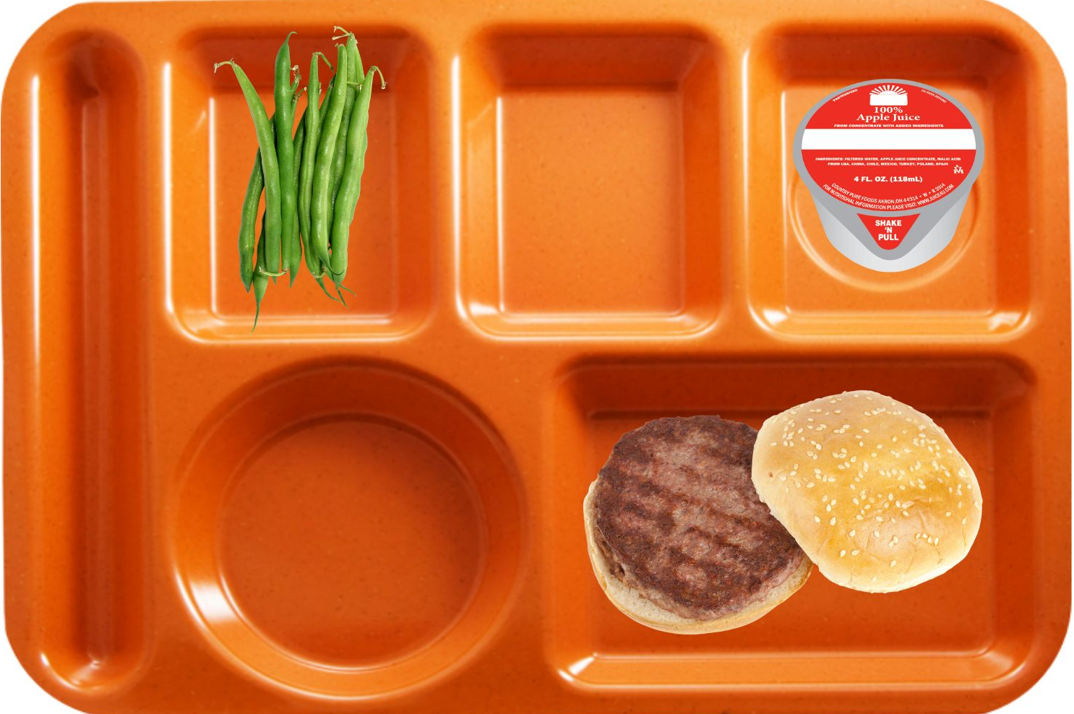
Lunch Reimbursable meal?
Menu Offered
Grain
WG hamburger bun (2 oz. eq)
Meat/Meat Alternate:
hamburger patty (2 oz. eq)
Fruit
4 fl. oz apple Juice (1/2 Cup)
½ cup peaches
Vegetable:
½ cup green beans
½ cup mashed potatoes
Milk:
1 cup: 1% unflavored milk and fat free flavored milk
Grades 9-12
Notes:
This lunch menu on the left is for grades 9-12. They are being offered 2 oz equivalent of a whole hamburger bun for the grain and 2 oz equivalent meat/meat alternate for the hamburger patty. For the fruit component, ½ cup of apple juice, ½ cup of peaches and ½ cup of green beans and ½ cup mashed potatoes are being offered in the vegetable component. In addition, 2 milk varieties within the milk component.
Does this menu include all the 5 components in their minimum required amounts?....... Yes
Is this a reimbursable meal? Yes… at minimum 3 different components have been selected with one of those components being ½ cup of fruit

Slide 31
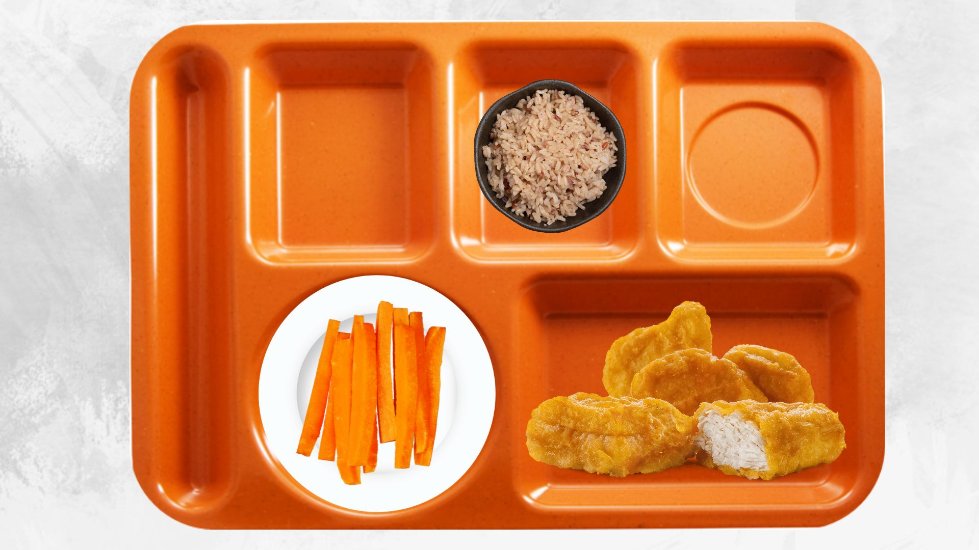
Reimbursable meal?
Menu Offered
Grain
½ cup brown rice (1 oz eq)
Meat/Meat Alternate:
chicken nuggets (2 oz eq)
Fruit
½ cup orange juice (4 fl oz)
½ cup apple slices
Vegetable:
½ cup corn
½ cup carrot sticks
Milk:
1 Cup: 1% white milk and fat free chocolate milk
Grades K-5
Notes:
This lunch menu on the left is for grades K-5. They are offering:
½ cup of brown rice (also 1 oz equivalent of grain)
Chicken Nuggets (2 oz eq)
½ cup orange juice
½ cup apple slices
½ cup corn
½ cup carrot sticks
1 cup milk variety
Does this menu include all the 5 components in their minimum required amounts?....... Yes
Is this a reimbursable meal? Yes. This student took an item from the grain component, meat/meat alternate component, and from the vegetable component in their minimum quantities.

Slide 32
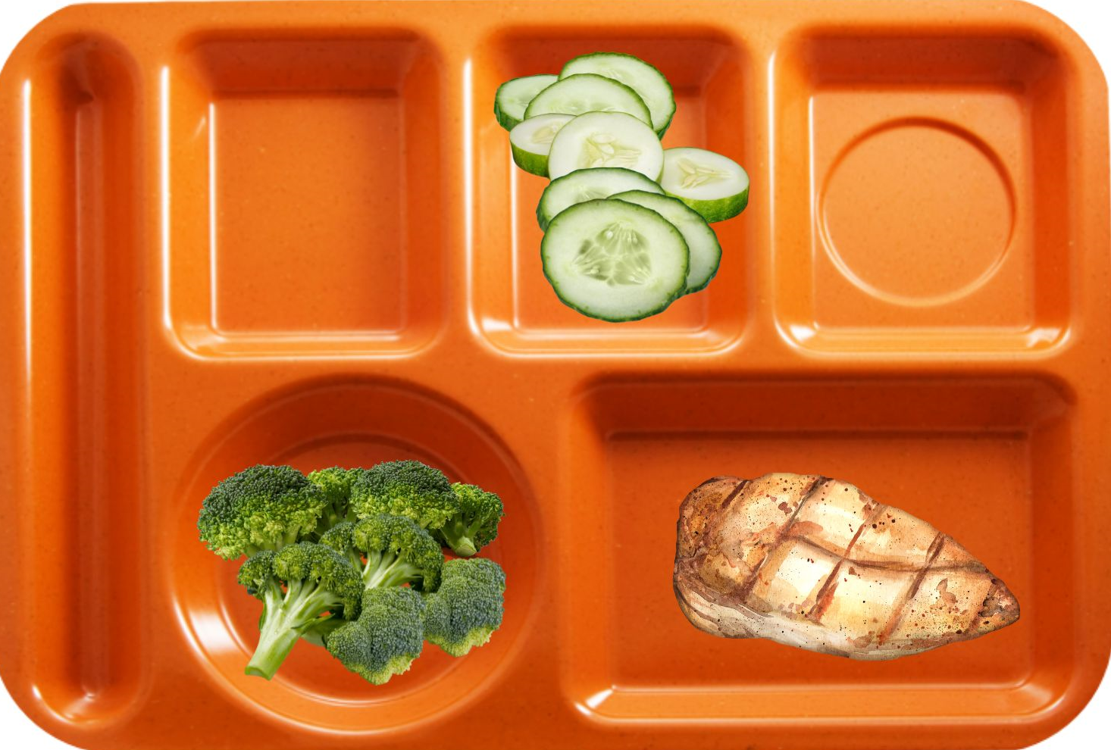
Reimbursable meal?
Menu Offered
Grain
1 WG tortilla (1 oz eq)
Meat/Meat Alternate:
chicken breast (2 oz eq)
Fruit
½ cup apple juice (4 fl oz)
½ cup fresh orange slices
Vegetable:
½ cup broccoli
½ cup cucumber slices
Milk:
1 cup: 1% unflavored and flavored milk
Grades K-8
Notes:
This lunch menu on the left is for grades K-5. They are offering:
1 whole grain tortilla (1 oz equivalent of grain)
Chicken breast (2 oz eq)
½ cup Apple juice
½ cup Fresh Orange slices
½ cup broccoli
½ cup Cucumber Slices
1 cup milk variety
Does this menu include all the 5 components in their minimum required amounts?....... Yes
Is this a reimbursable meal? NO. For lunch, we assess components, not individual items. A reimbursable meal must include: At least 1/2C of fruit or vegetable. And Two additional components in their full required amounts.
In this case, the student selected 1/2 cup of vegetable twice, and included Chicken from the meat/meat alternate component. This means only two components were selected, making it not reimbursable.

Slide 33
Fluid Milk Component
1 cup unflavored milk must be offered daily at Breakfast & Lunch
Must be 1% or fat-free
Must offer a variety of at least 2 types milk
1% or fat-free flavored milk may be offered
Final Rule
No changes to the process to request fluid milk substitutes for non-disability students
Updates the unit of measurement of vitamins A and D requirements in school meal programs and CACFP
International units (IU) to micrograms (mcg)
Courtesy of Schuylerville CSD
Schuylerville CSD
Notes:
At least 1 cup of fluid milk must be offered to all students daily, and 5 cups of milk over the course of the week for all age/grade groups.
Additionally, at least two different varieties of fluid milk must be offered each day. Menu planners may offer Unflavored or flavored milk, either fat-free or 1%. As a reminder, flavored milk will need to meet the added sugar requirements of no more than 10 grams per 8 fl. Ounces starting 2025-2026 SY.
Even if a smoothie is offered and milk is included in the smoothie, two fluid milk choices should be available to all students.
Lactose free or reduced lactose milk may be substituted for students with lactose allergies/intolerance (fat free or low fat 1%) as long as it meets all the requirements for substitutions. There has been no changes to the process to request fluid milk substitutes for non-disability students. However, the final rule updates the unit of measurement of vitamins A and D requirements for fluid milk substitutes in school meal programs and CACFP. The units have changes from international units (IU) to micrograms (mcg).

Slide 34
Daily Alternate Meals
Not required but could increase participation by adding to a variety of choices
Must comply with Meal Pattern Requirements for both breakfast and lunch
East Greenbush CSD
Notes:
Alternate daily meals are not required. However, we recommend having additional choices to add variety to your menu and assist with increasing student participation.
When offering these daily alternate meals, ensure that both your main entrée and your alternate meals meet the daily and weekly minimum quantities specified on the meal pattern chart for the grade groups being served.

Slide 35
Compliance with Weekly Requirements
Ensure the contribution of each component is accounted for in every meal offered
Determine the lowest creditable amount offered each day
Total the lowest creditable amounts to determine the weekly amount offered
Reference Meal Pattern chart to ensure compliance
Hermon Dekalb CSD
Notes:
When structuring daily alternate meals in your menu, it is crucial to calculate how all items are contributing to the required weekly minimum amounts.
This ensures compliance with meal pattern guidelines.
First, menu planners ensure every meal, including daily alternates, are counted as part of the weekly requirement determination. Evaluate the amount offered for each component. For example: Chicken Patty is 2 oz. eq. M/MA.
With every weekly menu item accounted for, the menu planner will need to determine the lowest creditable amount of each individual component daily, then total each day’s lowest creditable food item offered per component to calculate the total weekly contribution.
The menu planner will need to reference the meal pattern chart to confirm compliance with the weekly requirements per age/grade group.

Slide 36
Example
NSLP
K-5
Menu
Monday | Tuesday | Wednesday | Thursday | Friday
Hamburger 2 oz. eq. grain Bagel w/Yogurt 2 oz. eq. grain Pizza 1.5 oz. eq. grain | Chicken Patty on a bun 2 oz. eq. grain Ham & Cheese Sandwich 2 oz. eq. grain Pizza 1.5 oz. eq. grain | French Toast sticks w/Sausage 2 oz. eq. grain Nachos 2 oz. eq. grain Pizza 1.5 oz. eq. grain | Chicken Nuggets 1 oz. eq. grain Turkey & Cheese Wrap 2 oz. eq. grain Pizza 1.5 oz. eq. grain | Pizza Supreme 2 oz. eq. grain Grilled Cheese 2 oz eq grain Pizza 1.5 oz. eq. grain
Notes:
To take a closer look at this process, here is an example of ensuring enough weekly grain component is planned for K-5 Lunch.
In this slide we identified the lowest creditable amount of grain offered each day. Be aware the lowest amount may not necessarily be from the same reimbursable meal. As you can see here, the chicken nuggets on Thursday have the lowest creditable amount not the pizza.
Next, we will calculate the minimum weekly grain offerings using the lowest creditable amounts identified which totals 7-ounce equivalents.
The required minimum weekly amount of grain ounce equivalents for grades K-5 is 8-ounce equivalents.
While this menu meets the minimum daily requirement of 1-ounce equivalent grain, the minimum weekly grain is deficient by 1 ounce equivalent.
Although there are many ways the menu planner can correct this menu to comply with the weekly requirements, one option would be to serve a daily pizza that credits as 2-ounce equivalents of grain. Another option is to offer another grain with the entrée.
This process should be used to check all weekly minimums.

Slide 37
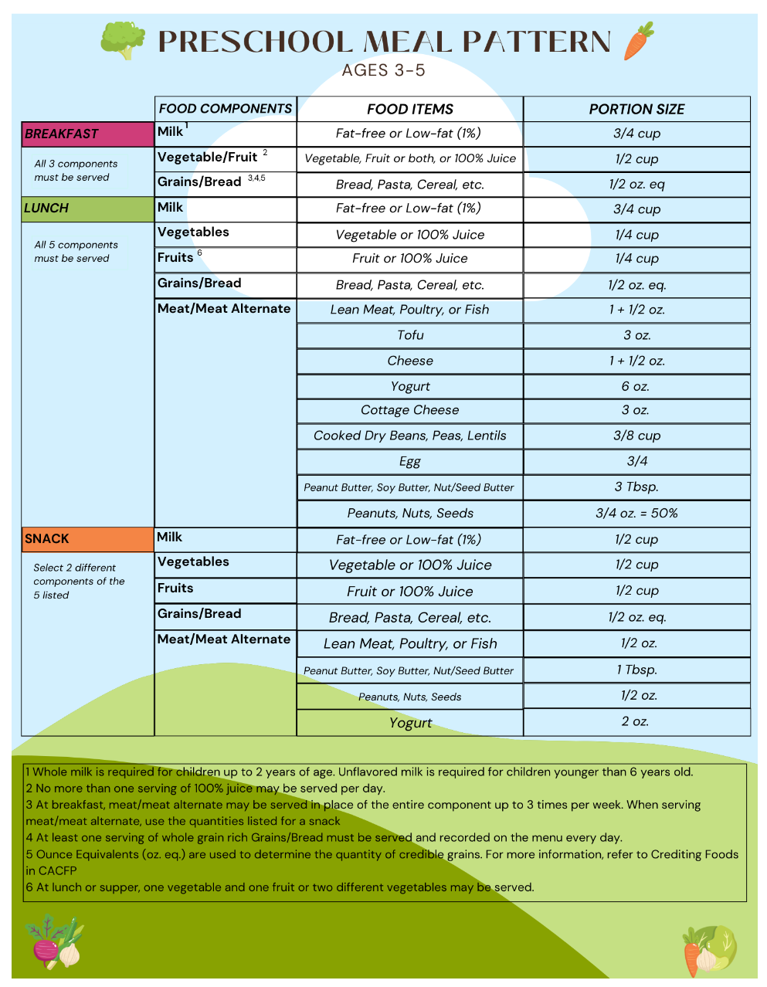
Preschool Meal Pattern
Preschool Meal Pattern MUST be followed unless preschool students are co-mingled with older students:
In a same service area and time
Ex: Classroom
Offer vs. Serve is not allowed
Production Records Required
https://www.cn.nysed.gov/content/preschool-meal-pattern
Notes:
Moving on to the preschool meal pattern.
The preschool meal pattern must be followed when serving preschool students unless the students are co-mingled with older students in the same service area and time.
One big difference between the preschool meal pattern and the meal pattern for older grade group is that the preschool meal pattern has smaller minimum portion sizes. The meal pattern also sets limits on sugars provided to students. For instance, in the preschool meal pattern: no flavored milks are allowed; most grain-based desserts are not creditable; and sugar limits are in place per portion for cereals and yogurts.
A few more notes on the preschool meal pattern: offer versus serve is not allowed (meaning all required components must be served in minimum quantities to all students). There are no dietary specifications for the preschool meal pattern. If using the Pre-K Meal Pattern, Production Records must reflect this, as regulations state that production records must reflect the distinct age/grade groups being served.
Further guidance on the preschool meal pattern can be found on Child Nutrition Knowledge Center under the Program tab, at National School Lunch, then click on Food Based Menu Planning.

Slide 38
It Takes a Village: Cultivating Community in Farm to School
November 20-22, 2024
The Oncenter Syracuse, NY
Registration is NOW OPEN!
Farmers and producers, food service directors, educators, school administrators, and more
The workshops, panel discussions, presentations, and optional field trips are wide-ranging and suitable for stakeholders of all experience levels
NYS Trade Floor
Notes:
Before we conclude today's presentation, we wanted to remind everyone of the Farm to School Summit, hosted by The NYSED Child Nutrition Program Office in partnership with Cornell Cooperative Extension, Harvest NY. Registration for this event is NOW OPEN.
The summit will be held November 21st-22nd, 2024 at the OnCenter in Syracuse, NY. This exciting event will increase the capacity of program operators to buy and serve local NY foods in their school meals programs and will offer ample opportunities for developing partnerships between schools and local farmers and producers. The Summit will have sessions for all Farm to School stakeholders including farmers and producers, food service directors, educators, school administrators, and more!
The first day of the summit includes optional pre-conference field trips available to attendees at an additional cost. Workshops will be held on important New York specific farm to school topics as well as a local tradeshow where farmers/producers will be invited to showcase their products and network with schools. The conference will surely result in many collaborations between schools and farms that will benefit everyone and increase the use of local products in school meals.
For more information on the Summit and to register to attend, please visit our website or scan the QR code at the top of the screen.

Slide 39
Questions?
Child Nutrition Program Administration
cntraining@nysed.gov
(518)- 473-8781

